Slide 1
Symmetry, Metamerism and Coelom
Dr. DEEPAK RAWAL
Assistant Professor
Department of Zoology
MLSU Udaipur

Slide 2
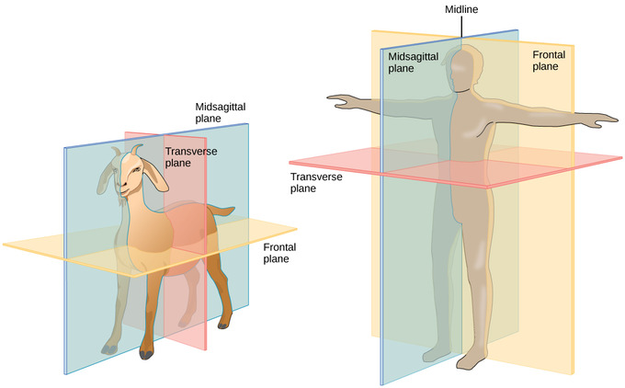
Symmetry
Def- arrangements of body parts/organs into geometrical axis/plans.
Axis- imaginary line having two poles
Advantages-Cepahlization, polarity, locomotion

Slide 3
Symmetry
Division of organisms on basis of symmetry
1. Asymmetrical- eg. Sponges
2. Symmetrical-
Spherical Radial Bilateral
eg. Volvox eg. Echinoderms eg. Platyhelminthes -Chordates
Cnidarians

Slide 4
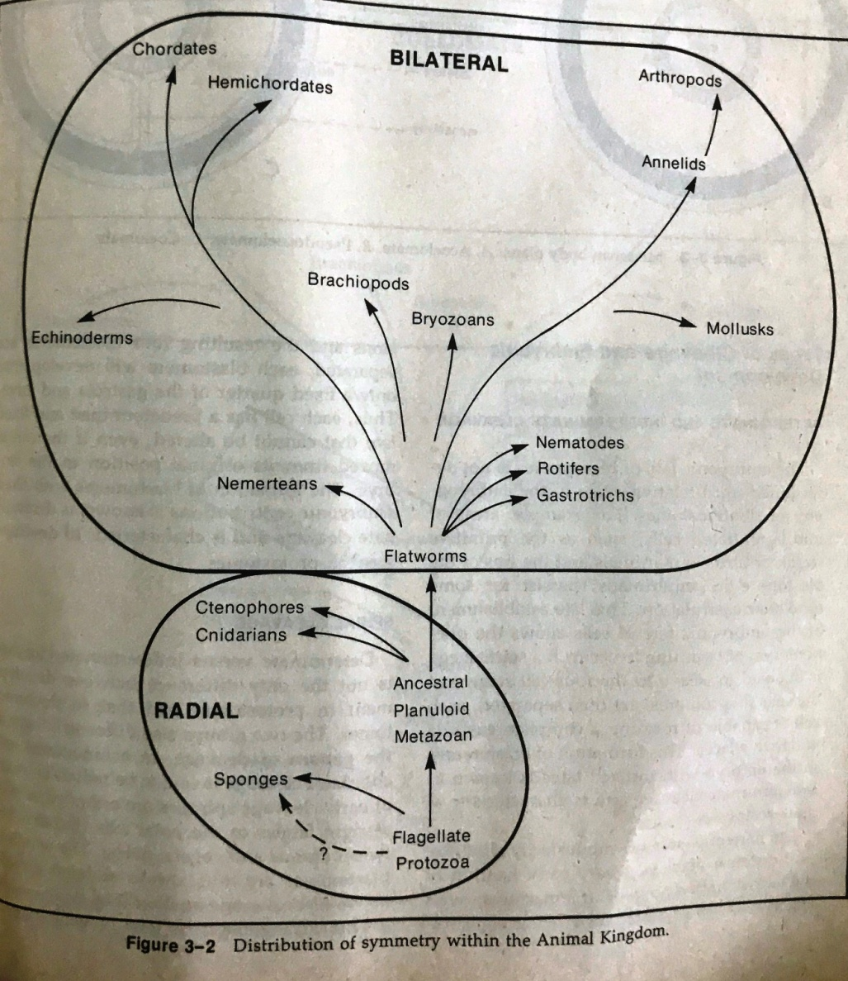
Symmetry

Slide 5
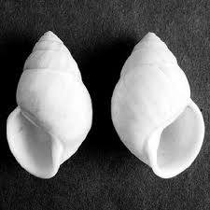
Symmetry

Slide 6
Metamerism
Def- division of body into linear series of similar parts/sections.
Each part is called segment/somite/metamere.
Hox genes are responsible for this.
Head/Prostomium
Trunk
Tail/Pygidium

Slide 7
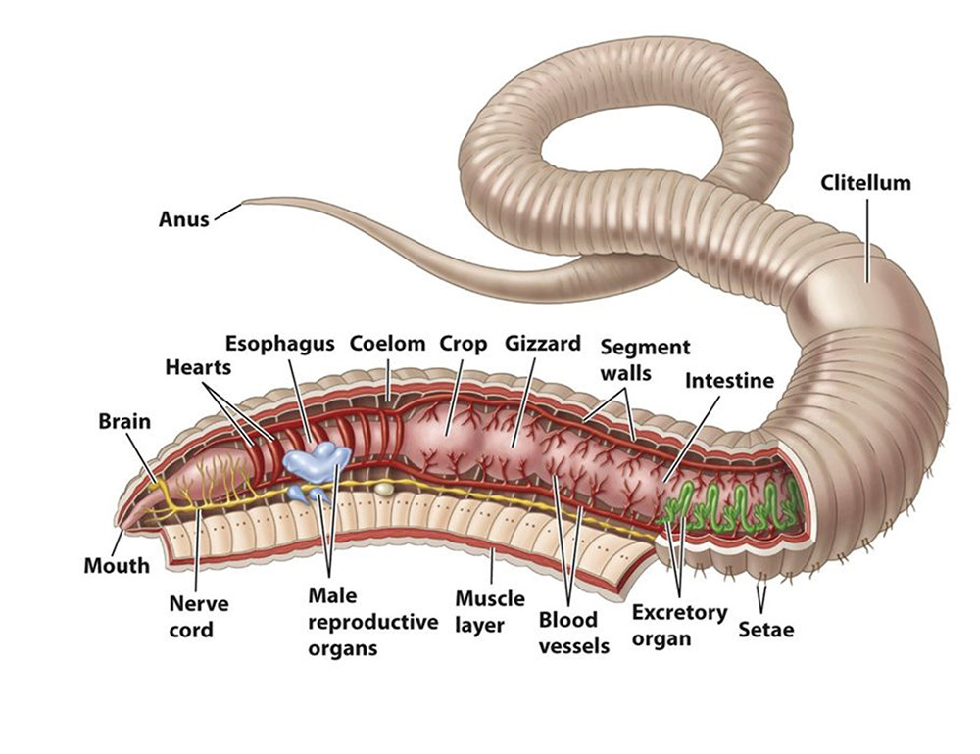
Metamerism

Slide 8
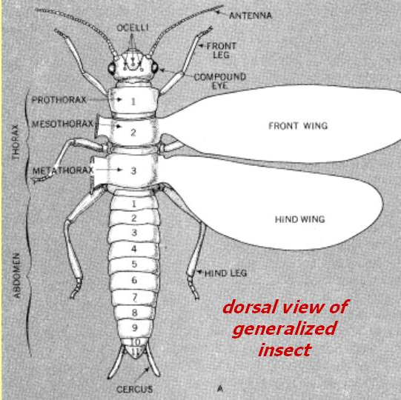
Metamerism
Types-
External (eg. Arthropoda)
Internal (eg. Chordata {ribs, vertebrae, somites etc.}
Both (eg. Annelida)

Slide 9
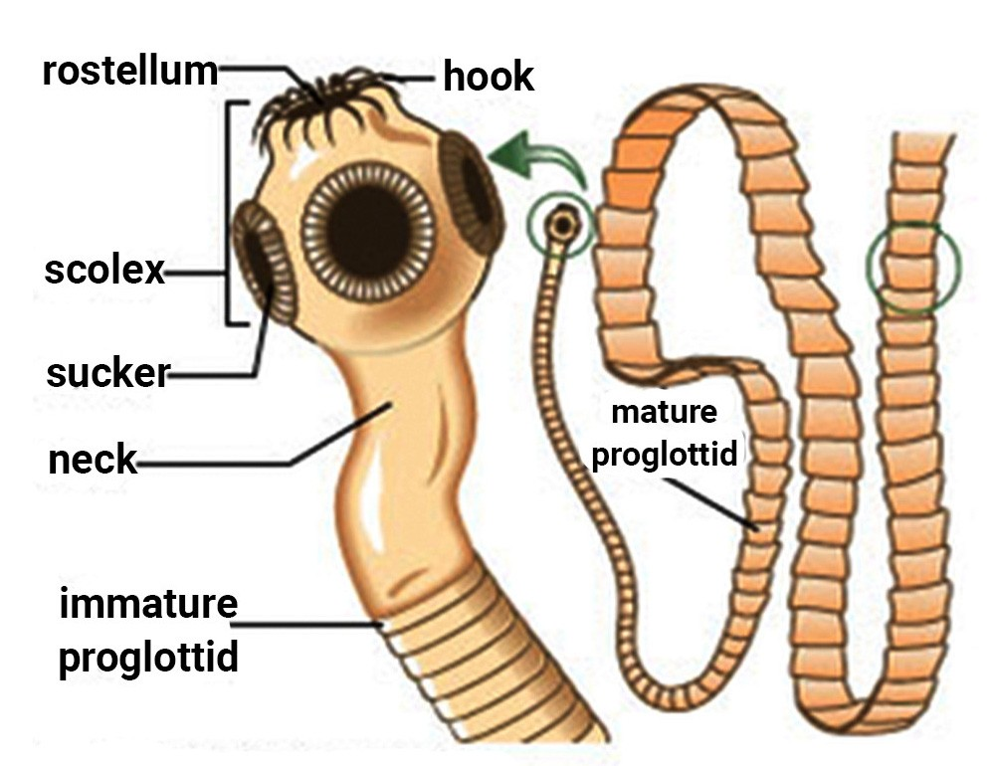
Metamerism
Pseudometamerism/strobilization eg. Taenia

Slide 10
Coelom
Def- fluid filled cavity between body wall and digestive tube covered on both side (outer and inner) by embryonic mesoderm.
Triploblastic organisms
Acoelomates Pseudocoelomates Coelomates
Enterocoelomates Schizocoelomates

Slide 11
Coelom

Slide 12
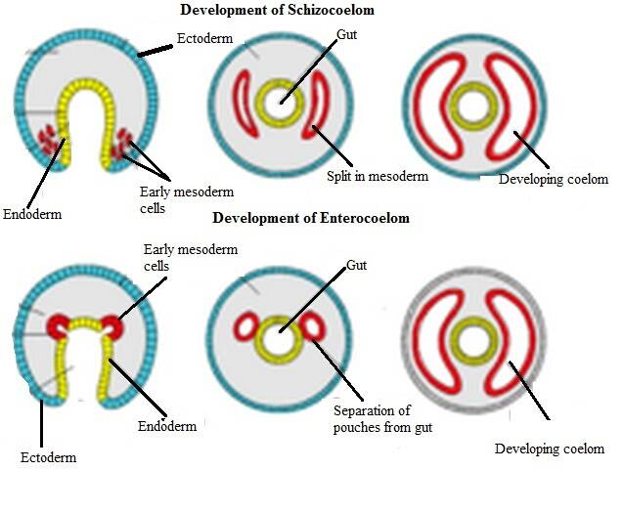
Coelom

Slide 13
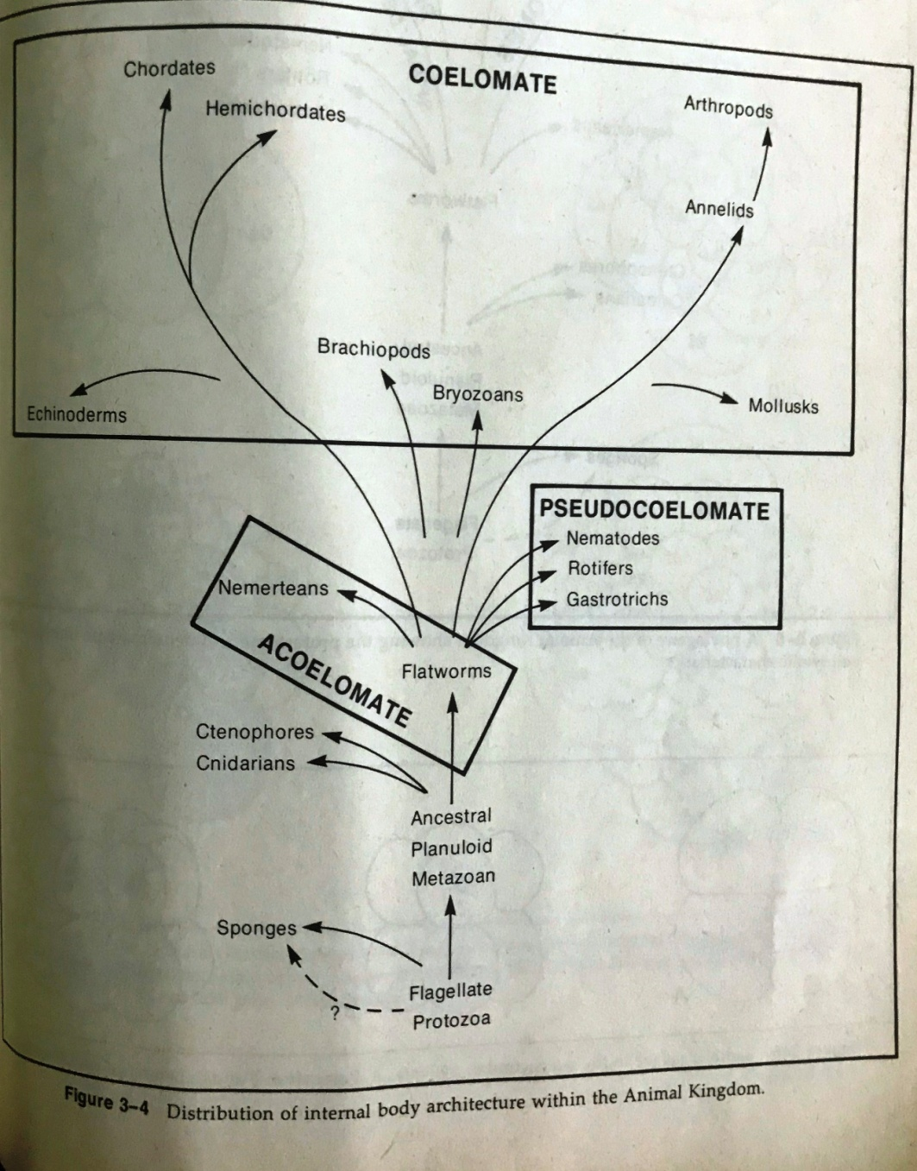
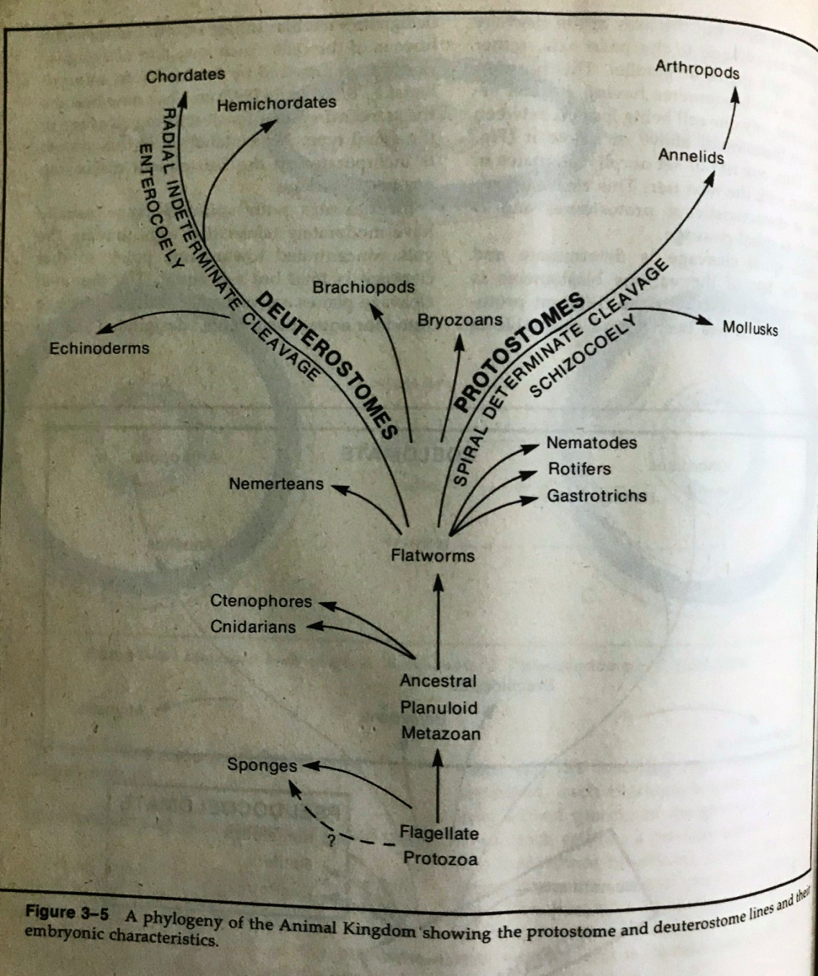
Coelom

Slide 14
Coelom
Significance of Coelom:
Provide space for viscera.
Provide flexibility.
Provide medium for circulation and nutrition.
Shok protection.
Collection of excretory matter.

Slide 15
THANK YOU
1970-Y
1950-X

