Slide 1
Locomotor mechanisms
Dr. DEEPAK RAWAL
Assistant Professor
Department of Zoology
MLSU Udaipur

Slide 2
Locomotion
Locomotion: change of space and position for feeding, breeding and survival.
Survival includes:
Excretion
Respiration
Avoid adverse climatic conditions
Reduce competition
Find suitable habitat and niche
Reduce dependency on genes

Slide 3
Amoeboid locomotion
Phylum Protozoa
Sarcodina (eg. Amoeba)
Locomotion by pseudopodia/lobopodia
Mastigophora (eg. Euglena)
Locomotion by flagella
Ciliata (eg. Paramecium)
Locomotion by cilia
Sporozoa (eg. Plasmodium)
parasitic
Suctoria (eg. Ephelota)
Locomotion by tentacles (filopodia/rhizopodia/reticulopodia/actinopodia/axopodia)

Slide 4
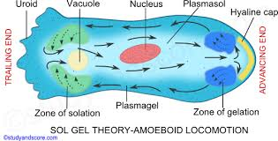
Amoeboid locomotion
By Pseudopodia/lobopodia
Average speed= 1-3 micron per sec
Sol-gel theory/change of viscosity theory

Slide 5
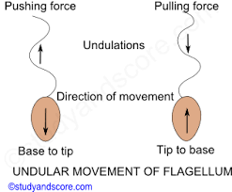
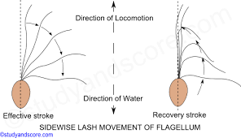
Flagellar locomotion
By sliding tubules/filaments with the help of ATPs.
speed= 15-300 micron per sec
require liquid medium
Undulation paddling gyration

Slide 6
Ciliary locomotion
By sliding tubules/filaments with the help of ATPs.
speed= 400-2000 micron per sec
require liquid medium
Bodies of all cilia are linked by kinetodesmata.
Spiral movement in anti clockwise direction.
metachronal rhythm
(in longitudianl rows from tail to head)
Synchronal rhythm
(in transverse rows)

Slide 7
Ciliary locomotion

Slide 8
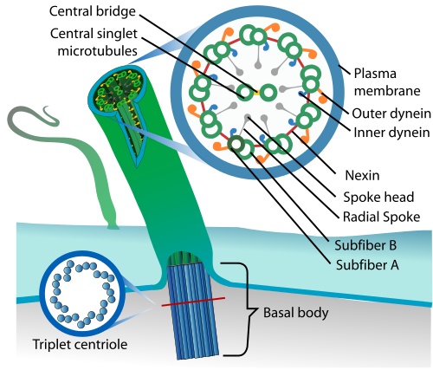
Ultrastructure (EM) of cilia and flagella

Slide 9
Thank you

