Slide 1
Feeding modes, Feeding apparatus and Digestion
Dr. DEEPAK RAWAL
Assistant Professor
Department of Zoology
MLSU Udaipur

Slide 2
Feeding
Why? Because eukaryotes are heterotrophic.
Food give us energy (ATP) and raw material for growth, regeneration, survival and reproduction.
It involves four stages:
1. Ingestion- capture and intake of food (Pseudopodia, teeth, tongue, radula, cilia, flagella, tentacles, appendages, hands etc help in this)
2. Digestion- mechanical and chemical breakdown of food into absorbable form.
hydrolases/hydrolytic enzymes /digestive enzymes
3. Absorption/assimilation- only micro molecules/monomers can pass the channel (active and passive transport)
4. Egestion/defaecation- removal of undigested residues

Slide 3
Feeding
Shri Prahalad Jani- lived without food and water for 65 years
Shahid Bhagat Singh JI- Do fasting of 116 days without food.
Digestive system is made up of gut and digestive glands.
Teeth:Homodont/Heterodont/acrodont/pleurodont/thecodont.
Vitamins, Hormones and Minerals are accessory elements.
Vitamins do not digest, they only absorbs.
Some bacteria synthesize Vit k and Vit B complex.

Slide 4
Feeding
Eukaryotes can metabolise only four molecules viz Carbohydrates, proteins, lipids and nucleic acids.
(Polymers) (Monomers)
Carbohydrates(starch/glycogen/cellulose) glucose/dextrose
Proteins Amino acids (20 AA)
Lipids/Fat Fatty acids/glycerol
Nucleic acids Nitogenous
(RNA/DNA) base/pentose sugar
Digestive enzymes/Hydrolases
Amylases
Proteases
lipases
Nucleases

Slide 5
Types of digestion

Slide 6
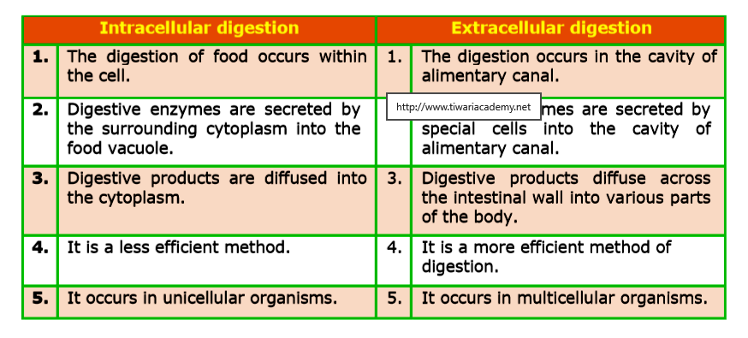
Types of digestion

Slide 7
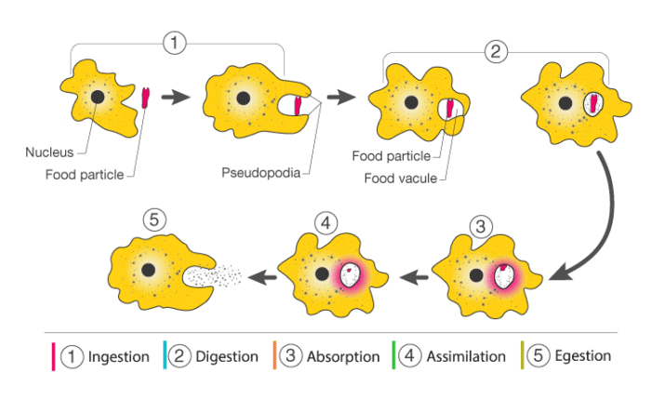
Intracellular digestion

Slide 8
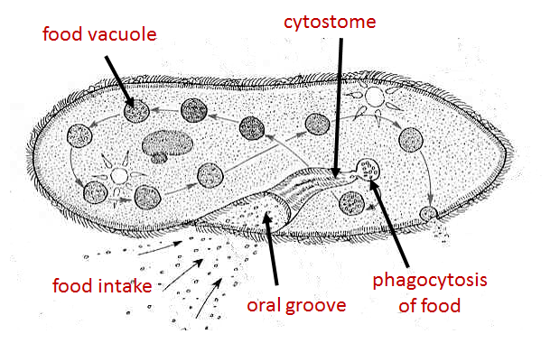
Intracellular digestion

Slide 9
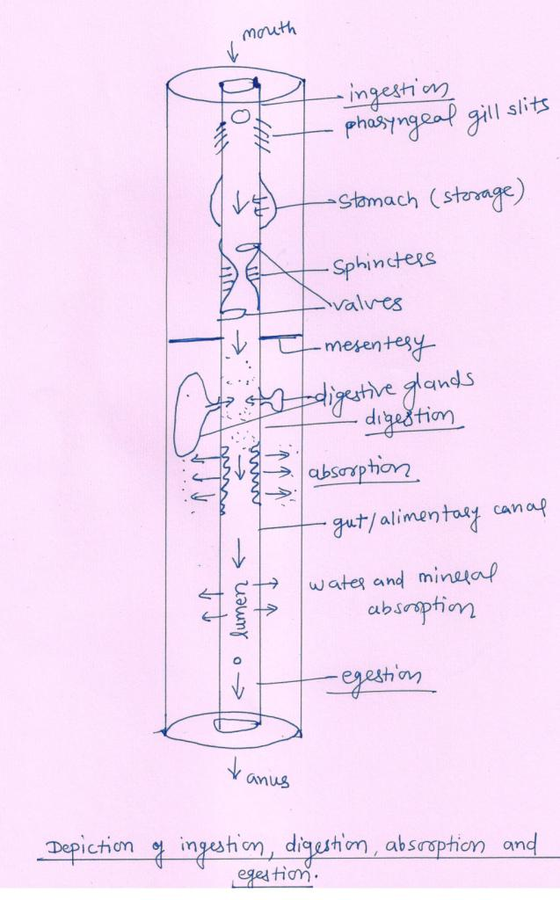
Extracellular digestion

Slide 10
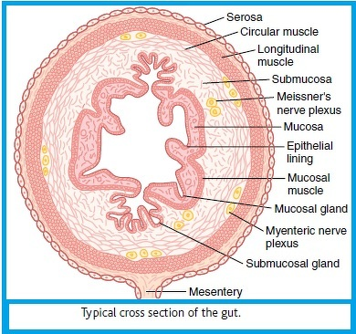
Extracellular digestion
lumen

Slide 11
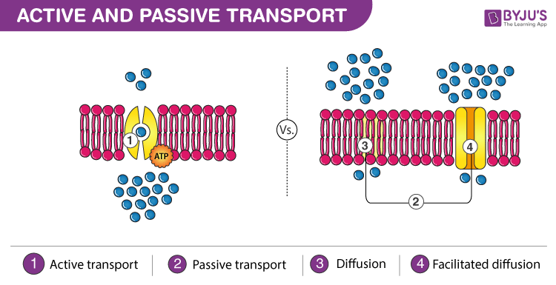
Extracellular digestion
Lumen of gut
lumen
Cytoplasm of mucosal epithelium

Slide 12
Extracellular digestion
amphostome

Slide 13
Extracellular digestion

Slide 14
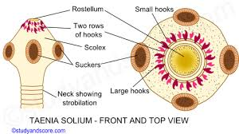
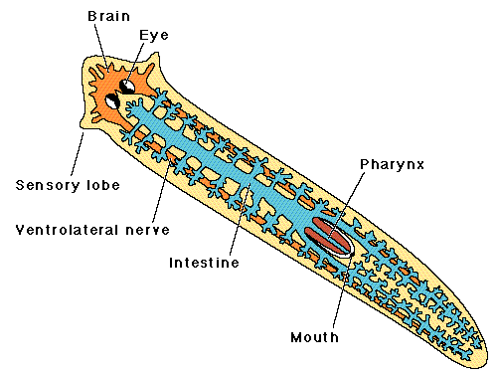
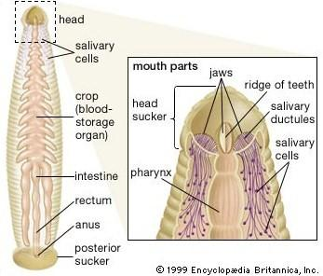
Extracellular digestion

Slide 15
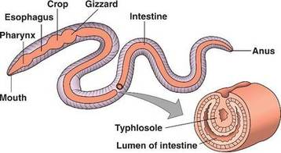
Extracellular digestion

Slide 16
Extracellular digestion

Slide 17
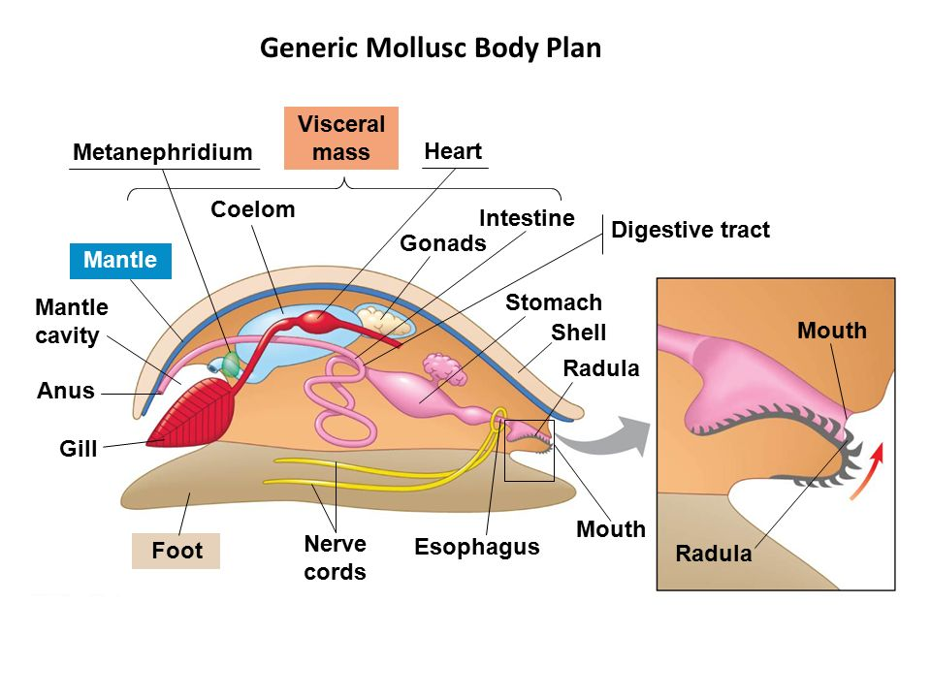
Extracellular digestion

Slide 18
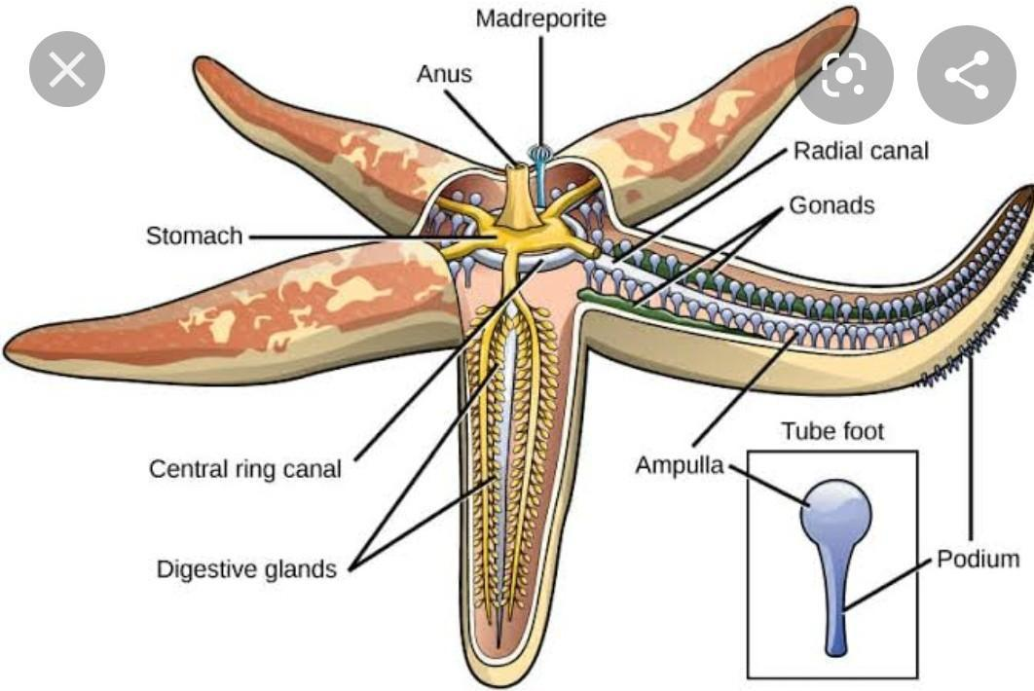
Extracellular digestion

Slide 19
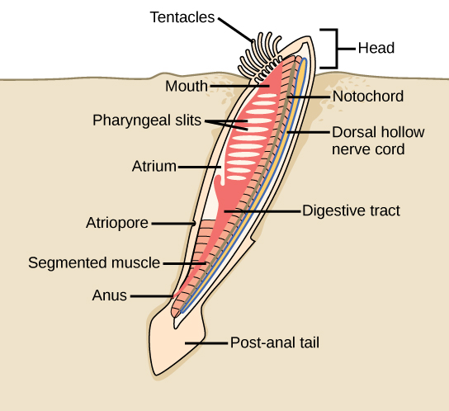
Extracellular digestion

Slide 20
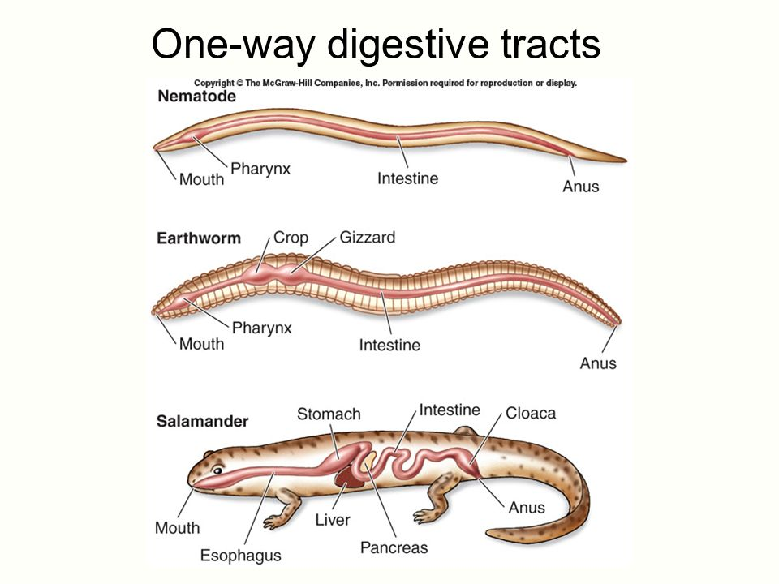
Extracellular digestion

Slide 21
Filter feeding
Is it intracellular or extracellular digestion?

Slide 22
Filter feeding
Holozoic nutrition/feeding in Amoeba

Slide 23
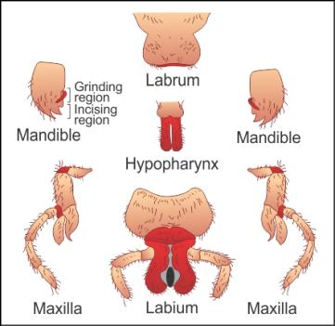
Feeding apparatus
Biting and Chewing Mouthparts (eg. Cockroach)

Slide 24
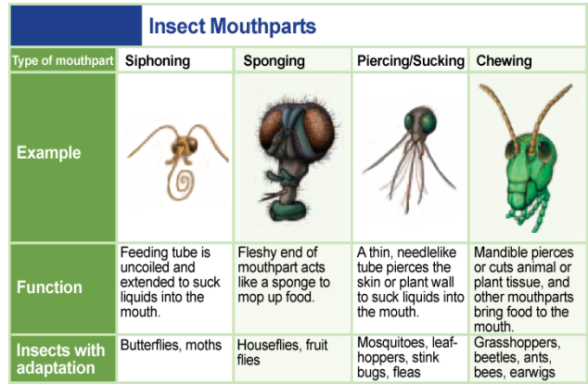
Feeding apparatus

Slide 25
Feeding
Microphagy:
These are mechanisms for dealing with small food particles. In this process pseudopodia, cilia, tentacles, mucus, setae and muscles are used for obtaining food.
Macrophagy:
These are mechanisms for dealing with large food particles or masses. This process involves swallowing of inactive food, scraping, boring, and seizing the prey. After seizing the prey, the animals chew, swallow and may digest it externally.

Slide 26
Mode of Feeding

Slide 27
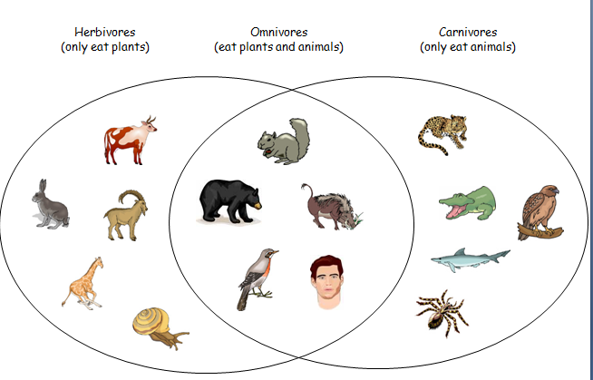
Mode of Feeding
Holozoic nutrition/consumers/Macrpphagy
Herbivores Carnivores Omnivores

Slide 28
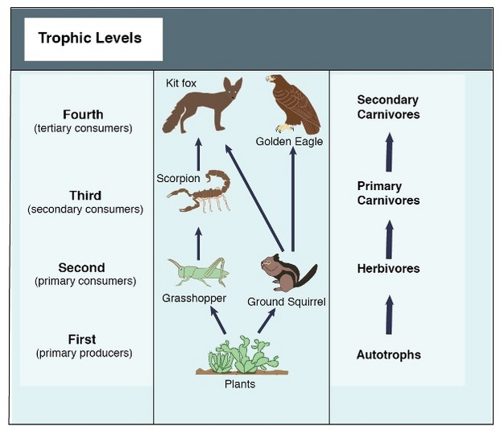
Mode of Feeding

Slide 29
Herbivores

Slide 30
Herbivores

Slide 31
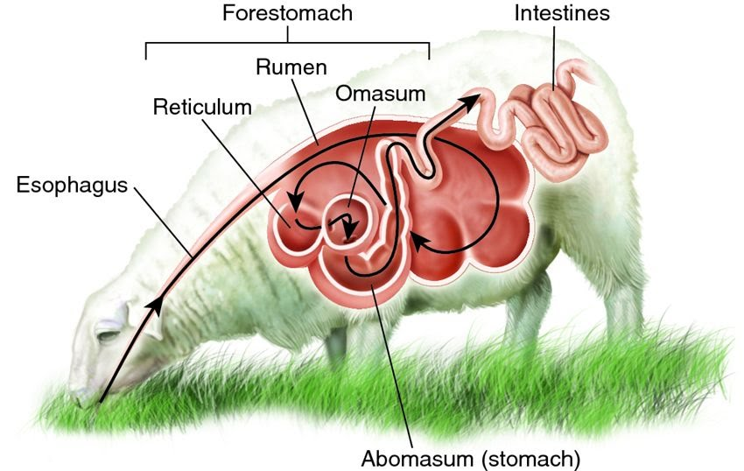
Herbivores

Slide 32
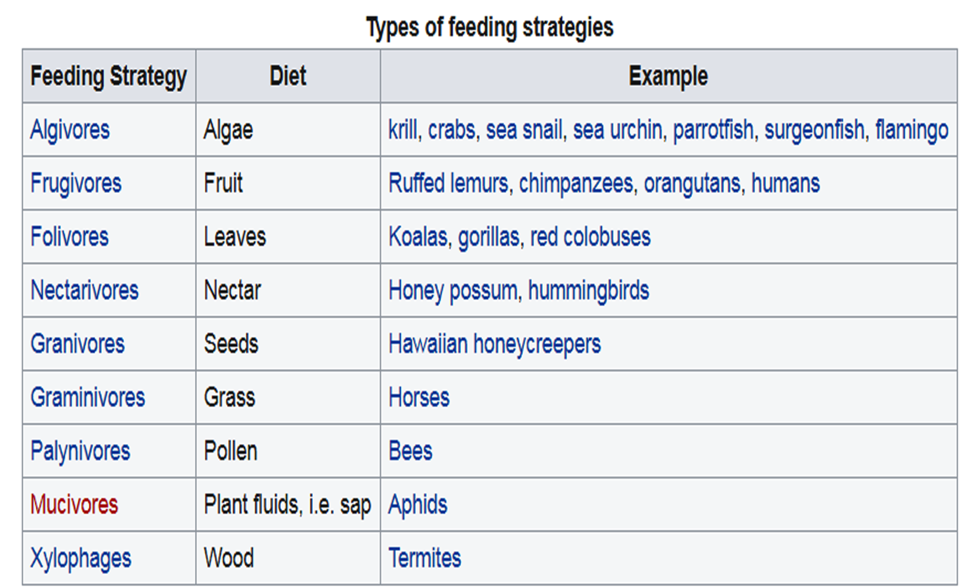
Herbivores

Slide 33
Carnivores

Slide 34
Carnivores
By amount of meat in diet
Hypercarnivores: more than 70% meat
eg. Lion, Tiger, Panther etc.
Mesocarnivores: 30–70% meat
eg. Red Fox, Coyote, Mangoose etc.
Hypocarnivores: less than 30% meat
eg. Grizzly bear, Black dear etc.
Sanguivory/hematophagy is also a type of carnivory.
Cannabalism is also a type of extreme carnivory

Slide 35
Comparisons

Slide 36
Comparisons

Slide 37
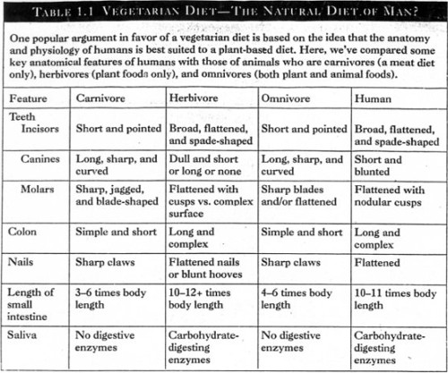
Comparisons

Slide 38
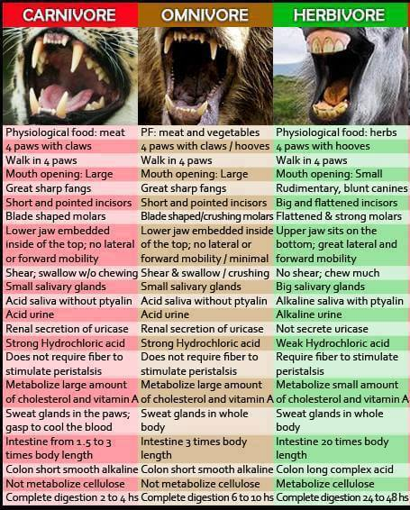
Comparisons

Slide 39
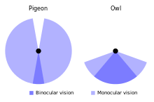
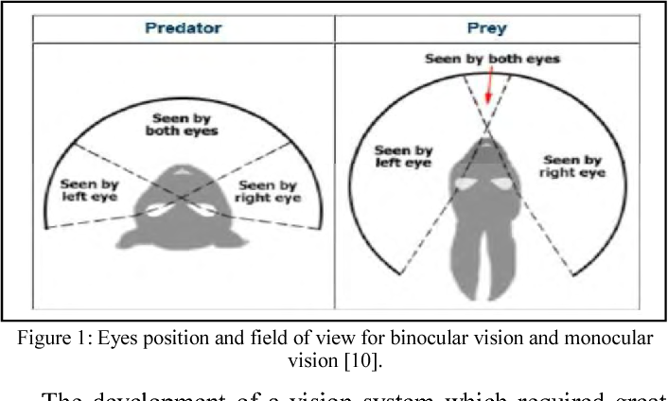
Comparisons

Slide 41
THANK YOU
1970-Y
1950-X

