Slide 1

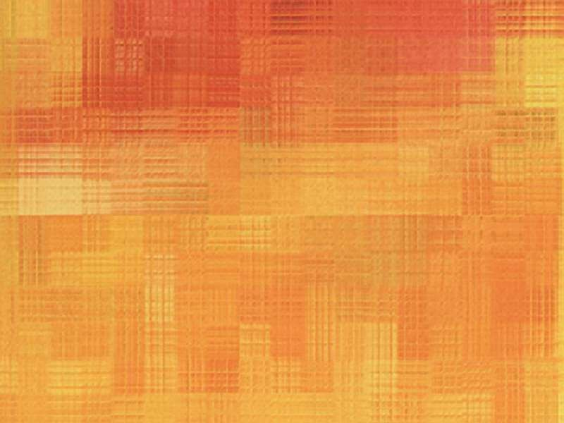





History of Microbiology

Slide 2

Microbiology is the study of microorganisms which is visible only with a microscope
.
The diverse group of organisms includes algae, archae, bacteria,
cyanobacteria, fungi, protozoa, viruses.
Most of the microorganisms are harmless.
99% are good.
Eg: Cynobacteria (blue green algae) Eg: Pathogens
1% are bad.
MICROBIOLOGY
Discovery Era
Transition Era
Golden Era
Modern Era

Slide 3

DISCOVERY ERA:
“Spontaneous generation”
Aristotle (384-322) and others believed that living organisms could develop from non-living materials.
In 13th century, Rogen Bacon described that the disease caused by a minute “seed” or “germ”.
Antony Van Leeuwenhoek (1632 – 1723)
Descriptions of Protozoa, basic types of bacteria, yeasts and algae.
Father of Bacteriology and protozoology.
In 1676, he observed and described microorganisms such as bacteria and protozoa as “Animalcules”.
The term microbe is used by Sedillot in 1878.

Slide 4
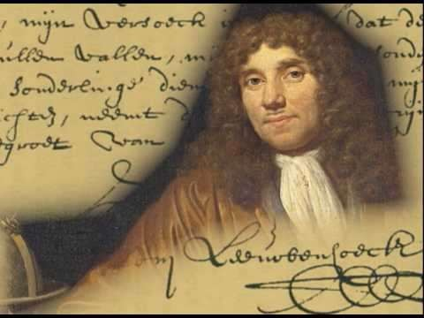
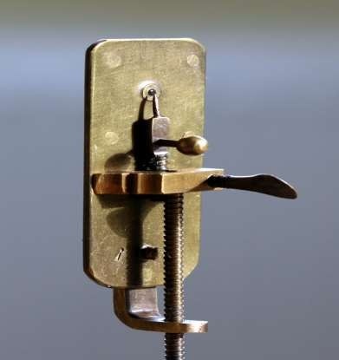
First observed by Antony van Leeuwenhoek – Father of Microbiology.
A Dutch draper - Hobby was lens grinding and microscope making.
Made 550 crude single lens microscopes with magnification of 50x – 300 x.

Slide 5
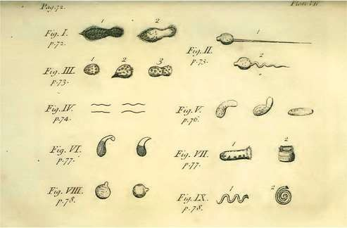
Anton van Leeuwenhoek’s observation of microbes

Slide 6
Leeuwenhoek examined rain water, saliva, pepper decoctions, cork, leaves of plants , seminal fluid, scrappings of teeth etc.
Portrayed several microorganisms and called them ‘Animal cules’.
Conveyed his findings in a series of letters to the British Royal Society, London during the mid 1670’s.
Spontaneous generation(Abiogenesis):living organisms could develop from non – living matter.
Theory of Biogenesis – Living organisms arise only from preexisting organisms.

Slide 7

TRANSITION ERA:
Francesco Redi (1626 - 1697)
He showed that maggots would not arise from decaying meat, when it is covered.
John Needham (1713 – 1781)
Supporter of the spontaneous generation theory.
He proposed that tiny organism(animalcules) arose spontaneously on the mutton gravy.
He covered the flasks with cork as done by Redi, Still the microbes appeared on mutton broth.
Lazzaro spallanzai (1729 – 1799)
He demonstrated that air carried germs to the culture medium.
He showed that boiled broth would not give rise to microscopic forms of life.

Slide 8
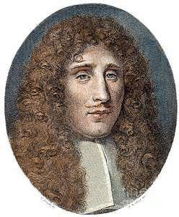
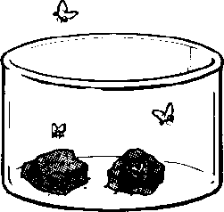
Experiments to disprove Abiogenesis
Francesco Redi’s Experiment (1688)
Carried out a series of experiments on decaying meat and its ability to produce maggots spontaneously.
Redi placed meat in 3 jars Jar 1 : Left open.
Flies laid eggs on meat - which developed into maggots .

Slide 9
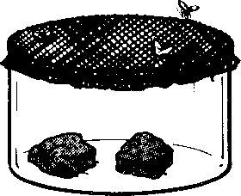
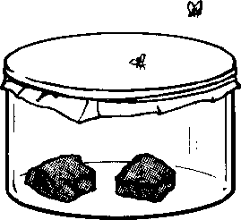
Jar-3 : Sealed
Jar-2 : Covered with netting
Flies laid eggs on the netting – developed into maggots on the netting.
No maggots developed on meat.
This experiment proved that the maggots developed from fly eggs , not from meat .
Thus Redi disproved the theory of spontaneous generation (Abiogenesis).

Slide 10

GOLDEN ERA:
Louis Pasteur
He is the father of Medical Microbiology.
He pointed that no growth took place in swan neck shaped tubes because dust and germs had been trapped on the walls of the curved necks but if the necks were broken off so that dust fell directly down into the flask, microbial growth commenced immediately.
Pasteur in 1897 suggested that mild heating at 62.8°C (145°F) for 30 minutes rather than boiling was enough to destroy the undesirable organisms without ruining the taste of the product, the process was called Pasteurization.

Slide 11
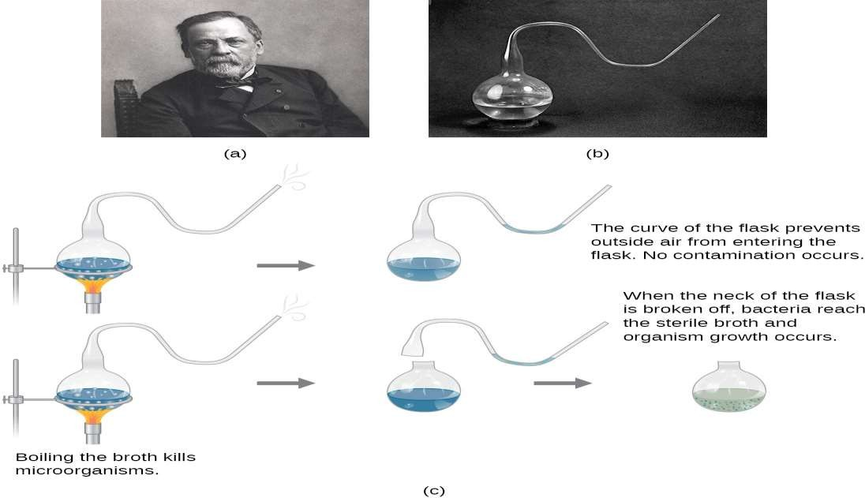

Slide 12
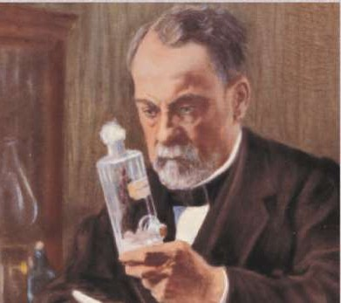
pasteurization, fermentation and the
 He invented the processes of
development of effective vaccines ( rabies and anthrax).
Pasteur demonstrated diseases of silkworm was due to a protozoan parasite.
Contributions of Loius pasteur:
He coined the term “microbiology”, aerobic, anaerobic.
He disproved the theory of spontaneous germination.
He demonstrated that anthrax was caused by bacteria and also produced the vaccine for the disease.
He developed live attenuated vaccine for the disease.

Slide 13
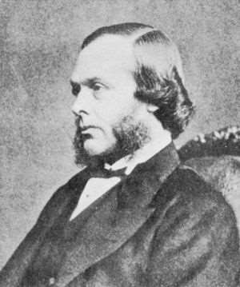
John Tyndall (1820 - 1893)
He discovered highly resistant bacterial structure, later known as endospore.
Prolonged boiling or intermittent heating was necessary to kill these spores, to make the infusion completely sterilized, a process known as Tyndallisation.
Lord Joseph Lister (1827-1912)
He is the father of antiseptic surgery.
Lister concluded that wound infections too were due to microorganisms.
He also devised a method to destroy microorganisms in the operation theatre by spraying a fine mist of carbolic acid into the air.

Slide 14
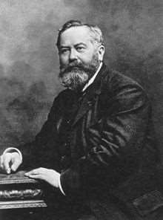
Construction of a bacterial filter by Charles Chamberland (1884) made possible the discovery of viruses and their role in diseases.

Slide 15
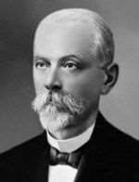
Dmitri Iwanowski (1892) discovered Tobacco Mosaic Virus (TMV) – the first viral pathogen studied.

Slide 16
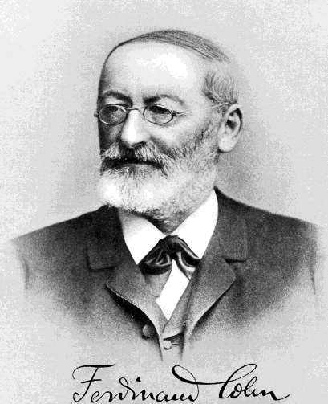
Contributions of F.J. Cohn
Discovered binary fission – the common method of multiplication in bacteria.
Discovered endospores
– certain bacteria form extremely resistant spores – Bacillus subtilis, Clostridium botulinum etc.

Slide 17

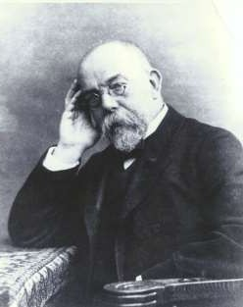
Robert Koch(1893-1910)
He demonstrated the role of bacteria in causing disease.
He perfected the technique of isolating bacteria in pure culture.
Robert Koch used gelatin to prepare
solid media but it was not an ideal because
  Since gelatin is a protein, it is digested by many bacteria capable of producing a proteolytic exoenzyme gelatinase that hydrolyses the protein to amino acids.
  It melts when the temperature rises above 25°C.

Slide 18
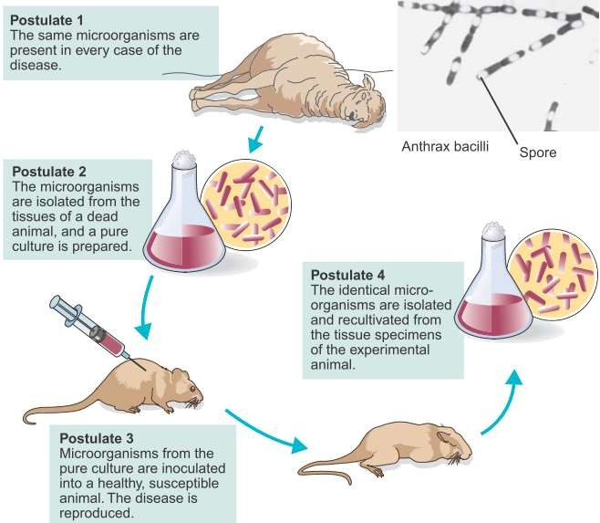
Koch's postulates

Slide 19

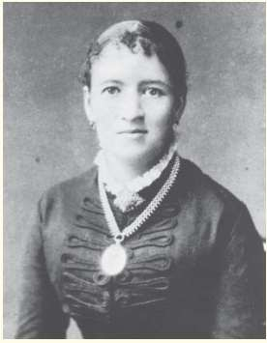
Fanne EilshemiusHesse (1850-1934)
One of Koch's assistant first proposed the use of agar in culture media.
It was not attacked by most bacteria.
Agar is better than gelatin because of its
higher melting pointing (96°c) and solidifying (40 – 45°c)points.
Richard Petri (1887)
He developed the Petri dish (plate), a container used for solid culture media.

Slide 20

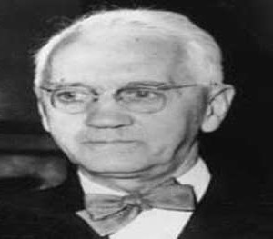
Edward Jenner (1749-1823)
First to prevent small pox.
He discovered the technique of vaccination.
Alexander Flemming
He discovered the penicillin from penicillium notatum that destroy several pathogenic bacteria.
Paul Erlich (1920)
He discovered the treatment of syphilis by using arsenic
He Studied toxins and antitoxins in quantitative terms & laid foundation of biological standardization.

Slide 21


IMPORTANT DISCOVERIES:
Bacteria:
 Hansen (1874)
Leprosy bacllus
Gonococcus
 Neisser (1879)
 Ogston (1881)
– Staphylococcus
 Loeffler (1884)
Diphtheria bacillus
Diphtheria toxin
 Roux and Yersin
Viruses:
 Beijerinck (1898) - Coined the term Virus for filterable
infectious agents.
Pasteur developed Rabies vaccine.
GoodPasteur - Cultivation of viruses on chick embryos.
 Charles Chamberland, one of Pasteur’s associates
constructed a porcelain bacterial filter.
 Twort and d’Herelle - Bacteriophages.
 Edward Jenner
- Vaccination for Smallpox.

Slide 22

MODERN ERA:
Nobel Laureates
Years |  | Nobel laureates | Contribution
 | 1901 | Von behring | Dipth antitox
 | 1902 | Ronald Ross | Malaria
 | 1905 | Robert koch | Tb
 | 1908 | Metchnikoff | Phagocytosis
 | 1945 | Flemming | Penicillin
 | 1962 | Watson,Crick | Structur DNA
 | 1968 | Holley,Khorana | Genetic code
 | 1997 | Pruisner | Prions
 | 2002 | Brenner, Hervitz | Genetic regulation of organ development &cell death

Slide 23

THANK YOU

