Slide 1
Cell Structure of Bacteria

Slide 2
Introduction
All bacteria are unicellular organisms that reproduce by binary fission. Most bacteria are capable of independent metabolic existence and growth, but species of Chlamydia and Rickettsia are obligately intracellular organisms.
Bacterial cells are extremely small and are most conveniently measured in microns (10⁻⁶ m). Bacterial cells are usually between 0.4 and 1.5μm in short diameter.

Slide 3
1. Morphology of Bacteria
Bacteria have characteristic shapes. The common microscopic morphologies are:
spherical or ovoid (cocci)
rod-shaped (bacilli) comma-shaped (vibrio)
spiral (spirillum and spirochete)
Some cocci characteristically grouped in pairs or
chains; some form grapelike clusters of spherical cells; some round cocci form cubic packets. Bacterial cells of other species grow separately. The microscopic appearance is therefore valuable in classification and diagnosis.

Slide 4
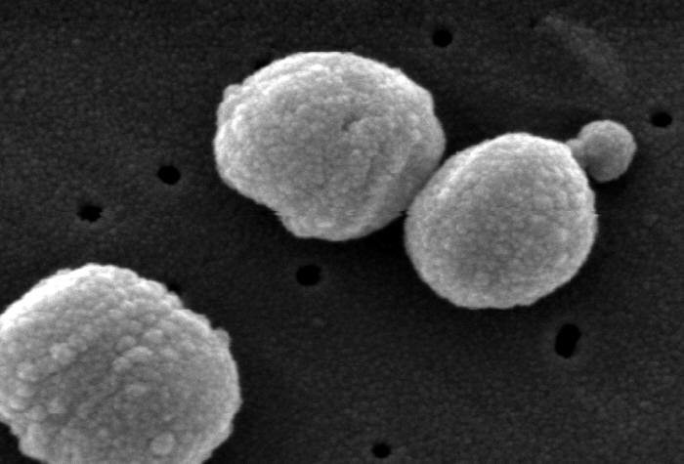
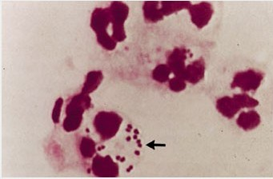
Streptococcus pneumoniae
meningococcus

Slide 5
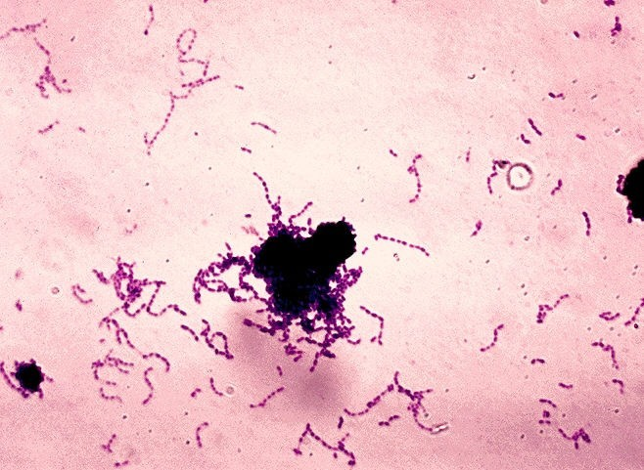
Streptococcus,×1500

Slide 6
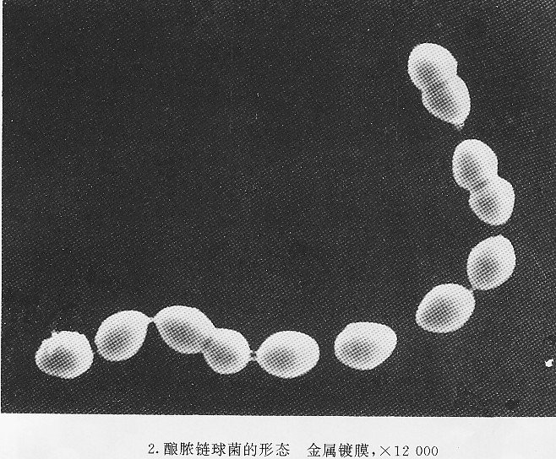
Streptococcus,×12000

Slide 7
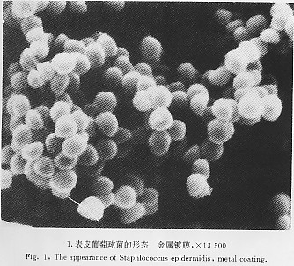
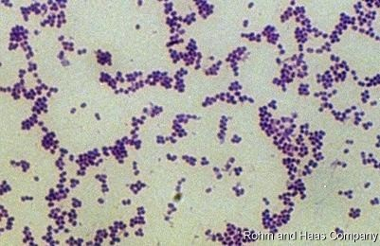
Staphylococcus

Slide 8
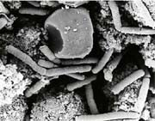
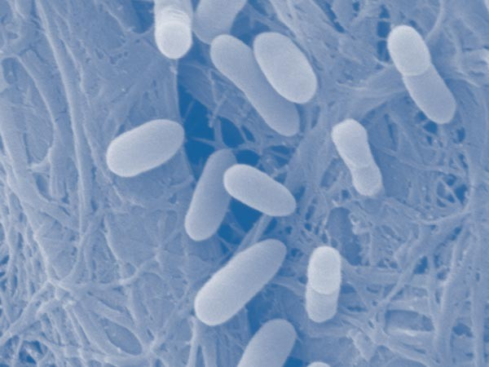
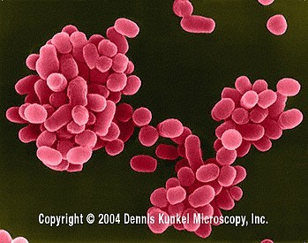
Bacilli
Different size
large
medium
small
bacillus
Esch.coli
Brucella

Slide 9
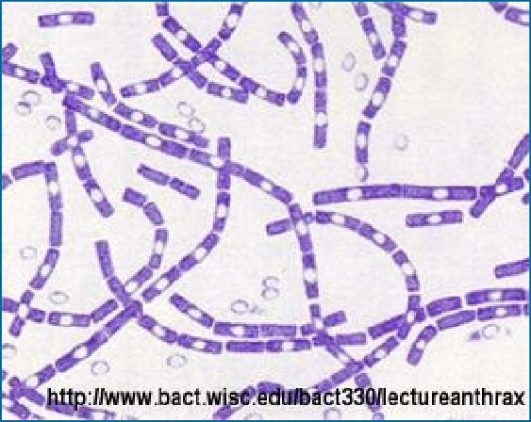
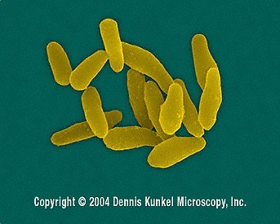
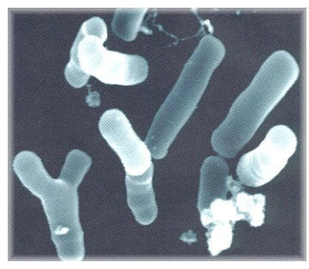
bacilli
Different shape
Coryneform bacteria
bifidobacterium

Slide 10
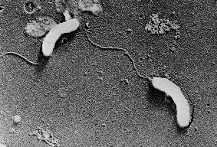
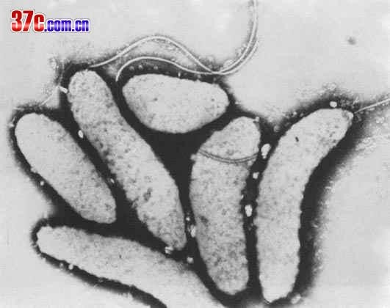
vibrio cholerae

Slide 11
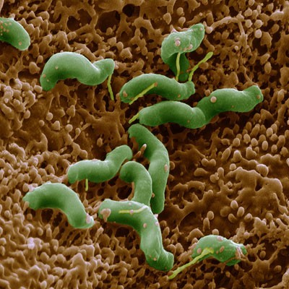
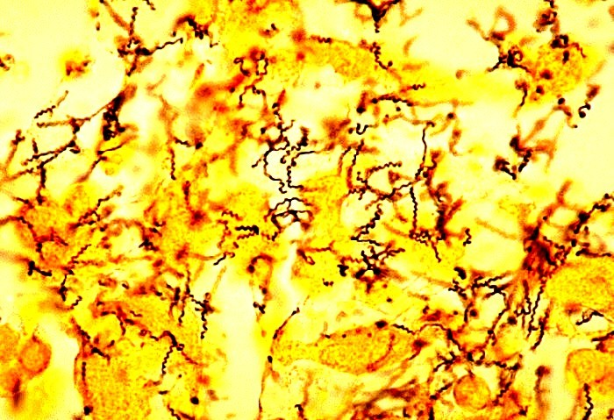
spirillum
spirochaete

Slide 12
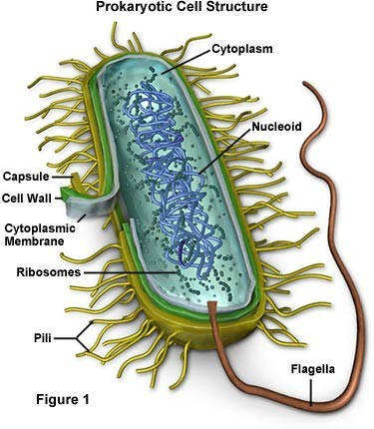
2.Structure of Bacteria
The protoplast, i.e. the whole body of living material (protoplasm),is bounded peripherally by a very thin, elastic and semipermeable cytoplasmic membrane. Outside, and closely covering this, lies the rigid, supporting cell wall, which is porous and relatively permeable.

Slide 13
Nucleoid (nuclear material)
Cytoplasm
Cytoplasmic membrane
Cell wall
Capsules Flagella
Pili (Fimbriae)
Endospore
Essential structures
Other structures

Slide 14
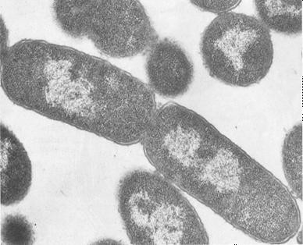
Nucleoid (nuclear material)
The bacterial nucleoid contains a single double-stranded deoxyribonucleic acid (DNA).
It is a closed circular thread about 1 mm long, being condensed and looped into a supercoiled state.
The number of copies of this chromosome in a cell depends on the stage of the cell cycle .Only one in some cells, but in others, as a result of nuclear division preceding cell division, two or more may be present.
Only containing a single chromosome. Having no nuclear membrane.
Having no nucleolus.
Replicating by growth and simple fission, and not by mitosis.

Slide 15
Cytoplasm
The cytoplasm of bacterial cell is a viscous watery solution, or soft gel, containing a variety of organic
and inorganic solutes, and numorous ribosomes.
Inclusion granules are observed in the cytoplasm in many species of bacteria.
Containing plasmids in some species of bacteria. Not containing endoplasmic reticulum.
Not containing membrane-bearing microsomes.
Not containing mitochondria.

Slide 16
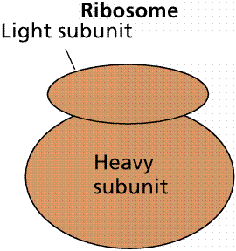
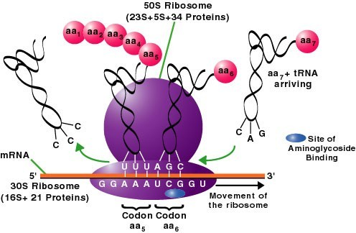
30s
40s
Prokaryotic cell
50s
60s
Eukaryotic cell
Inhibiting bacterial protein synthesis
Streptomycin Amikacin Kanamysin
…

Slide 17
Inclusion granules
Inclusion granules are insoluable, osmotically inert, round,neutral polymers in the cytoplasm of bacteria.
They are an excess metabolite stored as a nutrient reserve. They are present in largest amount when the bacteria have access to an abuudance of energy- yielding nutrients, and diminish or disappear under conditions of energy source starvation. They consist of
Volutin granules (syn. metachromatic granules) Lipid granules
Polysaccharide granules

Slide 18
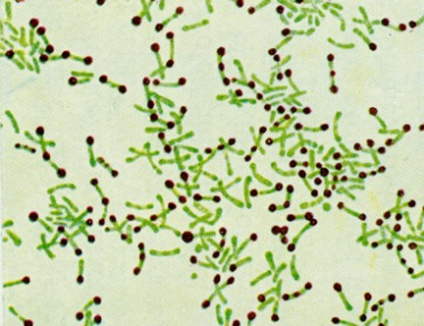
Volutin granules are 0.1~1.0μm in diameter.
They are characteristically found in the diphtheria bacillus.
Their metachromatic staining is thought to be due to their content of polymerized inorganic polyphosphate ,an energy-rich compound that may act as a reserve of energy and phosphate for cell metabolism or may be a by-product.
Stained Corynebacterium cells. The "barred" appearance is due to the presence of polyphosphate inclusions called metachromatic granules.

Slide 19
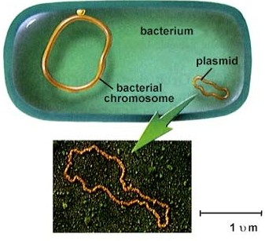
Plasmid
Plasmids are replicons that are maintained as discrete, extrachromosomal genetic elements in bacteria. They are usually much smaller than the bacterial chromosome. Plasmids usually
encode traits that are
not essential for bacterial viability,
and replicate independently of the chromosome.
Most plasmids are supercoiled, circular, double-stranded DNA
molecules, but linear plasmids have also been demonstrated in Borrelia and Streptomyces.

Slide 20
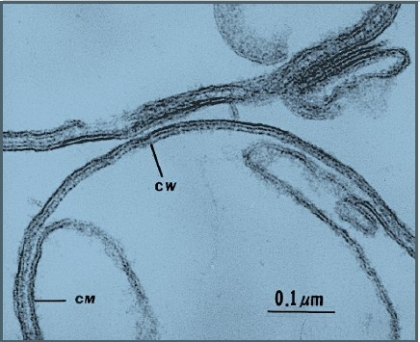
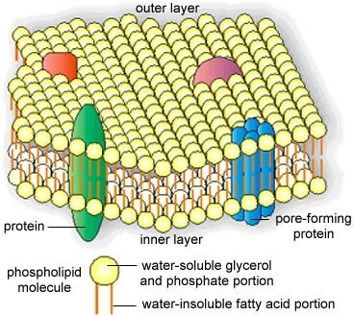
Cell membrane
The cell membrane. Fragments of the cell membrane (CM) are seen attached to the cell wall (CW) in preparations made from Escherichia coli.
A model of membrane structure. Folded polypeptide molecules are visualized as embedded in a phospholipid bilayer, with their hydrophilic regions protruding into the intracellular space, extracellular space, or both.
The membranes of prokaryotes are distinguished from those of eukaryotic cells by the absence of sterols, the only exception being mycoplasmas.

Slide 21

Function
Cell membrane
Selective permeability and transport of solutes Electron transport and oxidative phosphorylation in aerobic species.
Excretion of hydrolytic exoenzymes.
Bearing the enzymes and carrier molecules that function in the biosynthesis of DNA, cell wall polymers, and membrane lipids.
Bearing the receptors and other proteins of the chemotactic and other sensory transduction systems.

Slide 22
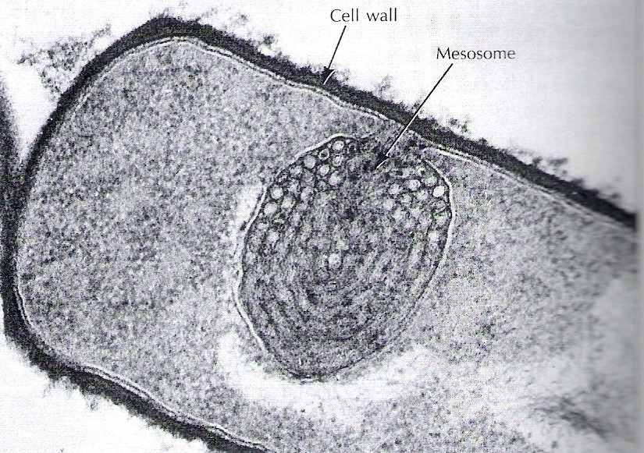
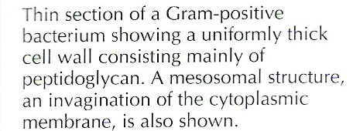
Cell membrane
Mesosome
Mesosomes are convoluted or multilaminated membranous bodies visible in the electron microscope. They develop by complex invagination of the cytoplasmic membrane into the cytoplasm.
Function
Functioning in the compartment of DNA at cell division and at sporulation.
Having a function analogous to the mitochondria of the eukaryotic cell----providing a membranous support for respiratory enzymes.

Slide 23
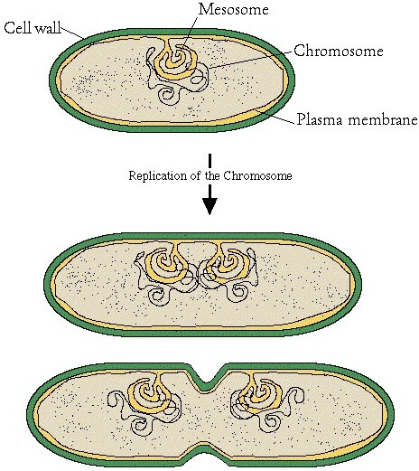
A diagram of the attachment of bacterial chromosomes, indicating the possible role of the mesosome in ensuring the distribution of the "chromosomes" in a dividing cell. Upon attachment to the plasma membrane, the DNA replicates and reattaches at separate points.
Continued growth of the cell gradually sepertates the chromosomes.

Slide 24
Cell wall
Cell wall
The cell wall encases the protoplast and lies immediately external to the cytoplasmic membrane. It is 10~25nm thick, strong and relatively rigid, though with some elasticity, and openly porous, being freely permeable to solute molecules smaller than 10 kDa in mass and 1 nm in diameter.

Slide 25
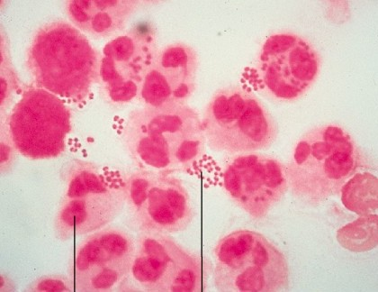
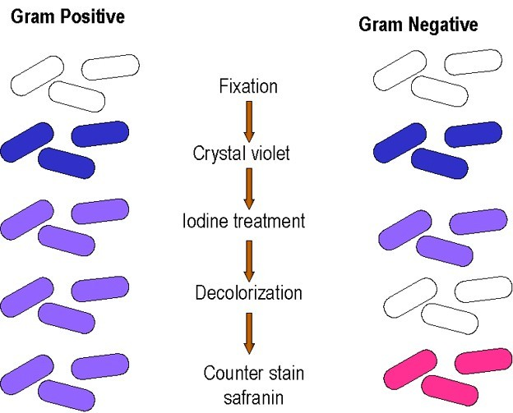
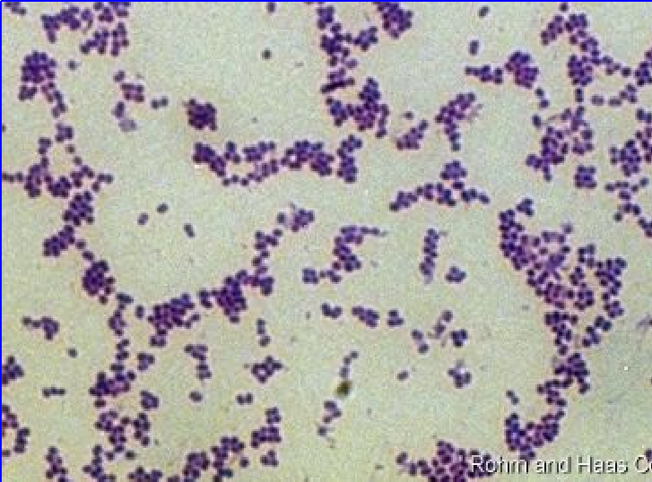
Bacteria are classified as gram-
positive or gram-negative according to their response to the Gram staining procedure.
Gram’s stain
G
-
G
+

Slide 26
Structure and chemical composition
Cell wall
Gram-positive bacteria Peptidoglycan Teichoic acid
Gram-negative bacteria Peptidoglycan Outer membrane

Slide 27
The peptidoglycan layer
Peptidoglycan is a complex polymer consisting of three parts:
a backbone, composed of alternating N- acetylglucosamine and N-acetylmuramic acid;
and a set of identical tetrapeptide side chains attached to N-acetylmuramic acid;
and a set of identical peptide cross bridges.

Slide 28

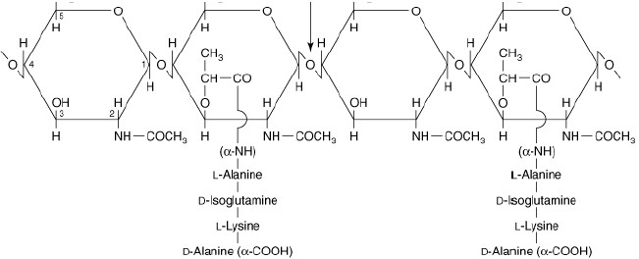
The backbone is the same in all bacterial species.

Slide 29
The tetrapeptide side chains and the peptide cross-bridges vary from species to species.
The tetrapeptide side chains of all species, however, have certain important features in common. Most have L -alanine at position 1 (attached to N- acetylmuramic acid), D -glutamate or substituted D – glutamate at position 2, and D -alanine at position 4.
Position 3 is the most variable one:
Most gram-negative bacteria have diaminopimelic acid (DAP) at this position, to which is linked the lipoprotein cell wall component discussed below.
Gram-positive bacteria usually have L -lysine at position 3; however, some may have diaminopimelic acid or another amino acid at this position.

Slide 30
The tetrapeptide side chains and the peptide cross-bridges vary from species to species.
In many gram-negative cell walls, the cross-bridge consists of a direct peptide linkage between the diaminopimelic acid (DAP) amino group of one side chain and the carboxyl group of the terminal D – alanine of a second side chain.

Slide 31
The fact that all peptidoglycan chains are cross-linked means that each peptidoglycan layer is a single giant molecule.
In gram-positive bacteria, there are as many as 40 sheets of peptidoglycan, comprising up
to
50% of the cell wall material; in gram-negative bacteria, there appears to be only one or two sheets, comprising 5~10% of the wall material.
Whose walls are thicker and stronger?

Slide 32
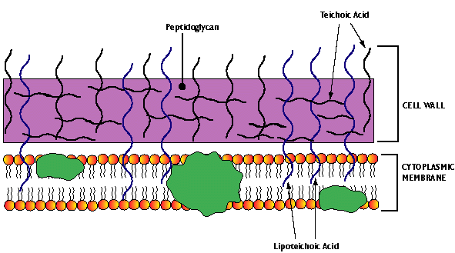
Special components of Gram-Positive Cell Walls:
Teichoic Acids
Teichoic acids are water soluble polymers, containing ribitols or glycerol residues joined through phosphodiester linkages and carrying one or more amino acid or sugar substituents.
There are two types of teichoic acids: wall teichoic acid (WTA), covalently linked to peptidoglycan, and membrane teichoic acid, covalently linked to membrane glycolipid. Because the latter are intimately associated with lipids, they have been called lipoteichoic acids (LTA).

Slide 33
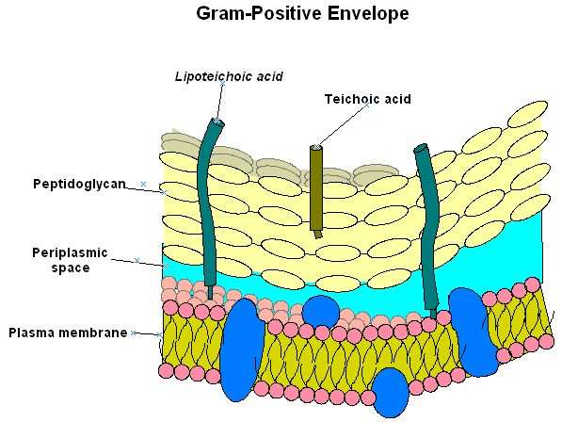
Function of teichoic acid
(1)Constituting major surface antigens of those gram-positive
species that possess them.
(2) In Streptococcus pyogenes , LTA is associated
with the M protein that protrudes from the cell membrane through the peptidoglycan layer. The long M protein molecules together with the LTA form microfibrils that facilitate the attachment of S. pyogenes to animal cells.

Slide 34
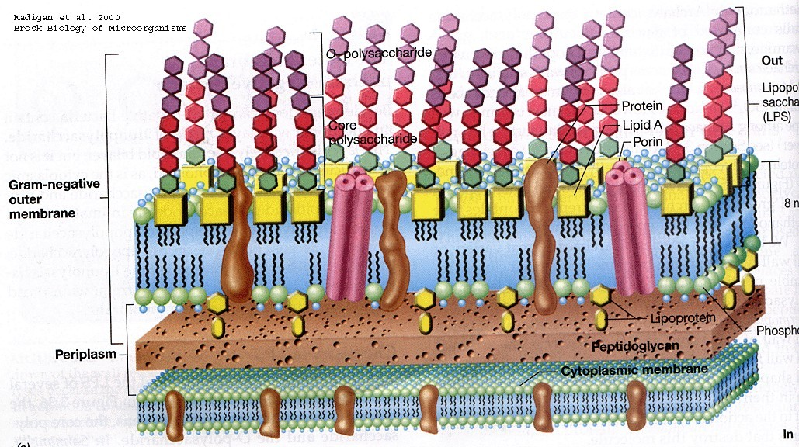
Special components of Gram-negative Cell Walls

Slide 35
Gram-negative cell walls contain three components that lie outside of the peptidoglycan layer:
lipoprotein, phospholipid bilayer, and lipopolysaccharide.
Outer membrane

Slide 36
Lipoprotein
Molecules of an unusual lipoprotein cross-link the outer membrane and peptidoglycan layers.
The lipoprotein contains 57 amino acids, representing repeats of a 15-amino-acid sequence; it is peptide-linked to diaminopimelic acid residues of the peptidoglycan tetrapeptide side chains.
The lipid component, consisting of a diglyceride thioether linked to a terminal cysteine, is noncovalently inserted in the phospholipid bilayer.
Its function is to stabilize the outer membrane and
anchor it to the peptidoglycan layer.

Slide 37
Phospholipid bilayer with structural and enzymic proteins
☺The phospholipid bilayer is chemically distinct from all other biological membranes.
☺It is a bilayered structure; its inner leaflet resembles in composition that of the cell membrane while its outer leaflet contains a distinctive component, a lipopolysaccharide (LPS).
☺The phospholipid bilayer has special channels, consisting of protein molecules called porins.

Slide 38
Function of Phospholipid bilayer
Excluding hydrophobic molecules and protecting the cell (in the case of enteric bacteria) from deleterious substances such as bile salts.
Because of its lipid nature, the outer membrane would be expected to exclude hydrophilic molecules as well. However, the porins permit the passive diffusion of low-molecular-weight hydrophilic compounds like sugars, amino acids, and certain ions.
Large antibiotic molecules penetrate the outer membrane relatively slowly, which accounts for the relatively high antibiotic resistance of gram-negative bacteria.

Slide 39
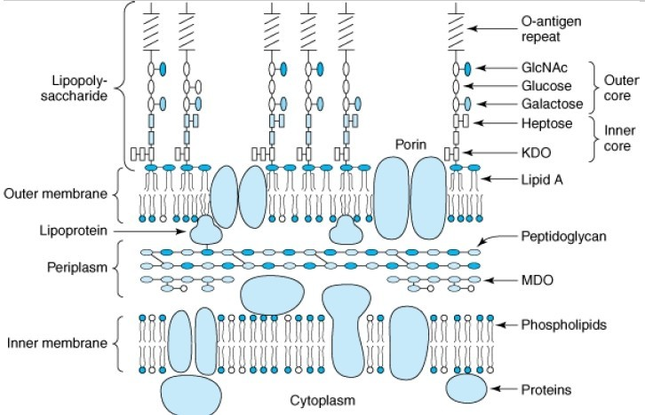
Lipopolysaccharide (LPS)
LPS, which is extremely toxic to animals, has been called the endotoxin of gram- negative bacteria because it is
firmly bound to the cell surface and is released only when the cells are lysed. When LPS is split into lipid A and polysaccharide, all of the toxicity is associated with the former.
LPS, the endotoxin of gram-negative bacteria, consists of lipid A, core polysaccharide and a terminal series of repeat units. The lipid A component is embedded in the outer leaflet of the membrane anchoring the LPS.

Slide 40
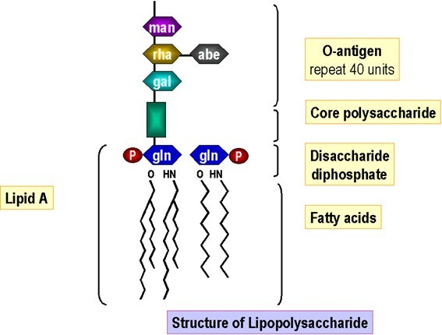
(1)Lipid A consists of phosphorylated glucosamine disaccharide units to which are attached a number of long-chain fatty acids.
Lipid A is the core structure of LPS. The structure and chemical compositions of lipid A are similar in nearly all Gram- negative bacteria. So the pathophysiologic effects of LPS (endotoxin) are similar regardless of their bacterial origin.

Slide 41
(2) The polysaccharide core is similar in all gram-negative species that have LPS and includes two characteristic sugars, ketodeoxyoctanoic acid (KDO) and a heptose.

Slide 42
(3)Each species, however, contains a unique repeat unit.
The repeat units are usually linear trisaccharides or branched tetra- or pentasaccharides. The repeat unit is referred to as the O antigen.
The hydrophilic carbohydrate chains of the O antigen cover the bacterial surface and exclude hydrophobic compounds.

Slide 43

Function
Cell wall
Giving osmotic protection. The integrity of the cell wall is essential to the viability of the bacterium.
Maintaining the characteristic shape of the bacterium.
Playing an important part in cell division. Various layers of the wall are the sites of
major antigenic determinants of the cell
surface.
Bearing some toxic components.

Slide 44
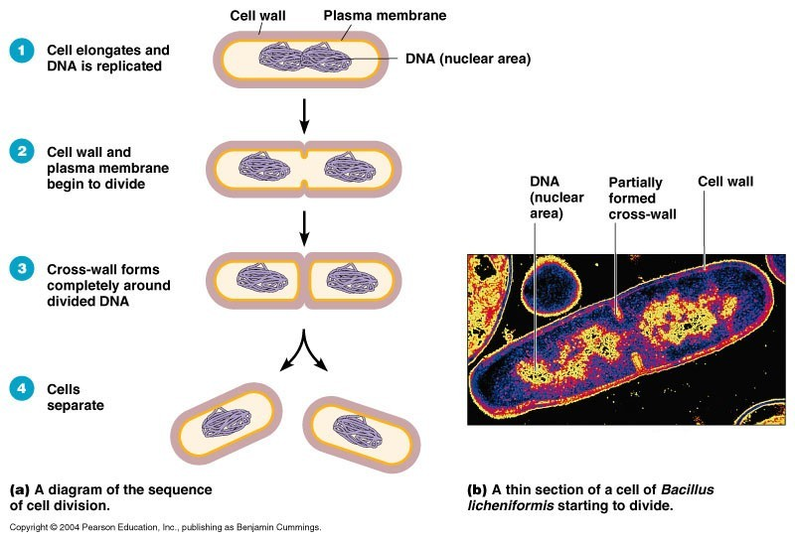
Playing an important part in cell division

Slide 45
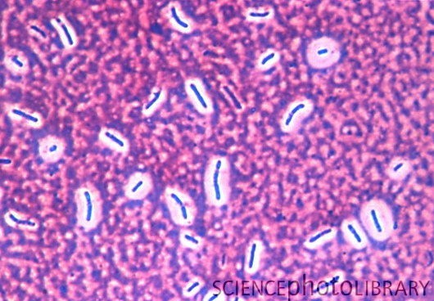
Capsule
Caption: Bacterial capsules. Light micrograph of unidentified bacteria (blue) encased in capsules (pink). Each capsule or slime layer (glycocalyx) is a thick layer of slimy material secreted by the bacteria onto their surfaces. They can help the bacteria to attach onto the host cells they are infecting. They may also serve to protect the bacteria from immune cells such as phagocytes. Phase contrast. Magnification: x1000 at 35mm

Slide 46
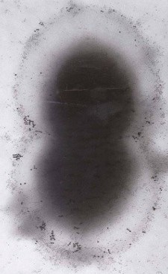
Capsule----Many bacteria are surrounded by a discrete covering layer of a relatively firm gelatinous material that lies outside and immediately in contact with the cell wall.
Chemical composition Consisting largely of water and has only a small content (e.g. 2%) of solids. In most species, the solid material is a complex polysaccharide, though in some species its main constituent is polypeptide or protein.
The development of capsules is often dependent on the existence of favorable environmental conditions. Thus their size may vary with the amount of carbohydrate in the culture medium.

Slide 47
Capsules, microcapsules and loose slime
When this layer, in the wet state ,is wide enough(0.2μm or more), it is called a capsule.
When it is narrower and detectable by indirect, serological means, or by electron microscopy, it may be termed a microcapsule .
Loose slime is an amorphous, viscid colloidal material that is secreted extracellularly by some non-capsulate bacteria and also, outside their capsules ,by many capsulate bacteria.
When slime-forming bacteria are grown on a solid culture medium, the slime confers on the growths a watery and sticky ‘mucoid’ character.

Slide 48
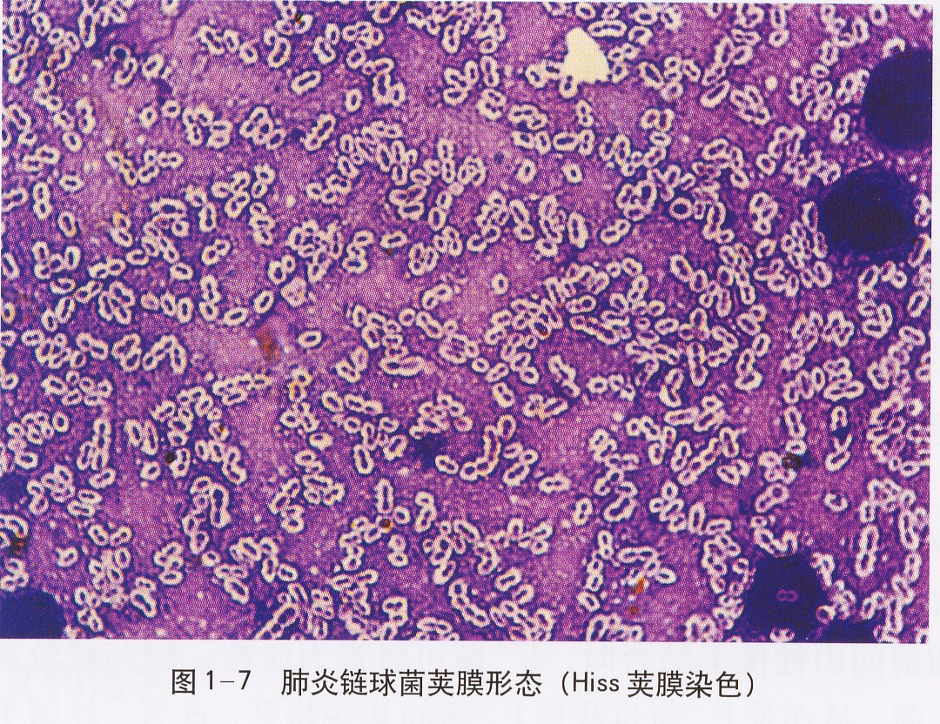
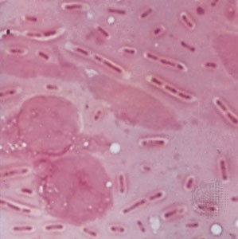
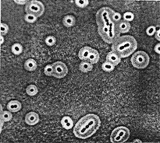
Demonstration
Direct: Dry-film methods :Staining :Ordinary methods
Special methods Wet-film methods :Negative staining: India ink
Indirect: Being deduced from serological evidence
Klebsiella pneumoniae, from a pneumonia lung abscess (magnified 1,000×).
Bacterial capsules outlined by India ink viewed by light microscopy.

Slide 49
Function
Protecting the cell wall against attack by various kinds of antibacterial agents, e.g. bacteriophages, colicins, complement, lysozyme and other lytic enzymes. Thus the capsule is an important virulence determinant.
The capsular substance is usually antigenic and the capsular antigens play a very important part in determining the antigenic specificity of bacteria.

Slide 50
Flagella
Flagella
Bacterial flagella are long, thin filaments, twisted spirally in open, regular wave forms.
About 0.02μm thick and usually several times the length of the bacteria cell.
Originating in the bacterial protoplasm and being extruded through the cell wall.
According to the species, there may be one, or up to 20 flagella.

Slide 51

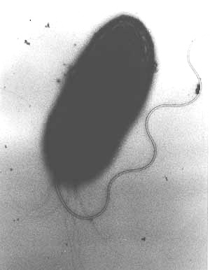
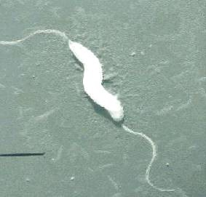
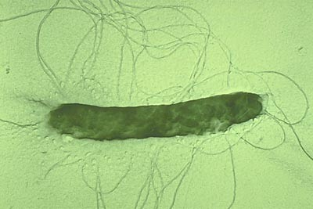
Three types of arrangement are known: monotrichous (single polar flagellum), lophotrichous (multiple polar flagella), and
peritrichous (flagella distributed over the entire cell).

Slide 52
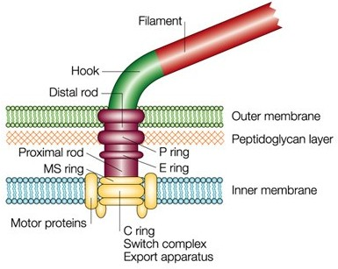
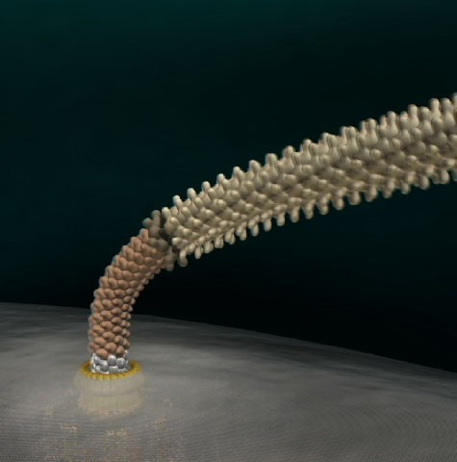
➢A bacterial flagellum is made up of several thousand molecules of a protein
subunit called flagellin.
➢The flagellum is formed by the aggregation of subunits to form a helical structure.
➢The flagellins of different bacterial species presumably differ from one another in primary structure. They are highly antigenic (H antigens), and some of the immune responses to infection are directed against these proteins.

Slide 53
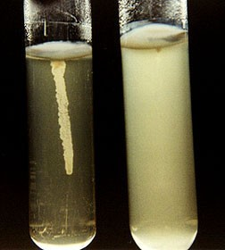
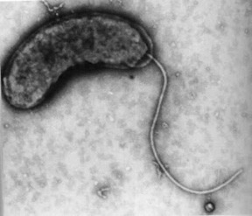
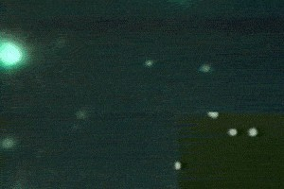

Demonstration
By the occurrence of spreading growth in semi-solid agar medium
dart, wriggle, tumble
By electron microscopy
By watching the swimming with light microscope
By the flagella stain

Slide 54

Function: Motility
Escherichia coli cells use long, thin structures called flagella to propel themselves. These flagella form bundles that rotate counter- clockwise, creating a torque that causes the bacterium to rotate clockwise.
Being beneficial in increasing the rate of uptake of nutrient
solutes by continuously changing the environmental fluid in contact with the bacterial cell surface.
Assisting pathogenic bacteria in penetrating through viscid mucous secretions and epithelial barriers, and in spreading throughout the body fluids and tissues.

Slide 55


Pili (Fimbriae)
Many gram-negative bacteria possess rigid surface appendages called pili (L "hairs") or fimbriae (L "fringes").
They are shorter and finer than flagella; like flagella, they are composed of structural protein subunits termed pilins.

Slide 56

Two classes can be distinguished: pili, and sex pili.
Surface appendages of bacteria. Electron micrograph of a cell of E coli possessing three types of appendages: ordinary pili
(short, straight bristles), a sex pilus (longer, flexible, with phage particles attached), and several flagella (longest, thickest).
Diameters: ordinary pili: 7 nm; sex pili: 8.5 nm; flagella: 25 nm.
ordinary

Slide 57

1.Ordinary pili: Playing a role in the adherence of symbiotic and pathogenic bacteria to host cells.
(Minor proteins termed adhesins are located at the tips of pili and are responsible for the attachment properties.)

Slide 58



2. Sex pili: Being responsible for the attachment of donor and recipient cells in bacterial conjugation.

Slide 59

Endospores
Some bacteria, notebly those of the genera Bacillus and clostridium, devolope a highly resistant resting phase or endospore, whereby the organism can survive in a dormant state through a long period of starvation or other adverse enviromental condition.
The process does not involve multiplication.

Slide 60

Sporulation and Germination

Slide 61

The appearance of the mature spores varies according to the species, being spherical, ovoid or elongated, occupying a terminal, subterminal or central position, and being narrower than the cell, or broader and bulging it.
Variations in endospore morphology: (1, 4) central
endospore; (2, 3, 5) terminal
endospore; (6) lateral endospore

Slide 62




Demonstration
Unstained. Being recognized by its greater refractivity.
The spore stain
Gram’s stain. Appearing as a clear space within the stained cell

Slide 63

Structure of Endospore
Core wall, the innermost layer surrounding the inner spore membrane. It contains normal peptidoglycan and becomes the cell wall of the germinating vegetative cell.
The cortex is the thickest layer of the spore envelope. It contains an unusual type of peptidoglycan. Cortex peptidoglycan is extremely sensitive to lysozyme, and its autolysis plays a role in spore germination.
The coat is composed of a keratin-like protein containing many intramolecular disulfide bonds. The impermeability of this layer confers on spores their relative resistance to antibacterial chemical agents.
The exosporium is a lipoprotein membrane containing some carbohydrate.

Slide 64
Viability of Endospore
Endospores are much more resistant than the vegetative forms to exposure to disinfectants, drying and heating.
Reasons
Impermeability of their cortex and outer coat. High content of calcium and dipicolinic acid.
Low content of water.
Very low metabolic and enzyme activity.

Slide 65
Staining
Stains combine chemically with the bacterial protoplasm.
The commonly used stains are salts.
Basic stains consist of a colored cation with a colorless anion (eg, methylene blue + chloride– ); acidic stains are the reverse (eg, sodium + eosinate – ).Bacterial cells are rich in nucleic acid, bearing negative charges as phosphate groups.
These combine with the positively charged basic dyes. Acidic dyes do not stain bacterial cells and hence can be used to stain background material a contrasting color (negative staining).

Slide 66



Gram’s stain
Gram-positive bacteria:
Gram-negative bacteria:
dark purple
light pink

