Slide 1

The Virus

Slide 2
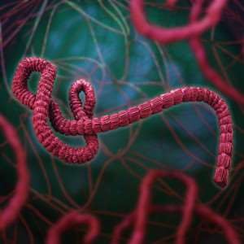
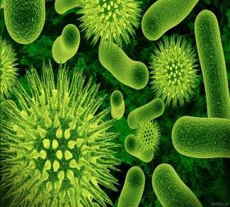
Definition:
An infective agent that typically consists of a nucleic acid molecule in a protein coat, is too small to be seen by light microscopy, and is able to multiply only within the living cells of a host.
Viruses:

Slide 3
Viruses do not have cells that divide; new viruses are assembled in the infected host cell
But unlike still simpler infectious agents, viruses contain genes, which gives them the ability to mutate and evolve.
Evolved from plasmids : pieces of DNA that can move between cells
while others may have evolved from bacteria.
Over 5,000 species of viruses have been discovered.
Introduction to viruses

Slide 4
A virus consists of two or three parts:
genes, made from either DNA or RNA,
long molecules that carry genetic information
protein coat that protects the genes; and in some viruses, an envelope of fat
Viruses vary in shape from the simple helical and icosahedral to more complex structures.
Viruses range in size from 20 to 300 nanometres; it would take 30,000 to 750,000 of them, side by side, to stretch to 1 centimeter.
Introduction to viruses

Slide 5
Viruses spread in many ways. Just as many viruses are very specific as to which host species or tissue they attack,
Plant viruses are often spread from plant to plant by insects and other organisms, known as vectors.
Some viruses of animals, including humans, are spread by exposure to infected bodily fluids
Viruses such as influenza are spread through the air by droplets of moisture when people cough or sneeze.
Viruses such as norovirus are transmitted by the faecal–oral route, which involves the contamination of hands, food and water.
Spreading , Vectors:

Slide 6
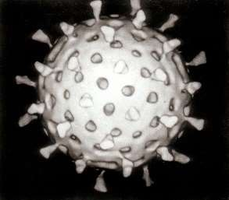
The human immunodeficiency virus, HIV, is transmitted by bodily fluids transferred during sex.
Dengue virus, are spread by blood-sucking insects.
Rotavirus is often spread by direct contact with infected children.
Antibiotics have no effect on viruses,
but antiviral drugs have been developed to treat life-threatening
infections. Vaccines that produce lifelong immunity can prevent some viral infections.

Slide 7
In 1884 the French microbiologist Charles Chamberland invented a filter, known today as the Chamberland filter or Chamberland–Pasteur filter, that has pores smaller than bacteria. Thus he could pass a solution containing bacteria through the filter and completely remove them from the solution.
In the early 1890s the Russian biologist Dmitri Ivanovsky used this filter to study what became known as the tobacco mosaic virus. His experiments showed that
extracts from the crushed leaves of infected tobacco-plants remain infectious after filtration.
Discovery:

Slide 8
In 1899 the Dutch microbiologist Martinus Beijerinck observed that the agent multiplied only in dividing cells. Having failed to demonstrate its particulate nature he called it a "contagium vivum fluidum", a "soluble living germ".
In the early 20th century the English bacteriologist Frederick Twort discovered viruses that infect bacteria
With the invention of the electron microscope in 1931 by the German engineers Ernst Ruska and Max Knoll came the first images of viruses.
Discovery:

Slide 9
Obligate intracellular parasites of bacteria, protozoa, fungi, algae, plants, and animals.
Ultramicroscopic size, ranging from 20 nm up to 450 nm (diameter).
Not cellular in nature; structure is very compact
Do not independently fulfill the characteristics of life.
Basic structure consists of protein shell (capsid) surrounding nucleic acid core.
Nucleic acid can be either DNA or RNA but not both
Multiply by taking control of host cell’s genetic material and regulating the synthesis and assembly of new viruses.
Lack enzymes for most metabolic processes.
Lack machinery for synthesizing proteins.
Viral infections range from very mild to life threatening.
Characteristics

Slide 10
Smallest infectious agents
Most are so small, they can only be seen with an electron microscope
Animal viruses
Proviruses- around 20 nm in diameter
Mimi viruses- up to 450 nm in length
Viewing viruses
Special stains and an electron microscope
Negative staining outlines the shape
Positive staining shows internal details
Shadow casting technique
Size of virus ?

Slide 11
All virions contain a nucleocapsid which is composed of nucleic acid (DNA or RNA) and a protein coat (capsid)
Some viruses consist only of a nucleocapsid, others have additional components
 Virion size range is ~10-400 nm
Size Of Virus :

Slide 12
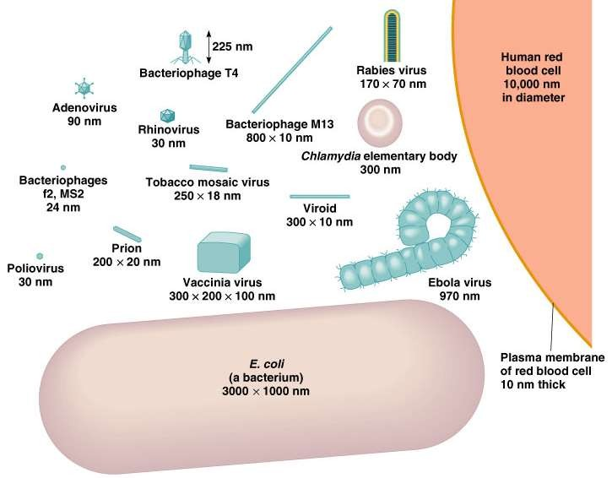

Slide 13
nucleocapsid
The capsid and the nucleic acid together are called the nucleocapsid
virion
Fully formed virus that is able to establish an infection
in a host cell
Capsids:

Slide 14
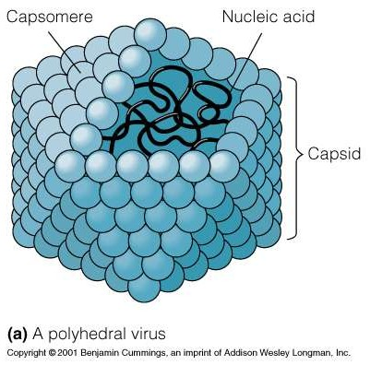

Slide 15
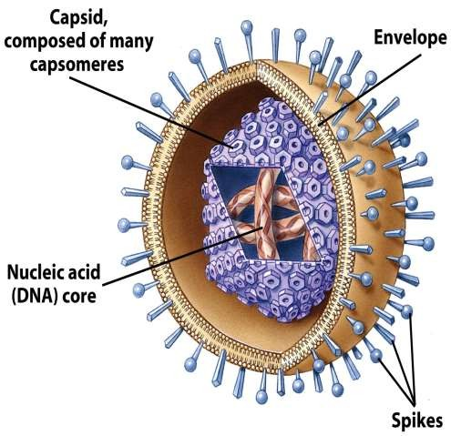
Viral components
Nucleic acids
Capsid
Envelope
Generalized Structure:

Slide 16
the sum total of the genetic information carried by an organism
Genome:
Number of viral genes compared with a cell- quite small
They only have the genes necessary to invade host cells and redirect their activity
Nucleic Acids:

Slide 17
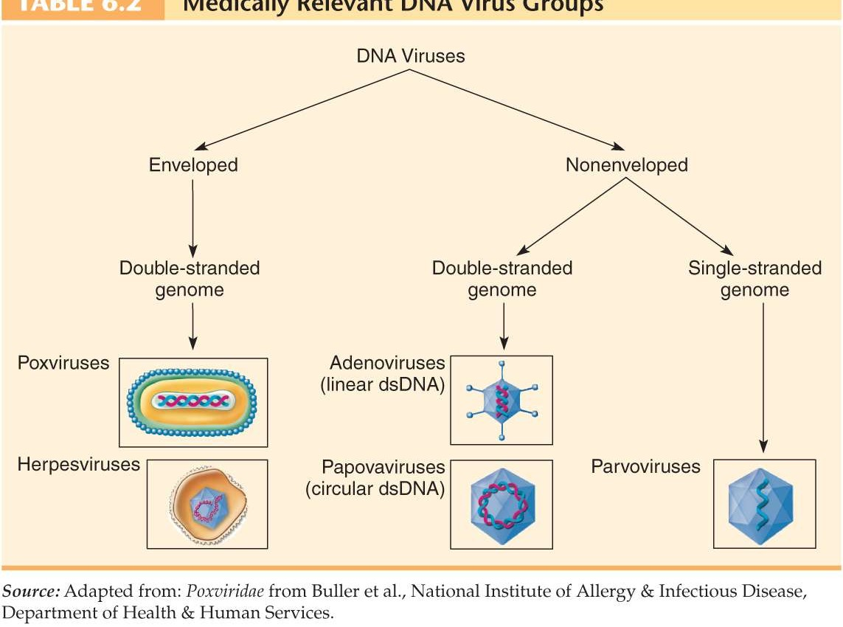

Slide 18
Mostly single-stranded
  Positive-sense RNA: genomes that are ready for immediate
translation into proteins
  Negative-sense RNA: genomes have to be converted into the proper form to be made into protein
RNA Viruses:

Slide 19
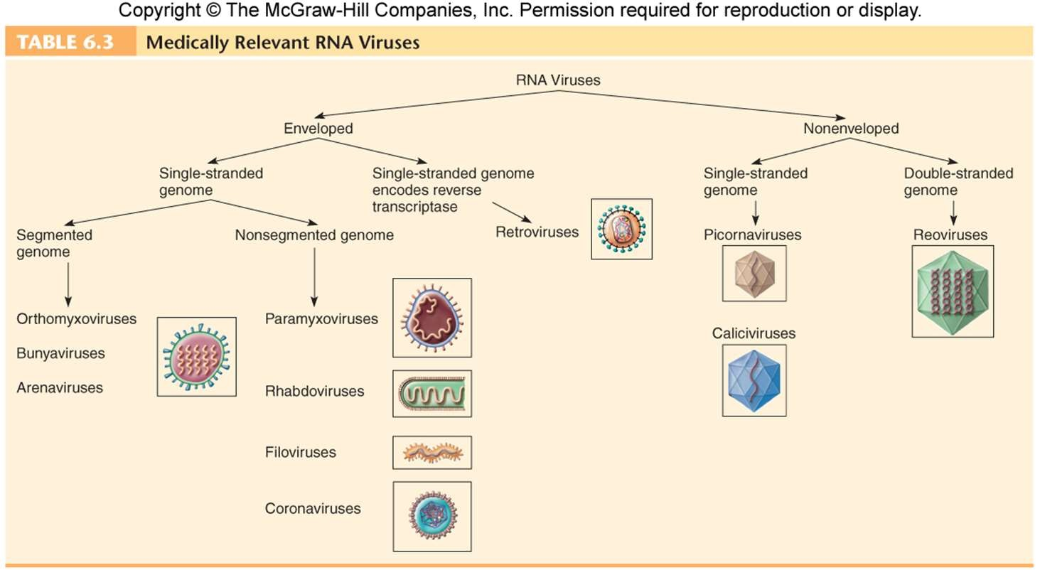
RNA viruses

Slide 20
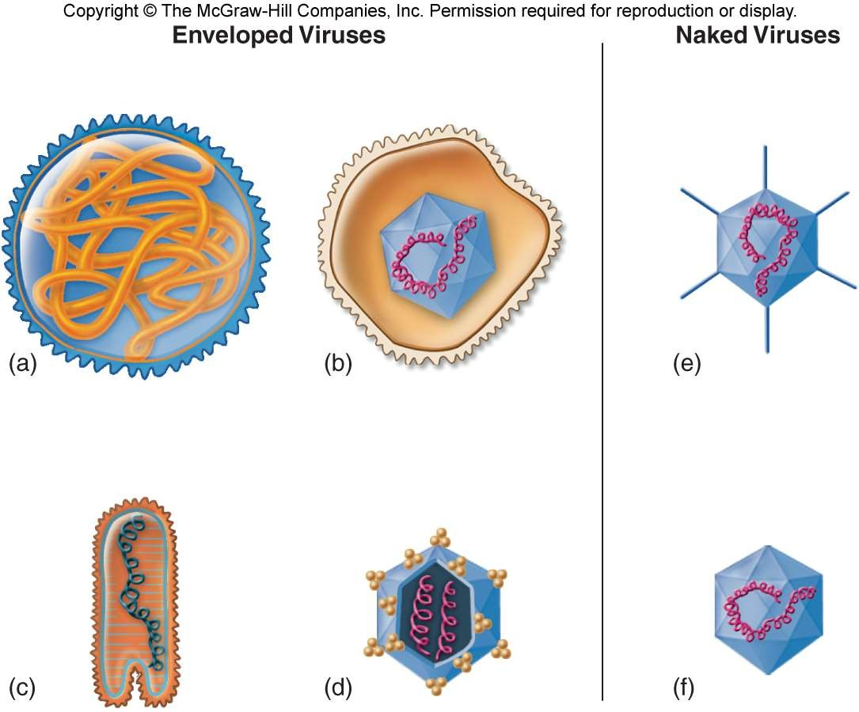

Slide 21
Constructed from identical subunits called capsomers
Made up of protein molecules
Two different types
  Helical
    Rod-shaped capsomers
    Assemble in to helical nucleocapsid
Capsid:

Slide 22
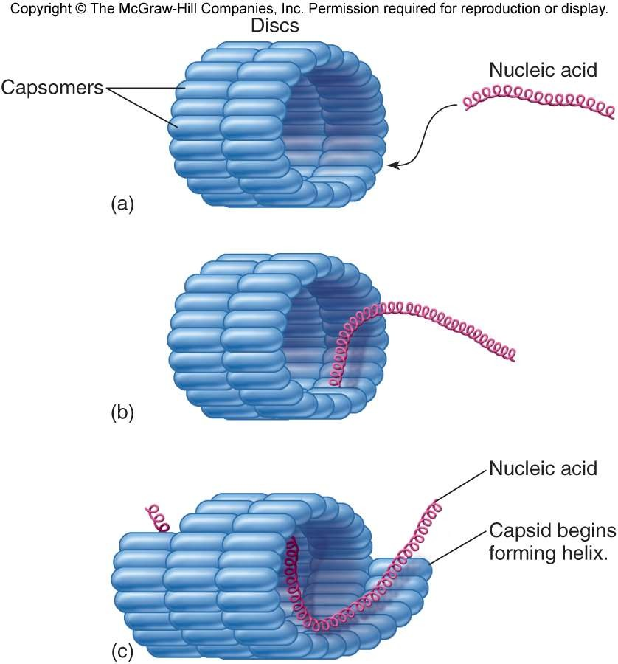

Slide 23
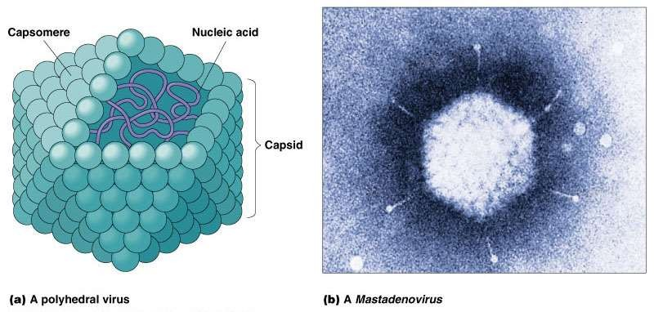

Slide 24
Three-dimensional
20-sided figure
12 evenly spaced corners
Although they all display this symmetry, there are wide variations
Icosahedral:

Slide 25
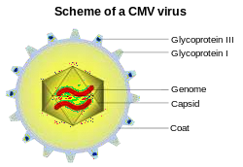

Slide 26
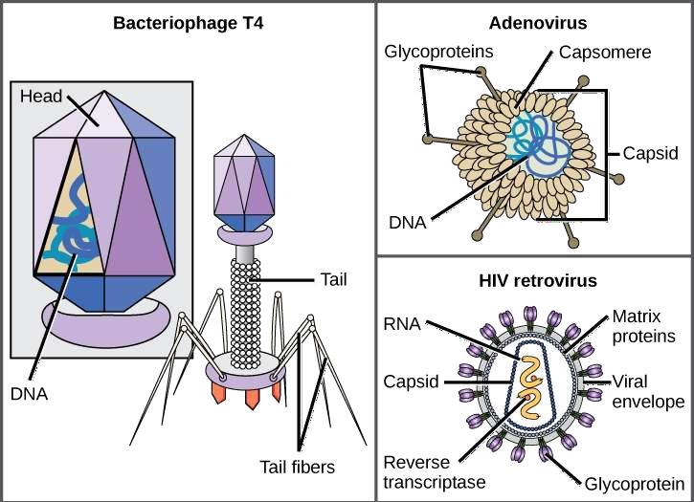

Slide 27
Protects nucleic acids
Help introduce the viral DNA or RNA into a suitable host cell
Stimulate the immune system to produce antibodies that can protect the host cells against future infections
Functions of the Viral Capsid

Slide 28
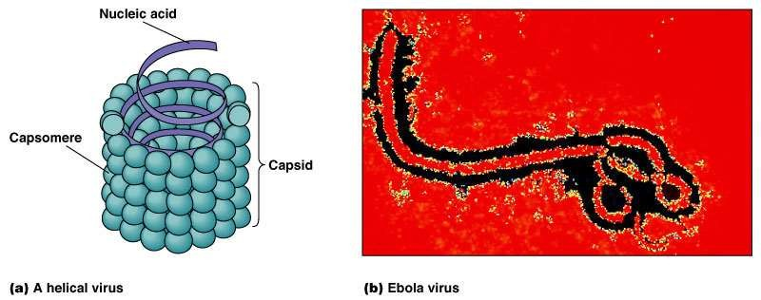

Slide 29
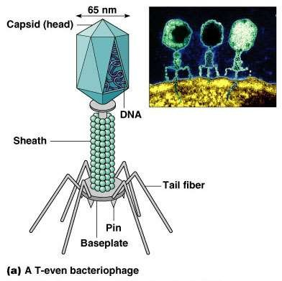

Slide 30
Morphology under electron microscope
  filamentous, enveloped RNA virus
  approx. 19 kb in length (1 kb = 1000 RNA
bases/nucleotides) or 60-80 nm in diameter
  single-stranded, linear, non-segmented
  negative-sense RNA (encoded in a 3’ to 5’ direction)
  appears to have “spikes” due to glycoprotein on
outside membrane
Ebola Virus:

Slide 31
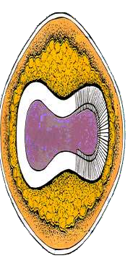
Brick shaped complex symmetry
  240nm x 300 nm
Enveloped
  antibody neutralization sites
Core contains enzymes for virus uncoating dsDNA
Inner membrane
Poxvirus:

Slide 32
Viruses can reproduce only when they enter cells and utilize the cellular machinery of their hosts. Viruses’ code their genes on a single type of nucleic acid, either DNA or RNA, but viruses lack ribosomes and the enzymes necessary for protein synthesis. Viruses are able to reproduce because their genes are translated into proteins by the cell’s genetic machinery. These proteins lead to the production of more viruses.
Viral reproduction

Slide 33
Viral multiplication proceeds as following manner.
Adsorption,
Penetration,
Uncoating,
Synthesis,
Assembly and Release
Adsorption.

Slide 34
Adsorption/attachment
Virus encounters susceptible host cells
Adsorbs specifically to receptor sites on the cell
membrane
Because of the exact fit required, viruses have a limited host range

Slide 35
Penetration
Flexible cell membrane of the host is penetrated by the whole virus or its nucleic acid
Endocytosis: entire virus engulfed by the cell and enclosed in a vacuole or vesicle
The viral envelope can also directly fuse with the host cell membrane
Uncoating
Enzymes in the vacuole dissolve the envelope and capsid
The virus is now uncoated

Slide 36
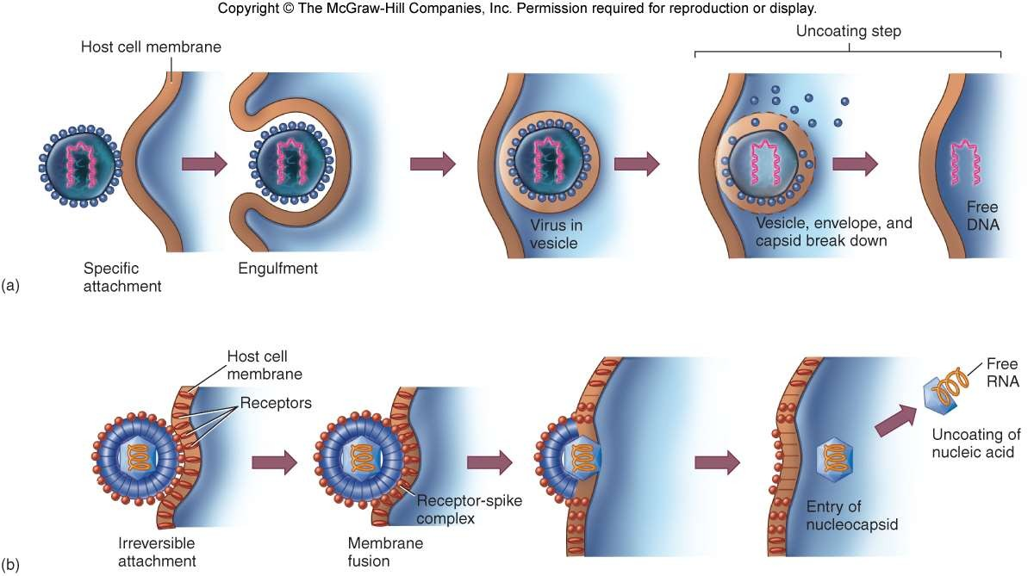

Slide 37
Free viral nucleic acid exerts control over the host’s synthetic and metabolic machinery
DNA viruses- enter host cell’s nucleus where they are replicated and assembled
DNA enters the nucleus and is transcribed into RNA
The RNA becomes a message for synthesizing viral proteins (translation)
New DNA is synthesized using host nucleotides
RNA viruses- replicated and assembled in the cytoplasm
synthesis

Slide 38
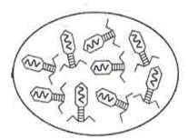
Mature virus particles are constructed from the growing pool of parts
Assembly

Slide 39
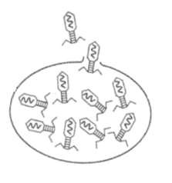
Nonenveloped and complex viruses are released when the cell lyses or ruptures
Enveloped viruses are liberated by budding or exocytosis
Anywhere from 3,000 to 100,000 virions may be released, depending on the virus
Entire length of cycle- anywhere from 8 to 36 hours
Release

Slide 40
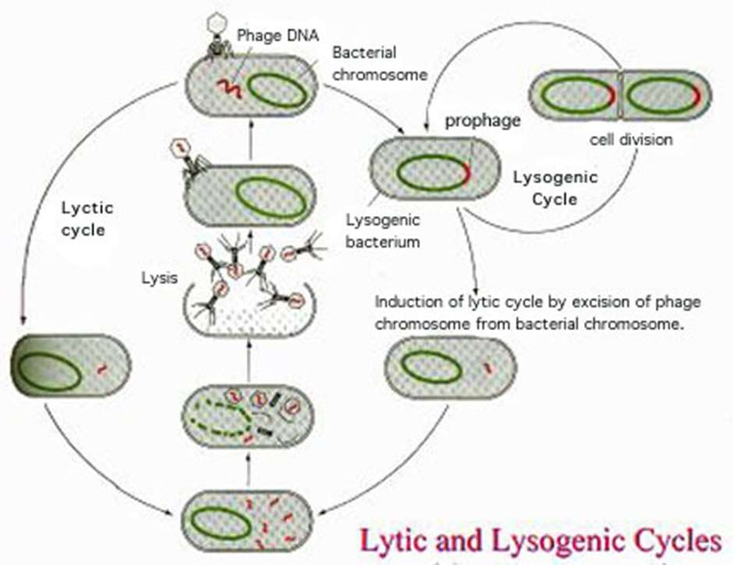
Bacteriophage life cycle

Slide 41
Primary purposes of viral cultivation
To isolate and identify viruses in clinical specimens
To prepare viruses for vaccines
To do detailed research on viral structure, multiplication cycles, genetics, and effects on host cells
Using Live Animal Inoculation
Specially bred strains of white mice, rats, hamsters, guinea pigs, and rabbits
Occasionally invertebrates or nonhuman primates are used
Animal is exposed to the virus by injection
Cultivation of viruses

Slide 42
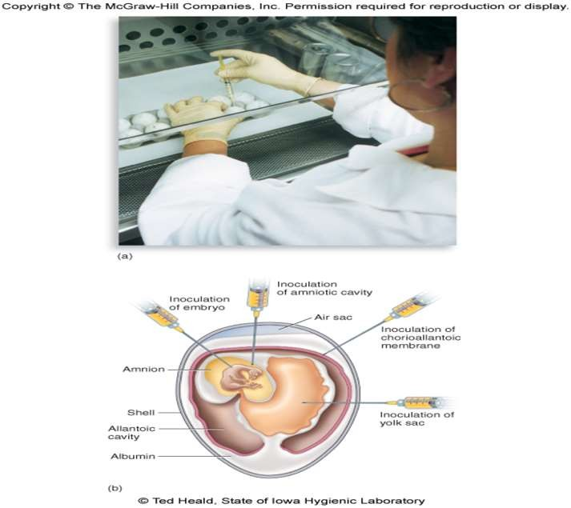

Slide 43
Most viruses are propagated in some sort of cell culture
The cultures must be developed and maintained
Animal cell cultures are grown in sterile chambers with special media
Cultured cells grow in the form of a monolayer
Primary or continuous
Tissue culture technique

Slide 44
Viruses are classified on the basis of habitat (host).which is trivial system beside this Viruses are classified on following criteria.
Structure
Chemical composition
Similarities in genetic makeup
International Committee on the Taxonomy of Viruses, which includes
3 orders
63 families “-viridae”
263 genera “-virus”
Classification

Slide 45
3 Types of systems were proposed to classify the viruses:
Baltimore Classification.
Classical System Classification.
Genetic Classification.
Types of Classification:

Slide 46
7 groups were made.
Its principles are fundamental to an understanding of virus classification and genome replication.
The Baltimore classification has + RNA as its central point.
I: dsDNA viruses (e.g. Adenoviruses, Herpesviruses, Poxviruses) II: ssDNA viruses (+ strand or "sense") DNA (e.g. Parvoviruses) III: dsRNA viruses (e.g. Reoviruses)
IV: (+)ssRNA viruses (+ strand or sense) RNA
(e.g. Picornaviruses, Togaviruses)
V: (−)ssRNA viruses (− strand or antisense) RNA (e.g. Orthomyxoviruses, Rhabdoviruses)
VI: ssRNA viruses (+ strand or sense) RNA with DNA
intermediate in life-cycle (e.g. Retroviruses)
VII: dsDNA viruses (e.g. Heptadnaviruses)
Baltimore Classification:

Slide 47
Animal viruses:
Viruses of animal host
Rabies, Polio, Mumps, Chicken pox, Small pox, and Influenza.
Plant Viruses:
viruses which show their live characteristics when attached to plants.
Tobacco mosaic virus (TMV), Banana streak virus, Carrot thin leaf virus
Bacterial Virus: Bacteriophages ( T1, T2, T3, and T4.)
Classification on basis of
host

Slide 48
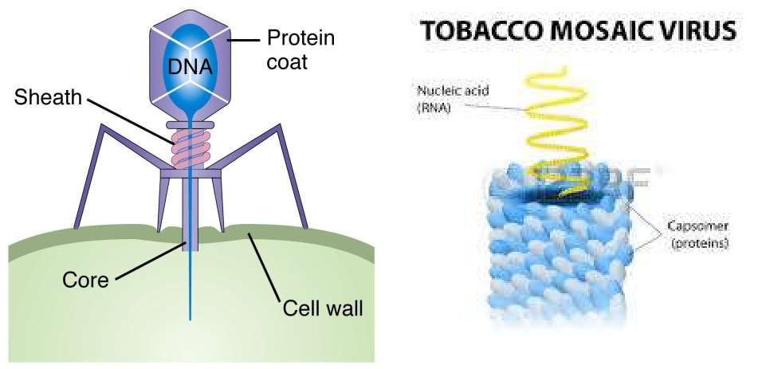

Slide 49
According to genetic consequences viruses are classified as. DNA Viruses and RNA Viruses
Genes may be linear or circular
The smallest have only 4 genes and largest have several hundred.
DNA Viruses
DNA Viruses are the viruses which consist of DNA genome . They complete their activities by transcription and most of them attack on organisms of similar genome.
RNA Viruses
RNA Viruses are the viruses which consist of RNA genome. They complete their activities by reverse transcription.
Classification on
Genetics basis

Slide 50
With relevant to morphology of viral structure viruses are
organized as Enveloped and Nonenveloped viruses.
However they are also arranges subclasses of DNA and RNA viruses
Classification on
structural basis

Slide 51
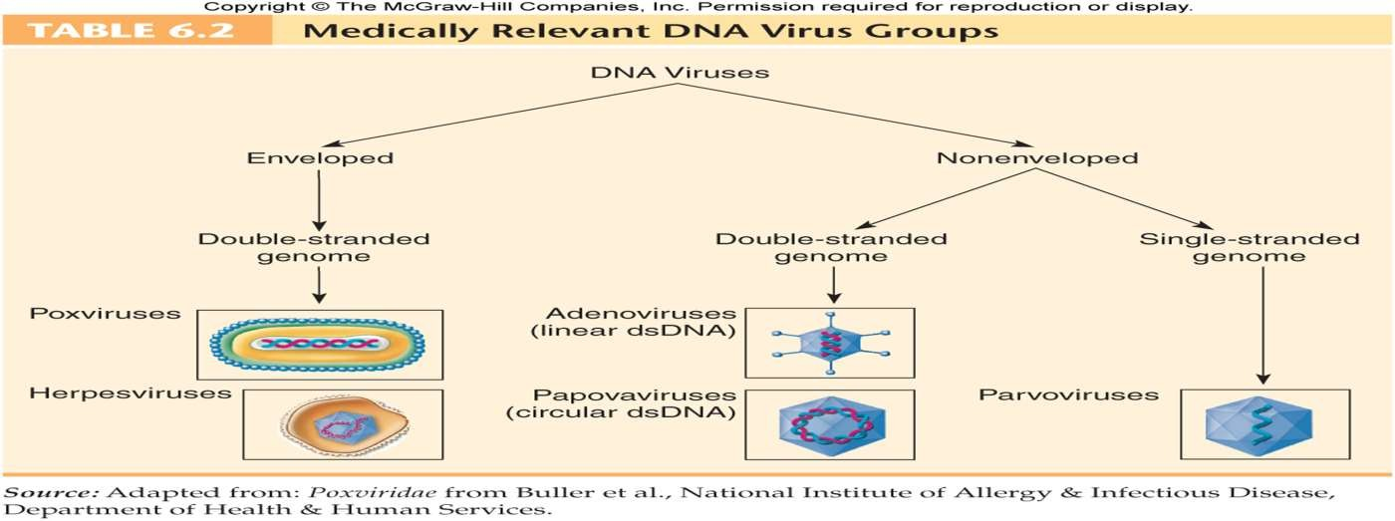
DNA viruses

Slide 52
In Genetic Engineering harmless virus are used as genetic vectors which carry good genes into cells.
Viral envelop Stimulate the immune system to produce antibodies that can protect the host cells against future infections
Viral genome contain enzymes for specific operations within the host cell
Antiviral drugs block virus replication by targeting one of the steps in the viral life cycle
Benefits

Slide 53
Interferon shows potential for treating and preventing viral infections
Some recently-developed drugs do combat some viruses, mostly by interfering with viral nucleic acid synthesis.
AZT interferes with reverse transcriptase of HIV.
Acyclovir inhibits herpes virus DNA
synthesis

Slide 54
The first vaccine was developed in the late 1700s by Edward Jenner to fight smallpox.
Vaccines can help prevent viral infections, but they can
do little to cure most viral infection once they occur.
Both plasmids and transposons are mobile genetic elements.
Uses of viruses

Slide 55
Human Diseases: Warts, common cold, Influenza (flu), Smallpox, Ebola, Herpes, AIDS, Chicken pox, Rabies are due to virus actions.
Viruses can be prevented with vaccines, but NOT treated with
antibiotics.
Cytopathic effects- virus-induced damage to the cell that alters its microscopic appearance
Inclusion bodies- compacted masses of viruses or damaged cell organelles
Oncoviruses- mammalian viruses capable of initiating tumors

Slide 56
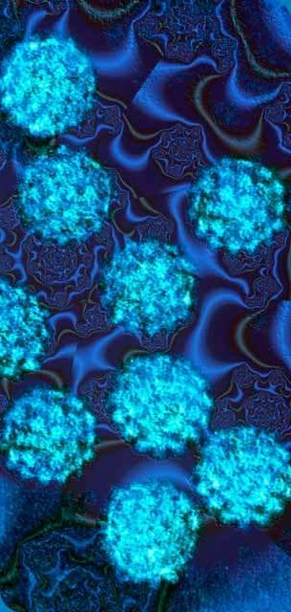
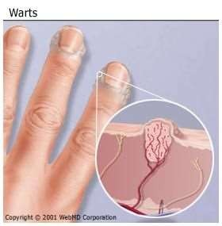
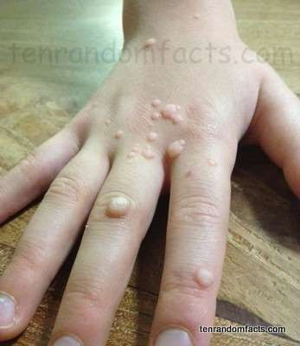
HPV Warts

Slide 57
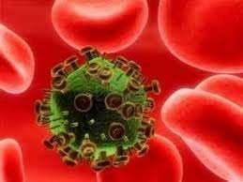
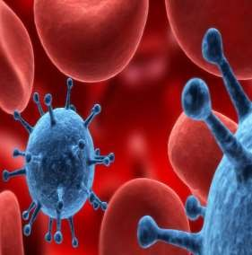
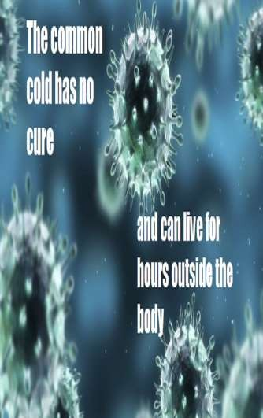
Rhinopharyngitis Coryza
Cold

Slide 58
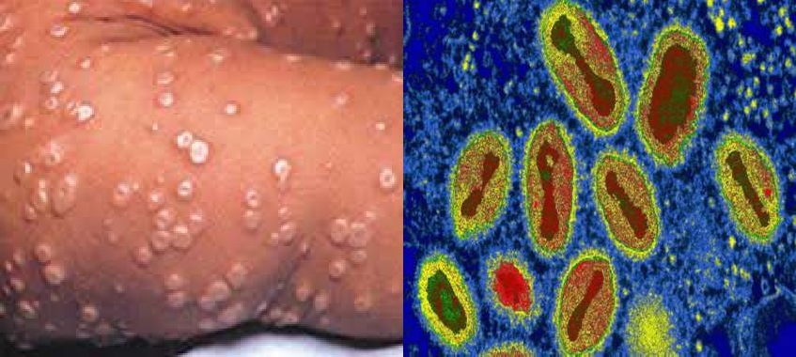
Variola
Smallpox

Slide 59
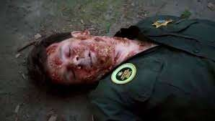
Ebola

Slide 60
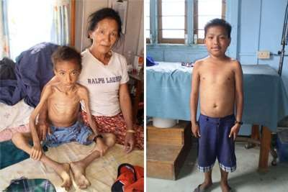
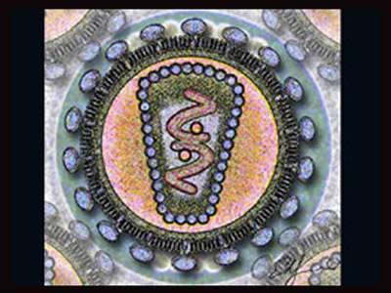
HIV/AIDS

Slide 61
ThankYou
For Your
Precious Time

