Slide 1
VIRUSES, VIROIDS
and PRIONS

Slide 2
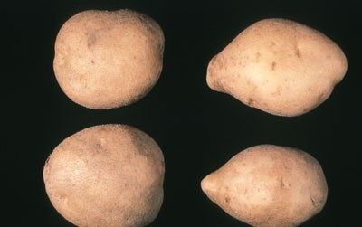
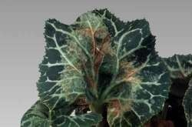
Viroids
Small, circular ss- RNA molecules without a protein coat
Infect plants
Do not infect animals
Potato famine disease in Ireland
Resemble introns cut out of eukaryotic

Slide 3
Viriods
ssRNA
Size from 246 to 399 nm
Show considerable sequence homology
Cause a no of plant diseases:
Coconut cadang cadang viroid-246 nucleotides
Citrus exocortis viroid- 375 nucleotides
Potato spindle tuber viroid -359 nucleotides

Slide 4
Extracellular form=naked RNA RNA has no protein encoding gene
Viroid totally dep on host for its replication.
■
■
■
■
Tho’ ssRNA circular,secondary structure=resembling ds molecule with closed ends.
Enters plant through wound:by insect or mechanical damage.
Replicated by plant RNA polymerases Symptomless or mild to lethal symptoms
Severe symptoms growth related.-are type of regulatory RNA
■
■
■
■

Slide 5
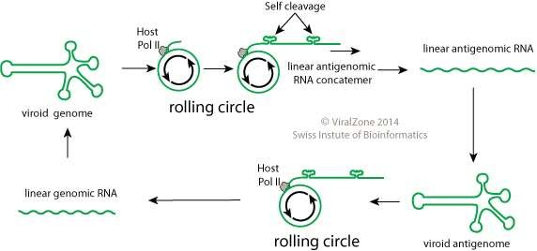
Mode of Replication

Slide 6
Transmission
Viroid infections are transmitted by cross contamination following mechanical damage to plants as a result of horticultural or agricultural practices.
Some are transmitted by aphids and they can also be transferred from plant to plant by leaf contact.

Slide 7
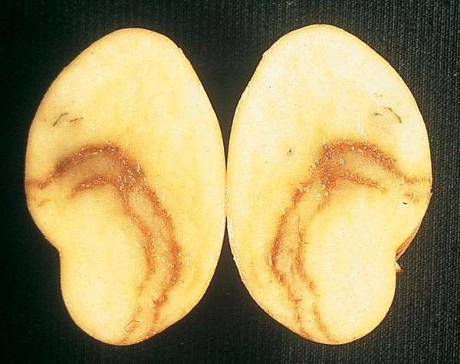
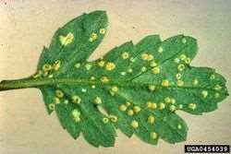
DISEASES CAUSED BY VIRIODS
Viriods causes over 20 different plant diseases of which the most studied are
POTATO SPINDLE-TUBER DISEASE
CHRYSANTHEMUM STUNT DISEASE

Slide 8
Hepatitis D
Caused by Hepatitis delta virus(HDV).
HDV is enclosed in a Hepatitis B virus capsid
The HDV genome exists as an enveloped negative sense, single- stranded, closed circular RNA.
HDV is the smallest viriod known to infect animals.

Slide 9
Hepatitis D
Liver failure and rapid progression to liver cirrhosis.
In combination to HBV, HDV has the highest mortality rate of all hepatitis infections.
Enters the bloodstream and can be transmitted via blood or serum.

Slide 10
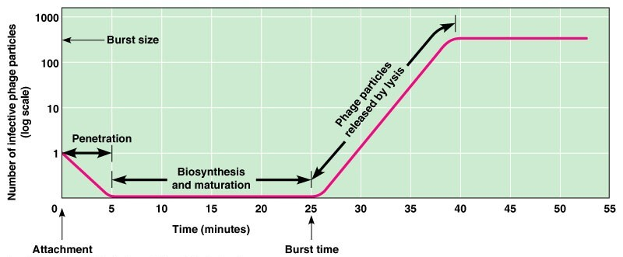
One-step Growth Curve

Slide 11
Viral Latency
Some viruses have the ability to become dormant inside the cell
Called latent viruses
They may remain inactive for long periods of time (years)
Later, they activate to produce new viruses in response to some external signal
HIV and Herpes viruses are examples

Slide 12
PRIONS
Prions are infectious agents composed primarily of sialoglycoprotein.
This protein is called prion protein (PrP)
They contain no nucleic acid.
They cause a variety of neurodegenerative diseases in humans and animals.

Slide 13
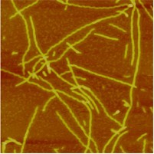
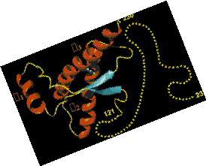
Prions
Prions are “infectious proteins”
They are normal body proteins that get converted into an alternate configuration by contact with other prion proteins
They have no DNA or RNA
The main protein involved in human and mammalian prion diseases is called “PrP”(neurons)
Prions don’t simply subvert host enzymes in the cell but convert a normal protein into a self propagating conformational state.

Slide 14
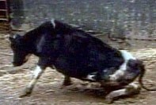
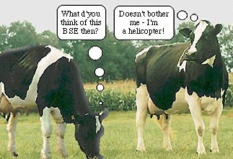
Prion Diseases
Prions form insoluble deposits in the brain
Causes neurons to rapidly degeneration.
Mad cow disease
(bovine spongiform
encephalitis: BSE) is an example
People in New Guinea
used to suffer from
kuru, which they got
from eating the brains of their enemies

Slide 15
Prions
■
■
■
Distict extracellular form Cause scrapie in sheep BSE in cattle
■
■
■
Chronic wasting disease in deer and elk
Kuru and Creutzfeldt-Jacob disease CJD in humans
Prion diseases =transmissible spongiform encephalopathies –TSE
1997-Stanley Pruisner –noble prize
1996 prion causing BSE can cause a new variant nv- CJD in humans by consuming beef with BSE
■
■

Slide 16
PATHOGENICITY
The most studied prion is scrapie prion that causes the scrapie disease in sheeps and goats.
Studies show that the causative agent, PrP^{Sc}, enters the brain of an animal converting the normal PrP^{c} to PrP^{Sc} which continue this conversion chain by changing its folding patterns.

Slide 17
MODE OF TRANSMISSION
It has been recognized that prion diseases can arise in three different ways:
Acquired
Familial
Sporadic
Current research suggests that the primary method of infection in animals is through ingestion.

Slide 18
DISEASES CAUSED BY PRIONS
In cattles
Bovine Spongiform Encephalopathy or Mad Cow Disease
In Humans
Alzheimer’s disease
Down’s syndrome
Fatal familial insomnia
Kuru Leprosy

Slide 19
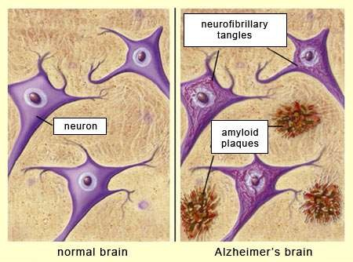
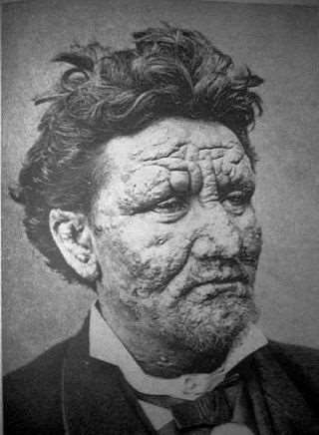
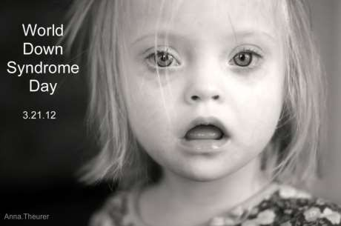

Slide 20
 | Virus | Viroids | Prions
Genome | DNA or RNA | RNA | None
Strand | Ds or ss | ss | ss
Coat | Capsid and Envelope | For HDV only | None
Target | Animal, plant, bacteria, archea | Plants | Animals
Host Cell / Organ | All type of cells | Plant cells | Nervous sysem

