Slide 1
Domain and kingdom classification

Slide 2
  Domains and Kingdoms
Grouping Species
    The broadest category in the classification used by most biologists is the domain.
    The most widely used biological classification system has six kingdoms and three domains.
    The three domains are Bacteria, Archaea, and Eukarya.
    The six kingdoms are Bacteria, Archaea, Protists, Fungi, Plantae, and Animalia.

Slide 3



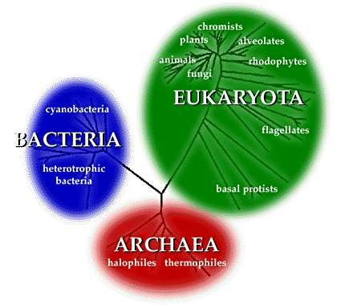
 The three domains are the domain Eukarya, which is composed of protists, fungi, plants, and animals;
the domain Bacteria, which corresponds to the kingdom Eubacteria;
and the domain Archaea, which corresponds to the kingdom Archaebacteria.

Slide 4
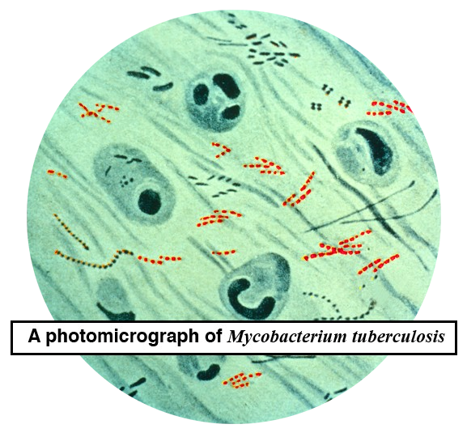
  Domains and Kingdoms
Domain Bacteria
    Eubacteria are prokaryotes whose cell walls contain peptidoglycan.
    Eubacteria are a diverse group that can survive in many different environments.

Slide 5
Domain Archaea
    Archaea are thought to be more ancient than bacteria and yet more closely related to our eukaryote ancestors.
    Archaea are diverse in shape and nutrition requirements.
    They are called extremophiles because they can live in extreme environments.

Slide 6
Domain Eukarya
    All eukaryotes are classified in Domain Eukarya.
    Domain Eukarya contains:
▪Kingdom Protista
▪Kingdom Fungi
▪Kingdom Plantae
▪Kingdom Animalia

Slide 7
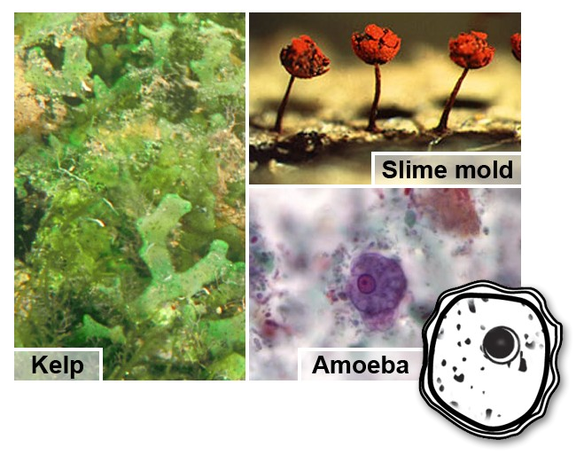
Kingdom Protista
    Protists are eukaryotic organisms that can be unicellular, colonial,
or multicellular.
    Protists are classified into three different groups— plantlike, animal- like, and funguslike.

Slide 8
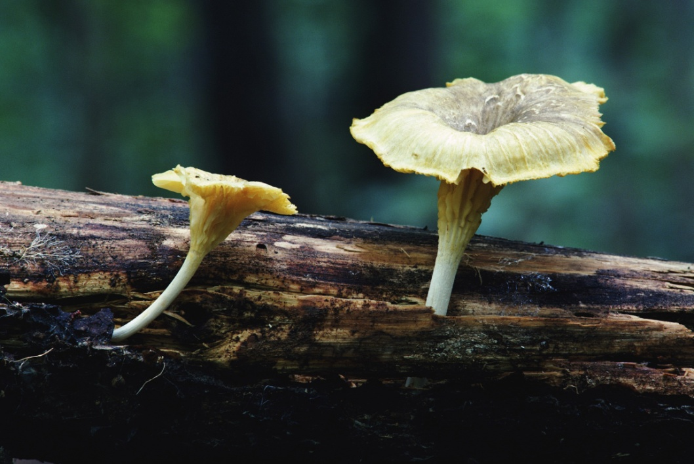
Kingdom Fungi
    A fungus is a unicellular or multicellular eukaryote that absorbs
nutrients from organic materials in its environment.
    Member of Kingdom Fungi are
heterotrophic, lack motility, and have cell walls.

Slide 9

Kingdom Plantae
    Members of Kingdom Plantae form the base of all terrestrial habitats.
    All plants are multicellular and have cell walls composed of cellulose.
    Most plants are
autotrophs, but some are heterotrophic.

Slide 10
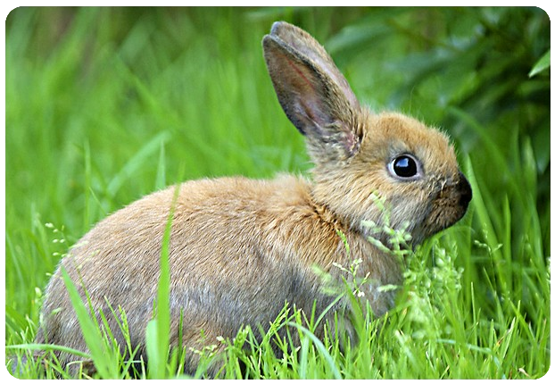
Kingdom Animalia
    All animals are heterotrophic, multicellular eukaryotes.
    Animal organs often are organized into complex organ systems.
    They live in the water, on land, and in the air.

Slide 11
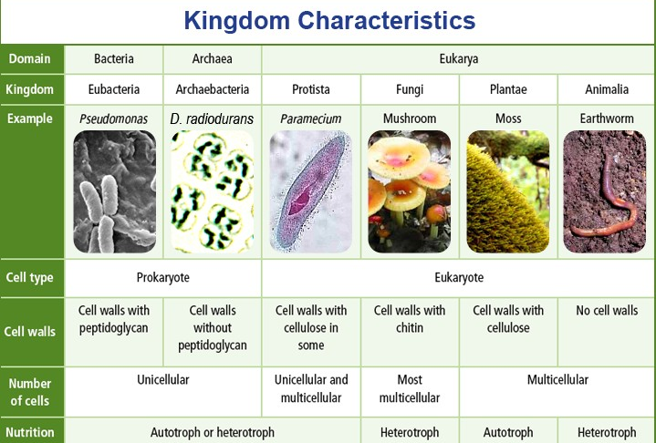
Organizing Life’s Diversity

Slide 12

Viruses—An Exception
    A virus is a nucleic acid surrounded by a protein coat.
    Viruses do not possess cells, nor are they cells, and are not considered to be living.
    Because they are nonliving, they usually are not placed in the biological classification system.

