Slide 1
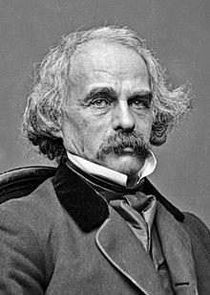
Nathaniel Hawthorne
An Introduction

Slide 2
Nathaniel Hawthorne(1804-1864)
He was an American novelist, dark romantic, and short story writer. His works often focus on history, morality, and religion.
His ancestors include John Hathorne, the only judge from the Salem witch trials, who never repented his involvement.
He entered Bowdoin College in 1821, was elected to Phi Betta Kappa in 1824, and graduated in 1825.
He published his first work in 1828, the novel Fanshawe; he later tried to suppress it, feeling that it was not equal to the standard of his later work. He published several short stories in periodicals, which he collected in 1837 as Twice Told Tales.

Slide 3
In 1839, he began working at Boston Custom House as a salt and coal measurer.
In 1846, he was given the job of surveyor at the port of Salem for his service to the Democratic party.
Later, when the Democrats were thrown out of office, Hawthorne was also thrown out of job. Then he wrote his masterpiece, The Scarlet Letter, which published in 1850, proved to be a great success.

Slide 4
Much of Hawthorne's writing centers on New England, many works featuring moral metaphors with an anti-Puritan inspiration.
His fiction works are considered part of the Romantic Movement and, more specifically, dark romanticism.
His themes often center on the inherent evil and sin of humanity, and his works often have moral messages and deep psychological complexity.

Slide 5
The Scarlet Letter(1850)
It is a tale a adultery set in Puritan America.
It is a romance of seventeenth- century Salem.
It concerns sins and the attempt of societies to purge themselves of it, as well as blundering nature of many of these attempts.

