Slide 1
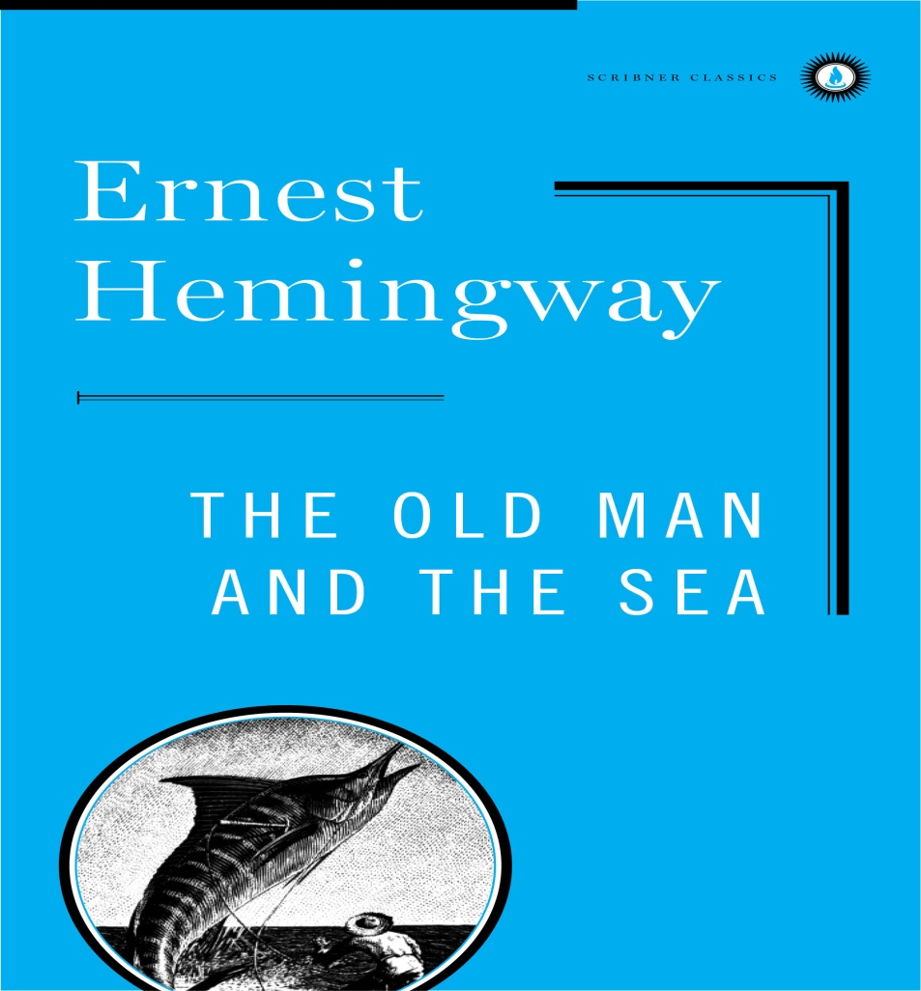
The Old man and the sea
Ernest Hemingway

Slide 2
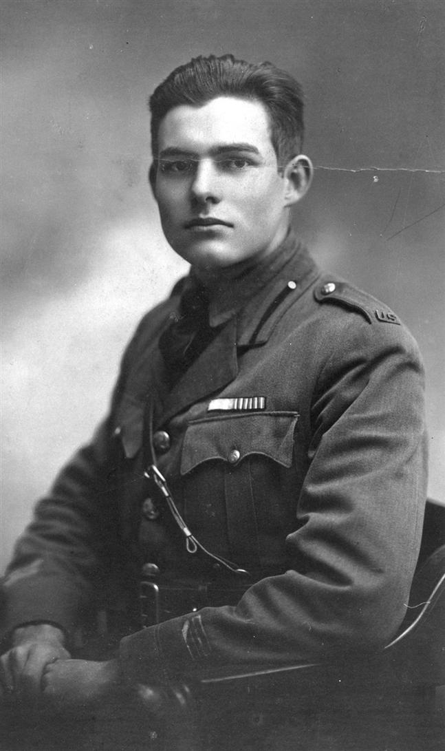
Author Background
Ernest Hemingway 1898-1961
Was born to an affluent family in Chicago
Began writing in high school
Became an ambulance driver during World War I in Italy

Slide 3
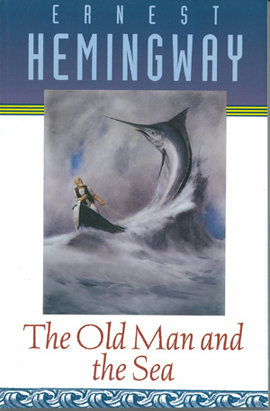
He lived in Cuba while writing The Old Man and the Sea
The Old Man and the Sea was published in full by Life magazine and sold all 5.3 million copies within 48 hours

Slide 4
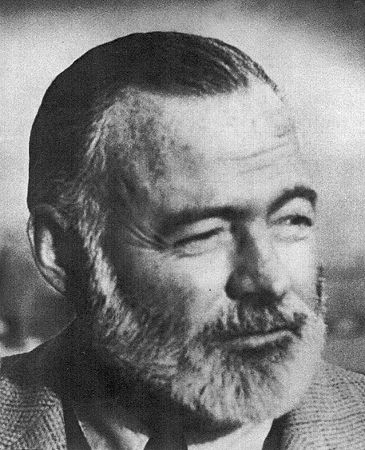
Hemingway’s Accolades
May 1953: Hemingway wins a Pulitzer Prize for writing The Old man and the Sea
October 1954: Hemingway wins the Nobel Prize in Literature
He is known for his Code Hero, a man who is stoic and stays strong against sometimes unbeatable odds.

Slide 5
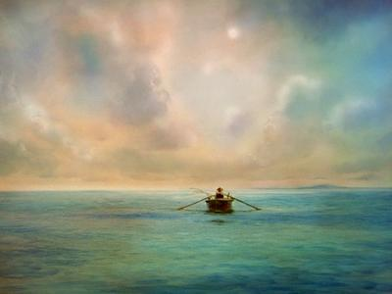
Literary Elements
A novella
Setting (time and place)
  A Cuban village near Havana
  Mostly set on the sea in the Gulf Stream
Characters
  Santiago—Old Cuban fisherman
  Manolin—The boy who is Santiago’s friend
  The giant marlin (symbolic)
  The sharks (symbolic)
  The sea (symbolic)
  Joe DiMaggio (symbolic)

Slide 6
Point of View
Third Person
The narrator describes the characters and events objectively.
The narrator often provides details about Santiago’s inner thoughts and dreams.
TONE/STYLE
Hemingway uses a journalistic, matter-of-fact, tone and style.
The monotonous tone of the novella matches the sensations of Santiago (alone) in the boat being dragged to sea.
Hemingway implores understatement throughout.

Slide 7
PLOT OVERVIEW
The Old Man and the Sea is the story of an epic struggle between an old, seasoned fisherman and the greatest catch of his life
On eighty-four days without success , Santiago, an aged Cuban fisherman, sets out to sea and returns empty-handed.
The old man used to be accomapanied by a boy who is no more with him because of his failure but the boy truly respects him and cares for him
One day on his veture to the sea he expertly hooks the fish, but he cannot pull it in. Instead, the fish begins to pull the boat.

Slide 8
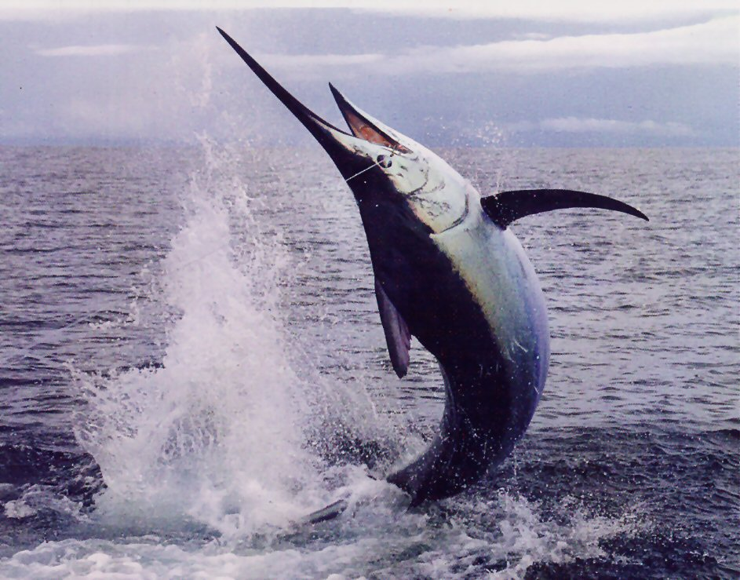
THE MARLIN

Slide 9
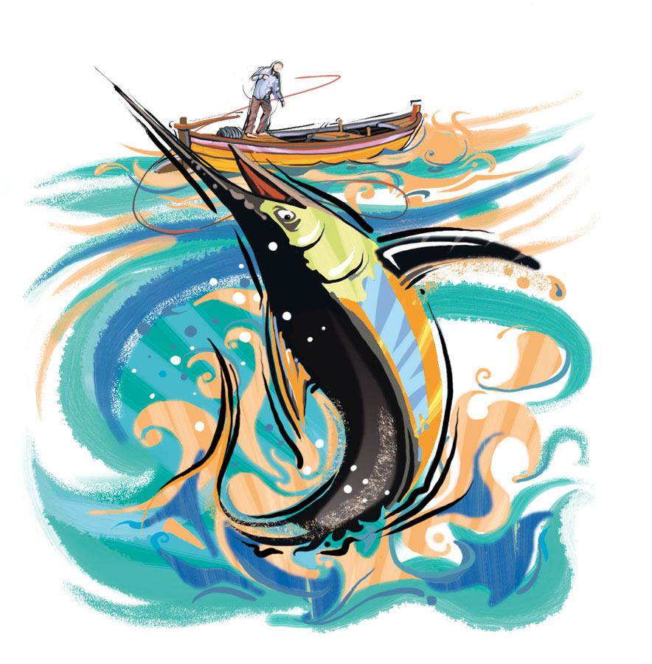
The fish pulls the boat all through the day, through the night, through another day, and through another night. It swims steadily northwest until at last it tires and swims east with the current
On the third day the fish tires, and Santiago, sleep-deprived, aching, and nearly delirious, manages to pull the marlin in close enough to kill it with a harpoon thrust.
As Santiago sails on with the fish tied outside the boat , the marlin’s blood leaves a trail in the water and attracts sharks. Santiago is unable to save the fish he caught.
He arrives home before daybreak, stumbles back to his shack, and sleeps very deeply.
Manolin, who has been worried sick over the old man’s absence, is moved to tears when he finds Santiago safe in his bed. They decide to become partners once again and they go fishing.

Slide 10
Themes
Endurance and Struggle:
Santiago finds the marlin worthy.
This admiration brings respect and honor to the struggle.
“Because I love you, I have to kill you.”
Santiago is destroyed but never defeated.
He emerges as a hero.

Slide 11
Themes
Pride and Determination:
Santiago’s pride becomes his tragic flaw.
He is aware of this flaw. What does this mean for his character?
After the sharks destroy the marlin, Santiago apologizes to his brother.
His pride ruins them both.
However, pride motivates Santiago to overcome the 84 days of misfortune.
Pride and determination are the source of greatness.

Slide 12
SYMBOLS
THE SEA:
The major symbol is the sea, which stands for all of life on which humankind must sail.
In both the sea and in life, there are a number of possibilities that lie hidden from the common eye; some are gifts to be treasured and some are problems to be defeated.

Slide 13
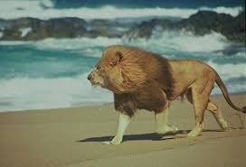
Symbols
The Lions:
Santiago associates the lions with his youth.
Suggest a circular nature to life.
Santiago imagines the lions, fierce predators, playing which suggests harmony between the opposing forces – life and death, love and hate, destruction and regeneration.

Slide 14
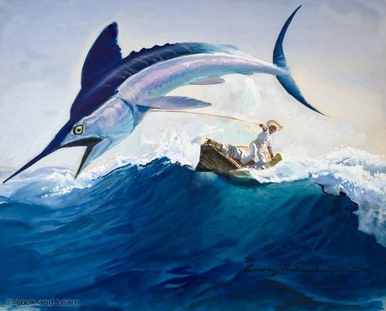
Symbols
The Marlin:
represents the ideal opponent.
Santiago feels fortunate to be matched with such an opponent.
brings out the best in Santiago: his strength, courage, love and respect.
The marlin can also be seen as one of life’s treasures to be found and fought for---something to strive for (family, education, accomplishment)

Slide 15
Symbols
The Sharks:
Gracelessly attack the marlin (Santiago’s brother).
Contrast the beauty and nature of the marlin.
The sharks themselves are portrayed as malevolent creatures and symbolize the deadly forces of evil that reign in nature and life.

Slide 16
Autobiographical Elements in the Novel
There is an unmistakable autobiographical element in the novel.
Prior to the publication of The Old Man and the Sea, he had been having difficulty with his writing. Between 1940 and 1950, he published no novels. When he finally published "Across the River and into the Trees" in 1950, Hemingway was criticized severely for falling below his usual standards.
It was obvious he was in a "literary drought," much like Santiago’s own round of bad luck in fishing. When he published The Old Man and the Sea in 1952, it was his prize, his giant fish. It was also a fitting reply to his critics, who eagerly tore his writing apart; the critics are obviously symbolized by the sharks in the novel.

Slide 17
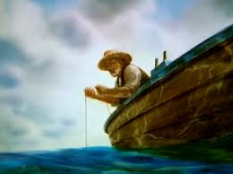
CHARACTER ANALYSIS
SANTIAGO
Santiago serves as a metaphor for the creative artist, someone like Hemingway himself.
His knowledge of the sea and its creatures, and of his craft, is unparalleled
Santiago always dreams of the lion which signifies his youth when he was the champion of the village
Santiago is a Yankee fan and of the Great DIMaggio

Slide 18
Santiago suffers terribly throughout The Old Man and the Sea. In the opening pages of the book, he has gone eighty-four days without catching a fish and has become the laughingstock of his small village.
Santiago endures 3 days on the sea for the fish
Santiago bears the weight of the fish on his back and the wounds to his hands ; this shows his determination
Santiago is a proud old man who goes fishing for a big fish but his pride also enables him to achieve his most true and complete self.
Hemingway seems to believe that there are only two options: defeat or endurance until destruction; Santiago clearly chooses the latter.
He is humble, long-suffering, courageous, he experiences failure, but is still not defeated.

Slide 19
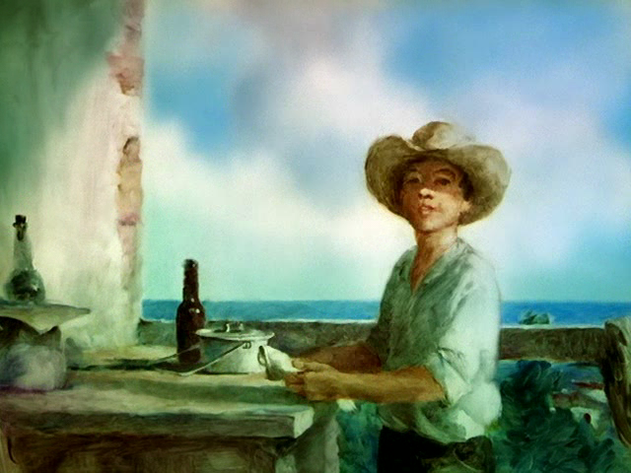
manolin
Manolin signifies the new generation here
Manolin has utmost love and respect towards the old man so he represents a perfect companion
Because of his father, this boy leaves the old man but at the end of the story the boy decides to go fishing once again with the old man
His dedication to learning from the old man ensures that Santiago will live on.

Slide 20
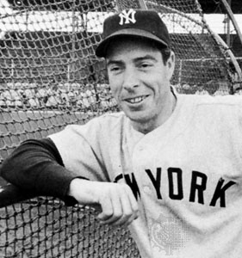
Joe DImaggio
DiMaggio, the partially handicapped baseball player, who often figures in the old man’s waking thoughts, as well as in his dreams. DiMaggio inspires him with leadership qualities and the determination to win, in spite of handicaps. When his left hand cramps and he feels drained of his strength, the old man reminds himself of the painful bone spur that handicaps the great DiMaggio. The image of the baseball hero playing in pain gives Santiago renewed vigor and stamina to bear his own pain

Slide 21
Important quotation s
He no longer dreamed of storms, nor of women, nor of great occurrences, nor of great fish, nor fights, nor contests of strength, nor of his wife. He only dreamed of places now and of the lions on the beach. They played like young cats in the dusk and he loved them as he loved the boy.

Slide 22
Important quotation s
Everything about him was old except his eyes and they were the same color as the sea and were cheerful and undefeated.
You did not kill the fish only to keep alive and to sell for food, he thought. You killed him for pride and because you are a fisherman. You loved him when he was alive and you loved him after. If you love him, it is not a sin to kill him. Or is it more?

Slide 23
conclusion
All of the symbols employed by Hemingway add to the basic theme that life is an endless struggle with illusory rewards. In order to gain nobility in life, a person must show bravery, confidence, courage, patience, optimism, and intelligence during the struggle. Then, even if the prize is lost, the person has won the battle, proving himself capable of retaining grace under pressure, the ultimate test of mankind.

Slide 24
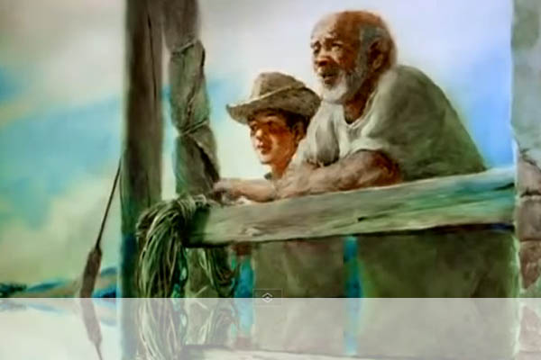
Major Themes in the story
Pride
Success
Heroism

Slide 25
Theme Summarized
It’s not in the winning or losing (in life) that matters, it is how you play the game.
Hemingway’s comment or opinion about “life” is that to be heroic, you must overcome life’s obstacles with dignity, decency, and courage so that even if you are destroyed, you are not defeated.

Slide 26
Hemingway’s Code Hero from all of his novels
A hero must be courageous but must avoid death at all costs
A hero does not have self-pity, but he does have self discipline and control
A hero realizes death is in all things, therefore, he tries to live life fully
A hero is a person of action
A hero practices humility—doesn’t discuss his achievements
A hero faces his greatest trial alone and tests himself to his limit.
A hero exhibits “grace under pressure.”

Slide 27
At last: Moral of the story
“A man can be destroyed but not defeated”

