Slide 1
Classified Catalogue Code
NEHA KUMARI TELI
Guest Faculty, DLISc, UCSSH, MLSU, Udaipur

Slide 2
SELECTON CARD OF MAIN ENTRY
According to CCC
Main Entry Card
 | Lea | ding Section
 |  | Heading Section ...................................................
 |  | Title Section .........................................................
 |  | Note Section ..........................................................
 | Acc | ession
 | Num | ber
(Front Portion of the Card)
Cl | as | s Number + Book Number +Collection Number
 | Acc Num | SURNAME (Forename) (Date of the birth-Date of the Death). Main title: Sub title. ED - . Ed. by - -. Tr. by - - (Name of the series. Ed. by - -. Series Number). ession ber

Slide 3
SELECTON CARD OF TRACING
(Back side of the main entry card)
Class Reference Entries | Class Index Entries
............................... | ...............................
............................... | ...............................
............................... | ...............................
 | Book Index Entries
 | ...............................
 | ...............................
 | ...............................
 | Cross Reference Index Entries
 | ...............................
 | ...............................
 | ...............................

Slide 4
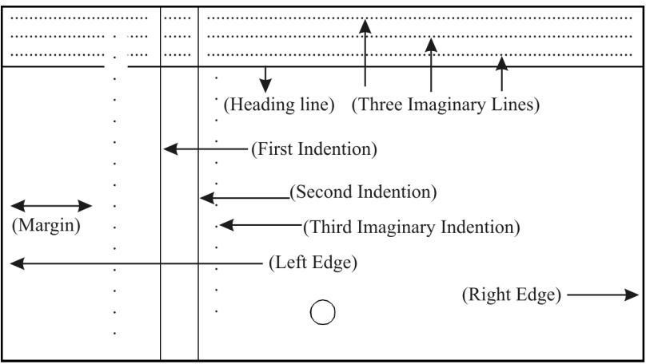
STRUCTURE OF CATALOGUE CARD

Slide 5
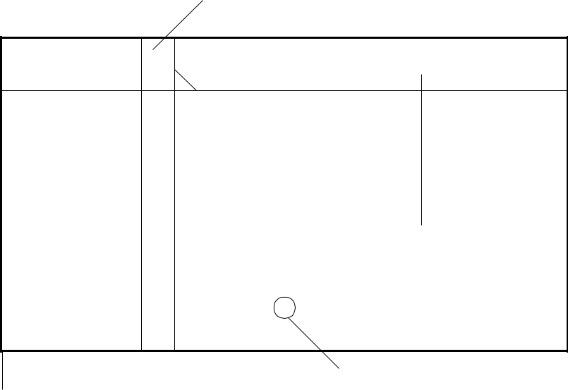
TYPES OF ENTRIES AS PER CCC
Main Entry
The main entry contain maximum bibliographic data of a document. It is a type of entry which provide a bibliographic data to all other entries. The main entry in classified catalogue code contain seven section in which each section have their own respected data.
Leading section;
Heading section;
Title section;
Note section;
Accession number section;
Tracing section; and
Annotation section.
Catalogue card and description of its different parts:
Classified Catalogue
First Indention
12.5 cms
Second Indention
7.5 cms
Leading Line
Hole of Card
Left edge of the card
Thickness of card 0.025 mm

Slide 6
Front Posion of Main Entry in Classified Catalogue
 | Call | Number (Class No. + Book No. + Collection No.)
 | Acc | SURNAME OR PERSONAL NAME (Forename) (Year of birth - Year of death.). Main title : Subtitle or Explanatory Title: Subtitle Edition. Collaborator statement. Notes (Name of the Series) ession Number
Note: Tracing Section to be given on the back of the Main Card.
Back Portion of the Main Entry in Classified Catalogue
Tracing
Cross Reference Entries
Class Index Entries
Book Index Entries
Cross Reference Index Entries

Slide 7
EXAMPLE
Title Page :-
Classified Catalogue Code with additional rules for Dictionary Catalogue Code by S R RANGANATHAN, Madras, Madras Library Association, 1960.
Back of the Title Page :-
Shiyali | Ramamrita | Ranganathan (1892)
Edition | 1 | 1934
Edition | 2 | 1945
Edition | 3 | 1951
Edition | 4 | 1958
Class No. 2:55 N3
9N60
Acc. No.
11497
Half Title Page:-
Madras Library Association, Publication Series, 24. Note :- No. of Pages – 605, No illustration

Slide 8
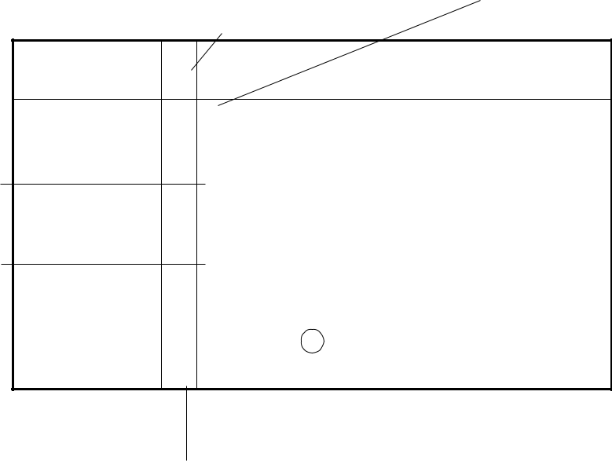
Main Entry
Leading | Heading
Section | Section
2:55 N3 9N60
RANGANATHAN (S R). (1892.-)
Title Section
Classified Catalogue Code with additional rules for Dictionary Catalogue Code. Ed 4.
Note
(Madras Library Association, Publication Series. 24)
11497
Acc. No.
Tracing Section
Back of the Main Entry Card
Cross Reference Entry | Classified Catalogue Code. | ⎫
 |  | ⎪
 | Cataloguing Practice. | ⎬CIE
 | Library Science. | ⎪
 |  | ⎭
 | Ranganthan (Shiyali | ⎫
 | Ramamrita) (1892). | ⎪
 | Classified Catalogue Code | ⎬BIE
 | with additional rules for | ⎪
 | dictionary Catalogue Code.☑ ✓ Madras Library Association,_{☒CRIE} Publication Series.

Slide 9
A catalogue card has 6 sections:
Call Number: The Leading section(call Number) in Classified Catalogue Code commenced from the first indention on the leading line with call no.
Heading Section: It Commenced from the second indention on the line below the leading section. It contains the creator of document(author) and the continuation line start from second indention.
Title section: It starts from the second indention on the below of heading section. It contains the title of document.
Note Section: The Note section than also starts from second indention. If any document has more than one note than each note has to be given separately ain fresh line starts from second indention.
Accession Number Section: To be given on the bottom –most line and will commence from the first vertical.
Tracing Section: It is last section in the classified catalogue code given on the back side of main card. It contains heading of all the added entries.
Punctuation marks and style of writing
In the leading section (call no.) class number and book should be separated from each other with a double space. No punctuation mark is required after call number and Book number. The call number must be write in pencil in a catalogue card as these are subject to change.
In the heading section, the surname of the author should be written in capital letter i.e RANGANATHAN (SR) as Forename in circular brackets in running letters. The full stop(.) without circular brackets is to be put at the end of the section.
Title section: Excluding all initial article (A, An & the) and honorific word, the title of the document is to be recorded in the main entry. A colon (:) is to be put between main title and subtitle or explanatory

Slide 10
title if any. A full stop(.) is to be put before giving information regarding edition, if any. A full stop (.) is to be put before giving information regarding collaborators, if any viz. editor, translator, illustrator, complier. A full stop (.) is to be put at the end of the section.
If series is given in any document it should be enclosed with circular brackets ( ).
There is no punctuation mark given by Dr. S R Ranganathan in Accession number.
Some Abbreviations used in CCC
Full | Abbreviated
Joint author | J Auth.
Edition | Ed.
Editor | Ed.
Translator | Tr.
Illustrator | Ill.
Some examples of Classified Catalogue Code
Joint Author Principles of Economics
By
B K Jain and K S Sen
Call No. X P12 Acc. No. 256
Should be written as in Heading Section JAIN (B K) and SEN (K S).

Slide 11
Three and more Author
Principles of Economics By
B K Jain, K S Sen and R C Roy Should be written as heading section
JAIN (B K) and Others.
Note : - The Same rule also applicable in four and more than four Authors.

Slide 12
TYPE
SINGLE PERSONAL AUTHOR
Dr. Ranganathan explained personal author in Classified Catalogue Code (CCC) rules as under:
Name of a person as author
Name of joint ( two or more persons) as author
The name of any corporate body as authors
The name of both person or corporate bodies as author and
The name of joint corporate authors
The Classified Cataloguing Code Rule (CCC, Ch. MA) have provision for the single author. The rule states that the personal author uses in the heading of the main entry by the rendering surname of the author. The CCC also advocates not to use the initials and honorific words like Rai Sahib, Sir or Padma Shri, etc. and degrees like Dr., Prof., Ph.D. etc needed to be omitted.

Slide 13
Title: 1 INTRODUCTION TO PHYSICS
By BENETT HOPKINS
London Medallion Press 1955
2 ed.
Acc. no.- 4489
Size - 26 x 24 cm.
Main Entry
nd
Call No.- C N55 Pages - 455
 | C N5 | 5
 | 4489 | HOPKINS (Benett). Introduction to physics. Ed 2.
Tracing |  | Physics.
 |  | Hopkins (Benett).
 |  | Introduction to physics.
Note: For the purpose of deriving class index entries the classification number is to be open using Sought link, unsought link and false link. Accordingly, in the below example only one Sought links is found i.e. Physics representing C in the Colon Classification. Further in all the CIEs the class number and in the BIEs the Call No. is to be written by pencil.
Chain Index
C - Physics ( Sought Link)

Slide 14
Class Index Entry
 | PHY | SICS.
 | see Cla | For documents in this Class and its Subdivisions, the Classified Part of the catalogue under the ss Number. C

Slide 15
Book Index Entry (Author)
 | HOPK | INS(Benett).
 |  | Introduction to physics. Ed2. | C N55
Book Index Entry (Title)
 | INT | RODUCTION TO physics.
 |  | By Hopkins.Ed 2. | C N55

Slide 16
TWO PERSONAL AUTHORS
The CCC Rule ( Ch. MD) define that in case of the title page consist with the two name of only two joint authors, both name can be used on the heading as in the sequence they occurred with conjunction ‘and’ to be used while rendering the heading.
Further, as the rule state that in such cases the book index entry will be made of the permutation of the names in the main entry.
This rule also state that book index entry can also be rendered under the collaborators like editors, illustrator, translator, etc.
Title: 2
Mathematics: New Aspects/ by S.N. Roy and Bipin Ghosh/ New Era
Publications/ New Delhi, Year of Publication 2011
Call No.- B P11 Size: 20 x 18 cms.
Acc. No.- 3458
Page: iv, 350
Main Entry
 | B | P11
 | 3458 | ROY (S. N.) and GHOSH (Bipin).
 |  | Mathematics: New aspects.

Slide 17
Tracing
Mathematics.
Roy (M.N.) and Ghosh (Bipin). Ghosh (Bipin) and Roy (M.N.). Mathematics.

Slide 18
Chain Index -
B - Mathematics (sought link)
Class Index Entry
 | MAT | HEMATICS.
 | Fo see Cla | r documents in this Class and its Subdivisions, the Classified Part of the catalogue under the ss Number B
Book Index Entry (Author)
 | RO | Y(M.N.) and GHOSH (Bipin).
 |  | Mathematics. B P11

Slide 19
Book Index Entry (Joint Author)
 | GHO | SH(Bipin) and ROY(M.N.).
 |  | Mathematics. | B P11

Slide 20
Book Index Entry (Title)
 | MAT | HEMATICS: New aspects.
 |  | By Roy and Ghosh. | B P11

Slide 21
Title 2
Education in India
by
Jatin Rai and Siddharth Mishra
Golden Publishers
New Delhi
2014
Call no.- T. 44 'P 14
Acc no.- 2386 Page: vi+520
Size - 26 x 24 cm

Slide 22
Chain Index
T - Education ( Sought link)
T. - False link
T.4 - Asia, Education (Unsought link)
T.44 - India, Education (Sought link)
Main Entry
 | T.4 | 4 P 14
 | 23 | RAI (Jatin) and MISHRA (Siddharth). Education in India. 86
Tracing | India, Education.
 | Education.
 | Rai (Jatin) and Mishra (Siddharth).
 | Mishra (Siddharth) and Rai (Jatin).
 | Education in India.

Slide 23
Class index Entry
 | INDI | A, EDUCATION.
 | see Num | For documents in this Class and its Subdivisions, the Classified Part of the catalogue under the Class ber T.44
Class index Entry
 | EDU | CATION.
 | see Cla | For documents in this Class and its Subdivisions, the Classified Part of the catalogue under the ss Number. T

Slide 24
Book Index Entry (Author)
 | RA | I (Jatin) and MISHRA (Siddharth).
 |  | Education in India. | T.44 P14
Book Index Entry (Joint Author)
 | MIS | HRA (Siddharth) and RAI (Jatin).
 |  | Education in India. | T.44 P 14

Slide 25
Book Index Entry (Title)
 | EDU | CATION IN india.
 |  | By Rai and Mishra. | T.44 P 14

Slide 26
THREE OR MORE AUTHORS
The Classified Cataloguing Code Rule (Ch. MD) have provision for three and more personal author which state that:
The name of the first author alone to be used as the heading and after the first name and others is to be followed in the main entry.
The book index entry shall be rendered under the heading of the main entry.
No book index entry shall be rendered under second or third author.
The rule (Ch MD) states that in case if the title page consist with name of three and more joint authors, the first author alone to be used in the heading of the main entry by adding the phrase and others. No Book Index Entry for other authors i.e. other than the first author has to be prepared.
Title: 1
UNEMPLOYMENT IN INDIA /by Aman Verma, Karan Patel and Ravi Sharma/Indian Press/New Delhi
Call no.- Y: 433. 44 P12
Page: xi, 234
Acc no.- 556
Year - 2012
Size: 21x19 cm

Slide 27
Main Entry
 | Y:4 | 33.44 P12
 | 556 | VERMA (Aman) and others. Unemployment in India.
Tracing
India, Unemployment, Destitution, Social Pathology, Sociology.
Unemployment, Destitution, Social Pathology, Sociology.
Destitution, Social Pathology,
Sociology.
Social Pathology, Sociology. Sociology.
Verma (Aman) and others. Unemployment in India.

Slide 28
Chain Index - Y:433.44
Y - Sociology (Sought link) Y: - False link
Y:4 - Social Pathology, Sociology (Sought link)
Y:43 - Destitution, Social Pathology, Sociology (Sought link)
Y:433 - Unemployment, Destitution, Social Pathology, Sociology (Sought link) Y:433. - False link
Y:433.4 - Asia (Unsought link)
Y:433.44 - India, Unemployment, Destitution, Social Pathology, Sociology (Sought link)
Class Index Entry
 | INDI | A,UNEMPLOYMENT, DESTITUTION,SOCIAL
 | PAT see Num | HOLOGY, SOCIOLOGY. For documents in this Class and its Subdivisions, the Classified Part of the catalogue under the Class ber. Y:433.44
Class Index Entry
 | UN | EMPLOYMENT, DESTITUTION, SOCIAL
 | PAT see Cla | HOLOGY, SOCIOLOGY. For documents in this Class and its Subdivisions, the Classified Part of the catalogue under the ss Number. Y:433

Slide 29
Class Index Entry
 | DES | TITUTION, SOCIAL PATHOLOGY,SOCIOLOGY.
 | see Cla | For documents in this Class and its Subdivisions, the Classified Part of the catalogue under the ss Number. Y:43
Class Index Entry
 | SO | CIAL PATHOLOGY, SOCIOLOGY.
 | see Cla | For documents in this Class and its Subdivisions, the Classified Part of the catalogue under the ss Number. Y:4
:
Class Index Entry
 | SO | CIOLOGY.
 | see Cla | For documents in this Class and its Subdivisions, the Classified Part of the catalogue under the ss Number. Y

Slide 30
Book Index Entry (Author)
 | VER | MA (Aman) and others.
 |  | Unemployment in India. Y:433.44 P12
Book Index Entry (Title)
 | UN | EMPLOYMENT IN India.
 |  | By Verma and others. | Y:433.44 P12

Slide 31
REFERENCES
IGNOU Study Material,
http://egyankosh.ac.in/bitstream/123456789/33130/1/Unit-
12.pdf, Accessed on 22 February 2020.
Krishan Kumar. An Introduction to Cataloguing Practice. New Delhi: Vikas Publishing.
Ranganathan, S.R. 1960. Classified Catalogue Code with Additional Rules for Dictionary Catalogue Code. Ed. 5. Bombay: Asia Publishing House, Print.
Ranganathan, S.R. 2006. Colon Classification. rep. Ed. 6. New Delhi: Ess Ess Publications, Print.

