Slide 1
Fatty Acid Metabolism

Slide 2
Fatty Acid Metabolism
Why are fatty acids important to cells?
  fuel molecules
    stored as triacylglycerols
  building blocks
    phospholipids
    glycolipids
  precursors of hormones and other messengers
  used to target proteins to membrane sites

Slide 3
Fatty Acid Metabolism
Why do triacylglycerols store large amounts of energy?
  fatty acid portion is highly reduced
  nonpolar molecules are stored in anhydrous form
Where are triacylglycerols stored?
  adipocytes

Slide 4
Fatty Acid Metabolism
What is needed for triacylglycerol breakdown?
  bile salts
    made in liver, stored in gall bladder
    glycocholate
  lipases
    pancreas
    hydrolyze ester bond

Slide 5
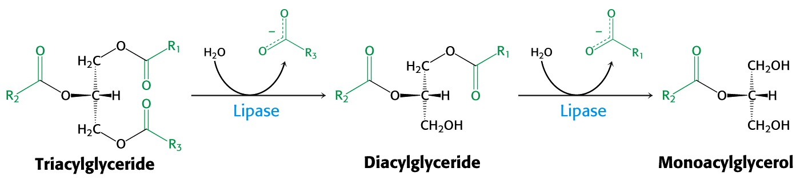
Fatty Acid Metabolism
What are triacylglycerols broken down into?
Fatty acids and monoacylglcerols are absorbed across plasma membrane of intestinal epithelial cells.

Slide 6
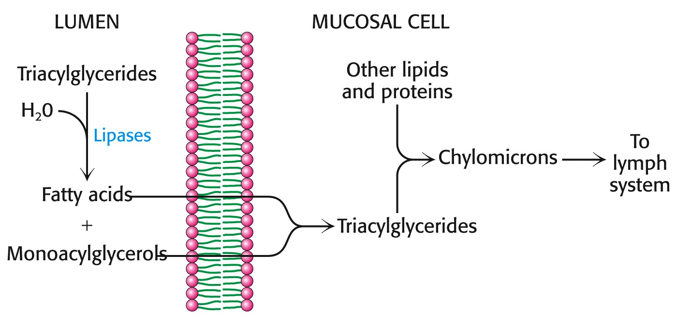
Fatty Acid Metabolism
What are chylomicrons?
  particles consisting of triacylglycerols and protein
    apolipoproteins

Slide 7
Fatty Acid Metabolism
How are fatty acids made available to peripheral tissues as an energy source?
  hormones trigger lipolysis in adipose tissue
    epinephrine, glucagon, ACTH
    insulin inhibits lipolysis
  released fatty acids insoluble in plasma
    must be attached to serum albumin for transport

Slide 8
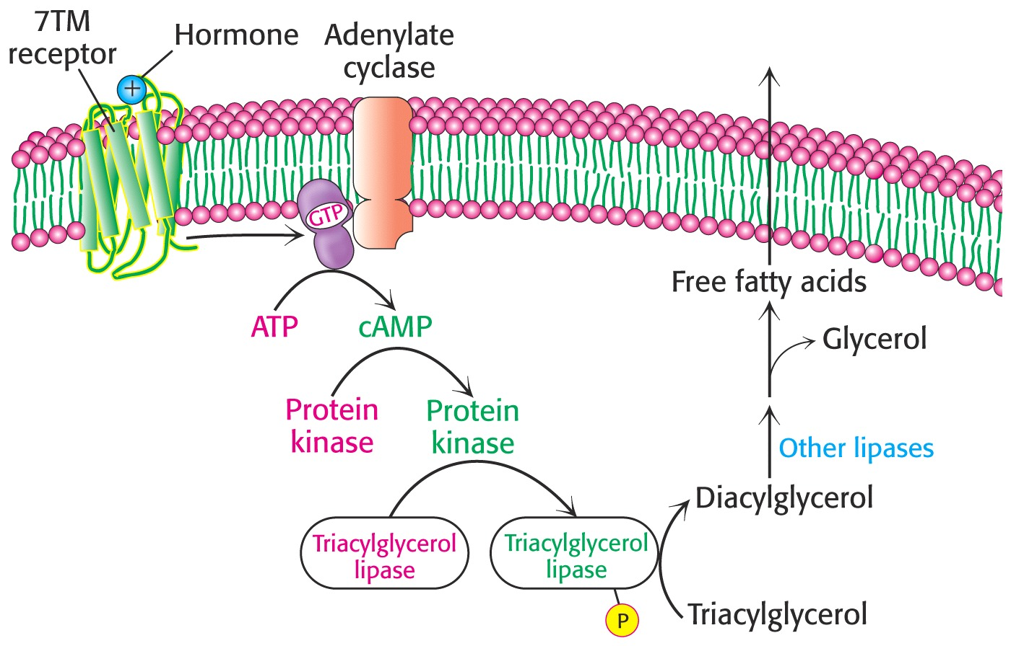
Fatty Acid Metabolism

Slide 9
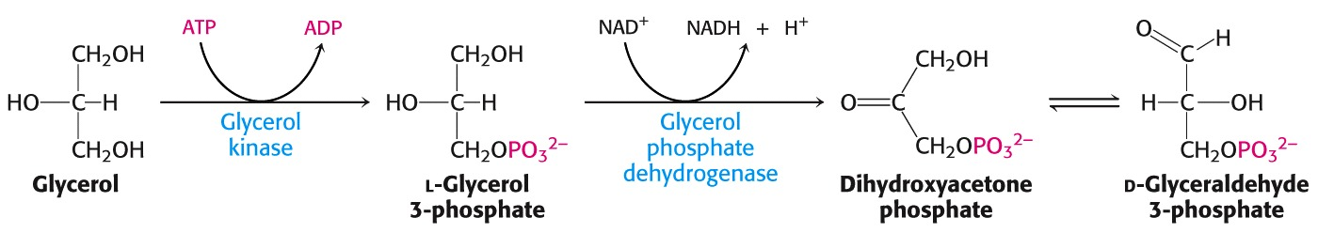
Fatty Acid Metabolism
What happens to the glycerol released?
  converted to glyceraldehyde-3-PO₄
    glycolysis
    gluconeogenesis

Slide 10
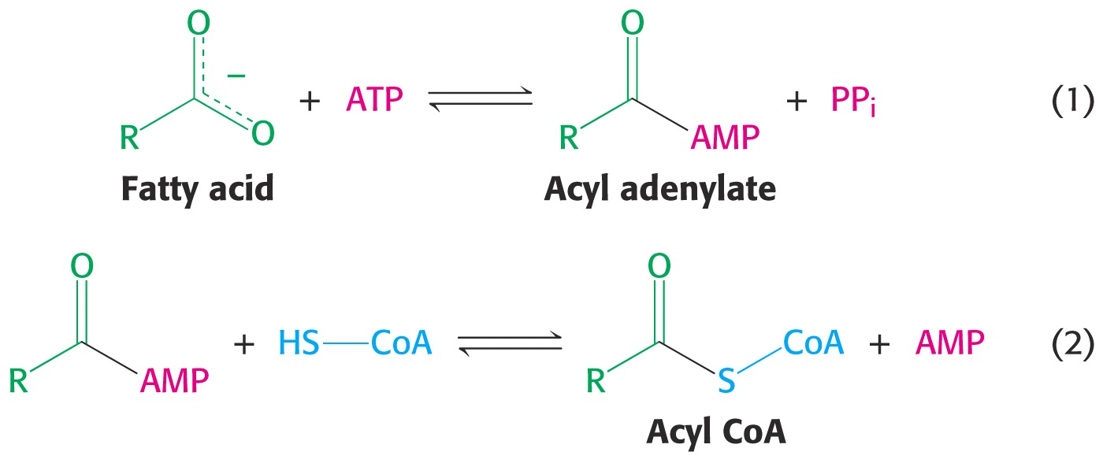
Fatty Acid Degradation
What must happen to fatty acids for them to be oxidized?
  activated
  transported into mitochondria
  Acyl CoA synthetase

Slide 11
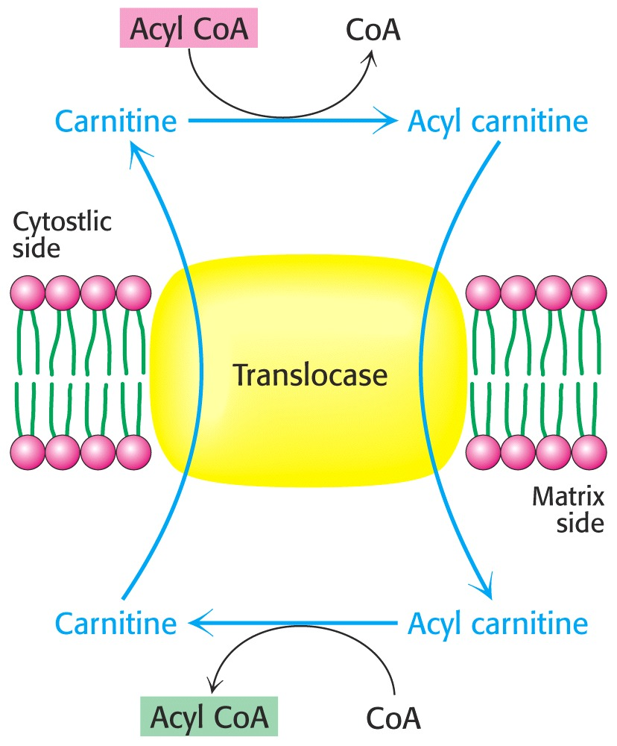
Fatty Acid Degradation
What is the role of carnitine in fatty acid oxidation?
  transport into mitocondria matrix
  Carnitine acyl transferase I and II

Slide 12
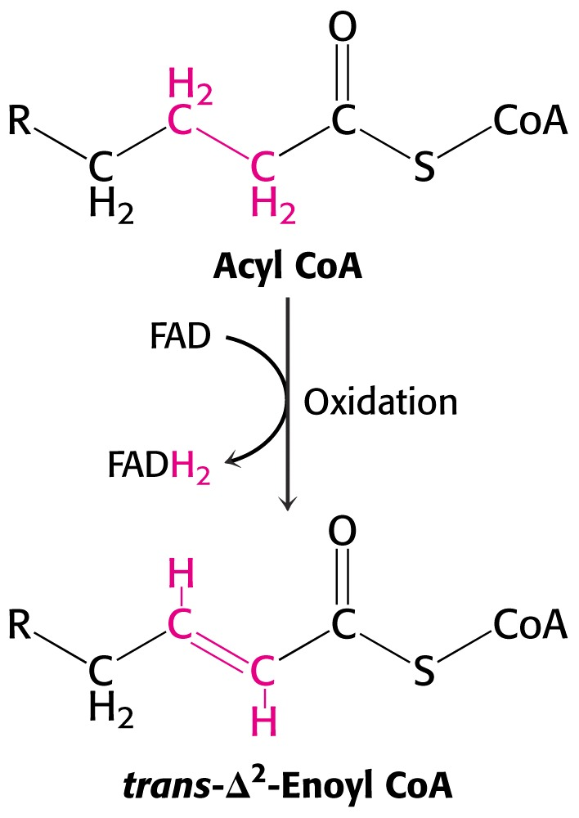
Fatty Acid Degradation- β oxidation
What is the reaction sequence for the oxidation of fatty acids?
  first step is an oxidation
    acyl CoA dehydrogenase

Slide 13
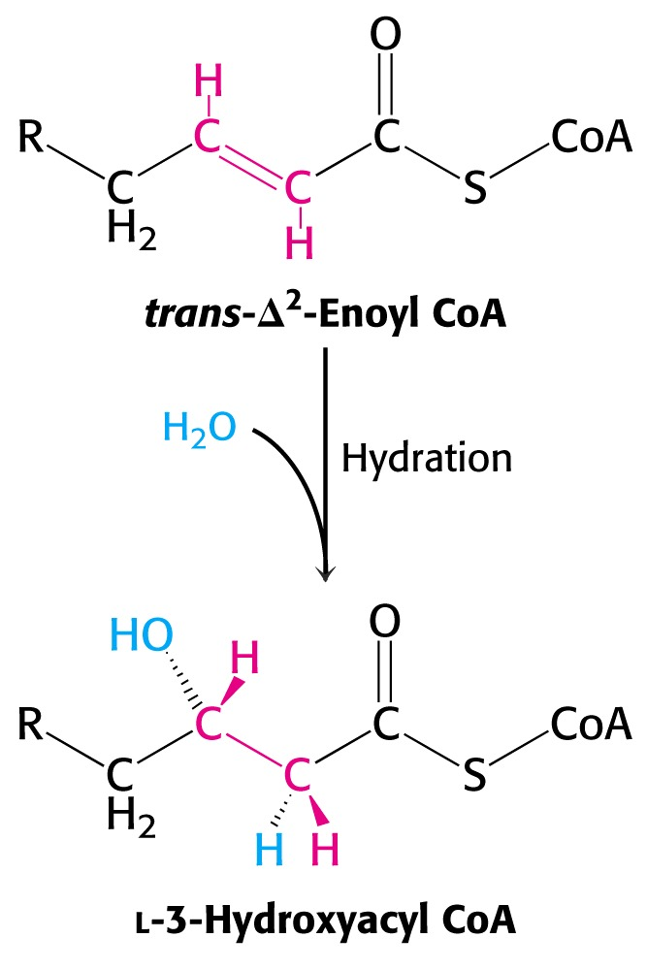
Fatty Acid Degradation
Second step is a hydration
  enoyl CoA hydratase
  stereospecific
    only L isomer is formed

Slide 14
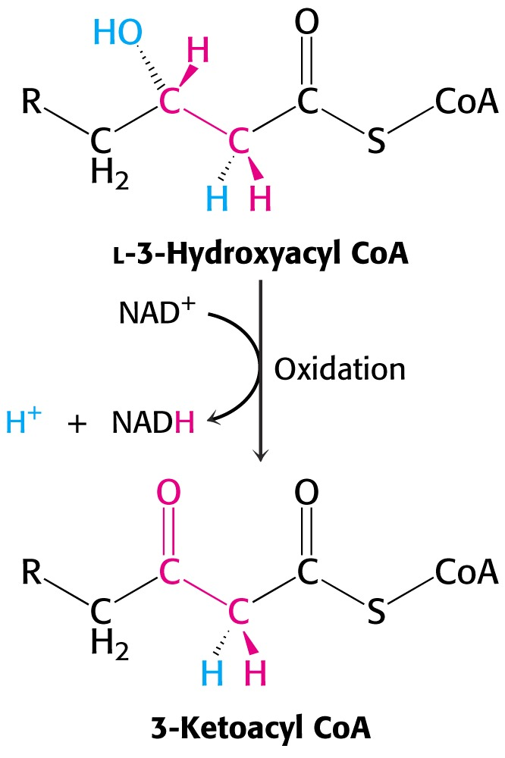
Fatty Acid Degradation
Third step is a second oxidation
  L-3-hydroxyacyl CoA dehydrogenase

Slide 15
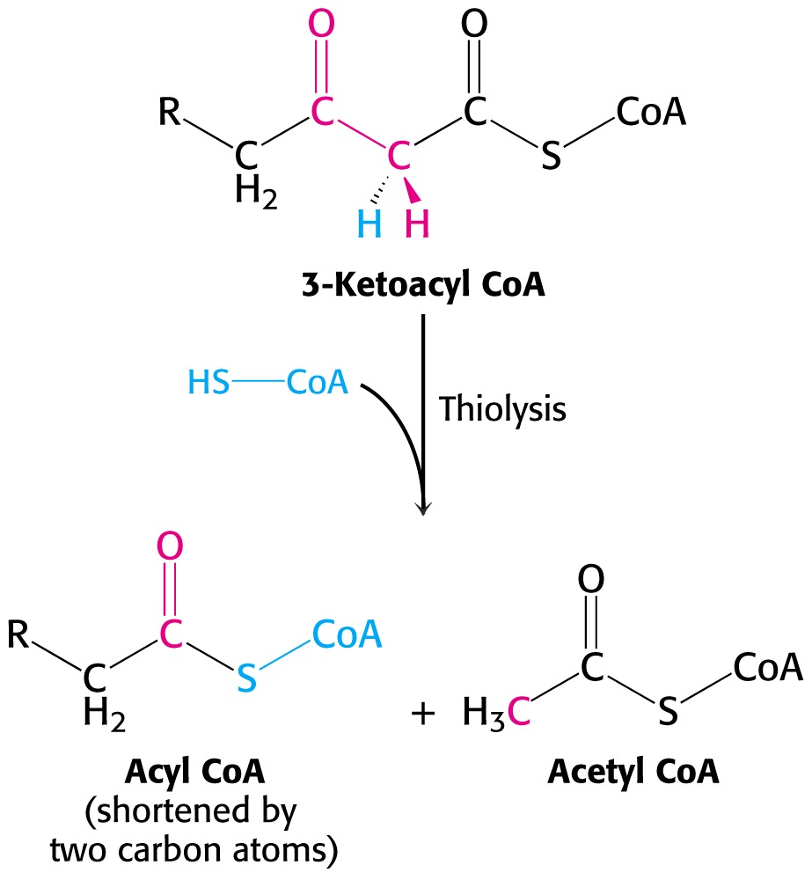
Fatty Acid Degradation
Last step is cleavage of 3-ketoacyl CoA by thiol group of CoA (Thiolase)
  acyl CoA shortened by 2 carbons
  acetyl CoA formed

Slide 16
Fatty Acid Degradation
What are the products of fatty acid degradation?
  For a C₁₆ fatty acid
    8 acetyl CoA
    7 FADH₂
    7NADH + 7 H⁺
  How much energy does this generate?
    7 x 1.5 ATP = 10.5
    7 x 2.5 ATP = 17.5
    8 x 10 ATP = 80
    Total = 108 ATP – 2 ATP (activation) = 106 ATP

Slide 17
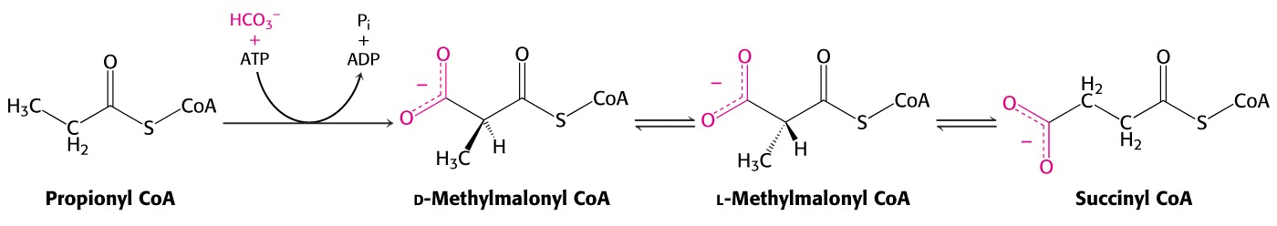
Fatty Acid Degradation
How is the oxidation of odd-chain fatty acids different from even-chain ones?
  in final round of degradation products are acetyl CoA and proprionyl CoA
  proprionyl CoA is converted to succinyl CoA

Slide 18
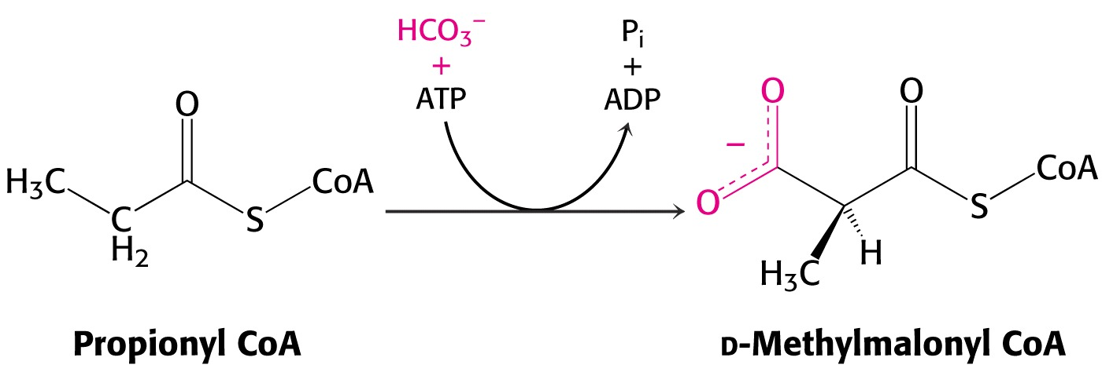
Fatty Acid Degradation
Proprionyl CoA is carboxylated to give D-methylmalonyl CoA
  catalyzed by proprionyl CoA carboxylase
    uses biotin

Slide 19
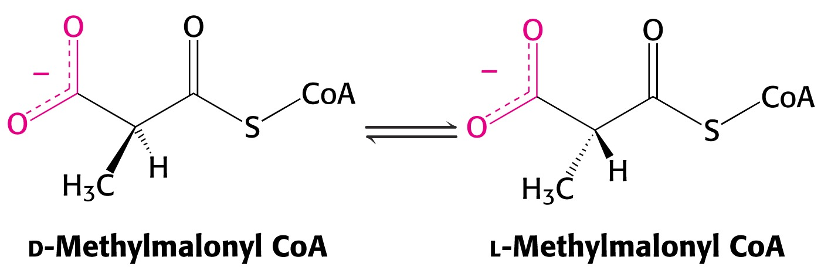
Fatty Acid Degradation
D-methylmalonyl CoA is racemized to L form
  methylmalonyl CoA mutase
    uses a derivative of vitamin B₁₂

Slide 20
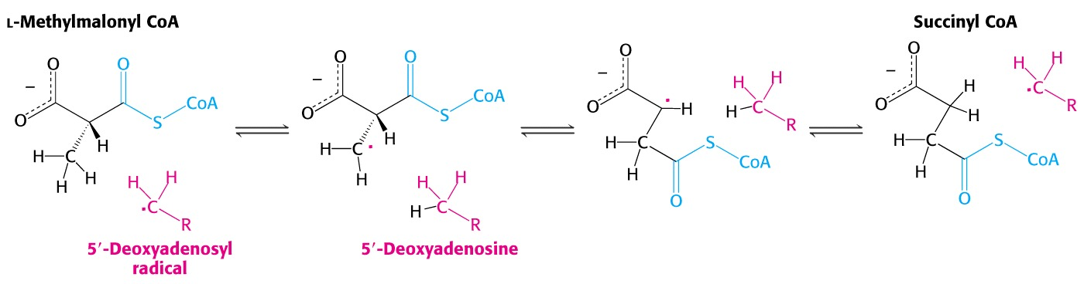
Fatty Acid Degradation
In last step a 5-deoxyadenosyl free radical removes a H atom to aid in rearrangement of L-methylmalonyl CoA to succinyl CoA

Slide 21
Fatty Acid Degradation
Unsaturated fatty acids require additional steps for degradation
  isomerization
    shifts position and configuration of a double bond
  reduction
    needed to remove double bond in wrong position

Slide 22
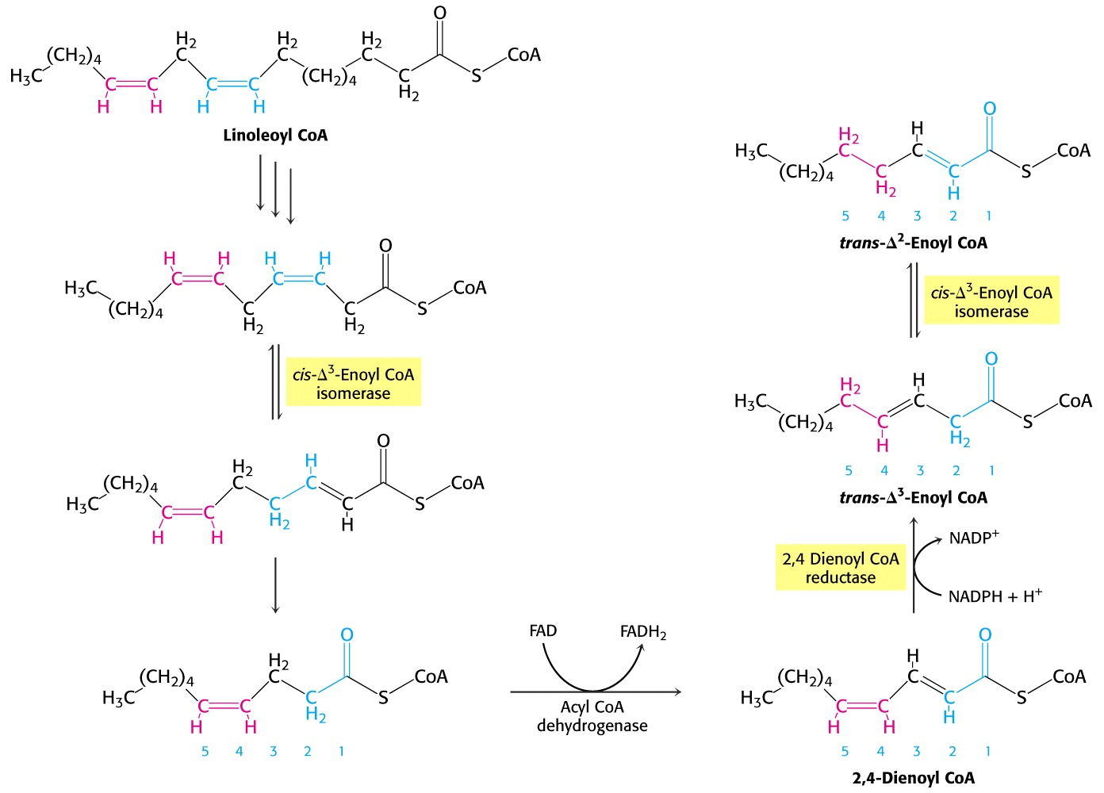
Fatty Acid Degradation

Slide 23
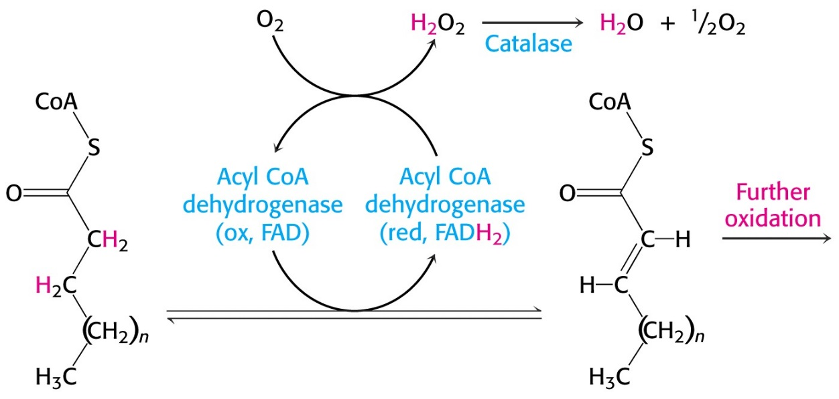
Fatty Acid Degradation
Where, in addition to the mitochondria does fatty acid oxidation take place?
  peroxisomes
How is this different from β oxidation?
  in first step electrons are transferred to O₂

Slide 24
Fatty Acid Metabolism
What are some of the differences between fatty acid degradation and synthesis?
  location in cell
  use of acyl carrier protein vs. coenzyme A
  association of synthetic enzymes into complex
  use of NADPH as opposed to NAD⁺ and FAD

Slide 25
Fatty Acid Synthesis
What is the first committed step in fatty acid synthesis?
  formation of malonyl CoA
    acetyl CoA carboxylase - biotin

Slide 26
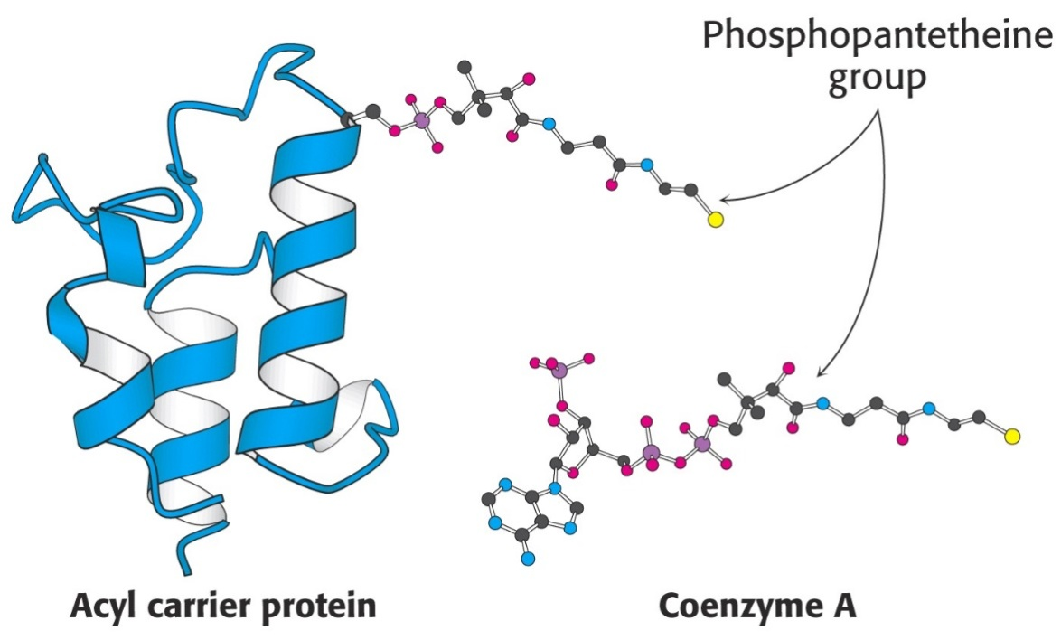
Fatty Acid Synthesis
Intermediates in fatty acid synthesis are linked to an acyl carrier protein
  role similar to coenzyme A

Slide 27
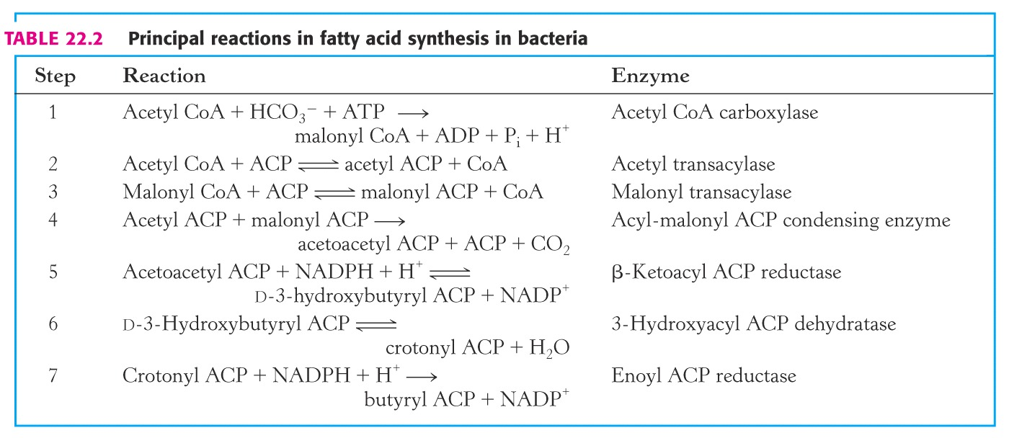
Fatty Acid Synthesis
What are the steps in fatty acid synthesis catalyzed by the fatty acid synthase complex?

Slide 28
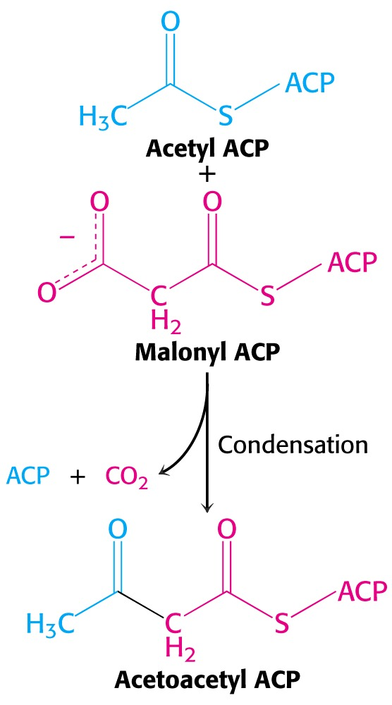
Fatty Acid Synthesis

Slide 29
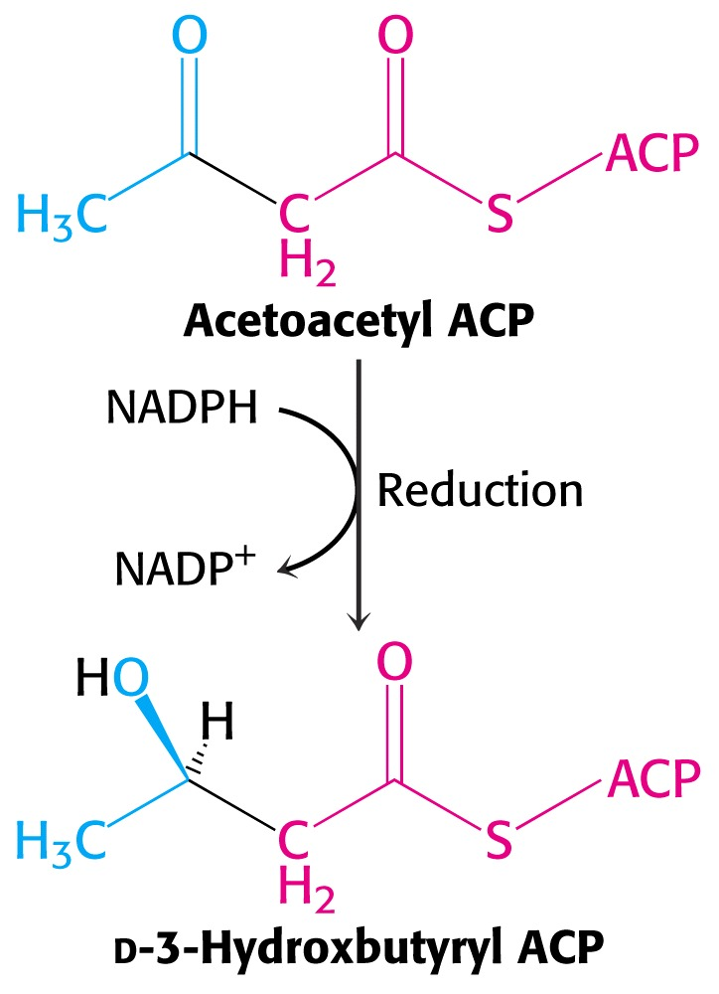
Fatty Acid Synthesis

Slide 30
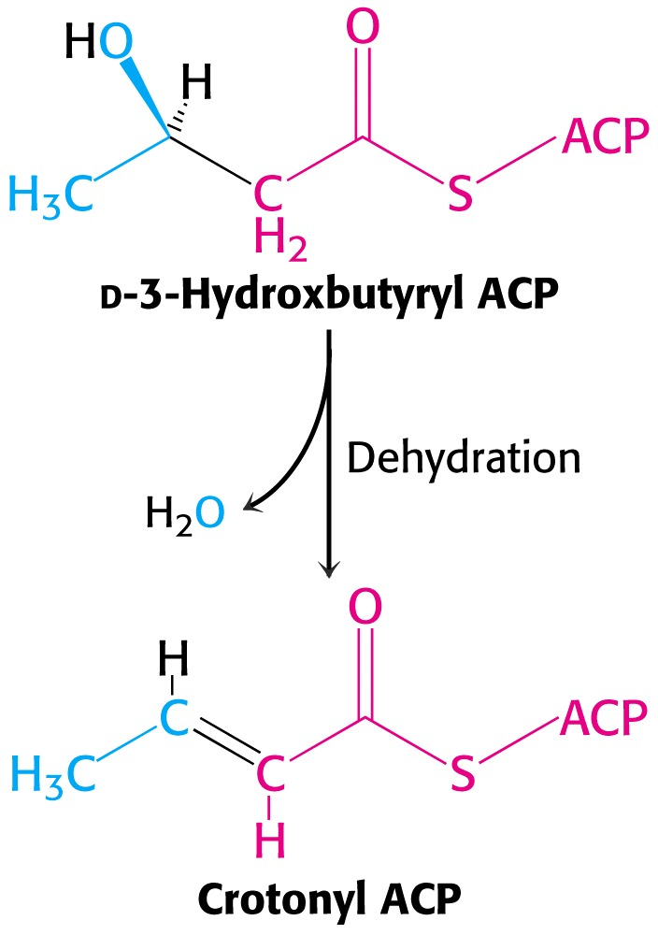
Fatty Acid Synthesis

Slide 31
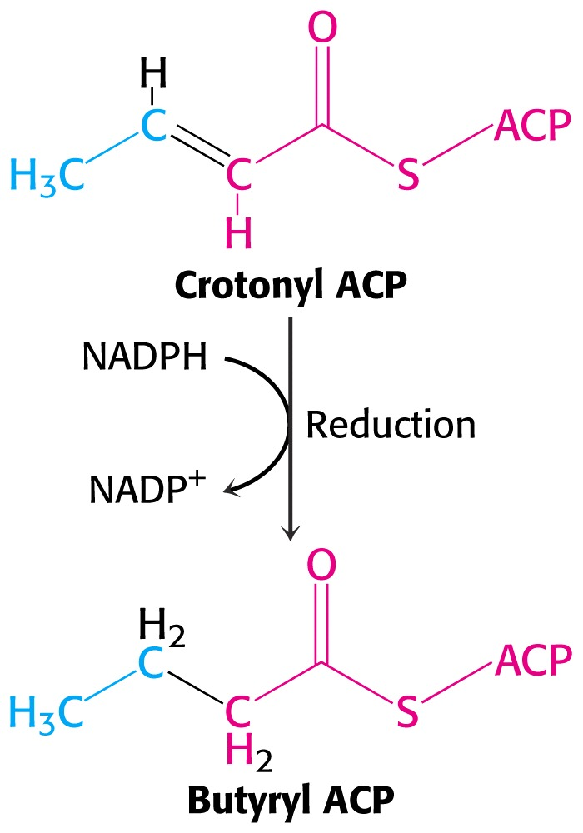
Fatty Acid Synthesis

Slide 32
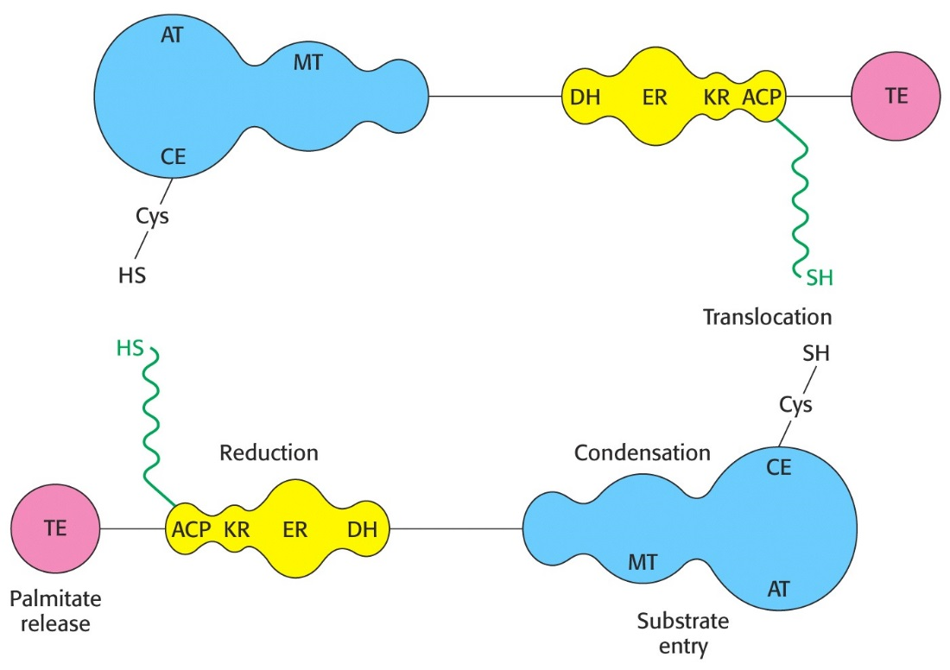
Fatty Acid Synthesis
Mammalian FAS is a homodimer with each chain containing three domains joined by flexible regions.

Slide 33
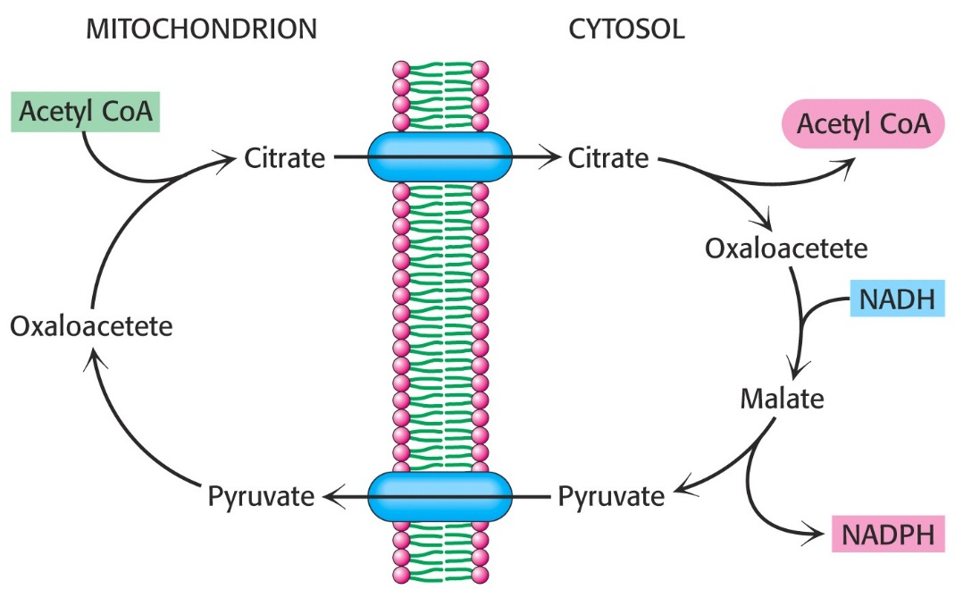
Fatty Acid Synthesis
Since synthesis occurs in cytosol acetyl CoA must be transported from mitocondria
  carried by citrate
  cleavage of citrate requires an ATP

Slide 34
Fatty Acid Synthesis
From where does NADPH needed for synthesis come?
  pentose phosphate pathway
    6 molecules
  reduction of OAA to malate followed by oxidative decarboxylation of malate to pyruvate
    8 molecules

Slide 35
Fatty Acid Metabolism
Which enzyme plays a key role in regulating fatty acid metabolism?
  acetyl CoA carboxylase
Global control of ACC by glucagon, epinephrine and insulin
  insulin activates
  glucagon and epinephrine inactivate

Slide 36
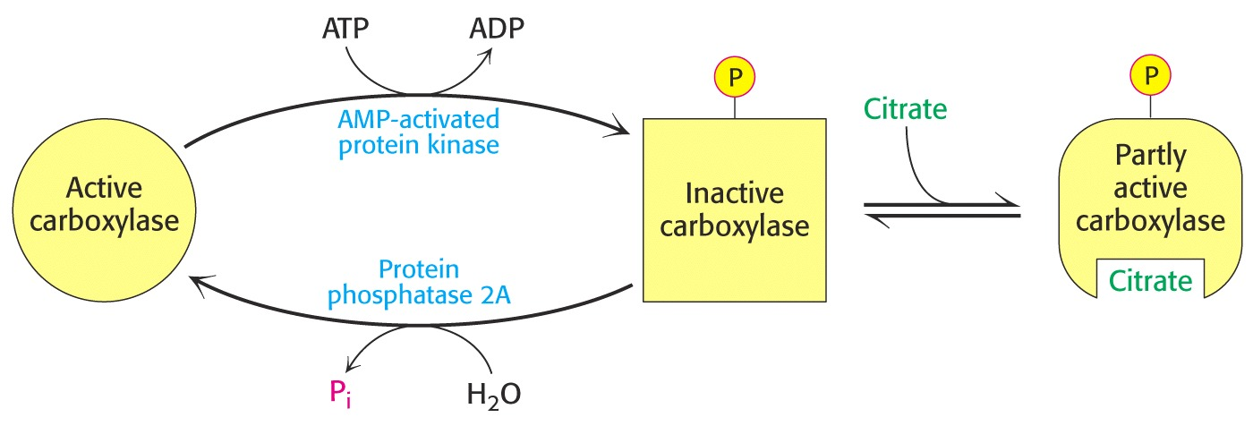
Fatty Acid Metabolism
ACC is inhibited by phosphorylation and allosterically activated by binding of citrate

Slide 37
Fatty Acid Metabolism
Synthesis and degradation are reciprocally regulated
  starvation – degradation occurs because epinephrine & glucagon stimulate lipolysis
  fed state – insulin inhibits lipolysis
ACC also influences degradation
  malonyl CoA inhibits carnitine acetyltransferase
    limits beta oxidation in mitocondria
Long-term control mediated by sythesis and degradation of key enzymes
  adaptive control

