Slide 1
INTRODUCTION
Vitamins are organic compounds required in the diet in small amounts.
They are conveniently classed as fat soluble (A, D, E and K) or water soluble (C and the B complex).
Except for Vitamin C, all water soluble vitamins are precursor of coenzymes.

Slide 3
RECOMMENDED DIETARY ALLOWANCES FOR 70 KG MALE,
AGE 25-50
•
Carbohydrate
364 g
•
Fat
80 g
•
Protein
56 g
•
Essential Fatty Acids
3-6 g
•
Calcium, Phosphorus
800 mg
•
Choline
500 mg
•
Ascorbic acid
60 mg
•
Niacin
19 mg
•
Iron,
Vitamin E
10 mg
•
Pyridoxine
2 mg
•
Riboflavin
1.7 mg
•
Thiamine
1.5 mg
•
Vitamin A
1 mg
•
Folic acid
400 µg
•
Vitamin K
80 µg
•
Vitamin D
15 µg
•
Vitamin B12
3 µg

Slide 4
VITAMIN A
Function: Retinol is a precursor for retinal that is used in the visual cycle and for retinoic acid that is required for maintenance of epithelial cells. In the visual cycle, opsin binds the 11-cis isomer of retinal. Light causes the conversion to the all-trans isomer which is only weakly bound to opsin.
Effect of Deficiency: Night blindness and keratinization of epithelial cells.
Sources: Vegetables, fish liver oil. Note beta-carotene is a precursor of retinol

Slide 5
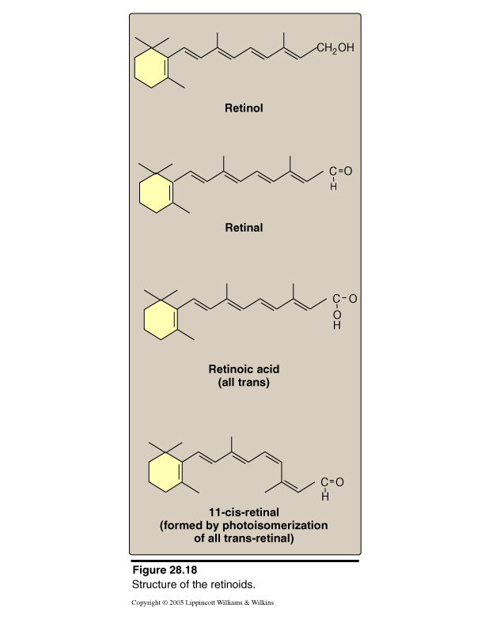
Converted to all-trans
retinal by
photoisomerization

Slide 6
THIAMINE
Function: Thiamine is converted to thiamine pyrophosphate which is a cofactor for oxidative decarboxylation of alpha-keto acids and for transketolase.
Effect of Deficiency: Beri-beri and Wernicke-Korsakoff syndrome.
Sources: Beans, nuts, fruits, etc.
RDA: 1.5 mg/day

Slide 7
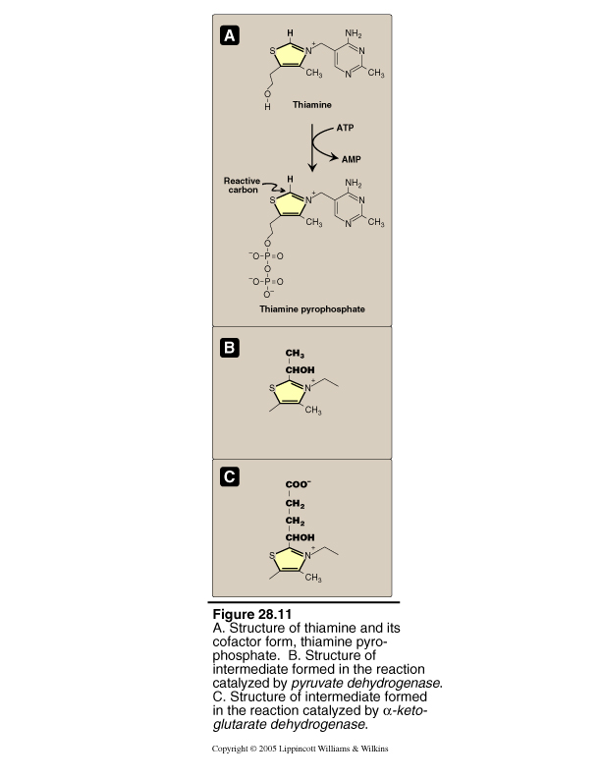

Slide 8
RIBOFLAVIN
Function: Riboflavin is a precursor for the coenzymes, FMN and FAD.
Effect of Deficiency: atrophy of filliform papillae, angular cheilosis
Sources: Milk, liver, green vegetables
RDA: 1.7 mg/day

Slide 9
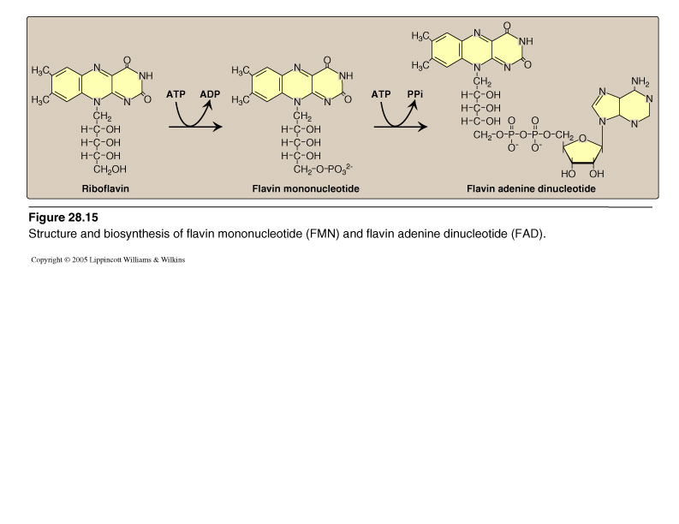

Slide 10
NIACIN (NICOTINIC ACID)
Function: As nicotinic acid or nicotinamide it is a precursor for the coenzymes NAD and NADP.
Effect of Deficiency: Pellagra (dermatitis, diarrhea, dementia and if severe, death)
Sources: Legumes, meat
RDA: 19 mg/day

Slide 11
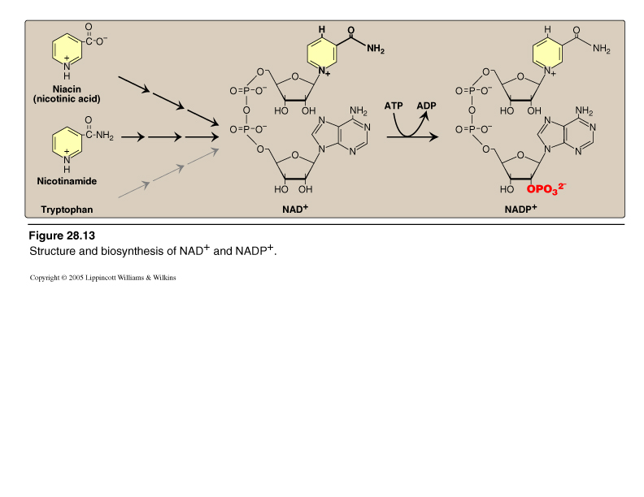

Slide 12
PYRIDOXINE (VITAMIN B6)
Function: Pyridoxine (pyridoxol) is a precursor of pyridoxal phosphate which is a coenzyme for enzymes catalyzing transamination, deamination,decarboxylation and for glycogen phosphorylase.
Effect of Deficiency: Dermatitis, convulsions, microcytic anemia
Sources: Liver, fish, nuts, whole grain cereals
RDA: 2 mg/day

Slide 13
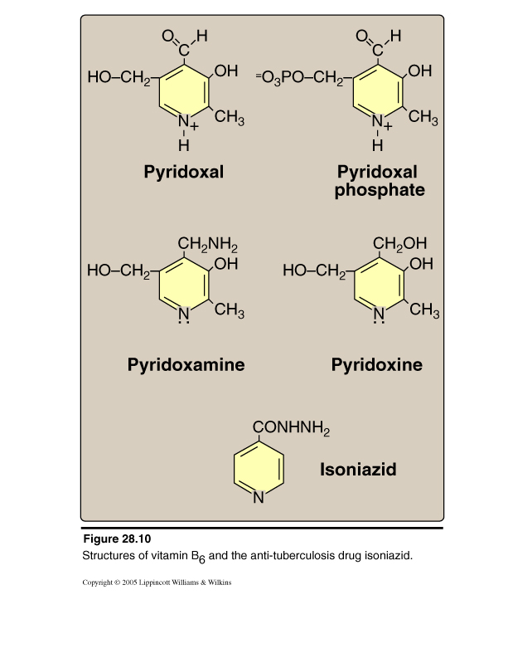

Slide 14
BIOTIN
Function: Biotin acts as a coenzyme in carboxylation reactions in covalent linkage to lysine side chains of enzymes.
Effect of Deficiency: Dermatitis, anorexia, nausea, muscle pain
Sources: Intestinal microorganisms, liver, vegetables
RDA: An RDA has not been established. Note avidin in raw eggs has tight binding for biotin and in high amounts can cause a biotin deficiency.

Slide 15
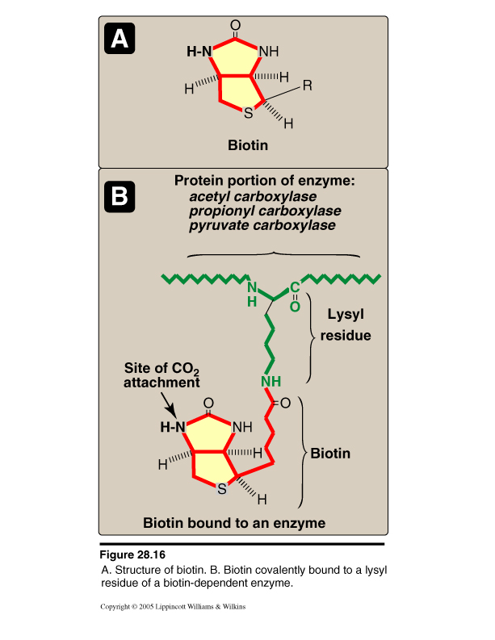

Slide 16
PANTOTHENIC ACID
Function: Pantothenic acid is a precursor of pantotheine. This structure forms part of coenzyme A.
Effect of Deficiency: A deficiency is practically unknown. There may be nausea and fatigue.
Sources: Pantothenic acid is widely distributed and is synthesized by some intestinal bacteria
RDA: An RDA has not been established. 5-10 mg/ day might be used.

Slide 17
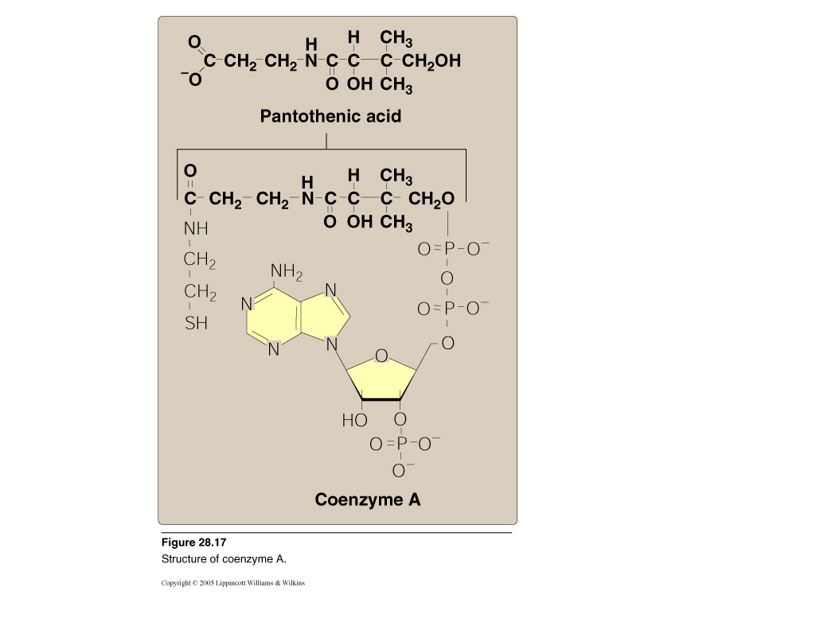

Slide 18
FOLIC ACID
Function: Folic acid is a precursor for tetrahydrofolate that is used as a carrier of one carbon units at different levels of oxidation.
Effect of Deficiency: Megaloblastic anemia, GI disturbances
Sources: Intestinal bacteria, liver, yeast and green vegetables
RDA: 400 µg/day. Before food supplementation, folic acid deficiency was the most common vitamin deficiency in the United States

Slide 19
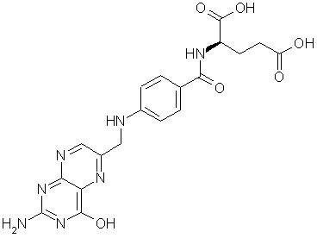
Folic Acid

Slide 20
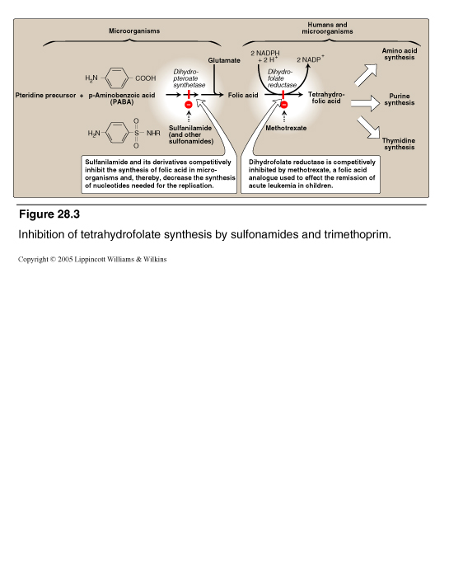

Slide 21
VITAMIN B12 (COBALAMIN)
Chemical Nature: Vitamin B12 is a complex multiple ring structure which includes a cobalt atom.
Function: Vitamin B12 (cobalamin) derived cofactors are used for two important reactions:
I. methylmalonyl CoA isomerase requires 5-deoxyadenosyl cobalamin
II. Homocysteine: tetrahydrofolate methyl transferase requires methyl cobalamin and N5-methyltetrahydrofolate
Vitamin B12 is absorbed from the ileum as a complex with intrinsic factor which is produced by the gastric mucosa.
Effect of Deficiency: Pernicious anemia and degeneration of spinal cord neurons
Sources: Meat and milk
RDA: 3 µg/day

Slide 22
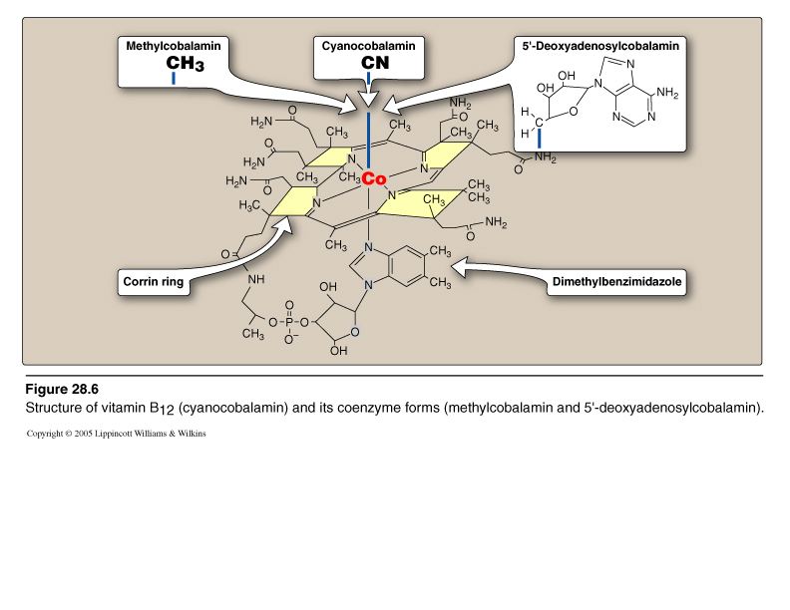

Slide 23
VITAMIN C (ASCORBIC AID)
Function: Ascorbic acid is a water soluble antioxidant and it promotes the hydroxylation of proline residues of collagen. Ascorbic acid is also required in the synthesis of carnitine, dopamine and bile acids.
Effect of Deficiency: Scurvy (hemorrhage, impaired wound healing and bone formation).
- Oral manifestations: Bleeding gums, loose teeth
Sources: Fruits and vegetables
RDA: 60 mg/day

Slide 24
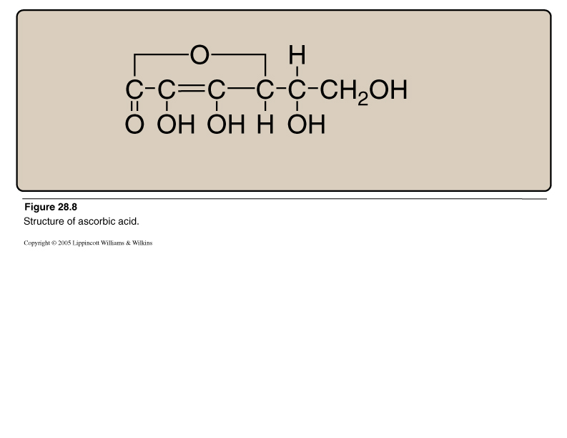

Slide 25
VITAMIN D
Function: Regulation of calcium levels through actions on intestine, kidney and bone. Vitamin D3 (cholecalciferol) requires conversion to 1,25-dihydroxy vitamin D3 to form the active compound.
Effect of Deficiency: Rickets, osteomalacia
Sources: UV irradiation of 7-dehydrocholesterol in the skin, fish liver oils and supplemented milk
RDA: 600 international units (15 µg cholecalciferol) - IOM recommendation 2010 - and not more than 4000 IUs

Slide 26
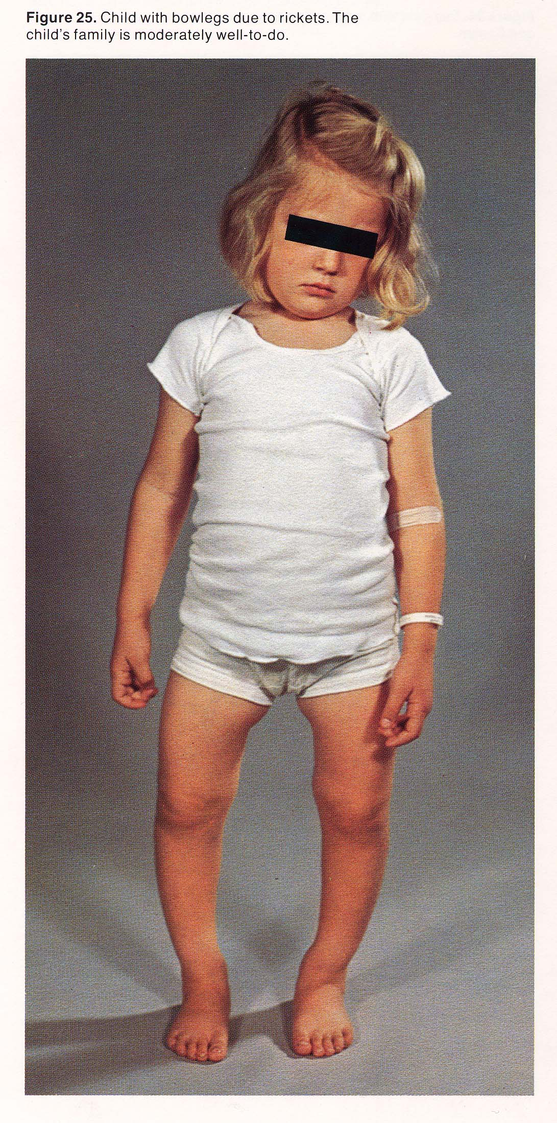

Slide 27
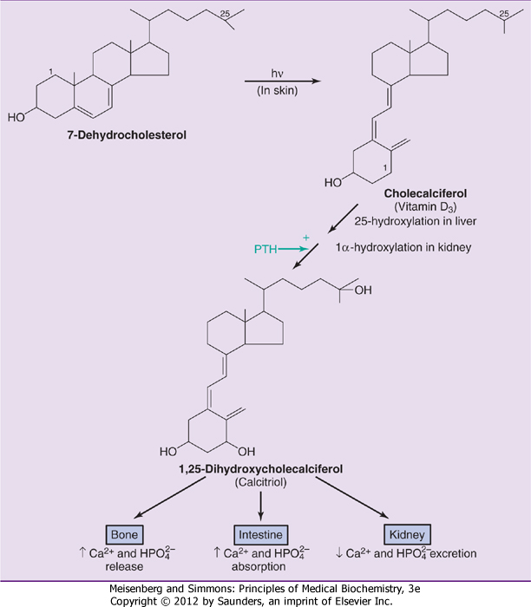
1,25-dihydroxy
cholecalciferol is the
active metabolite of
Vitamin D
Downloaded from: StudentConsult (on 28 September 2011 12:12 PM)
© 2005 Elsevier

Slide 28
VITAMIN E
Function: Vitamin E (Tocopherol)is a lipid-soluble antioxidant and helps to prevent lipid damage.
Effect of Deficiency: In humans, deficiency is associated with lysis of erythrocytes.
Sources: Vegetables and wheat germ oil
RDA: 15 international unit. Larger amounts (100-400 units) have been suggested but are probably not advisable.

Slide 29
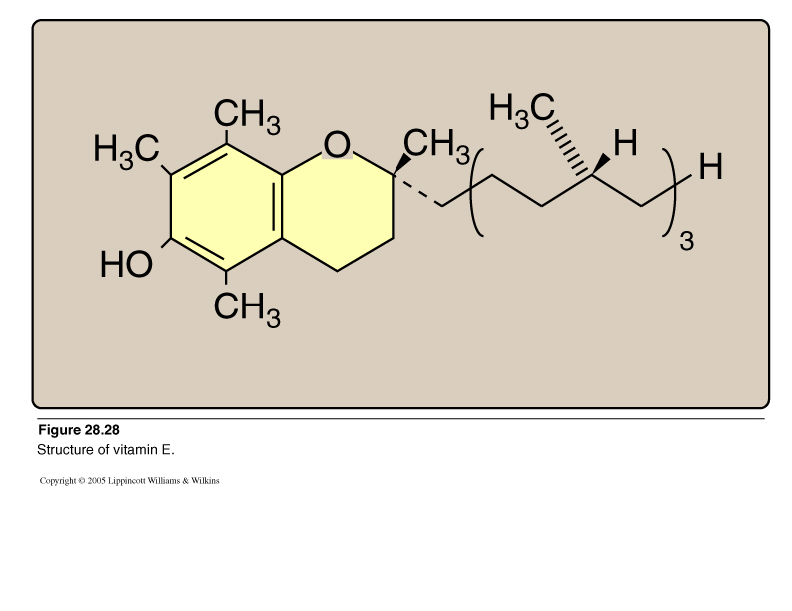

Slide 30
VITAMIN K
Function: Vitamin K is a coenzyme for the carboxylation of glutamic acid side chains of some blood clotting factors (prothrombin, factors VII, IX and X).
Effect of Deficiency: A deficiency of vitamin K is rare but can be associated with prolonged blood clotting times.
Sources: Vitamin K is produced by intestinal bacteria.
RDA: No RDA has been established but 70-140 µg may be appropriate.

Slide 31
