Slide 1
The Synthesis of Amino Acids

Slide 2
OVERVIEW OF AMINO ACID METABOLISM
ENVIRONMENT ORGANISM
Bio-
synthesis
Protein
Ingested
protein
1
2
3
a
AMINO
ACIDS
b
c
Degradation
(required)
c
Purines
Pyrimidines
Porphyrins
Nitrogen
Carbon
skeletons
Urea
(ketogenic)
(glucogenic)
Used for
energy
pyruvate
α-ketoglutarate
succinyl-CoA
fumarate
oxaloacetate
acetoacetate
acetyl CoA

Slide 4
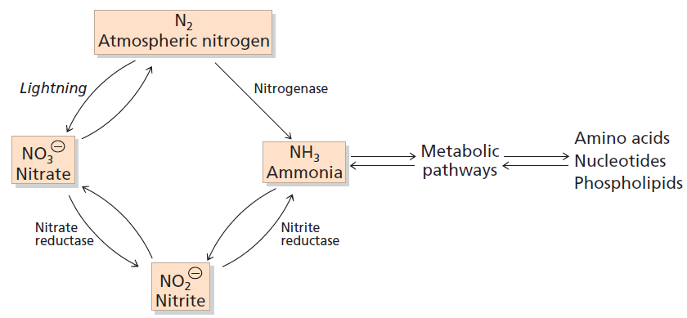
1.The Nitrogen Cycle and Nitrogen Fixation
The nitrogen cycle. The total amount of nitrogen fixed
annually in the biosphere exceeds 4x10¹¹ kg.

Slide 5
α-keto acid
Inorganic N NH₃ Amino Acids
Notes:
无机态N
+ α-酮酸
在植物体内，合成氨基酸所利用的碳源主要来自糖、脂肪产生的α酮酸，而直接利用的氮源则是NH₃

Slide 6
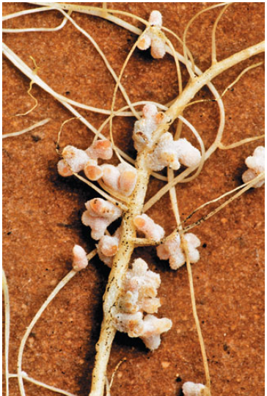
The Synthesis of Ammonia
Nitrogen fixation
—The cyanobacteria , Azotobacter and other nitrogen-fixing bacteria live as symbiont the root nodules of leguminous plants are capable of fixing atmospheric nitrogen.
Nitrogen-fixing nodules
Notes:
【固氮作用】
The cyanobacteria（蓝细菌）, Azotobacter（固氮菌属）and other nitrogen-fixing bacteria live as symbiont（共生的） the root nodules of leguminous (豆科的)plants are capable of fixing atmospheric nitrogen.

Slide 7
NO₃ ⁻、NO₂ ⁻ reduced to NH₃
nitrate reductase nitrite reductase
NO₃ ⁻
NO₂ ⁻
NH₃
Notes:
nitrate reductase nitrite reductas
【硝酸还原酶】 【亚硝酸还原酶】

Slide 8
2. Ammonia assimilation
All organisms assimilate ammonia via two main reactions catalyed by glutamate dehydrogenase and glutamine synthetase giving rise to Glu and Gln, respectively.
The amino nitrogen in Glu and Gln are then used in further biosynthetic reactions to give rise to other amino acids.
Notes:
【氨的同化】
glutamate dehydrogenase 【谷氨酸脱氢酶】 and glutamine synthetase 【谷氨酰氨合成酶】

Slide 9
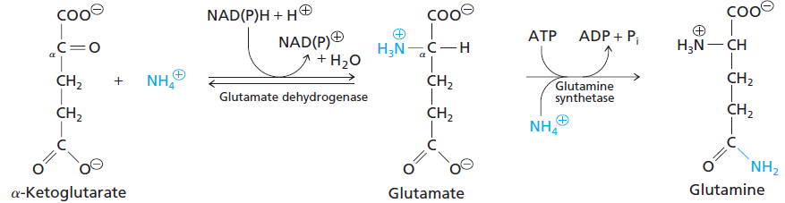
Ammonia Is Incorporated into Glutamate and Glutamine

Slide 10
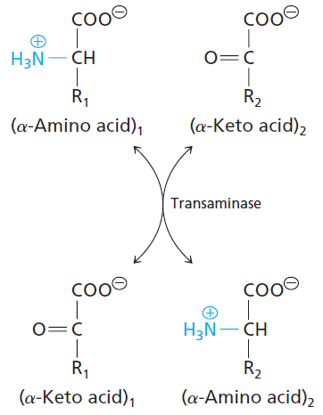
Transamination
The amino group of glutamate can be transferred to many a-keto acids in reactions catalyzed by enzymes known as transaminases or aminotransferases.

Slide 11
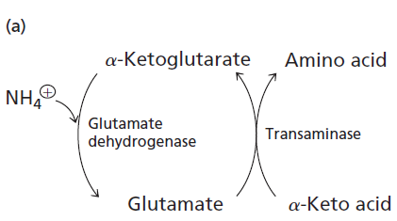

Slide 12
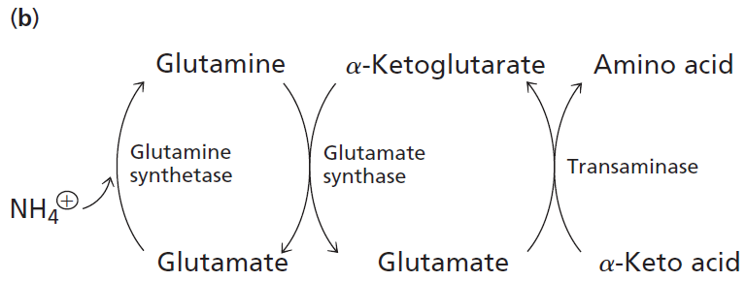

Slide 13
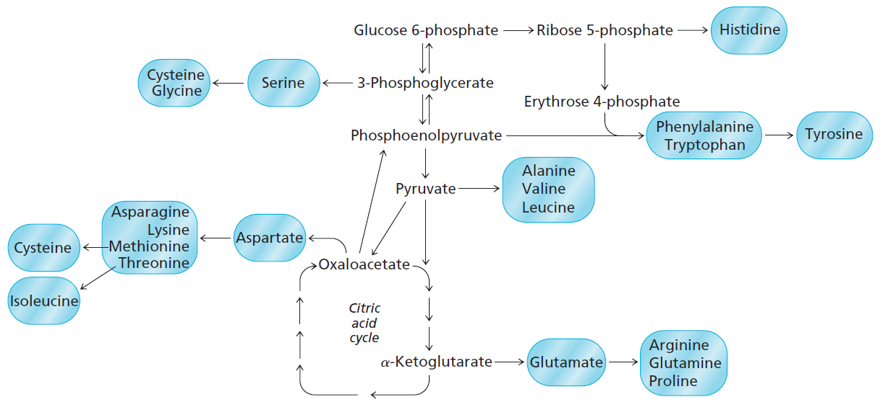
3. Biosynthesis of amino acids

Slide 14
NH₃：primarily donated by glutamate
material
Carbon Skeletons：α-keto acid，
Amino Acid Biosynthetic Families, Grouped by Metabolic Precursor.
Notes:
根据氨基酸合成的碳架来源不同，可将氨基酸分为若干族。

Slide 15
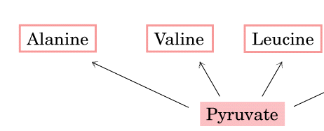
Synthesis of Ala, Val, and Lue
—Ala, Val, and Lue are derived from pyruvate （EMP）
carbon skeleton

Slide 16
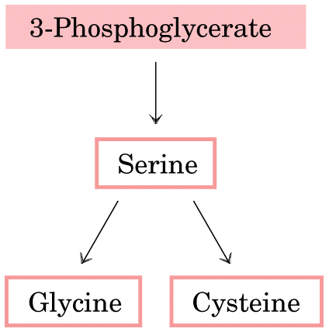
Synthesis of Ser, Gly and Cys
—Ser, Gly, and Cys are derived from 3-phosphoglycerate（EMP）
carbon skeleton

Slide 17
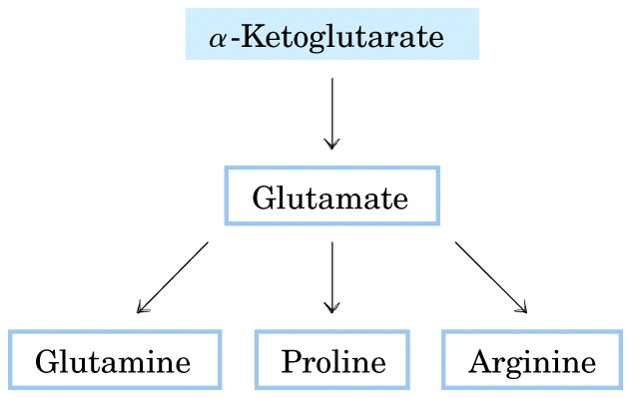
Synthesis of Glu, Gln, Pro and Arg
—α-Ketoglutarate （TCA） gives rise to Glu, Gln, Pro, and Arg synthesis
carbon skeleton

Slide 18
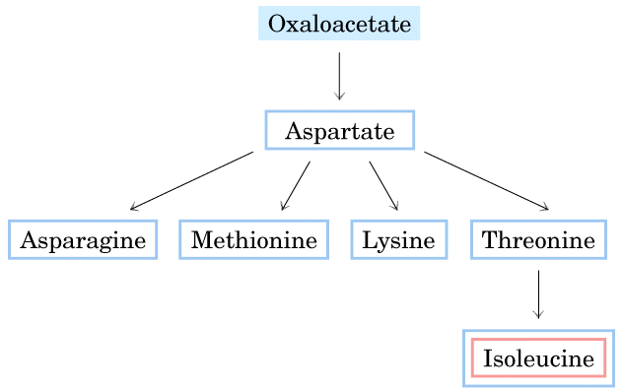
—Oxaloacetate（TCA） gives rise to Asp, Asn, Met, Lys,Thr and Arg synthesis
Synthesis of Asp, Asn, Met, Lys,Thr and Arg
carbon skeleton

Slide 19
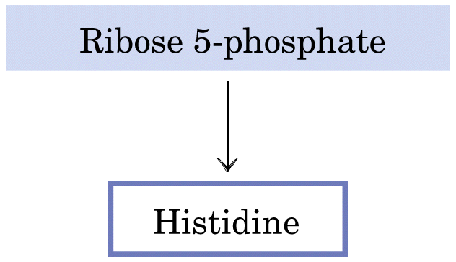
Synthesis of His
carbon skeleton

Slide 20
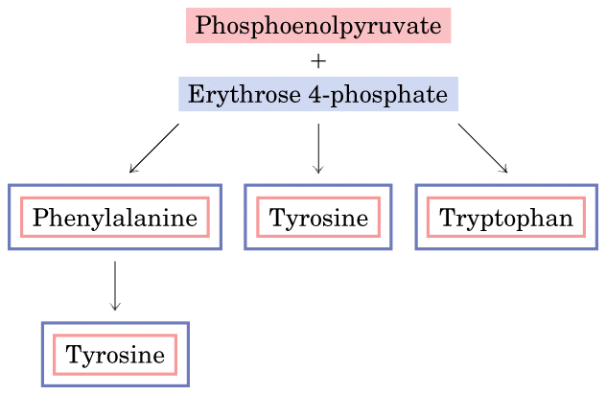
—The synthesis of shikimate by aromatic AA is called shikimate pathway.
Synthesis of Trp, Phe and Tyr
(EMP)
(PPP)
Notes:
The synthesis of shikimate【莽草酸】 by aromatic【芳香族】 AA is called shikimate pathway【莽草酸途径】.

Slide 21
Plants and bacteria synthesize all 20 common amino acids. Mammals can synthesize about half; the others are required in the diet (essential amino acids ——Leu、Trp、Phe、Val、Met、Leu、Thr、Ile).
Notes:
无论N素来源如何，生物体最先合成的Aa都是Glu或Gln ；
Aa的合成需要转氨作用，转氨作用的NH₃来源于Glu，而C架来自α-酮酸。由α-酮酸直接转氨合成的只有Ala、Asp。

Slide 22
The Degradation of Amino Acids

Slide 23
In animals, amino acids undergo oxidative degradation in three different metabolic circumstances:
Some amino acids that are released from protein breakdown and are not needed for new protein synthesis undergo oxidative degradation.
When a diet is rich in protein and the ingested amino acids exceed the body’s needs for protein synthesis, the surplus is catabolized; amino acids cannot be stored.
During starvation or in uncontrolled diabetes mellitus, when carbohydrates are either unavailable or not properly utilized, cellular proteins are used as fuel.
Notes:
在动物体内，氨基酸在3种不同的代谢条件下发生氧化降解：
1.在细胞中的蛋白质发生正常的合成和降解的过程中，一些在蛋白质分解过程中所释放出来的氨基酸如果没有被用于新蛋白质合成的话，则被氧化降解。
2.如果食物中含有丰富的蛋白质，那么多余的氨基酸就会被分解；因为氨基酸不能在体内贮存。
3.在饥饿或者患糖尿病期间，糖类或者不存在，或者不能被适当利用，那么细胞中的蛋白质就会被用作燃料。

Slide 24
Under all these metabolic conditions, amino acids lose their amino groups to form α-keto acids, the “carbon skeletons” of amino acids. The α-keto acids undergo oxidation to CO₂ and H₂O or, often more importantly, provide three- and four-carbon units that can be converted by gluconeogenesis into glucose, the fuel for brain, skeletal muscle, and other tissues.
Notes:
在所有这些代谢条件下，氨基酸是去氨基而变成a-酮酸，即氨基酸的“碳骨架”。a-酮酸进行氧化生成CO2和水，或者通常更为重要的是提供三碳和四碳单位，它们能够通过糖异生作用转化成葡萄糖，后者作为大脑，骨骼肌以及其他组织的燃料。

Slide 25
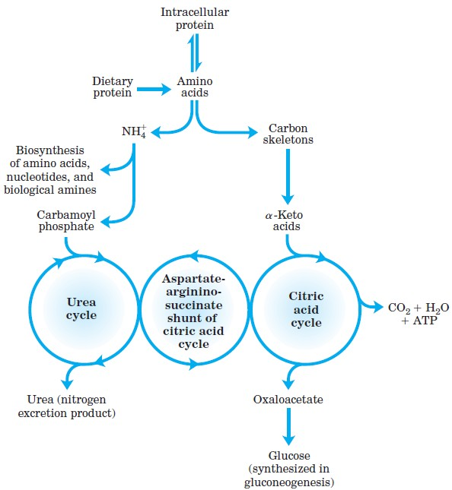
Overview of amino acid catabolism in mammals.
Notes:
哺乳动物氨基酸代谢概况

Slide 26
Metabolic fates of amino groups
Amino acids derived from dietary protein are the source of most amino groups.
Most amino acids are metabolized in the liver.
Some of the ammonia generated in this process is recycled and used in a variety of biosynthetic pathways.
The excess is either excreted directly or converted to urea or uric acid for excretion, depending on the organism
Notes:
氨基的代谢去向：
来自食物蛋白的氨基酸是大部分氨基的来源。
大多数氨基酸在肝脏中进行代谢。
该过程所产生的氨有一部分在一系列不同生物合成过程中得到重新利用，
多余的氨或者直接排出，或者转化成尿素或尿酸后排出，具体的途径与生物种类有关。

Slide 27
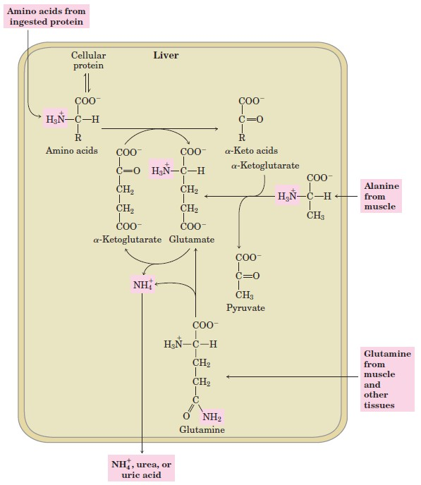
An overview of the catabolic pathways of ammonia and amino groups in vertebrates.

Slide 28
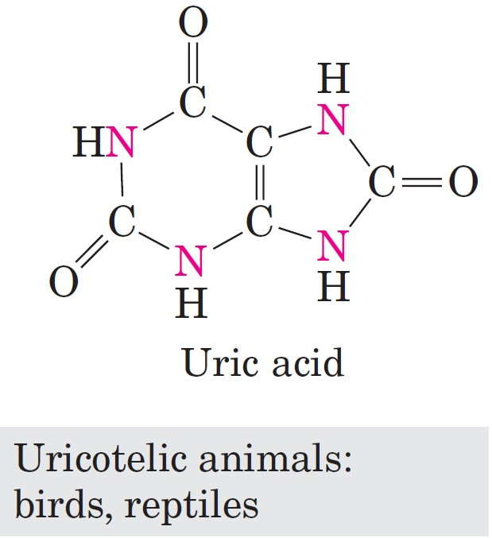
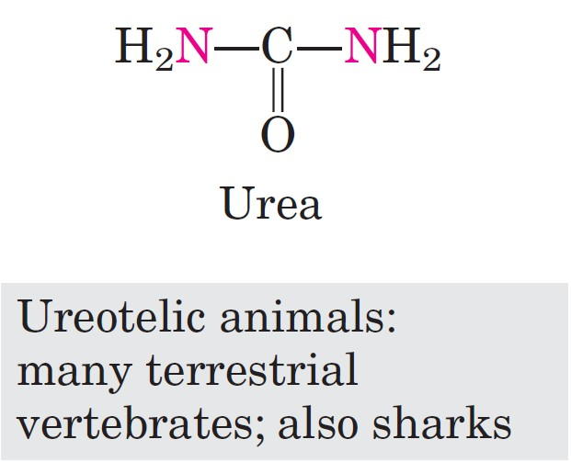
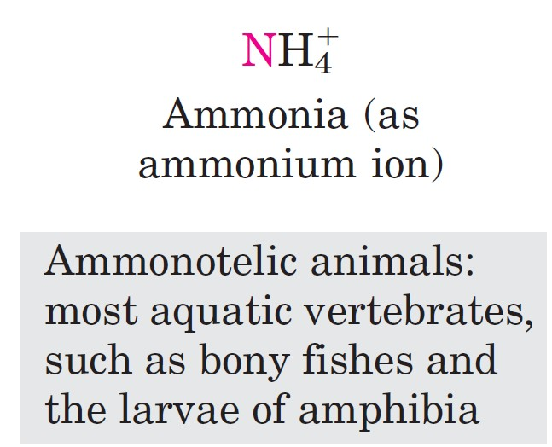
Excretory forms of nitrogen
The organism discards carbon only after extracting most of its available energy of oxidation.
Notes:
氨的排泄方式：
排氨动物：大多数水生脊椎动物，如硬骨鱼和两栖动物的幼体
排尿素动物：大多数陆地脊椎动物，鲨鱼也是
排尿酸动物：鸟类，爬行动物。
生物只有在用尽碳原子中的可利用能量之后才将它排出。

Slide 29
In the cytosol of hepatocytes, amino groups from most amino acids are transferred to α-ketoglutarate to form glutamate, which enters mitochondria and gives up its amino group to form NH₄⁺.
Excess ammonia generated in most other tissues is converted to the amide nitrogen of glutamine, which passes to the liver, then into liver mitochondria.
Notes:
在肝细胞的胞质溶胶中，大多数氨基酸的氨基被转移到a-酮戊二酸上，形成谷氨酸，然后谷氨酸被输送到线粒体中，在那里脱下氨基，形成NH4+。
大多数其他组织中所产生的过量氨被转化成谷氨酰胺侧链上的酰胺氮，再移动到肝脏并进入肝脏的线粒体。

Slide 30
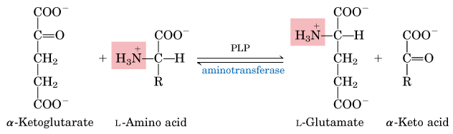
Transamination
In these transamination reactions, the α-amino group is transferred to the α- carbon atom of α-ketoglutarate, leaving behind the corresponding α-keto acid analog of the amino acid.
There is no net deamination (loss of amino groups) in these reactions.
Notes:
在这些转氨反应中，a-氨基被传递到a-酮戊二酸的a-碳原子上，留下的是原氨基酸的a-酮酸类似物。
在这些反应中并没有净的脱氨反应。
(转氨作用) The first is the reaction between an amino acid and an alpha-keto acid. The amino group is transferred from the former to the latter; this results in the amino acid being converted to the corresponding α-keto acid, while the reactant α-keto acid is converted to the corresponding amino acid

Slide 31
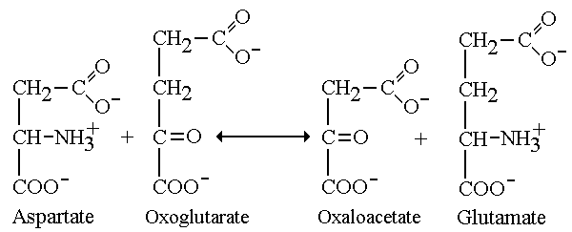
Two important aminotransferases:
GOT: Glutamate-oxaloacetate transaminase

Slide 32
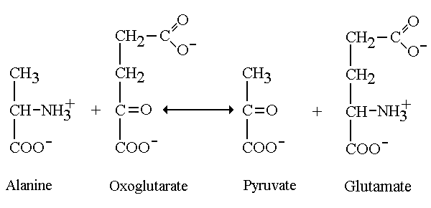
GPT: Glutamate-pyruvate transaminase

Slide 33
Transaminases
Cells contain different types of aminotransferases.
Many are specific for α-ketoglutarate as the amino group acceptor but differ in their specificity for the L-amino acid.
The reactions catalyzed by aminotransferases are freely reversible.
All aminotransferases have the same prosthetic group and the same reaction mechanism. The prosthetic group is pyridoxal phosphate (PLP)
Notes:
细胞中含有大量不同的转氨酶。
有许多以a-酮戊二酸作为特异氨基受体，但是它们对L-氨基酸的专一性却是不同的。
转氨酶所催化的反应是完全可逆的。
所有转氨酶都含有相同的辅基，并具有同样的反应机制。辅基是吡哆醛。（PLP)
Transaminases(aminotransferases)

Slide 34
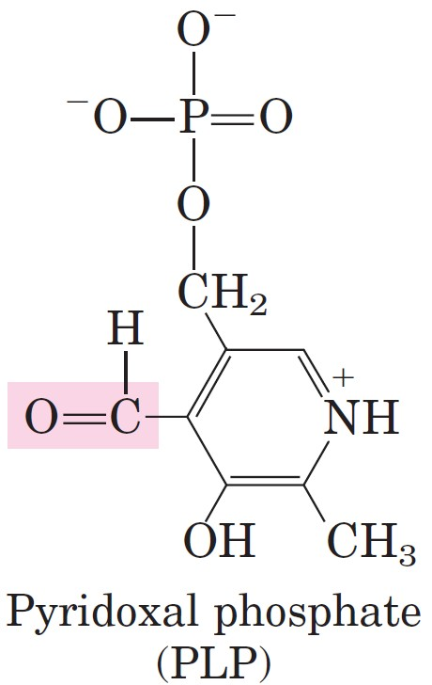
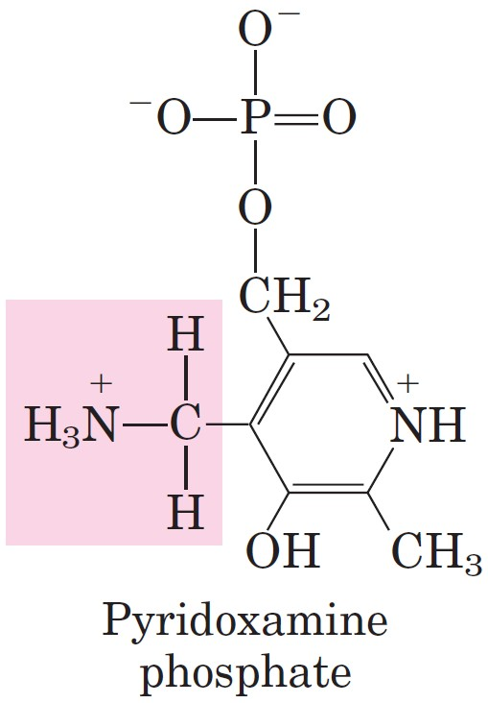


Slide 35
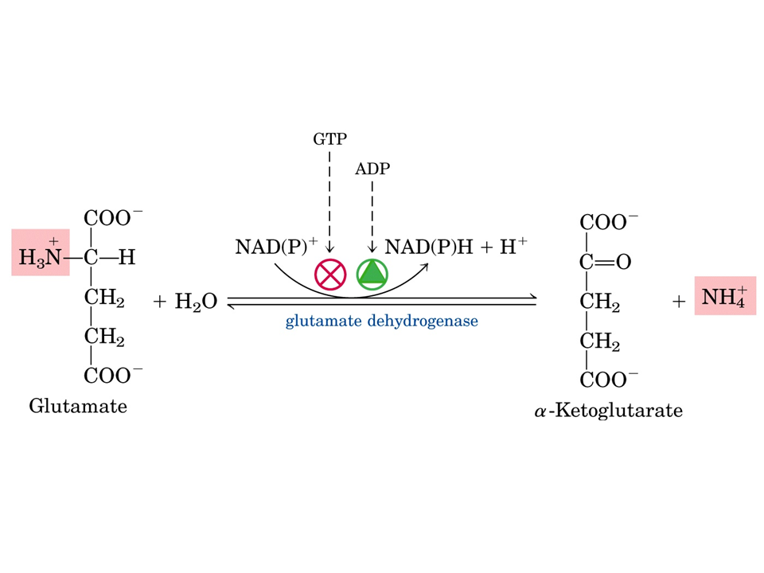
Oxidative deamination
The glutamate dehydrogenase of mammalian liver has the unusual capacity to use either NAD or NADP as cofactor.
The mammalian enzyme is allosterically regulated by GTP and ADP.
Notes:
哺乳动物肝脏中的谷氨酸脱氢酶具有不同寻常的能力既能使用NAD+也能使用NADP+作为辅因子。
哺乳动物中的这种酶受到GTP和ADP的变构调节作用。

Slide 36
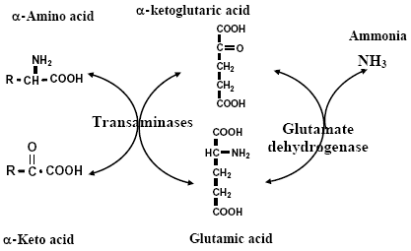
Transdeamination
The combined action of an aminotransferase and glutamate dehydrogenase is referred to as Transdeamination
Notes:
一种转氨酶与谷氨酸脱氢酶的联合作用称为联合脱氨作用。

Slide 37
Decarboxylation
Glu→γ-aminobutyrate
Trp→indole-3-acetate（ plant hormone）
Tyr→tyramine
Ser→ethanolamine→choline→cephalin, lecithin
decarboxylase
RCHNH₂COOH
CO₂ + RCH₂NH₂
PLP
amine
Notes:
Glu→γ-aminobutyrate【氨基丁酸】（抑制中枢神经传导）
Trp（脱氨、脱羧、氧化）→indole-3-acetate【吲哚乙酸-IAA】（ plant hormone）
Tyr→tyramine【酪胺】（升血压）
Ser→ethanolamine【乙醇胺】→ choline【胆碱】→cephalin【脑磷脂】, lecithin【卵磷脂】

Slide 38
The Metabolism of Amino Acid Degradation Production
CO₂+ Amine
Amino acid
NH₃+ α-keto acid
?
?

Slide 39
Metabolism of NH₃
The synthesis of new amino acids
Convert to ammonium
Convert to urea for excretion （ornithine cycle ）
Convert to the amide
Notes:
重新合成Aa
生成铵盐【铵盐】
合成尿素排泄【尿素】 【排泄】【鸟氨酸循环】
生成酰胺【酰胺】

Slide 40
Urea cycle ( in many animals )
The urea cycle (also known as the ornithine cycle) is a cycle of biochemical reactions occurring in many animals that produces urea (NH₂)₂CO from ammonia (NH₃).
Notes:
【尿素循环】肝脏中二分子氨和一分子二氧化碳生成一分子尿素的环式代谢途径

Slide 41
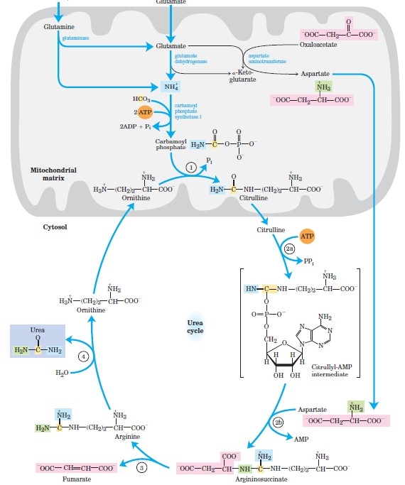

Slide 42
Fate of the carbon skeletons of amino acid
Synthesis of new amino acids
Completely oxidized via TCA cycle
Notes:
(合成氨基酸)

Slide 43
Convert to glucose and fat
Glucogenic amino acids
—A glucogenic amino acid is an amino acid that can be converted into glucose through gluconeogenesis .
Ketogenic amino acids
— A ketogenic amino acid is an amino acid that can be converted into ketone bodies through ketogenesis.
Notes:
Glucogenic amino acids (生糖氨基酸)可以转化成糖的Aa，即凡能生成丙酮酸、琥珀酰CoA、OAA和α-KG的Aa；

Slide 44
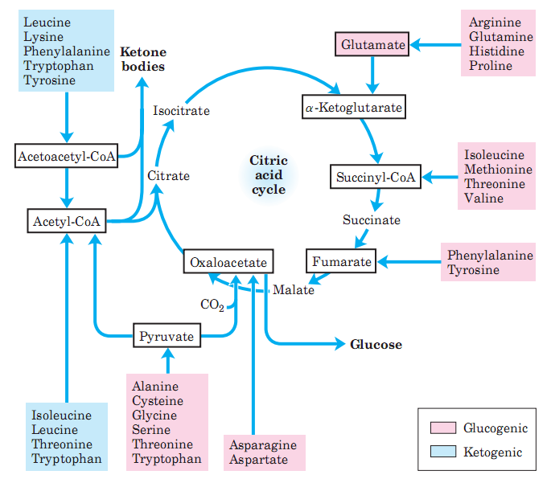
Notes:
Fates of the Carbon Skeletons of Amino Acids. Glucogenic amino acids are shaded red, and ketogenic
amino acids are shaded blue. Most amino acids are both glucogenic and ketogenic.

Slide 45
Uric acid biosynthesis

Slide 46
Degradation of Purines

Slide 47
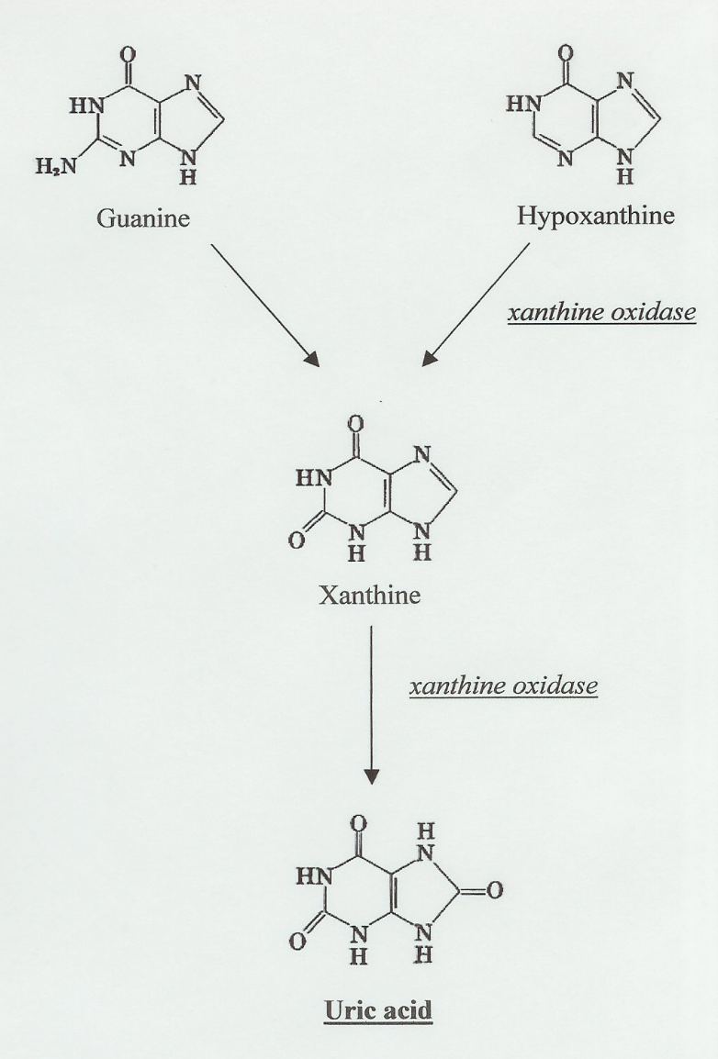
Degradation of Purines

Slide 48
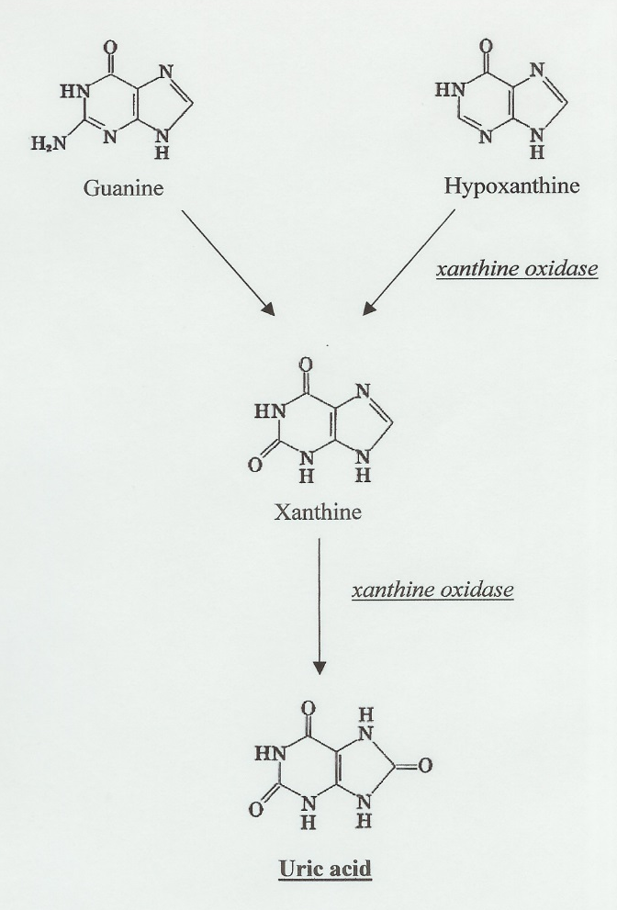
Allopurinol
Inhibits xanthine oxidase
X
X

Slide 49
Protein Sequencing

