Slide 1
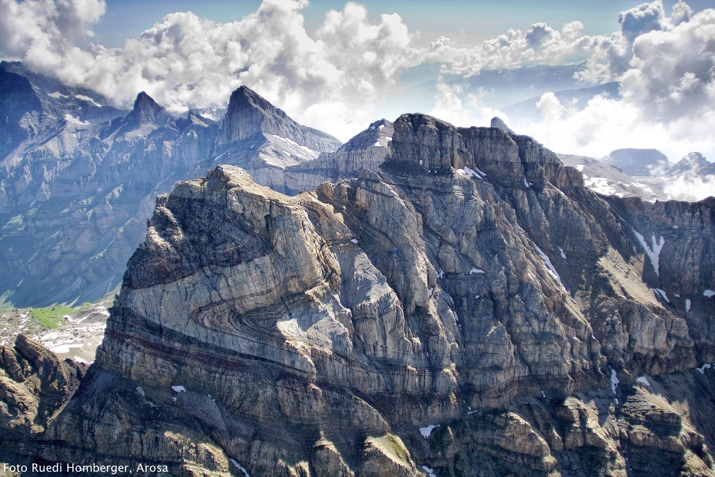
Fold
Presented By:
HARISH KAPASYA
Department of Geology,
Faculty of Earth Science,
M.L. Sukhadia University, Udaipur

Slide 2
FOLD
A fold is a structure produced when an originally planar surface becomes bent or curved as a result of deformation.

Slide 3
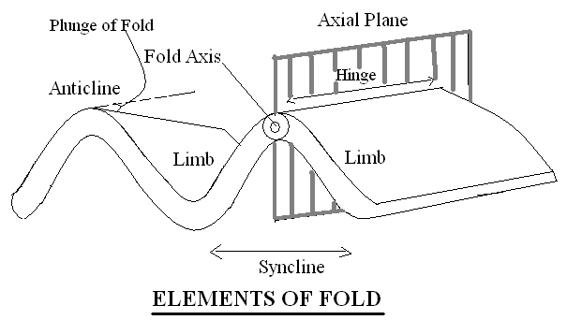
Elements of Folds

Slide 4
Classification of Fold
Based on interlimb angle:-
The size of interlimb angle measures the degree of tightness of fold.
Gentle 180°-120°
Open 120°-70°
Close 70°-30°
Tight 30°-0°
Isoclinal 0°

Slide 5
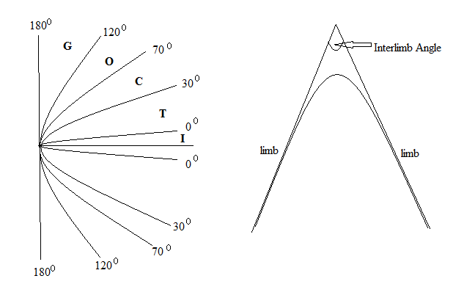

Slide 6
Based on attitudes of axial plane and fold hinge (axis)
Depending on the dip of axial planes all the folds can be divided into 3 broad groups:-
Recumbent (Axial plane dip 0° - 10°)
Inclined (Axial plane dip 10° - 80°)
Upright (Axial plane dip 80° - 90°)

Slide 7
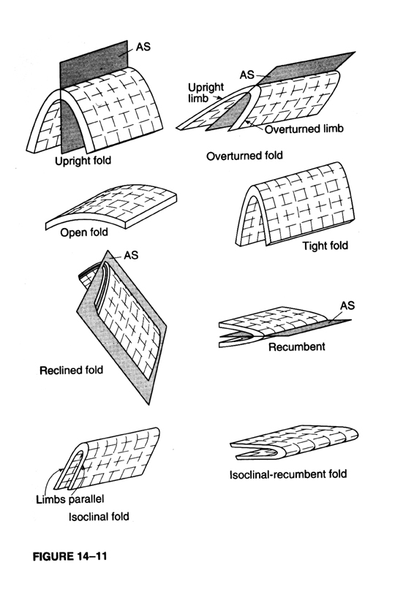

Slide 8
Based on the plunge of the fold hinge or fold axis, the folds divided into following groups:-
Horizontal Fold (Plunge 0° - 10°)
Plunging Fold (Plunge 10° - 80°)
Vertical Fold (Plunge 80° - 90°)

Slide 9
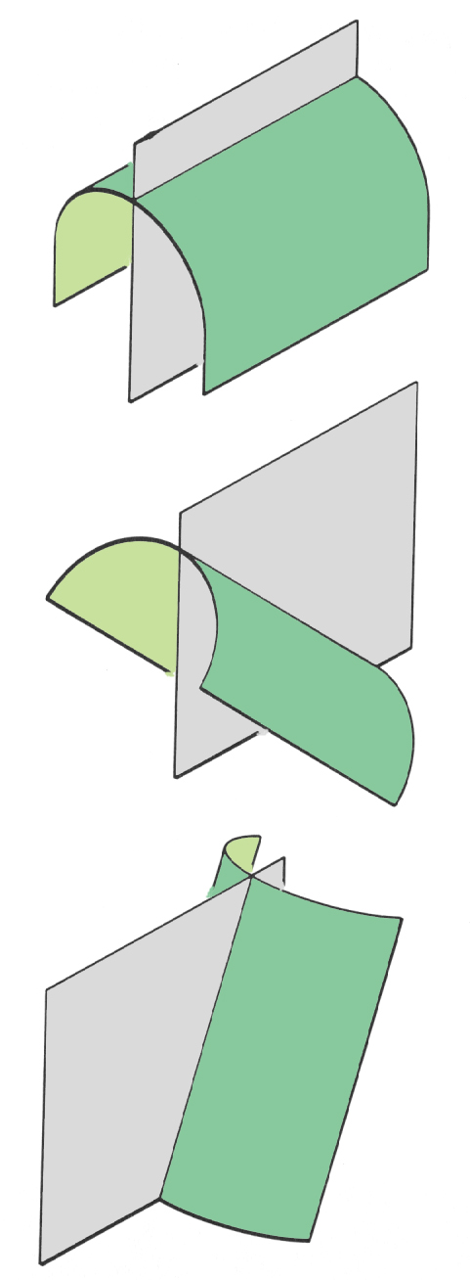
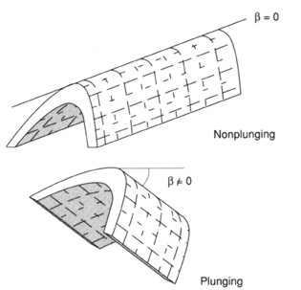

Slide 10
Based on the continuity of fold hinge:-
Cylindrical Fold –
Rectilinear fold hinge or fold axis
Non-Cylindrical Fold –
Fold hinge and axis are changes
En-Echelon Fold –
End of one fold is connected with the start of new fold

Slide 11
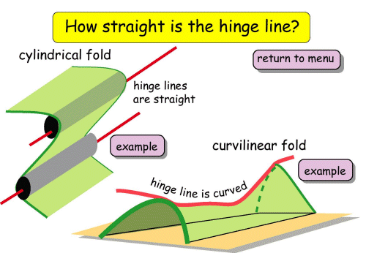
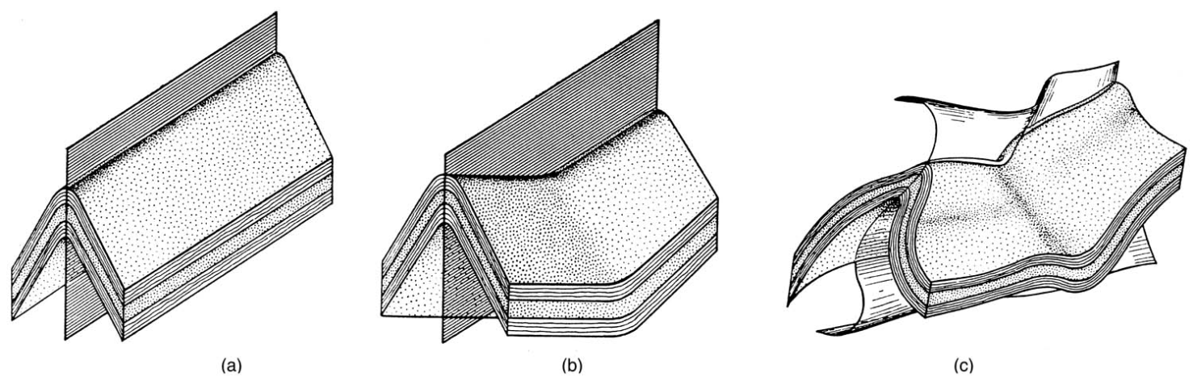
non-cylindrical fold

Slide 12
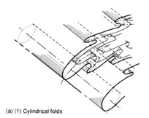
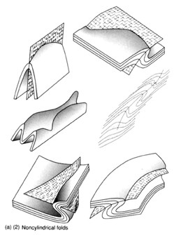

Slide 13
Based on the shape of fold on profile plane
Parallel Fold – orthogonal thickness is same in any directions.
Similar Fold – orthogonal thickness is variable.
Supratenuous Fold – hinge is thinner than limbs.
Flattened Folds – hinge is thicker than limbs.

Slide 14
Sharp Hinge Fold –
These folds having planer limbs and angular hinges.
Symmetrical – Chevron Folds
Asymmetrical – Kink Band, Zigzag or crenulations folds

Slide 15
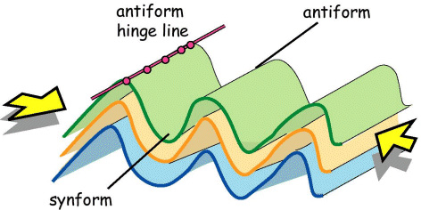
Based on closing of limbs and Stratigraphy
Antiform fold closes upward
Synform fold closes downward

Slide 16
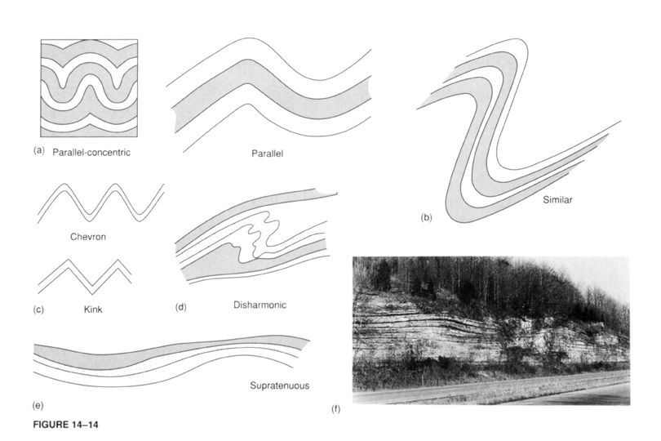

Slide 17
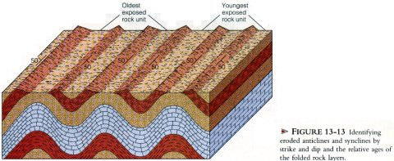
Symmetrical fold:-
In this fold two limbs dip at the same angle but opposite directions. So axial plane become vertical and divided fold in 2 equal half.

Slide 18
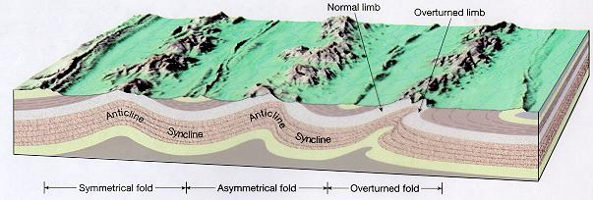
Asymmetrical fold:-
In this fold two limbs dip at the unequal angle and opposite directions. So axial plane become inclined and divided fold in 2 unequal half.

Slide 19
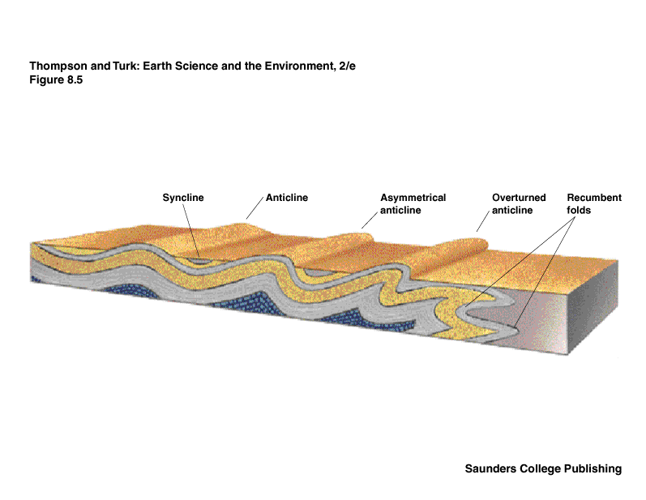

Slide 20
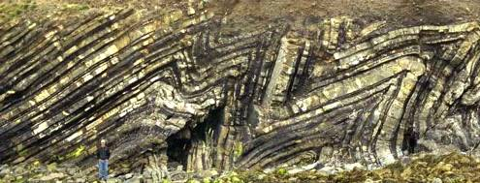
Chevron fold:-
The fold which have straight and nearly straight limbs and meet at sharp angle. Their crust and trough become sharp.

Slide 21
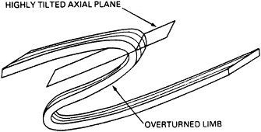
Overturned fold:-
It is an asymmetrical fold whose one limb is turned past vertical. In this case the axial plane become inclined and both limbs dip in the same directions.

Slide 22
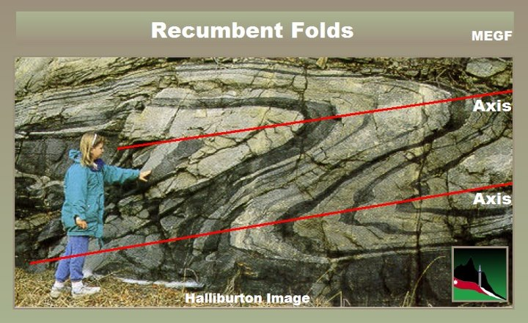
Recumbent fold:-
In the recumbent fold the folding is intense that both limbs become horizontal. So axial plane also become nearly horizontal.

Slide 23
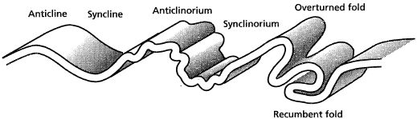
Anticlinorium & synclinorium:-
These are the complex large folds of anticline and syncline form. An Anticlinorium is a large anticline with number of secondary folds of smaller size.
A synclinorium is a large syncline of similar nature.

Slide 24
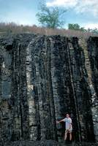
Isoclinals fold:-
In this fold, both limbs are parallel and dip at the same angle and direction.

Slide 25
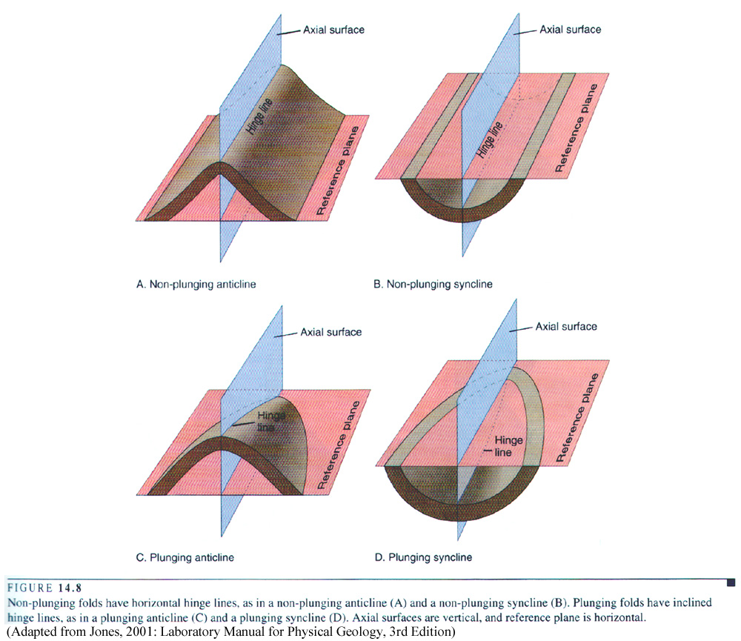
Plunging & Non-plunging fold:-
The angle of inclination of a fold axis with horizontal is called angle of plunge.

Slide 26
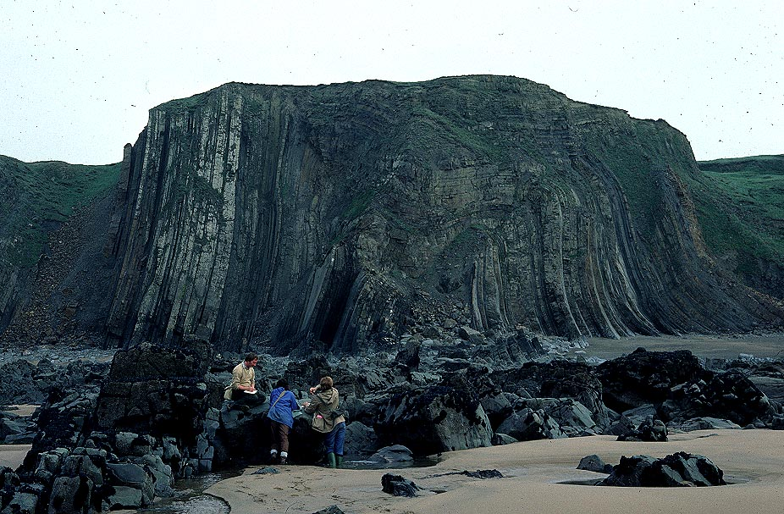
Box fold:-
A box fold has 2 hinges and the crust is board and flat. The limbs and hinge of this fold exhibit three side of rectangle.

Slide 27
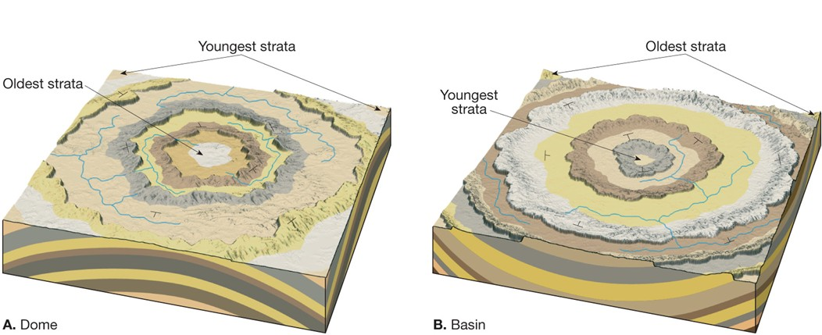
Dome and Basin:-
Dome is an up-fold where the beds dip radial outwards in all directions from the centre.
A basin is a down-fold where the beds dip inward towards the centre.

Slide 28
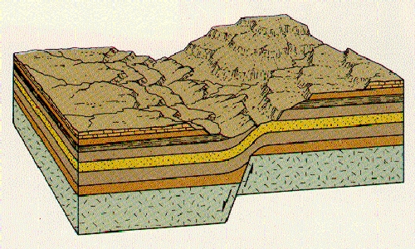
Monocline:-
A local warping in the horizontal beds is called “monocline”. In this case at particular place beds dipping in incline and than follow this original dip.

Slide 29
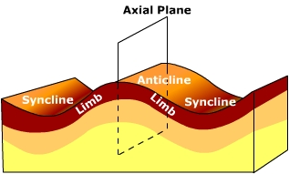
Open fold:-
In this fold folding is mild so limbs meet at bend & angle. In this case thickness of beds is uniform everywhere and unchanged.

Slide 30
Close fold:-
In this fold folding is so tight that incomponent strata flow plastically towards the crest & trough. In this case thinning at the flanks and thickening at crest.

