Slide 1
Concepts of Stress and Strain
By
Harish Kapasya
Faculty of Earth Sciences
Department of Geology
Udaipur

Slide 2
STRESS
A stress is a pair of equal or opposite forces acting on unit area of a body.

Slide 3
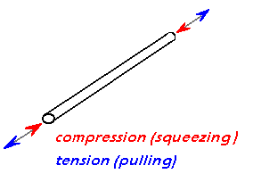
Three types of stress:
Compression
Tension
Shear

Slide 4
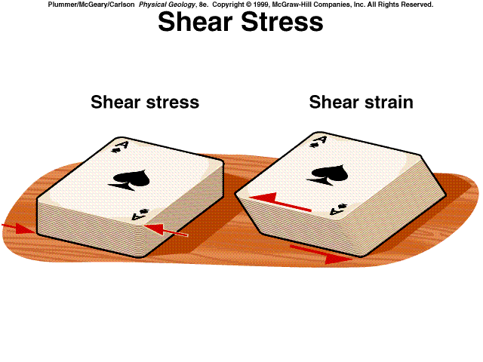

Slide 6
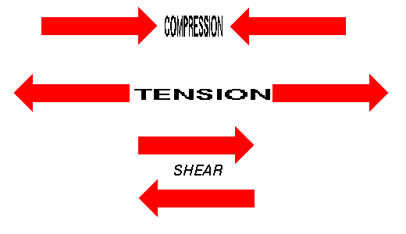

Slide 7
This is the reason why all the structures that develop in rocks after their formation are called secondary structures

Slide 8
EFFECTS OF STRESSES
APPLIED STRESSES
SHAPE CHANGE
VOLUME CHANGE
SHAPE AND
VOLUME CHANGE

Slide 9
CHANGE IN THE DIMENSION OF THE BODY
CHANGE IN SHAPE (DISTORTION)
OR
CHANGE IN VOLUME (DILATION)
OR
CHANGE IN ORIENTATION
(TRANSLATION AND ROTATION)
OR
ANY COMBINATION OF THE ABOVE

Slide 10
STRAIN IS THE GEOMETRICAL EXPRESSION OF THE AMOUNT OF DEFORMATION CAUSED BY THE ACTION OF THE SYSTEM OF STRESSES ON A BODY.

Slide 11
S T R A I N
STRAIN IS THE GEOMETRICAL EXPRESSION OF THE AMOUNT
OF DEFORMATION CAUSED BY THE ACTION OF THE SYSTEM
OF STRESSES ON A BODY.
STRAIN CAN BE DEFINED AS THE CHANGE IN
SIZE AND SHAPE
OF A BODY RESULTING FROM
THE ACTION OF APPLIED STRESS FIELD.
DILATION (VOLUME CHANGE)
or
DISTORTION (SHAPE CHANGE)
or
ROTATIONAL AND
NON-ROTATIONAL (COAXIAL)
or
TRANSLATION
OR
AS COMBINATION OF THESE PROCESSES
TRANSLATION
DILATION
VOLUME CHANGE
DISTORTION
SHAPE CHANGE
ROTATION
TOTAL STRAIN

Slide 12
HOMOGENEOUS AND INHOMOGENEOUS
S T R A I N
AMOUNT OF STRAIN IN ALL PART OF THE BODY IS EQUAL, THE STRAIN IS SAID TO BE HOMOGENEOUS.
STRAIGHT LINE REMAINS STRAIGHT AND PARALLEL LINE REMAIN PARALLEL AFTER DEFORMATION

Slide 13
AMOUNT OF STRAIN IN DIFFERENT PART OF THE BODY IS UNEQUAL THE STRAIN IS SAID TO BE INHOMOGENEOUS OR HETEROGENEOUS.
STRAIGHT LINE BECOMES CURVED AND PARALLEL LINE BECOMES NON-PARALLEL AFTER DEFORMATION

Slide 14
HOMOGENEOUS AND INHOMOGENEOUS S T R A I N

Slide 15
HOMOGENEOUS AND INHOMOGENEOUS S T R A I N

Slide 16
Pure shear and simple shear
If the orientation of the principal strain
X, Y and Z have not changed during the deformation, the strain may be defined as coaxial, this process is known as PURE SHEAR.
Where a change in orientation has occurred, the strain is defined as rotational (non-coaxial) and this process is known as SIMPLE SHEAR

Slide 17
PURE SHEAR AND SIMPLE SHEAR distortion and rotation

Slide 18
TYPES OF HOMOGENEOUS STRAIN
Homogeneous strain which can be distinguished by particular ratios of the principal strain axes X, Y and Z.
The general case, the three are unequal and X>Y>Z.
x
y
z
y
z
Triaxial ellipsoid
x

Slide 19
Special type of homogeneous strain
Axially symmetric extension:
X>Y=Z ; λ1> λ2= λ3
This type of strain involves uniform extension in the X direction and equal shortening in all directional right angles to it
PROLATE OR RUGBY BALL TYPE OF STRAIN ELLIPSOID

Slide 20
Special type of homogeneous strain
Axially symmetric shortening:
X=Y>Z ; λ1= λ2> λ3
This type of strain involves uniform shortening in the Z direction and equal extension in all directional right angles to it
OBLATE OR PANCAKE TYPE OF STRAIN ELLIPSOID

Slide 21
Special type of homogeneous strain
PLANE STRAIN:
X>Y=1>Z ; λ1> λ2=1> λ3
This type of strain involves INTERMEDIATE PRINCIPAL STRESS AXIS REMAINING UNCHANGED (i.e.,Y has unit length). X is extended and Z is shortened.
Special type of TRIAXIAL STRAIN ELLIPSOID

Slide 22
Unconformitiy
Major breaks in sedimentation are called “UNCONFORMITIES”.

Slide 23
An unconformity may be defined as an old erosion surface which separates younger series of rocks from the older series.
Unconformities represent an interval of time of unknown length which is spent in the erosion of the underlying strata before the deposition of the overlying rocks.

Slide 24
Types of Unconformity:-
Angular Unconformity
Disconformity
Nonconformity

Slide 26
Angular Unconformity:-
The rocks beds on opposite sides of an “Angular Unconformity” are not parallel.
The angular unconformities occur where the older series of beds have been tilted, deformed and eroded before the deposition of younger beds.

Slide 27
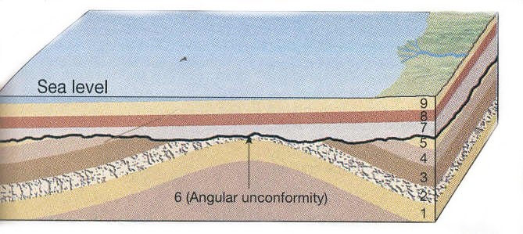

Slide 28
Disconformity:-
The rocks beds on opposite sides of a “Disconformity” are parallel.
Disconformities occurs where the strata of the older series have not been tilted or deformed before the deposition of younger beds.

Slide 29
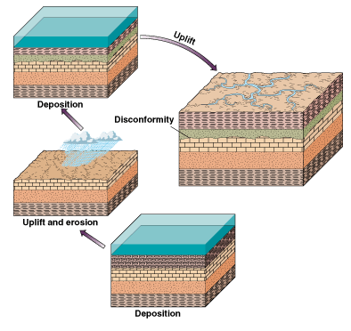

Slide 30
Nonconformity:-
Where a series of sedimentary layers is deposited over igneous or metamorphic rooks, mostly plutonic igneous rocks, it forms nonconformity.

Slide 31
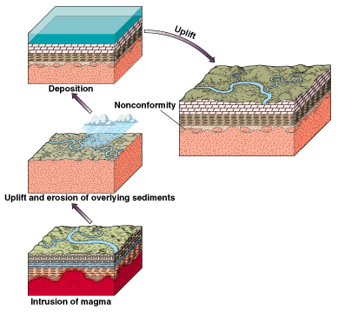

Slide 32
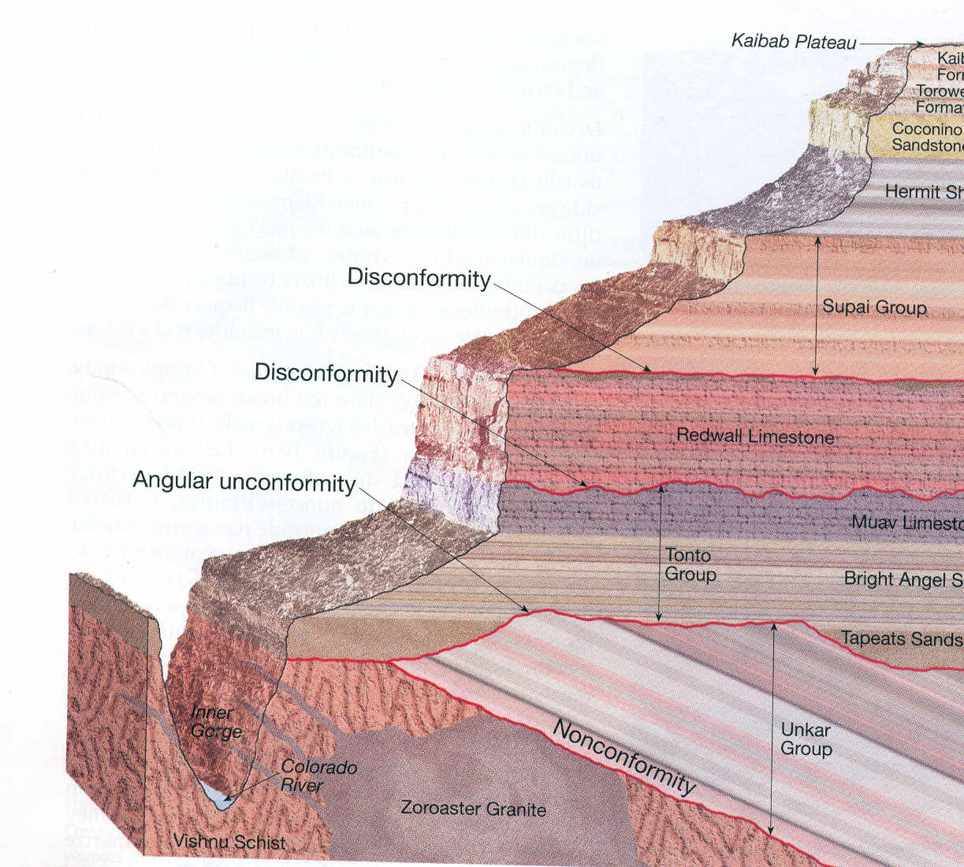
3 types of unconformities are seen

