Slide 1
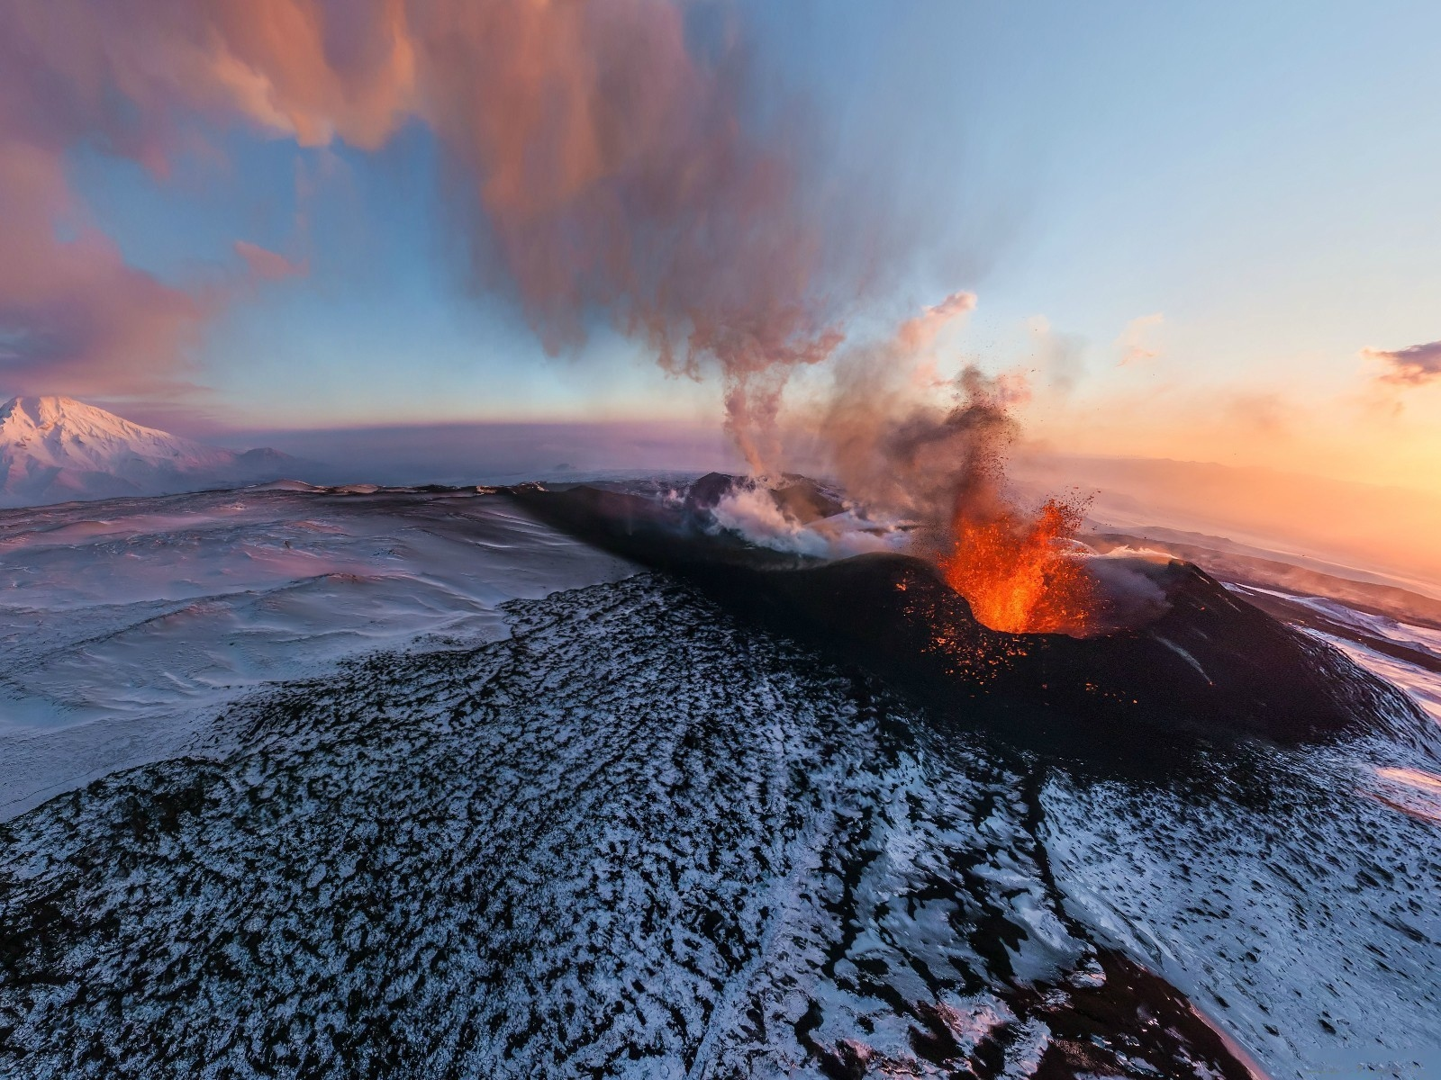
Primary Structures of Igneous & sedimentary Rock

Slide 2
Structures of Igneous Rocks
The development of various structures in rock depend upon several factors:
Composition of magma
Viscosity of magma
Rate of cooling of magma
Presence of gases and other volatile material in magma etc.

Slide 3
Igneous Structures are broadly divided into two groups:
Mega – Structures
Micro – Structures

Slide 4
Flow Structure
These structures are generally present in volcanic rocks and formed due to the mobility (movement) of lava.
In the flow structures, development of parallel or nearly parallel bands or layers are seen which are formed by the arrangement of early crystalline particles in the direction of flow of lava.

Slide 5
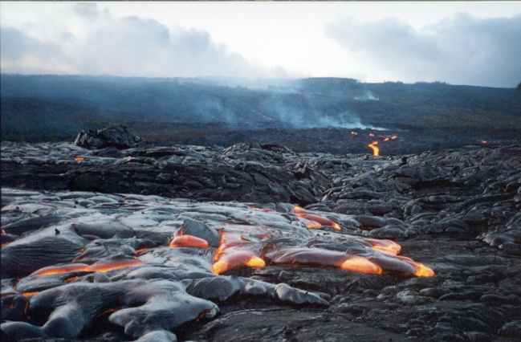
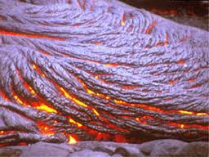
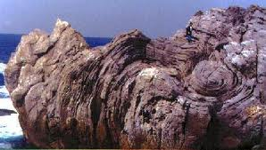
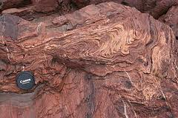

Slide 6
Vesicular & Amygdaloidal Structures
When lava charged by gases and other volatile materials, are erupted on the earth surface, the gases contents released out from the magma (lava).
As such at the top surface of flow, empty cavities of variable size and shape are formed.
The individual opening is known as “Vesicles” and the structure as a whole is called as “Vesicular Structure”.

Slide 7
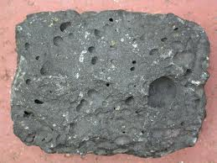
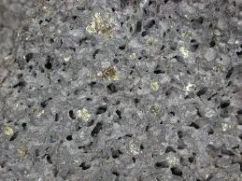
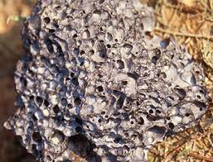
Vesicular Structure

Slide 8
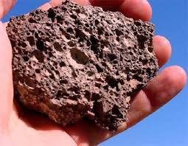
Cellular or Scoriaceous structures
When lava is heavily charged with volatile material or gases, numerous cavities are formed,
giving rise to the spongy
character.

Slide 9
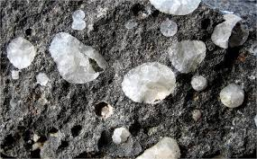
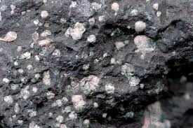
The vesicles sometimes filled in with some secondary minerals such as Calcite, Zeolite etc. These infillings are called as “Amygdales” and lava containing “Amygdaloidal Structures”.

Slide 10
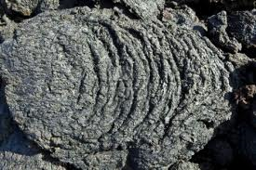
Block Lava
The lava of acidic composition is highly viscous. Due to their high viscosity it do not flow to greater distance and after solidification it has
very rough surface and
show broken and
fragmental appearance.

Slide 11
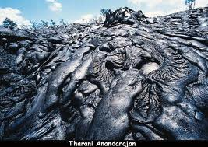
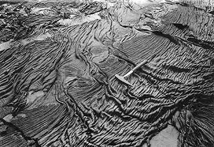
Ropy Lava
Lavas of basic composition are quite mobile because of their low viscosity and they can flow to greater distance and after solidification offers very smooth surface.

Slide 12
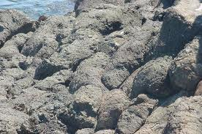
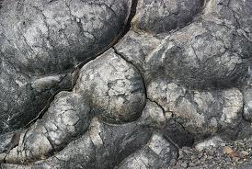
Pillow Structure
Basaltic lava flow that exhibit “Pillow like appearance” . They are rounded lumps of lava.

Slide 13
Pillow basalt is a volcanic igneous rock that forms when lava of basaltic compositionis erupted underwater. The rapid cooling of the lava by cold water on all sides forms the pillow-shaped bodies, which can then break open and extrude more of the hot lava from inside.

Slide 14
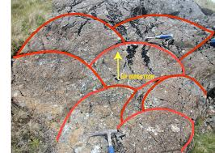
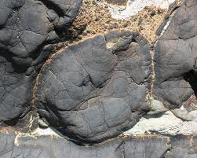

Slide 15
Jointing Structures
Cracks or joints are produced in the body of cooling magma or lava. These some times follow a definite pattern, giving rise different types of jointing structures.
Sheet Structure
Platy Structure
Columnar Jointing

Slide 16
Sheet Structure:
The development of one set of well defined horizontal joints give rise sheet structures.
Platy Structures:
The development of different sets of joints, give rise plate type appearance of rock.

Slide 17
Columnar Jointing:
During the cooling, sometimes few sets of vertical joints developed. Such joints bring about the formation of columns which are square, rectangular, hexagonal etc.

Slide 18
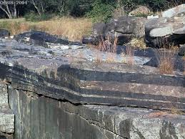
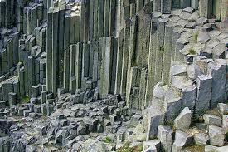
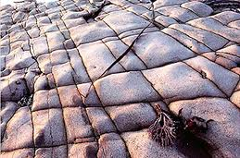
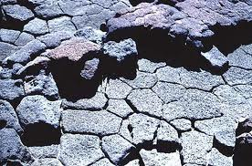

Slide 19
Micro – Structures
Primary Foliation:
Some times in igneous rocks parallel arrangement of platy mineral grains are seen, giving rise foliation structure.
Graphic Structure:
It is an intergrowth of quartz and orthoclase feldspar.

Slide 20
Myrmekite Structure
It is produced by an intergrowth of quartz and feldspar (plagioclase) where quartz occurs as drops in plagioclase.
Xenolithic Structure
Occurrence of foreign rock fragment within in an igneous rock give rise Xenolithic structure.

Slide 21
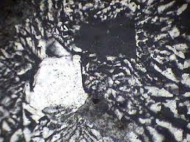
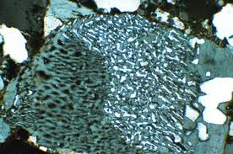
Graphic intergrowth
Myrmekitic structure

Slide 22
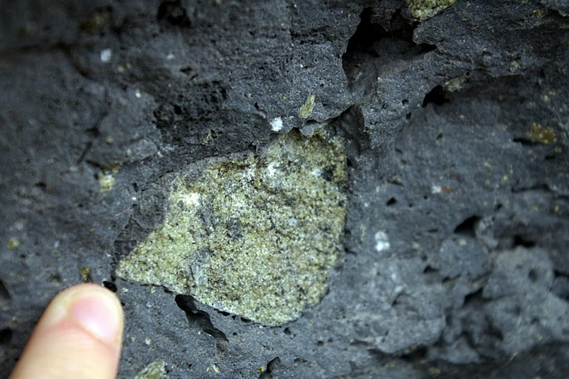
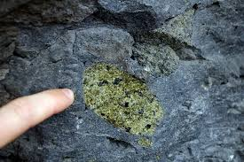
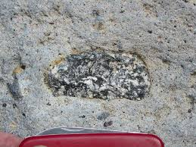
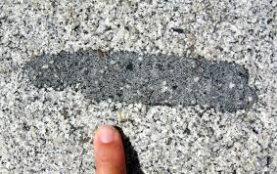

Slide 23
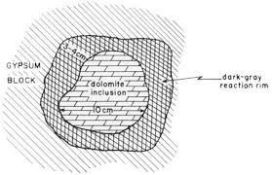
Reaction Rim
When already crystallized crystal reacts with magma, the corroded crystal is formed surrounded by product of reaction.

Slide 24
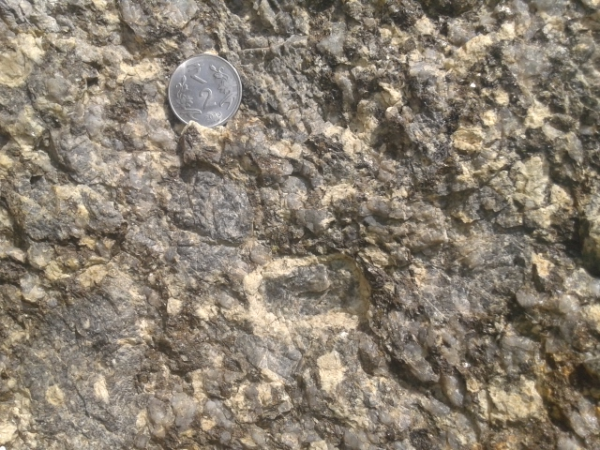

Slide 25
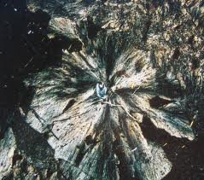
Spherulitic Structure
Structure present generally in volcanic rocks when in radiating arrangement of micro – crystal about a common centre.

Slide 26
Structures of Sedimentary Rocks
The important major structures of sedimentary rocks are
Stratification
Lamination
Graded bedding
Current Bedding and Ripple Marks

Slide 27
Besides these, there are some minor structures such as
Mud cracks
Rain prints and
Tracks etc.

Slide 28
Stratification
Deposition of sediments into layers or beds is called the “Stratification”. The planes dividing different beds are called the “Bedding Plane”. The thickness of a bed may vary from a few centimeter to many meters. Each bed is different to other by Different in mineralogical composition, Variation in grain size and texture, Different in color and Variation in thickness.

Slide 29
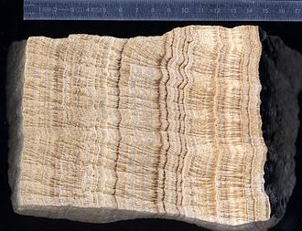

Slide 30
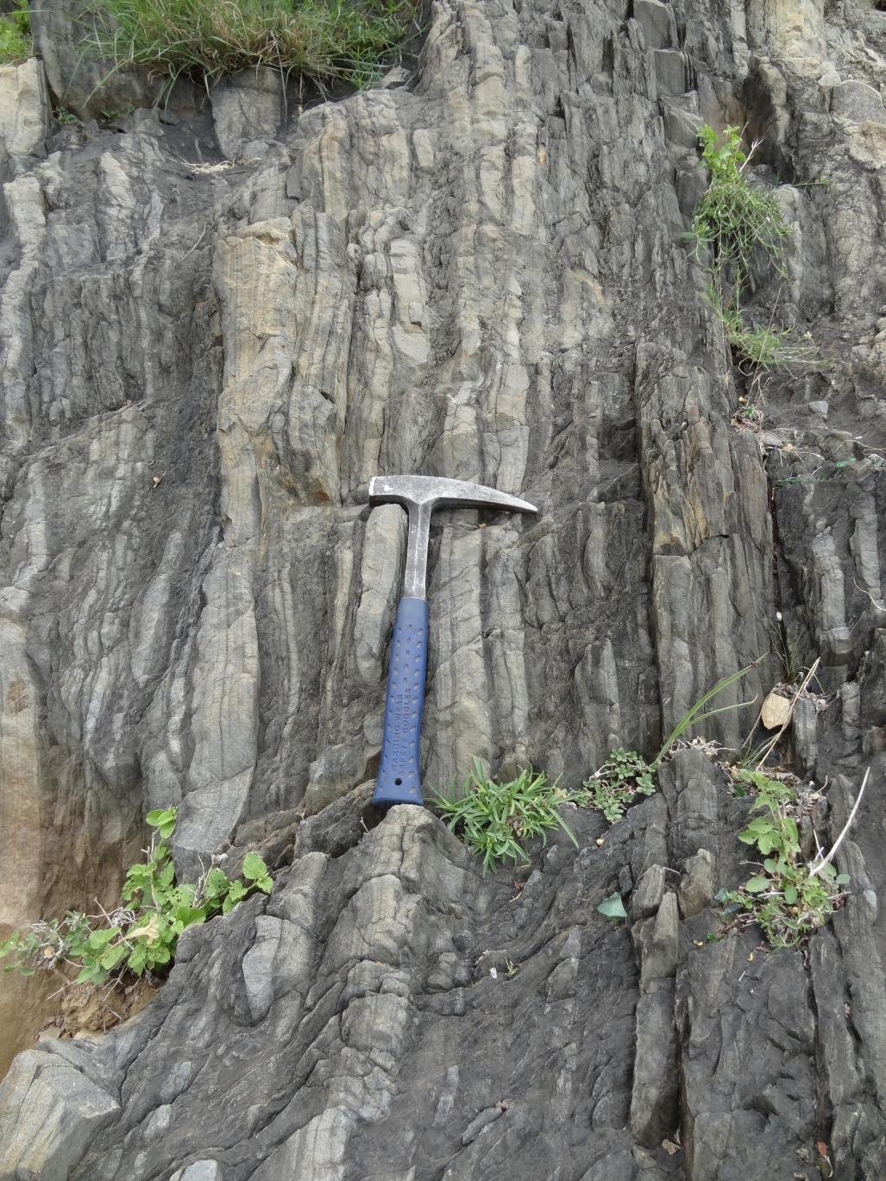

Slide 31
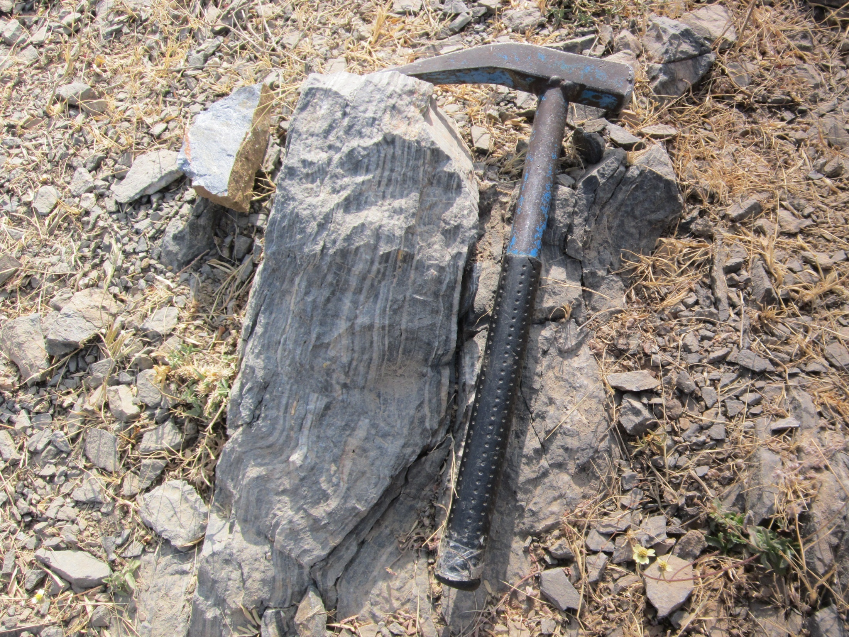

Slide 32
Lamination
The bedding, less than 1 centimeter in thickness, are called “Lamination”. Each bed which has 1 centimeter thickness is called “Lamina”. Lamination is usually found in very fined grained rocks.
In Lamination, parallel arrangements of minerals within a bed whereas Stratification refers to a succession of beds separated by bedding planes.

Slide 33
Graded Bedding
In graded bedding each bed represent a gradation in grain size from coarse to fine. The Graded Bedding result from rapid sedimentation in water. The largest particles are dropped first and then progressively finer particles are deposited.

Slide 34
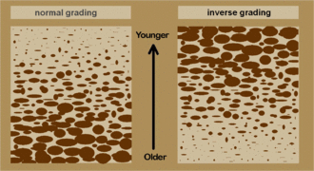
Used in determination of top and bottom of beds. Fine grains are show top and coarse grains are show bottom of beds.

Slide 35
Current Bedding
Current Bedding is also known as the “Cross Bedding”. In this structure minor beds or lamination lie at an angle. These minor beds commonly terminate abruptly at the top where they are overlain by the next current bedded deposit. Current bedding is commonly found in shallow water and wind formed deposits.

Slide 36
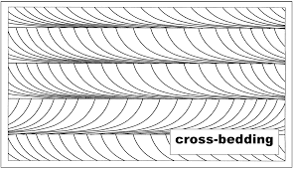
Used in determination of top and bottom of beds. The truncated side is top and tangential side is bottom.

Slide 37
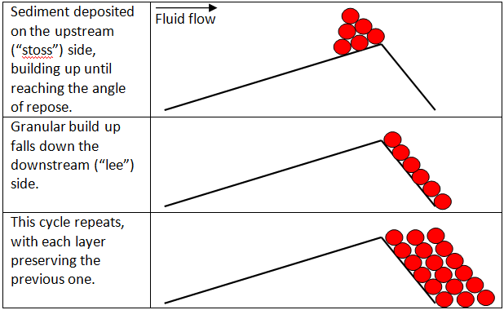

Slide 38
Ripple Marks
“Ripple Marks” are the wavy undulations seen on the surface of bedding planes. They are produced by the action of waves and current in shallow water. Ripple Marks are of two types:
Asymmetrical or Current Ripple Marks, and
Symmetrical or oscillation Ripple Marks

Slide 39
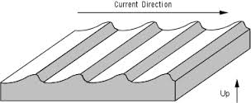
Used in determination of current direction where as the crests are dipping that the flow direction.

Slide 40
Mud - Cracks
“Mud - Cracks” are often found in the fine grained sedimentary rocks that have been exposed to drying under sub – aerial conditions. They are polygonal in plane. Used in determination of top and bottom of beds. Mud cracks are characteristic of the flood plains of large rivers. Mud Crack is also called is “Sun - Cracks”.

Slide 41
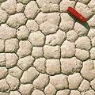

Slide 42
Rain Print
A “Rain Print” is a slight shallow depression rimmed by a low ridge which is raised by the impact of the rain drop. It is formed when a brief rain shower falls on a smooth surface of fine grained sediment.

Slide 43
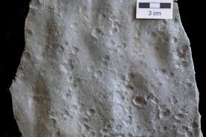

Slide 44
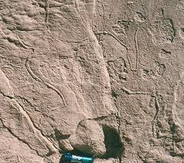
Tracks and Trails
“Tracks and Trails” are the markings indicating the passage of some animal over soft sediments.

Slide 45
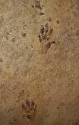

Slide 46
Thank
You

