Slide 1
Concepts of dip & strike
Presented By
HARISH KAPASYA
Department of Geology
Earth Science Faculty,
M.L. Sukhadia University
Udaipur

Slide 2
What is Dip……?
The angle of inclination of a rock bed with the horizontal plane is called “Dip”.

Slide 3
What is strike…?
The “Strike” is an imaginary line, which show the trend of rock bed or strata.

Slide 4
It is measured in plane perpendicular to the strike.
The amount of dip is the angle which varies from 0º to 90º according to the deposition of the bed.
The direction of dip is the geographical direction, along which a bed has maximum slope.
In case of horizontal beds, the dip is ‘zero’ degree and for a vertical beds, the dip is ‘90º’.

Slide 5
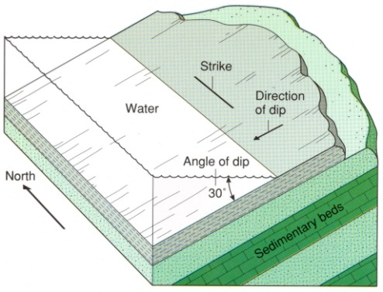

Slide 6
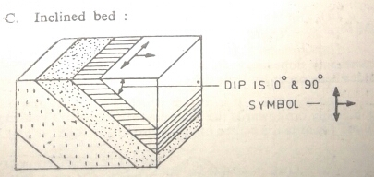
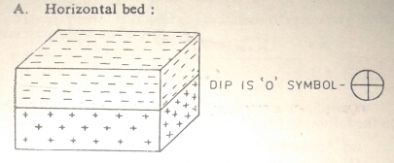
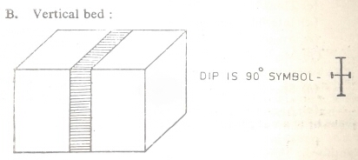
Accordingly, the symbolic representation of a horizontal and vertical bed in a map is also different, which may be seen from
the following figures:

Slide 7
Types of dip
There are two types of dip as
True Dip
Apparent Dip
True Dip:
It is the maximum amount of slope along a line perpendicular to the strike, in other words, it is the maximum slope with respect to the horizon.

Slide 8
Apparent Dip:
Along any direction other than that of the true dip, the gradient is scheduled to be much less and therefore it is defined as the apparent dip.
The apparent dip of any bed towards any direction must always be less than its true dip.

Slide 9
Relation between dip and strike:
The direction of dip and strike of any inclined bed must lie at right angles to each other.

Slide 10
Importance of strike and dip:
In structure geology, strike and dip are quite important for the following purpose:
To determine the younger bed or formation
It is well known that younger beds will always be found in the direction of dip. If we go in the direction of dip relatively beds of younger age will be found to outcrop and older beds in the opposite direction.

Slide 11
In the classification, and nomenclature of folds, faults, joints and unconformities the nature of dip and strike is of paramount significance.

Slide 12
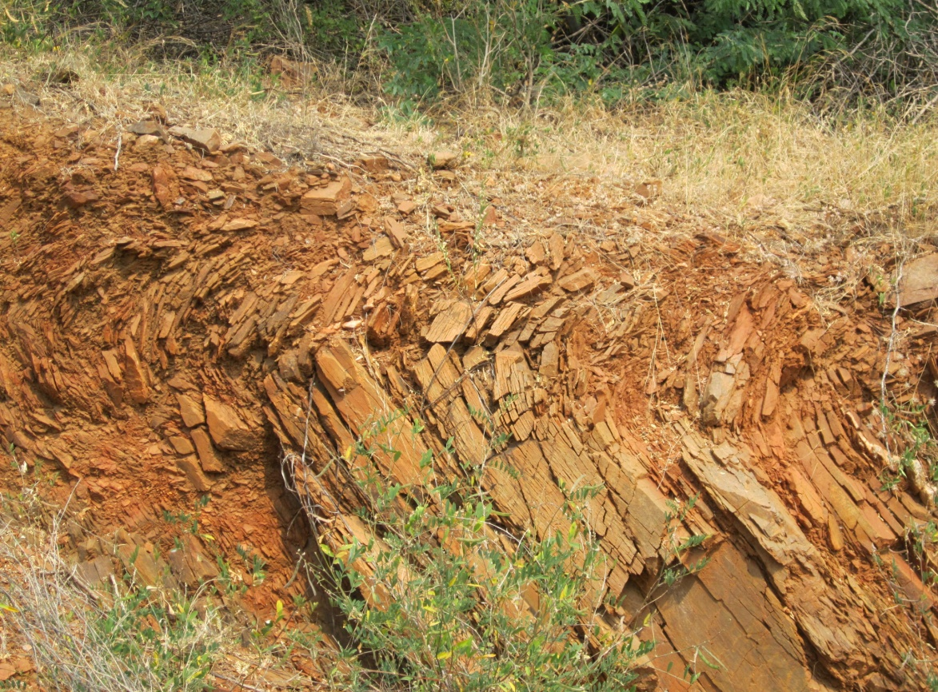
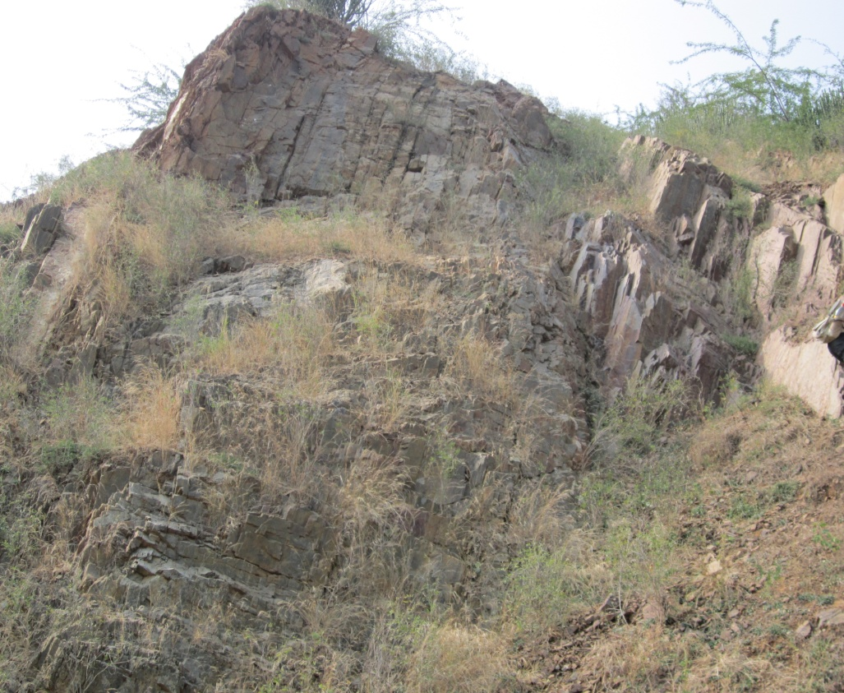
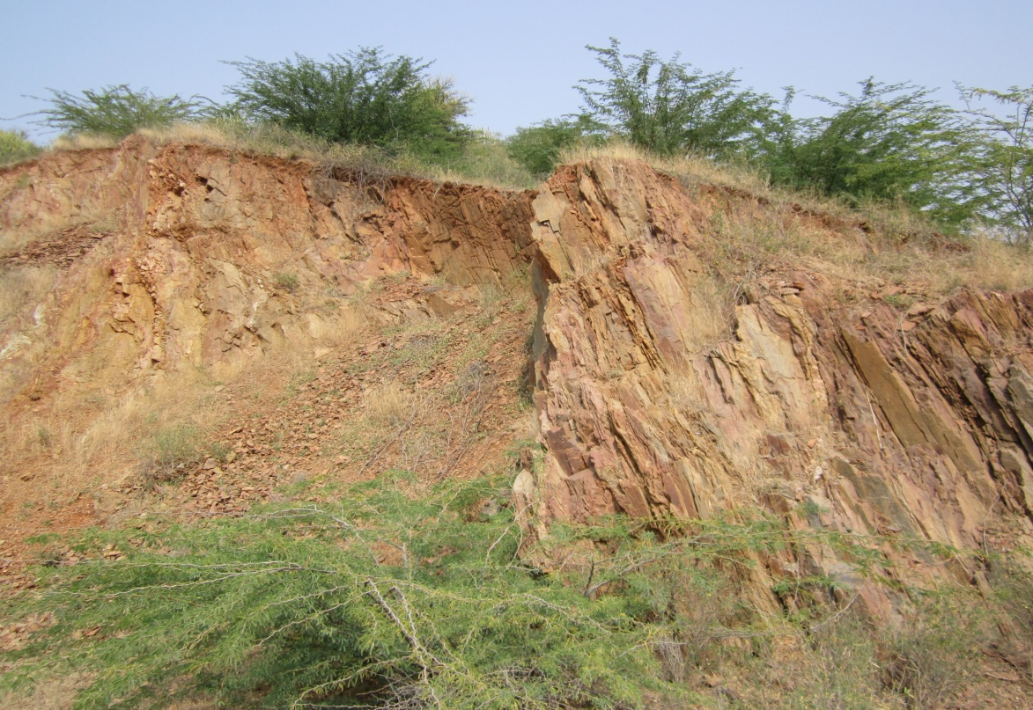
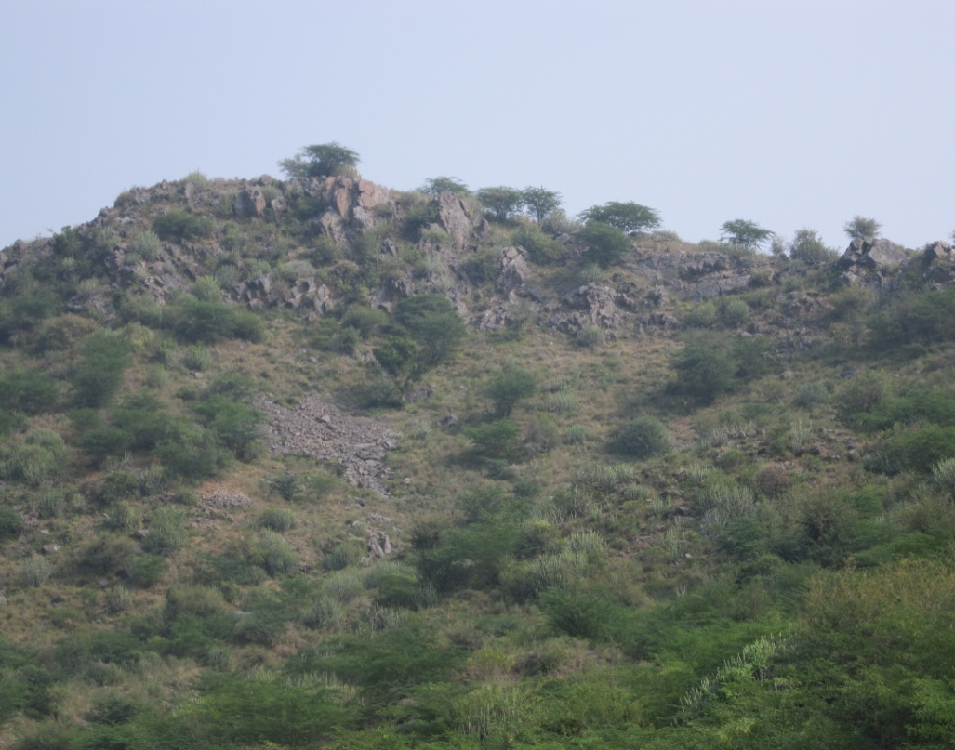

Slide 13
What is Structure Geology..?
“Structural Geology” is a branch of geology, in which detailed and systematic study of various structures which formed due to deformation on earth crust, also study of rocks which formed by magma and lava.

Slide 14
Relation with stratigraphy
Following features which related to stratigraphy:
Folding (Anticline & Syncline)
Faulting
Unconformities
Recumbent Fold

Slide 15
Relation with economic geology
Following features which related to economic geology:
Folding
Faulting
Unconformities

Slide 16
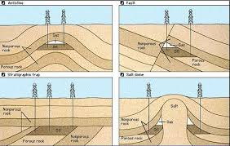
Relation with economic geology

Slide 17
Relation with engineering geology
Following features which related to engineering geology:
Dam
Tunnel
Bridge

Slide 18
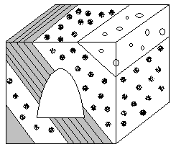
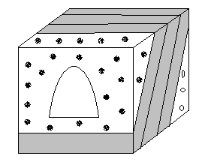
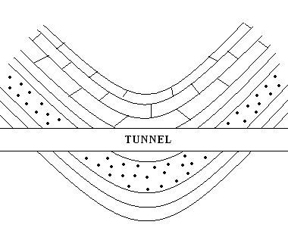
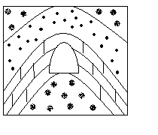

Slide 19
Relation with mining geology
Following features which related to mining geology:
Folding
Faulting
Unconformities

Slide 20
Relation with hydrology
Following features which related to hydrology:
Faulting
Joints
Fractures

Slide 21
Thank
You

