Slide 1
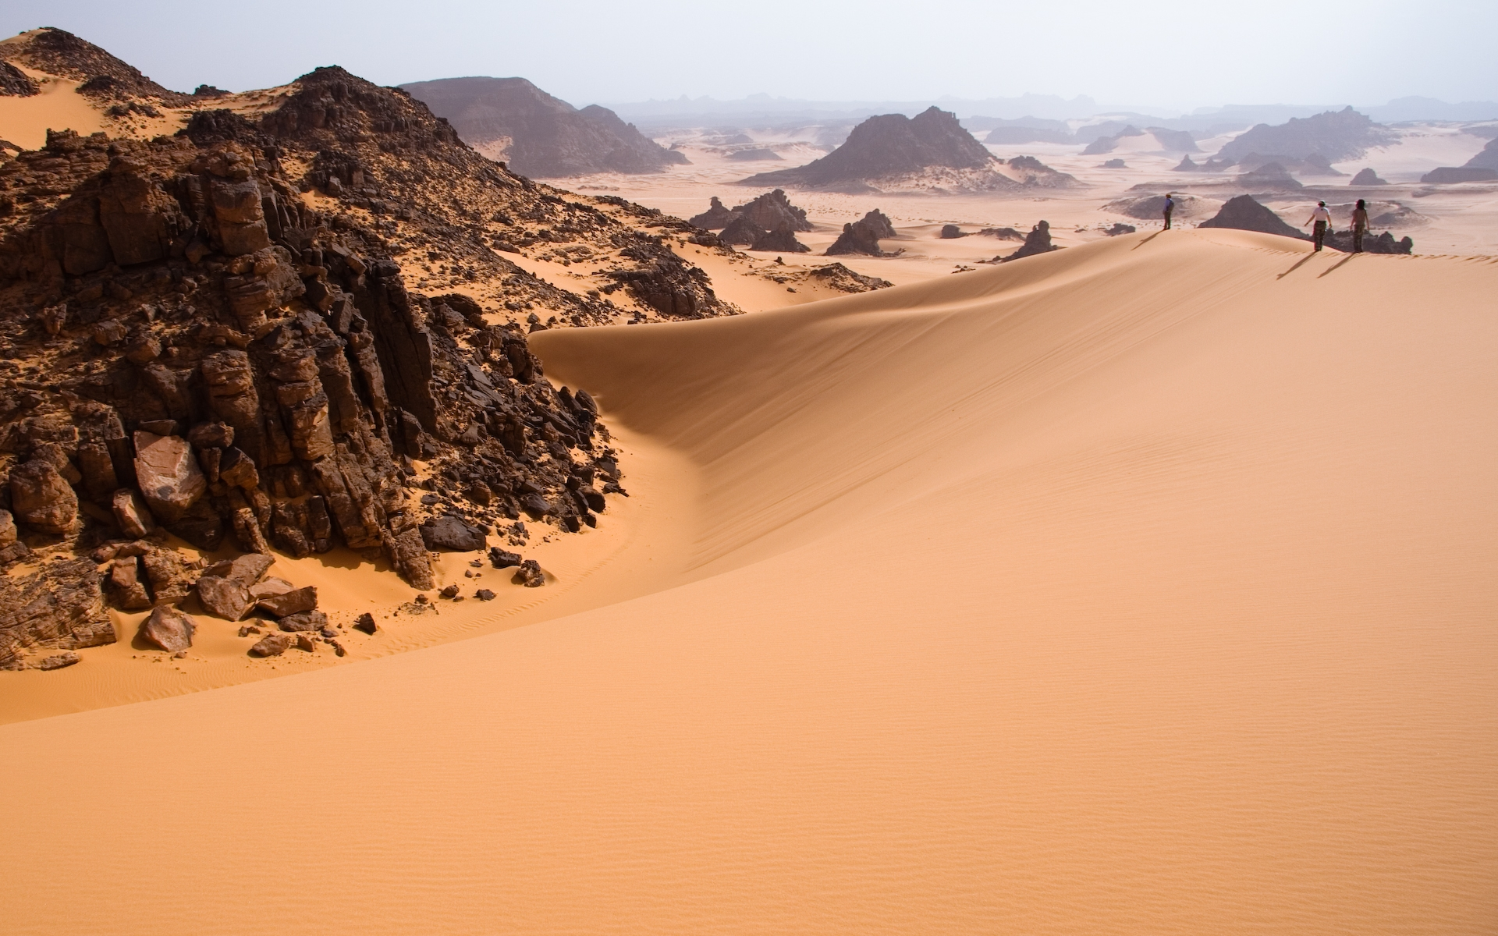
GEOLOGICAL WORK OF WIND
By
Dr. Harish Kapasya
Department of Geology
Udaipur

Slide 2
GEOLOGICAL WORK OF WIND
Atmosphere is composed mainly of gases that are collectively known as Air. Air in motion is called Wind.
The pressure difference so created makes the atmospheric gases (the air) to move from areas of high pressure to areas of low pressure in the form of winds.
During such a movement, wind may create temporary or semi permanent changes on the land surface.

Slide 3
These changes depending on wind volume, wind velocity, nature of the surface over which the wind blows, duration of time for which it blows and so on.
Wind acts as agent of erosion, as a carrier for transporting particles and grains so eroded from one place and also for depositing huge quantities of such wind blown material at different places.

Slide 4
Landforms developed through geological action of wind are known as “Aeolian, Eolian Landforms”.
These landforms are mostly developed in arid & semi – arid areas.
Those desert which are having mobile sands are known as “Ergs”.

Slide 5
Three principal modes of activity i.e.
Erosion
Transportation and
Deposition
Wind Erosion
Wind performs work of erosion by at least three different methods:
Deflation
abrasion and
attrition

Slide 6
Deflation
By itself, wind possesses not much erosive power over rocks or over the ground covered with vegetation.
But when moving with sufficient velocity over dry and loose sands or bare ground over dust, it can remove or sweep away huge quantity of the loose material from the surface.
This process of removal of particles of dust and sand by strong winds is called deflation. It is the main process of wind erosion in desert regions.

Slide 7
In fact, in some deserts, deflation may cause the removal of sand from a particular location to such an extent that a big enough depression is created, sometimes with its base touching the water table at quite a depth.
Such depressions are variously called blowouts when developed on a small scale and of shallower depth.
Much deeper and extensive depression where the water table is intersected and it gets partially filled up with water is called an OASIS.

Slide 8
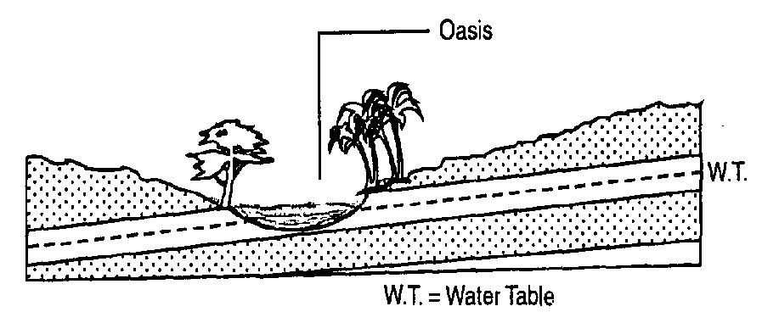

Slide 9
Slack is another term used for such depressions created by deflation.
The Quattara depression of western Egyptian is one of the biggest slacks. It is 300 km long and 150 km wide; its base is 130 m below sea level.
Another feature produced due to deflation is called a Hamada.
It is a bare rock surface in a desert from which thin cover of sand has been blown away by strong winds.
It is also called a desert pavement and may extend for considerable distance in a desert region.

Slide 10
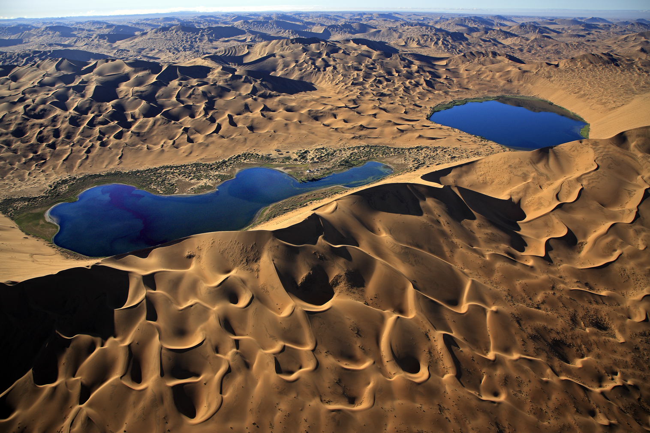

Slide 11
Abrasion
Abrasion is the mechanical scraping of a rock surface by friction between rocks and moving particles during their transport by wind, glacier, waves, gravity, running water or erosion.
This type of erosion involving rubbing, grinding, abrading and polishing the rock surfaces by any natural agent (wind, water or ice) with the help of its load while passing over the rocks is termed as abrasion.

Slide 12
Yardang
These are steep – sided deeply undercut overhanging rock ridges separated from one another by long grooves.
Yardangs are formed in areas where rocks of alternate hard and soft character are laying one above another with a general gentle slope.

Slide 13
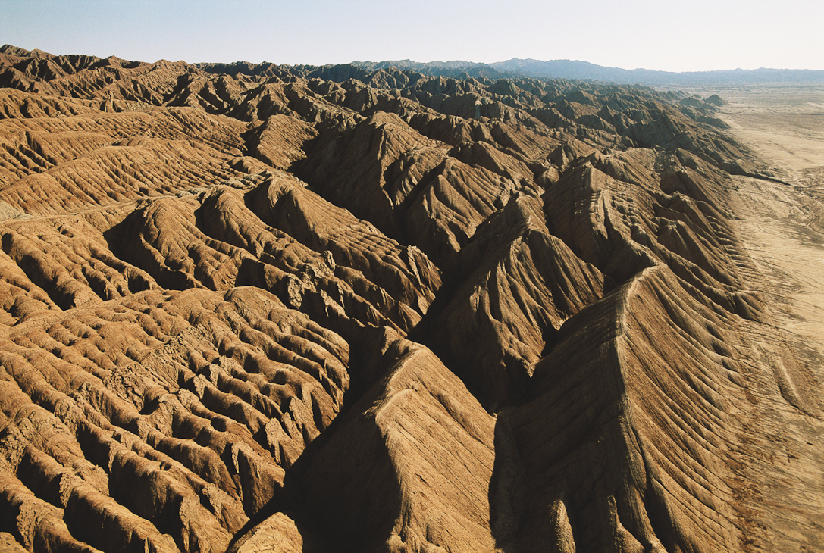

Slide 14
Pedestal rocks
These are pillar like rock masses with narrow base and wide rock caps Pinnacles are similar features with less prominent cap rock. These are produced by combined action of weathering, gravity and wind abrasion. However, it is the wind abrasion which is Pedestal rock mainly responsible for the formation of this pillar - like structures.

Slide 15
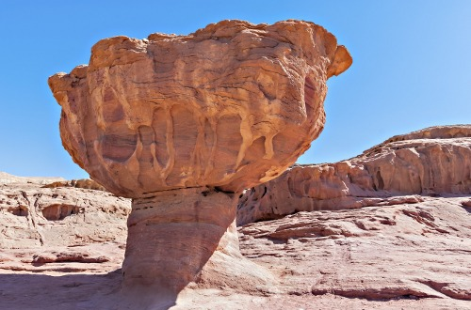

Slide 16
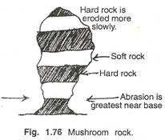

Slide 17
Ventifacts
These are small sized rock fragments showing one, two or three or even more typically win polished surfaces called faces. Polished and faceted rock fragments are called Ventifacts.
Wind blowing in a particular direction, produce smooth and flat surfaces.

Slide 18
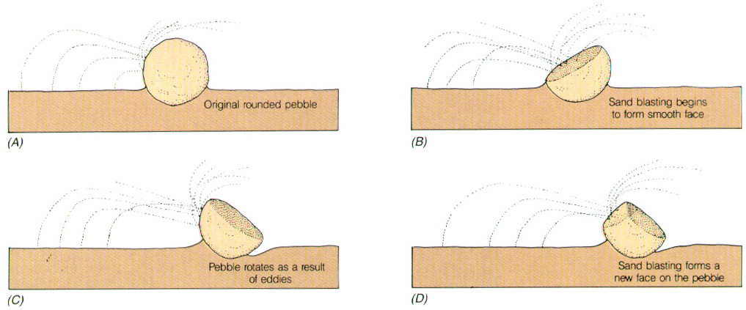

Slide 19
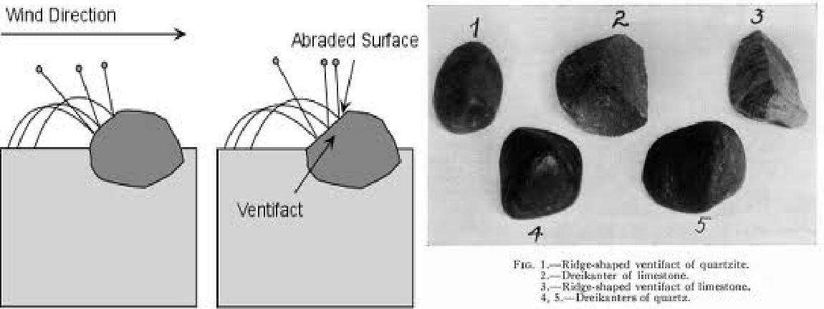

Slide 20
Desert pavement
In deserts and semi-deserts, the dust and finer particles of the weathered rocks are blown out by the wind, and heavier pebbles and rock fragments are left out. After long exposure to wind, the fragments and pebbles
become finely polished. This type of land surface is termed as desert pavement which is like a sea broken rocks.

Slide 21
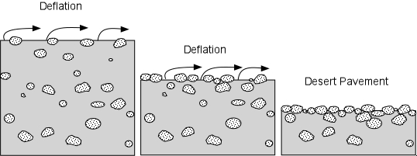
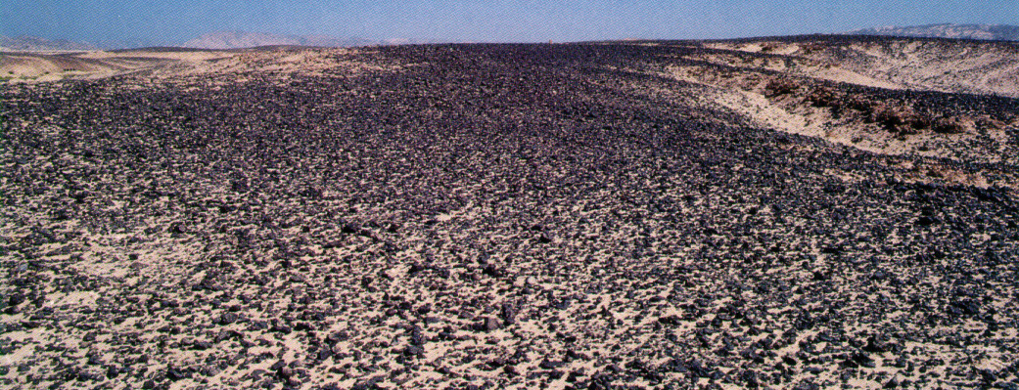

Slide 22
Attrition by wind
The wind-borne particles, traveling in suspension do often have the chance of colliding with one another. Such mutual collision amongst themselves causes a further grinding of the particles and the process is described as attrition. The three processes of erosion, namely deflation, abrasion and attrition generally operate simultaneously under favorable conditions and causes appreciable degradation of the landmass on which they work.

Slide 23
Wind Transportation
Observations made in the deserts and also in the laboratory show that loose particles are transported by wind in three ways
[1] Suspended load
[2] Saltation load and
[3] Traction load

Slide 24
1. The suspended load consists mainly of dust or clay sized particles, which are in continuous suspension due to the turbulence of the wind.
2. Most sand grains move forward in a series of leaps and jumps, commonly referred to as saltation. The sand grains bounce up into the air under the impact of another particle.
3. Some sand grains particularly the larger ones are unable to raise into the air due to their size even under the impact of other grains. They simply roll forward along the ground and this movement is called traction.

Slide 25
Wind Deposition
Whenever wind looses its velocity, the wind-borne particles are dropped back to the ground where they may accumulate to form wind deposits. Any obstacle in the path of the wind like boulders, hills, buildings etc. diverts the wind and causes the load to dropped resulting in the accumulation of the deposits.

Slide 26
The two main types of depositional features formed by the wind are
1] Sand dunes and
2] Loess.

Slide 27
Wind formed deposits of sand are commonly described as DUNES.
It is mound or a ridge of windblown sand that rises to a definite summit or crest. It shows a profile having a gentle windward slope and a steep leeward slope.
Many dunes grow to heights of 30m to 100m. As the wind blows over the sand dune, the sand grains roll along the wind ward slope towards the crest of the dune and they fall over onto the leeward slope.

Slide 28
The lee side thus, assumes an angle of repose for the sand grain, which is about 30˚ to 34˚. Thus, migration of a dune takes place by the transfer of sand from the windward side to the dune crest where the sand rolls or slides down the slip face onto the leeward side.
As the sand accumulation continues with periodic sliding of the sand grains along the slip face, the dune slowly migrates in the direction of the wind.

Slide 29
A dune may travel as much as 20m on an extremely windy day. Sand dunes are described according to their shape or form as
Barchan dune
Transverse dune
Parabolic dunes
Longitudinal dunes.

Slide 30
Barchans: These are small, isolated, crescentic shaped dunes formed when sand supply is limited and wind blows in a constant direction with moderate velocity. The wings or horns project in wind direction. The windward side is gentle sloping and convex while leeward side is steep and concave. These dunes are 1 to 50 meter high and about 300 meter long.

Slide 31
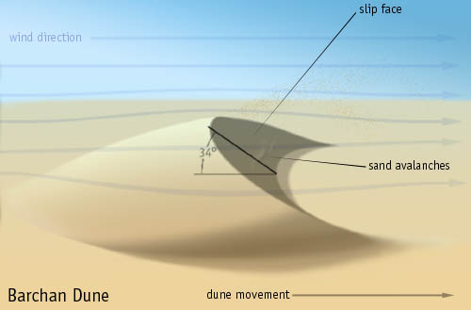

Slide 32
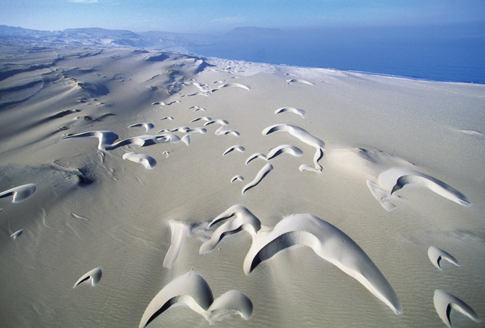

Slide 33
Transverse Dunes: Transverse dunes are developed when sand supply is large and wind direction is constant. These dunes are deposited in a wavelike form with their longer axis perpendicular to the wind direction.
Longitudinal Dunes: Large symmetrical ridges of sand formed parallel to the wind direction in the inner parts of desert. These dunes are developed when the strong prevailing wind from one direction is interrupted by occasional cross winds, converge and blow in constant direction with short sand supply. These are also known as Linear or Seif Dunes.

Slide 34
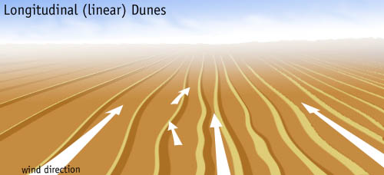

Slide 35
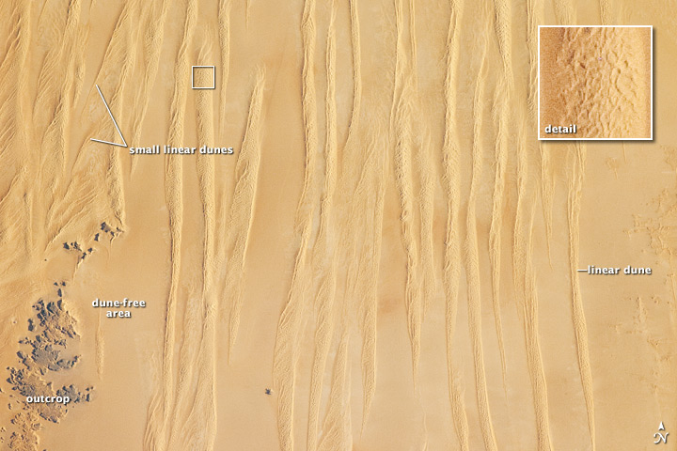

Slide 36
Parabolic Dunes: Parabolic dunes are parabolic or U-shaped in outline with their wings pointing in opposite direction of wind (upwind side) and crest curve downward. These dunes develop in partly stabilized sandy terrains where sand supply is large with steady wind direction. Hese develop around blow-outs and along coastlines. These are also known as Hair-pin dunes.
Star Dunes: Star dunes are the dunes with multiple slip faces, high central peak or several peaks extending three or more arms radially. Interference of air waves by the wind reflecting from mountain barrier results in the formation of star dunes. Star dune is also known as pyramidal dune or Rhourds.

Slide 37
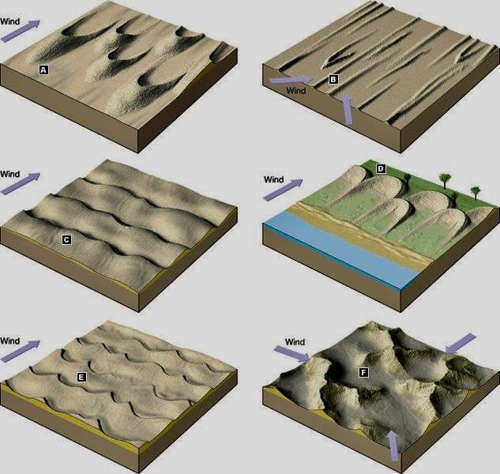
Barchans
B. Longitudinal
C. Transverse
D. Parabolic
E. Barchans +
Transverse
F. Star Dunes

Slide 38
Thank You

