Slide 1
Intracellular Transport

Slide 2
Eukaryotic cells have an elaborate membrane system.
This allow cell to
Endocytosis (form endosome by ‘coated pits’ and ‘caveolae’).
Exocytosis (by vesicle)
Pathway involves endosomes is called as “endocytic pathway”
Another outward process called “secretory pathway”.

Slide 3
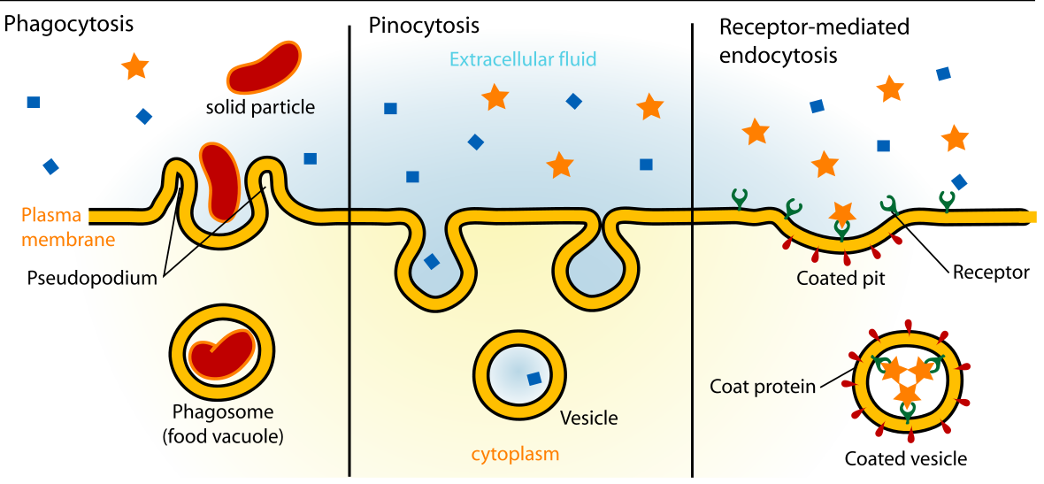
Cell surface
endosome
Lysosome
Endocytic pathway

Slide 4
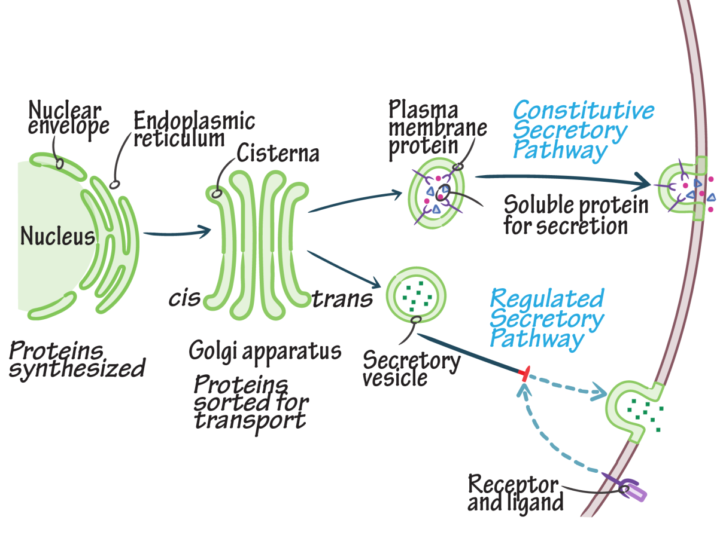
Golgi
Lysosome
Cell surface
Secretory vesicles
ER
Biosynthetic secretory pathway

Slide 5
Structure of Golgi complex
Components of golgi
Cisternae
Vesicles (smooth and coated)
Vacuoles/large vesicles

Slide 6
Protein trafficking
Protein synthesis on ER
Protein transfer from ER to Golgi
Retrograde transport (golgi to ER and ER to golgi)
Transport from cis-golgi to trans-golgi
Transport from trans-golgi network to lysosomes.
Transport from trans-golgi to cell surface

Slide 7
Protein synthesis
Initiation
Elongation
Termination

Slide 8
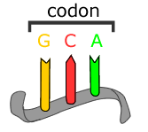
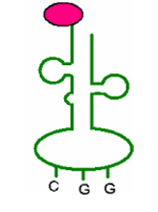
A series of three adjacent bases in an mRNA molecule codes for a specific amino acid—called a codon.
Each tRNA has 3 nucleotides that are complementary to the codon in mRNA.
Each tRNA codes for a different amino acid.
Amino acid
Anticodon

Slide 9
Initiation process

Slide 10
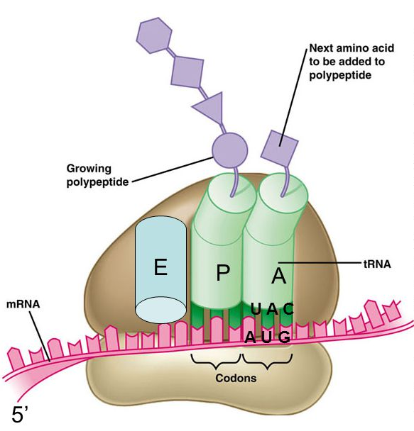
Protein synthesis

Slide 11
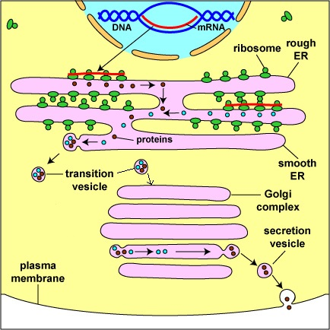

Slide 12
Signal recognition hypothesis
Protein synthesis begins on free ribosomes in cytoplasm.
Endomembrane protein have “signal sequence” that directs them to RER.
SRP (Signal recognition peptide) binds signal sequence when it pops out of ribosome and swaps GDP for GTP.

Slide 13
SRP stops protein synthesis until it binds “docking protein” (SRP receptor) in RER.
Ribosome binds translocon and secretes protein through as it is made.
BiP (a chaperone) helps the protein fold in the lumen.

Slide 14
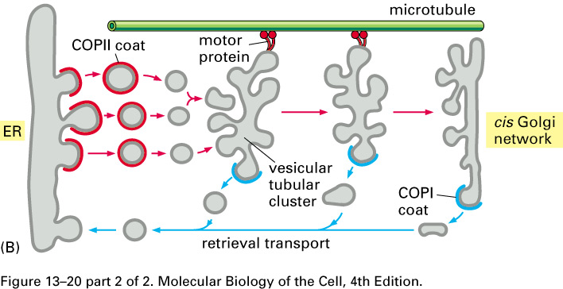
Transport from the ER to the Golgi
When the protein is properly folded, COPII coated vesicles transport the proteins via the vesicular tubular cluster (vtc) to the cis-Golgi network.
The COPII coating is removed (Sar1 hydolyzes GTP) and the vesicles fuse with each other to form the vtc.
The vtc is motored along microtubules that function like railroad tracks.
The vtc fuses with the cis-Golgi network.

Slide 15
THANKS

