Slide 1
Nuclear & Radiochemistry
Paper-Physical Chemistry
(BSc. I)

Slide 2
Nuclear chemistry is the sub discipline of chemistry that is concerned with changes in the nucleus of elements. These changes are the source of radioactivity and nuclear power.
Nucleons: two subatomic particles that reside in the nucleus known as protons and neutrons are called Nucleons.

Slide 3
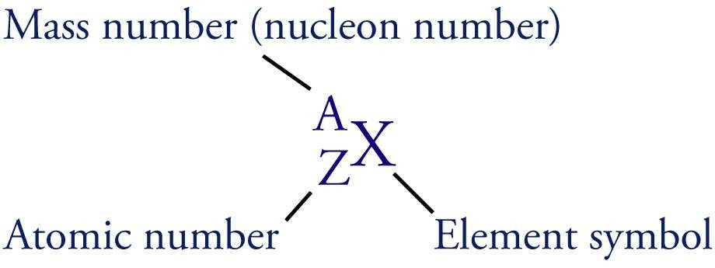

Slide 4
RADIOACTIVITY
Some atoms are unstable and it’s atomic nucleus breaks of its own accord to form a smaller atomic nucleus of another element. This causes the release of excess particles and energy from the original nucleus, which is called radiation.
The elements whose atomic nucleus emits radiation are said to be radioactive.
The spontaneous breaking down of the unstable atoms is termed Radioactive disintegration or radioactive decay.
The disintegration or decay of unstable atoms accompanied by emission of radiation is called Radioactivity.

Slide 6
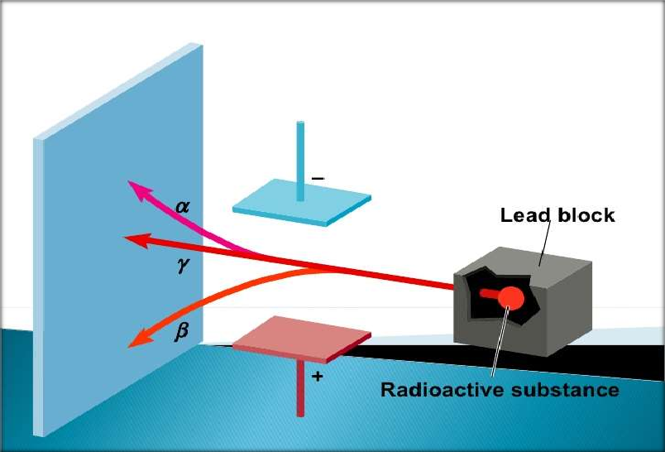

Slide 7
– Alpha emission (abbreviated as α):
emission of a
⁴ He
nucleus, or an alpha
2
particle, from an unstable nucleus.
– An example is the radioactive decay of radium-226
²²⁶ Ra→²²² Rn+⁴ He
88 86 2

Slide 8
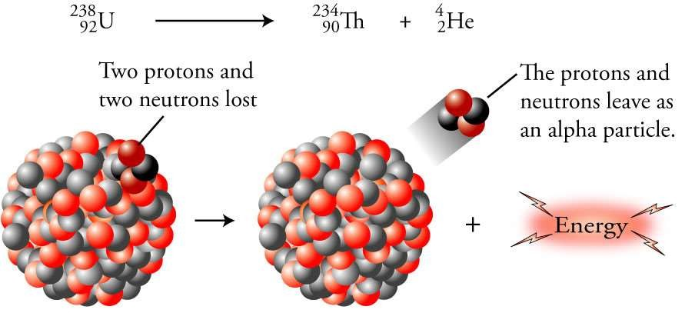

Slide 9
Beta emission (abbreviated β or β⁻): emission of a high speed electron from a stable nucleus.
neutron changes into proton & emits e⁻
¹ n ⇒ ¹ p + ⁰ e
0 1 -1
Daughter nuclide = parent nuclide atomic number plus 1
-1^{e-}
An example is the radioactive decay of carbon-14.
14 _{C→}14 _{N+} 0 _{β}
6 7 −

Slide 10
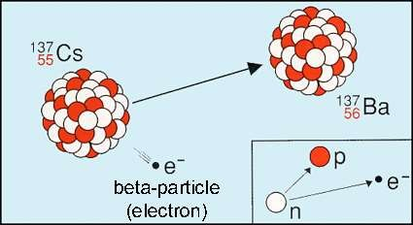

Slide 11
Gamma rays are unaffected by electric and magnetic fields.
⁰₀γ
They have been shown to be a form of electromagnetic radiation similar to x rays, but higher in energy and shorter in wavelength.

Slide 12
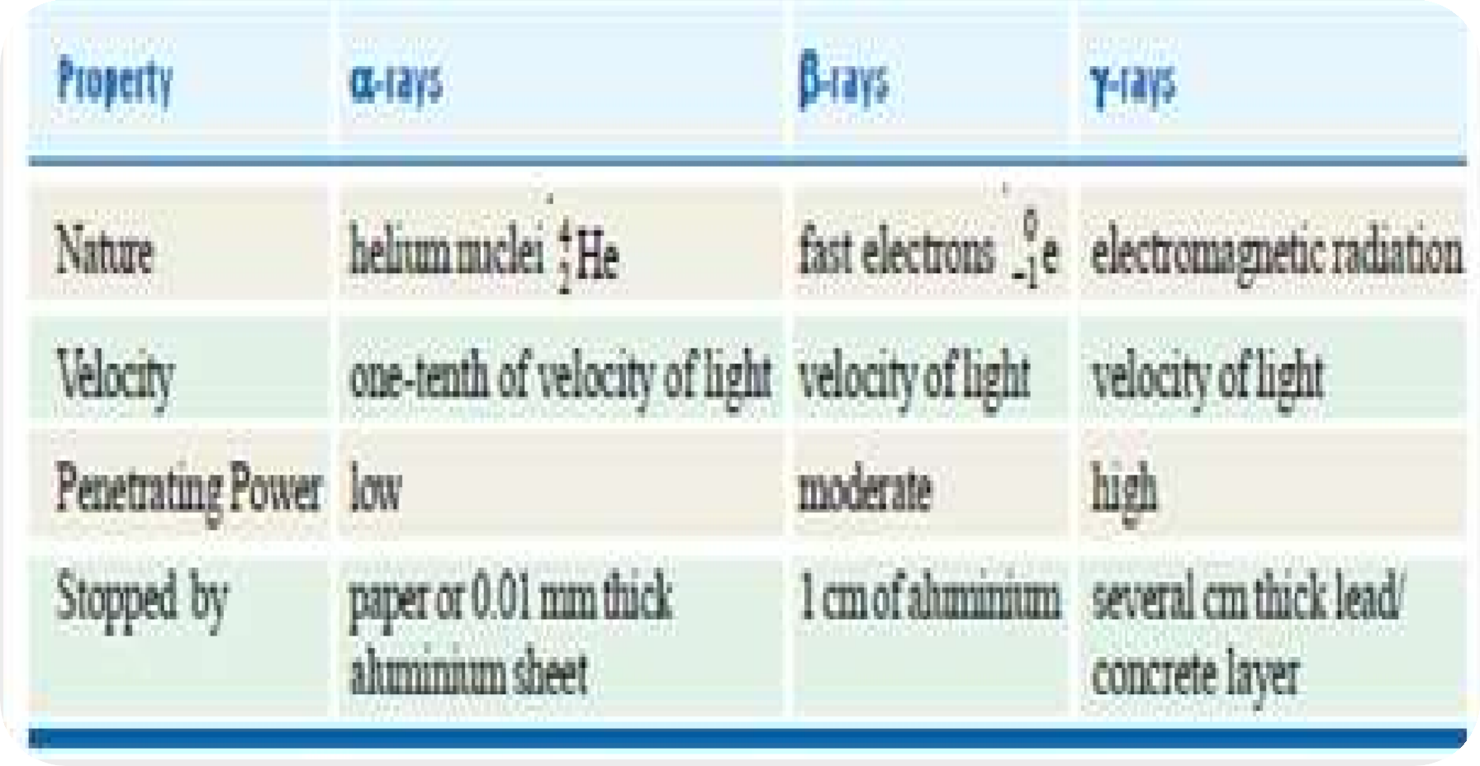

Slide 13
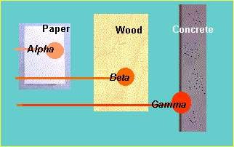

Slide 14
The decay of a radioactive isotope takes place by disintegration of the atomic nucleus. It is not influenced by any external conditions.
If N be the number of undecayed atoms of an isotope present in a sample of the isotope, at time t
,
….(1)
means the rate of decrease in the number of radioactive atoms in the sample;
and λ is the proportionality factor. This is known as the decay
constant or disintegration constant.

Slide 15
Putting dt = 1 in equation (1) we have
Thus decay constant may be defined as the proportion of atoms of an isotope decaying per second.

Slide 16
The atoms of an element which have the same number of protons and different number of neutrons are called Isotopes.
The atoms of an element which have the same atomic
number but different atomic masses or mass numbers.
Example :the isotopes of carbon (atomic number 6) having atomic masses 12 and 14 may be
written as 12 12
6 C or C or Carbon-12
14 14
6 C or C or Carbon-14

Slide 17
The atoms which have the same mass number but different atomic numbers are called isobars.
For example,
40 40 40
18 Ar, 19K, and 20Ca are isobaric atoms.
Similarly,
235 235 235
92 U, 93 Np, and 94 Pu are isobars.

Slide 18
Atoms which have different atomic number and different atomic masses but the same number of neutrons are called Isotones.
Examples of isotones
14 15 16
6 C, 7N and 8 O are isotones since each contains eight
neutrons.

Slide 19
The half-life, t½ ,of a radioactive nucleus is the time required for one- half of the nuclei in a sample to decay.
Half-life period is characteristic of a radioactive element.
The unit of half-life period is time– 1.

Slide 20
For example, half-life of radium is 1620 years. This means that 1g of radium will be reduced to 0.5 g in 1620 years and to 0.25g in further 1620 years; and so on.
Some other radioactive elements may have half-life of a fraction of a second and for others it may be millions of years.

Slide 21
Half life:
Here, λ is decay constant.
Example 1.Calculate the disintegration constant of cobalt 60 if its half-life to produce nickel – 60 is 5.2 years.

Slide 22
In a radioactive substance, some atoms decay earlier and others survive longer.
The statistical average of the lives of all atoms present at any time is called the Average life.
It is denoted by the symbol τ and has been
shown to be reciprocal of decay constant, λ.

Slide 23
The average life of a radioactive element is related to its half-life by the expression
Average life = 1.44 × Half-life
or τ = 1.44 × t1/2
The average life is often used to express the rate of disintegration of a radioactive element.
The average life of radium is 2400 years

Slide 24
Fajan, Russel and Soddy (1913) gave group displacement law which states that on the emission of an -particle the new element lies two columns left in the periodic table and mass number decreases by 4 units, and on the emission of -particle the new element lies one column right in the periodic table and mass number remains the same.
Due to the presence of many elements in the same
period of the same group.
To find number of a, b particles:
Number of a-particles =

Slide 25
Number of b-particles =
Example,

Slide 26
Let a radioactive substance A decay to give another radioactive substance B which decays to form substance C.
If λA and λB are the decay constants for the two changes, we can write
A ⎯λA→ B ⎯ λB→ C
The rate of disintegration of A is also the rate of formation of B. When the rate of disintegration of A (or formation of B) is equal to the rate of disintegration of B, the amount of B does not change with lapse of time..

Slide 27
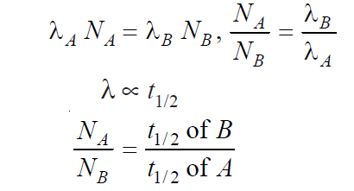
Then the radioactive equilibrium is said to be established between the substance A and the substance B.
At this Stage,
where NA and NB are atoms of A and B present at the equilibrium.

Slide 28
Geiger–Nuttall rule relates the decay constant of a radioactive isotope with the energy of the alpha
particles emitted. Roughly speaking, it states that short-lived isotopes emit more energetic alpha particles than long-lived ones.
In practice, this means that alpha particles from all alpha- emitting isotopes across many orders of magnitude of difference in half-life, all nevertheless have about the same decay energy.
where λ is the decay constant (λ = ln2/half-life), Z the atomic number, E the total kinetic energy (of the alpha particle and the daughter nucleus), and a1 and a2 are constants.

Slide 29
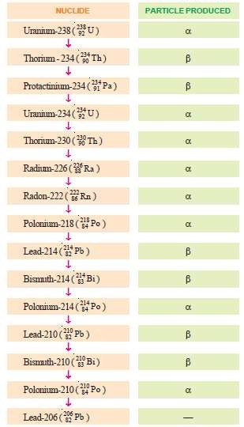

Slide 30
The actual dimensions of the nucleus present in the atom are called nuclear size.
Various experiments have been done to determine the size of nucleus (eg- Rutherford’s experiment).
The nuclear size can be determined as-
r = R_{o}A^{1/3}
Where r is the radius of nucleus and A is the mass no. of atom and R₀ is constant whose value is 1.5*10⁻¹³cm or 1.5*10⁻¹⁵m.
The nuclear radius is of order of 10⁻¹⁴, therefore very small.
It is measured in Fermi units.

Slide 31
Packing fraction is defined as a way of expressing the variation of isotopic mass from whole mass number (atomic mass).
This fraction can have positive or can have negative sign. A positive packing fraction describes a tendency towards instability. A
negative packing fraction means isotopic mass is less than actual mass number. This difference is due to the transformation of mass into energy in the formation of nucleus.

Slide 32
Atomic nucleus is made of protons and neutrons closely packed in a small volume. Although there exist intensive repulsive forces between the
component protons, the nucleus is not split apart.
This is so because the nucleons are bound to one another by very powerful forces.
The energy that binds the nucleons together in the nucleus is called the Nuclear binding energy.
When a nucleus is formed from individual protons and neutrons, there occurs a loss of mass (mass defect).

Slide 33
According to Einstein’s theory, it is this mass defect which is converted into binding energy.
Hence binding energy is the energy equivalent of the mass defect. The various nuclei have different binding energies.
Binding energy is a measure of the force that holds the nucleons together.
Hence an energy equivalent to the binding energy is required to disrupt a nucleus into its constituent protons and neutrons. Since the nuclear energy is of an extremely high order, it is not easy to fission a nucleus.

Slide 34
It depends on a variety of factors
Neutron to proton ratio
Strong nuclear force exists between nucleons. The more protons packed together the more neutrons are needed to bind the nucleus together.
Atomic nucleus with an atomic number up to twenty has almost equal number of protons and neutrons.
Nuclei with higher atomic numbers have more
neutrons to protons.
The number of neutrons needed to create a stable nucleus increase more than the number of protons.

Slide 35
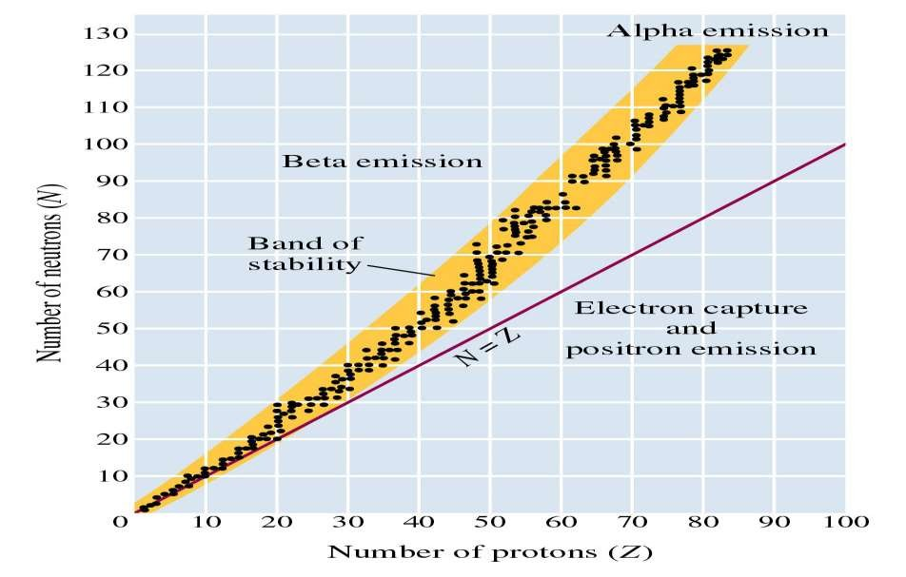

Slide 36
All nuclei with 84 or more protons are radioactive
Nuclei above the belt of stability These neutron rich isotope can lower their ratio and move to the belt of stability by emitting a beta particle. This increases number of protons and decreases neutrons.
Nuclei below the belt of stability These proton rich nuclei increase their neutrons and decrease protons by positron emission (more common in lighter nuclei) and electron capture (more common in heavier nuclei)
Nuclei with atomic numbers greater than 84 These tend to undergo alpha emission. This emission decreases the number of neutrons and protons by 2 moving the nucleus diagonally toward the belt of stability.

Slide 37
In 1939, Hahn and Stassmann discovered that a heavy atomic nucleus as of uranium-235 upon bombardment by a neutron splits apart into two or more nuclei.
U-235 first absorbs a neutron to form an unstable ‘compound nucleus’.
The excited ‘compound nucleus’ then divides into two daughter nuclei with the release of neutrons and large amount of energy.

Slide 38
The splitting of a heavy nucleus into two or more smaller nuclei is termed nuclear fission.
The smaller nuclei formed as a result of fission are called fission products.
The process of fission is always accompanied by the ejection of two or more neutrons and liberation of vast energy.

Slide 39
The fission of U-235 occurs in about 35 ways.
Two of these are given below in the form of equations.
235 1 139 94 1
92 U + 0n ⎯⎯→ 56Ba + 36Kr + 3 0n + energy
235 1 106 128 1
92 U + 0n ⎯⎯→ 42Mo + 50Sn + 2 0n+energy

Slide 40
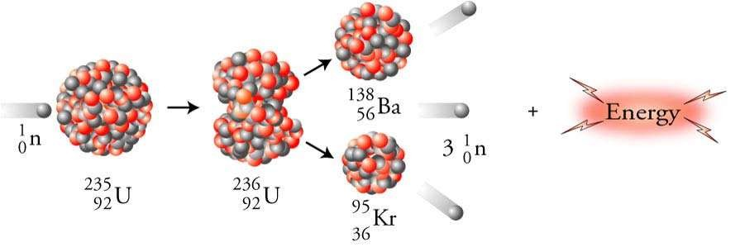

Slide 41
This process is opposite of nuclear fission.
Nuclear fusion may be defined as :
the process in which two light- weight nuclei combine or fuse to form a single heavier nucleus.
In a fusion reaction, the mass of the reacting nuclei is greater than that of the nucleus formed.

Slide 42
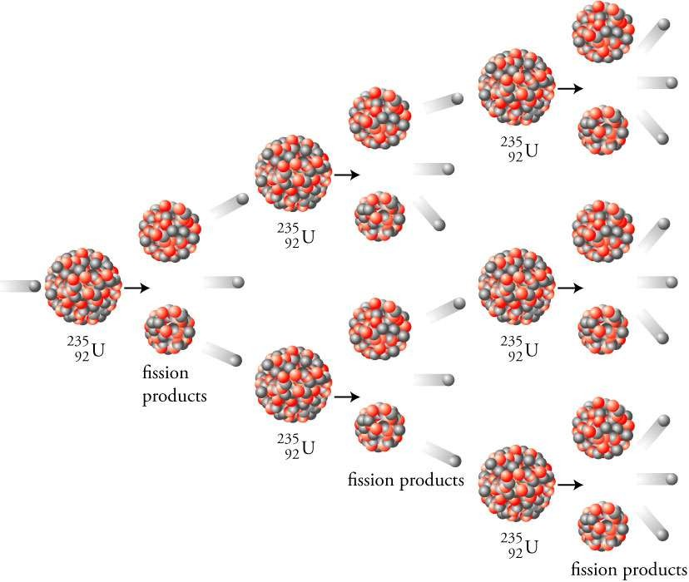

Slide 43
The differential mass is manifested in the great amount of energy released in the reaction.
For example,
3 |  | 1 |  | 4
1H | + | 1H | ⎯⎯→ | 2He + energy
3.01495 |  | 1.00782 | 4.00260
amu |  | amu | amu

Slide 44
Let us explain the mechanism of fusion by taking the example of the fusion of deuterium ²H cited above.
At extremely high temperatures, 100 million °C or more, atoms do not exist as such. At these temperatures, deuterium atoms are completely stripped of orbital electrons.

Slide 45
Thus results a system containing positive nuclei and electrons, called plasma. In this state, the high kinetic energy of the nuclei can overcome electrostatic repulsions between them.
The nuclei collide with such great force that they merge or fuse to form larger nuclei.

Slide 46
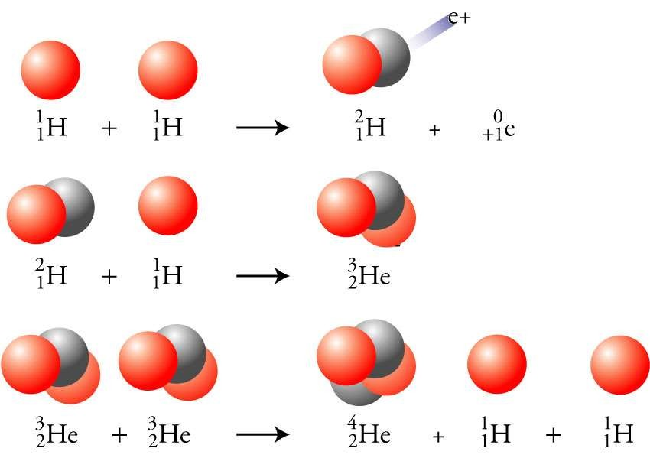

Slide 47
The energy released by the sun results from a series of nuclear fusion reactions.
The overall reaction consists of the fusion of four hydrogen nuclei (protons) to form helium nucleus. One mechanism suggested for the process is:
1 1 2 0
1H + 1H ⎯⎯→ 1H + 1 e
2 1 3
1 H + 1H ⎯⎯→ 2He
3 1 4 0
2H + 1H → 2He + 1e
1 4 0
Overall
4 1H → 2He + 2 1 e (positrons)

Slide 48
The fusion reactions in the sun take place at exceedingly high temperatures-greater than 40 million °C.
Every second the sun loses 4.3 × 109 kg (4, 20,000 tons) of mass by the fusion reactions. This mass is converted to energy.
But the total mass of the sun is so great that its loss of mass is imperceptible.
It is hoped that the sun will continue to pour energy on the earth for billions of years.

