Slide 1
DEPARTMENT OF PSYCHOLOGY,
UCSSH, MLSU
Unit 2- Variables, Probability and Hypothesis Testing
Variables: IV, DV, and extraneous variables.
Hypothesis- definition, characteristics, types; Hypothesis testing (Type I & type II errors).
Concept of Probability, Normal Probability Curve, Characteristics of the Curve.

Slide 2
VARIABLES
Something that may or does vary or change; a variable feature or factor
A variable is any property, a characteristic, a number, or a quantity that increases or decreases over time or can take on different values (as opposed to constants, such as n, that do not vary) in different situations.
Any person, object, situation or event that varies in its value and that variation is measurable.

Slide 3
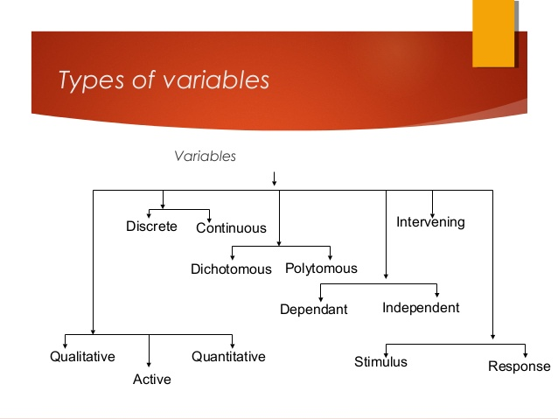
TYPES OF VARIABLES

Slide 4
Qualitative And Quantitative Variables
Qualitative Variables: Sometimes referred to as “categorical” variables, these are variables that take on names or labels and can fit into categories. Examples include:
Eye color (e.g. “blue”, “green”, “brown”)
Gender (e.g. “male”, “female”)
Quantitative Variables: Sometimes referred to as “numeric” variables, these are variables that represent a measurable quantity. Examples include:
Number of students in a class
Number of square feet in a house
Population size of a city

Slide 5
Discrete and Continuous Variables
Discrete variables- A discrete variable is a type of statistical variable that can assume only fixed number of distinct values and lacks an inherent order.
Also known as a categorical variable, because it has separate, invisible categories. Eg- Number of road accidents in New Delhi, Number of siblings of an individual.
Continuous variable, as the name suggest is a random variable that assumes all the possible values in a continuum. Eg- Height of a person, Age of a person

Slide 6
Dichotomous and Polytomous
A categorical variable that can take on exactly two values is termed a binary variable or a dichotomous variable. Eg- head and tail, yes no, pass fail, dead alive etc.
Categorical variables with more than two possible values are called polytomous variables.

Slide 7
Independent and Dependent
Independent variable is one which is manipulate by the researcher. It is also known as cause
Dependent variable is the one which gets changed due to the changes in independent variable. It is also known as effect

Slide 8
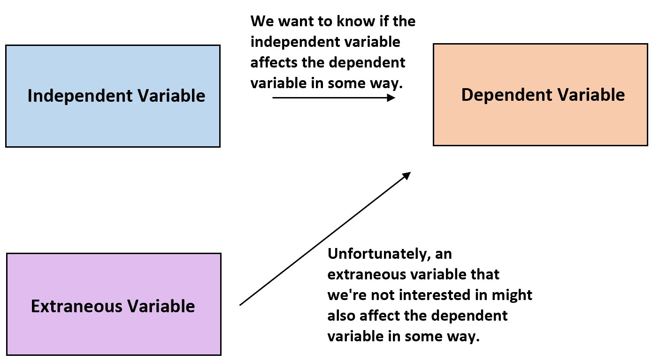
Intervening, controlled, extraneous
Controlled variables are those potential independent variables which can cause effect but the researcher don’t want to study their effect that’s why the effect is controlled.
Extraneous Variable -An extraneous variable is any variable you’re not interested in studying that could also have some effect on the dependent variable.

Slide 9
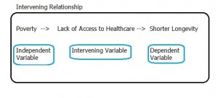
Intervening, controlled, extraneous cntd…
The term intervening was first used for variables by behavioral psychologist Edward C. Tolman in 1938 during studies on rat behavior for food rewards. He suggested that hunger was an intervening variable (it could not be observed during the actual experiments). Tolman’s work on intervening variables was an extremely important contribution to cognitive psychology as the concept made it possible to consider and measure unseen behaviors. Source: (a2zpsychology.com, 2002)

Slide 10
Stimulus and Response
Stimulus- Any event, activity , person which can stimulate the behavior is called stimulus.
Response- any reaction given towards the stimulus is called as response.
S-O-R formula of behavior.

Slide 11
Hypothesis
Hypothesis..
Hypotheses..
What is the difference..?

Slide 12
Meaning, Definition
Hypothesis Definition in Statistics
In Statistics, a hypothesis is defined as a formal statement, which gives the explanation about the relationship between the two or more variables of the specified population. It helps the researcher to translate the given problem to a clear explanation for the outcome of the study. It clearly explains and predicts the expected outcome. It indicates the types of experimental design and directs the study of the research process.
Types of Hypothesis
The hypothesis can be broadly classified into different types. They are:
Simple Hypothesis
A simple hypothesis is a hypothesis that there exists a relationship between two variables. One is called a dependent variable, and the other is called an independent variable. It may be positive or negative.
Complex Hypothesis
A complex hypothesis is used when there is a relationship between the existing variables. In this hypothesis, the dependent and independent variables are more than two.
Null Hypothesis
In the null hypothesis, there is no significant difference between the populations specified in the experiments, due to any experimental or sampling error. The null hypothesis is denoted by H₀.
.

Slide 13
Meaning, Definition
Alternative Hypothesis
In an alternative hypothesis, the simple observations are easily influenced by some random cause. It is denoted by the H_{a} or H₁.
Empirical Hypothesis
An empirical hypothesis is formed by the experiments and based on the evidence.
Statistical Hypothesis
In a statistical hypothesis, the statement should be logical or illogical, and the hypothesis is verified statistically.
Apart from these types of hypothesis, some other hypotheses are directional and non-directional hypothesis, associated hypothesis, casual hypothesis.

Slide 14
Characteristics
Characteristics of Hypothesis
The hypothesis should be short and precise
It should be specific
A hypothesis must be related to the existing body of knowledge
It should be capable of verification

Slide 15
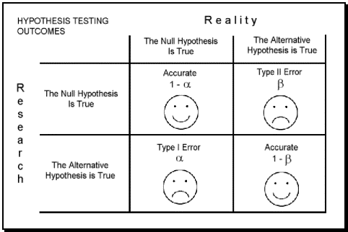
Hypothesis testing (Type-I and Type-II error)

Slide 16
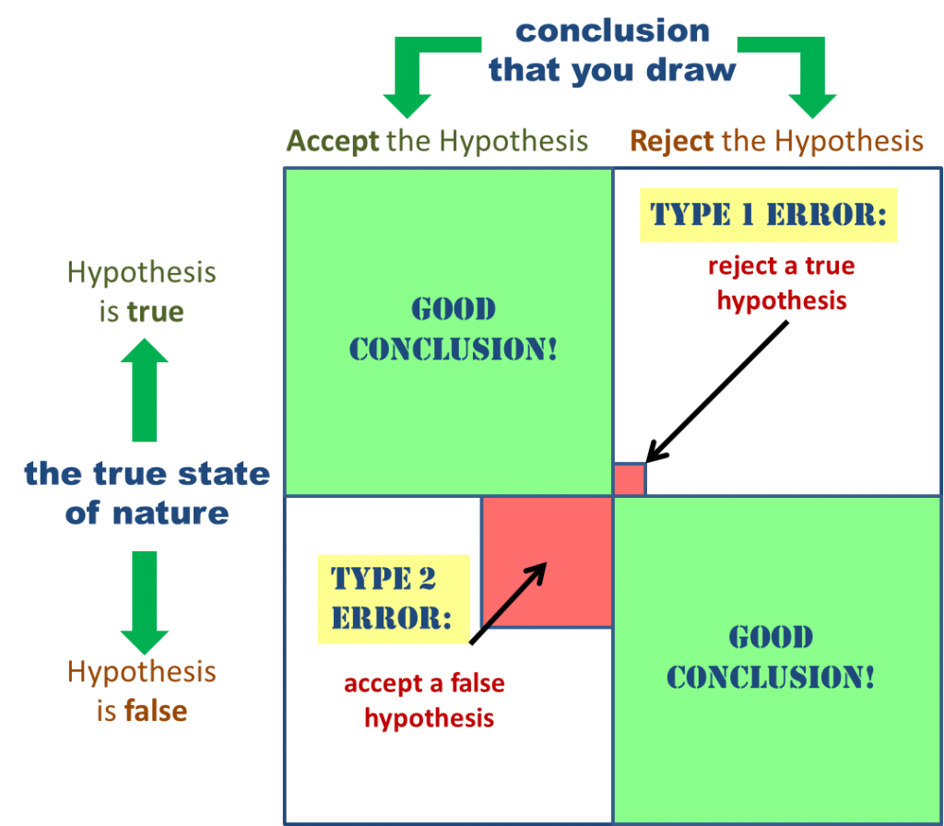
Hypothesis testing (Type-I and Type-II error)

Slide 17

Concept Of Probability
Probability is the number of possibility of occurrence of any event.
In context of sampling the equal chance of selection of each unit from the population into the sample.

Slide 18
Normal Probability..
What is Normal Distribution?
Normal distribution, also known as the Gaussian distribution, is a probability distribution that is symmetric about the mean, showing that data near the mean are more frequent in occurrence than data far from the mean. In graph form, normal distribution will appear as a bell curve.

Slide 19
Normal Probability Curve/ Bell Shaped Curve
A bell curve is the informal name of a graph that depicts a normal probability distribution. The term obtained its name due to the bell-shaped curve of the normal probability distribution graph.

Slide 20
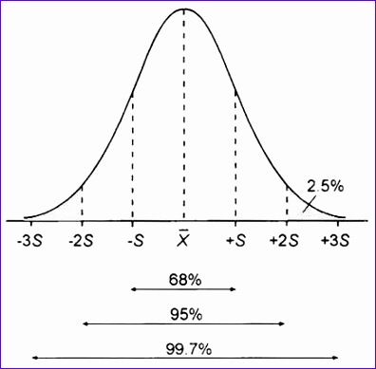

Slide 21
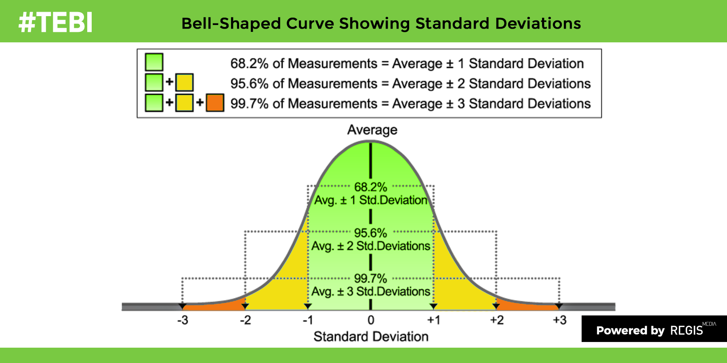

Slide 22
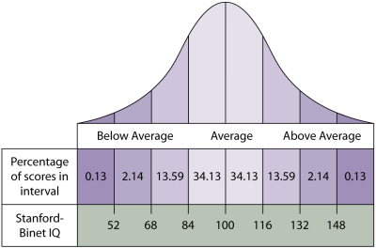

Slide 23
