Slide 1
DEPARTMENT OF PSYCHOLOGY, UCSSH, MLSU
UNIT-I
TOPICS-RESEARCH PROCESS: MEANING, TYPES OF RESEARCH, SCIENTIFIC RESEARCH, STEPS INVOLVED IN RESEARCH PROCESS,FORMULATION OF RESEARCH PROBLEM, FORMULATION OF A RESEARCH PROBLEM, FORMULATION OF A RESEARCH PROBLEM, LITERATURE REVIEW, RESEARCH DESIGN, ETHICAL ISSUES FOR RESEARCH

Slide 2
RESEARCH
“research is a systematic inquiry to describe, explain, predict, and control the observed phenomenon. It involves inductive and deductive methods.”

Slide 3
What is the purpose of research?
There are three main purposes:
Exploratory: researchers conduct exploratory studies to explore a group of questions. It is undertaken to handle new problem areas that haven’t been explored before. This exploratory process lays the foundation for more conclusive data collection and analysis.
Descriptive: It focuses on expanding knowledge on current issues through a process of data collection. Descriptive studies describe the behavior of a sample population. Only one variable is required to conduct the study. The three primary purposes of descriptive studies are describing, explaining, and validating the findings..
Explanatory: Explanatory or causal research is conducted to understand the impact of specific changes in existing standard procedures.

Slide 4
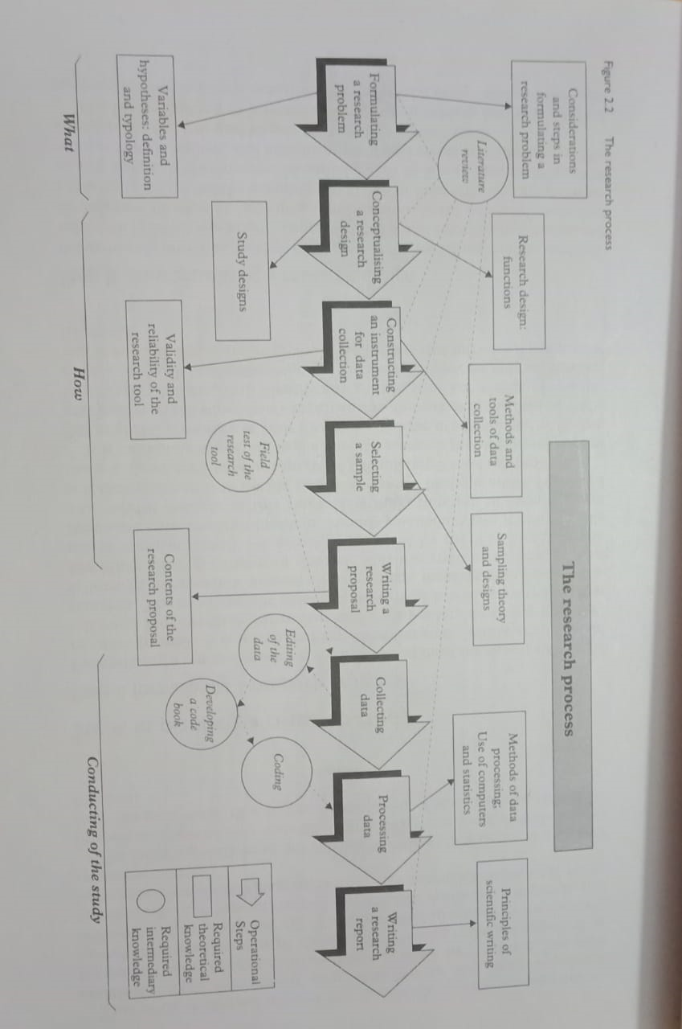
Source: Research Methodology( Ranjit Kumar)

Slide 5
Research Problem
A research problem is a specific statement about any issue, difficulty, contradiction, or gap in knowledge that can be addressed in any research. Research Problems are aimed at contributing to change, solution of existing problem situation, theoretical problems aimed at expanding knowledge.

Slide 6
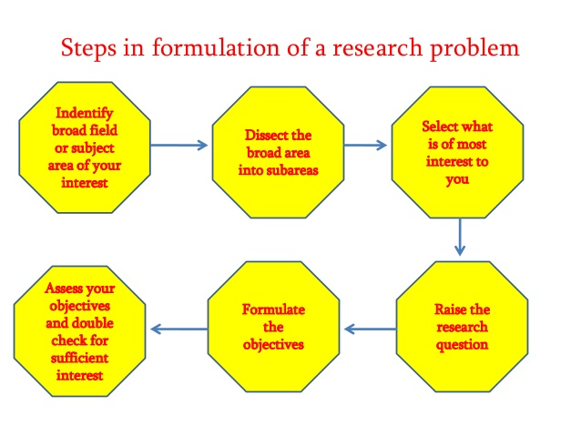
Formulation of a Research Problem

Slide 7
Characteristics of a good problem
Is the study related to current situation?
Does your field of study have enough scope to conduct the research?
Will you be able to find a solution to the issue through the investigation?
Will the research add value on a scientific or social level?
Can the data needed to conduct the analysis be gathered easily?
Is the research problem important for the upliftment of society?
Are you skilled enough to conduct the study?

Slide 8
Literature Review
Literature review is the process of scientifically reviewing the research work already done in the proposed research.
It is a survey of scholarly articles from the sources like books, journals, theses etc.
It includes the evaluation of the available research work.

Slide 9
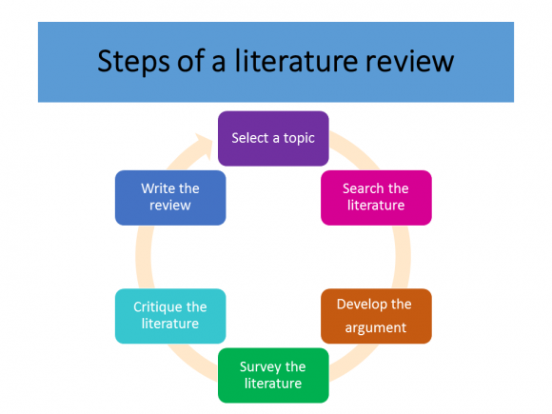

Slide 10
Research ethics
It indicates the standards of conduct for scientific researchers
It provides guidelines for the responsibilities for the conduction of research with ethical code of conduct.

Slide 11
Ethical issues of research
Five principles for research ethics by APA
Discuss intellectual property frankly.
Be conscious of multiple roles. APA's Ethics Code
Follow informed-consent rules.
Respect confidentiality and privacy.
Tap into ethics resources

Slide 12
