Slide 1
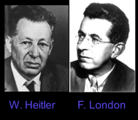
Valence Bond Theory 1927 Heitler and London introduced this theory.
Walter Heitler- German physicist
2 January 1904 – 15 November 1981= 77 Yrs
He brought chemistry under quantum mechanics through his theory of valence bonding.
Fritz London-

Slide 2
Fritz London-
One of the most distinguished scientists on the Duke University faculty, was an internationally recognized theorist in Chemistry, Physics and the Philosophy of Science.
He was born in Breslau, Germany (now Wroclaw, Poland) in 1900. In 1933 he was forced to resign his post at the University of Berlin by the advent of the Nazi regime. He left Germany for England, then for France where he was appointed "Maitre de Recherches" at the College de France (later becoming "Directeur de Recherche’).
He immigrated to the United States in 1939, and came to Duke University, first as a Professor of Chemistry. In 1949 he received a joint appointment in Physics and Chemistry and became a James B. Duke Professor. In 1953 he became the 5th recipient of the Lorentz medal, awarded by the Royal Netherlands Academy of Sciences, and was the first American citizen to receive this honor. He died in Durham in 1954. (Lived 54 Yrs)

Slide 9
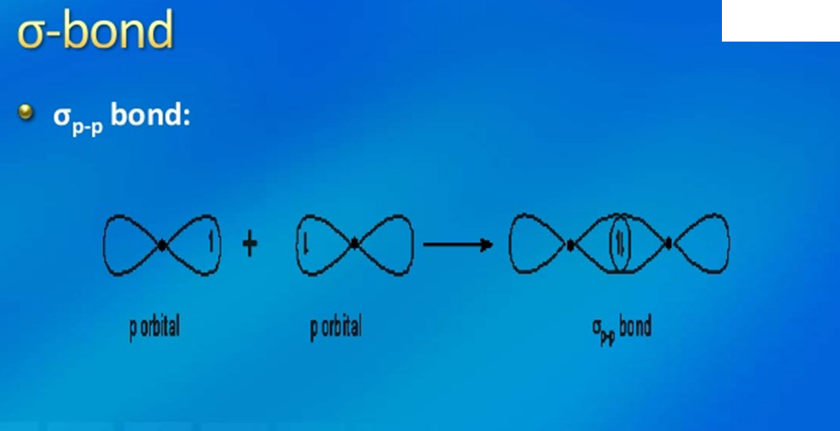

Slide 12
Applications of VBT

