Slide 1
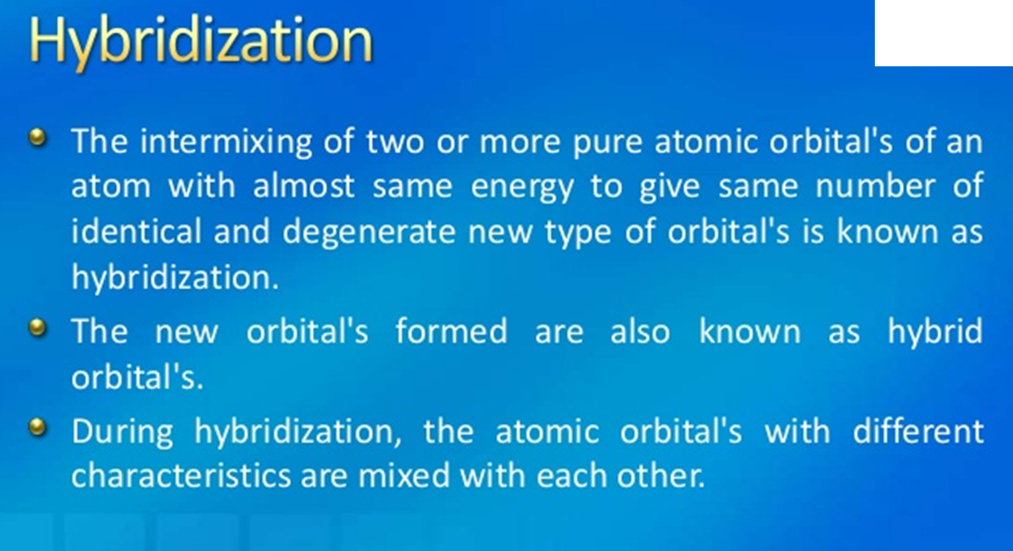

Slide 2
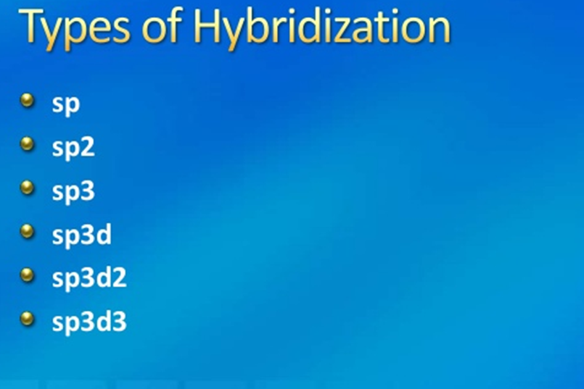

Slide 3
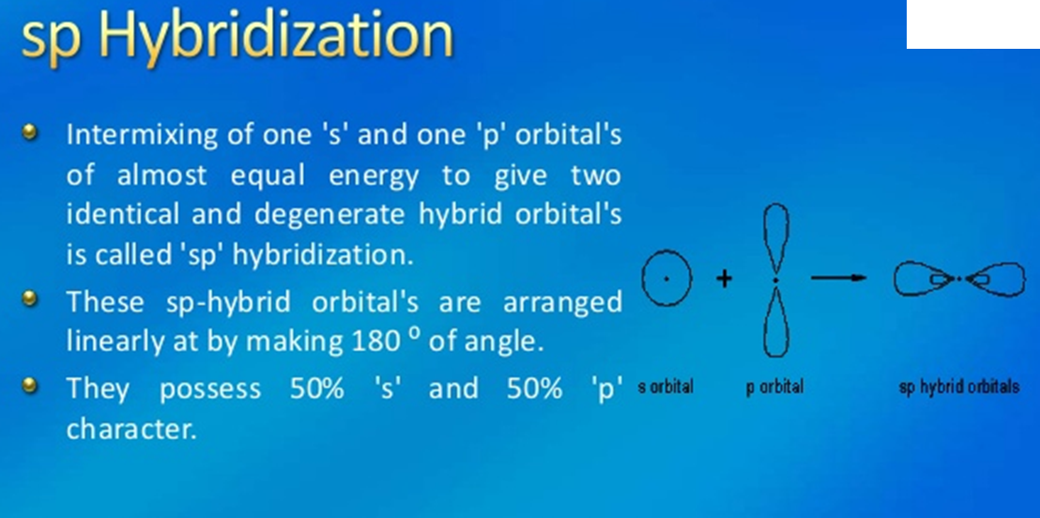

Slide 4
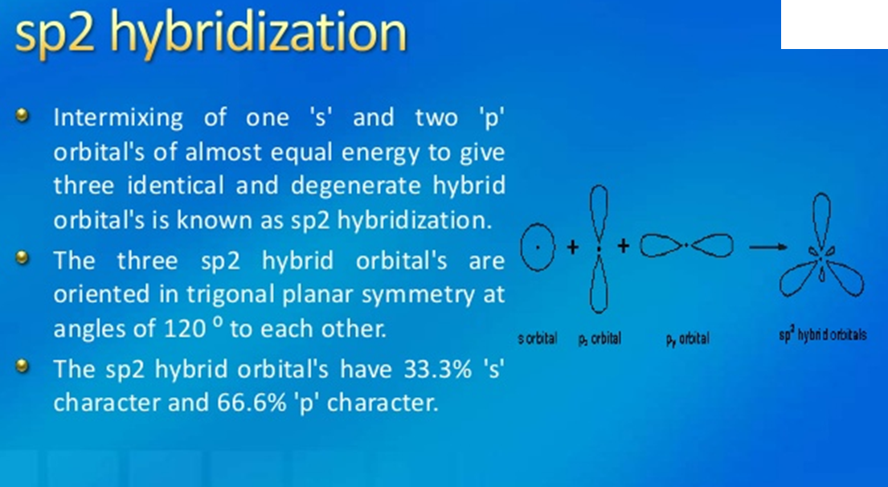

Slide 5
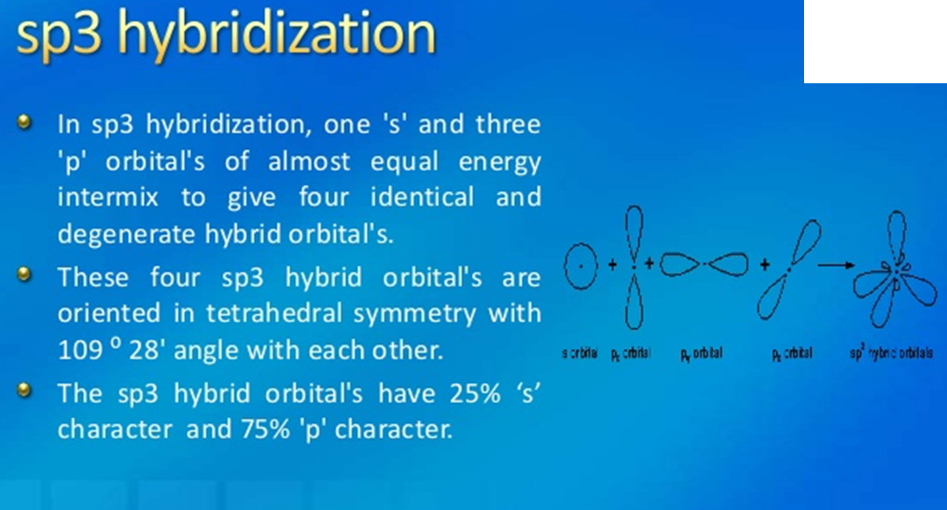

Slide 6
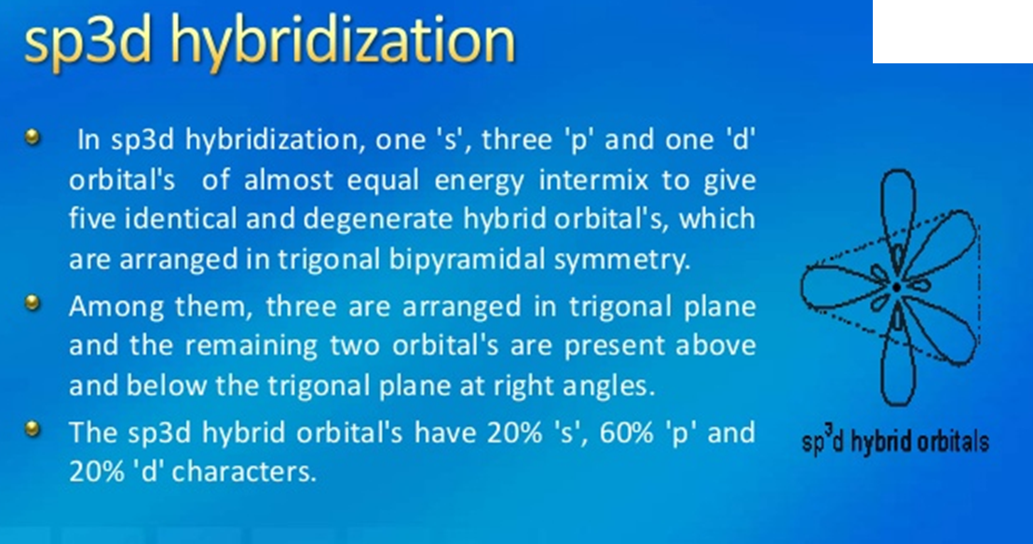

Slide 7
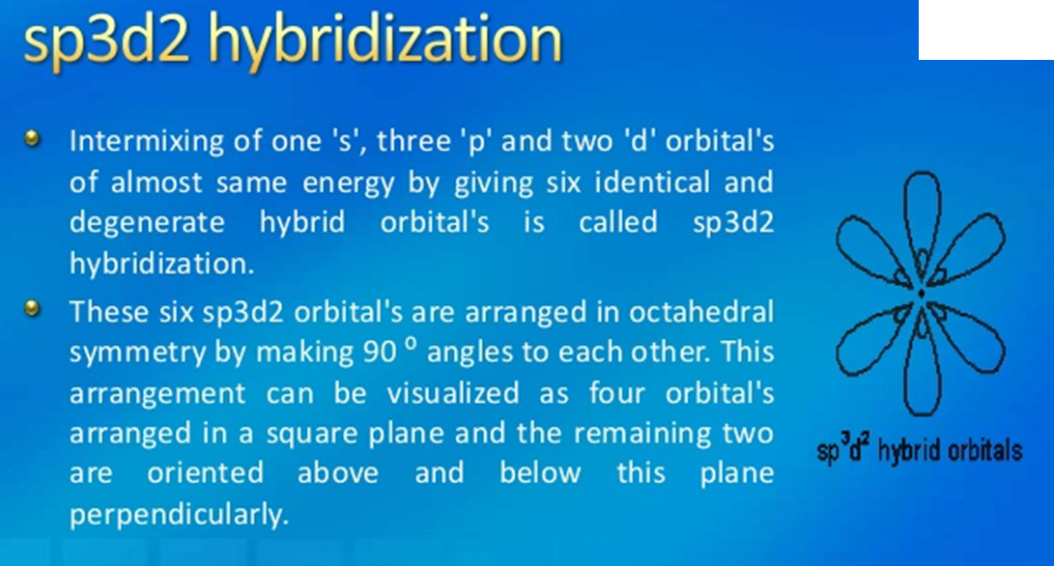

Slide 8
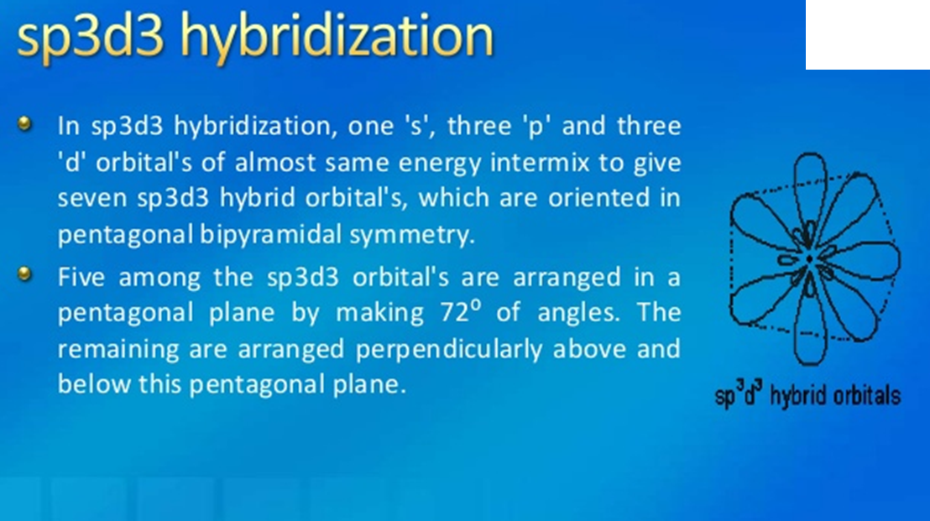

Slide 9
Coordinat-ion number | hybridization | Shape | Example
2 | SP | Linear | HgCl2
3 | SP2 | Trigonal Planar | BCl3
4 | SP3 | Tetrahedral/ Pyramidal/ Bent | CH4, [NiCl4]2-
4 | dSP2 | Square Planar | [NiCN4]2-
5 | dSP3 | Trigonal Bipyramidal | [Fe (CO)5]
5 | Sp3d | Trigonal Bipyramidal/ trigonal Planar/ Linear | PCl5
6 | SP3d2 | Octahedral/ Square planar/ Linear | SF6
7 | SP3d3 | Pentagonal bipyramidal | IF7

Slide 10
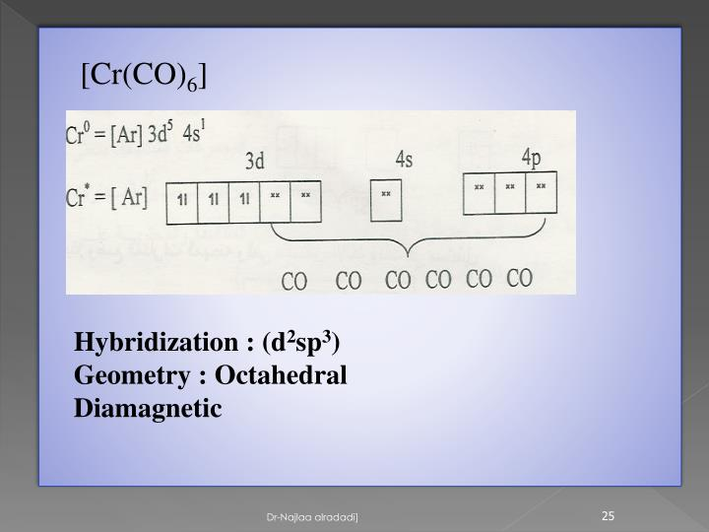

Slide 11
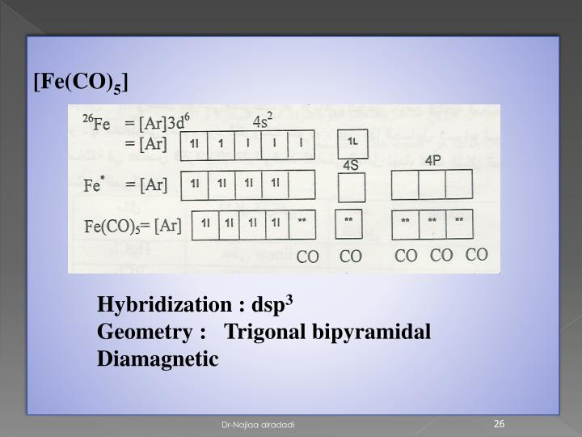

Slide 12
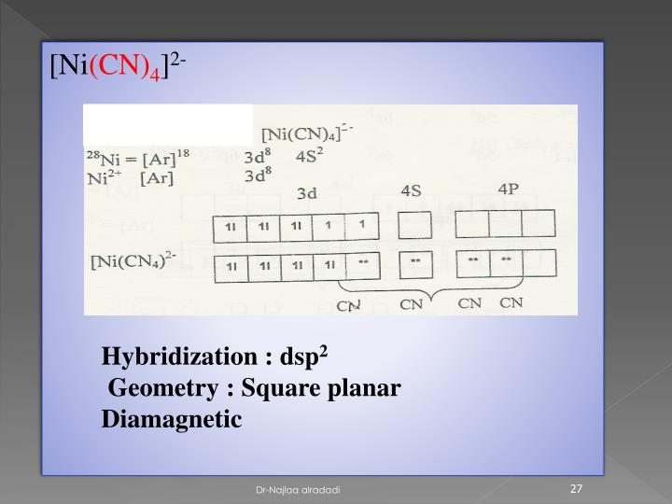

Slide 13
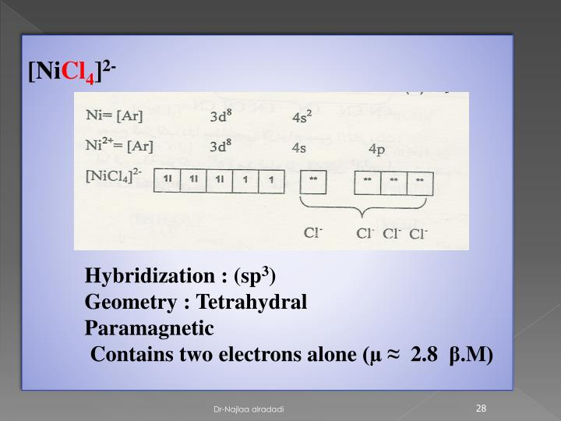

Slide 14
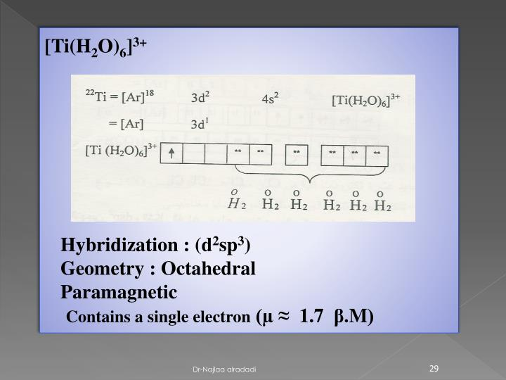

Slide 15
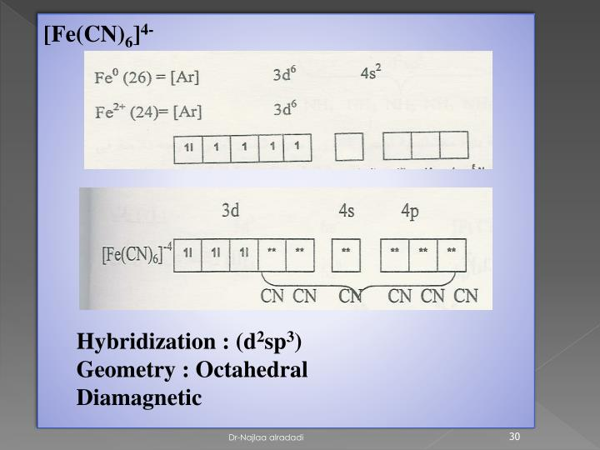

Slide 16
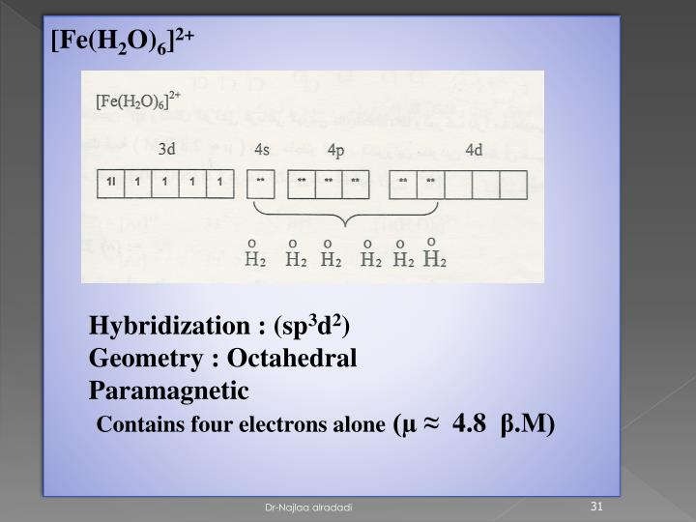

Slide 17
Limitations of VBT
1. The attention in focused only on the orbitals of central atom
and the importance of the ligands are not properly stressed
It does not explain color of complexes, absorption spectrum of complexes, quantity of magnetic moment of complexes- Because according to this theory splitting of d- orbitals does not occurs.
According to this theory we can not explain that when inner orbital complex will form and when outer orbital complex will form. Why strong field ligands (NH3, CN-) favors Inner orbital complex. Example[Fe(CN)6]3-, [Co(NH3)6]3+ and Weak field ligands H2O, X- favors outer orbital complex [Fe(F)6]3-, [Co(F)6]3-

Slide 18
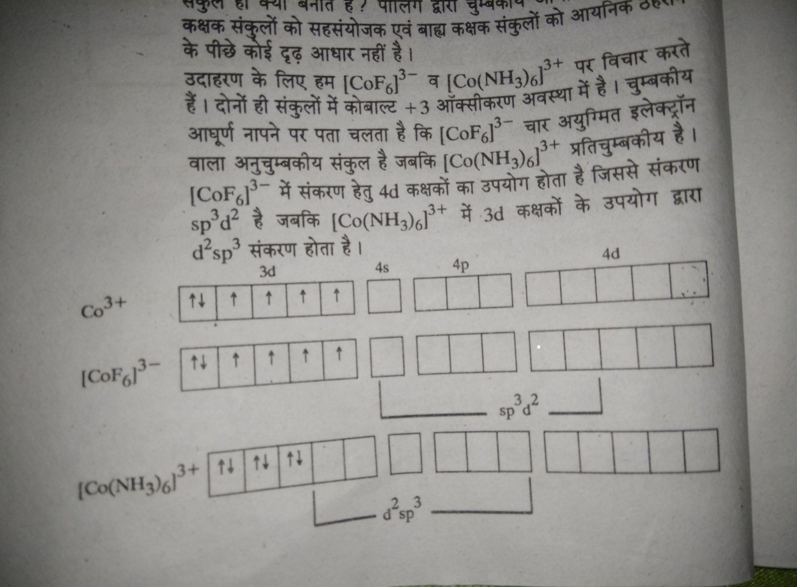

Slide 19
4. To explain the geometry of Co(II) and Cu (II) is necessary to one unpaired electron into higher energy exited state, here Cu (II) complexes are used as reducing agents but Co(II) does not used as reducing agents. This property caoud not be explained by VBT
It is cleared by next slide

Slide 20
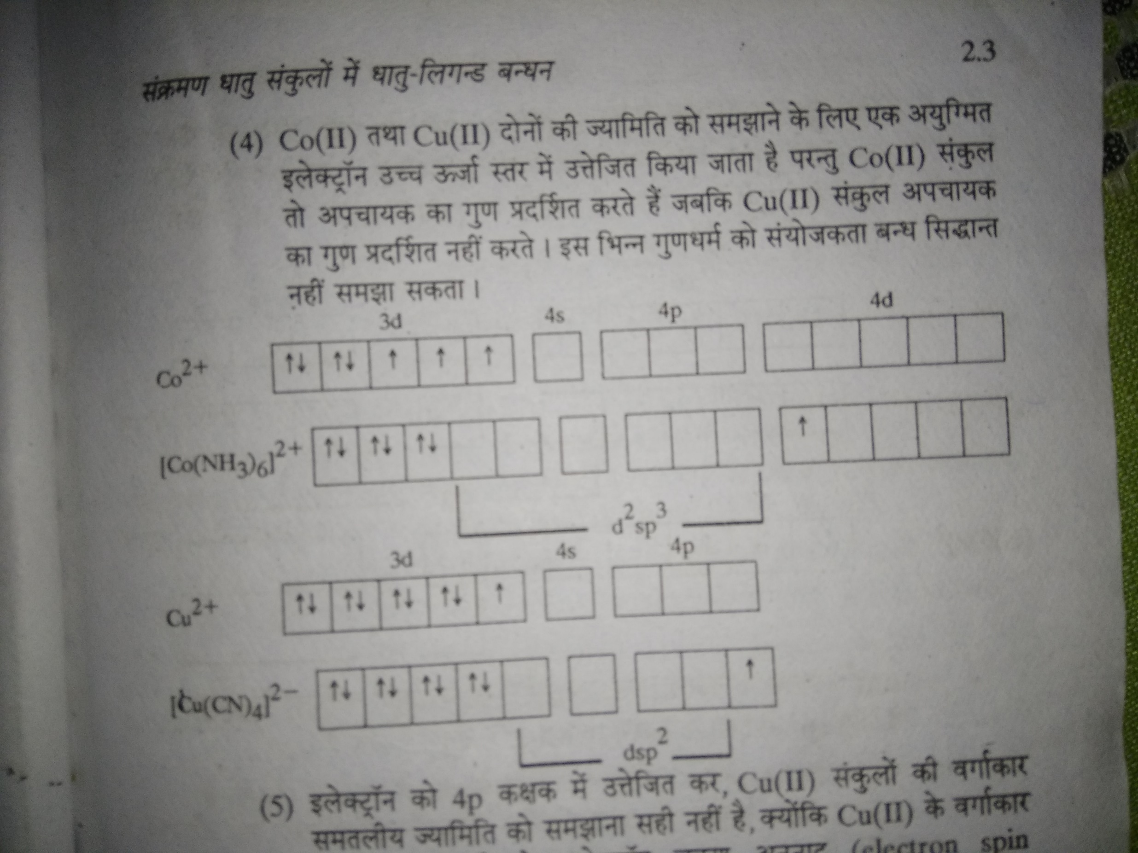

Slide 21
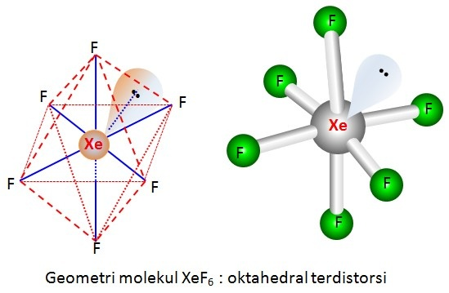
    According to last 4th draw back- Excitation of last electron into the 4P orbital and obtained square planar geometry is not right it is observed by the study of electron spin resonance that the last excited electron is part of 3d
    VBT cant explain rate of reaction and its mechanism
    VBT cant explain the distortion in geometry of complexes. In the complex [Ti(H2O)6] is octahedral having four ligands are situated in the corners of square, while two are situated at more distances …….therefore it is distorted octahedral

Slide 22
      8. On the basis of Magnetic behavior VBT explain the geometry of a complex which is not right, because X-Ray diffraction study showed that some Ni(II) complexes are square planar
Its could explained as

Slide 23
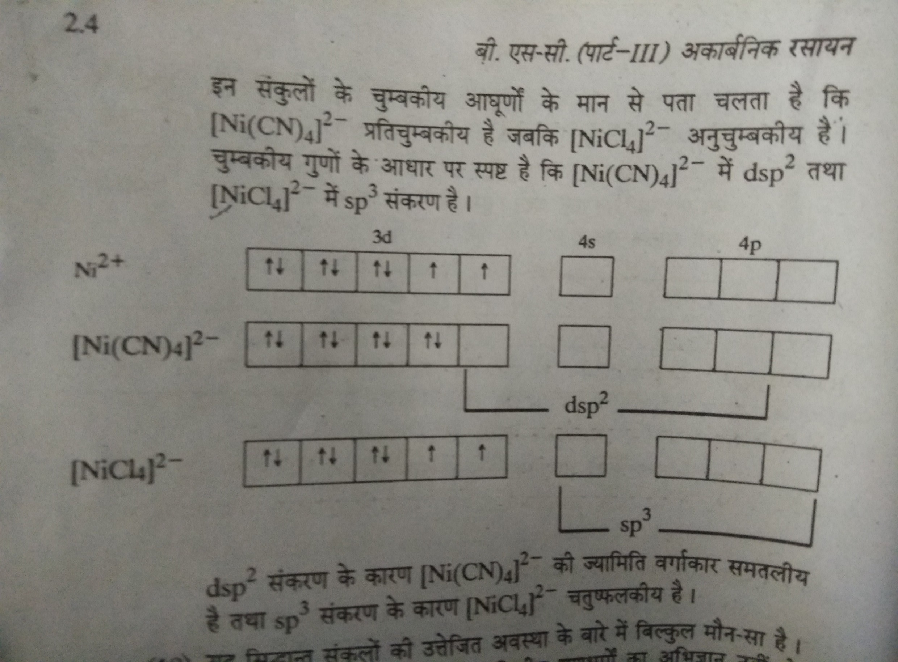

Slide 24
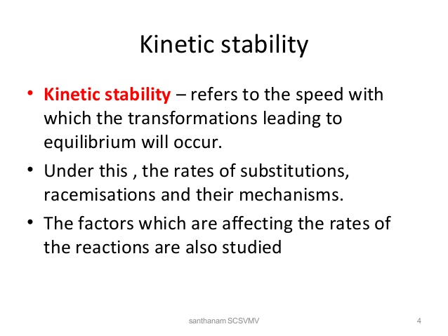
9. VBT cant explain the stability of complexes
Thermodynamically stable complex- study of stability of complexes with the temperature
Kinetically stable Complexes-

