Slide 1
NEW ECONOMIC POLICY

Slide 2
NEW ECONOMIC POLICY
The father of NEP:
New Economic Policy of India was launched in the year 1991 under the leadership of P. V. Narasimha Rao. This policy opened the door of the India Economy for the global exposure for the first time

Slide 3
NEW ECONOMIC POLICY
The LPG model of growth:
The P. V. Narasimha Rao government reduced the import duties, opened reserved sector for the private players, devalued the Indian currency to increase the export. This is also known as the LPG Model of growth

Slide 4
NEW ECONOMIC POLICY
Objectives: The union Finance Minister Dr. Manmohan Singh are stated the objectives as follows:
To plunge Indian Economy in to the arena of ‘Globalization and to give it a new thrust on market orientation
The NEP intended to bring down the rate of inflation
It intended to move towards higher economic growth rate and to build sufficient foreign exchange reserves.

Slide 5
NEW ECONOMIC POLICY
Objectives: The union Finance Minister Dr. Manmohan Singh are stated the objectives as follows:
It wanted to achieve economic stabilization and to convert the economy into a market economy by removing all kinds of un-necessary restrictions.
It wanted to permit the international flow of goods, services, capital, human resources and technology, without many restrictions.
It wanted to increase the participation of private players in the all sectors of the economy. That is why the reserved numbers of sectors for government were reduced. As of now this number is just 2.

Slide 6
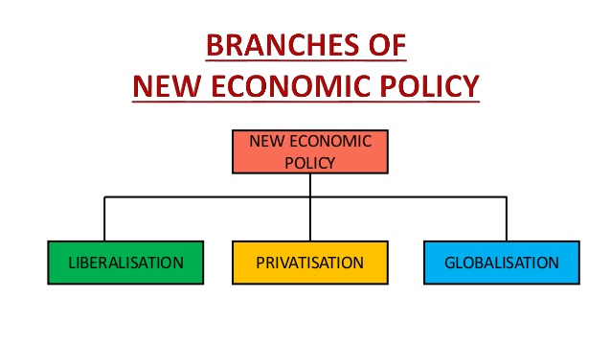
NEW ECONOMIC POLICY

Slide 7
NEW ECONOMIC POLICY
Liberalisation
All commercial banks were now free to fix their interest rates. This was previously done by the RBI.
Investment limit for small-scale industries was increased to Rs. 1 Crore.
Indian industries were given the freedom to import capital goods.
Companies were given the freedom to expand and diversify their production capacities based on market requirements. Previously, the government used to fix the maximum limit of production capacity.
Restrictive trade practices were abolished. Licensing was removed in the private sector and only a few industries were required to obtain licenses, namely, liquor, cigarette, industrial explosives, defence equipment, hazardous chemicals and drugs.

Slide 8
NEW ECONOMIC POLICY
Privatisation
Under this, many public sector undertakings (PSUs) were sold to private players.
PSU shares were sold to private players.
PSUs were disinvested.
The number of industries reserved for the public sector was reduced to 3 (mining of atomic minerals, railway and transport, and atomic energy).

Slide 9
NEW ECONOMIC POLICY
Globalisation
Tariffs were reduced – reduction of customs duties in import and export to attract global investors.
Foreign trade policy was for the long-term – Liberal and open policy was enforced.
The Indian currency was made partially convertible.
The equity limit of foreign investment was increased.

Slide 10
NEW ECONOMIC POLICY
THANK YOU

