Slide 1
What is Kurtosis?
Kurtosis is a statistical measure used to describe the degree to which scores cluster in the tails or the peak of a frequency distribution. The peak is the tallest part of the distribution, and the tails are the ends of the distribution.

Slide 2
Types of kurtosis:
Mesokurtic: Distributions that are moderate in breadth and curves with a medium peaked height.
Leptokurtic: More values in the distribution tails and more values close to the mean (i.e. sharply peaked with heavy tails)
Platykurtic: Fewer values in the tails and fewer values close to the mean (i.e. the curve has a flat peak and has more dispersed scores with lighter tails).

Slide 3
What does it mean when kurtosis is zero?
When kurtosis is equal to 0, the distribution is mesokurtic. This means the kurtosis is the same as the normal distribution, it is mesokurtic (medium peak). The kurtosis of a mesokurtic distribution is neither high nor low, rather it is considered to be a baseline for the two other classifications.

Slide 4
Mesokurtic

Slide 5
What does it mean when kurtosis is negative?
Negative values of kurtosis indicate that a distribution is flat and has thin tails. Platykurtic distributions have negative kurtosis values.
A platykurtic distribution is flatter (less peaked) when compared with the normal distribution, with fewer values in its shorter (i.e. lighter and thinner) tails.

Slide 6
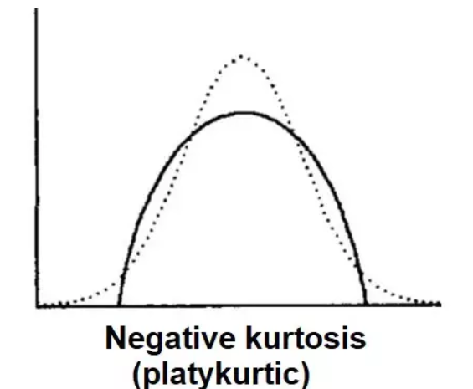
Platykurtic

Slide 7
What does it mean when kurtosis is positive?
Positive values of kurtosis indicate that a distribution is peaked and possess thick tails. Leptokurtic distributions have positive kurtosis values.
A leptokurtic distribution has a higher peak and taller (i.e. fatter and heavy) tails than a normal distribution.

Slide 8
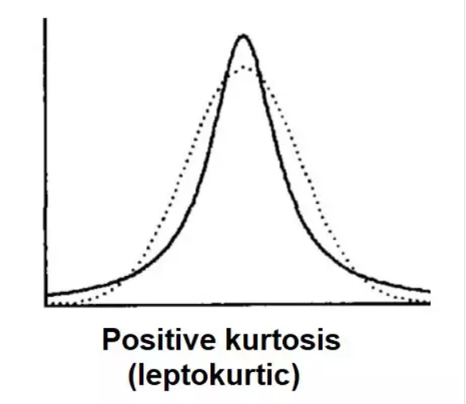
leptokurtic

Slide 9
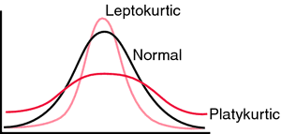

Slide 10
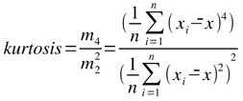
Formula

Slide 11
Problem:

Slide 12
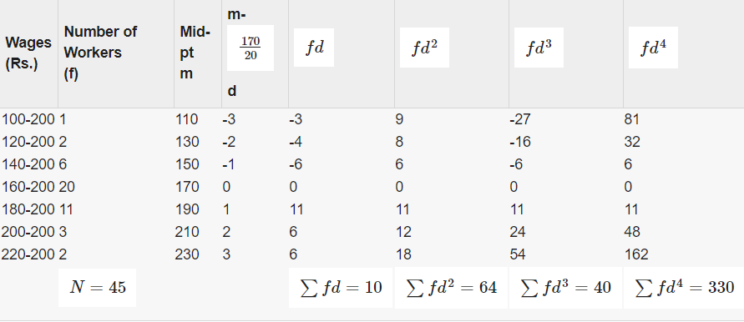
Solution:

Slide 13
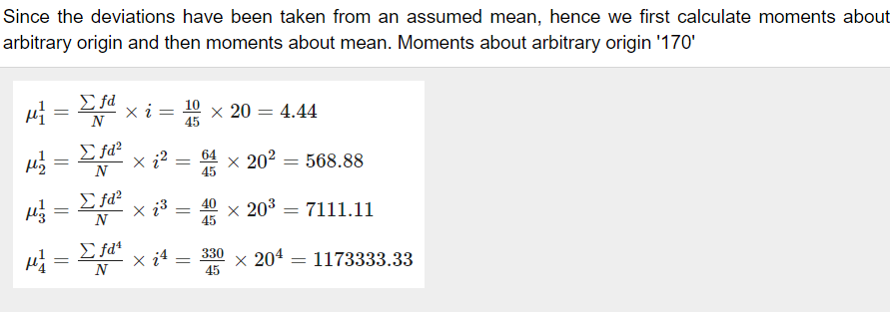

Slide 14
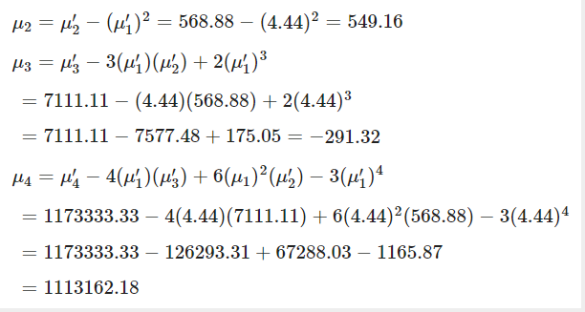
Moments about Mean

Slide 15
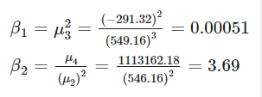
From the value of movement about mean, we can now calculate β1 and β2:

Slide 16
From the above calculations, it can be concluded that β1, which measures skewness is almost zero, thereby indicating that the distribution is almost symmetrical. β2 Which measures kurtosis, has a value greater than 3, thus implying that the distribution is leptokurtic.

Slide 17
THANK YOU

