Slide 1
Dharwar Protocontinent
Presentation by
Dr. Ritesh Purohit

Slide 2
Introduction:
The Dharwar Protocontinent covers a large area of Indian Peninsula.
It is one of the best studied Precambrian crustal block of the Indian Shield.
One of the prominent character is continuous increase in the grade of metamorphism from the greenschist facies in the north through amphibolite to granulite facies towards the south.
Another character is roughly east-west trending isograd line that demarcates the amphibolite-granulite facies transition called as ‘Charnockite Line’ of Fermor.

Slide 3
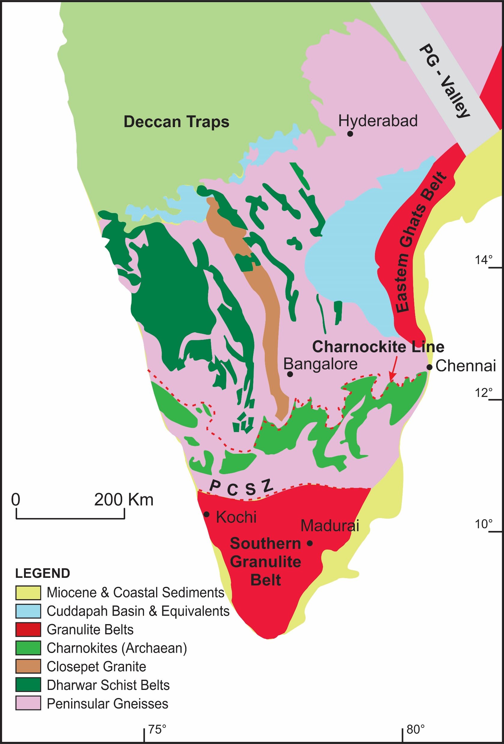

Slide 4
Eastern and Western Dharwar Cratons
The granite-gneiss-greenstone terrane is divided into two different blocks: Eastern Dharwar Craton and Western Dharwar Craton
The occurrence of the linear belt of Closepet Granite has been conceived as a ‘convenient landmark’ representing ‘stitching granite’ between the two cratons.
The most apparent difference between the two is that the eastern part contains abundant ‘post-tectonic’ younger granites unlike the western part.
The most characteristic features of the Dharwar Protocontinent is the occurrence of a number of schist belts, separated by wide zones of gneiss-granite terrane.

Slide 5
Distribution of Dharwar Protocontinent
In the north: Extends up to the Narmada basin beneath the covers of the Deccan Traps.
In the west: Continue into Madagascar (assuming the pre-fragmented situation) but presently truncated at the eastern coastline of the Arabian Sea.
In the northeast: Bounded by the Godavari ‘graben’ comprising the Proterozoic Pranhita-Godavari and the Phanerozoic Gondwana basins.
The eastern boundary: Large arcuate outcrop of the Cuddapah rocks constitute a part of the Dharwar Province (Protocontinent).
In the southern part: The irregular, broadly east-west lying Charnockite Line of Fermor (1936) considered to demarcate the southern margin from the dominantly charnockite bearing granulite terrane in the south.
However, the southern limit of this Protocontinent seems to favour an extension up to the Palghat Cauvery Shear Zone further south of Fermor’s Charnockite Line.

Slide 6
Peninsular Gneiss
Smeeth (1915) described the gneisses as the ‘Peninsular Gneiss Complex’ and interpreted as intrusive into the ‘Dharwar schists’.
Clarified by Fermor (1936) that the intrusive masses were nothing but the products of re-melting of the pre-existing gneissic basements.
Majority of these rocks show complex banding with evidence of multiple folding and ductile shearing.
Most of the basement gneisses are of TTG type (tonalite-trondhjemite-granodiorite) with a large number of enclaves of different dimension.
Some of the Peninsular Gneiss appears much darker in shade with only few thinner leucocratic bands

Slide 7
Peninsular Gneiss: Folded ductile and banded

Slide 8
Characterization of Peninsular Gneiss
Classic examples of bodies of trondhjemite gneiss occur at Holenarasipur (mapped as Holekote Trondhjemite), Kolar Schists Belt, Chitradurga Schist Belt, and several other schist belts.
Presence of isolated bodies of aluminous minerals like kyanite and sillimanite in Peninsular Gneiss may hint about the possible concentration of aluminous clay like sediments in the milieu gneisses and granites, providing unequivocal evidence of development of erosional surface with patches of aluminous clay deposits possibly indicating a surface of unconformity which got highly metamorphosed.
The contact between the gneisses and the supracrustal rocks is marked in some places by quartz pebble conglomerate notably where younger schist belts occur above the Peninsular Gneiss

Slide 9
Ages of Peninsular Gneiss
The oldest age recorded in Peninsular Gneiss ranges from 3.4 to 3.2 Ga; with crustal inheritance age up to 3.8 Ga has been noted in some samples (Beckinsale et al., 1980; Bhaskar Rao et al., 1992; Meen et al., 1992; Peucat et al., 1993). Apart from these oldest ages, the Peninsula Gneiss shows record of thermal event of 3.0 and 3.1 Ga.
The end-Archaean granitic intrusions took place in two phases. The older one is between 2.7 and 2.6 Ga and the youngest intrusion is 2.56 Ga old detected in the migmatitic gneisses bordering the western part of the Closepet Granite (Chardon et al., 2011). Conformable whole-rock Rb-Sr isochron age of 2.50± 0.05 Ga from banded charnockites in amphibolite facies gneiss in south Karnataka by Hansen et al. (1997).

Slide 10
Charnockites and Granulites from South Dharwar
Bodies of Charnockites and Granulites occur in close association with garnet-bearing gneisses, banded iron formation, calc-silicate rocks, quartzites and amphibolites in the southern Dharwars. The northern limit of these occurrences is marked as Charnockite Line (Fermor).
This implies that a continuity of the Archaean Dharwar rocks further south of the defined boundary.
The proof of the presence of a single continuous belt of rocks also comes from the occurrences of the trails of the coevally metamorphosed Archaean granite-greenstone belt rocks well within the massifs of Biligirirangan, Coorg and Nilgiri Hills in the south.
The continuity of Peninsular Gneiss into the massive granulite-charnockite ensemble is detected by the presence of relict banding within granulite facies rocks south of the Charnockite line.
Continuous occurrence of the linear bodies of metasedimentary and metavolcanic rocks within the granulite-charnockites is a clear proof of transformation of the rocks of the granite gneiss-greenstone belts into granulites.
The ages of granulite facies metamorphism in the southern part of the Dharwar Protocontinent range between 2500±50 Ma and 2540±17.

Slide 11
Geology of Schist Belts: Nuggihalli Schist Belt
Located in the SW part of the Dharwar Protocontinent, extending NW for a distance of over 60 km & max. width of 2 km near Nuggihalli.
Differentiated intrusion of serpentinized peridotite with lenses of altered dunite, tremolite-actinolite-cummingtonite-anthophyllite-talc-chlorite magnetite schist (metapyroxenites) and gabbroic amphibolite ± garnet with layers of anorthosite.
Importance of this schist belt lies in the occurrence of Cr, Au and Cu.
There is no clear cut evidence of unconformity between Peninsular Gneiss and the ultramafic schist of the Nuggihalli belt. On the other hand, the occurrence of schistose ultramafic rocks close to the massive bodies of trondhjemite suggests intrusive character of these plutonic bodies.

Slide 12
Holenarasipur Schist Belt
The ‘trident-shaped’ Holenarasipur Schist Belt is considered the most “critical, complicated and oldest (3.2-3.5 by) supracrustal” belts in the Dharwar Protocontinent. Older westernmost succession of this schist belt includes mafic-ultramafic rocks at the base overlain by meta-sedimentary rocks.
Compositionally the mafic-ultramafic rocks are similar to peridotite, pyroxenite and basaltic komatiite interbedded with fuchsite-quartzite.
The characteristic trident shape of the Holenarasipur Schist belt is thought to have developed due to the deflection of schistosity during the intrusion of plutonic ‘boss-like’ bodies which range in composition between trondhjemite and granodiorite (Bouhaller et al. 1993). A pre-3.00 Ga age has been suggested for the Holenarasipur Schist Belt rocks based on the age of these intrusive bodies like the Halekote Trondhjemite (Stroh et al. 1983) into the supracrustal rocks.

Slide 13
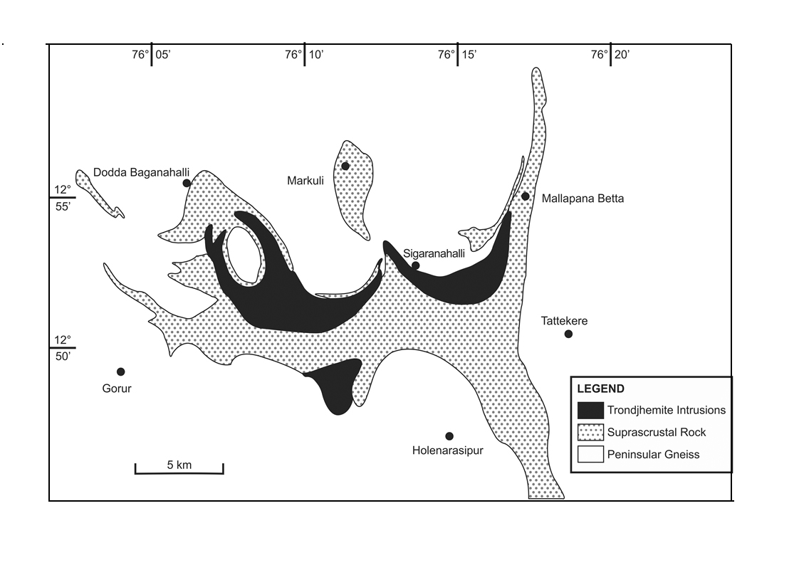

Slide 14
Salem Schist Belt
It has been conceived as one of the oldest ‘group’ of schist belt rocks comparable to the Nuggihalli and the lower part of the Holenarasipur belts. The approximate age of the evolution of this Archaean greenstone belt is thought to be between 3100-3300 Ma.
Main lithology hosting magnesite deposits include dunite which has been locally altered to serpentinite along with criss-crossed veins of magnesite
Tectonically, the Salem Schist Belt is also known as Dharmapuri Rift Zone bound between two NNE-SSW trending Lineaments extending between Gudiyattam in the north and Bhavani in the south

Slide 15
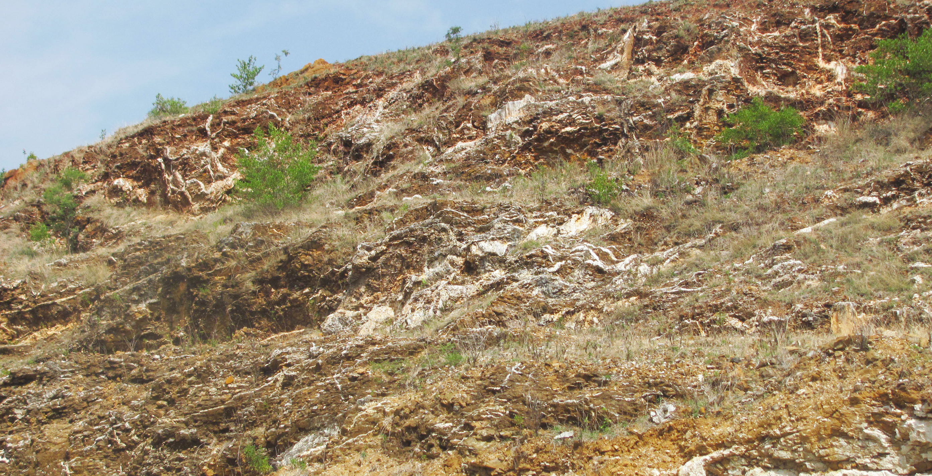

Slide 16
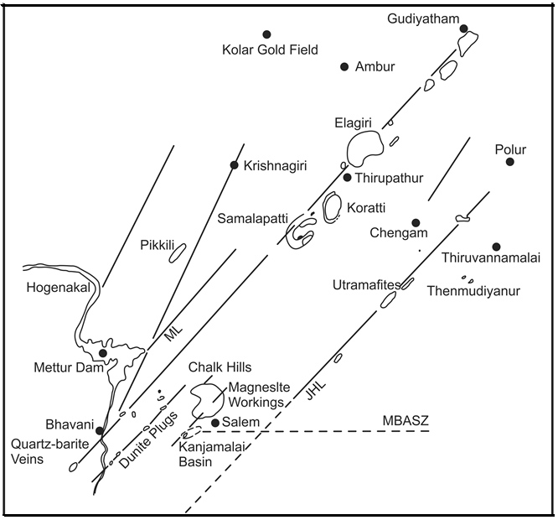

Slide 17
Kolar Schist Belt
Eastern most gold-bearing schist belt in the Dharwar Protocontinent located 80 kilometres east of Bangalore, N-S trending, predominantly of amphibolites, banded iron formation, graphitic schists, felsic schists
The schist belt is divided into an eastern block and a western block by a massive, fine grained tholeiitic meta-basalt occurring in the central part of the belt.
The felsic schists commonly known as Champion Gneiss occur along the eastern margin of the Kolar Schist Belt. It comprises granite gneiss, amphibolite, banded iron formation and vein quartz. Thin bands of graphitic schist occur along the western margin.
Komatiitic meta-basalt (amphibolite) occurs on both the eastern and the western sides of the belt. The central zone where gold mineralization is confined, marks a zone strong ductile shearing. Regarding the age of the Kolar Schist belt, Bhalla et al. (1978) recorded 2889±96 Ma Rb/Sr isochron age from a sample collected from the Champion Gneiss.

Slide 18
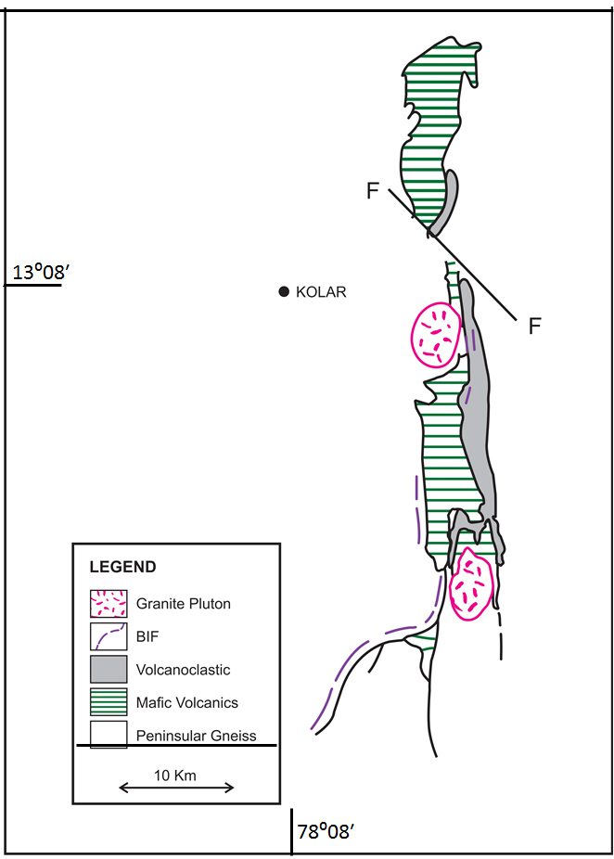

Slide 19
Gold Mineralization in Kolar Schist Belt
Gold mineralization occurs in the quartz-carbonate veins in the shear zones within the central massive tholeiitic meta-basalt.
Gold mineralization in the Kolar Schist Belt show two types of occurrences:
(1) As the amphibolite hosted quartz-carbonate vein type which is economically the most important and
(2) As stratiform sulphide type hosted in the banded iron formation within the amphibolites.
The quartz vein type mineralization is of epigenetic origin. The first order control of mineralization is tectonic, which provided structures for channel ways for migration of fluid. These ores appear to be syngenetic with the protoliths of the amphibolites.

Slide 20
Hutti Schist Belt
The Hutti Schist Belt, also known as the Hutti-Maski Schist Belt, is considered the northernmost extension of the Kolar Schist Belt occurring west of the outcrops of the Closepet Granite.
It is a hook shaped schist belt about 65 km in length and about 8 km in width.
Consists predominantly of a mafic volcanic rocks including minor bands of BIF, greywacke and polymictic conglomerate intercalated with bands of quartzite, phyllite, limestone and calc-silicate rocks.
The volcanic rocks range in composition from basalt (the dominant suite) to acid to intermediate lavas like rhyolite porphyry.
The metasediments of are exposed in the eastern part of the belt and are represented by andalusite bearing mica schist, garnet-cordierite gneiss and mica schist. The schist belt is surrounded on all sides by granitic bodies of different composition, locally showing intrusive relationship.

Slide 21
Chitradurga Schist Belt
The Chitradurga Schist Belt also described as Chitradurga-Gadag Superbelt is a 450 km linear Archaean greenstone belt, vary in width between 5-25 km from Gadag in the north to Dodguni in the south.
The volcanic rocks show composition varying from komatiitic peridotite to rhyolite. The mafic volcanics include pillowed meta-basalt associated with sulphuric cherts hosting deposits of Cu, Au, minor Pb and Sb (antimony). The banded iron formation is an important component of chemogenic sediments which include some minor carbonate. Amongst terrigeneous clastics, greywacke is recognized at two different stratigraphic levels.

Slide 22
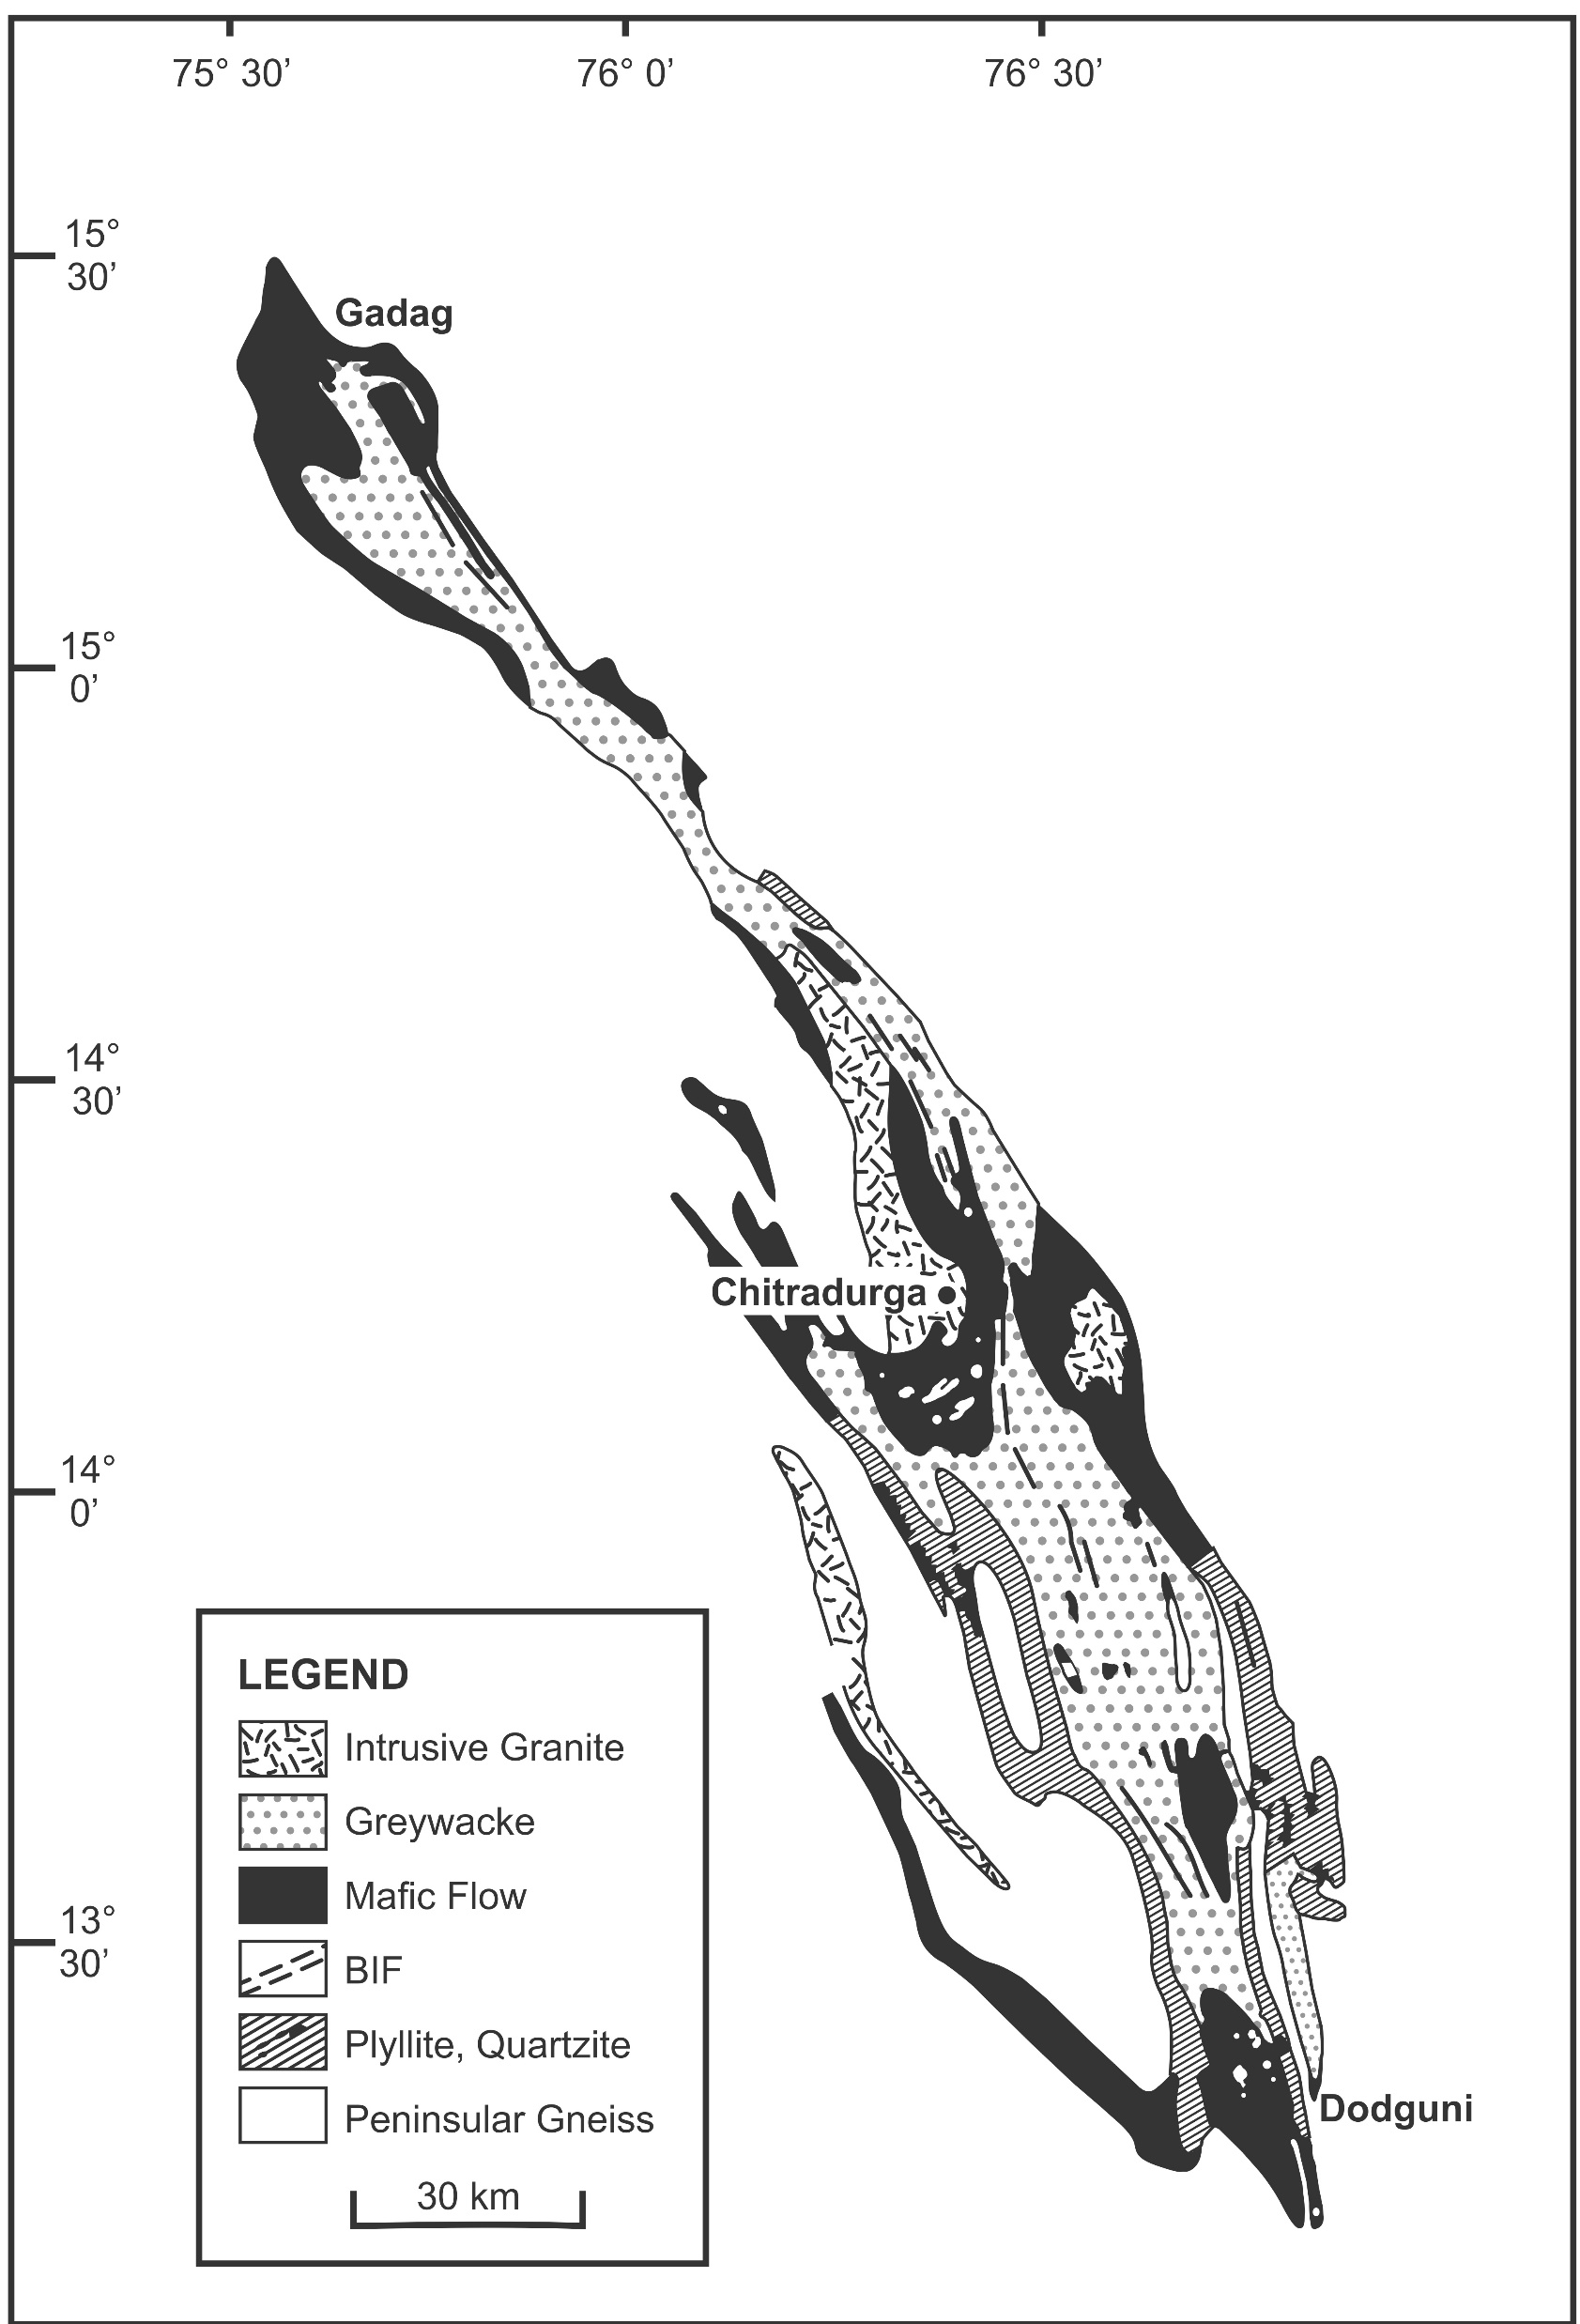

Slide 23
Pillowed metabasalt

Slide 24
Conglomerate in Schist Belt
A stratigraphically important formation of the Chitradurga Schist Belt is the Talya Conglomerate which separates two different litho-units, mapped as older Bababudan Group and younger Chitradurga Group.
The Talya Conglomerate comprises diamictites (i.e. matrix-supported conglomerates) interbedded with mudstone and sandstone units.
Presence of good number of faceted and bullet shaped clasts suggest a possible reworked glacial origin of the conglomerates(Ojakangas et al. 2014).
The Talya Conglmerate consists of clasts of basement gneiss and granitoids, and of the orthoquartzite of the older schist belt rocks. The conglomerate is interpreted as products of debris flow in glacial deposits.

Slide 25
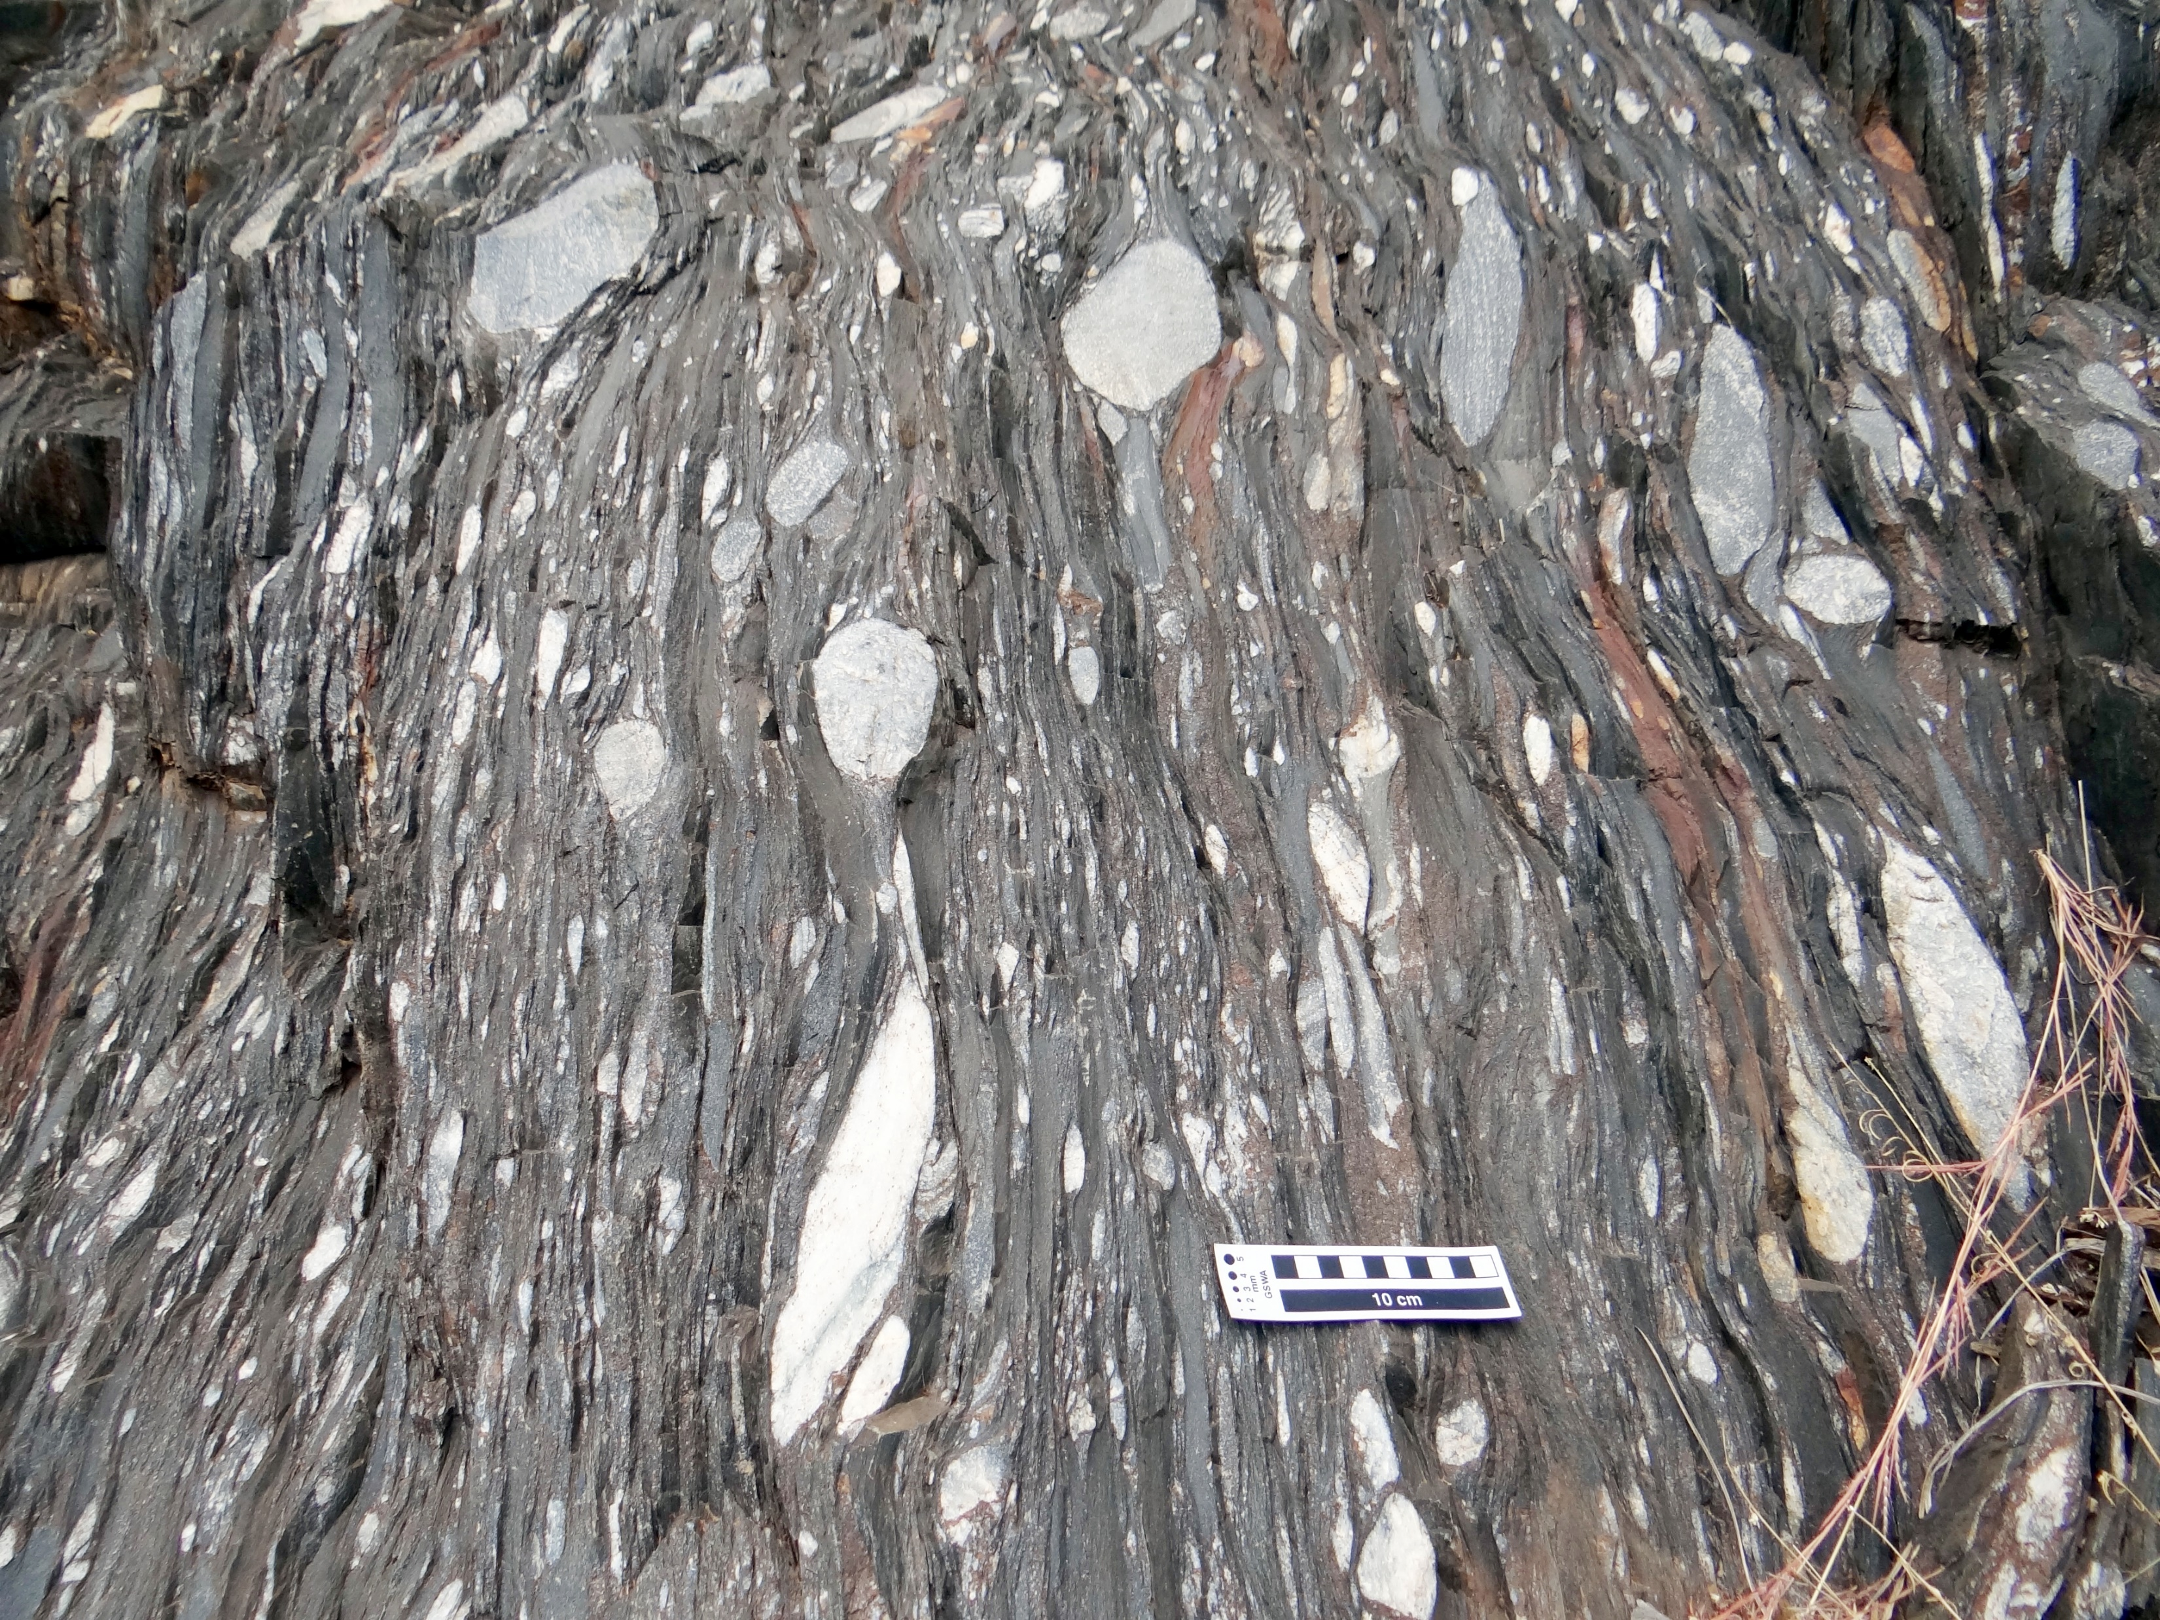

Slide 26
Ages of Chitradurga Schist Belt
Nutman et al. (1996), based on SHRIMP U/Pb dating of zircon grains from a schistose acid volcanic rock from the Chitradurga Group suggested 2614 ± 8 Ma age. The authors interpreted the age as the time of melt crystallisation of the acid volcanic rocks.
Very similar ages of 2648±40 Ma, 2598±19 Ma and ca. 2600 Ma have been reported from the younger granites occurring near Chitradurga town by Chadwick et al. (2007).
The ages suggest a little time difference between the deposition of acid volcanics and the emplacement of granitic bodies during the basin closing phase of the Chitradurga Schist Belt.

Slide 27
Shimoga-Bababudan Schist Belt
This is the largest schist belt in the Dharwars covering about 30,000 sq. km. between Kudremukh in the south and Belgaun in the north.
The schist belt is linked with the Chitradurga Schist Belt in the east through small occurrences of ‘schists’ enclosed within Peninsular Gneiss.
The main Bababudan outcrop that occurs in the southeast constitutes the type area of Bababudan rocks.
A thin but prominent horizon of quartz pebble conglomerate marks a profound ‘erosion’ unconformity between the Peninsular Gneiss and the schist belt.
The Bababudan Group consists dark green meta-basalts, at places pillowed, containing differentiated ‘sills’ of ultramafic rocks with Cr-titanomagnetite.
Locally, sulphide mineralization is recorded within these layered bodies. The meta-basalts are interbedded with quartzite and phyllite.

Slide 28
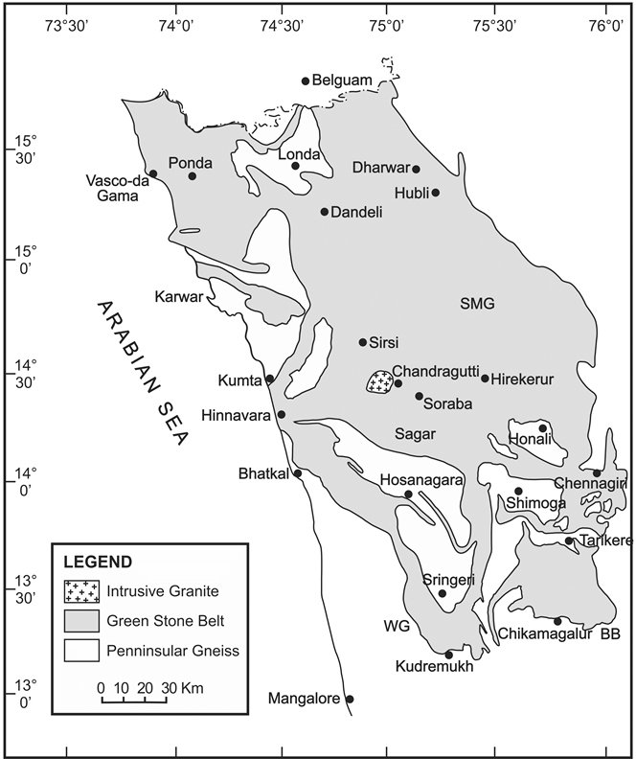

Slide 29
Shimoga Belt
The Bababudan rocks continues in the north forming a part of the much larger outcrop of the Shimoga belt, separated by a narrow belt of Peninsular Gneiss in the eastern part of the Tartikere valley.
Basal conglomerate (quartz pebble conglomerate) extends discontinuously for some distance (roughly about 40 km) along. The QPC is explored locally for the occurrence of U, Cu & Au mineralization.
The QPC grades upward into quartzite and amygdular meta-basalt, represented by chlorite-actinolite schist.
The association of chlorite phyllite, banded iron formation, meta-gabbro, meta-pyroxenite along with mafic flows forms the main bulk of the younger succession.
Banded iron formation constitutes the prominent lithology capping some important hill ranges, such as at Kudremukh and nearby hills(Figure).

Slide 30
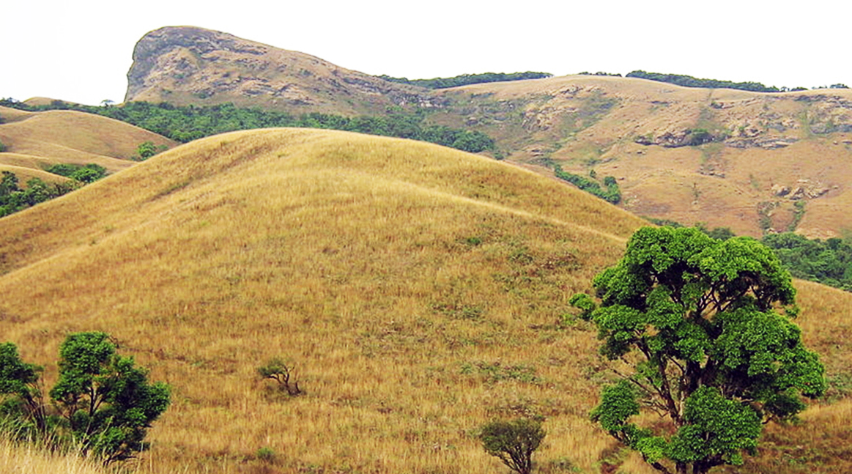

Slide 31
Sandur Schist Belt
The Sandur Schist Belt covers a part of the linear band of the Closepet Granite in the north. The irregular shape of the outcrop is said have resulted due to complex deformation during the repeated the thrusting of the rocks.
The lower succession of the Sandur Schist Belt in the SW part is dominated by mafic and ultramafic schists with some quartzite. The overlying rocks include a siliciclastic association of greywacke and quartzite, limestone (showing development of cyanobacterial structure), mafic volcanics and banded iron formation.
A unique feature of the Sandur Schist Belt is the presence of “gneissic” veins as “intrusive bodies” (Ramakrishnan and Vaidyanadhan, 2008). The unusual feature may be interpreted as the slices of partially melted gneissic basement enclosed in the Sandur Schist Belt rocks.
The basic volcanics of the Sandur Belt has estimated ~2.9 Ga age of this greenstone belt. The gneissic basement on which this belt is resting has yielded ~3.1 Ga age. In view of the available radiometric age data, the age of the Sandur schist belt may be presumed to be somewhere between 3.1 and 2.6 Ga. The U-Pb age of felsic volcanic from the Sandur schist belt is reported to be 2658±14 Ma.

Slide 32
Closepet Granites
The Closepet Granite is a unique linear, arcuate body consisting of granite-types having diverse composition.
The southern part extending from the Cauvery River to Kalyandurga and the northern part extends from Rayadurga to the Deccan Trap boundary.
The Closepet Granite has been considered as a ‘Stitching Granite’ marking a Suture Zone between two tectonic belts.
The outcrops is about 400 km long band between 20-30 km wide band of linear hill range in the midst of the peneplained terrane of gneisess running north-south through Closepet and Channapatna.

Slide 34
Petrology and age of Closepet Granites
Predominantly potash-rich adamalite, quartz monzonite, and granite.
There is a considerable variation of composition from north to south, thought to be due to different structural levels of the body from deeper in the northern region to shallower in the southern part.
Commonly appearing as porphyritic granite.
Uniformly planar foliation on the either side of the body granite indicates ductile shearing during emplacement of the granite.
It is a sheet-like pluton forming a part of the Peninsular Gneiss.
The SHRIMP U/Pb age of zircon grains in the Closepet Granite at Kabbaldurga is 2513±5 Ma.
Quartz monzonite yielded 2518±5 Ma and The Rb/Sr whole rock isochron age at Toranagallu is 2452±50 Ma.

Slide 35
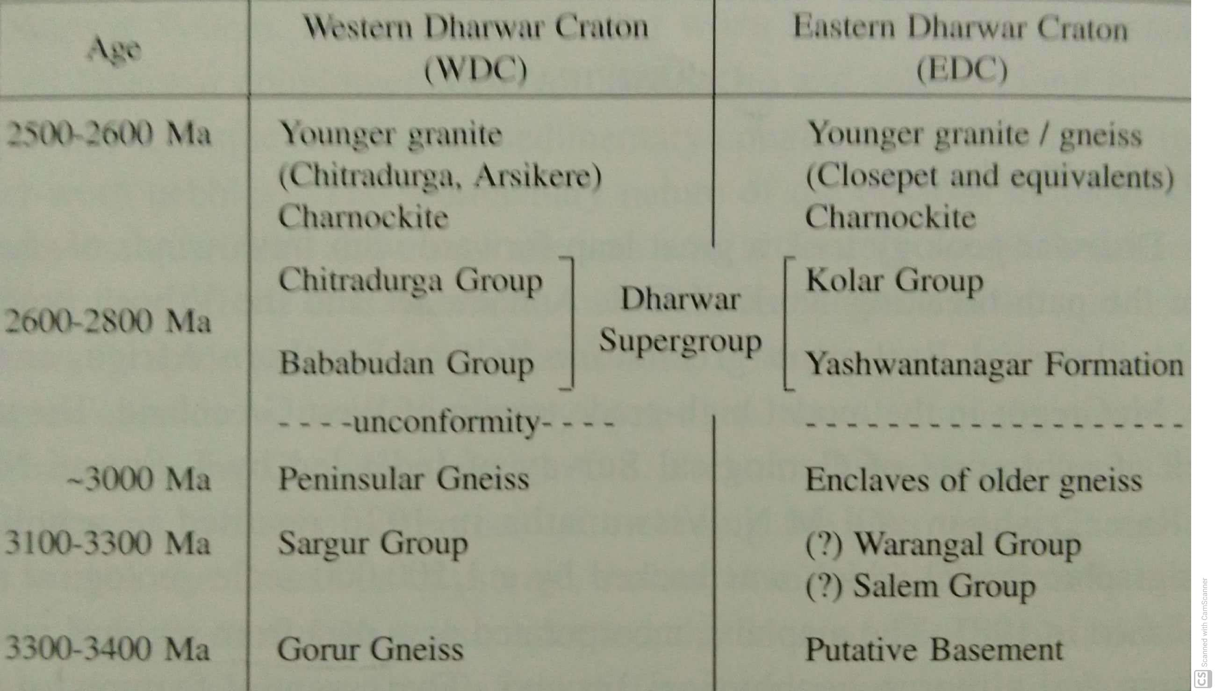

Slide 36
Group | Subgroup | Characteristic associations
Dharwar Group | Chitradurga Subgroup | Mobile belt association; sedimentary-volcanic source of deposits with conglomerate-greywacke-BIF association; mafic volcanics indicate Island Arc type tholeiite.
 | Dodguni Subgroup | Typical platformal (stable shelf) depositional environment; occurrence of stromatolites indicate oxygenated atmoshphere; carbonate and banded Mn Formation; mafics are LREE enriched.
 | Bababudan Subgroup | Meta-volcanic (Na-rich tholeiites) and meta-sediments; graphite schists and iron silicates suggest non-oxygenic atmosphere; U-bearing QPC.
 | Nuggihalli Subgroup | Dominantly igneous character; Komatiite lava implying thin Crust; Schists are derived from mafic-ultramafic source; No evidence of older basement.

Slide 37
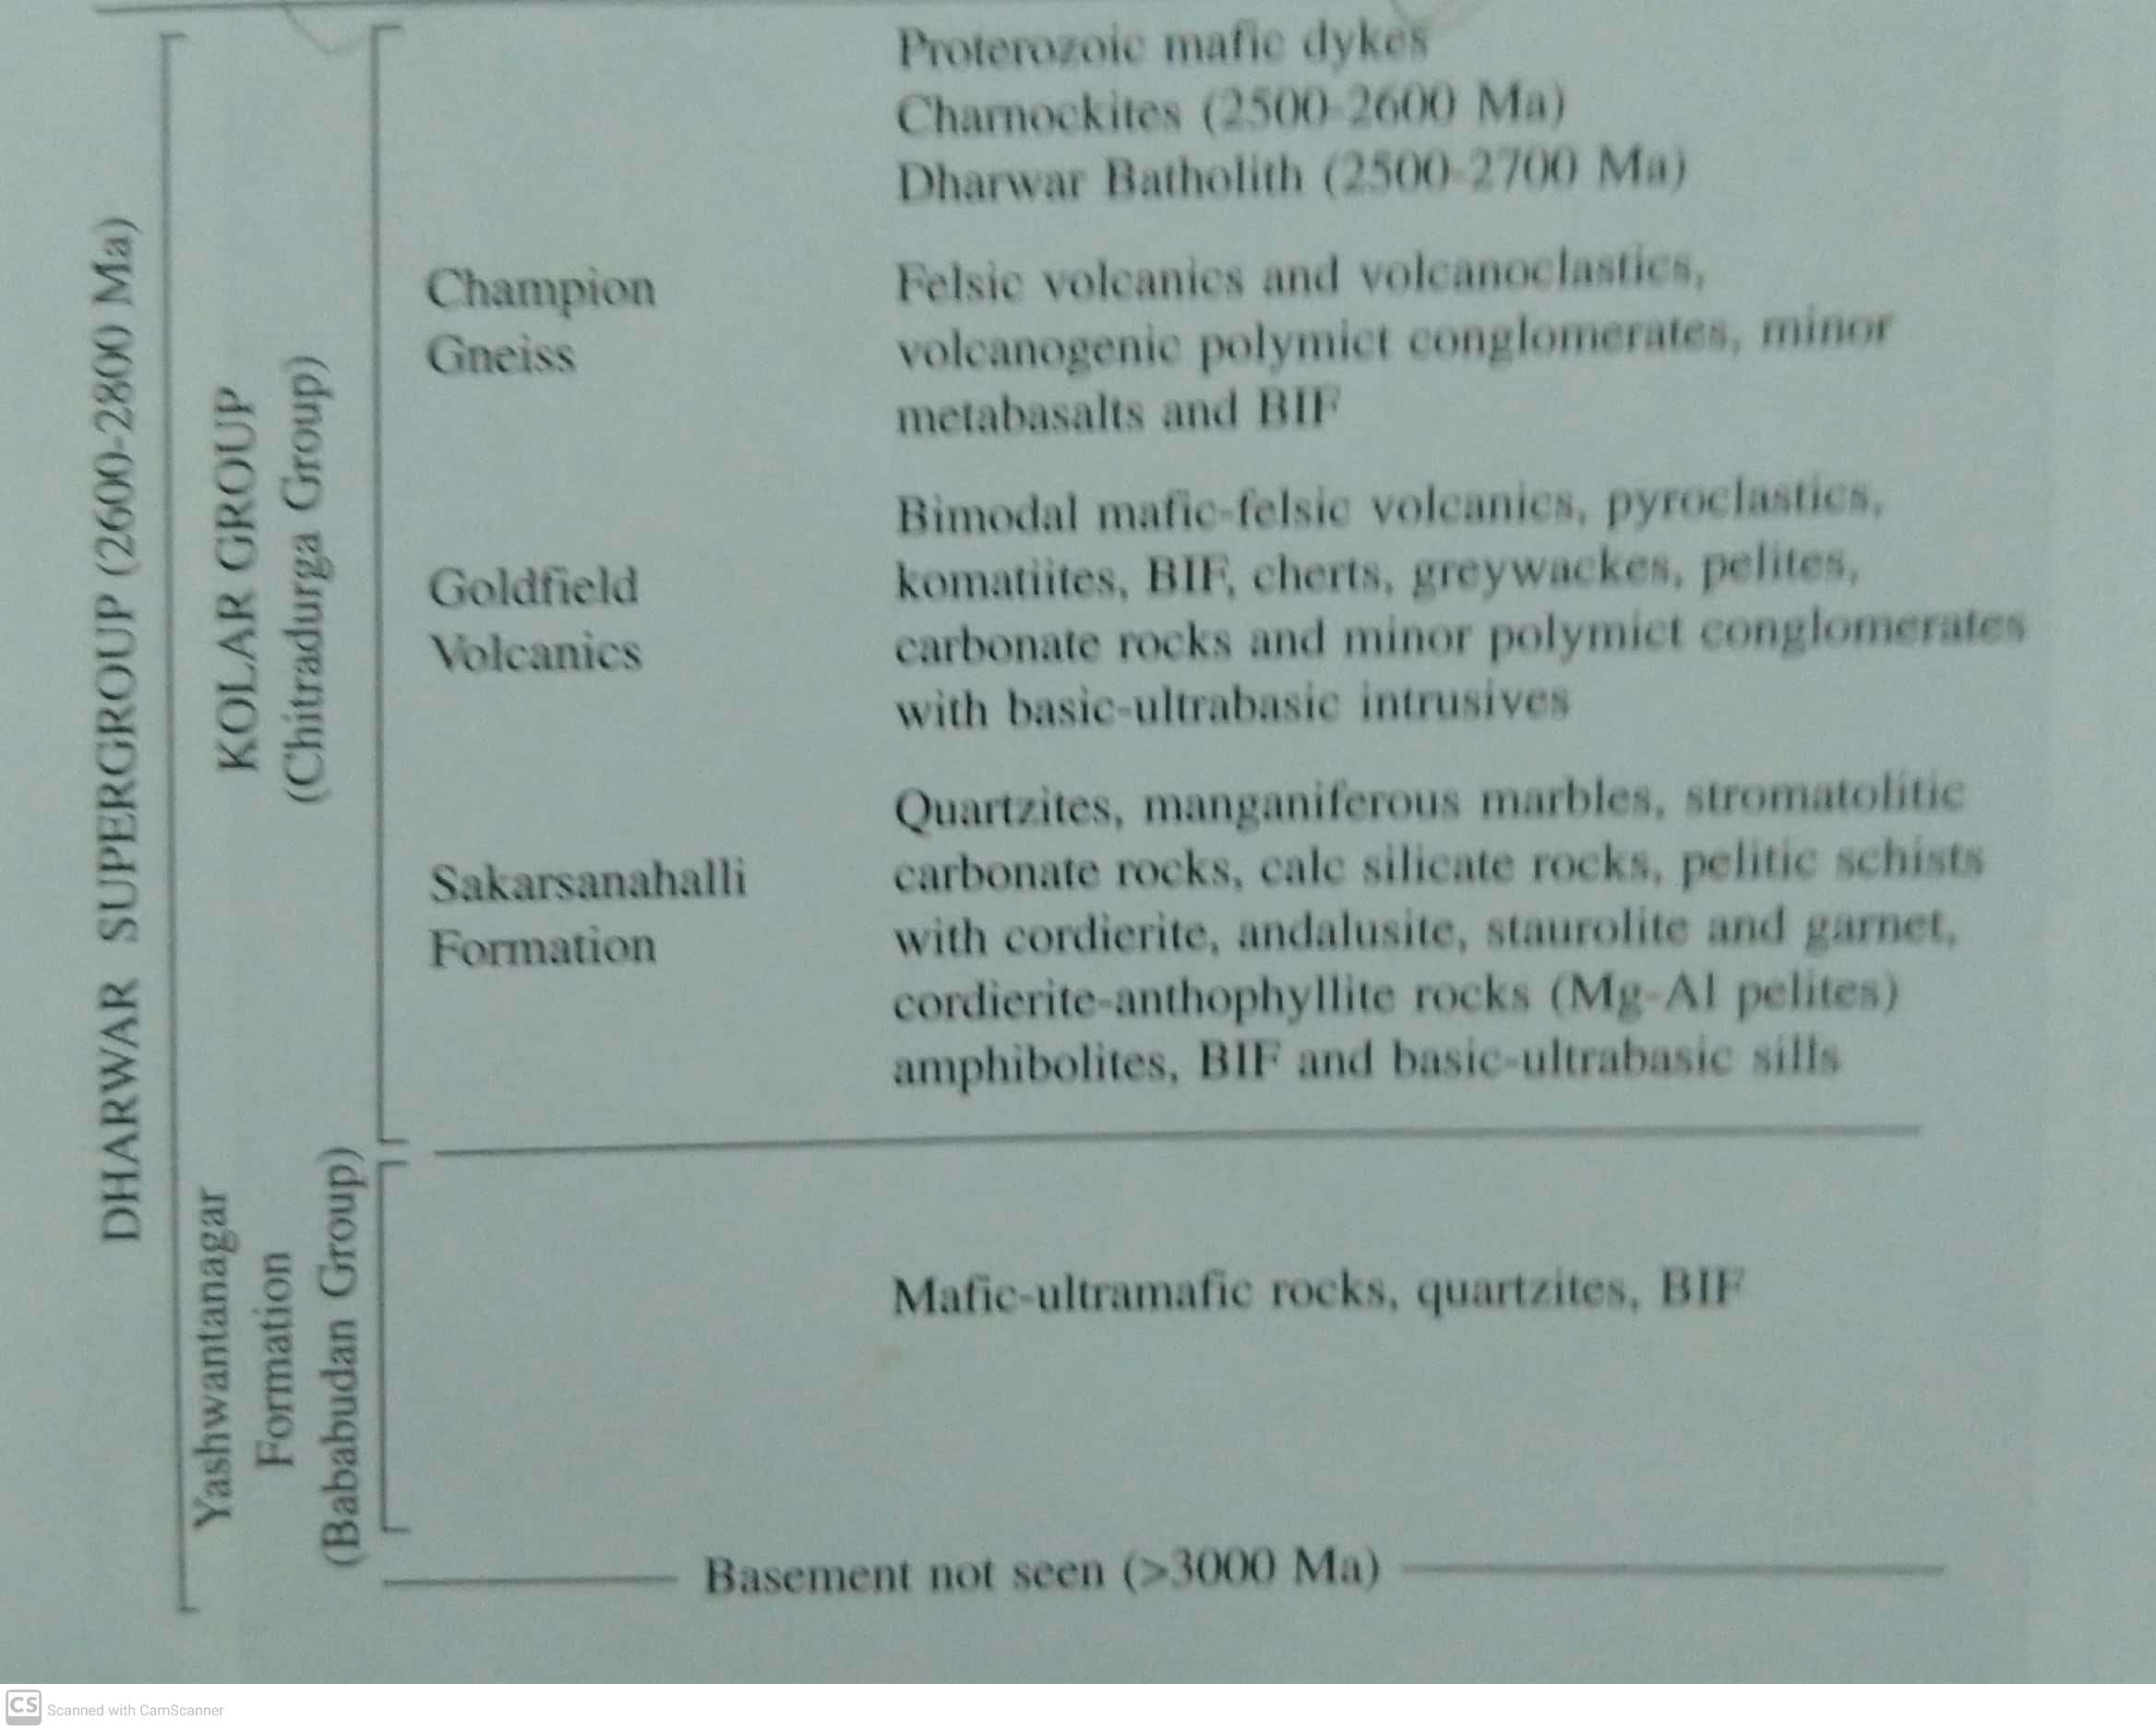

Slide 38
