Slide 1
Bastar Protocontinent
Presentation by
Dr. Ritesh Purohit

Slide 2
Bastar Protocontinent
The Bastar Protocontinent occupies a quadrangular area bounded by the Narmada-Son Lineament in the NW, the Godavari Lineament (Rift basin) in the SW, the Mahanadi Lineament (Rift basin) in the NE and the Eastern Ghats Granulite Belt in the SE.
Lithologically, the Protocontinent comprises patches of Archaean supracrustal rocks (greenstone belts) developed over a vast expanse of gneiss-granite ensembles of various ages.
The post-Archaean (Proterozoic) supracrustals include the Sausar Group in the north and the intra-cratonic platformal successions of the Chattisgarh Group and its equivalents in the south.
All these cover successions occur over the sialic Archaean basement. The Deccan Trap covers a considerable part of the Bastar Protocontinent in the north.

Slide 3
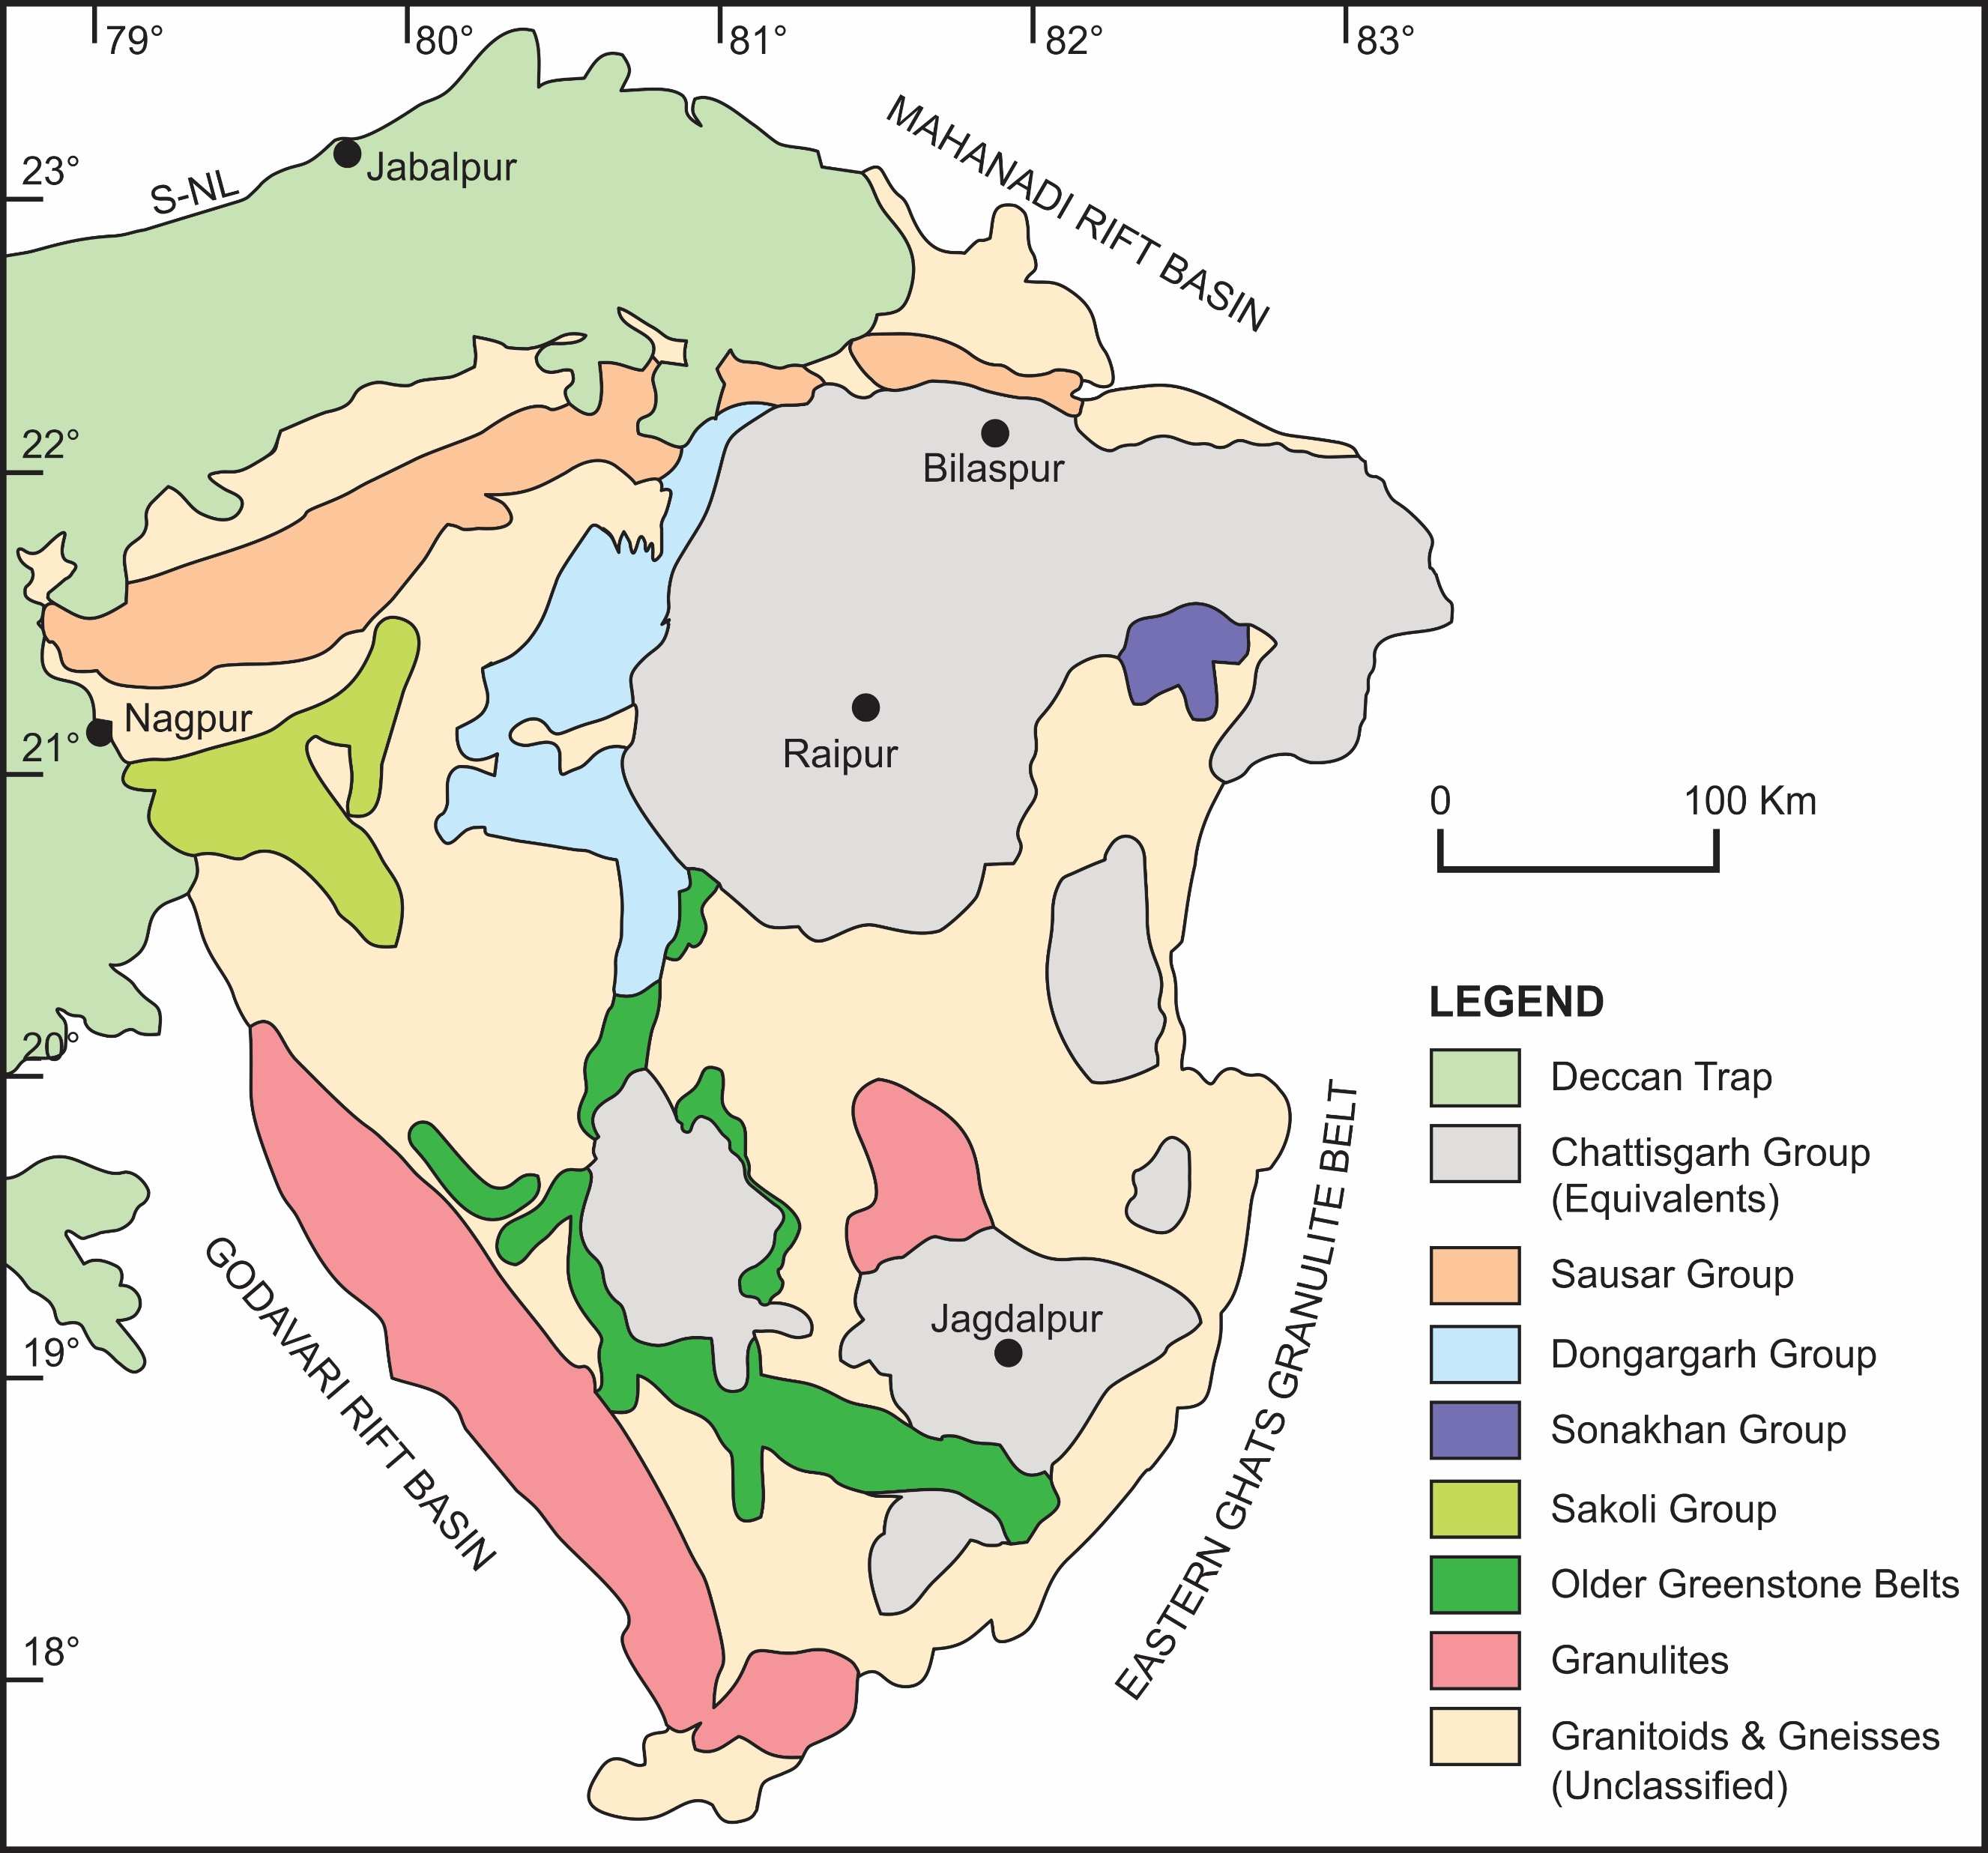

Slide 4
1. Basement rocks and younger Granites
The oldest supracrustals which occur predominantly in the southern part show features of dismembered greenstone sequences enclosed within the vast stretch of the sialic basement rocks.
The most primitive basement rocks evolved at ~ 3.6 Ga. A number of episodes of reconstitution of basement rocks have been reported from the different parts of the Bastar Protocontinent.
The youngest ones occur as irregular massive bodies of granites often enclosing relics of the foliated gneissic rocks.
Some patches of granulite-facies rocks occur in this Precambrian crustal block along with granites formed during different periods in the Archaean.

Slide 5
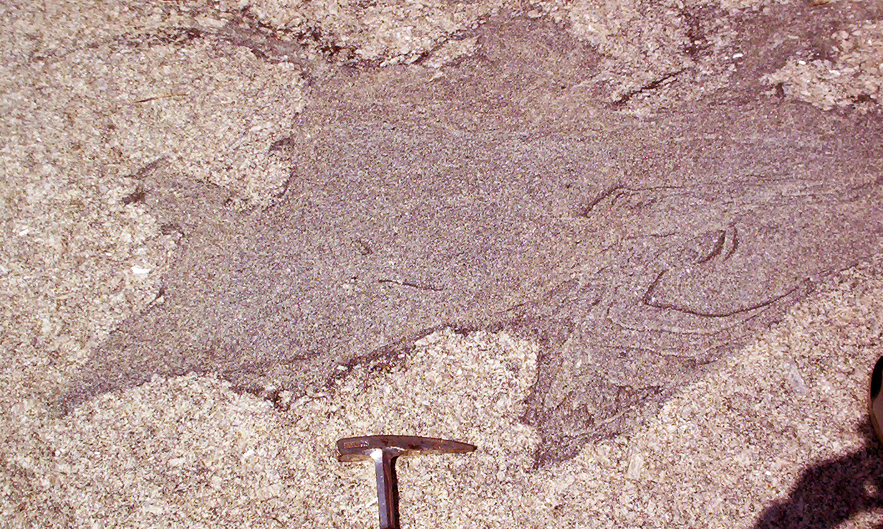

Slide 6
Gneisses, Granites and Granulites
The gneissic rocks in the Bastar Protocontinent are similar to the Peninsular Gneiss of the Dharwar Protocontinent.
Three different gneissic bodies are recognised which occupy distinctly different geographic domains. These are:
1. Tirodi Gneiss forming the basement for the Palaeoproterozoic Sausar Group, in north of what has been described as “Central Indian TectonicZone”
2. Amgaon Gneiss occupying the triangular area around the Sakoli Group outcrops in the northwest; and
3. Sukma Gneiss occurring in the southern part of the Protocontinent.

Slide 7
Gneisses contd.
Apart from the larger bodies of tonalite-trodhjemite-granodiorite gneisses with ill-defined boundaries, several patches and enclaves of gneisses also occur within the outcrops of granites of diverse composition.
One such is the Baya Gneiss forming the base of the Sonakhan Greenstone Belt in the northeast.
Unlike the typical ‘Archaean’ banded gneiss of the Baya Gneiss ‘type’, the gneissic rocks which constitute the basement for the younger Palaeoproterozoic Sausar belt looks more like a mylonite gneiss (‘streaky gneiss’, Pascoe, 1973) that usually develop in sheared rocks.

Slide 8
Banded Gneiss and Mylonite/Streaky Gneiss

Slide 9
Granites:
Several bodies of massive granite which vary in composition from k-granites to granodiorite, trondhjemite and tonalite at different parts of the Protocontinents.
The major bodies of granite include Dongargarh, Malanjkhand and Kanker Granites (Ramachandra and Roy, 1998).
Wanjari et al. (2005) reported occurrence of at least four phases of granite that also include high-Al₂O₃ trondhjemite from the “Amgaon Gneissic Complex” in the northern part (Sausar Belt) of the Bastar Protocontinent.
These granites, according to the authors, represent lower-crustal and mid-crustal level anatexis of tonalities (tonalite-trondjhemite-granodiorite) interlayered with metasediments along shear zones that supplied both heat and fluids.

Slide 10
Geochonology of Gneisses and Granites:
Sarkar et al. (1993) reported single zircon U-Pb age of 3509 +14/−7 Ma from the trodhjemite-tonalite from Markampara in the southern part of the Protocontinent.
Ghosh (2004) reported 3562±2 Ma ²⁰⁷Pb/²⁰⁶Pb zircon-concordia age from the tonalite (tonalite-trondhjemite gneiss) from the central part of the Protocontinent.
Rajesh et al. (2009) reported 3582.6 ± 4 Ma U-Pb zircon concordia age from the low-K tonalite–trondhjemite–granodiorite rocks the Dalli-Rajhara region in the central part of the Bastar Protocontinent.
The younger well-constrained ages of granite-gneiss complex point to two different late/end-Archaean events. These are 3018 ± 61 Ma Pb-Pb isotope age of granite intrusive into the Sukma Gneiss, and 2573 ± 139 Ma Rb/Sr isochron age of the youngest (end-Archaean) intrusive leucocratic granite which include the Malanjkhand Granite hosting Andean-type Porphyry Copper-Molybdenum deposits (Stein et al., 2004).

Slide 11
Granulites:
Intermingling of granulites and gneisses is quite common in the belt of Tirodi Gneiss.
Petrologically, these include mafic granulite, porphyritic charnockite, cordierite granulite and amphibolites, all occurring as rafts and lensoid bodies within the gneissic complex.
The oldest age from these granulite lenses is 2672 ± 54 Ma (Roy et al. 2006), which is thought as the age of the basement (represented by Tirodi Gneiss) of the overlying Sausar Group.
Two more granulite belts are reported in the Bastar Protocontinent.
Bhopalpatnam granulite belt at the northern shoulder of Godavari Rift Basin.An age range between 1.6–1.9 Ga (Santosh et al., 2004).
Kondagaon granulite belt occurring in the middle of the Protocontinent. Charnockite and leptynite dominate especially in the western part of this granulite body. An age of around 2.6 Ga (Vansutre and Hari, 2010).

Slide 12
2. Archaean Greenstone Belts:
Overlying the granite-gneiss ensemble whose antiquity dates back to ~3.6 Ga occur a series of greenstone belts formed at different times.
Four different groups of greenstone belts of different ages are known in the Bastar Protocontinent. These are from oldest to the youngest: 1. Sukma Greenstone Belt;
2. Bengpal Greenstone Belt;
3. Bailadila Greenstone Belt;
4. Kotri-Dungargarh / Sakoli / Sonakhan Greenstone Belts.

Slide 13
Sukma Greenstone Belt
Several discontinuous, widespread bodies of the Sukma Group, occur within the oldest gneissic basement locally known as the Sukma Gneiss.
The main lithological unit of this ensemble includes sillimanite-bearing quartzite, calc-silicate gneiss and amphibolite, cordierite-anthophyllite schist, cordierite-biotite-sillimanite-garnet schist and banded iron formation.
The basal unit of the Sukma Group is sillimanite bearing quartzite with or without fuchsite, corundum and graphite. The association of high-alumina minerals in the quartzite is significant suggesting derivation from sialic source and may be interpreted as alumina-rich palaeosols.
The presence of fuchsite in the sequence further indicates that the source rocks also included chromium-bearing ultramafic protoliths.
The presence of graphite indicates a reducing ‘oxygen-deficient’ condition of the depositional environment.
The Sukma Basin was evolved on the tonalite-trondhjemite-granodiorite gneiss. The oldest age of the basement is cited by Sarkar et al. (1993), the single zircon U-Pb age of 3509 +14/−7 Ma of the trodhjemite-tonalite gneisses of Markampara.

Slide 14
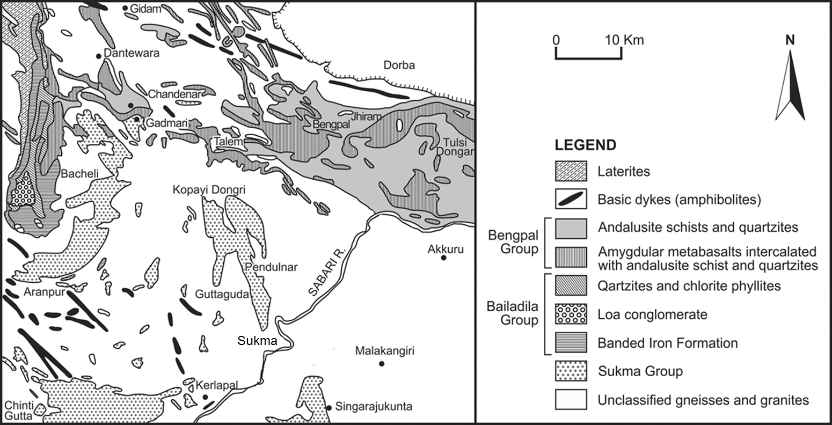

Slide 15
Bengpal Greenstone Belt:
The rocks occurs in a NNW-SSE trending band which extends from Bailadilla Hills in the central Bastar to Tulsi Dongar Hills close to the Eastern Ghats Granulite Belt
In the eastern part the outcrops show more continuous presence than in the western part where the outcrops are relatively sparse.
Lithologically, it is similar to that of the Sukma Group. The main constituents include sericite quartzite interlayered with amygdular meta-basalt and tuff, ferruginous quartz schist, banded iron formation and some isolated bodies of conglomerate.
The meta-basalts are interlayered with immature arkose grading to orthoquartzite quartz-wacke/lithic wacke, meta-pelites and banded iron formation.
There are several enclaves of rocks associated with andalusite-chiastolite schist, andalusite quartzite and chloritoid schist, which formed during an event of thermal metamorphism induced by intrusion of granitic bodies.
Ramakrishnan (1990) has reported an angular unconformity between the Bengpal Group and the underlying Sukma Group from the Gadmari-Chandenar area in the northern part of the Southern Bastar.
The Sukma Group with respect to the Bengpal Group is indicated in the nature of the outcrops of the former making a girdle like pattern of the isolated outcrops compared to the straight-running band-like appearance of the Bengpal outcrops.

Slide 16
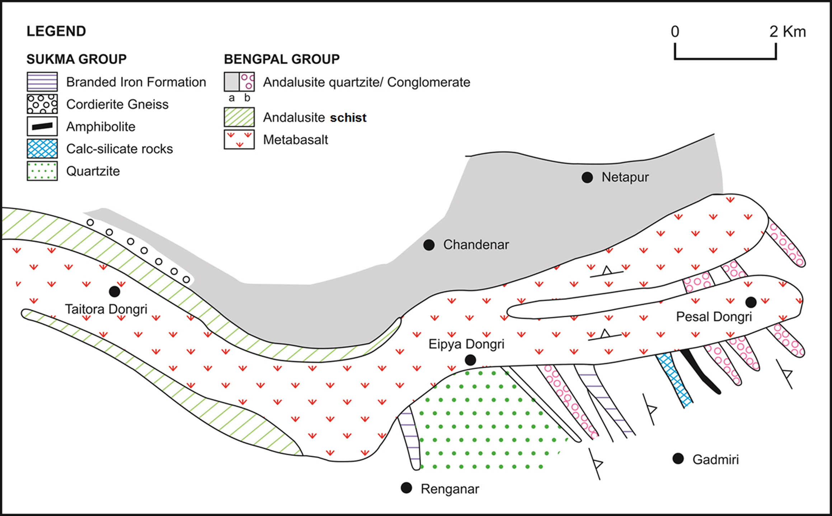

Slide 17
Bailadila Greenstone Belt
The components of the greenstone belt includes an ensemble of mildly metamorphosed, dominantly ferruginous sedimentary rocks.
The Bailadila Hills, representing the type area for the Bailadila Group, form the southernmost part of the Kotri-Dongargarh belt.
The iron ore deposits extend from the north of Bailadila to Rowghat and Delli-Rajhara.
The Bailadila ores are considered similar to the Superior-type banded iron ore formation occurring in association with the fine clastics, tuffs and some minor mafic volcanics.
The Sukma Group forms a garland like outcrops of around the north-south trending Bailadila Hills. The predominantly east-west trend of the Sukma Group as well as the west north-south trending Bengpal Group have been swept in parallelism with the north trending Bailadila Group.

Slide 18
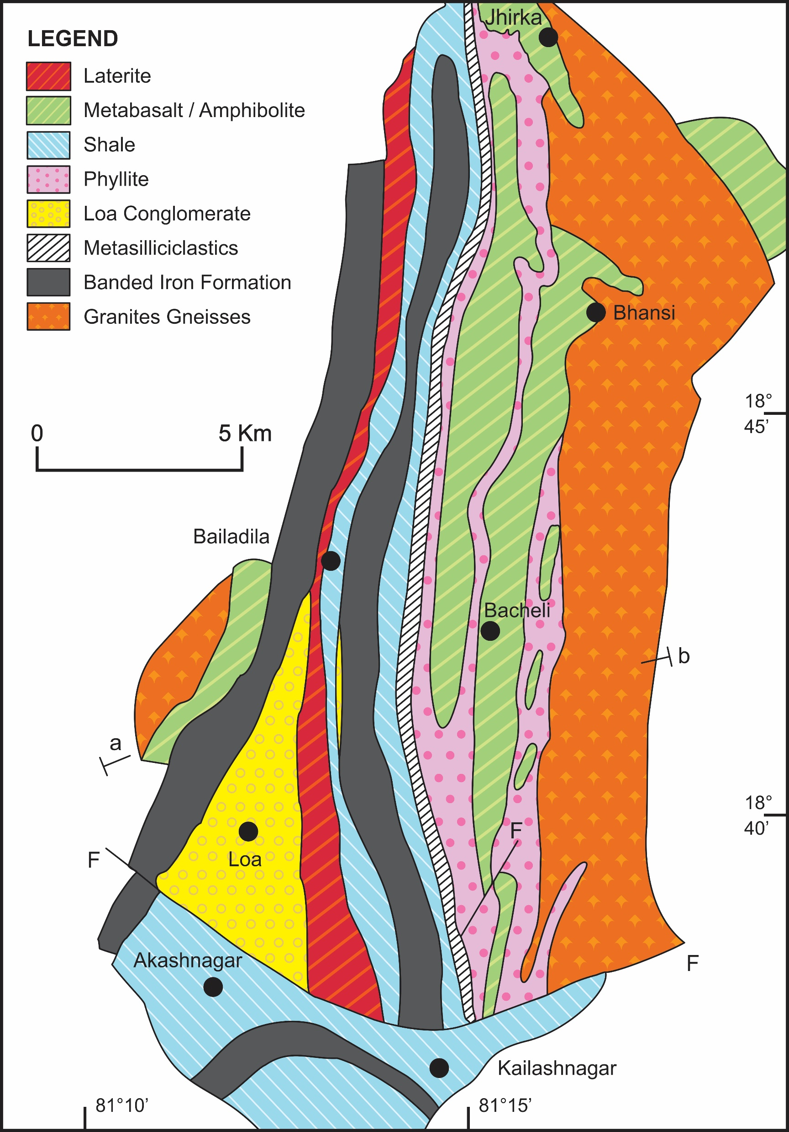

Slide 19
Stratigraphic succession of the Bailadila Group (After Khan and Bhattacharyya, 1993)
Formation | Lithology
Kailashnagar Formation (200-500 m) Loa Formation (5-150 m) East Ridge Formation (206-639 m) Bacheli Formation (240-335 m) Bansi Formation (600-1,000 m) | Banded heamatite quartzite, banded magnetite quartzite with pockets of iron ore deposits. Upper horizon: Intensely lateritized ferruginous shale. Lower horizon: Polymictic conglomerate in silt and sand. Ferruginous tuffaceous shale interbedded with ferruginous chert, banded ferruginous chert/jaspillite and carbonaceous phyllite. Graded bedded wackes and cross bedded arenite with intercalations of shale. Chlorite-mica phyllite with or without porphyroblasts of andalusite. Amydular basalt.

Slide 20
Sakoli Greenstone Belt (end-Archaean)(~Donagrah Group)
It covers an area of about 350 sq. km forming a triangular outcrop pattern (the Bhandara Triangle of Naqvi and Rogers, 1986)
It constitutes the westernmost ensemble of the end-Archaean greenstone belts in the Bastar Protocontinent.
The ensemble consists of low-grade metamorphic rocks comprising dominantly of a volcano-sedimentary sequence made of slates, phyllites, bimodal volcanic suite including metabasalts, along with meta-chert, conglomerate and banded iron formation.
The slate and phyllite dominate the rock assemblages covering about 80% of the area. The rest 20% of the outcrops belong to the felsic to mafic bimodal volcanics.
The Amgaon Gneiss constitute the basement of the Sakoli Group.
The Sakoli Group does not host any major mineral deposit except the reported occurrence of gold in the felsic volcanic suites.

Slide 21
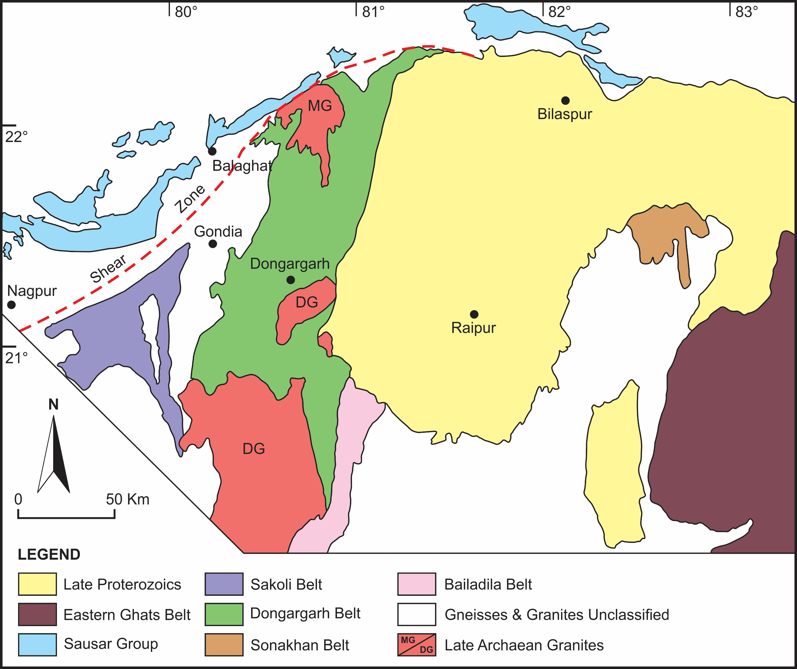

Slide 22
Stratigraphic succession of the Sakoli Group
Formation | Lithology
Pawni Formation Bhiwapur Formation Dhabetekri Formation Gaikhuri Formation | Slate, phyllite, arkose, quartz-arenite, and conglomerate Mainly meta-pelites (±chloritoid, andalusite, garnet, staurolite) with interbands of felsic volcanic/tuffs and exhalative sediments (coticules, tourmalinites, chlorites, banded iron formation, rare basalts; and Zn-Cu-gold and scheelite mineralization. Mainly metabasalts with minor ultramafics, cherts, metapelites and banded iron formation. Conglomerate, coarse arenite, arkose, minor pelites (partly carbonaceous) and banded iron formation.

Slide 23
Kotri-Donagarh Belt (~Sakoli Group)
Sarkar (1958) introduced a new stratigraphic entity in the Kotri-Dongarh region in the north-central part of the Bastar Protocontinent, which he named the Dongargarh Group.
The newly recognised Dungargarh Group were earlier considered a part of the pristine ‘Sakoli system’ (Pascoe, 1973).
Sandwiched between the Sakoli Belt and the granite-gneiss (Amgaon Gneiss) on the west and the late Proterozoic Chattisgarh Basin on the east, the broadly linear outcrops of the Dongargarh Group extend for about 300 km in the north-south direction.
The Dongargarh Group consists of pyroclastics and volcanics which also include volcano-clastic arenite and arkosic wackes.
Sensarma and Mukhopadhyay (2014) proposed a revision of Dongargarh stratigraphy defining a continuous stratigraphic succession with only minor breaks between different lithostratigraphic formations.
The Dongargarh succession shows a weakly developed regional synformal structure (Sitagota Syncline) which has a low 20° plunge towards north.

Slide 24
Stratigraphic succession of the Dongargarh Group (After Sensarma and Mukhopadhyay, 2014).
Group | Formation
Dongargarh Group | Mangikhuta Volcanics Karutola Formation Sitagota volcanics Chandsuraj Formation Pitepani Volcanics Bijli Rhyolites (including Habitola rhyolitic breccia- conglomerate)

Slide 25
Geochronology of Donagarh Group
The study of Rb-Sr systematics of the Bijli Rhyolite,which vary between 2180 ± 25 Ma (Sarkar et al. 1981) and 2503 ± 35 Ma (Krishnamurthy et al. 1990).
Such a wide variation in ages, according to Sensarma and Mukhopadhyay (2014), could be the result of mere thermal disturbance on the isotope system at different times.
On the other hand, the dating based on U-Pb single-crystal zircon study (Ghosh, 2004) indicates ~2530 Ma age of the oldest rhyolite in the Kotri belt.
The granites intrusive into the components of the Dungargarh Group show younger range age.
(i) 2465 ± 22 Ma (Dongargarh Granite) (Rb-Sr whole rock age, Krishnamurthy et al. 1988);
(ii) 2405 ± 63Ma (Malanjkhand Grey-Gneiss)(Rb-Sr whole rock age, Panigrahi et al. 1993)
(iii) 2467 ± 38 Malanjkhand Granite (Rb-Sr whole rock age, Panigrahi et al. 1993)
(iv) 2478 ± 9 (Re-Os age, Stein et al. 2004); and
(v) 2490 ± 8 (U-Pb single zircon age, Panigrahi et al. 2002).
All the above cited ages confirm a virtual conformable end-Archaean evolution of the granites which intruded into the Dongarhgarh Group, marking the culmination of the Archaean crustal evolutionary history of the belt.

Slide 26
Sonakhan Greenstone Belt:
It covers an area of about 1200 sq. km extending in NNW-SSE for about 40 km from Sonakhan in the north to Remra in the south having maximum width of 40 km in the central part.
The belt exposes a bimodal volcanics-sedimentary sequence which unconformably overlies the basement gneissic complex locally known as the Baya Gneiss.
The Sonakhan Group comprises three formations (i) Baghmara Formation and (ii) Arjuni Formation, and (iii) Bilari Formation.
The oldest Baghmara Formation consists dominantly of meta-ultramafics, meta-basalt, meta-gabbro, pyroclastics of intermediate to basic composition, ignimbrite, rhyolite, acid tuff, pebbly tremolite-actinolite schist, and banded iron formation.
The Arjuni Formation constitutes a thick sedimentary pile interspersed with minor volcanics overlies the basal Baghmara Formation. The polymictic conglomerate member the Arjuni Formation is known as the Jonk Conglomerate includes mixtures of boulders and large-sized pebbles and blocks of protolith rocks.
The very nature of the Jonk Conglomerate suggests characters of fluvio-glacial origin of the conglomerate body.
The youngest Bilari Group comprises both felsic and mafic intrusive and extrusive bodies like the Arangi mafic volcanics, meta-basalt and pyroclastics along with rhyolite.

Slide 27
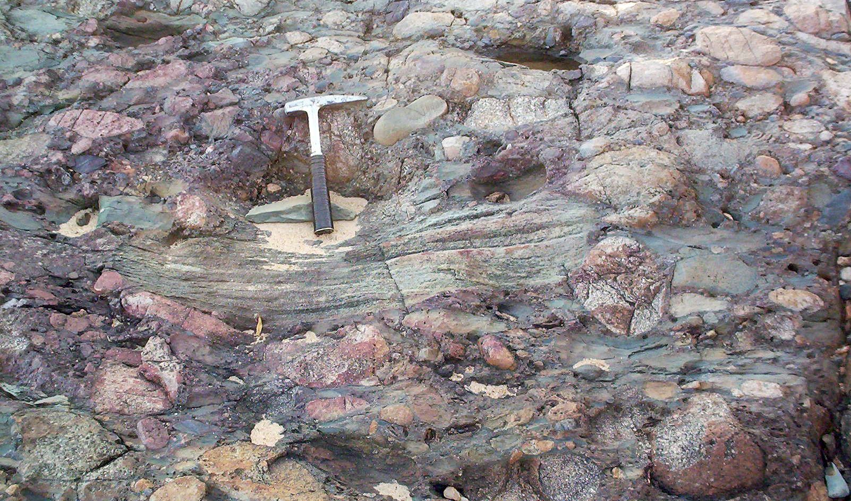

Slide 28
Palaeoproterozoic Sausar Group/Thrust Belt
The Sausar Fold Belt extends from the N of Nagpur to the NE of Bilaspur.
Forms a narrow, about 32 km wide, arcuate zone spanning over 215 km between Ramakona in the east and Baihar in the west.
Lithostratigraphically, the different components show intimate intermixing with gneisses and granites of different ages (Tirodi Gneiss and younger granites).
Sausar Group is made up primarily of metamorphosed rocks of the sand-shale-carbonate association hosting rich manganese ore deposits (Fermor, 1909, 1936). The calcareous sedimentary formations are better developed in the north and west, whereas the argillaeous formations dominate in the south and east of the belt.

Slide 30
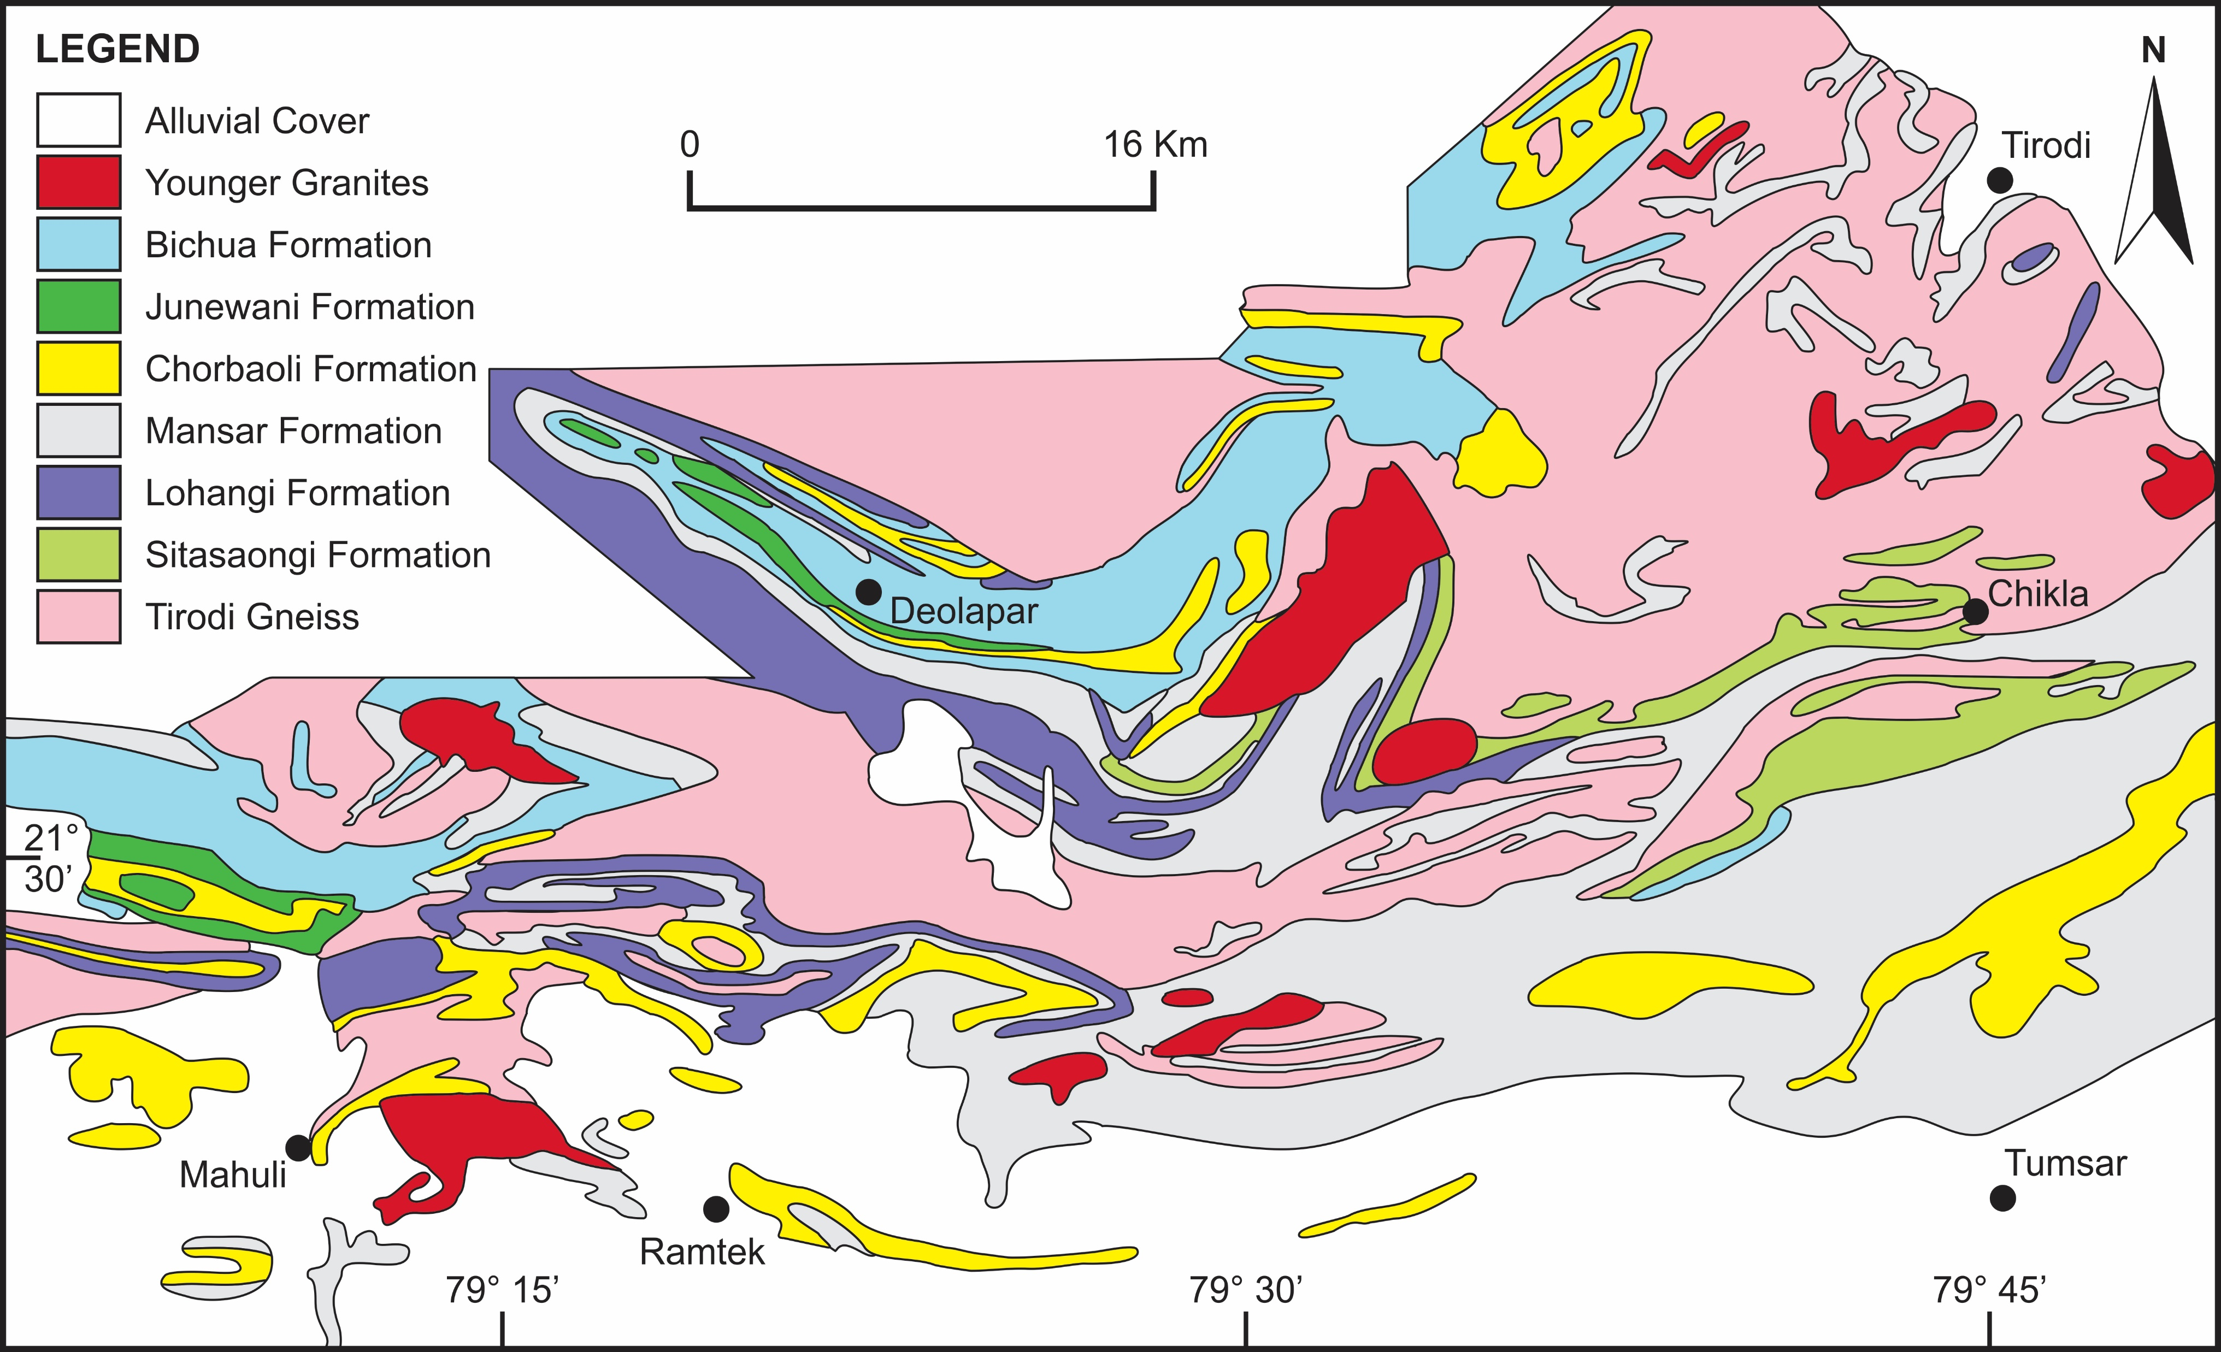

Slide 31
Stratigraphic scheme issues:
A complex deformation pattern resulting from the development of large recumbent folding and thrusting which greatly inhibited proper understanding of the normal stratigraphic order of the constituent rocks.
Absence of indubitable field evidence for determining the basement-cover relationship over the major part of the area.
In spite of the reported occurrences of polymictic conglomerate in different parts, there is little evidence to prove that these are ‘basal’ conglomerates formed during the basin opening of the Sausar Group
Widespread sedimentary facies variation in highly dismembered rocks.
The scheme proposed by Narayanaswamy et al. (1963) is being thought as a ‘workable’ stratigraphic succession in a highly tectonized belt in the northern part of the Bastar Protocontinent. The stratigraphic succession does not differ significantly from that which was originally proposed by L. L. Fermor and W.D. West about seven decades ago.

Slide 32
Stratigraphic succession of Sausar Group (After Narayanaswamy et al. 1963)
Formation | Lithology
Bichua Junewani Chorbaoli Mansar Lohangi Sitasaongi | Dolomite, serpentine-bearing marble, calc-silicate granulite Muscovite-biotite-quartz schists, granulite and gneisses Quartzite, micaceous and feldspathic quartz schist, (local) conglomerate Mica schist and graphite phyllite and quartzite hosting manganese ores Three inter-digitating members: Lohangi Member: Calcareous dolomite and marble Utiketa Member: Calc-silicate granulite and gneisses Kadbikhera Member: Quartz-biotite granulite and gneisses Quartz-muscovite feldspar schist and intercalated quartzite
Tirodi Gneiss (Basement)

Slide 33
Some important points to understand the Sausar lithostratigraphy
The first is that the Sausar Group does not comprise only the meta-sedimentary rocks but also include volcanic rocks especially in the basal part (Mohanty, 2006).
A suggestion has been made about the glaciogenic origin for the diamictites that occur in the lower part of the succession (Mohanty et al. 2015).
Added to these is the discovery of palaeosols from the contact of the Sausar Group and its basement, the Tirodi Gneiss (Mohanty and Nanda, 2016).

Slide 34
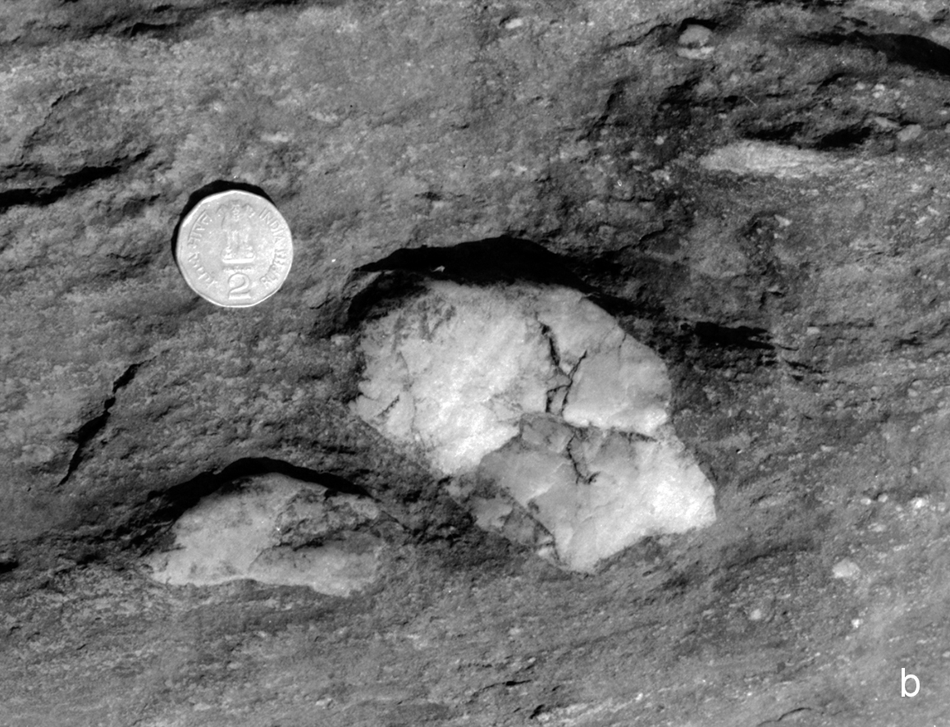
Glaciogenic diamictic conglomerate

Slide 35
Structures in Sausar Group
The Sausar Fold-Thrust Belt is bounded between two very prominent northerly dipping shear zones. The southern Shear Zone separates the high-grade Sausar metasediments in the north from the dominantly low-grade end-Archaean greenstone belts in the south.
In early literatures, the Sausar Group rocks have been described as stacks of complexly folded sequence (Pascoe 1973). The complexity of structure finds expression in the outcrop pattern of this fold-thrust belt (Figure 5.13a, b).
According to Fermor (1909), the reversal of rock sequence from the northern to the southern part is because of the development of large recumbent folding.
The major recumbent fold which occurs as a large fold-thrust nappe is called the Deolapar Nappe (West, 1936). The development of thrust slices in the form of nappes in the Sausar Belt has also been compared with the Alpine tectonics by the early nineteenth century geologists (Pascoe, 1973).

Slide 36
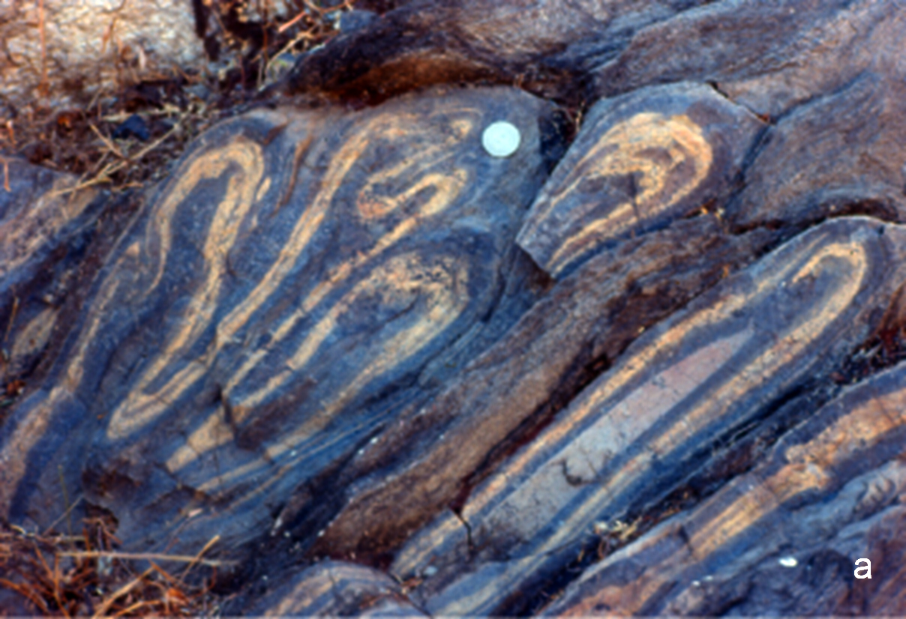
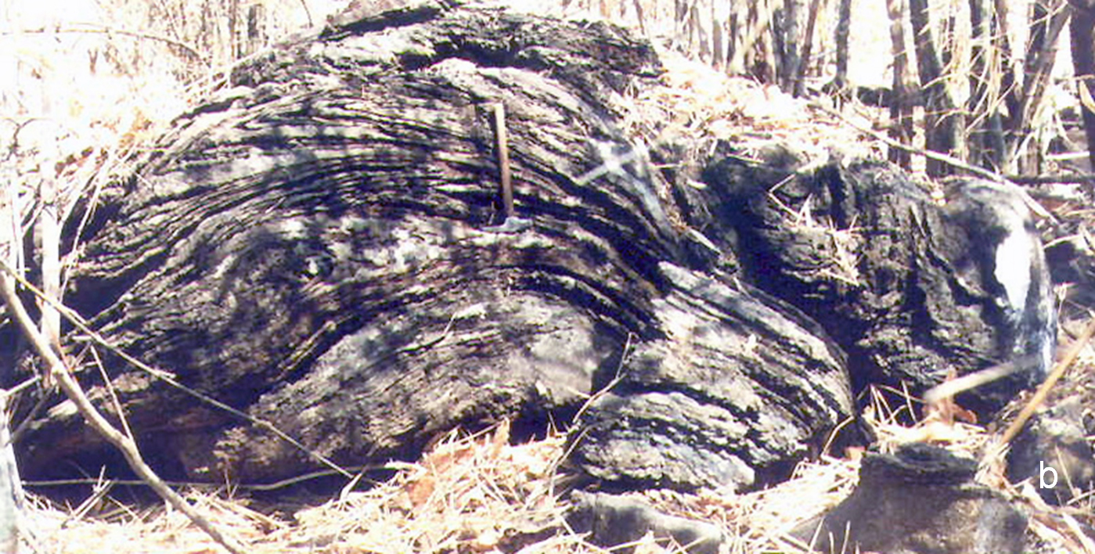
Sheared and dissected isoclinal folds

Slide 37
Ages of basement in Sausar Group
Close intermingling of the bodies of granulites and the granite-gneisses described as the Tirodi Gneiss.
The granulite bodies occur as rafts and ‘lens-shaped’ outcrops of different sizes on either side of the Sausar belt rocks. The oldest age of these granulite lenses is 2672 ± 54 Ma which is thought as the age of the Tirodi Gneiss representing the basement on which the overlies Sausar Group.
Several isotope age data are known from different parts which suggest that the Archaean Crust forming processes in the Bastar Protocontinent did not culminate precisely at 2500 Ma, but the tectonothermal activity continued beyond this landmark date. e.g. 2465 ± 22 Ma is Dongargarh Granite, 2405 ± 63 Ma is Malanjkhand Granite
The Sausar Group did not get fully cratonized at least before ~2450 Ma.

Slide 38
Age brackets for Sausar Group
The depositional age of the Sausar Group is not known precisely.
The occurrence of palaeosols over the peneplained basement (Mohanty and Nanda, 2016) provides an indication of a prolonged period of erosion, weathering and non-deposition subsequent to the date of cratonization of the youngest Archaean basement, which in the case of Bastar Protocontinent could not have been earlier than ~2450 Ma.
The peneplanation is a very slow process, it may be rationally presumed that the Sausar Basin did not open at least before 2350 Ma.
Some information on the possible age of the basin formation comes from the reported evidence of ‘snowball’ Earth from the basal succession of the Sausar Group (Mohanty et al. 2015). Globally, this Palaeoproterozoic snowball event is broadly known as the Huronian glaciation which spans between 2400 and 2100 Ma. In this context the occurrence of sedimentary manganese deposits in Sausar Group assume importance.

Slide 39
Summary of Crustal Evolution
The Bastar Protocontinent is endowed with well-preserved records of Precambrian evolutionary history that spans over two and a half billion years before present.
Four different stages of crustal growth beginning with the development of the earliest sialic Crust over which were deposited the successive supracrustals ensembles.
The growth history of the Precambrian Crust was initiated with the development granite gneisses which are compositionally comparable with the tonalite-tronjhemite-granodiorite gneisses that characterize the oldest basement.
The available geochronologic data indicate that the oldest sialic Crust in the Bastar Protocontinent formed at ~3.56 Ga before present. The older supracrustal formations which evolved over this sialic basement included greenstone sequences formed during the mid-Archaean to the late-Archaean time.
The most primitive of these was the lithostratigraphic ensemble called the Sukma Group.

Slide 40
Summary Contd.
No precise date is available about the formation of the Sukma Group. But conventionally it is taken to have developed before the intrusion of the 3.00 Ga old granitic rocks.
Lithologic formations of Sukma Group show dominance of aluminous silicate minerals in the succession. Apart from that there are some localized pockets of high-alumina deposits which may be interpreted as alumina rich palaeosols.
The next greenstone sequence is the Bengapal Group which overlies the Sukma Group with a profound angular unconformity in between.
Lithologically the Bengapal formations show considerable similarity with the older Sukma Group rocks.
The Bailadila Group, which comes next in the succession, includes an ensemble of mildly metamorphosed, dominantly ferruginous sedimentary rocks in the Bastar Protocontinent.
The Bailadila Hills, representing the type area for the Bailadila Group host rich iron ore deposits that are considered similar to the Superior-type banded iron ore formation occurring in association with the fine clastics and tuffs, with minor mafic volcanics.

Slide 41
Summary contd.
The greenstone belts that occur north of the north-south running linear Bailadila Greenstone Belt are described as the end-Archaean greenstone belts. These include 1. the Sakoli Belt in the west, 2. the Kotri-Dongargarh Belt in the middle and the Sonakhan Belt in the east.
The Sakoli Group consists of low-grade volcano-sedimentary sequence with meta-chert, conglomerate and banded iron formation. The complex structural geometry of the Sakoli Group is thought to have developed due to repeated folding of the intricately framed initial basin geometry.
A new stratigraphic entity in the Kotri-Dongarh Belt, the newly defined Dongargarh Group include, meta-pelites, quartz arenite, with minor ultramafic rocks, felsic volcanics and the banded iron formation. Available isotope data confirm the end-Archaean age of the Dongarhgarh Group. The intrusion of granites marks the culmination of the Dongargarh tectonothermal cycle.

Slide 42
Summary Contd.
The Sonakhan Group includes a bimodal volcano-sedimentary sequence overlying the basement gneissic complex locally known as Baya Gneiss. An important component of the Sonakhan Group is known as the Jonk conglomerate, which includes mixtures of boulders and large-sized pebbles and blocks and chunks of protolith rocks simulating the characters of fluvio-glacial deposits.
The Proterozoic Sausar Group occurs intimately intermingled with granite-gneiss complexes of different ages and bodies of granulites. It is made up primarily of metamorphosed rocks of the sand-shale-carbonate association hosting rich manganese ore deposits.
The basal succession of the Sausar Group comprises some diamictites of glaciogenic origin. The Sausar Group occurs as stacks of complexly folded sequence showing development of thrust slices in the form of nappes which have been compared with the Alpine Nappes of the central Europe.
Based on scanty data on geochronology collating with the different depositional features the age of Sausar Group may be tentatively set at 2.2 to 2.1 Ga before present.

Slide 45
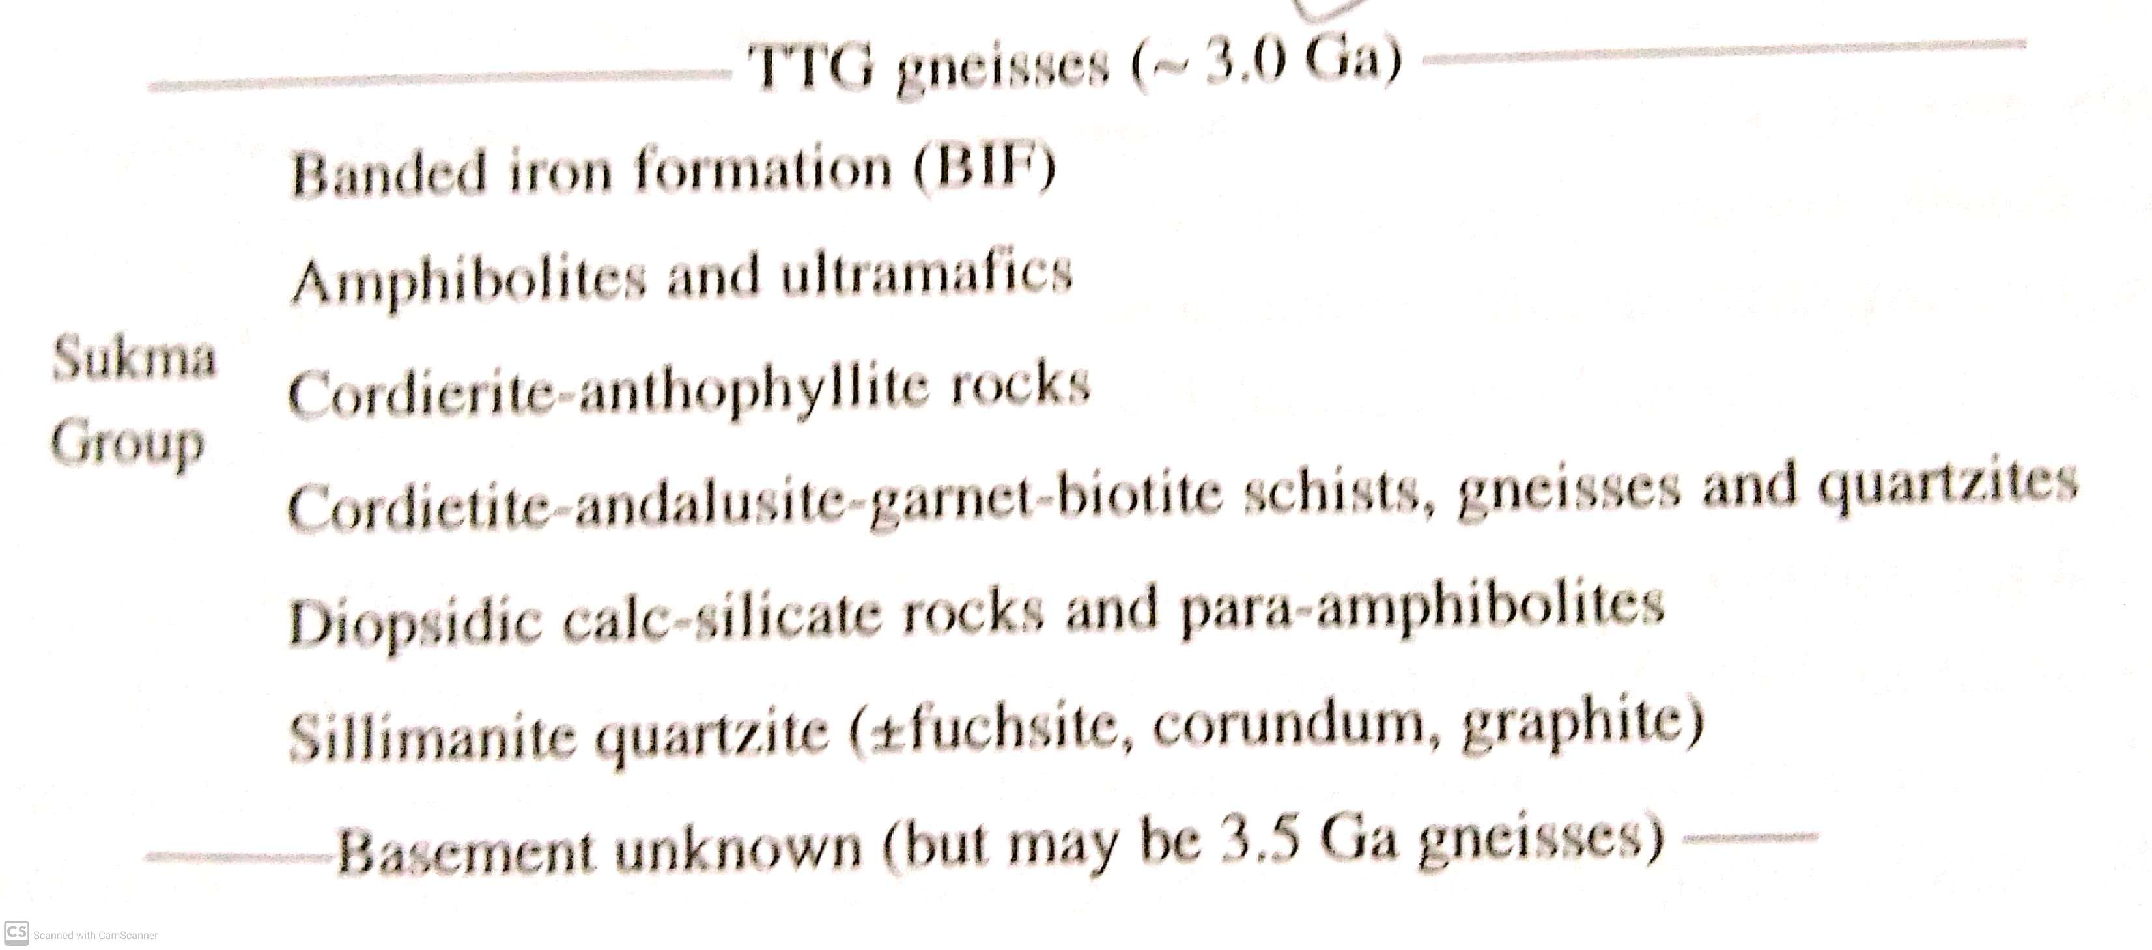

Slide 47
