Slide 1
Bundelkhand Protocontinent
Presentation By
Ritesh Purohit

Slide 2
Introduction
The Bundelkhand Protocontinent occurring between the Aravalli Protocontinent in the west and southwest and the Narmada-Son Lineament in the south and southeast constitutes a distinctive Precambrian crustal block in the northern part of the Peninsular Indian Shield.
The major Precambrian constituents comprise the semi-circular granitoid-dominated terrane and the Vindhyan Supergroup which virtually encircle it except in the alluvial covered northern part.
Much of the Precambrian geology of the Protocontinent is also obscured because of the cover of Deccan Volcanics in the southern and southwestern part.
Some isolated patches of the Vindhyan rocks occur as ‘inliers’, mostly in the southeastern parts, which help in defining the extent of the Vindhyan Basin in the south.

Slide 3
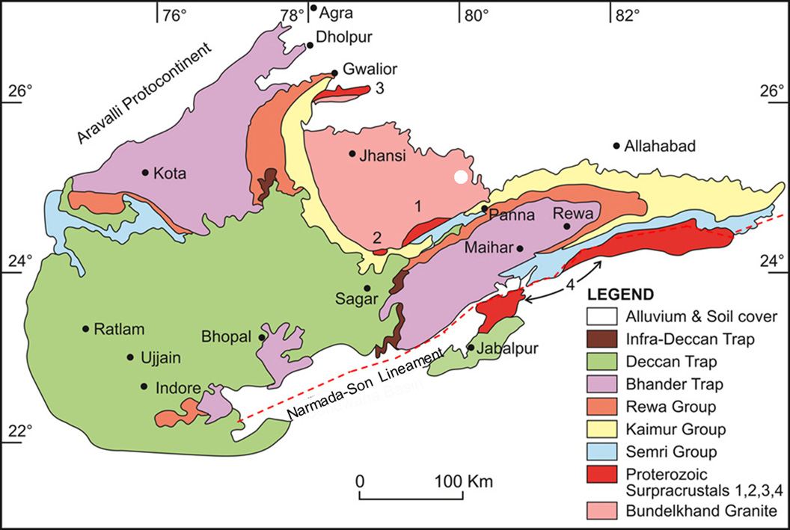

Slide 4
General Geology
The dominant lithology is the granitoids of diverse composition and textural characters.
The terrane includes outcrops of some volcano-sedimentary rocks representing dismembered greenstone belts along with the isolated outcrops of granite gneiss that constitutes the oldest Archaean basement.
The dominantly granitoid terrane is bounded both in the northwest and in the southeast by two major sedimentary basins named the Gwalior and Bijawar Basins, respectively.
The Sonrai Basin occurring south of Girar in all likelihood occurs in continuation of the larger Bijawar Basin in the northeast.
The geological depiction of the Bundelkhand Craton would be incomplete without the mention of two other rather ‘unique’ features
(i) the northeast-southwest trending Quartz reefs and
(ii) the WNW – ESE trending mafic dykes cross-cutting the reefs.

Slide 5
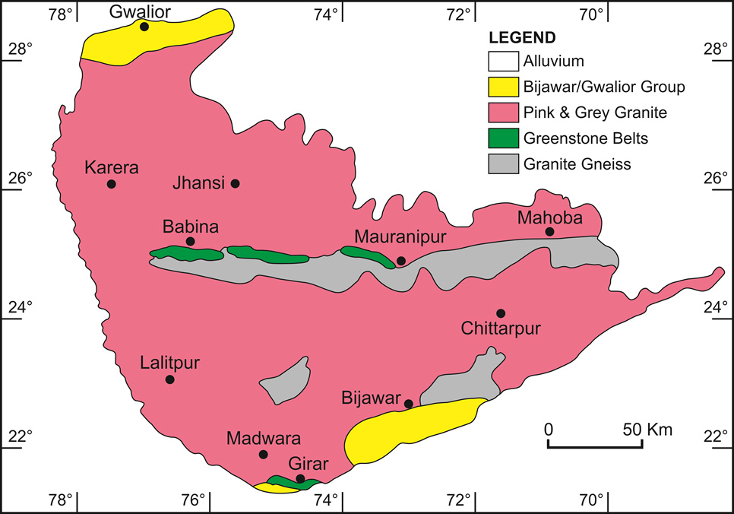

Slide 6
Banded Granite Gneiss: Basement Complex
The oldest rocks recorded in the Bundelkhand Craton include a group of gneisses of diverse composition and character, which occur as slivers, rafts and enclaves in the Bundelkhand Granite.
The most characteristic feature in these rocks is the gneissic banding, which in certain instances show complex deformation features.
Large, linear, E–W trending outcrops of banded granite gneisses with mafic enclaves occur in different parts of the massif around Mahoba, Kuraicha, Babina and Karera.
Though occur mainly along east-west running bands within the younger granitoids, the foliation trend in the gneissic rocks is generally in the WNW-ESE direction.

Slide 7
Petrology
Petrologically trondjhemite-tonalite-granodiorite gneiss that commonly occur in the Archaean basement complexes. Some of the dark coloured varieties represent quartz diorite.
Shows highly fractionated REE patterns with HREE and Yb depletion and no significant Eu anomaly comparable well with the rocks described from the different Archaean terranes.
There are reported occurrences of some high-aluminous rocks along with clinopyroxene bearing amphibolites in the basement gneisses. The common mineral assemblage of the high-aluminous metasediments includes K-feldspar, plagioclase, biotite, cordierite, sillimanite, ±garnet and quartz.
It may be suggested that the occurrence of the high aluminous sediments in the basement association represent the localized zones of paleosols which formed on top of the exposed basement rocks, formed and metamorphosed at different times along with the associated rocks.
A close association of the high aluminous metasediments with the ‘quartz-free Fe, Na-poor high-Mg schists has been reported from the Bundelkhand Craton.
The association of such unusual metasedimentary rock association may be explained by assuming these as palaeosols drawing sediments from two different sources, the granitic as well as Mg rich ultramafic rocks.

Slide 8
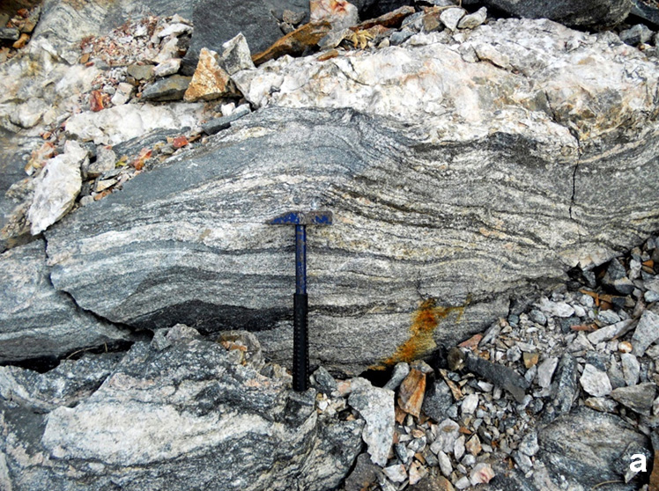
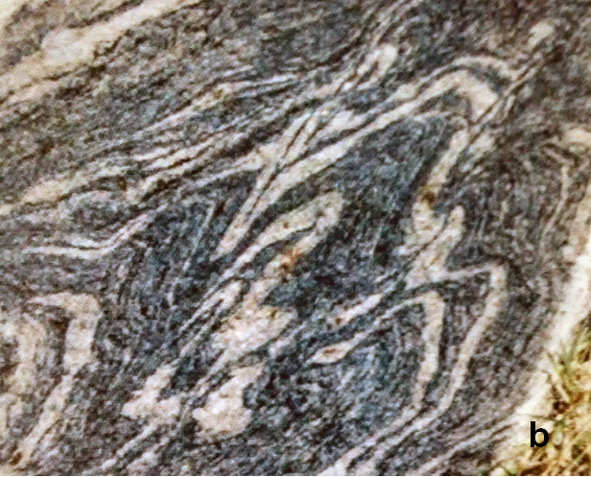
Outcrops of the typical banded granitic gneiss from Bundelkhand

Slide 9
Geochronology
The ²⁰⁷Pb/²⁰⁶Pb zircon ages of the banded gneisses from the Kuraicha region yielded 3297±8 and 3270±8 Ma ages (Mondal et al. 2002).
A mafic enclave within the banded gneiss from the adjacent Babina area yielded 3249±5 (Mondal et al., 2002).
Kaur et al. (2014) based on LA-ICP-MS study using the combined U–Pb and Lu–Hf isotope of zircon from the similar gneissic rocks suggested 3551 ± 6 Ma and 3551 ± 30 Ma ages.
A little older U–Pb and Lu–Hf isotope age of 3.59 Ga is reported by Saha et al. (2016) from the gneisses in the nearby area.

Slide 10
Greenstone Belt Association
Some dismembered greenstone belts are:
(i) the Babina-Kuraicha-Mauranipur-Mahoba Belt in the central part
(ii) the Madawra to Baraitha belt through Girar in south.
The dominant metasedimentary constituent of these greenstone belts is the banded iron formation which occurs in association with amphibolite and ultramafic schist along with quartzite (generally fuchsite bearing), metapelite and marble.
The ultramafic rocks include peridotite, dunite, pyroxenite and gabbro in close association with metabasics. Veinlets of chrysotile asbestos are noted in the ultramafic rocks. At places, smaller bodies of felsic volcanics of dacite-rhyolite composition have also been reported.

Slide 11
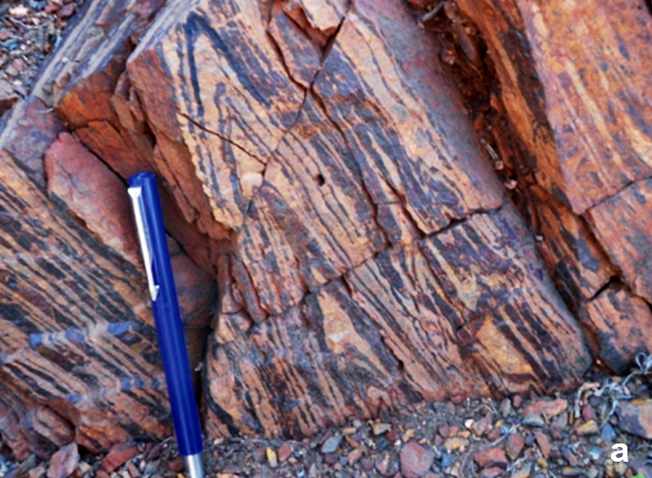
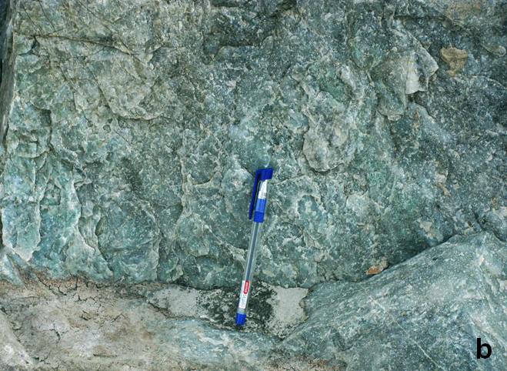
Outcrop of banded iron formation from the Babina region.
Fuchsite bearing quartzite from the green stone belt near Jhansi (courtesy Vinod Singh)

Slide 12
Geological map between Babina and Prithvipur southeast of Jhansi showing disposition of rock assemblages. Modified after Singh and Slabunov (2015).

Slide 13
Deformation and ages
The Babina-Kuraicha-Mauranipur-Mahoba greenstone belt generally shows an east-west linear trend bounded between parallel shear zones. Even the contact between different components of the greenstone belts appears tectonic, marked by development of ductile shear zones.
The U-Pb zircon age of early felsic volcanics in the Babina area is 2813±20 Ma (Singh and Slabunov, 2015).
Similar, ~2.8 Ga age is also reported for the banded iron formation and amphibolite of the Babina-Karaicha-Mauranipur-Mahoba belt (Singh and Slabunov, 2015).
There are some monazite and zircon ages which vary in age between 2.73 and 2.54 Ga in the Babina area (Saha et al., 2011; Singh and Slabunov, 2015). The younger ages could have resulted from the overprinting in the younger thermal events.

Slide 14
Bundelkhand Granite
The major component of the Bundelkhand Craton is the Bundelkhand Granite described as a vast plutonic complex of ‘batholithic dimension’ and so better known as a ‘granite country’ marked by rounded outcrops, ranging from small mounds and tors of granite to large dome-shaped hillocks.
Bundelkhand Granite have been classified into four different categories: (i) hornblende granite, (ii) biotite granite, (iii) hornblende-biotite granite and (iv) leucogranite. The leucogranite, apart from occurring in diverse shades between grey and pink, shows wide variation in grain size from fine to very coarse.
Some of these show coarse porphyritic character in which large grains of feldspar crystals (usually pink coloured k-feldspar) occur within a fine grained matrix. The most granitoid types belong to the uniformed textured, medium-grained pink varieties of biotite granite and the leucogranite, which are used as building stones.

Slide 15
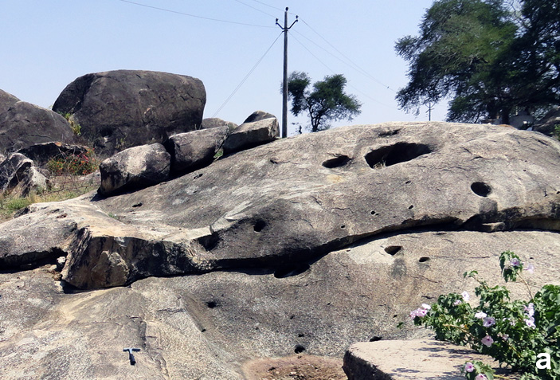
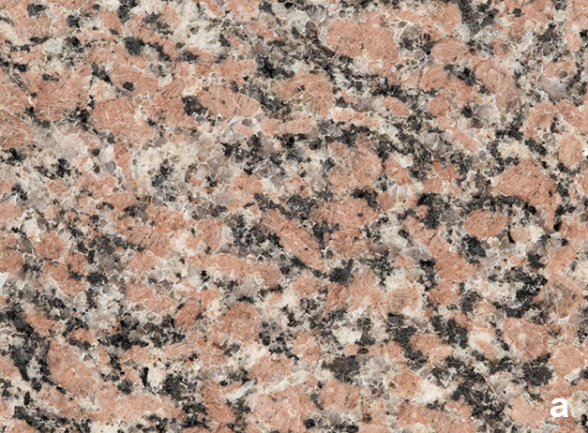
The granite country is marked by rounded outcrops, ranging from small mounds and tors of granite. Photo courtesy Erfan Mondal.
The polished slabs of pink biotite granite from the Bundelkhand Granite.

Slide 16
Based on the cross-cutting field relationship, the hornblende bearing granitoids have been classified as the oldest granitoid bodies (Mondal and Zainuddin, 1996).
The youngest ones are represented by the coarse porphyritic leucogranites.
The granitoids range between quartz diorite to ‘normal’ k-feldspar bearing granite. These granitoids are having calc-alkaline trend showing meta-aluminous character.
All the granitic bodies are undeformed and unmetamorphosed in character; often containing small, angular enclaves of older rocks. Presence of faint traces of planar fabric defined by the traces of dark and lighter shades even within the massive varieties is not uncommon in the massive granitoids.
Studies on ²⁰⁷Pb/²⁰⁶Pb zircon geochronology (Mondal et al. 2002) indicated 2516 ± 4 Ma age of the hornblende bearing quartz diorite.
Virtually similar 2521 ± 7 Ma has been ascribed to the age of the biotite bearing granitoids (Mondal et al. 1998). The leucogranitoids from the Bundelkhand Granite yielded 2492 ± 10 Ma age.
The emplacement of these end-Archaean, undeformed and unmetamorphosed granitoids marks the cratonization of the Archaean Crust in the region.

Slide 17
Quartz Reefs and Dolerite Dykes
The quartz reefs and the dolerite dykes are two key features that show cross cutting relationship making an obtuse angle of about 105⁰ in the easterly direction.
They form a series of wall-like topographic feature abruptly rising to the formidable heights, at places about 175 m above the ground level.
Basu (1986) has recorded about 11 major reefs in the entire region, spaced at 12.5 to 19 km apart. The longest reef runs for about 100 km. There are numerous smaller bodies of quartz reefs which are spaced at an average of 6 km.
The average trend of the reefs is N35⁰E–S35⁰W.
The vein-like reefs are composed almost essentially of coarse-grained quartz having diffused grain boundaries. Less than 5% of the composition is made of impurities like hematite and pyrite.
The veins show virtually monotonous grey-white colour. Though generally strain-free, evidence of shearing is noted along the margin of the veins with the host bodies at some places.

Slide 18
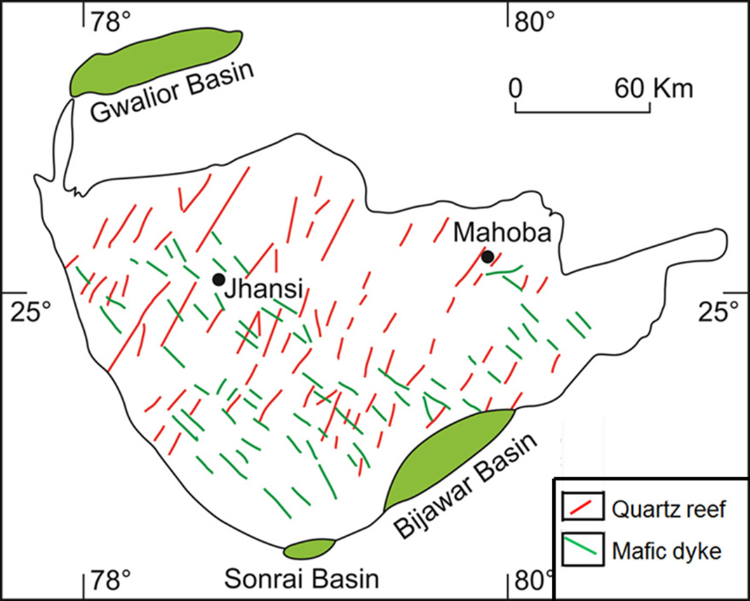

Slide 19
Reefs and Dykes contd.
The dolerite dykes like the quartz reefs are so numerous that some authors described these intrusives as the ‘mafic dyke swarms’. The dykes, unlike the quartz reefs, do not form local topographic highs but generally occur in levelled ground.
Like the quartz reefs, most of the dykes are discontinuous and run for variable lengths. Many dykes instead being a single band occur in a number of parallel bands having different widths.
The maximum width of the dykes is around 45 m in SW corner of the Bundelkhand Craton. The dolerite dykes generally show dark, greyish green colour in the exposed surfaces.
Like quartz reefs, the dykes also maintain a very persistent trend. The average trend of these dykes is N40⁰W-S40⁰E.
At some localities, the dolerite dykes are seen to cut across the quartz reefs. The reverse relationship has not been observed in the field. The information indicates that the quartz reefs were formed earlier than the intrusion of the dolerite dykes.

Slide 20
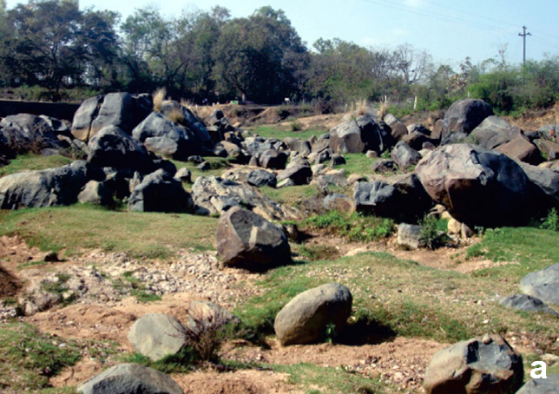
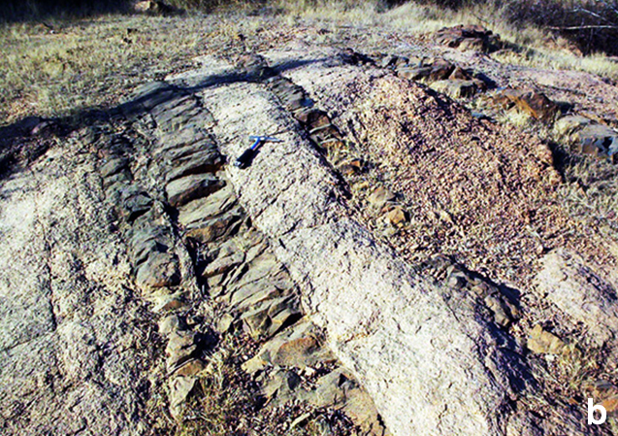
Scattered boulders of dolerite occurring almost at the ground level near Lalitpur-Mehrauni road near Chapru. Photo reproduced from Kaur et al. (2016).
Several set of thin, parallel dolerite dykes intruding into Bundelkhand Granite. Photo courtesy Erfan Mondal.

Slide 21
Petrologically, most of the dolerite dykes are typically tholeiites and quartz normative types (Mallikajuna Rao et al., 2005). The ultramafic types are komatiite or basaltic komatiite in composition and show olivine normative character.
⁴⁰Ar/³⁹Ar determinations of the dolerite suggest two phases of dyke activity at ca. 2150 Ma and 2000 Ma. A polyphase evolution of the mafic-ultramafic dykes is also supported by the Palaeomagnetic study of these dykes (Mallikajurna Rao et al., 2005).
Some dykes, rarely though, show different orientations like the prominent Mahobha dyke which runs for about 20 km in the ENE-WSW direction. Petrochemically, the ENE-WSW oriented Mahoba dyke is said to be similar to the WNW-ESE trending dykes.
Detailed field studies, however, indicated occurrence of dykes of diverse petro-chemical character irrespective of their orientation. Palaeomagnetic studies indicated occurrences of number of phases of mafic-ultramafic dyke intrusion in the Bundelkhand Craton (Mallikharjuna Rao et al., 2005).

Slide 22
Younger Supracrustals: Bijawar Group
The Bijawar Basin is a ENE-WSW trending, about 100 km long, narrow basin in the southeastern part of the Bundelkhand Craton­.
The Bijawar sediments with some volcanics were deposited on the eroded surfaces of the gneiss-granite complex of the Bundelkhand Craton.
At Girar, in the southern part of the Craton, however, the Bijawar sediments lie over the BIF of the greenstone assemblage.
The Bijawar rocks which generally have gently dipping beds, locally show folding and faulting.
The basal succession starts with quartz pebble conglomerate overlain by thick pile of mafic lava. The next overlying unit includes stromatolite bearing dolomitic limestone. The youngest succession consists of ferruginous sandstone and shale. Some lenses of conglomerate occur in the upper section.

Slide 23
Stratigraphic succession
Kumar et al. (1990) have suggested the following stratigraphic succession of the Bijawar Group:
Karri Sandstone
Hirapur Phosphorite
Malehra Chert-Breccia
Pukhra Sandstone
Dargaowan Sill
Bajno Dolomite
Bhusar Basalt
Kawar Conglomerate

Slide 24
Stratigraphy and age
The suggested stratigraphic framework may need revision in view of the possibility that the repetition of beds shown in succession might be fault controlled, and do not due to repetitive depositional events.
No well-constrained data are available for the Bijawar rocks except the age data for the Bijawar basalt (Dargawan Sill) which indicate 1989 ± 71 Ma, and that of the Kurat lava indicate 1691 ± 16 Ma.
However, in spite of very high error factor, the age of the Bijawar Group is presumed to be between 1700 and 1800 Ma (Haldar and Ghosh, 2000).

Slide 25
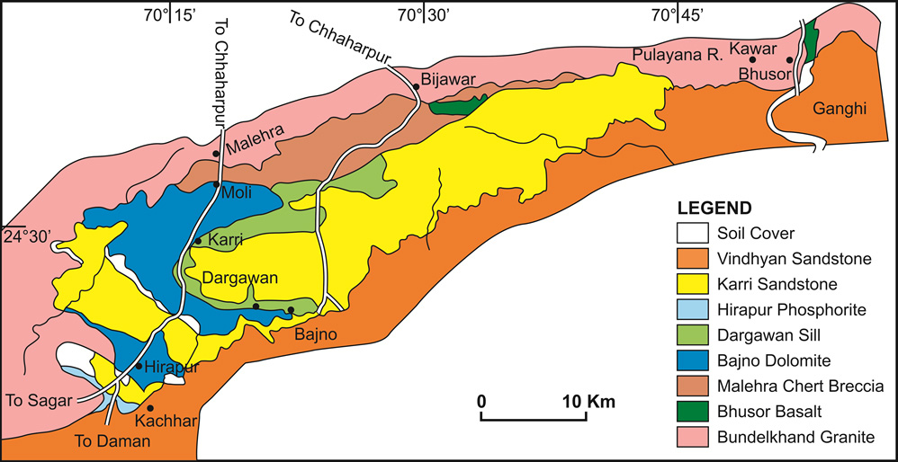
Geological map of the Bijawar Basin. Reproduced from Kumar et al. (1990)

Slide 26
Gwalior Group
The Gwalior Basin, occurring in the NW part, is a narrow basin unconformably overlying the Budelkhand Craton.
It consists of a basal sequence (Par Formation) comprising grit and conglomerate grading upward into glauconitic sandstone and layers of stromatolitic limestone.
The overlying Morar Formation includes siliceous and ferruginous shale, chert, banded red jasper, limestone and sandstone; the latter having some volcanic contributions. In addition, several layers of tholeiite basalt and grabboic sills are present in the Morar Formation.
There are ill-constrained Rb-Sr isotope ages for the Gwalior Group lava is 1830±200 Ma. The combined Rb-Sr and K-Ar studies indicate ~1800 Ma ages of mafic dykes.
Age-wise, therefore, the Bijawar and the Gwalior Groups appear to be broadly contemporaneous.

Slide 27
Table showing tectonostratigraphic evolution of the Bundelkhand Craton
1850-1800 Ma | Deposition of Bijawar and Gwalior Groups
2150 to 2000 Ma ????? | Intrusion of dolerite & other mafic dykes Formation of Quartz reefs
Development of post cratonization fractures
2500 Ma | Emplacement of Bundelkhand Granite & Cratonization
2800 Ma | Evolution of the Greenstones belts
3200 Ma to 3550 Ma | Formation of Bundelkhand granite-gneiss (the basement)
3800 Ma | Growth of early Crust

