Slide 1
Dryers
Dr. Garima Joshi
Assistant Professor
III sem, Unit operations

Slide 2
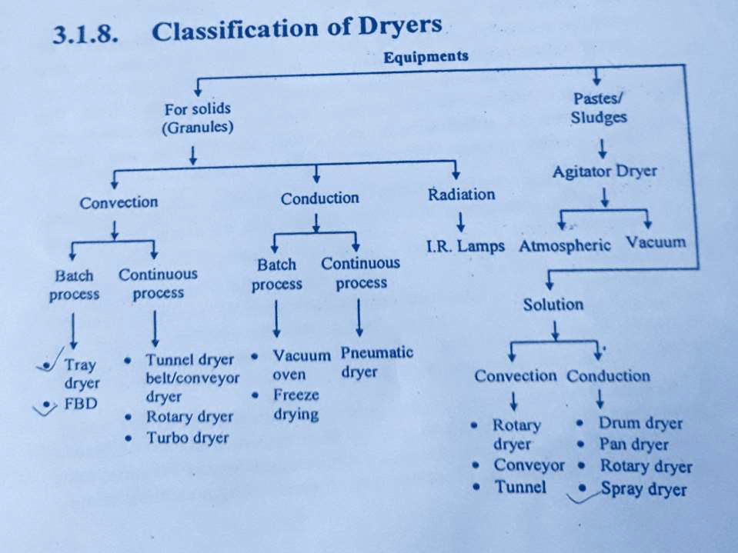
Dryers

Slide 3
List of equipments
Drum dryer,
Spray dryer,
Fluidised bed dryer,
Tray dryer,
Tunnel dryer,
Vacuum dryer,
Microwave,
Radiant heat dryer (infra red)
Rotary dryer
Freeze dryer

Slide 4
Drum Dryer/ Film dryer
Principle:
In drum dryer heated hollow cylindrical drum
is rotate on longitudinal axis,which is dipped
into the solution to be dried.
The solution is carried as a film on the
surface of the dryer and dried to form a layer.
Dried material is removed with the help of the knife.

Slide 5
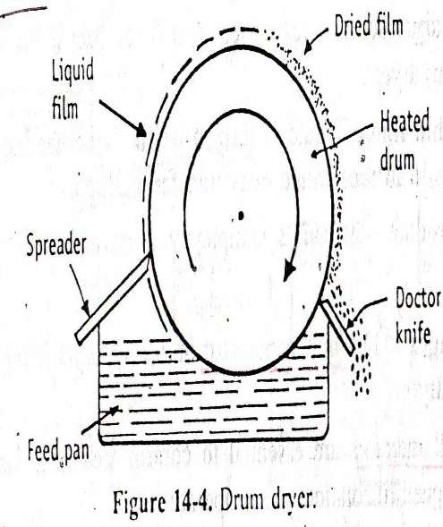
Construction:
It consist of horizontally mounted
hollow steel drum of 0.6 to 3m diameter and
0.6 to 4m length.
Below the drum feed
pan is placed in such a
way that the drum dips
partially into the feed.
One side of the drum
spreader and other side
knife is placed.
Storage bin is placed to
collect the material

Slide 6
Working
Steam is passed inside the drum
Drum is rotated at 1-10 rotations per minute
The liquid present in feed pan adheres to the
surface of drum.
Material is dries during the rotation of drum
and collected in storage bin by using knife.
Note: Drying procees in drum dryer completes in less than one cycle so the time of contact of material with drum is only 6 to 15seconds

Slide 7
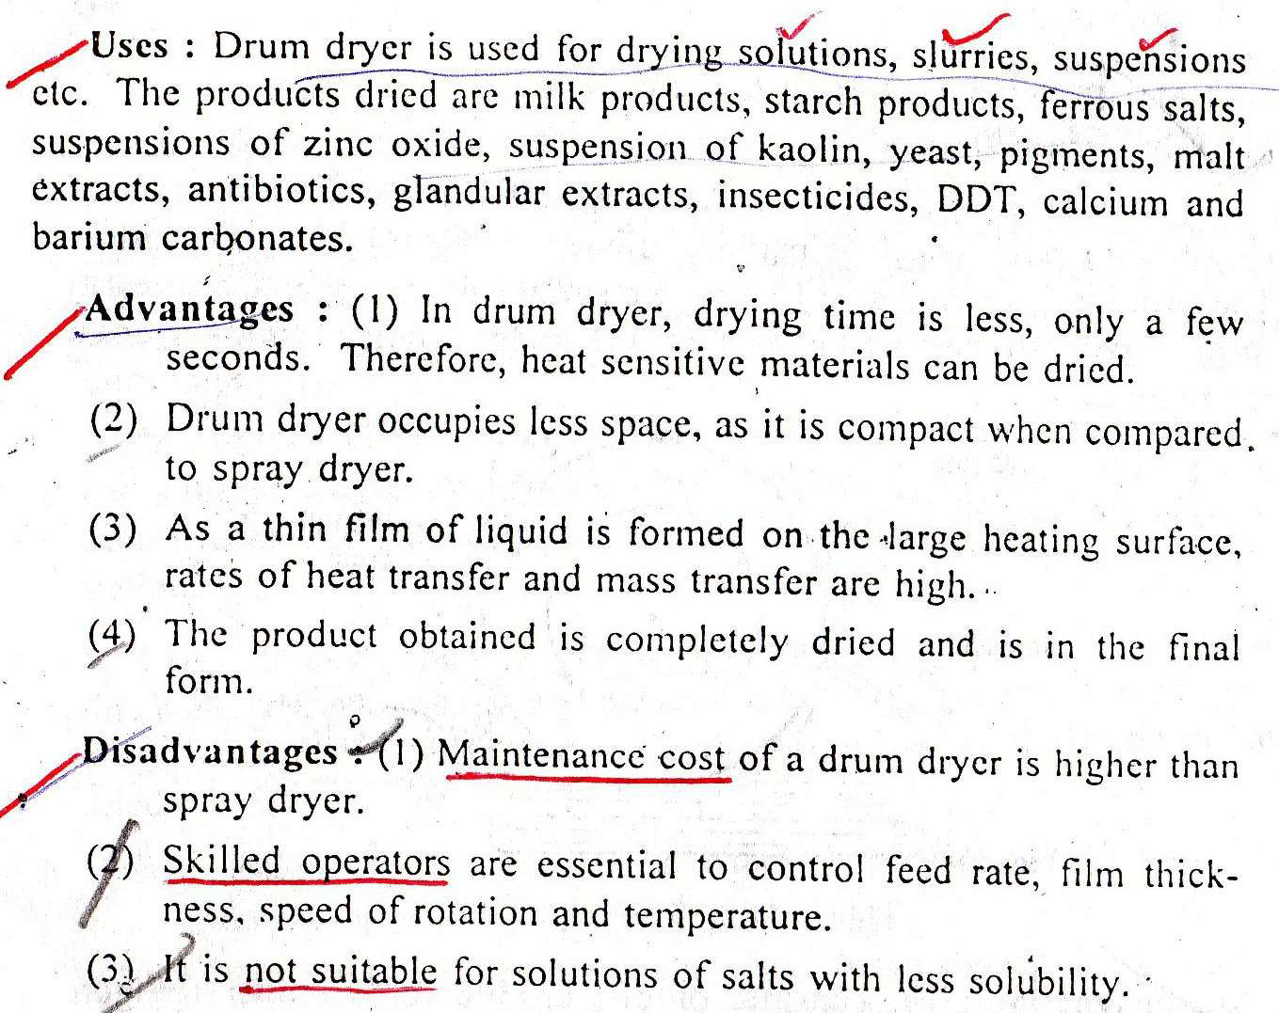
Uses

Slide 8
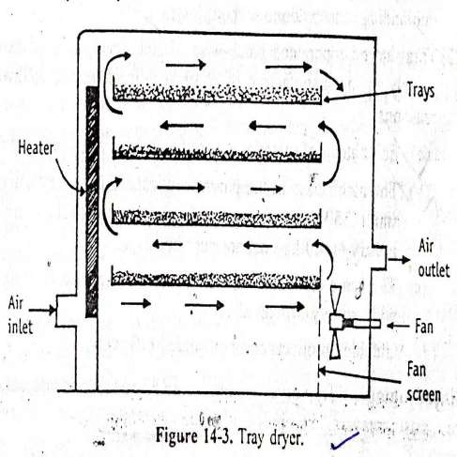
Tray Dryer

Slide 9
Principle and working of tray dryer
Principle:
In tray dryer hot air is continuously passed over wet mass. Heat transfer takes place by forced convection.
Construction: It consist of rectangular chamber whose wall is insulated. Trays are placed in the chamber according to need.

Slide 10
Working
Wet solid is loaded into trays. Trays are placed in the chamber.
Fresh air is introduced through inlet which
passes through the heaters and heated up.
The hot air is circulated by means of fans at 2
to 5 meter per second.
The water is picked up by air and moist air is
removed from outlet.
During the cycle of drying only 10 to 20 % of
fresh air is introduced and 80 to 90% air is
circulated back.

Slide 11
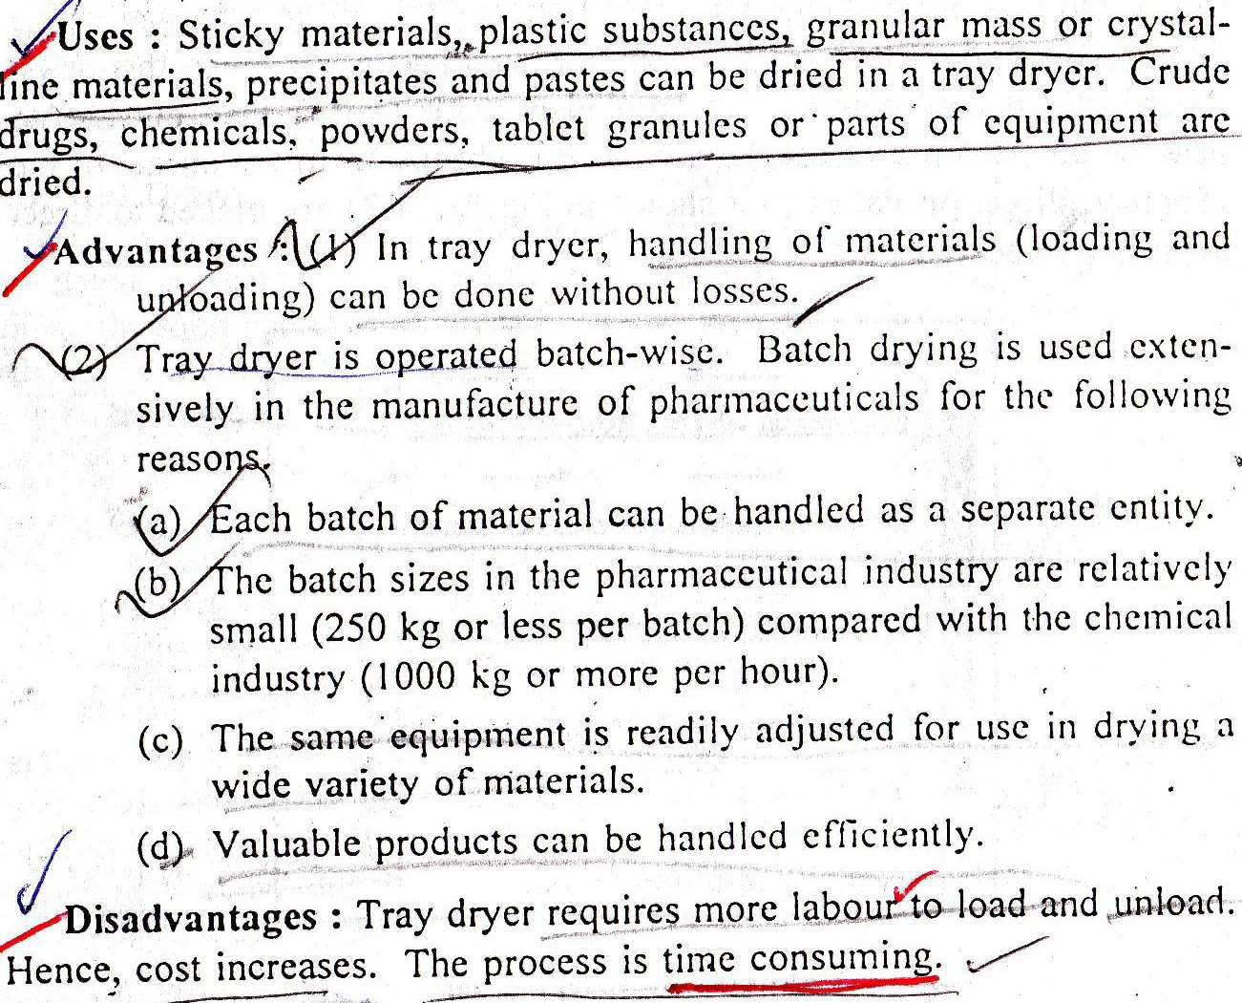
Uses

