Slide 1
Vacuum Drying
Dr. Garima Joshi
Assistant Professor, MLSU
Unit operation
III Semester

Slide 2
Vacuum dryer
Principle:
In vacuum dryer material is dried by the
application of vacuum. When vacuum is created
the pressure is lowered so that water boils at
lower temperature. Hence evaporate faster.
Construction:
It is made up of cast iron heavy jacketed vessel.
The enclosed space (approx. 1.5 meter cube) is
divided into a number of portions by means of
20 hollow shelves which are part of jacket.

Slide 3
These shelves provide larger surface area (about 45 to 50 m2 ) for conduction of heat. Over these shelves metal trays are placed.
The oven is connected to vacuum pump by
placing condenser in between.

Slide 5
Working
Material to be dried is placed on trays.
The trays are placed on shelves and pressure
is decreased up to 30 to 60 kilopascals.
Steam or hot air is supplied into hollow
space. Drying of material is done by presence
of vacuum.
Water vapour passes into the condenser
where it is condensed.
At the end of drying vacuum line is
disconnected and material is collected from
trays.

Slide 6
uses

Slide 7
Advantages

Slide 8
Freeze dryer
Principle:
In freeze drying water is removed from the
frozen state by sublimation. (direct change of
water from solid into vapour)
Construction:
Freeze dryer is consist of
1) Drying chamber in which trays are loaded
2) Heat supply in the form of radiation
3) Vapour condensing or adsorption system
4) Vacuum pump or steam jacket or both

Slide 10
Working
It involves following steps;
1) Preparation and pretreatment
2) Pre-freezing for solidifying water
3) Primary drying (sublimation of ice)
4) Secondary drying (removal of residual
moisture)
5) Packing

Slide 12
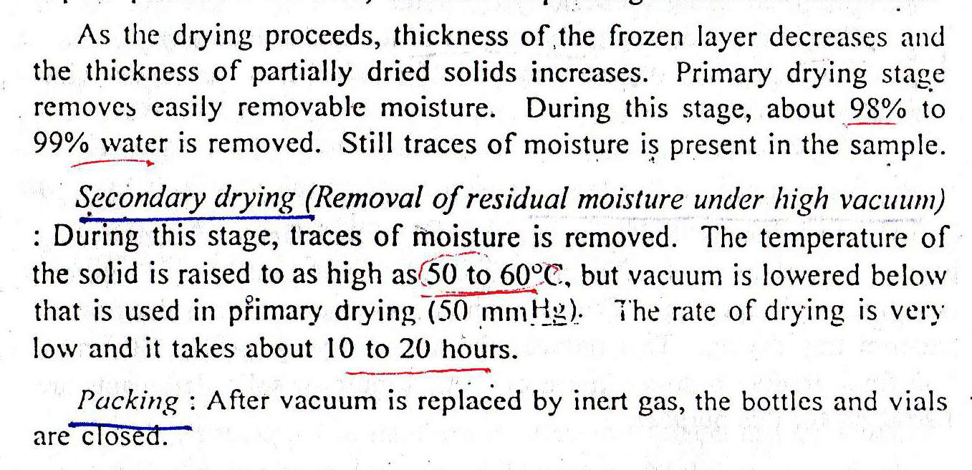

Slide 13
Uses

