Slide 1
Filtration
Dr. Garima Joshi
Assistant Professor MLSU
B Pharm III sem Unit operation

Slide 2
Filtration
Filtration: It may be define as a process of separation of solids from a fluid by passing the same through a porous medium that retains the solids but allows the fluid to pass through.
Clarification: When solid are present in very low concentration, i.e., not exceeding 1.0% w/v, the
process of its separation from liquid is called clarification.

Slide 3
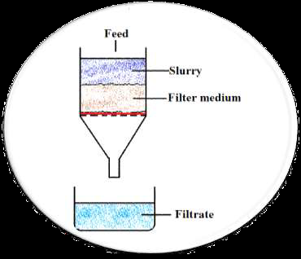
Basic terminology of filtration
Slurry: Suspension to be filtered Filter medium
Filter medium: Porous medium used to retain solid.
Filter cake: Accumulated solids on the filter.
Filtrate: Clear liquid passing through the filter.

Slide 4
Need/ applications of filtration
Production of sterile products:
HEPA filters or laminar air bench
Membrane filters.
Production of bulk drugs
Production of liquid dosage
Effluents and waste water treatment

Slide 5
Mechanism of filtration
The mechanism whereby particles are retained by a filter :
Straining: Similar to sieving, i.e., particles of larger size can’t pass through smaller pore size of filter medium.
Impingement: Solids having the momentum move along the path of streaming flow and strike (impinge) the filter medium. Thus the solids are retained on the filter medium.
Entanglement: Particles become entwined (entangled) in the masses of fibres (of cloths with fine hairy surface or porous felt) due to smaller size of particles than the pore size. Thus solids are retained within filter medium.
Attractive forces: Solids are retained on the filter medium as a result of attractive force between particles and filter medium, as in case of electrostatic filtration.

Slide 6
Types of filtration
Surface/ screen filtration: It is a screening action by which pores or holes of medium prevent the passage of solids. Mechanism involved : straining and impingement. For this, plates with holes or woven sieves are used.
Depth filtration: In this slurry penetrates to a point where the diameter of solid particles is greater than that of the tortuous void or channel. Mechanism : Entanglement. The solids are retained with a gradient density structure by physical restriction or by adsorption properties of medium.

Slide 7
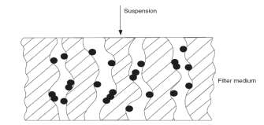
Surface Filtration
Depth Filtration

Slide 8
Theory of filtration
The flow of liquid through a filter follows the basic rules that govern the flow of any liquid through the medium offering resistance.
The rate of flow may be expressed as-
The rate of filtration may be expressed as volume (litres) per unit time (dv/dt).
Driving force = pressure upstream – pressure downstream
Resistance is not constant.
It increases with an increase in the deposition of solids on the filter medium.
Therefore filtration is not a steady state.

Slide 9
Poisuelle Equation
Poiseullie considered that filtration is similar to the streamline flow of liquid under pressure through capillaries.
Poiseullie’s Equation is-
Where, V = rate of flow, m3/s (l/s)
ΔP= Pressure difference across the filter, Pa
r = radius of capillary in the filter bed, m
L = thickness of filter cake (capillary length), m
𝝶 = viscosity of filtrate, Pa.s
If the cake is composed of bulky mass of particles and the liquid flows through the interstice, then flow of liquids through these may be expressed by this equation.

Slide 10
Darcy’s law
Poiseullie's law assumes that the capillaries found in the filter
are highly irregular and non-uniform.
Therefore, if the length of capillary is taken as the thickness of bed, a correction factor for radius is applied so that the rate is closely approximated and simplified.
The factors influencing the rate of filtration has been incorporated into an equation by Darcy, which is:
Where, K = permeability coefficient of cake, m2
A = surface area of porous bed (filter medium), m2 Other terms are same as previous equation
K depends on characteristics of cake, such as porosity, specific surface area and compressibility.

Slide 11
Permeability may be defined quantitatively as the flow rate of a liquid of unit viscosity across a unit area of cake having unit thickness under a pressure gradient of unity.
This equation is valid for liquids flowing through sand, glass beds and various porous media.
This model is applied to filter beds or cakes and other types of depth filter.
This equation is further modified by including characteristics of K by Kozeny-Carman.

Slide 12
Kozeny-Carman (K-C) equation
Kozeny-Carman equation is widely used for filtration.
■ Where,
𝝴 = porosity of cake (bed)
S = specific surface area of particles comprising the cake m2 / m3
K = Kozeny constant (usually taken as 5)
Other terms are same as previous equations
Limitations:
It does not consider the fact that depth of granular bed is lesser
than the actual path traversed by the fluid.
The actual path is not same through out the bed, but it is
sinuous or tortuous.

