Slide 1
Microencapsulation
Dr. Garima Joshi
Assistant Professor

Slide 2
Microencapsulation
Introduction
Fundamental Consideration
Reason for Encapsulation
Techniques of Manufacturing Microcapsule
Applications

Slide 3
Definition:-
MICROENCAPSULATION is a process by which very tiny
droplets or particles of liquid or solid material are surrounded or
coated with a continuous film of polymeric material.
The product obtained by this process is called as Microcapsules

Slide 4
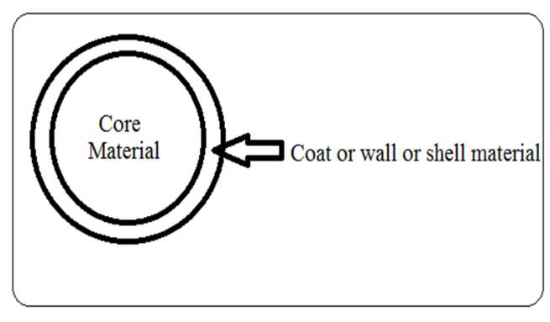
Microcapsule

Slide 5
Fundamental Consideration
Generally Micro particles consist of two components
a) Core material.
b) Coat or wall or shell material

Slide 6
Core Material
The material to be coated. It may be liquid or solid or
gas. Liquid core may be dissolved or dispersed material.
Composition of core material:
Drug or active constituent
Additive like diluents
Stabilizers

Slide 7
Coating Material
Inert substance which coats on core with desired thickness.
Composition of coating:
Inert polymer
Plasticizer
Coloring agent
Resins, waxes and lipids
Release rate enhancers or retardants

Slide 8
Coating Materials
Water soluble resins- Gelatin, Gum Arabic, Starch, PVP, CMC, .
….MC, Arabinogalactan, Polyvinyl alcohol.
2. Water insoluble resins- EC, Polyethylene, Polymethacrylate, …
.. Polyamide (Nylon), Cellulose nitrate, Silicones.
3. Waxes and lipids- Paraffin, Carnauba, Beeswax, Stearic acid, .
.. Stearyl alcohol, Glyceryl stearates.
4. Enteric resins- Shellac, Cellulose acetate phthalate, Zein.

Slide 9
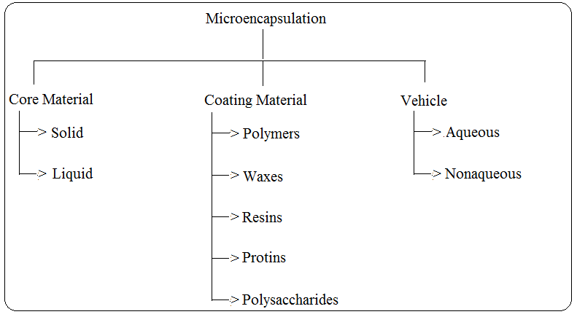

Slide 10
REASONS FOR ENCAPSULATION
The core must be isolated from its surroundings, as
1. To protect reactive substances from the environment,
2. To convert liquid active components into a dry solid system,
3. To separate incompatible components for functional reasons,
4. To protect the immediate environment of the microcapsules from
the active components.

Slide 11
To control the rate at which it leaves the microcapsule, as
1. To control release of the active components for delayed (timed)
….release or long-acting (sustained) release,
2. The problem may be as simple as masking the taste or odor of
….the core,
3. To Increase of bioavailability,
4. To produce a targeted drug delivery,
5. Protects the GIT from irritant effects of the drug,
6. Extension of duration of activity for an equal level of active
….agent.

Slide 12
