Slide 1
Techniques of Microencapsulation
Dr. Garima Joshi
NDDS, VII sem

Slide 2
General Consideration
The technique of microencapsulation depends on the physical and
chemical properties of the material to be encapsulated.
The stability and the biological activity of the drug should not be
affected,
▪ Yield and drug encapsulation efficiency should be high,
▪ Microsphere quality and drug release profile should be
reproducible within specified limits,
▪ Microsphere should not exhibit aggregation or adherence,

Slide 3
Physical or Physico-mechanical methods
1. Air-suspension coating
Inventions of Professor Dale E.Wurster
Basically the wurster process consists of the dispersing of solid,particulate core materials in a supporting air stream and the spray-coating of the air suspended particles.
Equipment ranging in capacities from one pound to 990 pounds.
Micron or submicron particles can be effectively encapsulated by air suspension techniques.

Slide 4
Processing variables for effective encapsulation by air suspension
1.Density, surface area, melting point, solubility, friability,
volatility, Crystallinity, and flow-ability of core the core material.
2.Coating material concentration (or melting point if not a
solution).
3.Coating material application rate.
4.Volume of air required to support and fluidizes the core material.
5.Amount of coating material required.
6.Inlet and outlet operating temperatures.

Slide 5
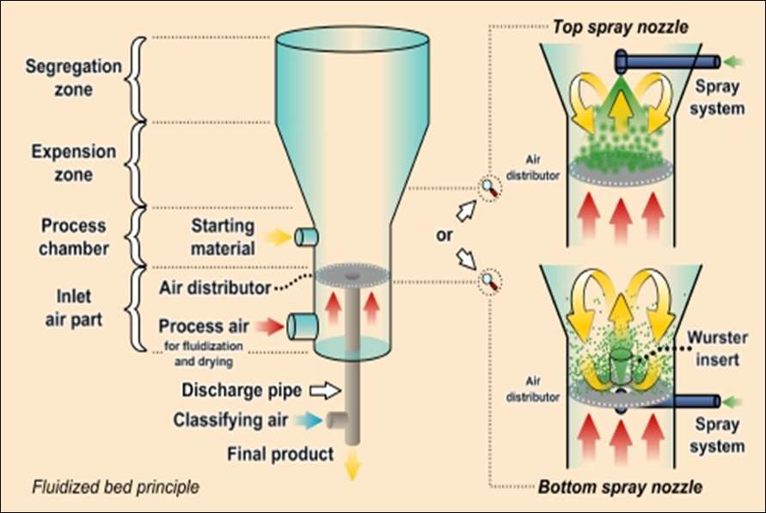

Slide 6
2. Centrifugal extrusion
Liquids are encapsulated using a rotating extrusion head
containing concentric nozzles.
This process is excellent for forming particles 400–2,000 μm in
diameter.
Since the drops are formed by the breakup of a liquid jet, the
process is only suitable for liquid or slurry.
A high production rate can be achieved, i.e., up to 22.5 kg of
microcapsules can be produced per nozzle per hour per head.
Heads containing 16 nozzles are available.

Slide 7
3. Pan coating
Oldest industrial procedures for forming small, coated particles or tablets.
The particles are tumbled in a pan or other device while the coating material is applied slowly.
Solid particles greater than 600 microns in size are generally considered essential for effective coating.
Medicaments are usually coated onto various spherical substrates
such as nonpareil sugar seeds, and then coated with protective layers of various polymers.

Slide 8
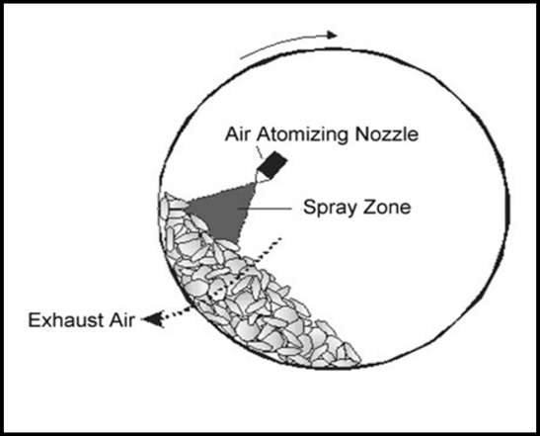

Slide 9
4. Spray-drying
In modern spray dryers the viscosity of the solutions to be sprayed can be as high as 300mPa.s
Spray drying and spray congealing- dispersing the core material in a liquefied coating substance and spraying.
Spray drying is effected by rapid evaporation of a solvent in which the coating material is dissolved.

Slide 10
The equipment components of a standard spray dryer include
1. an air heater,
2. atomizer,
3. main spray chamber,
4. blower or fan,
5. cyclone and
6. product collector.

Slide 11
Spray congealing can be accomplished with spray drying equipment when the protective coating is applied as a melt.
Core material is dispersed in a coating material melt rather than a coating solution.
Coating solidification (and microencapsulation) is accomplished
by spraying the hot mixture into a cool air stream.

Slide 12
Physico-chemical methods
Ionotropic gelation
Chemical reaction between sodium alginate and calcium
chloride or other Counter ion solution such as barium chloride.
Verapamil hydrochloride causes gastric irritation on sudden
release. It is usually administered as conventional tablets
containing 40-120 mg, 3 times a day. Due to its ready solubility
in water and shorter half-life.
Microparticulate system of verapamil hydrochloride for
prolonged release delivery system.

Slide 13
2. Coacervation-Phase Separation
Patents of B.K. Green et al.
Three steps carried out under continuous agitation:
1) Formation of three immiscible chemical phases
2) Deposition of the coating
3) Rigidization of the coating

Slide 14
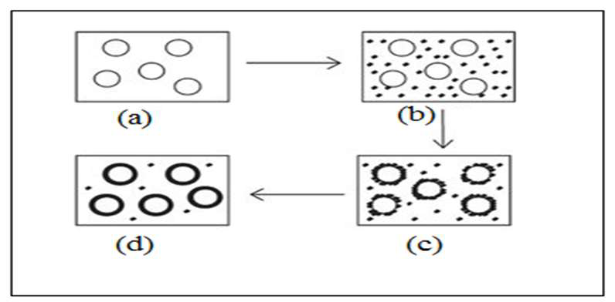
Schematic representation of the coacervation process.
(a) Core material dispersion in solution of shell polymer;
(b) separation of coacervate from solution;
(c) coating of core material by microdroplets of coacervate;
(d) coalescence of coacervate to form continuous shell around core
particles.

