Slide 1
Intracratonic / Purana basins in Central India
Presentation by
Dr. Ritesh Purohit

Slide 2
Intracratonic / Purana Basins
Several isolated bodies of late-Proterozoic cratonic-basins, descrived in early literatures as the Purana Basins, occur in Bastar Protocontinent.
Of these, the Chattisgarh Basin, covering an area of 36,000 sq.km area in the Bilaspur-Raipur region is the largest situated on the northeastern edge of the Archaean cratonic block of Bastar.
There are also several other smaller cratonic basins like Khariar, Ampani, Abujmarh, Indravati and Sabari.
Apart from these, number of smaller ‘outlier’ type outcrops of cratonic platform type depositories occur in the Protocontinent.
Two different opinions exists about these Purana Basins, which are broadly undeformed and unmetamorphosed. The deformation structures noted in some localized blocks are the results of ‘post inversion’ cratonic deformations processes.

Slide 3
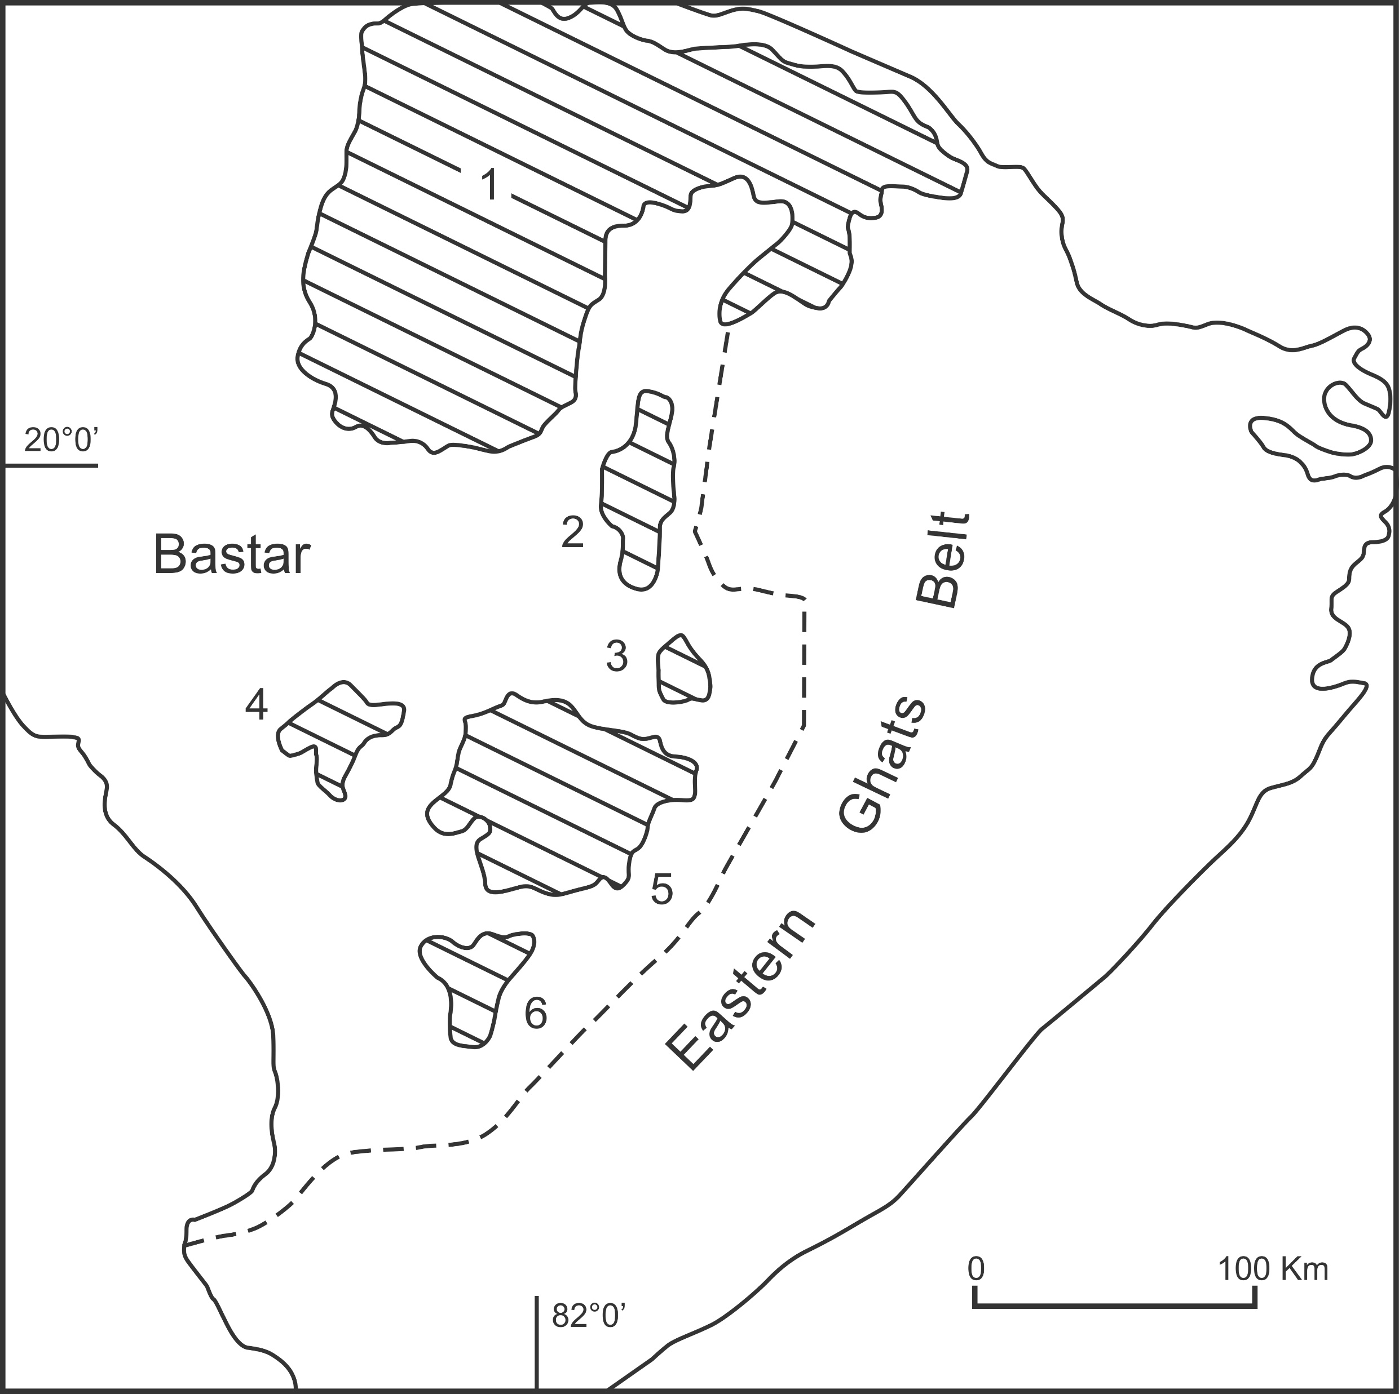
Geological sketch map showing distribution of late-Proterozoic cratonic basins (Purana Basins) in the Bastar Protocontinent.
Chattisgarh
Khariar
Ampani
Abujhmar
Indravati
Sabari

Slide 4
Chattisgarh Basin
The Chattisgarh Basin is the largest late-Proterozoic cratonic basin in the Bastar Protocontinent.
The basin contains about 2500 m thick sediments belong to the shale-sand-carbonate association deposited in multiple sedimentary cycles in three different sub-basins.
The presence of fan-delta deposits at the base, followed by thick sandstone-mudstone succession, welded tuff (ignimbrite) in the shale units and carbonate platform grading into pelagic environment suggests deposition essentially in cratonic basin environment without major hiatuses (Deb, 2004).
The vast limestone and dolomite resources of the basin feed the Bhillai Steel Plant and some other nearby cement factories.

Slide 5
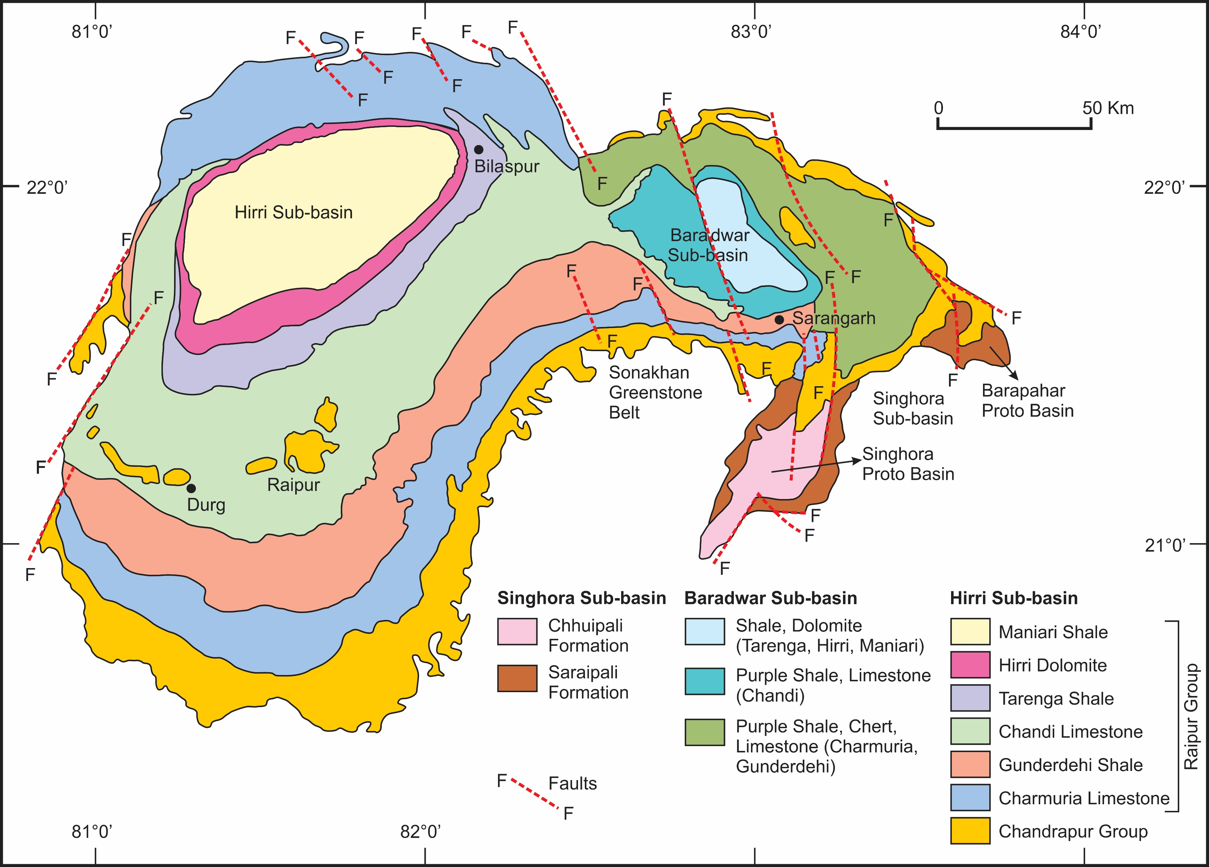

Slide 6
Group | Formation (thickness in m) | Lithology
Raipur Group | Maniari Shale (70) Hirri Dolomite (70) Tarenga Shale (180) Chandi Limestone (670) Gunderdehi Shale (430) Charmuria Limestone (490) Bijepur Shale (100) | Purple shale, dolomite, gypsum Grey dolomite Dolomitic shale, shale-chert beds, purple shale, limestone Stromatolitic dolomite, limestone, glauconitic standstone, shale Shale with limestone interbeds arenite –shale, ignimbrite Phosphatic limestone with shale interbeds cherty limestone and phosphatic dolomite, chert-like interbeds Green and brown calcareous shale with sandy interbeds
Chandrapur Group | Kansapathar Sandstone (200) Chaporadih Shale (200) Lohardih Conglomerate (20) | Glauconitic sandstone Shale with arenite interbeds Purple arkose, gritty arenite and basal conglomerate
Singore Group | Chhuipali Shale (300) Bhalukona Stone (20) Saraipali Shale (60) Rehatikhol Conglomerate (20) | Shale with chert, limestone, dolomite, siltstone Sandstone, siltstone, minor shale Variegated shale with siltstone, limestone, porcellenite, felsic tuff Feldspathic arenite, arkose and basal conglomerate
Crystalline basement of the Bastar Protocontinent

Slide 7
Deformation and Ages
Over the major part of the basin, the beds show horizontal to sub-horizontal orientation with rolling dips in areas showing mild folding.
A few open antiformal folds have developed close to the faults which generally developed in the marginal parts of the Basin.
The eastern projections of the basin are deformed at their margins due to “collision” type impact of the Eastern Ghats Granulite Belt.
Geochronological study based on K/Ar -systematics on the glauconites from Chandrapur Group suggests sediment deposition age in the time span between 1250 and 1300 Ma (Krueger et al. 1977). The basin with irregular rectangular shaped configuration of the outcrop is surrounded by a number of kimberlite pipes.

Slide 8
Khariar Basin
It covers about 1500 sq. km area containing over 1000 m thick sediments in the eastern part of the Bastar Protocontinent.
This irregular, oval shaped N-S trending basin is juxtaposed against the faulted margin close to the Eastern Ghats Granulite Belt in the east.
On the western side, the basin is underlain by the Archaean gneiss-granite complex containing enclaves of supracrustals like the banded iron formation, mica schist, amphibolite and pillowed meta-basalt.
As in the case of the Chattisgarh Basin several intrusions of kimberlites are noted near the basin margins.

Slide 9
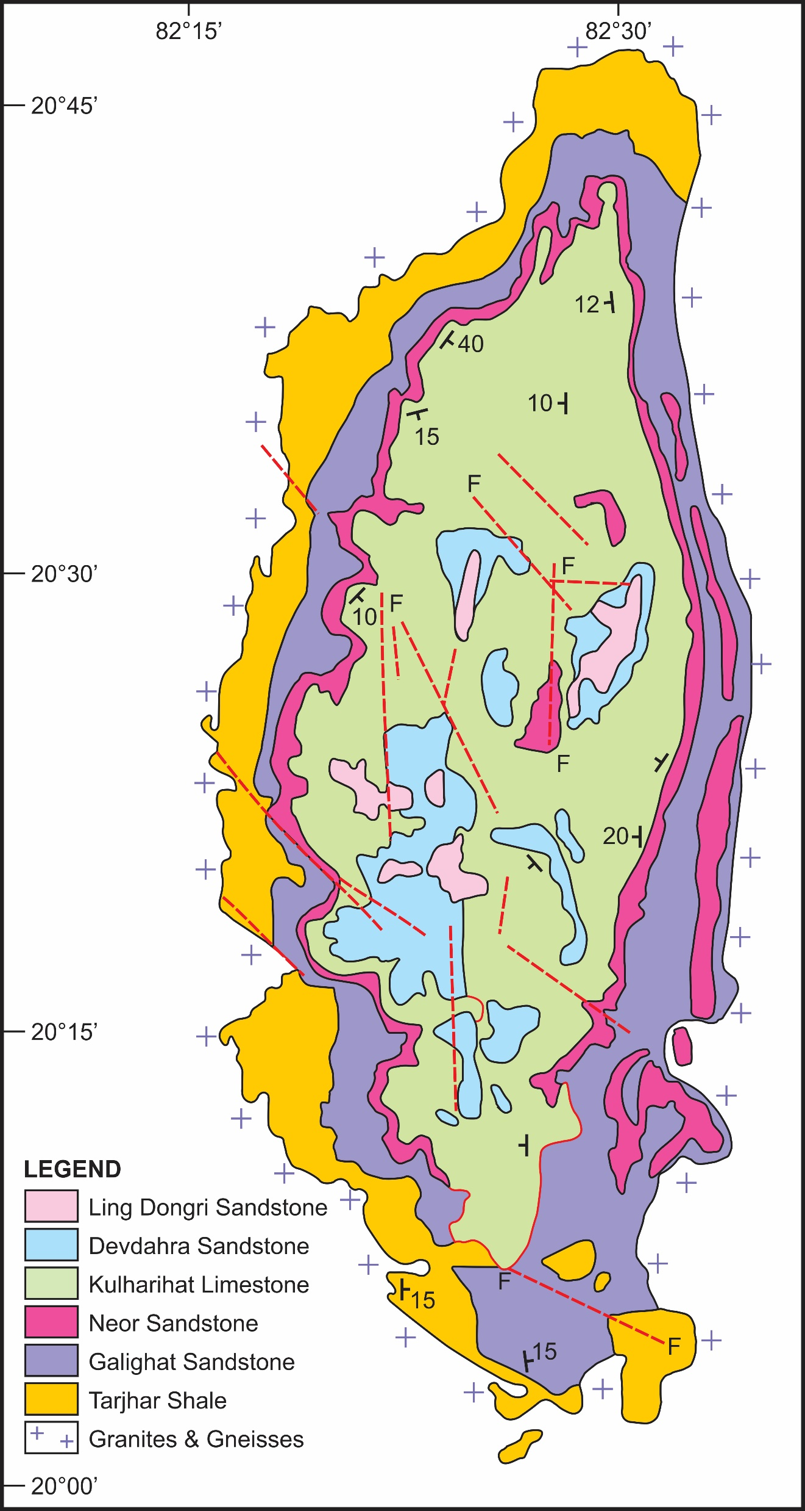

Slide 10
Lithostratigraphy of the Khariar Basin (After Das et al. 2001)
Group | Formations
Piari Group (600-1000 m) | Ling Dongri Sandstone (60-120 m) Tarjhar Shale (205 m) Galighat Sandstone (150-300 m) ------------disconformity----------- Neor Sandstone (40-160 m) Kulharighat Limestone (980-120 m) Devdhara Sandstone (10-80 m)
Basement gneisses and granites

Slide 11
Deformation and Ages
The Piari Group rocks are involved in open to tight asymmetrical folding trending NW-SW. The intensity of deformation increases in the easterly direction near the contact of the Eastern Ghats Granulite Belt showing evidence of strong shearing and faulting.
No precise age data are available for the rocks of the Khariar Basin. However, suggestion has been made about the Lower to Upper Riphean age (i.e. between 1,400 to 800 million years ago) based on study of the stromatolite structures developed in the carbonate formations of Piari Group (Ramakrishnan and Vaidyanadhan, 2008).

Slide 12
Ampani Basin
It occurs on a small plateau south of Khariar.
The basin includes about 280 m thick sandstone-shale sequence occupying an outcrop area of about 220 sq. km.
The lithostratigraphy of the basin as worked out Balakrishnan and Mahesh Babu (1987) includes a thin body of basal conglomerate with interbands of subarkose (180 m), siltstone (20 m) and purple shale interbanded with impure limestone (70 m).
Like the Khariar Basin, The Ampani basin shows gently folding over the major part of the outcrop. The intensity of deformation increases towards the eastern margin close to the western boundary of the Eastern Ghats Granulite Belt, where the overturned isoclinal folds have developed along with shear zones.

Slide 13
Indravati Basin
This is an irregular, rhomb-shaped basin covering an area of 900 sq. km.
The basin shows about a 500 m thick sequence of shale-sand-carbonate association.
The carbonate succession includes cement-grade limestone and dolomite.
Structurally the Indravati Group comprises a flat-lying sequence with gentle undulating dips, except in the southeastern margin with the Eastern Ghats Granulite Belt where the rocks show deformation with development of faults and shear zones.

Slide 14
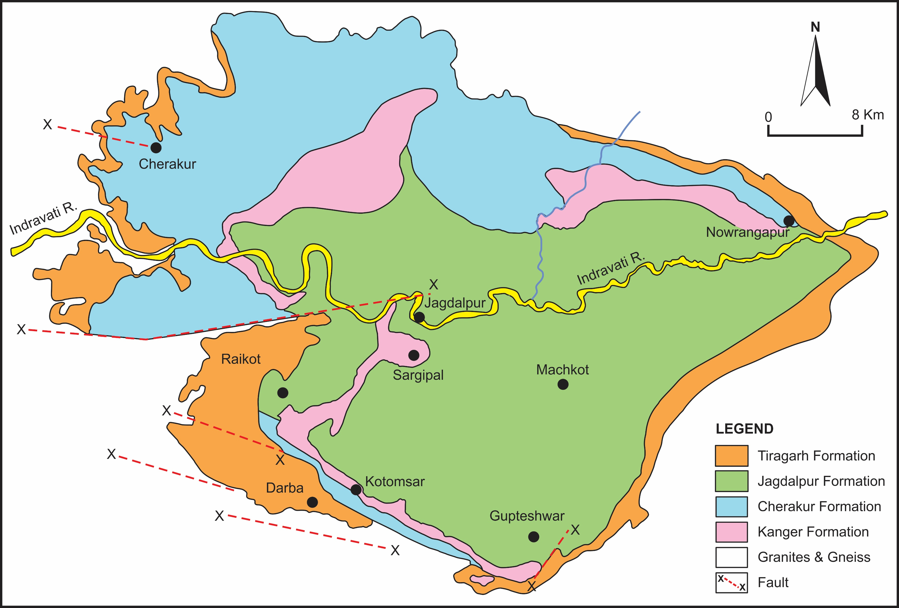

Slide 15
Lithostratigraphy of the Indravati Group (after Ramakrishnan, 1987)
Jagdalpur Formation (200-250 m) Kanger Limestone (50-200 m) Cherakur Formation (50-60 m) Tiratgarh Formation (50-60 m) | Purple shale with stromatolitic dolomite Purple limestone and laminated shale Purple shale and siltstone with interbeds of arkosic sandstone, chert pebble with conglomerate and ‘grit’ Quartz arenite with minor laminated shale, sandstone and pebble conglomerate
Granites gneisses and other Archaean supracrustals

Slide 16
Sabari Basin
This is a triangular-shaped small basin near Sukma, named Sabari Basin because the River Sabari cuts across the basin almost through the middle.
The main lithology of the basin includes
Purple to grey coloured shales.
Creamy and grey coloured limestone.
Thick-bedded orthoquartzite
Basal conglomerate

Slide 17
Summary:
Several isolated bodies of late-Proterozoic cratonic-basins (Purana Basins in early literatures) occur in Bastar Protocontinent of which the Chattisgarh is the largest situated on the northeastern edge of the Archaean cratonic block of Bastar.
There are also several other smaller cratonic basins like Khariar, Ampani, Abujmarh, Indravati and Sabari, apart from a number of smaller ‘outlier’ type outcrops.
The basins contain thick sediments belonging to the shale-sand-carbonate association, and were deposited in multiple sedimentary cycles along with welded tuff (ignimbrite) in the shale units.
Carbonate is absent in some of the basins. The vast limestone and dolomite resources which occur in some major basins feed the Steel Plants and cement factories.
Majority of the basins show horizontal to sub-horizontal orientation of beds and have with rolling dips. Folding and shearing are noted at the eastern margins of some basins which resulted from ‘collision’ type impact of the emplacement of the Eastern Ghats Granulite Belt in the east of the Bastar Protocontinent.

Slide 18
Summary Continued:
No precise age data are available for these cratonic basins. However, based on the study of the stromatolite structures developed in the carbonate formations suggestion has been made about the depositional age of these basins during 1,400 to 800 million years ago.
Geochronological study based on K/Ar systematics on the glauconites suggests sediment deposition age in the time span between 1300 and 1250 million years before present.
Majority of the cratonic basins with irregular rectangular shaped configuration of the outcrop is surrounded by a number of kimberlite pipes.
The association of the two suggest possibility that the cratonic-platformal basins evolved due to underplating of mafic alkaline magmatism like those in the Dharwar Protocontinent.
Based on the emplacement age of the southern Indian kimberlites at 1.1 Ga (Chalapati Rao et al. 2009) we may therefore conclude that the cratonic-platformal basin of the Bastar Protocontinent took place during the onset of Neoproterozoic at ~ 1.Ga before present.

