Slide 1
Test of significance: basic concepts
Shurveer S. Bhanawat Ph.D.
Professor & Head
Department of Accountancy and Business Statistics
Mohanlal Sukhadia University, Udaipur, Rajasthan

Slide 2
Basic terminologies used
Population
Sample
Parameter
Statistic
Hypothesis
Errors in Hypothesis Testing
Level of significance
Critical value
P-Value
Standard error
One tailed and two tailed

Slide 3
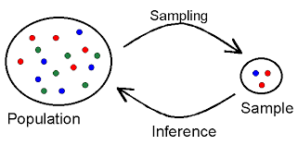
Terminologies
Particulars | Population | Sample
No. of Items | N | n
Mean | µ | X
S.D. | σ | s
Proportion | P | p
Parameter Statistic
Objective
Census Vs Sampling Estimation Testing Hypothesis
Point Interval
Statistical

Slide 4
Terminologies
Standard Error : Standard deviation of sampling distribution of a statistics is known as its standard error. It provide the measurement of variation of statistic (measurement of sample) from parameter (measurement of population)
Standard Deviation : The measurement of variations on both side of arithmetic mean of original values is known as standard deviation

Slide 5
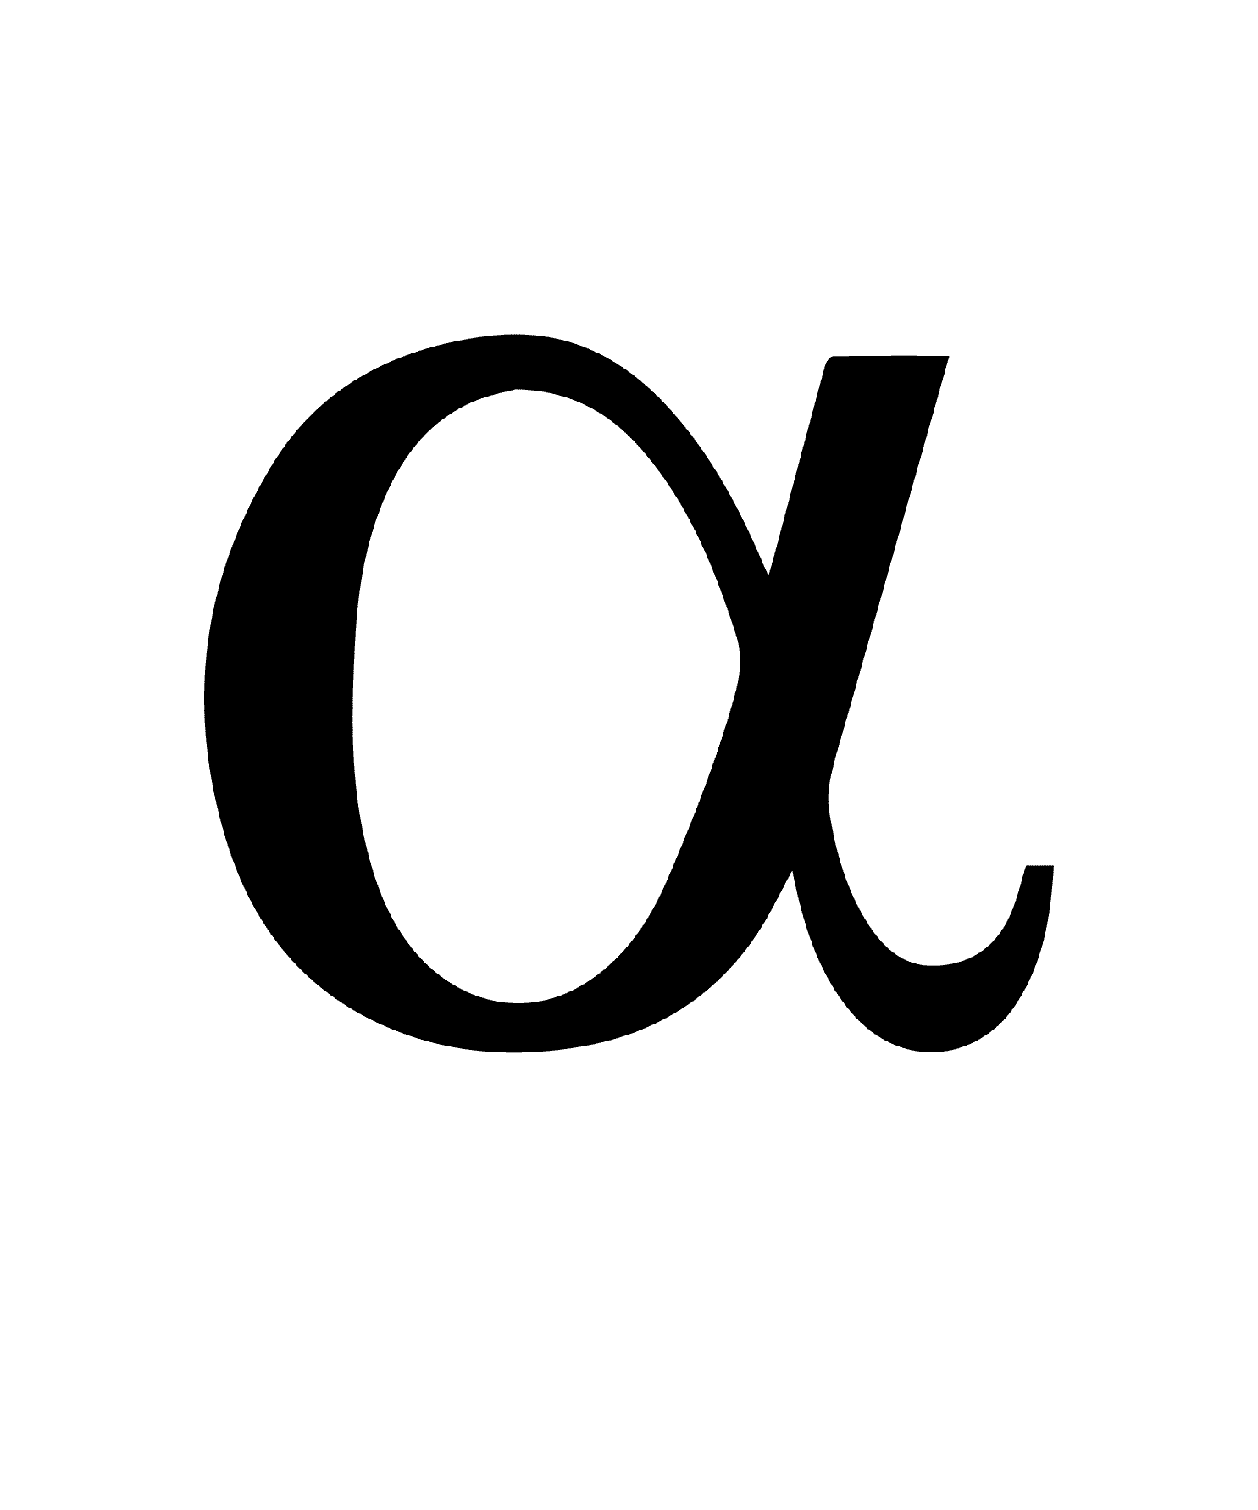
ERRORS IN HYPOTHESIS TESTING s
 | Null Hypothesis
Null Hypothesis |  | Accept | Reject
 | True | Correct Decision | Type I error =P(rejecting a good lot) Producer’s Risk
 | False | Type II error β =(Accept a bad lot) Consumers’ Risk | Correct Decision

Slide 6
Testing Hypothesis
On the basis of Critical Values
Calculated Value > Critical Value Reject
Calculated Value < Critical Value Accept
On The basis of p-Value: p-Value > Level of Significance Accept
P-Value < Level of Significance Reject

Slide 7
Relationship among critical value, level of significance & level of confidence
Area Covered | Critical Value Two tailed one tailed |  | Level of Confidence | Level of Significance
Mean ± S.D. Mean± 1.96S.D. Mean ± 2 S.D Mean ± 2.58 S.D. Mean ± 3S.D. | 1 1.96 2 2.58 3 | 1.645 2.33 | 68.27% 95% 95.45% 99% 99.73% | 31.27% 5% 4.55% 1% 0.27%

Slide 8
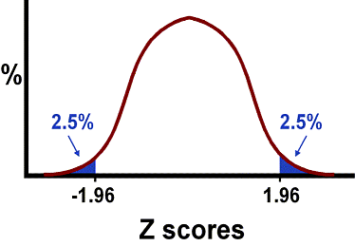
Determination of critical value
at 5% level of significance 0.5-.025=0.475 corresponding Z score is 1.96
0.475
0.475

Slide 9
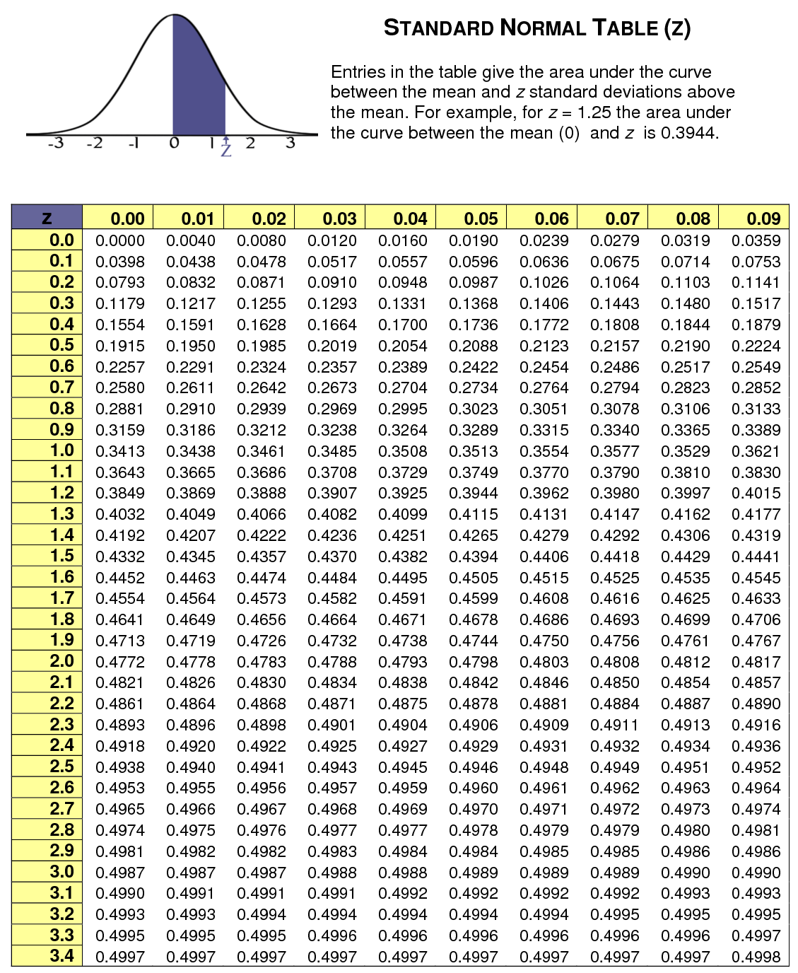

Slide 10
Critical Value

Slide 11
Determination of p value
X - Mean Z= S.D.
The p value is determined using the standard normal table. The area between the mean and a Z value is found, then such area is subtracted from 0.5, the resultant figure is p value.
For example value of Z comes 2.5 (1.96). The area between mean and Z value i.e. 2.5(1.96) is 0.4983 (0.4750) (derived from standard normal table). So p value for one tailed test would be 0.5 – 0.4983 = 0.0017 and for two tailed test it would be 0.0017*2=0.0034

Slide 12
Probability Values (p Values)
Hypothesis can be accepted or rejected on the basis of p values. p value method of presenting the result of a statistical test report the extent to which the test statistic disagree with the null hypothesis. This method has become popular because analysts want to know what percentage of the sampling distribution lies beyond the sample statistic on the curve. Most of the statistical computer programs report the results of statistical tests as probability values (p values). the p value is the probability of observing a sample value as extreme as , or more extreme than, the value actually observed, given that null hypothesis is true. This area represents the probability of a type I error that must be assumed if the null hypothesis is rejected.

Slide 13
One tailed and two tailed test
When rejection area lies on both side of normal curve is known as two tailed test. It is also called non directional test.
When rejection area lies on either side of normal curve is known as one tailed test

Slide 14
Parametric Test
The observations should be drawn from normally distributed population
Random selection of sample
The measurement scale should be at least Interval or Ratio scales data

Slide 15
Non-parametric Tests
The NPTs are useful under the following conditions
Not Normal Distribution
Nominal or ordinal scaled data
Incomplete or partial data
Very small samples

Slide 16
How to Select a Test
In attempting to choose a particular significance test, the researcher should consider at least three questions:
Does the test involve one sample, two sample or k samples?
If two samples or k samples are involved, are the individual cases independent or related?
Is the measurement scale nominal, ordinal, interval or ratio?
Others
What is the sample size?
Have the data been transformed?

Slide 17
Recommended statistical test
Measurement level | One sample case | Two sample case |  | k- sample case
 |  | Related samples | Independent samples | Related samples | Independent samples
Nominal | Binomial Chi square | McNemar | Chi square | Cochran Q | Chi square for k samples
Ordinal | Kolmogorov-smirnov Run test | Sign test Wilcoxon matched pairs | Median test Mann-Whitney U test Kolmogorov-smirnov test | Friedman two-way ANOVA | Median extension Kruskal-wallis one way ANOVA
Interval and Ratio | t test Z test | t test for paired samples | t test Z test | ANOVA | One way & N-way ANOVA

Slide 18
Process of hypothesis testing
Formulation of Hypothesis
Set the level of significance
Determination of suitable Significant test
Determine the critical value
Decision: Interpret the test
Measuring the power of test

Slide 19
SMALL CASE STUDY
A marketing research firm conducted a survey 10 years ago and found the average household income of a particular geographic region was Rs. 10,000. Mr. Bhatanagar, who has recently joined the firm as a vice president has expressed doubt about the accuracy of the data. For verifying the data, the firm has decided to take random sample of 200 households that yield a sample mean (for household income) of Rs. 10200. Historical data shows that population standard deviation of the household income is Rs.1200. Verify the Mr. Bhatanagar’s doubt at 5% level of significance.

Slide 20
Step 1 Set null hypothesis or alternate hypothesis
The null hypothesis is set as no difference or status quo that is, the average of household income has not changed. Or there is no difference between average value of household income ten years ago i.e. Rs.10000 and average value of household income derived i.e. Rs.10200 recently.

Slide 21
Step 2 Set the level of significance: already given = 5% step3: Determine appropriate test
Sample size is greater than 30 and sample mean is used as statistic, so the Z test can be used for hypothesis testing. i.e. Test of significance of single mean
Z = 10200-10000/ 1200√200 = 2.36
Note: 1. if population standard deviation remains unknown then sample standard deviation can be used.
The z formula is based on the assumption that the sample is drawn from an infinite population.

Slide 22
Step 4: Testing the hypothesis
By using critical value approach
The calculated value of Z is 2.36 which is greater than critical value of 1.96 at 5% level of significance. Hence null hypothesis is rejected. On the basis of hypothesis testing, it can be concluded that the average household income of the particular geographic region is not Rs.10000. Mr. Bhatanagar’s doubt about this average household income was right.

Slide 23
By using p-Value approach
The p-Value approach for hypothesis testing is used for large samples and is sometime referred to as observed level of significance. This approach is very advantageous especially after the introduction of many statistical software programmes. Here the value of p is 0.0182 ((0.05-0.4909)*2) i.e. less than 0.05 hence null hypothesis is rejected.
The observed test statistics is computed as 2.36, from the normal table, the corresponding probability area for z 2.36 is 0.4909. so, the probability of obtaining a Z value greater than or equal to 2.36 is 0.5000- 0.4909 = 0.0091 for a two tailed test, this value is multiplied by 2. Thus for a two-tailed test, this value is (0.0091*2= 0.0182). it has to be noted that for α=0.05, the null hypothesis is rejected because 0.0182 is less than 0.05

Slide 24
SETTING THE LIMITS
Limits = 10000 + 1,96* 1200√200
= 10000+ 1.96*84.86
= Rs. 9833 Rs10167
Sample mean i.e. 10200 is out of range hence null hypothesis is rejected

Slide 25
MEASURING THE POWER OF TEST
It is quite important to know how well a hypothesis test is working. The measure of how well the test is working is called the power of the test.
Rejection of hypothesis means we run a risk of committing an error of type I but acceptance of null hypothesis means we run some risk of committing an error of type II. The probability of type one error is denoted by α (level of significance) and the probability of type II error is referred as β. Usually significance level of a test is determined in advance and once we decide it, there is nothing else we can do about alpha. Hypothesis test can not be fool proof: sometimes the test does not reject null hypothesis when it happens to be a false and this way a type II error is made. But we would certainly like the probability of accepting null hypothesis when it is not true i.e. β to be as small as possible. Alternatively, we would like that 1- β to be as large as possible. If 1- β is very much nearer to unity ( i.e. nearer to 1). We can infer that the test is working quite well, and if 1- β is very much nearer to 0m then we infer the test is poorly working.

Slide 26
DECISION: INTERPRET THE TEST
The computed value of test statistic ( Z,t,F, etc) is compared with the tabulated value (Z,t, F) at the given level of significance. In case of parametric test if calculated value of statistic is greater than critical value (at 5% 1.96 and at 1% 2.58) then null hypothesis is rejected otherwise accepted. In case of non parametric test critical value is derived from corresponding table at given degree of freedom and level of significance. If calculated value of statistic is less than derived table value, null hypothesis is accepted otherwise rejected. Simultaneously hypothesis can also be tested on the basis of p values. If the p value is less than the significant level, the null hypothesis is rejected, if p value is greater than or equal to the significance level, the null hypothesis is not rejected.
Null hypothesis is rejected means difference between parameter and statistic is significant and there is a good reason to believe the difference does not represent random sampling fluctuations only. Null hypothesis accepted means visible difference is available only due to chance or sampling fluctuations not due to major reasons.

Slide 27
THANKS

