Slide 1
Digital Marketing

Slide 2
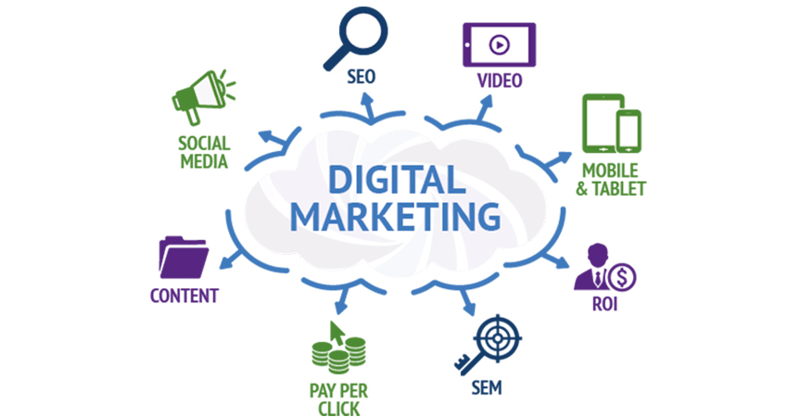
Digital Marketing
Ddigital marketing refers to advertising delivered through digital channels such as search engines, websites, social media, email, and mobile apps. Using these online media channels

Slide 3
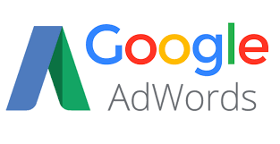
Google AdWords is a pay-per-click online advertising platform that allows advertisers to display their ads on Google's search engine results page. Based on the keywords that want to target, businesses pay to get their advertisements ranked at the top of the search results page.

Slide 4
Campaigns Structuring
Google Ads is organized into three layers:
account, campaigns, and ad groups.
Your account is associated with a unique email address, password, and billing information. Your campaigns have their own budget and settings that determine where your ads appear. Your ad groups contain a set of similar ads and keywords.
Log into your Google Ads account
Click on “Campaigns,” and then “New Campaign”
Select "Display Network only" as the campaign type
From here, select the types of Google Display Network targeting that you’d like to include as part of your campaign. To find out about the different types of ways to show ads to users and how to set them, keep reading.

Slide 5
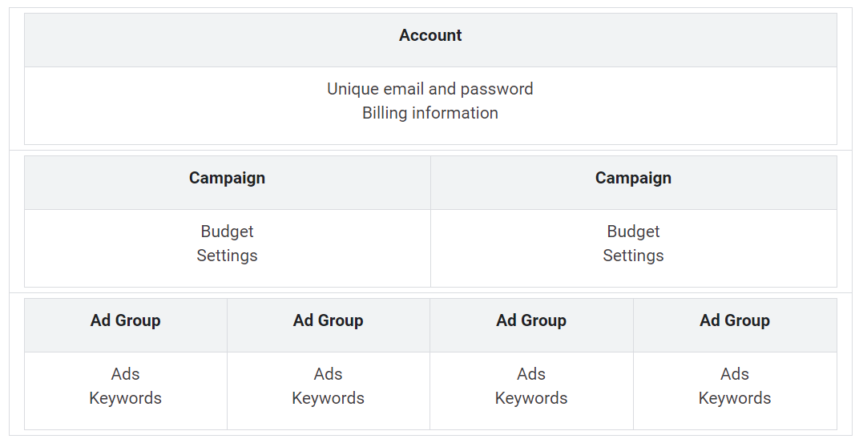
Campaigns Structuring

Slide 6
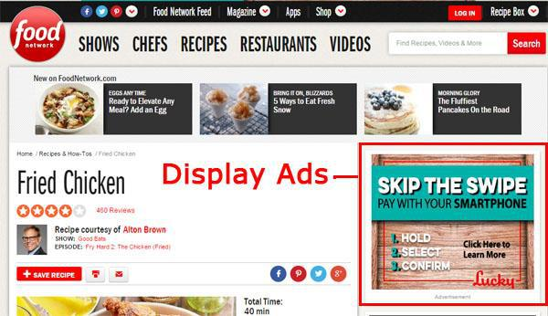
Display Networks
A group of more than 2 million websites, videos, and apps where your ads can appear.
Display Network sites reach over 90% of Internet users worldwide*. With the Display Network, you can use targeting to show your ads in particular contexts (like “outdoor lifestyles” or “cnn.com”), to particular audiences (like “young moms” or “people shopping for a new sedan”), in particular locations, and more.

Slide 7
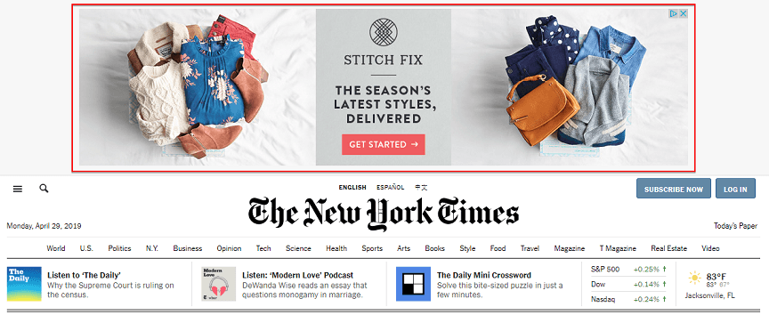

Slide 8
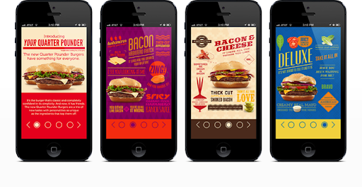
Mobile Ads
A type of ad that can appear on webpages and apps that are viewed on a mobile device like a cell phone or tablet.
For Google Ads, "mobile" is defined as where the ad can appear on "mobile" devices. These include high-end mobile devices with smaller screens, such as smartphones.
Text ads
Image ads
Mobile app promotion ads
Call-only ads

Slide 9
YouTube Ads
On YouTube, people can discover videos in various ways (for example, by searching on the YouTube search page, clicking suggested videos on the watch page, or choosing a video from the homepage feed). You can use YouTube to advertise more effectively to people who are searching for your product or brand.
Benefits
Connect with your audience
Reach the right audience
Note:
You can only target ads to countries where YouTube allows ads. Availability may differ between countries.
https://support.google.com/youtube/answer/1342206
Ad formats for YouTube
Depending on your goal, you can use different ad formats built for YouTube. These ad formats are:
Skippable in-stream ads
Non-skippable in-stream ads
Responsive display ads

Slide 10
Keyword Research Methodology
Keyword research and analysis methods are the most important, valuable, and high return activities in the search and content marketing fields.
Keyword research should be the basis of any online marketing campaign. Search engines want to rank the most credible, comprehensive resource for a given keyword term. Ranking for the right keywords can make or break your website.
The simple goal of keyword research is to find out what your target audience is searching and what it will take to actually rank for those keywords and phrases.
Keywords analysis and research methods do not only drive traffic to your website, but also bring the right kind of visitors who’d be interested in your services or products.

Slide 11
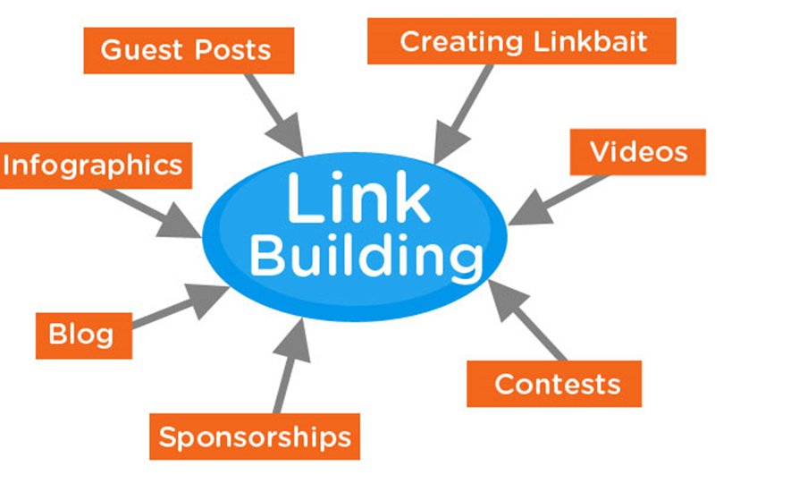
Link Building Methodology and Strategies

Slide 12
Thank you

