Slide 1
MIS

Slide 2
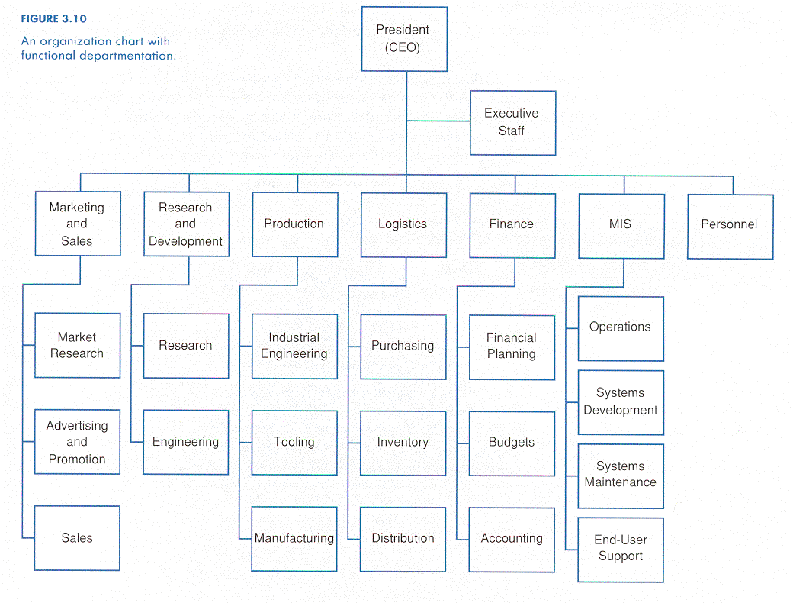

Slide 3
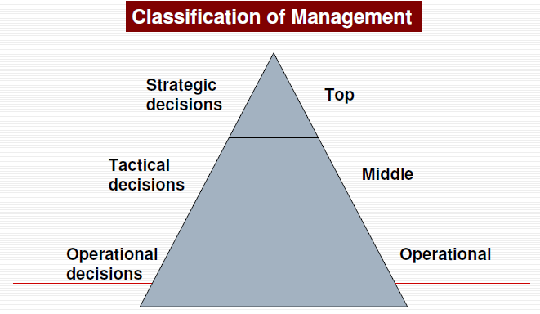

Slide 4

A Business - MIS
Sales
Supplier
Purchase Order
Forecast
Order
Stock Details
Material
Customer Order
Dispatch
Instruction
Order
Acceptance
Customer
Goods & Invoice
Delivery Doc & Invoice
Ins. Report
Warehouse
Stock Details
Customer Invoice
RM Issue
Production
Ins Req
Accounts
FG Receipt
Work In Progress (WIP)
Payment
Vendor Invoice
Quality
Payment
Notes:
There are many functional in a organization like sales, purchase, inventory, accounts, manufacturing etc. Each departments functional in particular way. Each department has its own process, controls and documentation
ERP system integrates them.
ERP is a software system that integrates all the functions of an organization into one single software system.
ERP supports provide the base for operating the business
This research study is related to ERP system.

Slide 5
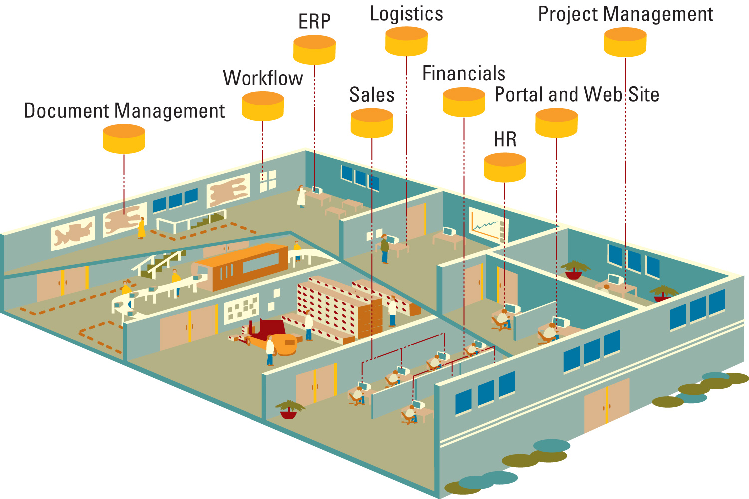
Bringing the Organization Together
ERP – The organization before ERP

Slide 6
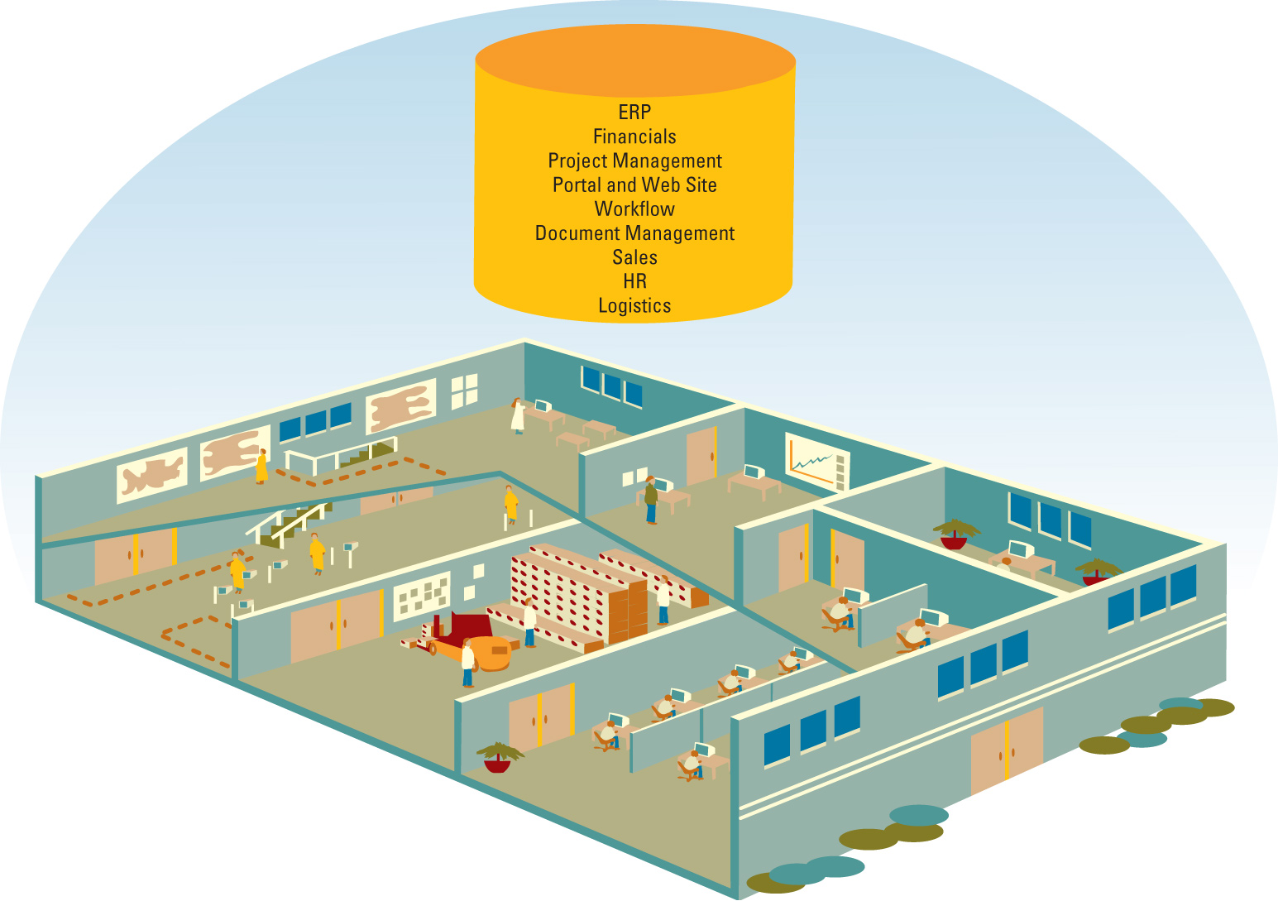
Bringing the Organization Together
ERP – bringing the organization together

Slide 7
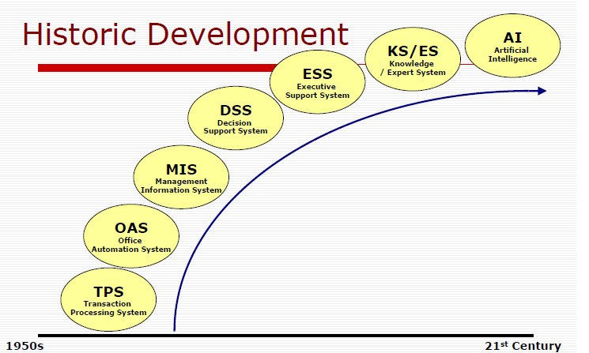
Historic Development

Slide 8
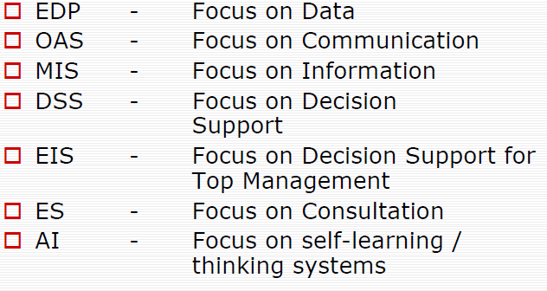
Historic Development

Slide 9
I. Management Information Systems
A. Management: What is management?
B. Information: What is information?
C. Systems: What are systems?

Slide 10
Management Information Systems
Management: What is management?
    “Management is group of individuals who does :
  Planning - Goal setting, Environmental scanning, Forecasting and Data collection
  Organizing - Staffing, Coordinating, Delegating, Understanding, Procedures/ Policies
  Leading- Authority, Motivating, Directing ( Delegation of responsibilities ) activating, Supervising, Negotiation and Persuading
  Controlling - Controlling: Resources- Money (capital), manpower (people), materials, machines, movement (Distribution, flow), and Information. Measuring, Evaluating , Reporting, corrective action and feed back
  Communicating: Goals/Objectives, standards of desirability. Informing, Persuading, Negotiation, Corrective action, Listening

Slide 11
Management Information Systems
  Information: What is information?
      “ A definition: Information is data that has been processed into a form that is meaningful to the recipient (USER) and is of real or perceived value in current or prospective actions or decisions.
  Data (raw material)- Alpha-numeric and Symbolic : Stored facts, inactive (they exist), technology based and gathered from various places
  Processed data :meaningful, perceived value, motivating action, HAS SURPRISE VALUE, HAS NEWS VALUE, Presented facts, active (it enables doing), business based (Domain based) and transformed form data
  Model : entity, attribute and relationship
  Reduces Uncertainty
  Reduces Equivocal (ambiguity)
  Knowledge/Power
  Send/Receive Messages

Slide 12
Management Information Systems
      Systems Concepts: What are systems?
            “physical system is a set of components (subsystems or elementary parts) that operate together to achieve a common objective (or multiple objective).
    Input-process-output an orderly arrangement of interdependent ideas or constructs (ABSTRACT SYSTEM)
    a set of elements which operate together to accomplish an objective (PHYSICAL SYSTEM)

Slide 13
Transforming Data Into Information
Data Inputs
Information Outputs
Query Response
Decision Outcome
Expert-System Advice
Transaction Document
Report
External
Data
Internal
Data
Capture
Manipulation
Storage
Provision of Access
at User Location
Organization
Environment
Information System

Slide 14
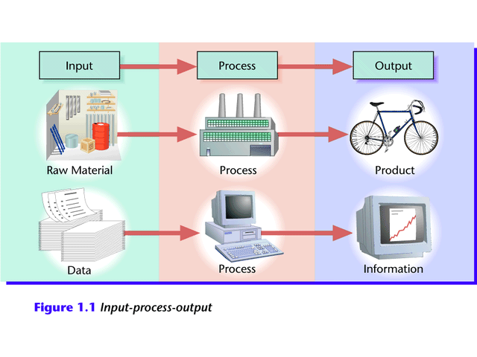
Data, Information, and Systems
Generating Information
  Computer-based ISs take data as raw material, process it, and produce information as output.

Slide 15
MIS
Data vs. Information
  Data
    A “given,” or fact; a number, a statement, or a picture
    Represents something in the real world
    The raw materials in the production of information
  Information
    Data that have meaning within a context
    Data in relationships
    Data after manipulation
Data Analyses:
  Example: customer survey
    Reading through data collected from a customer survey with questions in various categories would be time-consuming and not very helpful.
    When manipulated, the surveys may provide useful information.

Slide 16
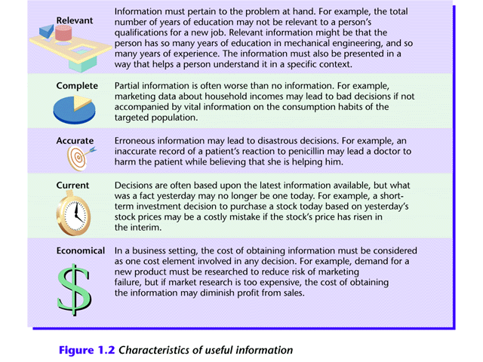
MIS
Information in Context

Slide 17
Meaning of MIS
1. An organized approach to the study of the information needs of an organization's management at every level in making operational, tactical, and strategic decisions. Its objective is to design and implement procedures, processes, and routines that provide suitably detailed reports in an accurate, consistent, and timely manner.
2 .In a management information system, modern, computerized systems continuously gather relevant data, both from inside and outside an organization. This data is then processed, integrated, and stored in a centralized database (or data warehouse) where it is constantly updated and made available to all who have the authority to access it, in a form that suits their purpose.

Slide 18
Meaning of MIS
MIS is the system, which makes available the right information to the:
  Right Person
  At Right Place
  At right time
  In the right format/form
  At right cost.

Slide 19
Definition of MIS
Lucey, defines MIS as
“a system to covert data from internal and external sources into information to communicate that information in an appropriate form to managers at all levels, in all functions to make timely and effective decisions for planning, directing and controlling the activities for which they are responsible”

Slide 20
What is MIS?
A system to convert the data from internal and external sources into information and to communicate it in an appropriate manner, to managers at all levels and helps in taking timely and effective decisions for planning, directing and controlling the activities for which they are responsible.

Slide 21
Need, Purpose and Objective of MIS
  Decision making
  Problem Solving
  Controlling
  Getting competitive edge

Slide 22
Globalisation
Worldwide marketplace
24x7 nature
Firms can achieve extraordinary cost reductions by finding low-cost suppliers and managing production facilities in other countries.
Google, e-bay, amazon……….

Slide 23
The emerging digital firm
A digital firm is one in which nearly all of the organisation’s significant business relationships with customers, suppliers, and employees are digitally enabled and mediated.
Core business processes are accomplished through digital networks spanning the entire organisation or linking multiple organisations
  Developing a new product, generating and fulfilling an order, creating a marketing plan, and hiring an employee……..
Time shifting and space shifting

Slide 24
MIS as an instrument for the Organizational Change
External Change
  MIS has made world smaller
  Worldwide reorganization environment and attempt to control the calamity.
  Health conscious among the group leading less sufferings
  Change in the work lifestyle for better result
  Creating Knowledge is an assets
Internal Change
  MIS will change the Business Process
  MIS will change the old standards and set new standards
  MIS key for Continuous improvement Process
  MIS will reduce the hierarchy and hence less operation cost
  MIS focus on “Shared information”
  MIS will accelerate restructure work flow for both line and staff functions.
  MIS will bring change in Authority and power by merit and not by age or number of years of experience.
  MIS brings cultural change.
  MIS measures the results and performance.
  MIS brings Continuous addition to Organizational knowledge base.
Is MIS instrument for Changes ?
“Yes”

Slide 25
Information as Strategic Resource
Yes…. Information is Strategic Resources. Because Information helps in taking Strategic, Tactical and operational Decisions. It is one of critical and importance resource.
It helps us understand Cost, Quality, price, technology, productivity and product.
It helps to smooth following of business process and there by smooth managing of business operation.
It helps to maintain the business standards like ISO, QS, CMMI, Six Sigma etc.
It helps to be ahead in the competition
It helps company in analyzing their own SWOT
It helps in maintaining it’s own profitability.
It will help in taking new business decisions like new plant, new product, new business line etc.
It protects company from business cycles.
It provides future direction to the organization.
It provides the competitive edge.

Slide 26
Use of Information for Competitive Advantages
A. According Porter Miller: Information helps in following:
  Change in industry structure: this includes Five Forces:
    Customers’ bargaining power
    Suppliers’ bargaining power
    Threats of new entrant in market
    Pressure from substitute products and services and
    Existing Industry competitors
  Birth of new business/new business initiatives
  New ways of doing business
B. Functional Use:
  Lower the cost
  Information and information system facilitate value chain e.g. product delivery, quality
  In increased the speed, accuracy and timeliness of the organization
  It helps in simplifying the business processes
  It helps organization in meeting the standards and benchmarks
C. Strategic Use
  New way of doing the work
  New way of dealing in Product differentiation
  It helps in new way of developing strategies, planning, forecasting and monitoring
  It helps in problem solving and decision making by extensive internal and external data analysis.
  It improves the ability to perform
  It helps in getting advantages of market situation and keeps ahead in the competition.
  It helps in eliminating waste, inefficiencies and gaps in the business operations
  Provides the flexibility and helps manage the uncertainties
  Analysis external information and making use of business

Slide 27
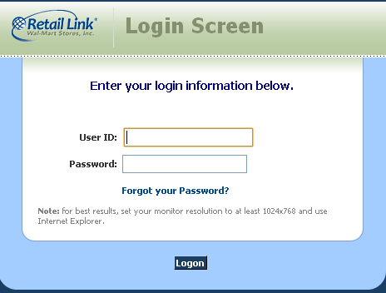

Strategic objectives of Information Systems:
1. Operational excellence
Higher levels of efficiency and productivity in business operations

Slide 28
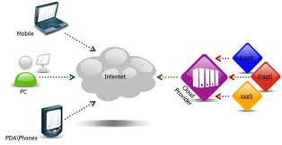

Strategic objectives of Information Systems:
2. New Products, Services and Business Models
Information Systems and technologies are a major enabling tool for firms to create new products and services as well as entirely new business models

Slide 29

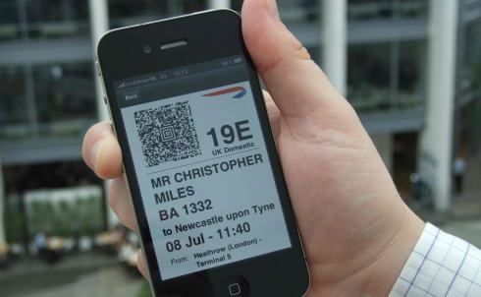


Strategic objectives of Information Systems:
3. Customer and Supplier Intimacy
More you know your customers and serve them well, the more they respond by returning and purchasing more.
More you engage your suppliers, the better the suppliers can provide vital inputs.

Slide 30

Strategic objectives of Information Systems:
4. Improved decision making
Forecasts
Over production and under-production of goods
Best Guesses
Luck !
Cost
Customers
poor allocation of resources
Poor response times

Slide 31

Strategic objectives of Information Systems:
4. Improved decision making

Slide 32

Strategic objectives of Information Systems:
5. Competitive advantage
Doing things better than your competitors
Charging less for superior products
Responding to customers and suppliers in real time
“mass customisation”

Slide 33
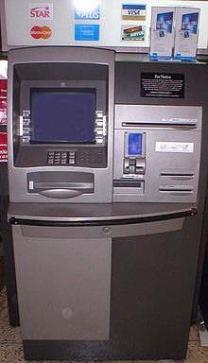
Strategic objectives of Information Systems:
6. Survival
Investment in IS and technologies are becoming necessities of doing business.

Slide 34
Contemporary (modern) Approaches to MIS
Contemporary MIS systems involve one or more computers, working in concert, to achieve the stated goals of an organization. The function is always the same, but the desired results fluctuate with the specific goals and needs of individual organizations. Since the universal language of commerce is numbers, using the incredible speed of computers, MIS systems achieve their function amazingly well.
Technical Approach:
  It includes mathematical and normative
  Rely on physical technology and formal capabilities of systems
  Computer science, management science and operation research contributes significantly.
Behavioral Approach:
  Depends on Developer consider- behavioral aspects political science, psychology, sociology and organizational behavior.
Socio-Technical Approach.- it include both technical as well as behavioral approaches.
The most important features of contemporary MIS systems involve flexibility and reasonable cost. In the world of business, it matters little what industry you are in, how large or small the company may be and how computer savvy the management is. There are MIS systems that are easy to use, affordably priced and immensely reliable available to all businesses.

Slide 35
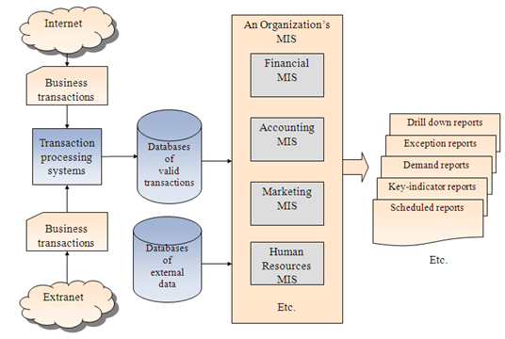
Inputs and Outputs of mis

Slide 36
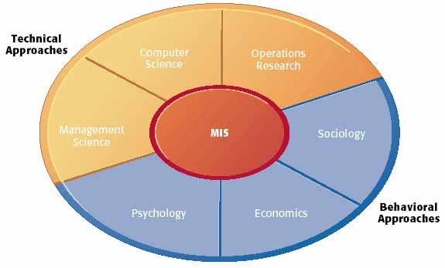
Contemporary Approaches to MIS

Slide 37
Characteristics of MIS
I. Management-oriented: The basic objective of MIS is to provide information support to the management in the organization for decision making. So an effective MIS should start its journey from appraisal of management needs, mission and goal of the business organization. It may be individual or collective goals of an organization. The MIS is such that it serves all the levels of management in an organization i.e. top, middle and lower level.
II. Management directed: When MIS is management-oriented, it should be directed by the management because it is the management who tells their needs and requirements more effectively than anybody else. Manager should guide the MIS professionals not only at the stage of planning but also on development, review and implementation stages so that effective system should be the end product of the whole exercise in making an effective MIS.
III. Integrated: It means a comprehensive or complete view of all the sub systems in the organization of a company. Development of information must be integrated so that all the operational and functional information sub systems should be worked together as a single entity. This integration is necessary because it leads to retrieval of more meaningful and useful information.
IV. Common data flows: The integration of different sub systems will lead to a common data flow which will further help in avoiding duplicity and redundancy in data collection, storage and processing. For example, the customer orders are the basis for many activities in an organization viz. billing, sales for cashing, etc. Data is collected by a system analyst from its original source only one time. Then he utilizes the data with minimum number of processing procedures and uses the information for production output documents and reports in small numbers and eliminates the undesirable data. This will lead to elimination of duplication that simplify the operations and produce an efficient information system.
V. Heavy planning-element: The preparation of MIS is not a one or two day exercise. It usually takes 3 to 5 years and sometimes a much longer period. So the system expert has to keep 2 things in mind – one is that he has to keep future objectives as well as the firm’s information well in advance and also he has to keep in mind that his MIS will not be obsolete before it gets into action.

Slide 38
Characteristics of MIS
VI. Sub System concept: When a problem is seen in 2 sub parts, then the better solution to the problem is possible. Although MIS is viewed as a single entity but for its effective use, it should be broken down in small parts or subsystems so that more attention and insight is paid to each sub system. Priorities will be set and phase of implementation will be made easy. While making or breaking down the whole MIS into subsystems, it should be kept in mind that the subsystems should be easily manageable.
VII. Common database: This is the basic feature of MIS to achieve the objective of using MIS in business organizations. It avoids duplication of files and storage which leads to reduction in costs. Common database means a “Super file or Master file” which consolidates and integrates data records formerly stored in many separate data files. The organization of the database allows it to be accessed by each subsystem and thus, eliminates the necessity of duplication in data storage, updating, deletion and protection.
VIII. Computerized: MIS can be used without a computer. But the use of computers increases the effectiveness and the efficiency of the system. The queries can be handled more quickly and efficiently with the computerized MIS. The other benefits are accuracy, storage capacity and timely information.
IX. User friendly/Flexibility: An MIS should be flexible i.e. there should be room for further modification because the MIS takes much time in preparation and our environment is dynamic in nature.MIS should be such that it should be used independently by the end user so that they do not depend on the experts.
X. Information as a resource: Information is the major ingredient of any MIS. So, an MIS should be treated as a resource and managed properly

