Slide 1
IGNEOUS ROCKS TEXTURES & STRUCTURES
Rajnikant patidar
Department of Geology
M.L. Sukhadia University, Udaipur

Slide 2
WHAT IS TEXTURE ?
In general the term texture refer to the size, shape, and arrangement of mineral grains in a rock.
It is normally by the texture that a geologist will first recognize whether a rock is igneous, sedimentary, or metamorphic, before they get down to the business of identifying the rock or naming it.

Slide 3
IGNEOUS ROCK TEXTURES
In Igneous rocks the texture is controlled by factors like:
Rate of Cooling.
Depth of Cooling.
Composition of Magma/Lava.
The textures in these rocks can be described on the basis of:
(a) Degree of Crystallization (Crystallinity)
(b) Size of Crystals (Granularity)
(c) Shape of Crystals
(D) Relation between Crystals and Crystals/Glass

Slide 4
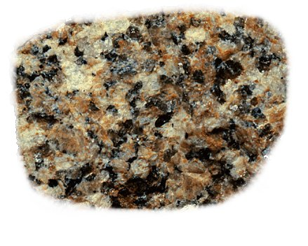
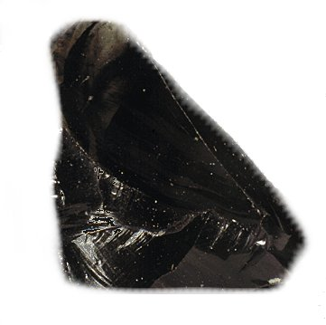
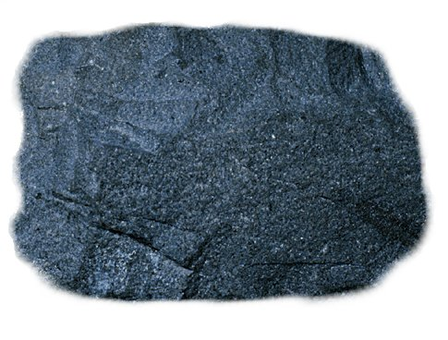
Degree of Crystallization
It refer to ratio between crystallized and non-crystallized material within a rock.
(A) Holocrystalline – Completely crystallized (no glass)
(B) Holohyaline – Completely glassy (no crystals)
(C) Hemicrystalline – Partly crystals and partly glassy.
Holocrystalline
Holohyaline
Hemiocrystalline

Slide 5
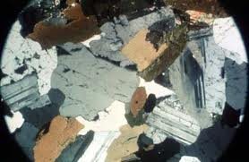
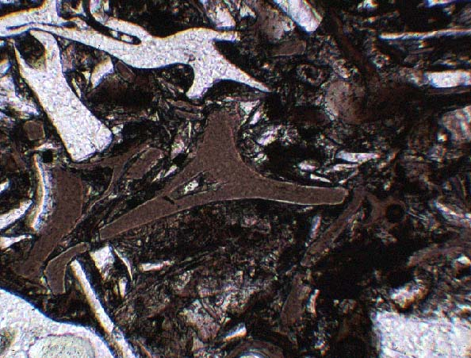
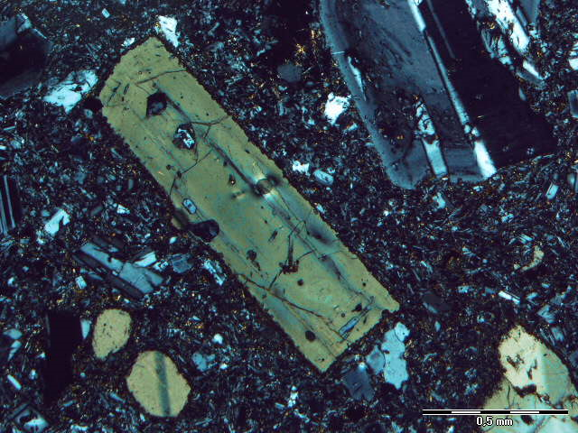
Holocrystalline
Holohyaline
Hemicrystalline

Slide 6
Size of Crystals
Phaneric – grains are visible with unaided eye
Coarse grained - > 5 mm size
Medium grained – 1 – 5 mm
Fine grained - < 1 mm
Aphaneric – microscope is needed
Glassy - No crystallization
Micro-crystalline – Can identify
Cryptocrystalline – Difficulty in
identification

Slide 7
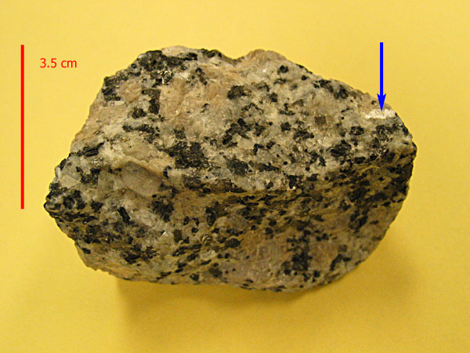
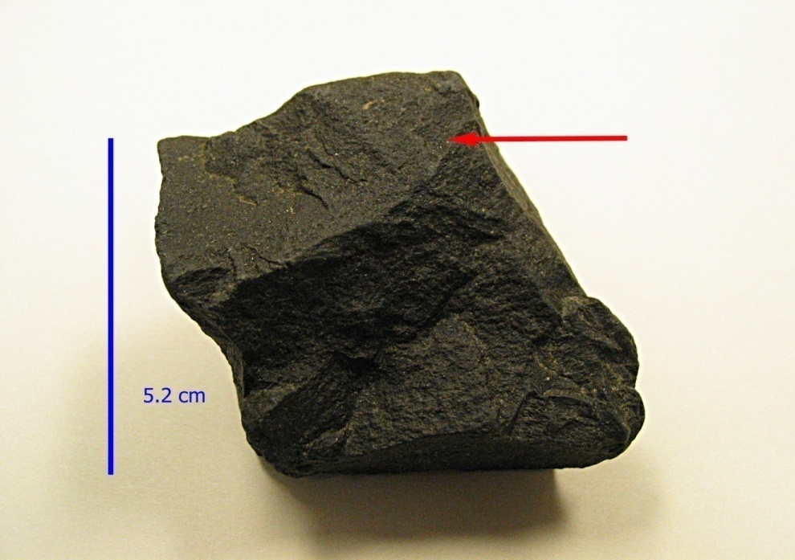
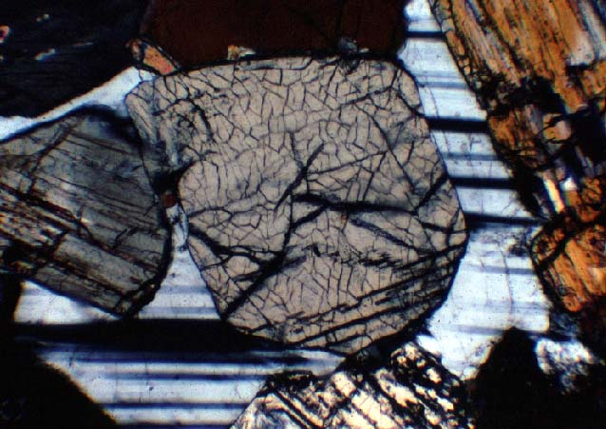
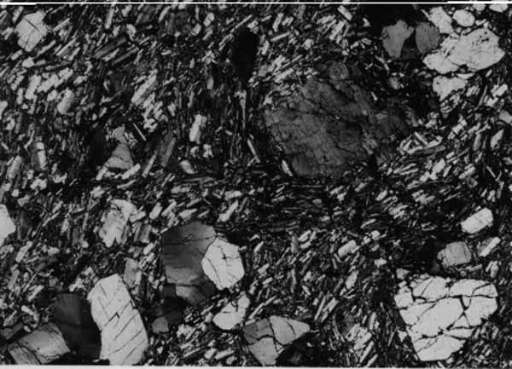
Phaneric
Aphaneric
Coarse grained
Medium and Fine grained

Slide 8
Shape of Crystals
On the basis of Development of Crystal Faces:
Euhedral crystals
Sub-hedral crystals
Anhedral crystals
Shape in three dimensional space:
Equidimensional Crystals
Tabular Crystals
Rod shaped Crystals
Irregular Crystals

Slide 9
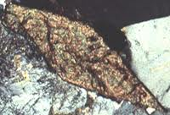
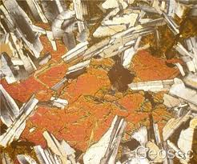
Anhedral grain
Euhedral grain
Subhedral grain

Slide 10
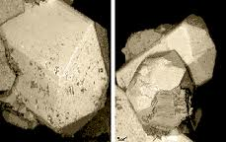
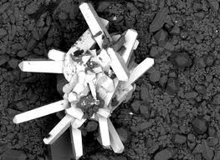
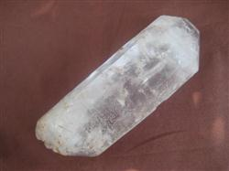
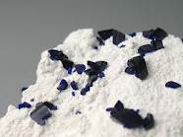
Equidimensional
Rod shape
Tabular
Irregular

Slide 11
Mutual Relationship between Crystals
Equigranular Texture
Panidiomorphic Texture
Hypidiomorphic Texture
Allotriomorphic Texture
Inequigranular Texture
Porphyritic Texture
Poikilitic Texture / Ophitic Texture

Slide 12
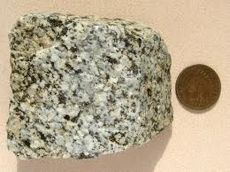
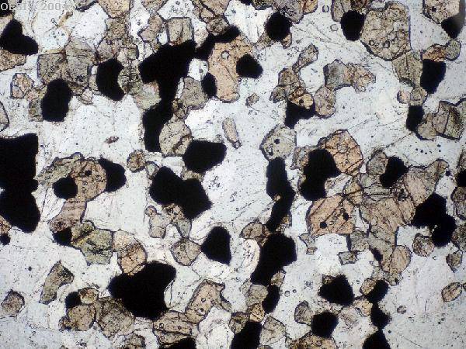
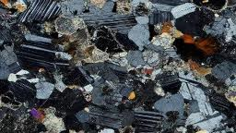
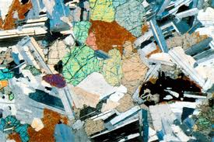
Equigranular Textures

Slide 13
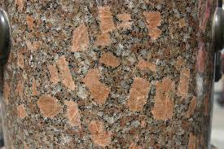
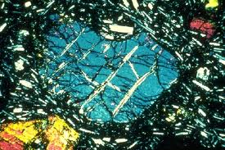
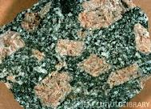
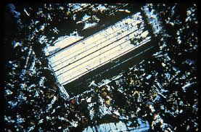
Porphyritic Textures

Slide 14
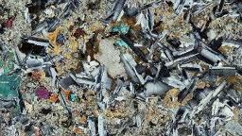
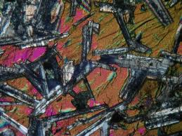
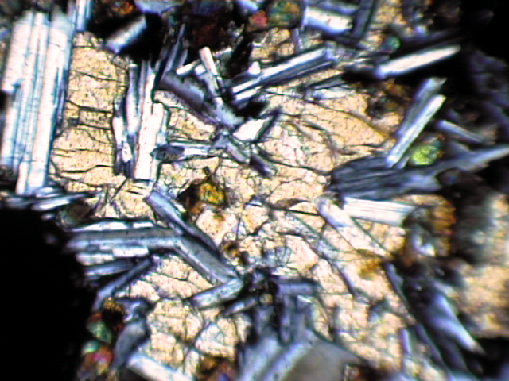
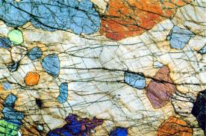
Ophitic Texture
Poikilitic Texture

Slide 15
Structures in Igneous Rocks
Igneous structures are broadly divided into Two Groups:
(a) Mega - Structures
(b) Micro - Structures

Slide 16
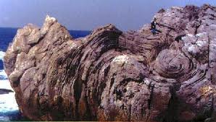
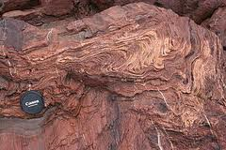
Flow Structure
Generally present in volcanic rocks.
Layers or banding is seen in the direction of lava flow.

Slide 17
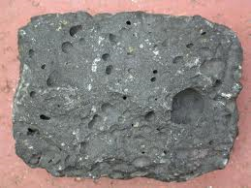
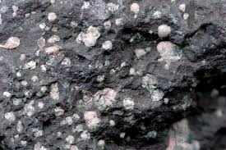
Vesicular & Amygdaloidal Structures
Vesicular structures formed by the release of gases and rapid cooling.
Filling of vesicles by secondary minerals give rise amygdaloidal structure.

Slide 18
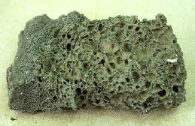
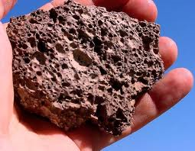
Cellular or Scoriaceous Structure
Highly gaseous lava on rapid cooling give rise numerous cavities.

Slide 19
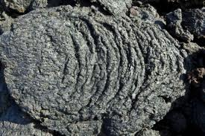
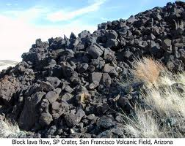
Block Lava
Acidic lava has high viscosity hence unable to flow greater distance. Cooling of highly viscos lava resulted rough surface and fragmented appearance.

Slide 20
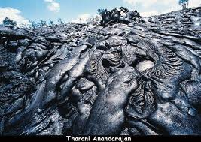
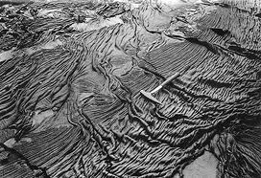
Ropy Lava
Basic lava are quite mobile and on cooling give rise smooth surface.

Slide 21
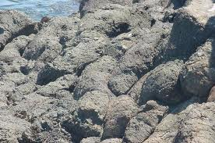
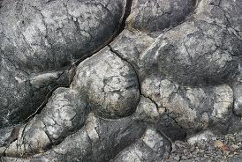
Pillow Structure
Basaltic lava flow that exhibit “Pillow like appearance” . They are rounded lumps of lava.

Slide 22
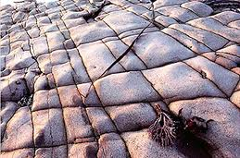
Joints
Joints are fractures in igneous rocks, resulted during cooling of magma/lava.
Joint in granitic rock
Rectangular joint in rhyolites

Slide 23
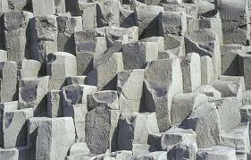
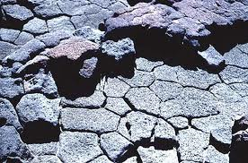
Columnar Joints
Hexagonal to Pentagonal jointing Developed
during cooling

Slide 24
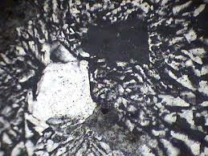
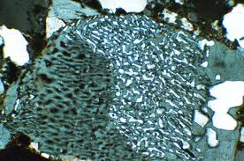
Micro - Structures
Graphic intergrowth: Intergrowth of quartz and orthoclase (potash feldspar).
Myrmekite structure : Intergrowth of quartz and plagioclase feldspar (quartz occur as drops in palgioclase)
Graphic intergrowth
Myrmekitic structure

Slide 25
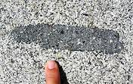
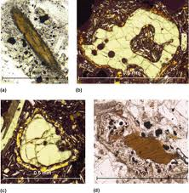
Xenolithic structure – Foreign rock fragment in igneous rocks.
Reaction Rim – Corroded mineral grain, reaction with magma.

Slide 26
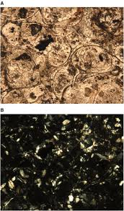
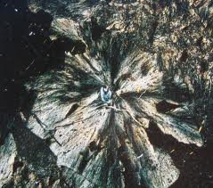
Spherulitic structure – radiating arrangement of micro-crystals through a common centre.
Perlitic cracks – cracks developed due to contraction of glassy mass during cooling.

