Slide 1
Origin of Granites
Rajnikant Patidar
Department of Geology, M.L. Sukhadia University, Udaipur – 313002

Slide 2
Introduction
The word granite comes from the Latin granum, a grain, in reference to the coarse-grained structure of such a crystalline rock.
Granite is a common and widely-occurring group of intrusive felsic igneous rocks.
Granite is a hard, compact and medium to coarse grained igneous rock. It is leucocratic rock ranging in colours from pink, reddish pink and white.
Strictly speaking, the term “ granite ” is restricted to plutonic rocks containing 20 – 40% quartz and 35 – 70% alkali to plagioclase feldspars. Thus, the two essential mineral groups in granite are quartz and feldspars.
The average density is 2.75 g/cm3 with a range of 1.74 to 2.80.

Slide 3
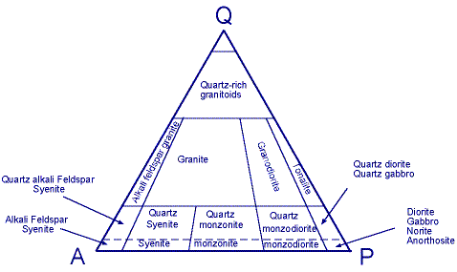

Slide 4
They formed by very slow cooling and show corresponding large crystals
Most of the rocks are medium to coarse grained
They are intrusive rocks. Granite batholiths are common and are often huge in size (>100 sqkm).
Examples include:
Sierra Nevada batholith
Idaho batholith (which extends into western Montana)
Coast Range Plutonic Complex of western British Columbia
Alaska-Aleutian Range batholith of Alaska, among many others

Slide 5
Granite has been intruded into the crust of the Earth during all geologic periods, except perhaps the most recent.
Much of it is of Precambrian age.
Granite is widely distributed throughout the continental crust of the Earth and is the most abundant basement rock that underlies the relatively thin sedimentary rock of the continents.

Slide 6
Types of Granites
Chappell and White (1974), Loiselle and Wones (1979), Pitcher (1982 ), and others recognize four distinct types of granites, based upon the nature of the parental source rock:
M - types
I - types
S - types
A - types
M - , I - , and S - type granites are orogenic granites associated with subduction, whereas A - type granites are anorogenic in origin.

Slide 7
M - type granites are derived from mantle - derived parental magmas, as indicated in the low Sr 87 /Sr 86 ratios ( < 0.704). M - type granites develop in island arc settings.
I - type granites are generated by the melting of an igneous protolith from either the downgoing oceanic lithosphere or the overlying mantle wedge. I - type granites are enriched in Na 2 O and Ca 2 O and contain lower Al 2 O 3 concentrations. I - type granites have Sr 87 /Sr 86 ratios of less than 0.708, usually in the range 0.704 – 0.706, indicating magma derived from a mantle source. I - type granites may be enriched in mafic minerals such as hornblende, biotite, magnetite and sphene.

Slide 8
S - type granites are produced by the melting of sedimentary crustal rocks in collision zones. S - type granites are depleted in Na2O but enriched in Al2O3 (peraluminous).
A - type granites are anorogenic rocks produced by activities that do not involve the subduction and collision of lithospheric plates. A - type granites are enriched in alkaline elements with high K/Na and (K + Na)/Al ratios as well as high Fe/Mg

Slide 9
The major features of M - , I - , S - and A - type granites
 | M - Type | I – Type | S – Type | A - Type
SiO2 | 54 – 73% | 53 – 76% | 65 – 79% | 60 – 80%
Na 2O | Low, < 3.2% | High, > 3.2% | Low, < 3.2% | > 2.8%
K2O/Na 2O | Very low | Low | High | High
Sr 87 /Sr 86 | < 0.704 | < 0.706 | > 0.706 | 0.703 – 0.712

Slide 10
Origin of Granite
Geologists have debated rival theories of granite's origin for over 150 years.
There are two theories suggested for the origin of granite.
The magmatic theory
The granitization theory
The magmatic theory states that granite is derived by the crystal fractionation of magma. Thus granite bodies are the result of intrusion of liquid magma into the existing rocks.
The granitization theory states that granite is formed "in situ" by ultra-metamorphism.
There is evidence to support both theories, and current thinking is that magma forms from both processes; in many instances, from a combination of the two.

Slide 11
Magmatic Theory
The magmatic theory involves the use of the Bowen Reaction Series. Thus, if crystal fractionation of a magma of tholeiitic basalt composition were to occur, one of its end products would be granite.
There are many evidences which support the magmatic origin of granites.
Many granitic bodies are clearly intrusive rocks and intruded into the country rocks. This cutting and intrusive nature suggest the magmatic origin.
Such plutons (intrusive body) typically show sharp contacts; a lack of deformation in the country rock, chilled margins and contact aureoles. these phenomena suggest that granite was emplaced as a hot liquidus magma.

Slide 12
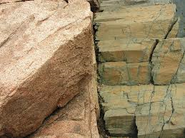
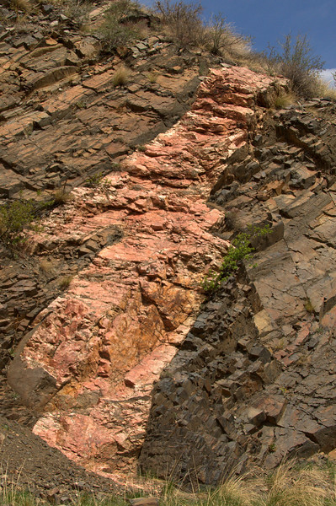
Intrusive nature of granite,
showing sharp contact and lack of deformation in country rocks

Slide 13
Chemically, there is similarity in the composition of many granite plutons to their extrusive associates, the andecite-dacite-rhyolite series of rocks. This suggests there is some kind of relationship between the emplacement of granite plutons and volcanism.
The general model composition of granites is the strongest evidence for magmatic origin. The granites has typical mineral composition i.e. potash felspar, quartz and albite. The quartz content is 20 – 40%. If it form by granitization of heterogenous sediments having more than 40% quartz then how the excess quartz removed from the sediments? (which is not possible).
The range of composition of granite – granodiorite series is strikingly parallel with that of rhyolite – rhyodacite – dacite (volcanic rocks).

Slide 14
Zoned plagioclase, perthitic and myrmekitic structures, and presence of accessory minerals like apatite, sphene, magnetite, zircon (in idiomorphic form) etc. suggesting magmatic crystallization.
The granite has medium to coarse grained, hypidiomorphic texture, a characteristic igneous texture.
In many places, emplacement of granite plutons is synchronous to volcanic eruptions and commonly form ring complexes.
Chilled borders are found at many granitic contacts.

Slide 15
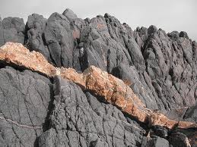
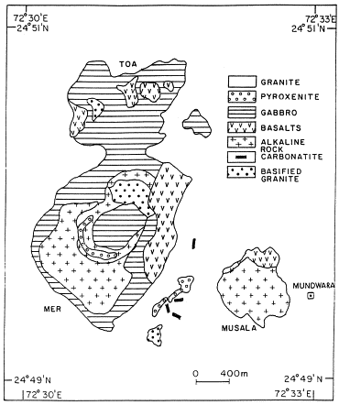
Granite dyke – Cross cutting
Relationship
Mundwara Igneous Complex (Sirohi)
Granite is associated with other
igneous rocks

Slide 16
Granitization Theory
The granitization theory states that granite (or some types of granite) is formed by extreme metamorphism of pre-existing rock, under conditions of extreme heat and pressure. This ultra metamorphism process is also known as "Anatexis". Anatexis is defined as the melting of pre-existing rock to give
There are evidences which support the granitization theory that the granites are developed by replacement of pre-existing rocks.
Supporters of granitization theory had a valid question : How a room was made available for a large size intrusion (batholith) of magma?

Slide 17
How is the immense amount of country rocks removed to make room for the batholith? Therefore, they reject the magmatic origin of large sized plutons because the question could not be answered.
The process of granite formation is evident in Migmatites, which consist of two components: one light coloured granitic component, called neosome, and a dark metamorphic component called paleosome. Both components have been ultra-mixed. In the granitization theory it was thought that migmatites were rocks in the process of becoming granite. Thus, the neosome, granitic component, was anatexic component; in which case, it may have formed by partial melting of the rock in place and segregation of the melt from the solid, or migration of the melt from its source of origin and intrusion into the host rock.

Slide 18
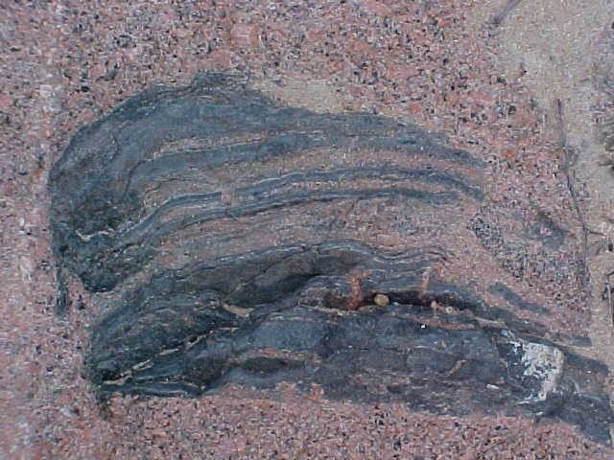
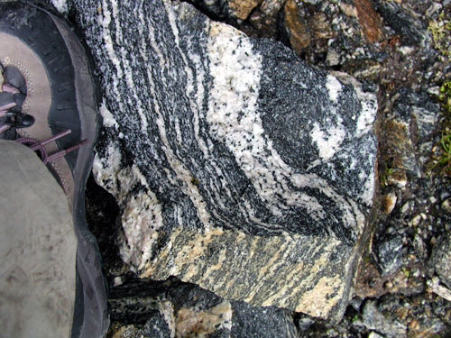
Neosome
Paleosome
Neosome
Migmatites

Slide 19
Many mountain belts contain huge volumes of granite (batholith). If the granites are magmatic origin and formed by fractional crystallization then >10 times greater volume of the mafic magmas requires in such case. The huge volumes of mafic magmas are not observed. Therefore, the general belief now is that granites are generated primarily by the partial melting of various source rocks.
Laboratory experiments have shown that the partial melting of amphibolites or gabbros can produce the tonalites-diorite-granodiorite series (I-type granites) and partial melting of meta-pelites or meta-graywackes can produce S-type granites.

Slide 20
Some time bedding and other structures of country rocks may be traced into granites.
Many a times the shape of granitic pluton is controlled by the structure of country rock.
Some time gradational boundaries from granite to country rocks is also observed.
Irregularity in texture and composition in granitic mass is evidence of granitization.

Slide 21
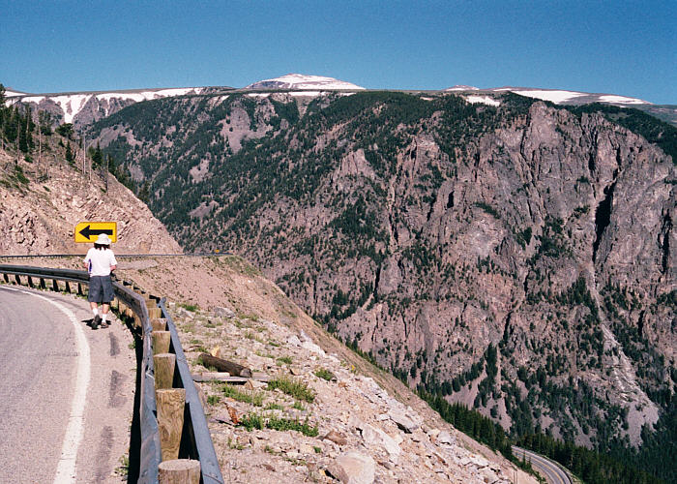
Beartooth Mountain (USA) is one of the important outcrops where the granitization concept for the origin of granite was originally developed.

Slide 22
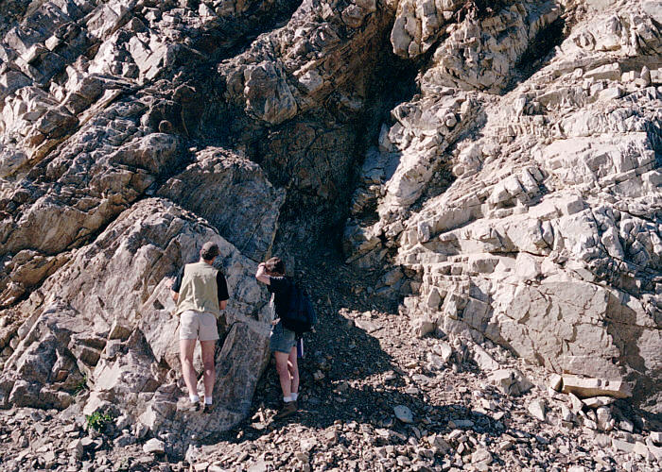
The rock on the right is a coarse-grained granite. The rock on the left is metamorphic and is made up of interbedded schist and quartzite. The concept here is that granitizing fluids moved in from the right, converting the metamorphic rock (once sedimentary) into granite.

Slide 23
Marmo (1968) proposed a ‘hydrothermal model’ for the origin of granites. This model has been proposed primarily to explain the formation of microcline-albite granites, which are comparatively wide-spread among the Precambrian rocks.
According to this model, the materials necessary to form granites derive from rocks which are predominantly of sedimentogenous origin and which contain water.
At a depth favourable to regional metamorphism, the recrystallizing rock mass expels (removed) water containing dissolved granite-forming components. The rock mass itself is thereby poor in potassium, that is to say granodioritized. The expelled material may granitize other areas, or be redeposited in tectonically suitable places as microline-albite granite.

Slide 24
Current thinking is that the granite forms from both processes; in many instances, from a combination of the two.

