Slide 1
IGNEOUS ROCKS Classification and Nomenclature
Rajnikant Patidar
Department of Geology
M.L. Sukhadia University, Udaipur

Slide 2
Different types of igneous rocks are found in nature.
Identification, correct naming (nomenclature) and their classification is important while studying the igneous rocks.
The nomenclature and classification of igneous rocks is depend upon factors like:
Colour
Textural Characteristics
Mineralogical Composition
Chemical Composition
Genesis

Slide 3
Classification based on Colour and Texture
Igneous rocks can be grouped on the basis of Colour Index ( Percentage of dark minerals present in the rock)
On the basis of Texture the igneous rocks are classify into:
Phaneritic Rocks (minerals visible with eye)
Aphanitic Rocks (minerals are too small)
Porphyritic Rocks (phenocrysts present)
Fragmental Rocks (pyroclastic)
Pegmatitic Rocks (very large size minerals)
Glassy Rocks (very fine, non-crystallized rocks)

Slide 4
Composition | Phaneritic | Aphanitic | Color index (% dark minerals)
Felsic | Granite Syenite Monzonite | Rhyolite Trachyte Latite | 10 15 20
Intermediate | Granodiorite Diorite | Dacite Andesite | 20 25
Mafic | Gabbro | Basalt | 50
Ultramafic | Peridotite |  | 95

Slide 5
Classification based on Genesis
Extrusive Igneous Rocks
Volcanic Rocks
Pyroclastic Rocks
Intrusive Igneous Rocks
Plutonic Rocks
Hypabyssal Rocks

Slide 6
Mineralogical Classification
Leucocratic Rocks – Rich in felsic minerals
(Granite, Granodiorite)
Melanocratic Rocks – Rich in mafic minerals
(Pyroxenite)
Mesocratic Rocks – Intermediate composition
(Diorite, Gabbro)

Slide 7
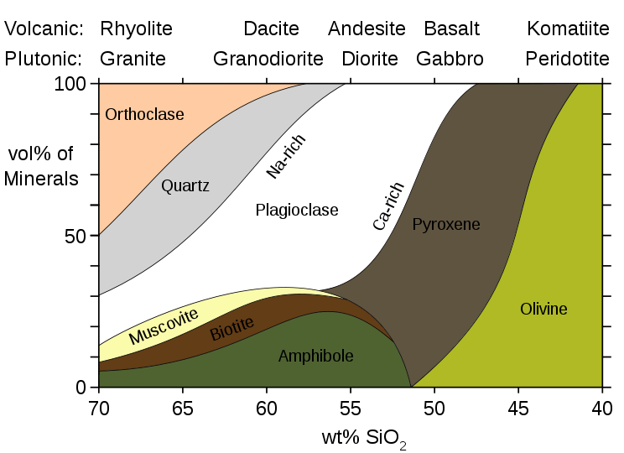

Slide 8
Chemical Classification
On the basis of SiO₂ content:
Acid Igneous Rocks - > 65% of SiO₂ (Granite)
Intermediate Igneous Rocks – 55 to 65% SiO₂ (Andesite)
Basic Igneous Rocks – 44 to 55% of SiO₂ (Basalt)
Ultrabasic Igneous Rocks - < 44% SiO₂ (Anorthosite)

Slide 9
On the basis of Alkali content:
Suggested by Irvine & Baragar (1971) for volcanic rocks
Peralkaline Rocks – (Na₂O + K₂O) > Al₂O₃ e.g. Commendite
Alkaline Rocks – (Na₂O + K₂O) = Al₂O₃ e.g. Alkali basalt
Sub-alkaline Rocks – (Na₂O + K₂O) < Al₂O₃ e.g. Rhyolite

Slide 10
TAS Classification
The TAS diagram is the mostly used classification of aphanitic volcanic rocks . The acronym originated from initial letters of compounds projected along both axes (Total Alkalis vs. Silica). Hence, it is a classic cartezian variation diagram, in which horizontal axis is numerical expression of SiO₂ content in wt. % correlated with the sum of Na₂O+K₂O on the vertical axis (LeBas et al. 1986).
The TAS diagram is descriptive and it does not have any genetic meaning. It can be used also for the classification of glass-rich or glassy rocks with less than 2 wt. % H₂O⁺ and 0.5 wt. % CO₂. However, prior to classification, the chemical analysis must be recalculated to 100 wt. %, excluding H₂O and CO₂.

Slide 11
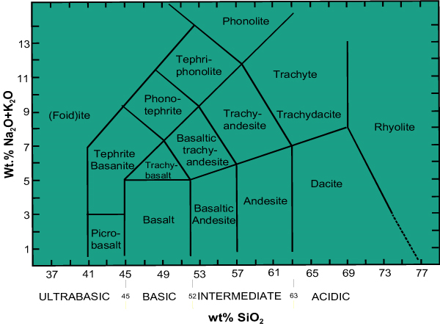
Total Alkali – Silica (TAS) Classification:
Suggested by Le Bas et.al. (1986) for volcanic rocks

Slide 12
Continue……
Chemical classification of volcanic rocks based on the total alkali content (Na₂O+K₂O in wt. %) and SiO₂ (LeBas et al. 1986, 1992).Rocks in shaded fields are further classified according to bottom table.
Other criteria must be employed to distinguish between rocks projected within the same field. For instance, basanite differs from tephrite by normative olivine, whose content is less than 10 mol. % in tephrite and above this value in basanite. Similarly, trachyte differs from trachydacite by content of normative quartz. Numbers within the diagram correspond to intersection coordinates of boundary lines.

Slide 14
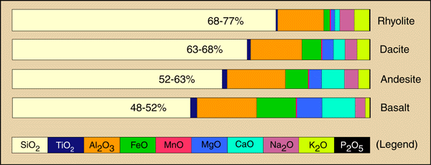
General Chemical Composition of common Igneous Rocks

Slide 15
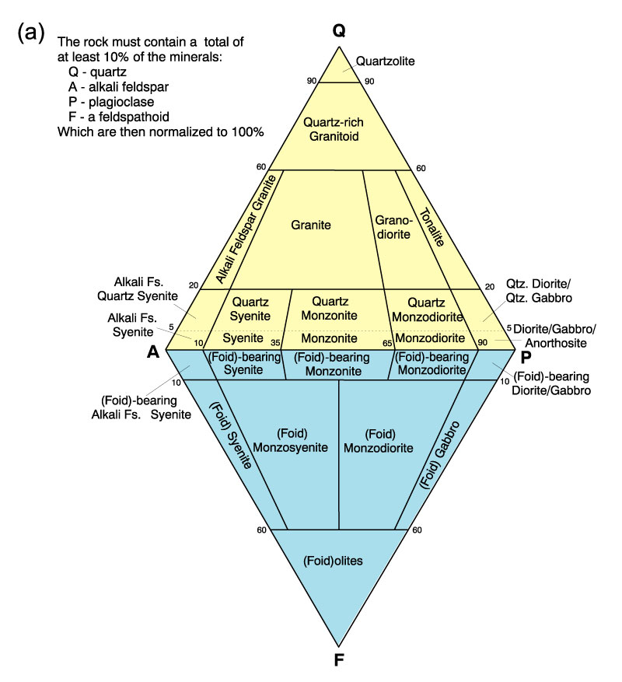
IUGS Classification (QAP Diagram)
For Plutonic Rocks:
Based on Modal
Concentration of
Common minerals

Slide 16
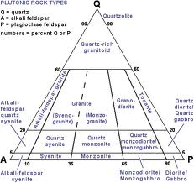

Slide 17
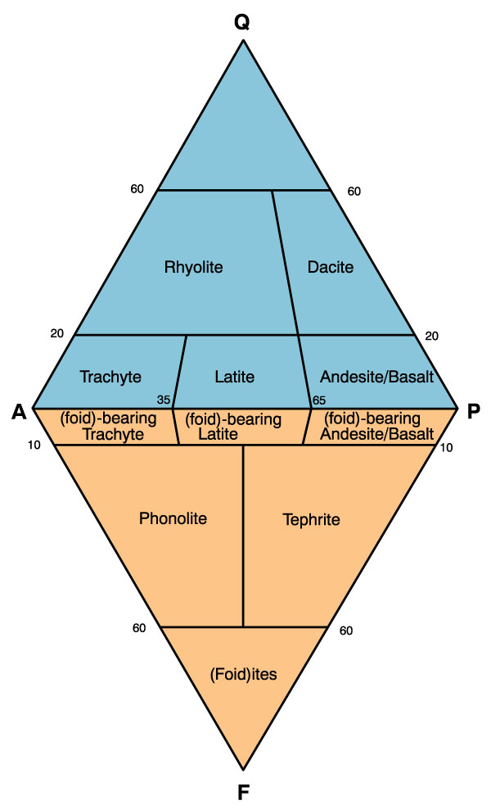
IUGS Classification (QAP Diagram)
For Volcanic &
Hypabyssal Rocks
Based on norms
(if modes are not
calculated)

Slide 18
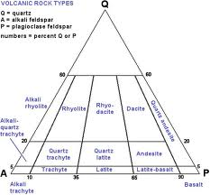

Slide 19
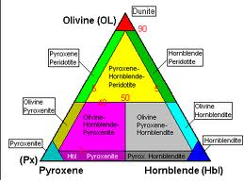
Classification of Ultramafic Rocks

Slide 20
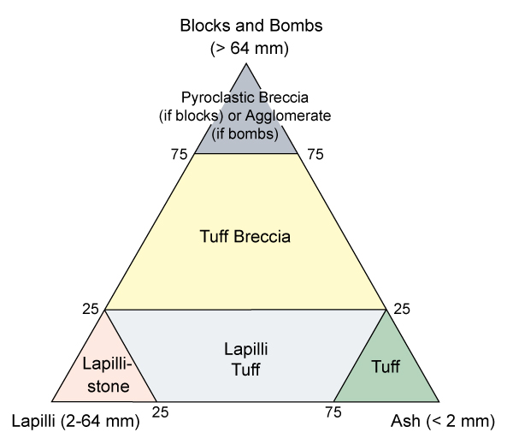
Classification of Pyroclastic Rocks

Slide 21
