Slide 1
Major, Trace Elements & Isotopic Composition : Application in Petrogenesis
Rajnikant Patidar
Department of Geology
M.L. Sukhadia University, Udaipur

Slide 2
Major Elements
Major elements are those which occur in high concentrations in common rocks (usually > 0.1 % by weight).
Their concentrations are commonly expressed in weight% oxides.
The major element composition is obtained from the chemical analysis of rock or mineral.
These elements are not only useful in classification and nomenclature or rock but also helps in establishing the petrogenetic aspects.

Slide 3
Major elements that are generally measured in petrochemical studies:
SiO₂
Al₂O₃
Fe₂O₃
FeO
MgO
CaO
Na₂O
K₂O
TiO₂
MnO
P₂O₅
H₂O
Major elements concentrations are expressed as wt % oxydes (SiO₂, Al₂O₃, etc.)

Slide 4
Table 8-3. Chemical analyses of some
representative igneous rocks
Peridotite
Basalt
Andesite
Rhyolite
Phonolite
SiO2
42.26
49.20
57.94
72.82
56.19
TiO2
0.63
1.84
0.87
0.28
0.62
Al2O3
4.23
15.74
17.02
13.27
19.04
Fe2O3
3.61
3.79
3.27
1.48
2.79
FeO
6.58
7.13
4.04
1.11
2.03
MnO
0.41
0.20
0.14
0.06
0.17
MgO
31.24
6.73
3.33
0.39
1.07
CaO
5.05
9.47
6.79
1.14
2.72
Na2O
0.49
2.91
3.48
3.55
7.79
K2O
0.34
1.10
1.62
4.30
5.24
H2O+
3.91
0.95
0.83
1.10
1.57
Total
98.75
99.06
99.3
99.50
99.23

Slide 5
Major Elements : Petrogenesis
For the interpretation of major element data for petrogenesis, usually variation diagrams are used by the petrologists.
Two types of variation diagrams are applied:
X – Y Plots (Bi-variate diagrams)
Triangular Plots

Slide 6
Harker Variation Diagram: It is the most widely used X – Y Plot diagram, suggested by Harker (1909).
In this diagram the major element analysis of rock is plotted against the SiO_{2.}
It is assumed that if the rocks / rock-suite are cogenetic / comagmatic, then a clear-cut trend in chemical variation will be visible in Harker Diagrams.
SiO₂ increases with magmatic evolution.
Many major elements show more or less positive correlation with SiO₂ (K₂O, Na₂O)
Al₂O₃ show initial increase then decrease.
Other elements show negative correlation (decreasing trend) with the progress of fractional crystallization / magmatic differentiation.

Slide 7
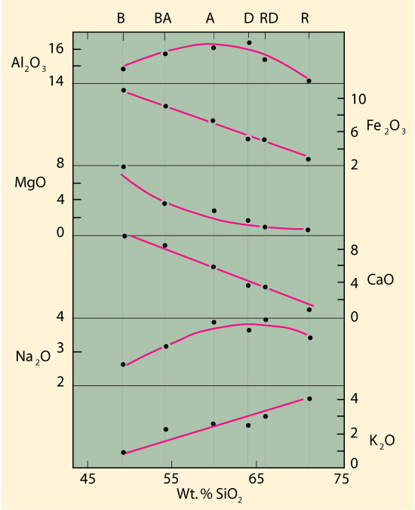
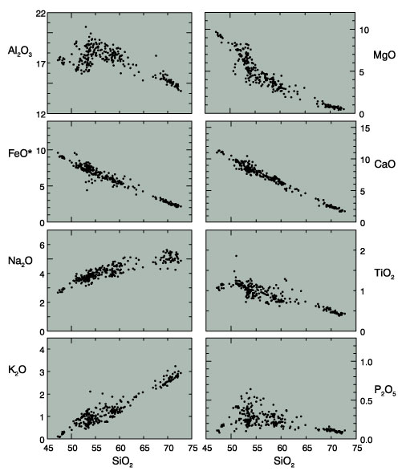

Slide 8
Apart from the Harker Diagram, TWO other variation diagrams are commonly used :
(A) Solidification Index (SI) of Kuno: SI used in place of SiO₂ .
SI = 100 MgO
MgO + FeO + Fe₂O₃ + Na₂O + K₂O
(B) Differentiation Index (DI) of Thornton and Tuttle:
DI = normative (Q + Or + Ab + Ne + Lc)

Slide 9
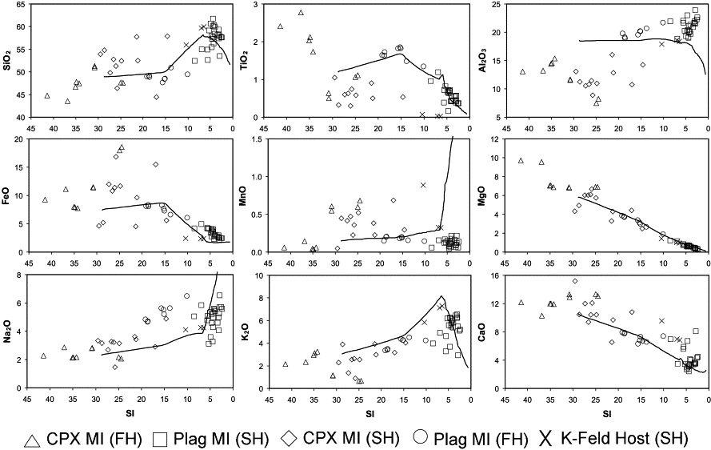
Variation Diagram using SI

Slide 10
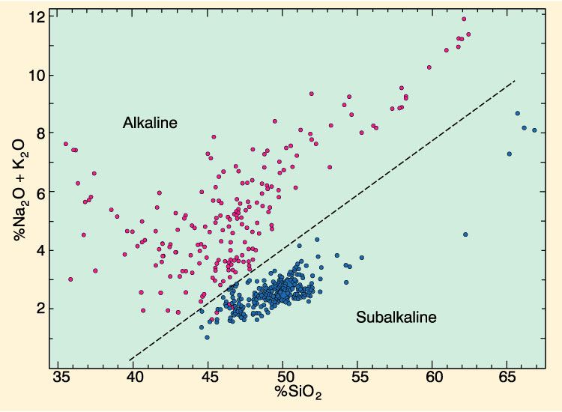
Total Alkali – Silica Variation Diagram: Help in establishing the affinity of the rock suite

Slide 11
Triangular Diagrams: Triangular Diagrams showing the relative variation of three chemical parameters.
These diagrams are widely used and usefully employed in establishing genetic aspects, evolutionary trend as well as comparative studies of rock suites.
There are many types of triangular diagrams used in petrological studies. However, the most common is AFM diagram.

Slide 12
AFM Diagram: The AFM diagram is a ternary plot in which the concentrations of Na₂O + K₂O (alkalis; A), FeO + Fe₂O₃ (F) and MgO (M) in an igneous rock are plotted after recalculation to a sum of 100%.
If the rocks plotted belong to a magmatic series, they will define a trend.
It also shows the difference between two commonly observed trends: an Fe-enrichment trend (representative of the differentiation of a tholeiitic magma; and "a straight line trend" representative of the differentiation of a calc-alkalic magma. This diagram can therefore be used as a tool for classifying different igneous rocks.

Slide 13
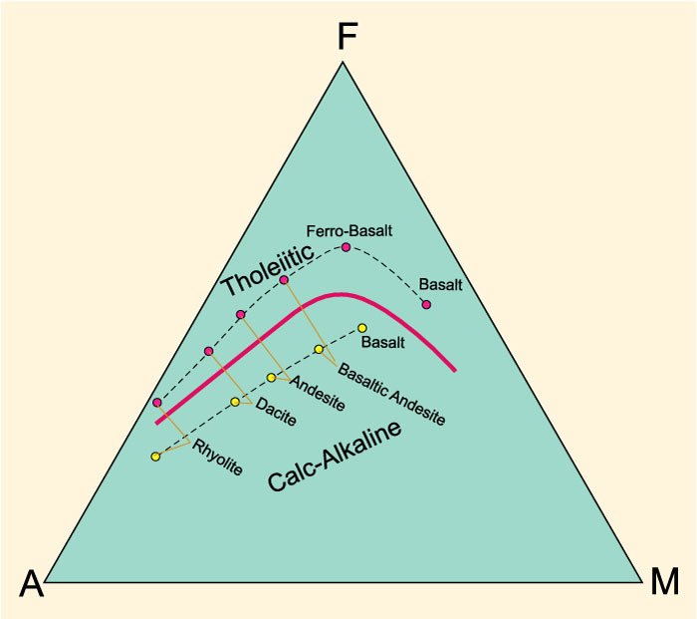

Slide 14
Trace Elements
Trace elements are those which occur in very low concentrations in common rocks (usually < 0.1 % by weight).
Their concentrations are therefore commonly expressed in parts per million (ppm).
Unlike major elements, trace elements tend to concentrate in fewer minerals, and are therefore more useful in formulating models for magmatic differentiation, and in some cases, in predicting the source of a particular magma.

Slide 15
Taylor (1965) has suggested the importance of trace elements to workout the genetic aspects of igneous rocks.
Following are the “Key Trace Elements” useful in evaluating the petrogenetic model.
Ni, Cr, Co, Rb, Ba, Sr, Li, Cu, Zn, Zr, Y, Nb and the rare earth elements (REE)
The REE are a group of minerals of 15 elements (La, Ce, Pr, Nd, Pm, Sm, Eu, Gd, Tb, Dy, Ho, Er, Tm, Yb, Lu) with atomic number ranging from 57 (La) to 71 (Lu). These elements are very important for petrogenetic interpretations. However, these elements occur in very low concentrations in igneous rocks, and are difficult to analyze for.

Slide 16
In Petrogenetic studies the trace elements and REE are used in many ways:
By interpretation the concentration of these elements.
Through plotting the Bi-variate ( X-Y Plot) and Triangular diagrams.
REE vs REE diagrams
Discriminant diagrams

Slide 17
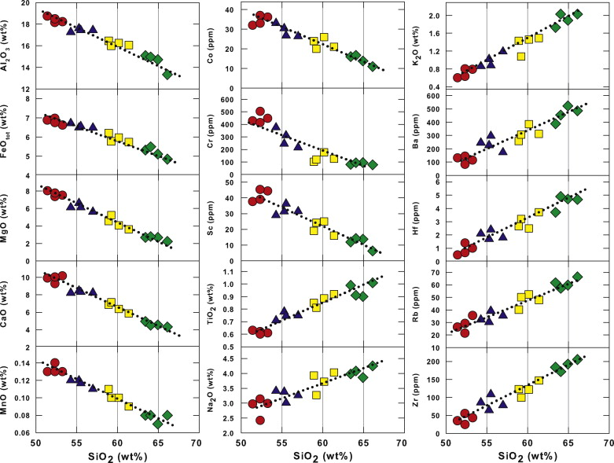
Harker Variation Diagrams for Major & Trace Elements

Slide 18
High values of Ni (250 – 300 ppm) and Cr (500 – 600 ppm) are good indicators of derivation of magma from a peridotitic mantle source.
Decrease of Ni through a rock suite suggest Olivine Fractionation, decrease in Cr suggest Clinopyroxene Fractionation.
The Ni/Co ratio shows decrease with the progress of magmatic differentiation.
Li generally decrease with progress of differentiation.

Slide 19
The Ba/Sr ratio show a progressive decrease with progress of fractionation.
Ba/Rb ratio also show the decreasing trande while Rb show an increase from basalt to rhyolite.
The K/Rb ratio is an indicator of source region (e.g. for crustal derived rocks the ration is 160 to 300)
If rocks are evolved from crustal contamination then the concentration of selected trace elements like Ba, Rb, Sr, Th, Zr, Hf etc. will be very high.

Slide 20
Zr/Y vs Zr variation diagram is useful in petrogenesis especially in tectonic setting of basalts.
Rb vs Y+Nb variation diagram is useful in petrogenesis especially in tectonic setting of granites.
Zr-Ti-Y trainagular diagram is useful in petrogenesis especially in tectonic setting of basalts.

Slide 21
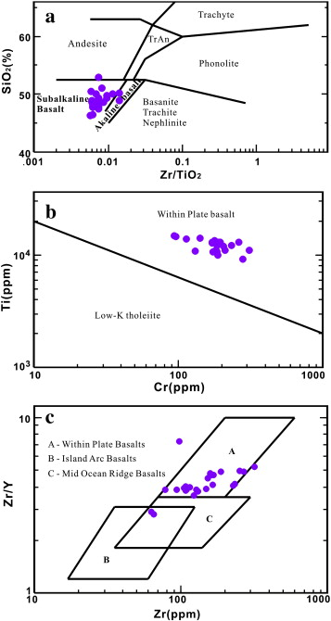
Trace Element Variation Diagrams
Classification & Nomenclature
Tectonic Setting for Basalts
Tectonic Setting for Basalts

Slide 22
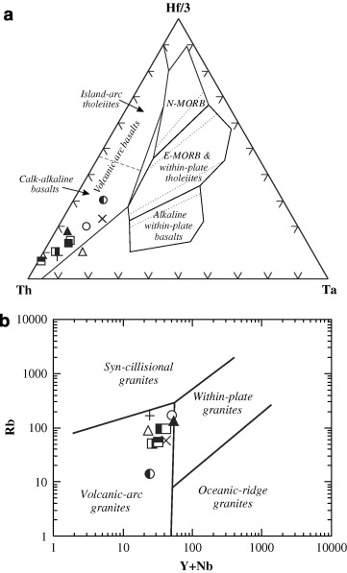
Trace Element Variation Diagrams
For Tectonic Setting for Basalts
Trace Element Variation Diagrams
For Tectonic Setting for Granites

Slide 23
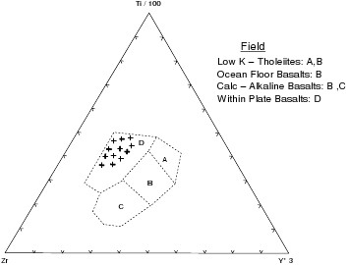
Hf-Th-Ta discrimination diagram (after Wood, 1980) for the basaltic rocks

Slide 24
Isotopic Composition
Isotopes are two or more forms of the same element that contain equal numbers of protons (Same Atomic Number) but different numbers of neutrons (Different Atomic Weight).
Isotope geochemical studies are now fundamental part of petrogenetic interpretation of igneous rocks.
These studies are based on Two groups of isotopes (1) Radiogenic isotopes (2) Stable isotopes.
Radiogenic – Radioactive decay remain continue and convert into stable for.

Slide 25
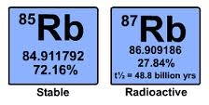
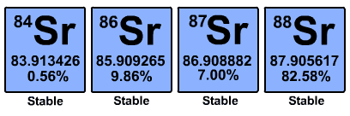
Important Isotopes used in petrogenetic studies are :
Isotopes of Rubidium (Rb-85, Rb-87)
Isotopes of Strontium (Sr-88, Sr-87, Sr-86, Sr-84)
Isotopes of Lead (Pb-208, Pb-207, Pb-206, Pb-204)
Isotopes of Uranium (U-238, U-235, U-234)
Isotopes of Thorium (Th-232)
Isotopes of Samarium (Sm-147)
Isotopes of Neodymium (Nd-143, Nd-144)
Isotopes of Oxygen (O-16, O-17, O-18)

Slide 26
The isotope studies provides information related to:
The age of the rock or minerals
Temperature of the crystallization of minerals
Source of the rocks
Process acting in the formation of the rock
Few Examples:
The Sr-87/Sr-86 ratio serve as a valuable petrogenetic tracer. It has been found by the petrologists that magma derived from mantle have ratio generally <0.706 while those derived from melting or assimilation of continental crust have ratio >0.706.

Slide 27
Typical crustal rocks have lower Nd-143/Nd-144 ratio then those derived from mantle.
The isotopic ratios of a cogenetic suite of igneous rocks should have straight line (isochrons) in plots of Pb-206/Pb-204 v/s Pb-207/Pb-204.
Typical O-18 values for mantle derived rocks are from +5 to +7‰. The crustal rocks has values +7 to +13‰. Basaltic magmas of mid-ocean ridges and most common island arc basalt are characterized by a relatively narrow 5.7±0.2‰ range of O-18 values.

Slide 28
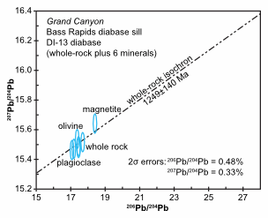
THANKS

