Slide 1
Ultrabasic & Ultramafic Rocks
Rajnikant Patidar
Department of Geology
M.L. Sukhadia University, Udaipur

Slide 2
Definition
Ultrabasic Rocks – Very Low silica content (<45%)
Ultramafic Rocks – Low silica rocks with more than
90% of mafic minerals.
Ultrabasic (also referred to as ultramafic) rocks are igneous and meta-igneous rocks a with very low silica content (less than 45%), generally >18% MgO, high FeO and low potassium. These rocks are composed of usually greater than 90% mafic minerals.
Ultrabasic is a general term, probably first used by J.W. Judd in 1881, applied to igneous rocks containing little or no feldspar and characterized essentially by the abundance of one or more common mafic minerals such as olivine, pyroxene, and amphibole.

Slide 3
Mineralogy of Ultrabasic Rocks
The mineralogy of ultrabasic rocks is usually dominated by olivine and pyroxene, however, they can also contain amphibloes, plagioclase, spinel, garnet, amphiboles and micas.

Slide 4
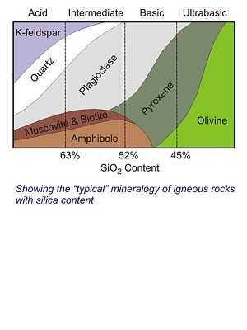

Slide 5
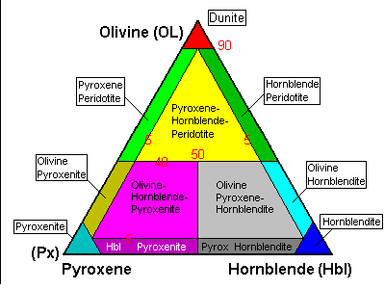
IUGS CLASSIFICATION OF ULTRABASIC ROCKS

Slide 6
Examples of Ultrabasic Rocks
Intrusive ultramafic rocks
Dunites
Peridotites
Pyroxenites
Hornblendite
Volcanic ultramafic rocks
Komatiite
Picritic basalt
Ultrapotassic ultramafic rocks
Lamprophyre
Lamproite
Kimberlite

Slide 7
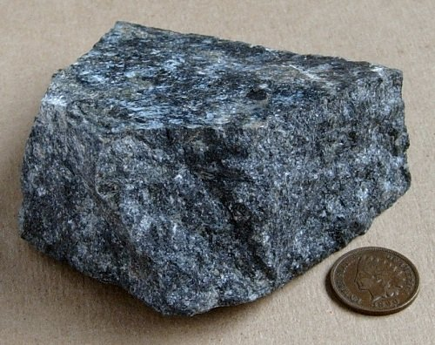
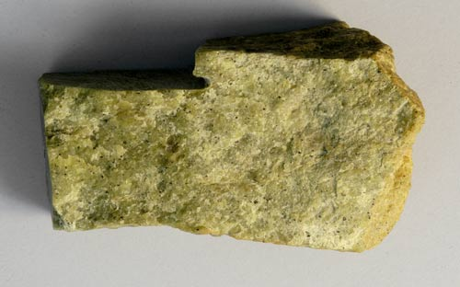
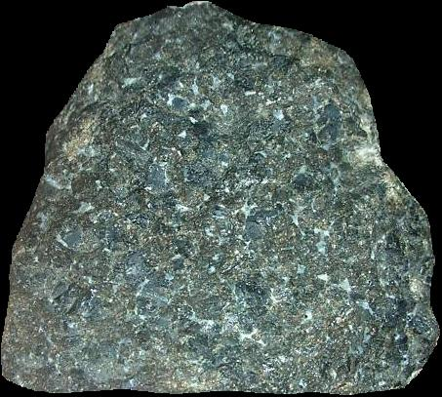
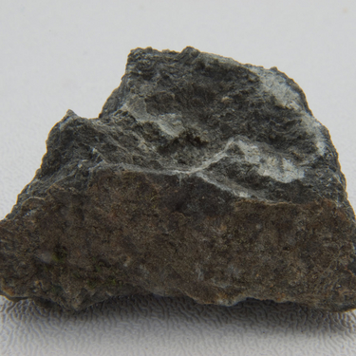
Pyroxenite
Dunite
Hornblendite
Peridotite

Slide 8
Pyroxenite
Pyroxenite is an ultramafic igneous rock consisting essentially of minerals of the pyroxene group, such as augite and diopside, hypersthene, bronzite or enstatite.
The rock is medium to coarse-grained, containing individual crystals of pyroxenes. The principal accessory minerals are olivine, feldspar, chromite and spinels.
They are essentially of igneous origin and can be formed by accumulation of pyroxene crystals at the base of the lava chamber of ultramafic intrusions.

Slide 9
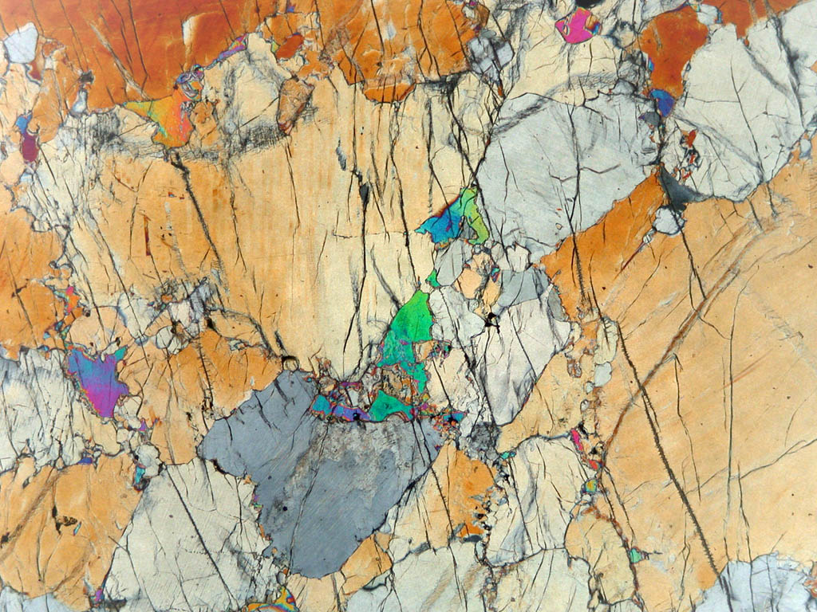
Oxides | Wt%
SiO ₂ | 46.27
TiO ₂ | 1.47
Al ₂ O ₃ | 7.16
Fe ₂ O ₃ | 4.27
FeO | 7.18
MgO | 16.04
CaO | 14.08
Na ₂ O | 0.92
K ₂ O | 0.64
Pyroxenite : Specimen, Thin Section
And Average Chemical Composition

Slide 10
Peridotite
A peridotite is a dense, coarse-grained igneous rock, consisting mostly of the minerals olivine and pyroxene.
Peridotite is ultrabasic, as the rock contains less than 45% silica. It is high in magnesium, reflecting the high proportions of magnesium-rich olivine, with appreciable iron.
Peridotite is an intrusive igneous rock and the dominant rock of the upper part of the Earth's mantle.

Slide 11
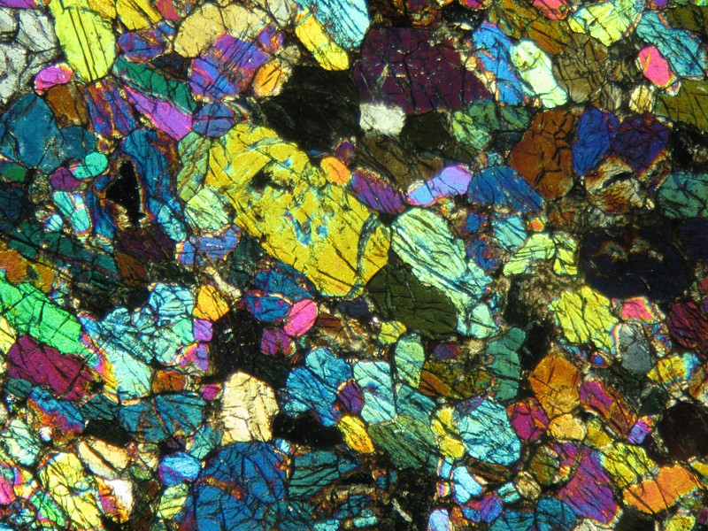
Oxides | Wt%
SiO ₂ | 42.26
TiO ₂ | 0.63
Al ₂ O ₃ | 4.23
Fe ₂ O ₃ | 3.61
FeO | 6.58
MgO | 31.24
CaO | 5.05
Na ₂ O | 0.49
K ₂ O | 0.34
Peridotite : Specimen, Thin Section
And Average Chemical Composition

Slide 12
Dunite
Dunite is an igneous, plutonic rock, of ultramafic composition, with coarse-grained or phaneritic texture.
The mineral assemblage is greater than 90% olivine, with minor amounts of other minerals such as pyroxene, chromite and pyrope.
Dunite is the olivine-rich end-member of the peridotite group of mantle-derived rocks.
Dunite may form by the accumulation of olivine crystals on the floor of large basaltic magma chambers.

Slide 13
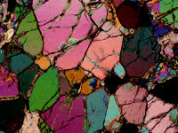
Oxides | Wt%
SiO ₂ | 38.29
TiO ₂ | 0.09
Al ₂ O ₃ | 1.82
Fe ₂ O ₃ | 3.59
FeO | 9.38
MgO | 37.94
CaO | 1.01
Na ₂ O | 0.20
K ₂ O | 0.08
Dunite : Specimen, Thin Section
And Average Chemical Composition

Slide 14
Hornblendite
Hornblendite is a plutonic igneous rock consisting mainly of the amphibole hornblende.
A hornblendite is an ultramafic igneous rock dominated by hornblende. It is different from an amphibolite which is a amphibole and plagioclase dominated metamorphic rock.
Horblendite is a rare rock most commonly associated with diorite, granite, gabbro and peridotite.

Slide 15
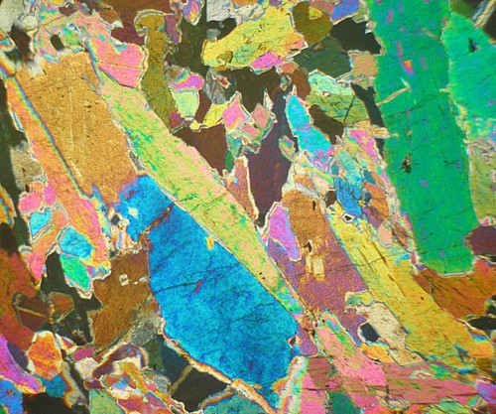
Hornblendite : Specimen, Thin Section
And Average Chemical Composition

Slide 16
Komatiites
Komatiite is a type of ultramafic mantle-derived volcanic rock.
Komatiites have low silicon, potassium and aluminium, and high to extremely high magnesium content.
Komatiite was named for its type locality along the Komati River in South Africa.
The mineralogy of komatiites is composed of forsteritic olivine (Fo90 and upwards), calcic and often chromian pyroxene, anorthite (An85 an upwards) and chromite.

Slide 17
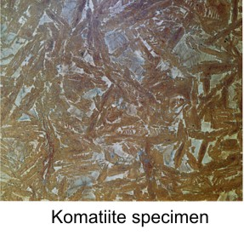
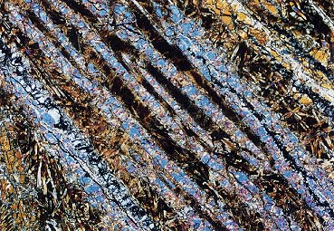
Komaiitite : Specimen, Thin Section
And Average Chemical Composition

Slide 18
Kimberlite
Kimberlite is an igneous rock best known for sometimes containing diamonds. It is named after the town of Kimberley in South Africa.
Kimberlite occurs in the Earth's crust in vertical structures known as kimberlite pipes as well as igneous dykes and sills. Kimberlite pipes are the most important source of mined diamonds today.
It has a distinctively inequigranular texture and peculiar mineralogy because they contain a variety of mineral species with peculiar chemical compositions. These minerals such as potassic richterite, chromian diopside (a pyroxene), chromium spinels, magnesian ilmenite, and garnets.

Slide 19
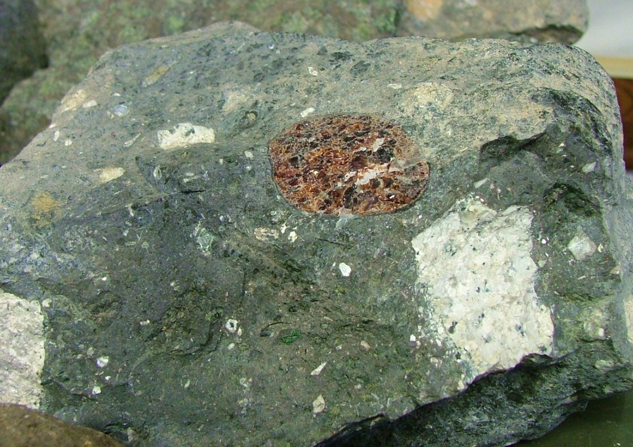
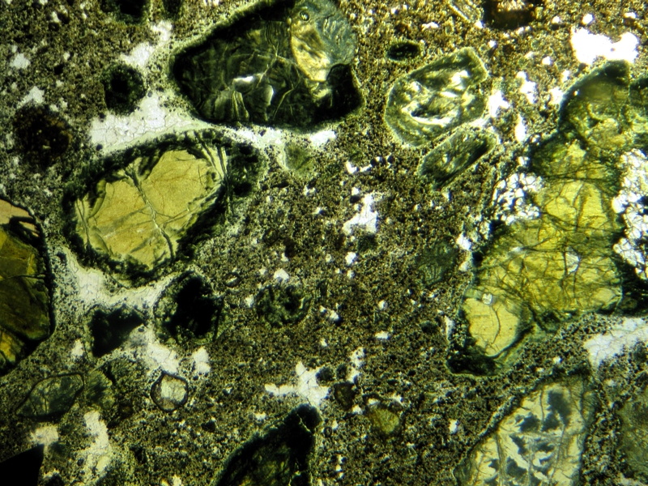
Oxides | Wt%
SiO ₂ | 31.10
TiO ₂ | 2.03
Al ₂ O ₃ | 4.90
Fe ₂ O ₃ | 5.97
FeO | 10.05
MgO | 23.94
CaO | 10.60
Na ₂ O | 0.03
K ₂ O | 2.14
Kimberlite : Specimen, Thin Section
And Average Chemical Composition

Slide 20
Lamprophyre
Lamprophyres are uncommon, small volume ultrapotassic igneous rocks primarily occurring as dikes, lopoliths, laccoliths, stocks and small intrusions.
They are alkaline silica-undersaturated, ultramafic rocks with high magnesium oxide, >3% potassium oxide, high sodium oxide and high nickel and chromium.
Modern science treats lamprophyres as a term for ultrapotassic mafic igneous rocks which have primary mineralogy consisting of amphibole or Mg-rich biotite (Phlogopite) , and with feldspar in the groundmass.

Slide 21
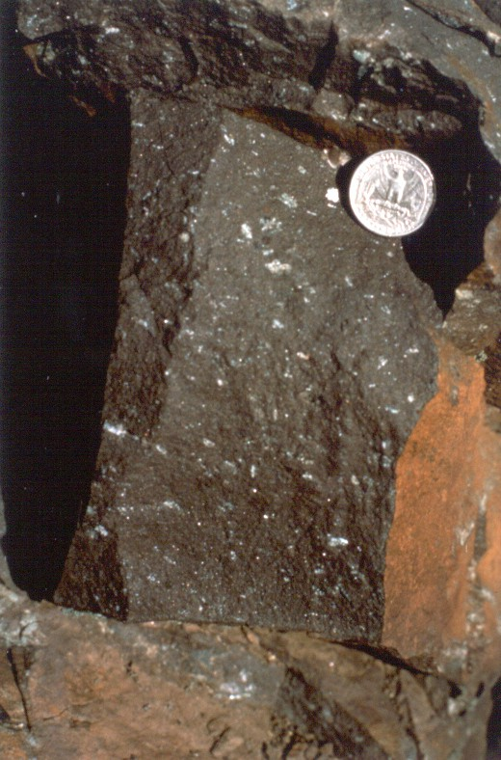
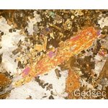
Oxides | Wt%
SiO ₂ | 45.17
TiO ₂ | 1.90
Al ₂ O ₃ | 14.78
Fe ₂ O ₃ | 5.10
FeO | 5.05
MgO | 6.26
CaO | 11.06
Na ₂ O | 3.62
K ₂ O | 2.64
Lamprophyre : Specimen, Thin Section
And Average Chemical Composition

Slide 22
Picrite-basalt
Picrite basalt, picrobasalt or oceanite is a variety of high-magnesium olivine basalt that is very rich in the mineral olivine.
The rock has yellow-green olivine phenocrysts (20 to 50%), black to dark brown pyroxene, mostly augite and plagioclase.

Slide 23
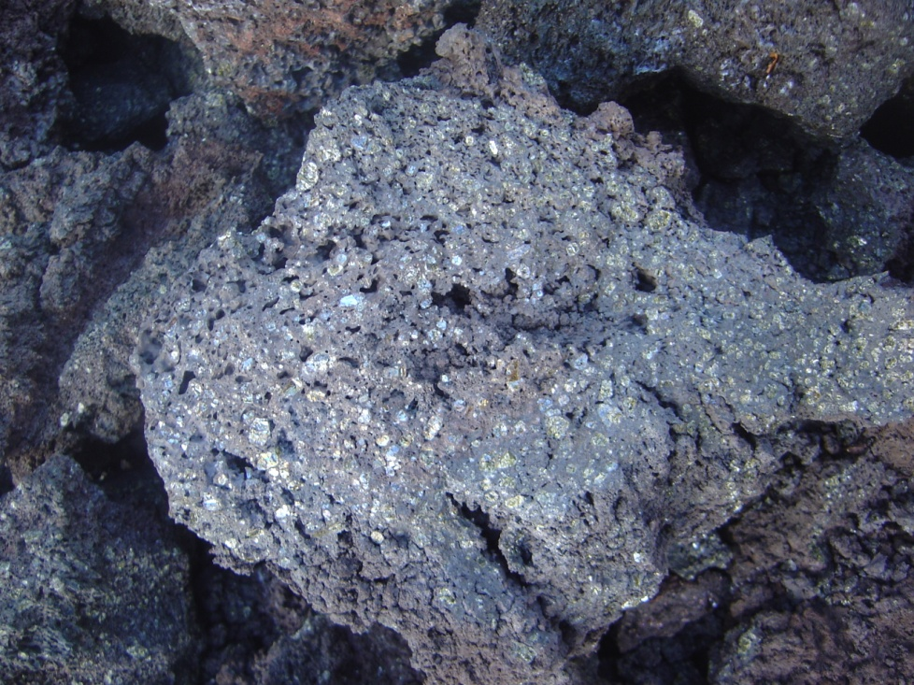
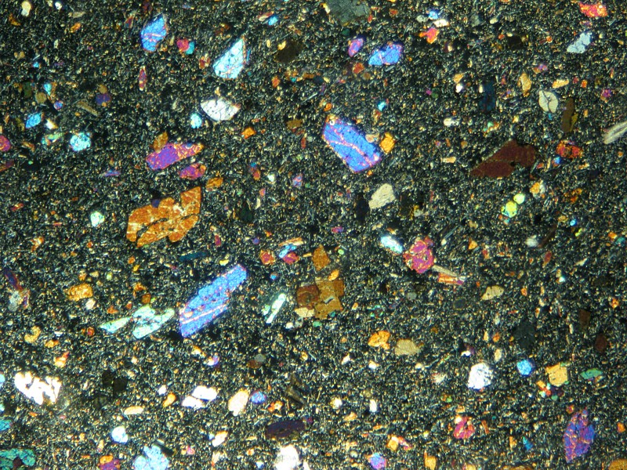
Picrobasalt : Specimen, Thin Section
And Average Chemical Composition

Slide 24
Lamproites
Lamproites are ultrapotassic mantle-derived volcanic and subvolcanic (intrusive) rocks.
Lamproite is a porphyritic ultrapotassic igneous rock dominated by phlogopite, richterite, olivine, diopside, leucite, sanidine. A variety of rare trace minerals occur.

Slide 25
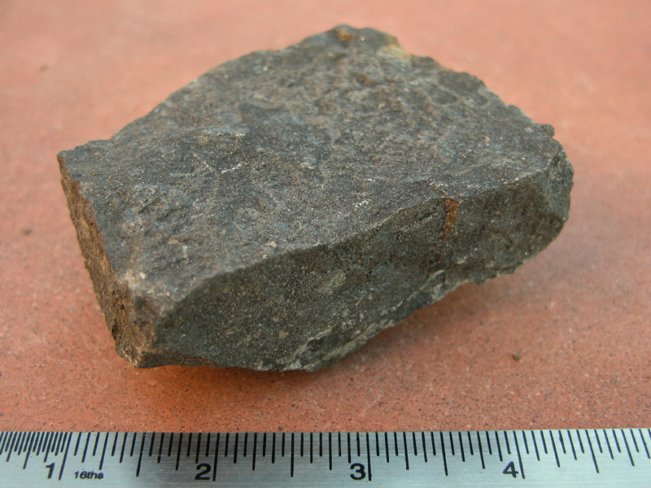
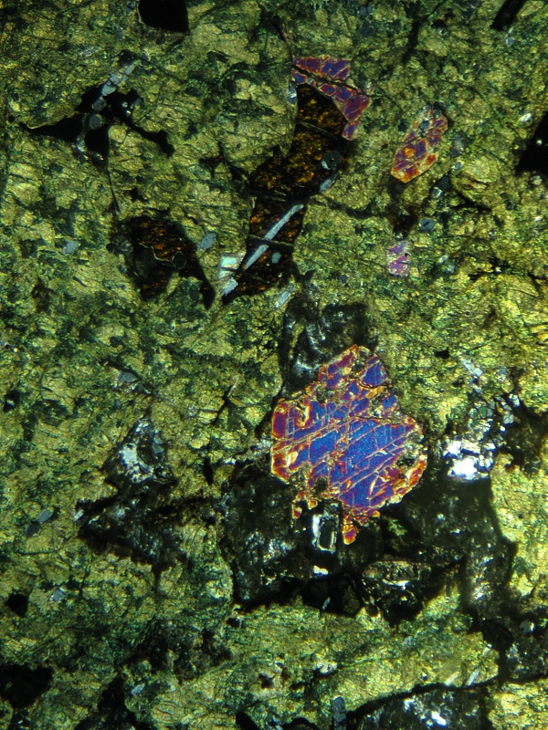
Lamproite : Specimen, Thin Section
And Average Chemical Composition

