Slide 1
Plate Tectonics

Slide 2
Most of these changes in the earth’s surface takes place so slowly that they are not immediately noticeable to the human eye.
The idea that the earth’s landmasses have broken apart, rejoined, and moved to other parts of the globe forms part of the
  plate tectonic theory.

Slide 3
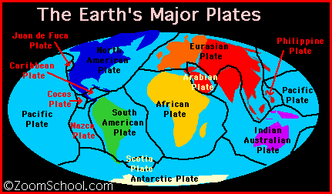
Plate Tectonic Theory
About forty years ago, scientists exploring the seafloor found that it is full of tall mountains and deep trenches, a single seafloor mountain chain circles Earth and contains some of Earth’s tallest mountains.
Along this mountain chain is a deep crack in the top layers of earth. Here the seafloor is pulling apart and the two parts are moving in opposite directions, carrying along the continents and oceans that rest on top of them. These pieces of Earth’s top layer are called tectonic plates. They are moving very slowly, but constantly. (Most plates are moving about as fast as your fingernails are growing -- not very fast!) Currently Earth’s surface layers are divided into nine very large plates and several smaller ones.

Slide 4
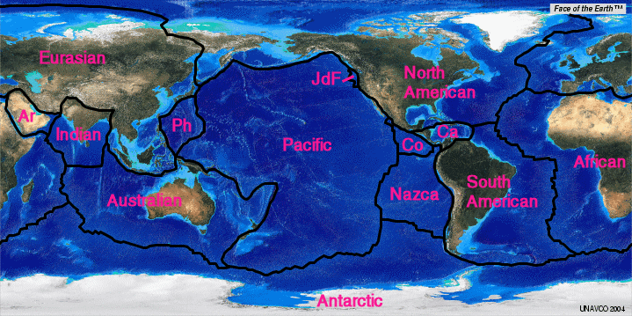
According to the theory of plate tectonics, the earth’s outer shell is not one solid piece of rock. Instead the earth’s crust is broken into a number of moving plates. The plates vary in size and thickness.

Slide 5
The North American Plate stretches from the mid-Atlantic Ocean to the northern top of Japan. The Cocos Plate covers a small area in the Pacific Ocean just west of Central America.
These plates are not anchored in place but slide over a hot and bendable layer of the mantle.

Slide 6
  How is the earth always changing?
  What is the theory of plate tectonics and how does it work?

Slide 7
To really understand how the earth became to look as it does today, and the theory of plate tectonics, you also need to become familiar with two other ideas:
Continental Drift
and
Seafloor Spreading.

Slide 8
Less than 100 years ago, many scientists thought the continents always had been the same shape and in the same place.
A few scientists noted that the eastern coastline of South America and the western coastline of Africa looked as if they could fit together.
Some also noted that, with a little imagination, all the continents could be joined together like giant puzzle pieces to create one large continent surrounded by one huge ocean.
In your study groups for today, take your continent cut outs and shape them into one large land mass.

Slide 9
So, if my contintents fit together, why does the earth look like it does today?

