Slide 1
Networks of Digital Marketing

Slide 2
Advertising network is a network representing many Web sites in selling advertising, allowing advertising buyers to reach broad audiences relatively easily.

Slide 3
What is Display Advertising?
Advertising on websites or apps or social media through banners or other ad formats made of text, images, flash, video, and audio.
Display advertisers can frequently target users with particular traits to increase the ads' effect.
Display ads can show up on any website that’s offering advertising space, and it means that one can tap into millions of additional websites beyond search engines.
Shown to users who might not be actively searching for you when your adverts show up.
How?
Contact directly the owners of a website
Use networks that match businesses with lots of different websites that have ad space to sell. (Google Display Network)

Slide 4
How Display Advertising helps in the digital marketing funnel?
Explore
Discovery
Consider
Convert
target a broad audience and use adverts that make a great first impression.
Narrow down your audience to include people who have been to your site before, or people who are really interested in the products and services you offer.
refine your message, zeroing in on what exactly makes your product or service so great.
adverts to be limited to people who you know have been looking for you.
use adverts with special offers or incentives targeted at people who you know have shown interest in your products, but who haven’t become customers. - Retargeting

Slide 5
Display Advertising Network
A system that lets you advertise on many different websites
To help you build and run your display campaigns
Allows you to decide where the adverts will show up, and who will see them.
For example, you can target local people heading out on their morning commute by choosing to advertise to English speakers who are using smartphones within 20 miles of your shop in the morning.

Slide 6
Google AdWords (Ads)
Google Ads (previously Google AdWords effective on July 24, 2018) is an online advertising platform developed by Google, where advertisers pay to display brief advertisements, service offerings, product listings, video content and generate mobile application installs within the Google ad network to web users.
Google Ads' system is based partly on cookies and partly on keywords determined by advertisers.
Google uses these characteristics to place advertising copy on pages where they think it might be relevant.
Advertisers pay when users divert their browsing to click on the advertising copy (Pay Per Click-PPC).
Partner websites receive a portion of the generated income.

Slide 7
Google Ad networks
1. Google Search Network: It is a group of search-related websites and apps where your ads can appear. When you advertise on the Google Search Network, your ad can show near search results when someone searches with terms related to one of your keywords.
2. Google Display Network

Slide 8
What is a Google’s display network?
A group of more than 2 million websites, videos, and apps where your ads can appear.
Display Network sites reach over 90% of Internet users worldwide*.
With the Display Network, you can use targeting to show your ads in particular contexts (like “motorbike accessories”), to particular audiences (like “young students”), in particular locations, and more.
Google Ads lets you measure how well you’re meeting your goals. See which webpages run your ads, which ads deliver the most clicks, and which sites give you the most value for the lowest cost.
* https://support.google.com/google-ads/answer/117120?hl=en

Slide 9
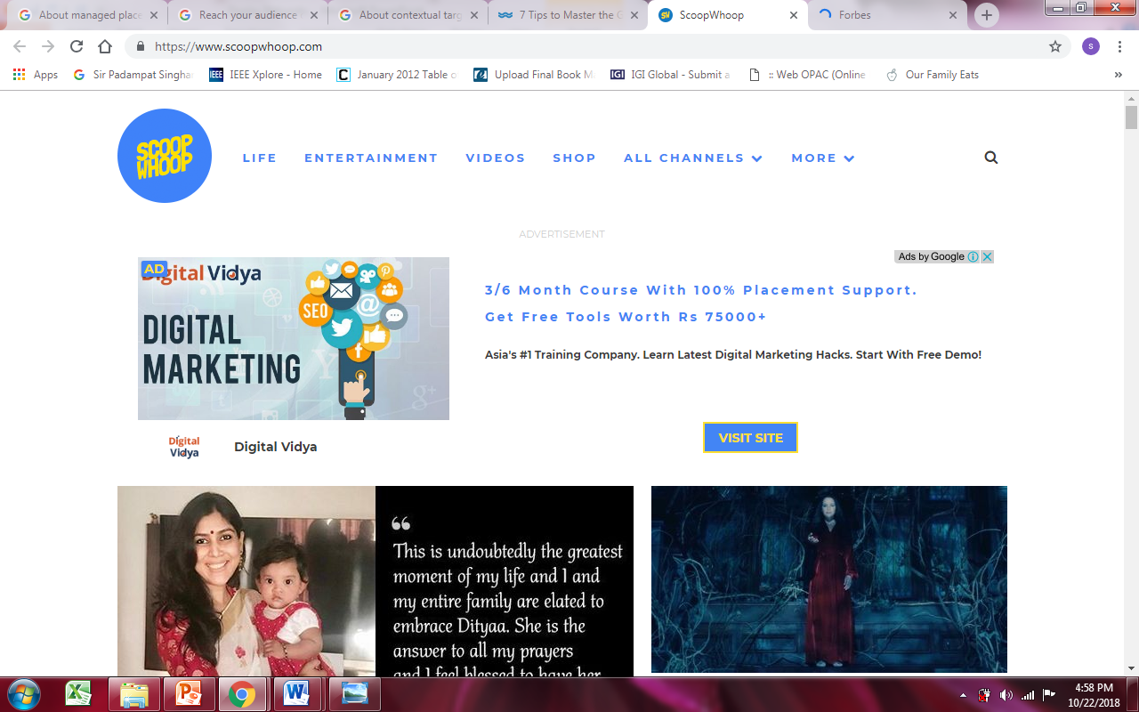

Slide 10
Types of campaigns

Slide 11
Display Campaign
Create visually appealing ads that serve across the Google Display Network, on Youtube, and on mobile or in app
Sub-types:
Smart Display campaign
Standard Display campaign
Gmail campaign

Slide 12
Types of Ads that can be run on the Google Display Network
Responsive Display Ads
Ad creation is partially automated.
Uploaded Image Ads
you can create and upload ads.
Engagement ads
engaging image and video ads on YouTube and across the Display Network.
Gmail ads
expandable ads on the top tabs of people's inboxes.

Slide 13
Responsive Display Ads
When creating a Responsive Display ad, you provide up to 5 headlines, descriptions, and logos, and up to 15 marketing images.
Google uses machine learning algorithms to combine these assets in countless appearances across the web and apps, continuously optimizing for performance.
These ads automatically adjust their size, appearance, and format to fit just about any ad space.
Both new and advanced users benefit from responsive ads because they show as "native" ads, and blend into the font and feel of the publisher's site.

Slide 14
Uploaded Image Ads
Full control over ad creation
Provide pre-designed ads in various image formats for uploading as display ads on websites.

Slide 15
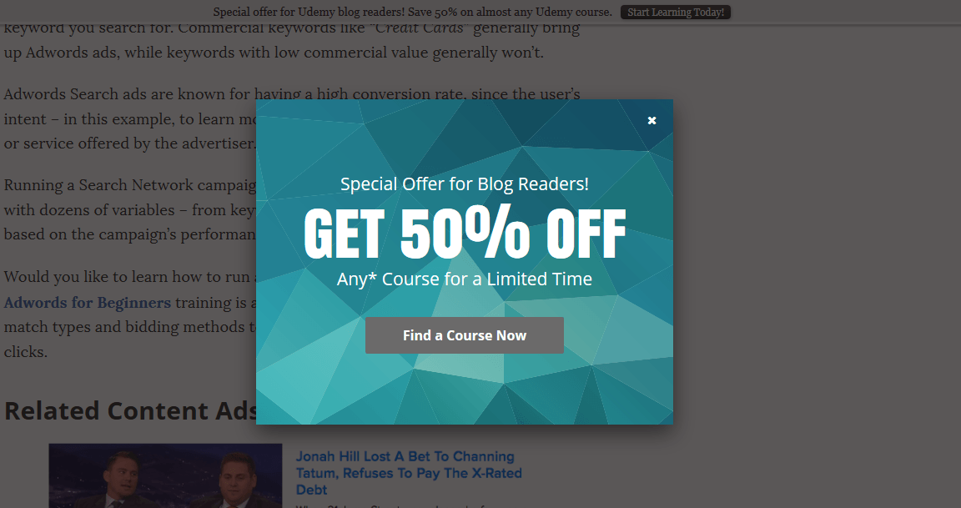
Engagement Ads
E.g. a lightbox. These ads begin as a standard, scalable ad unit.
If a user engages by hovering over the ad for some set amount of time (often 2 seconds), the ad expands while the page behind it dims, increasing emphasis on the ad. Advertisers pay for the number of times the ad is expanded.

Slide 16
Gmail Ads
Targeting Gmail users with promotional messages/ads, directly in their inbox.
Google targets customers based on aggregated data from YouTube, Chrome, and their other services.
At first, they might look like a disguised regular email. When clicked on, the ad will expand to its fullest without sending the user to another third party page.
This expanded ad version can take a diversity of forms.
Gmail measurement metrics provided in AdWords are Gmail Forwards, Gmail Saves, and Gmail Clicks to Website.

Slide 17
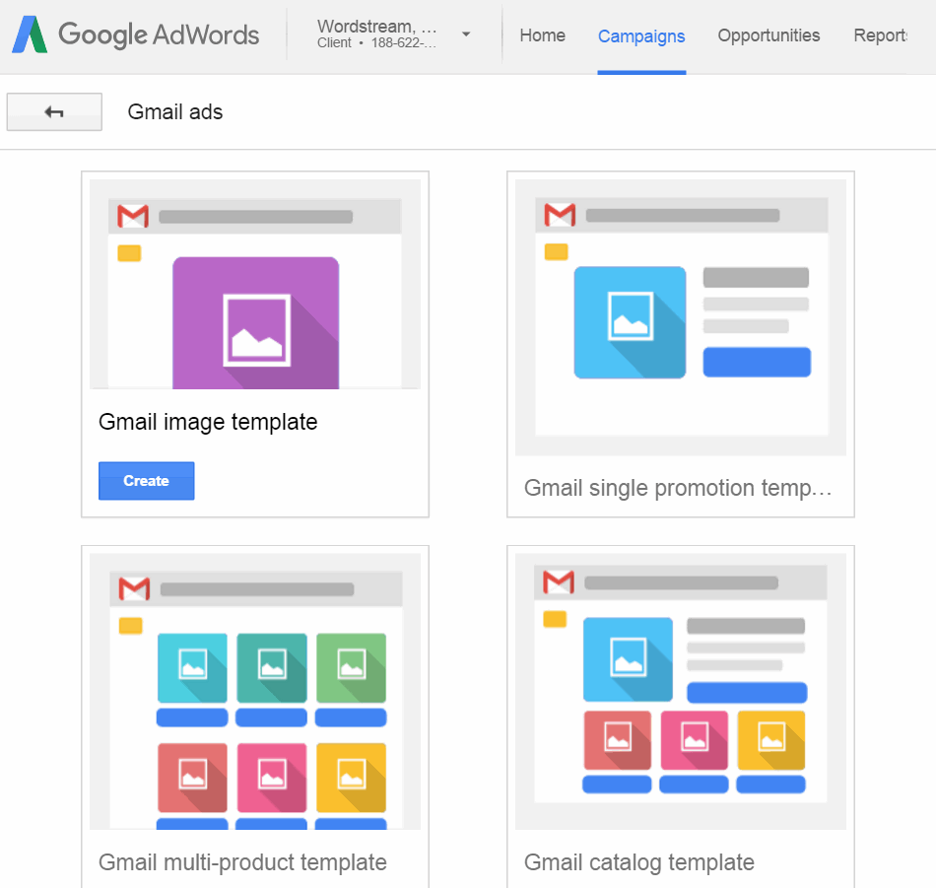
Gmail Ads
Gmail Ads offers four different ad formats to choose from:
Gmail image template
Gmail single promotion template
Gmail multi-product template
Gmail catalog template

Slide 18
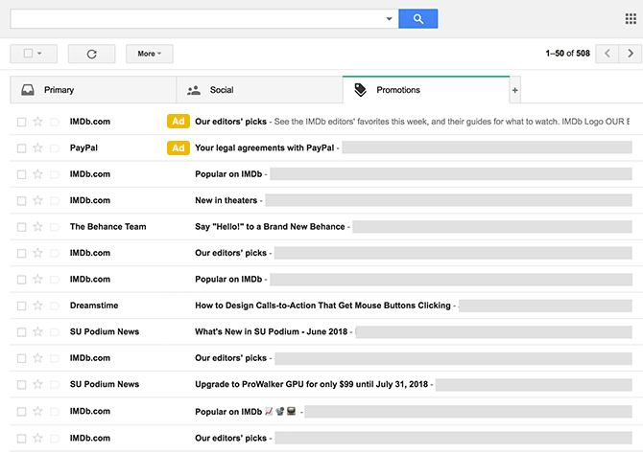
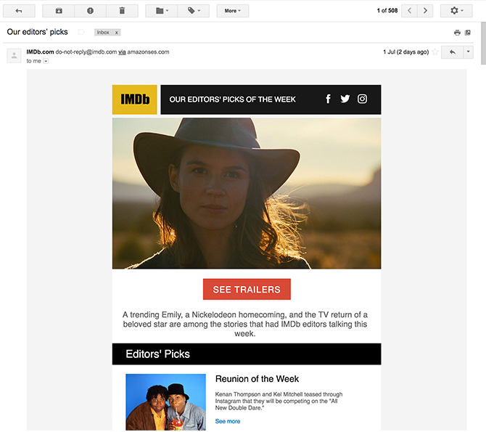
Gmail Ads Example

Slide 19
How Targeting works using Google Display Networks?
Targeting: Get ads seen by the people most important to the business.
Targeting options:
Audience specific
Contextual targeting

Slide 20
How Targeting works using Google Display Networks?
1. Audience Specific Targeting
Remarketing : show your ads on Display Network sites and apps to people who previously visited your website or interacted with your business, and tailor your messages specifically for them.
Audience targeting: reach people based on their interests, such as sports or travel
Affinity audience: Potential customers
In-market audience: Actively searching or considering buying products or services like those you offer.
Demographic targeting: gender or age range.
Customer Match: show ads to customers based on data about those customers that you share with Google e.g. email-ids.

Slide 21
Example of Audience Targeting
Say you own an online business that sells bags:
Remarketing: You can show ads about handbags to people who’ve already viewed the bags section of your site when they visit other sites that aren't necessarily related to bags. You could even show these customers a special offer.
Affinity audiences: You could also add the “Bag lovers" affinity audience to your ad group to show your ads to people who we think may be in this audience, even when they visit sites related to other topics.
Demographics: If you have a line of bags for women only, you could use demographic targeting to show ads about these products just to women.
Customer Match: You can show ads promoting a post-season sale to customers who have signed up for your newsletter who are also Google users.

Slide 22
How Targeting works using Google Display Networks?
2. Content/Contextual Targeting
This method of targeting uses the keywords or topics you’ve chosen to match your ads to relevant sites.(automatic placement)
It can also place ads on certain types of websites for example, a managed placement on forbes.com website.

Slide 23
Have a look!
https://blog.bannersnack.com/banner-ads-examples-from-tech-industry/

Slide 24
Video Advertising
Using Videos for customer engagement and advertising.
Video advertising is becoming the dominant force in the digital marketing universe.
Main drivers:
Low attention spans
Proliferation of smartphones
Omni-present, reliable high-speed internet connections
Ability to engage users on a deep and substantial level

Slide 25
Few stats
92% of marketers say it’s an important part of their marketing strategy
People will spend 100 minutes a day watching online videos in 2021
Mobile in-app ads saw higher impressions, better completion rates than ads on mobile web.
Rising click-through rates (CTR) raise the possibility of a new trend: connected to an increase in direct response ads, also known as shoppable ads
66% of video advertisements were 30 seconds long at the end of 2019
Source: https://www.smartinsights.com/digital-marketing-platforms/video-marketing/video-marketing-statistics-to-know/

Slide 26
Video advertising strategy
Use engaging, well-produced high-quality video.
Use a proper script and seek professional help if required.
Speak to your audience at a level that they can understand.
Use Call-To-Action adequately.
Consider all screen types, browsers and Internet bandwidth.
Too lengthy videos may not result into conversions.
Mix and match videos of different length pieces.
Short length videos should be able to connect with the viewer without the aid of sound.
Use Social media effectively by utilising their targeting and personalization abilities

Slide 27
Types of Google Video Ads
True View Video Ads
You’re only charged when viewers watch or interact with elements of your video. There are two types of TrueView ads:
In-stream:
video content promoted before other videos on YouTube and across the Display Network.
Skippable in-stream ad: pay when a viewer watches 30 seconds of video (or the full duration if it's shorter than 30 seconds) or interacts with video, whichever comes first.
Non-skippable in-stream ad(15 seconds or shorter)
pay based on impressions. Non-skippable ads use target CPM (cost-per-thousand impressions) bidding, so you pay each time your ad is shown 1,000 times.
Video discovery:
formerly known as “TrueView in-display ads.
video is promoted in places of discovery, including next to related YouTube videos, as part of a YouTube search result, or on the YouTube mobile homepage.
charged only when viewers choose to watch your ad by clicking the thumbnail.

Slide 28
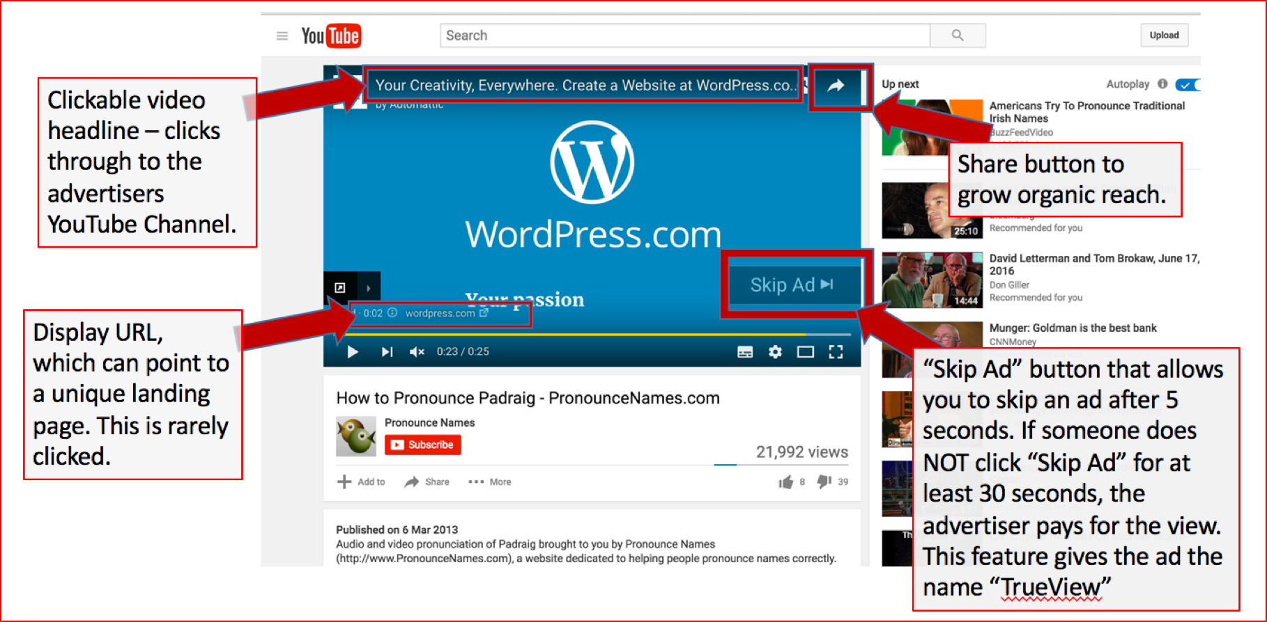
True-View Instream Ad

Slide 29
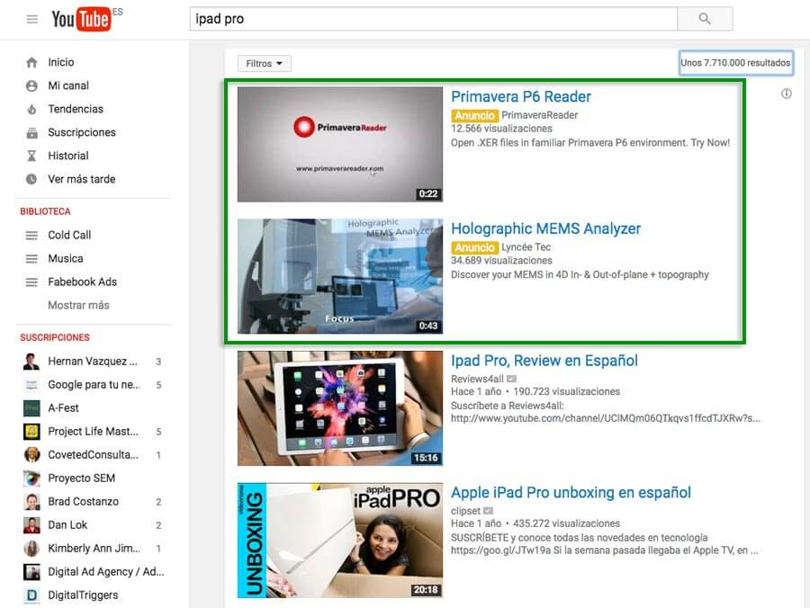
True-View Discovery ad

Slide 30
Types of Google Video Ads
2. Bumper Ads
A short video ad format designed to allow you to reach more customers and increase awareness about your brand.
Bumper video ad is 6 seconds or shorter and plays before, during, or after another video. Viewers do not have the option to skip the ad.
Pay based on impressions. Bumper ads use CPM (cost-per-thousand impressions) bidding, so you pay each time your ad is shown 1,000 times.

Slide 31
Types of Google Video Ads
3. Outstream Ads
Outstream ads are mobile-only (phones and tablet devices) video ads that play on partner websites and within apps.
The ad unit can play in between paragraphs of text on a webpage, within mobile apps, and on the mobile web — all without requiring YouTube’s embedded player.
Ads begin playing with the sound off. Users tap the ad to unmute. Advertisers are only charged when more than half of the ad screen space is shown for two seconds or more.

Slide 32
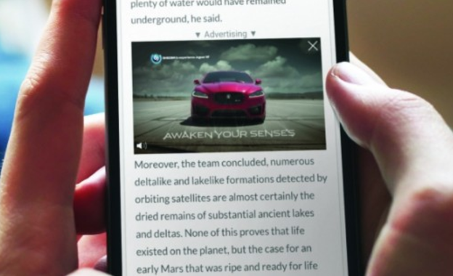

Slide 33
Types of Google Video Ads
4. YouTube Masthead ads
Native video-ad based format that appear at the top of the YouTube Home feed on desktop, mobile, and TV screens.
Masthead ads are only available on a reservation basis through a Google sales representative.
Charged on a fixed cost-per-day (CPD) or cost-per-thousand-impressions (CPM) basis.

Slide 34
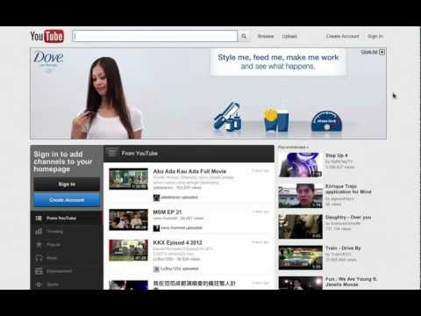
Masthead ad

Slide 35
Trends in Video Advertising
Micro Videos: Short length videos(10 secs or less)
Outstream Videos: a digital video advertising unit that’s integrated within a page and autoplays once the user scrolls near it.
Virtual Reality
Influencer campaigns
User-generated content: e.g. Pepsi’s #CrashThePepsiIPL campaign
Personalisation (localization, device compatibility, demographics)

Slide 36
Assignment
Consider a business you think could benefit from using video to attract customers.
Learn about designing and creating a video ad for that business by completing the following tasks:
Create a storyboard for a 30-second ad for a product or service from the business. Sketch this out on paper, or use a storyboard tool or template such as Studiobinder.
Consider the video's call to action (CTA). What do you want the audience to do when they’ve watched the video? For example, do you want them to sign up for updates or visit the business’s website to learn more? Write out a few variations of your CTA and decide which you think would be most effective.
Using a mobile phone or handheld camera, record the shots detailed in your storyboard.
Upload the video content to editing software such as iMovie or Windows Movie Maker, or explore other online tools available. Using the knowledge and tips acquired from this topic, edit your video, adding a music soundtrack and transitions between shots.
If you're happy for the video to go public, why not upload it to your YouTube account for the world to see? Otherwise, use what you’ve learned here to further develop your video making skills or inspire your next ad.

Slide 37
Mobile Advertising
Mobile searches make up more than half of searches on Google.com
Majority of website traffic comes from advertisements on mobile phones.
69% of digital media time is spent on mobile.
Mobile ads can drive:
Search based website traffic
Calls
App downloads
Mobile site visits and more.
*Source: http://www.businessofapps.com/guide/mobile-advertising-companies/

Slide 38
Where mobile ads can appear?
On mobile phones or tablets and Within Apps
Text ads
Image ads
App promotion ads
Call-only ads (show only on devices that can make calls)
All new campaigns and text ads on Google Ads are automatically eligible to run on most mobile devices.

Slide 39
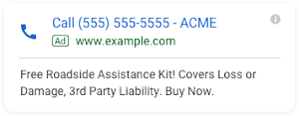
Call only Ads
Designed to encourage people to call your business, and can appear only on devices that make phone calls.
When a potential customer clicks your ad, the ad places a call to you from their device.
How it works?
Your ad wins an auction and is shown on the Search Network.
Someone taps the ad.
That person’s mobile phone dialer opens with the number set (either your own number or a GFN, depending on your settings).
The person taps the call button to place the call.

Slide 40
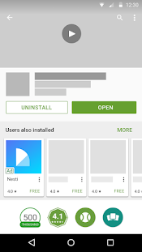
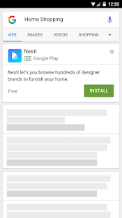
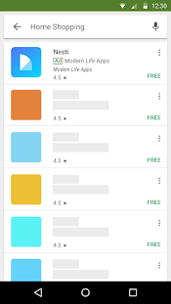
Universal App promotion ad
Allows you to promote your app across Google Search, Google Play, YouTube, Gmail, and within other apps and mobile websites on the Display Network.
These campaigns generate your ads based on your app listing in the Google Play Store, a few independent lines of text, and an optional YouTube video link.

Slide 41
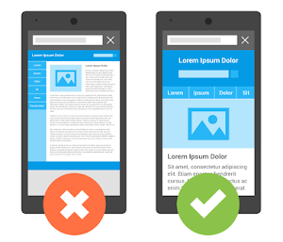
Mobile Advertising strategies
1. Build a mobile friendly website
A mobile website that's tailored to the small screen and makes it easy for people to make a purchase or take other action on your site.
Simplify site navigation
Use expandable product images
Keep any directions or "buy now" buttons front and center.
Use existing account info to minimize data entry for your customers.
Use click-to-call buttons or links
Keep content limited
Make sure that your landing page doesn't
contain Flash content.
Google’s Mobile Friendly Test

Slide 42
Mobile Advertising strategies
2. Create mobile preferred ads
Design mobile specific ads by selecting different ad groups in Google Ads.
3. Set up targeting for mobile
Set up targeting to mobile devices by selecting device targeting to Mobile/Tablets
4. Bid higher for mobile devices
Advertisers can control their mobile bids by setting a mobile bid adjustment for their keywords at the campaign or ad group level in Google Ads.

Slide 43
Analysis and Tools for Digital marketing networks

Slide 44
Monitoring and Analysis tools for Display ads
Status: This shows if your ads are running. For example, an "Eligible" status means your ads may be served.
CTR (Clickthrough rate): One of the main indicators of ads' health. It shows how often people click your ad after seeing it. As a rule of thumb, a CTR under 1% indicates that your ads aren't targeted to a relevant audience.
Avg. CPC (cost-per-click): determined by totalling the cost of all clicks and dividing it by the number of clicks
Placements: Locations on the Display Network where your ad appeared.

Slide 46
Reporting tools in Google Ads
1. Reports: allows you to create various charts or tables to see performance data.
Combine dozens of custom metrics, seeing granular detail on factors such as impressions, targeting, and conversions. These reports can be saved for future reference.
2. Predefined reports (formerly Dimensions): lets you see basic performance data from a selected set of metrics, which you can further refine.
3. Dashboards: designed to let you access your most useful data in one place.
Drag and drop saved charts and tables you made using Reports into multiple panes on the dashboard, create new charts, create Scorecards to see quick performance data, and add notes.

Slide 47
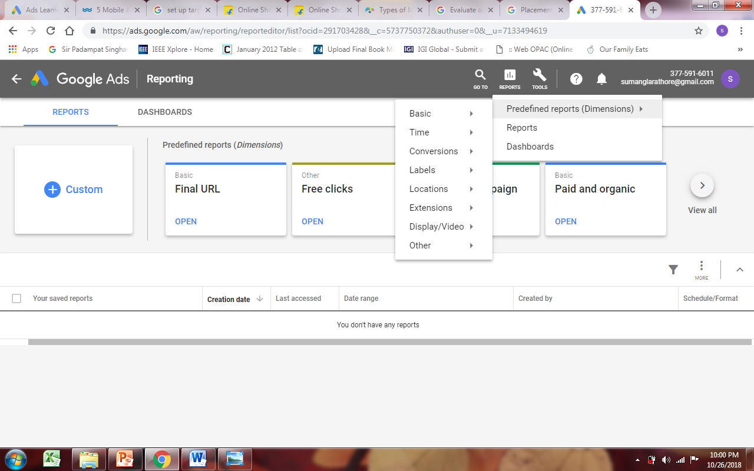

Slide 48
Video Ad metrics and reporting
Core performance:
Views: show you the number of times people watched or engaged with your video ad.
View rate: shows you the number of views or engagements your video ad receives divided by the number of times your ad is shown (video and thumbnail impressions).
Avg. CPV is the average amount you pay when a viewer watches 30 seconds of your video (or the duration if it's shorter than 30 seconds) or engages with your video, whichever comes first.
Watch time measures the total amount of time people watched your video ads, shown in seconds.
Avg. watch time / impr. measures the average number of seconds someone watched your video ad per impression of the ad.
Click performance:
Clicks show you the number of times people clicked on your video. Clicks can help you understand how well your ad is appealing to people who see it.
Clickthrough rate (CTR) is the number of clicks that your ad receives divided by the number of times your ad is shown.
Engagement performance:
Engagements show you the number of clicks on interactive elements, such as on teasers or icons to expand any cards on your video. (These clicks don't take people to a website or other external destination).
Engagement rate is the number of engagements that your ad receives divided by the number of times your ad is shown.

Slide 49
Video Ad metrics and reporting
Reach and frequency:
Unique users shows the total number of people who saw an ad over a given time period.
Unique cookies is the number of cookies (which store preferences and other information that’s used on webpages that they visit) specific to an individual browser on people's computers.
Unique viewers (cookies) is the number of times your video ad was viewed by a unique cookie over a given time period.
Avg. impr. freq./user is the average number of times a unique person is shown your ad over a given time period.
Avg. impr. freq./cookie is the average number of times your video ad is shown to a unique cookie over a given time period.
Avg. view freq./cookie is the average number of times that a unique cookie viewed your video over a given time period.

Slide 50
Video Ad metrics and reporting
Video viewership (also known as "quartile reporting")
Video played to: 25% shows how often a video is played to 25% of its length.
Video played to: 50% shows how often a video is played until the middle of its view length.
Video played to: 75% shows how often a video is played to 75% of its length.
Video played to: 100% shows how often a video is played to its completion.
YouTube engagement: Earned actions happen when a viewer watches a video ad and then takes a related action on YouTube. The following are different types of earned actions:
Earned views increment if a YouTube viewer watches subsequent videos on your YouTube channel or Watch pages.
Earned subscribers happen when a viewer subscribes to your channel. Earned playlist additions happen when a viewer adds the video to a playlist.
Earned likes happen when a viewer likes the video.
Earned shares happen when a viewer shares the video.
Active View
ActiveView metrics show how often your ad appeared in a position on a webpage, device, or app that people could see.

Slide 51
References
www.support.google.com
https://www.wordstream.com/blog/ws/2014/08/18/mobile-ad-strategies
https://ads.google.com/home/resources/learning/
https://blog.visme.co/types-of-mobile-advertising/
https://www.searchenginejournal.com/digital-video-advertising-domination/256031/

