Slide 1
Introduction to Digital Marketing

Slide 3
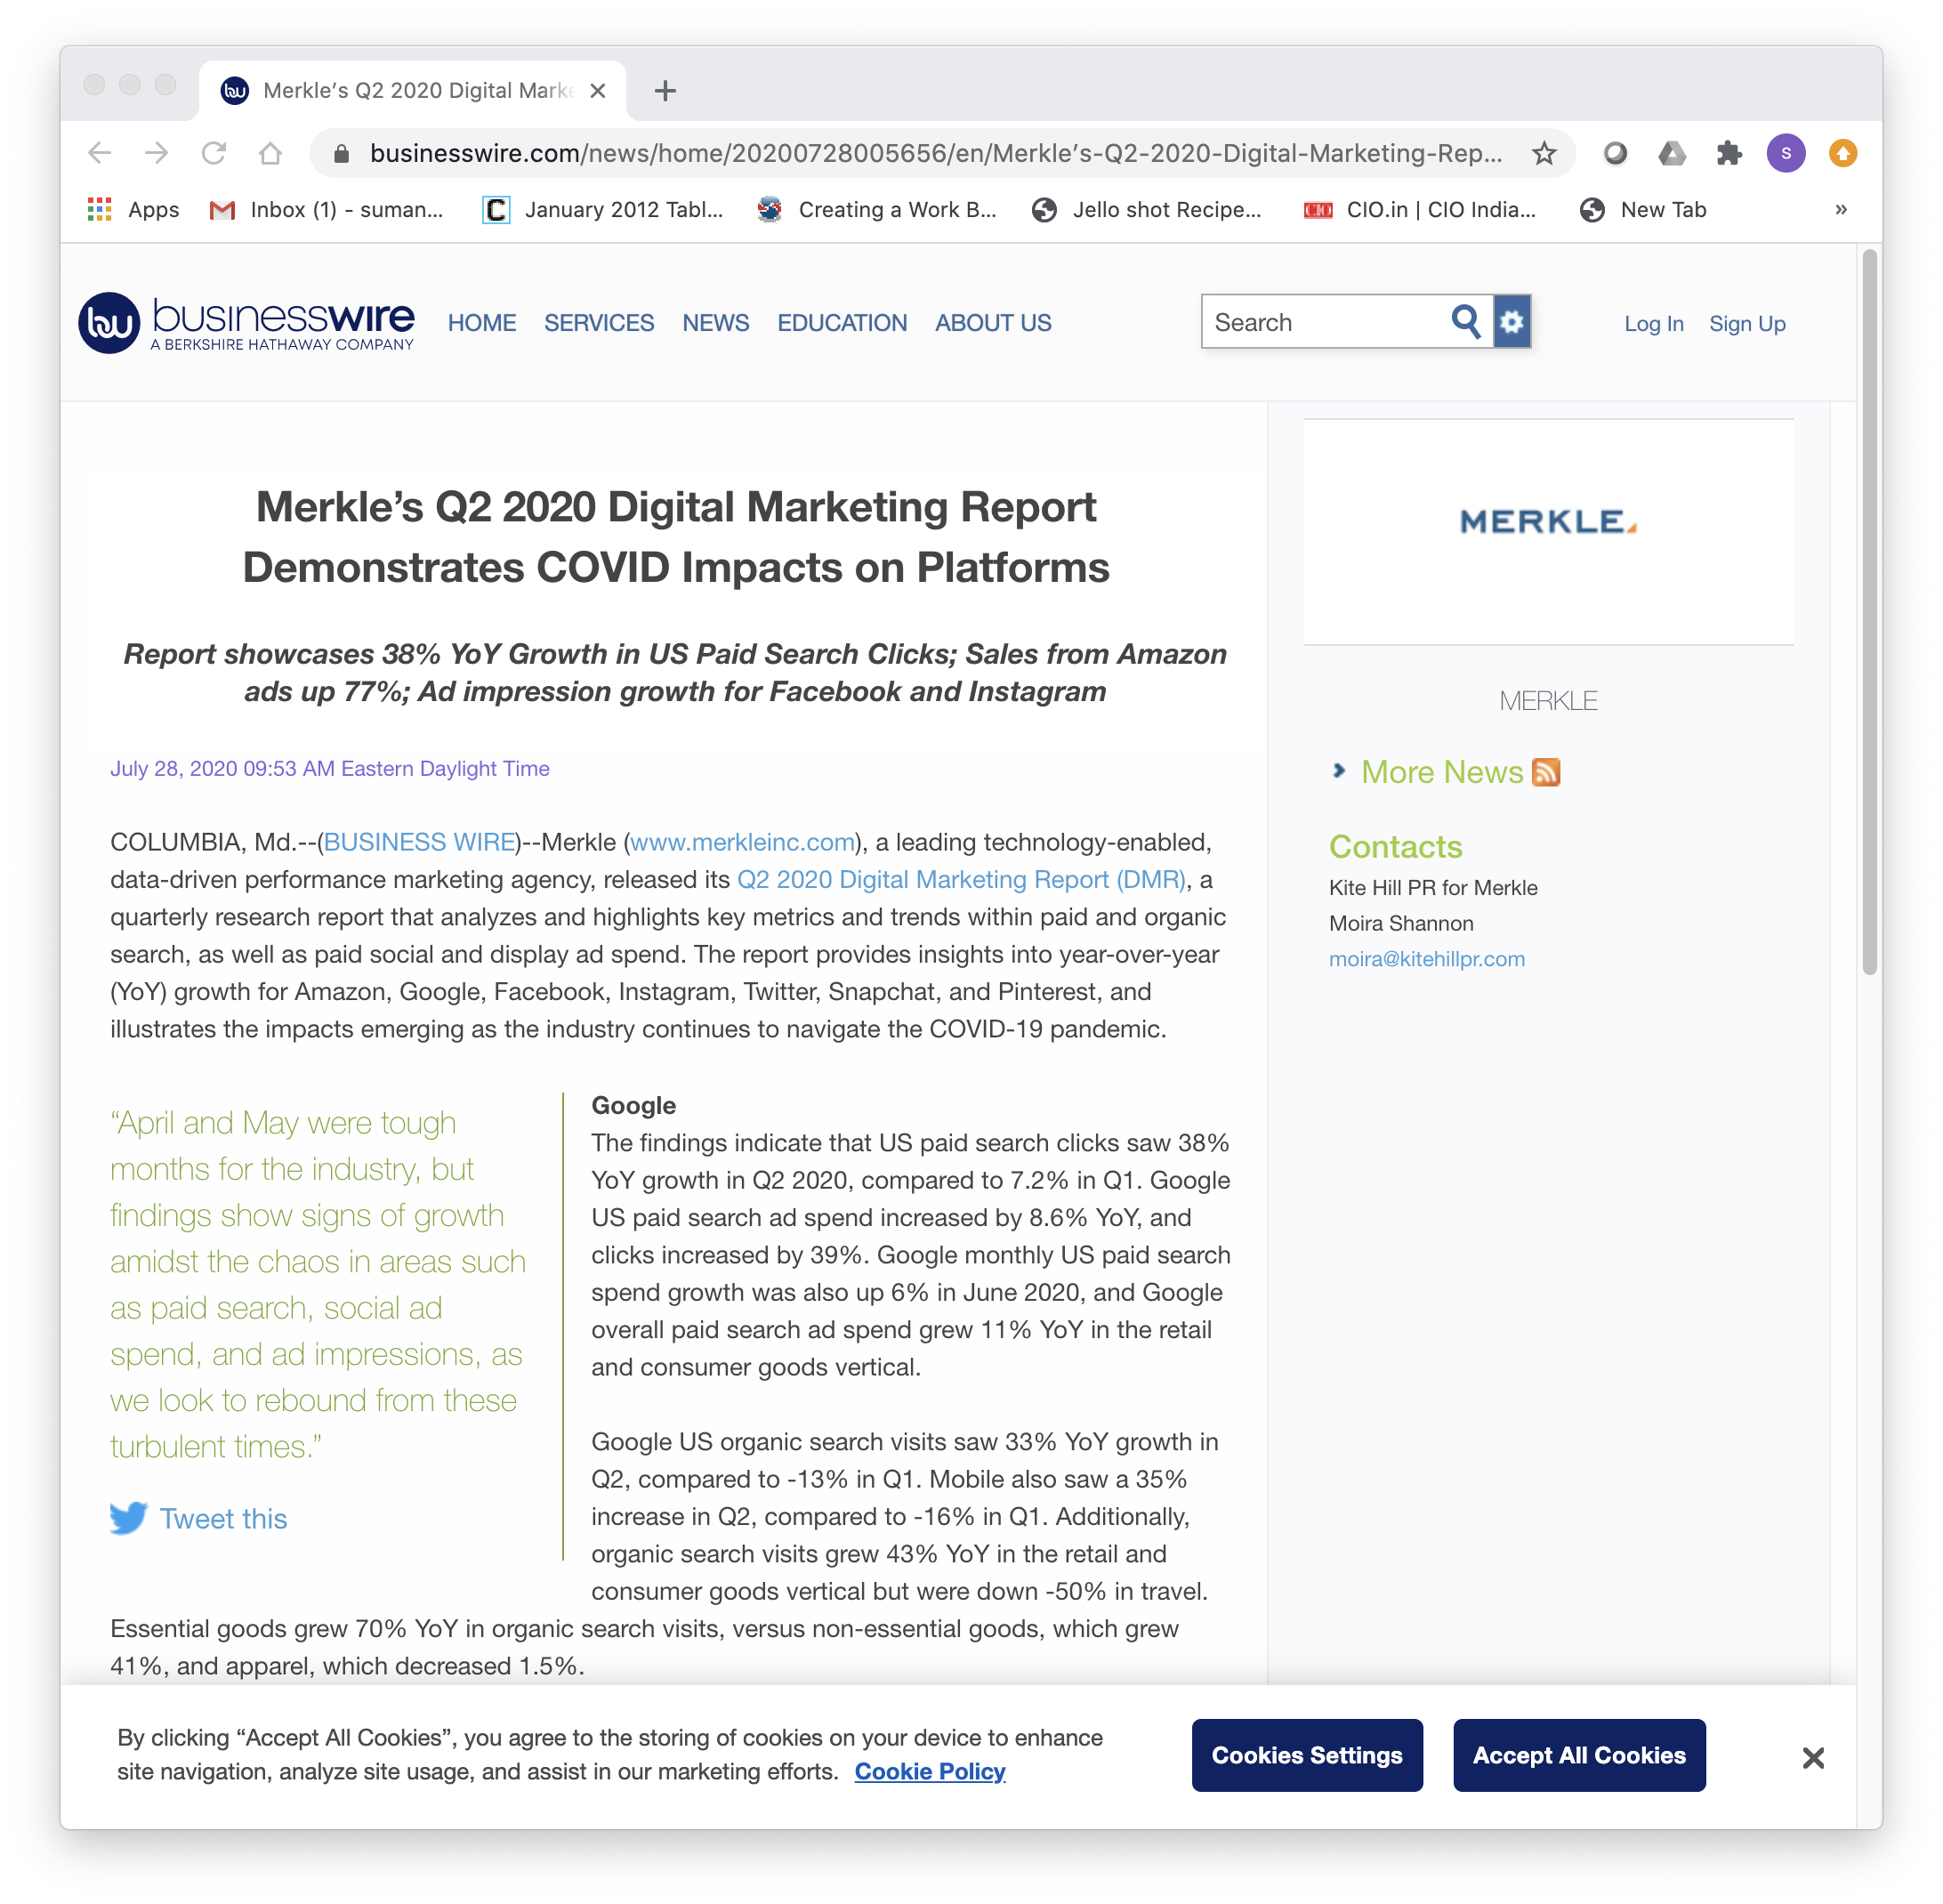
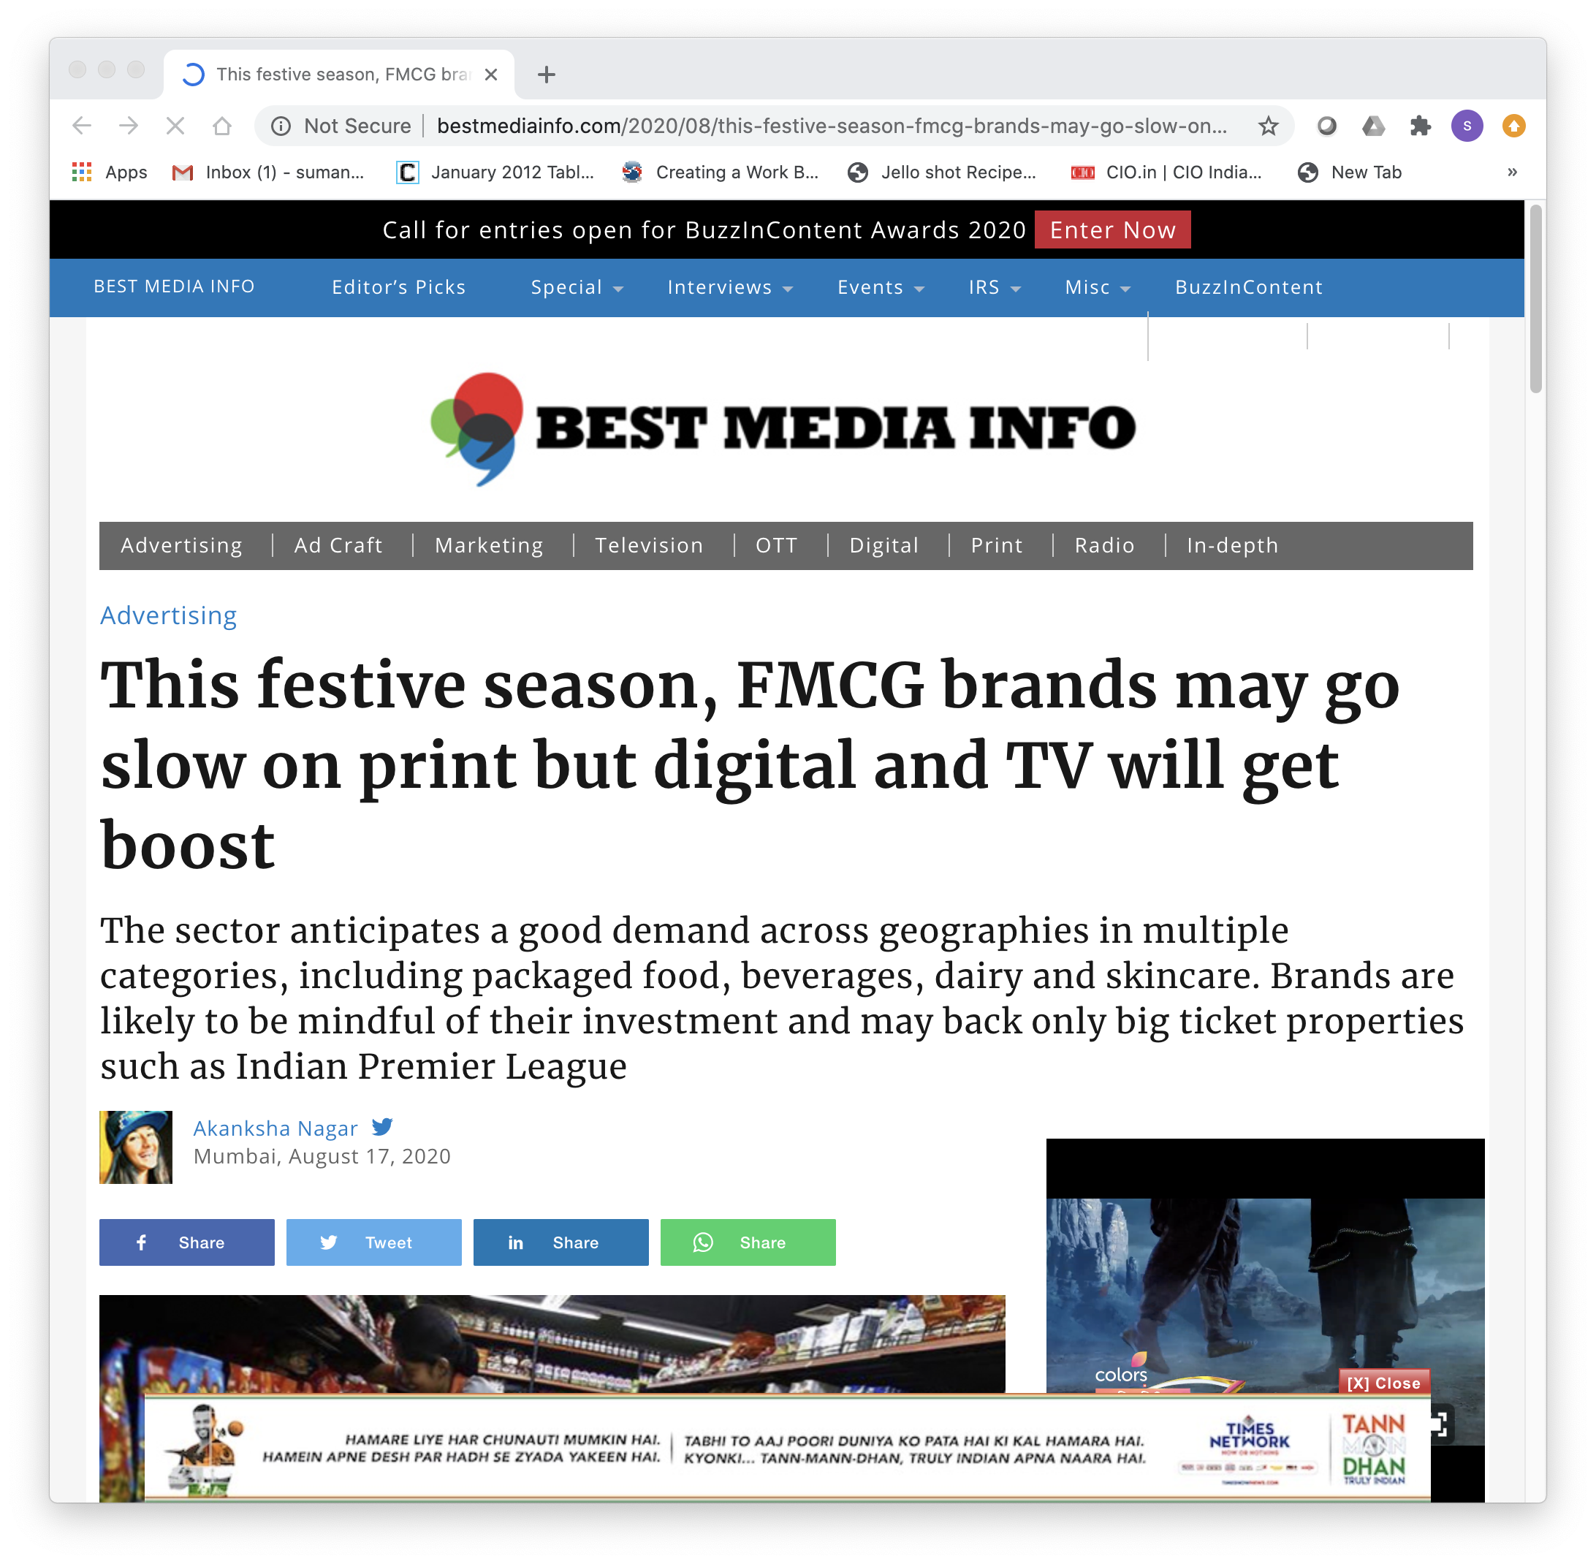
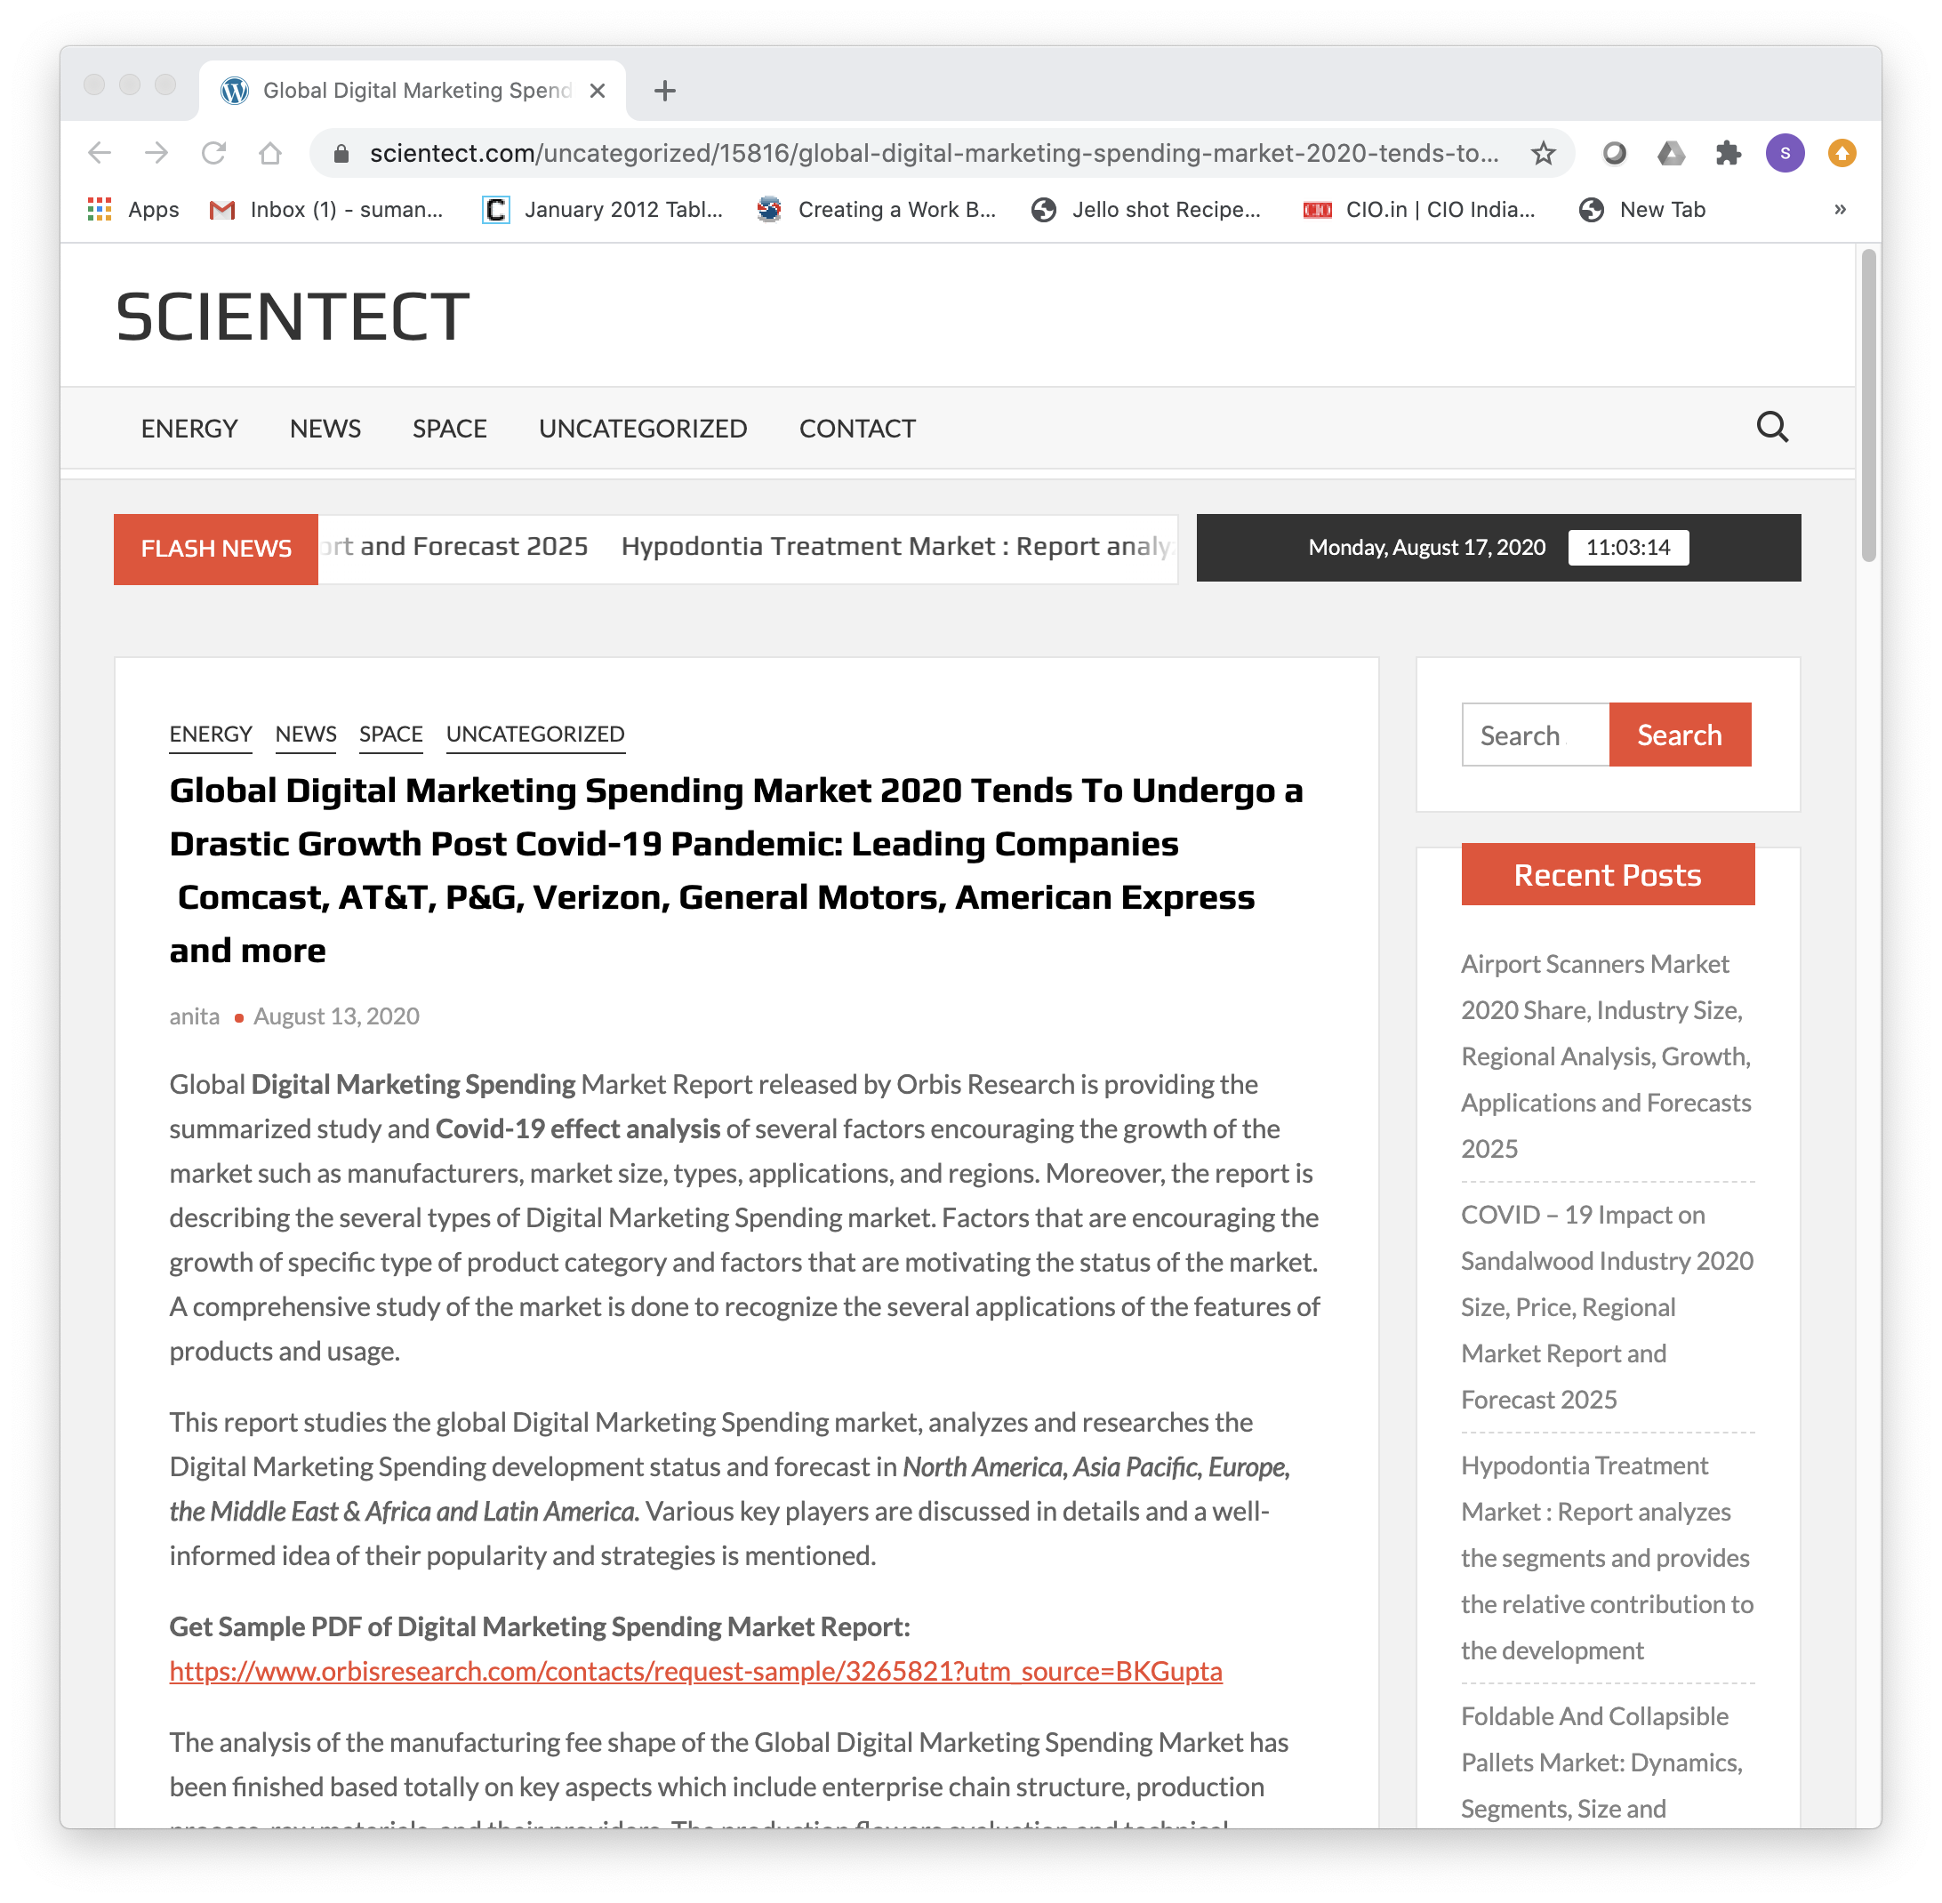

Slide 4
What is Digital Marketing?
Digital marketing encompasses all marketing efforts that use an electronic device or the Internet.
Marketing efforts that leverage digital channels such as search engines, social media, email, and other websites to connect with current and prospective customers.

Slide 5
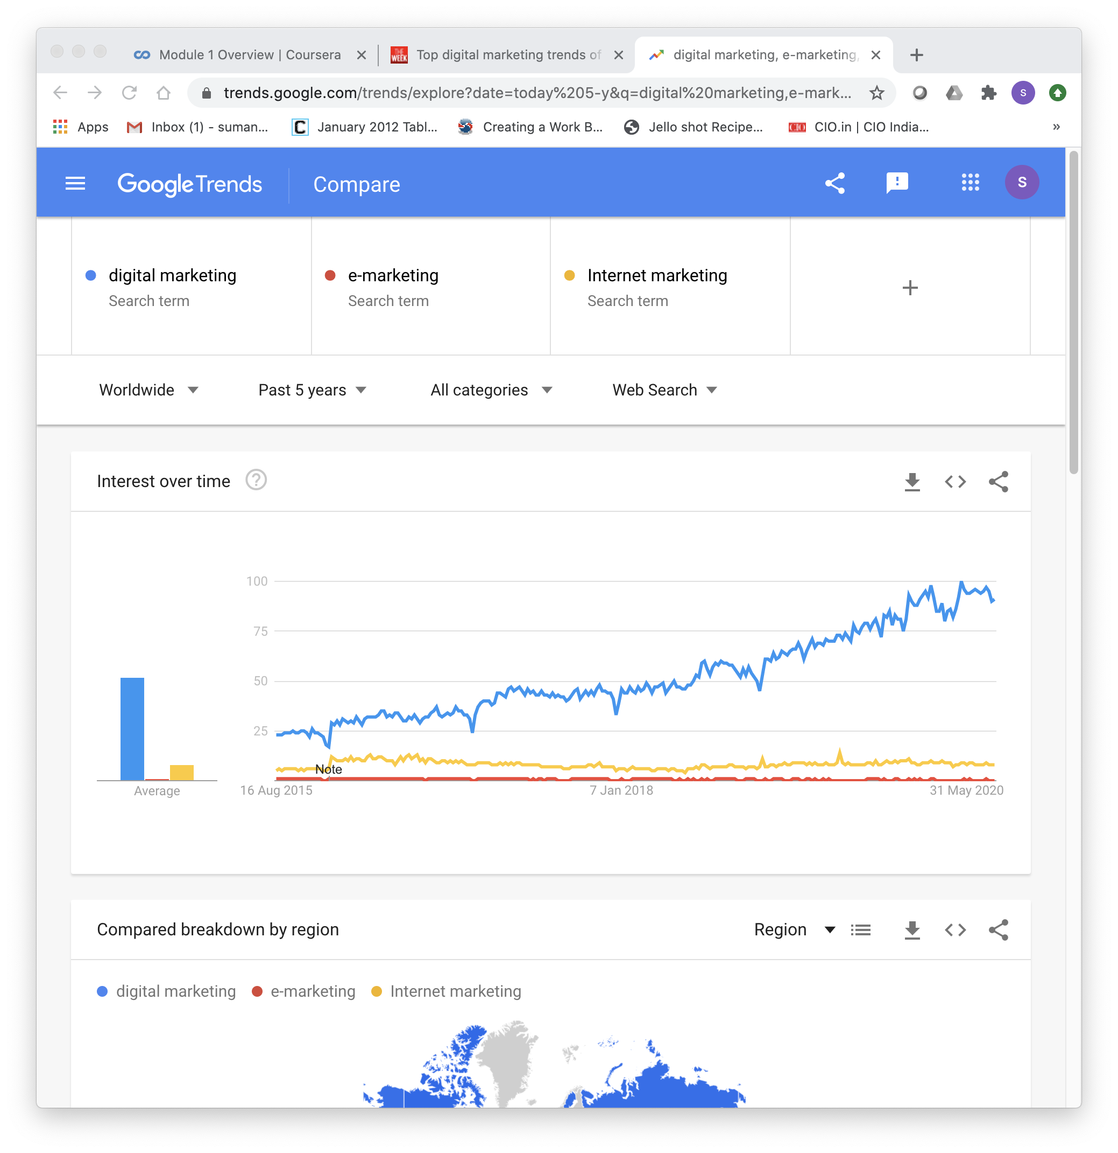
Terms such as digital marketing, Internet marketing, e-marketing and web marketing have been used and varied through time...as shown in this plot from 2014 to 2020 from Google Trends.

Slide 6
Examples???

Slide 7
https://www.smartinsights.com/internet-marketing-statistics/happens-online-60-seconds/

Slide 8
Check your online activity on Mobile now!

Slide 9
This upward trend of content consumption is not sustainable because every human has a physiological, inviolable limit to the amount of content they can consume. I believe as marketers, we have been lulled into a false sense of security thinking that this consumption trend will continue to rise without end. That is simply not possible.
By Mark Schaefer
https://businessesgrow.com/2014/01/06/content-shock/

Slide 10
Challenging times ahead for Digital Marketers
Huge amount of digital content and constant bombardment with messages presents an equally huge challenge for marketers who need to get their message heard through the storm.

Slide 11
Important terms
CTR – Click-Through Rate
Click-through Rate identifies the percentage of people who click on link. Usually placed in an email, an ad, website page… etc.
CPA – Cost per Acquisition
Cost per Acquisition is a pricing model where companies are charged by advertising platforms only when leads, sales or conversions are generated.
CPC – Cost per Click
Cost per Click is a pricing model where companies are charged by publishers for every click people make on a displayed/test ad which leads people to your company’s website
Conversion
When a visitor takes the desired action while visiting your site, it is called conversion. This can be a purchase, membership signup, download or registration for newsletter.
Impressions
This term is used to define the number of times a company’s ad will appear to its target audience. Impression could also be related to a website and the number of times the web page appear in total.

Slide 12
Organic Traffic
This is traffic that is directed to your website which is generated by a Search Engine.
Paid Traffic
Paid search is when a company bids on keywords and makes advertisements around those keywords to be displayed on search engines.
SEM – Search Engine Marketing
Search Engine Marketing is a way companies can get higher placement on search engines by bidding on search terms.
SERP – Search Engine Results Page
Search Engine Results Page is the list of results provided by a search engine after a search query is made.
Domain Authority
This is a scale from 1-100 that search engines use to determine how authoritative a company’s website is, 1 being the lowest rank and 100 being the highest. The higher your domain authority the more Search Engines trust you.
Hyperlocal
Hyperlocal means an area close to home—the people within walking or driving distance to a particular destination or those united in one identifiable community.
Quality Score
Quality Score is Google AdWords’ rating of the relevance and quality of keywords used in PPC campaigns.

Slide 13

META Description
The META description is the few lines of text that appear on the search engine results page.
Subscriber
A subscriber is a person who allows a company to send him/her messages through email or other personal communication means.
RSS – Really Simple Syndication
Really Simple Syndication is a technology that allows users to become subscribers of content and ultimately get automatic alerts if updates are made.
Viral Marketing
This is a way of marketing where the audience is encouraged by companies to pass on their content to others for more exposure.
Landing Page
This is the page on a company’s website that is optimized to act as the entry page to a site.
Contextual Marketing
Contextual marketing is all about delivering the right content at the right moment based on a potential client’s preferences using behavioral targeting and enabling brand awareness, recall and engagement.

Slide 15
Why Digital Marketing?
Wider reach
Internet is widespread
Almost 4.57 billion people were active internet users as of July 2020, (59 percent of the global population).
China, India and the United States rank ahead of all other countries in terms of internet users. (Statista)
Nearly 50% of the world's population uses social media. That's over 3 billion users worldwide. (Statista)
Each person spends an average of 2 hours and 22 minutes on social networks and messaging. (Globalwebindex)

Slide 16
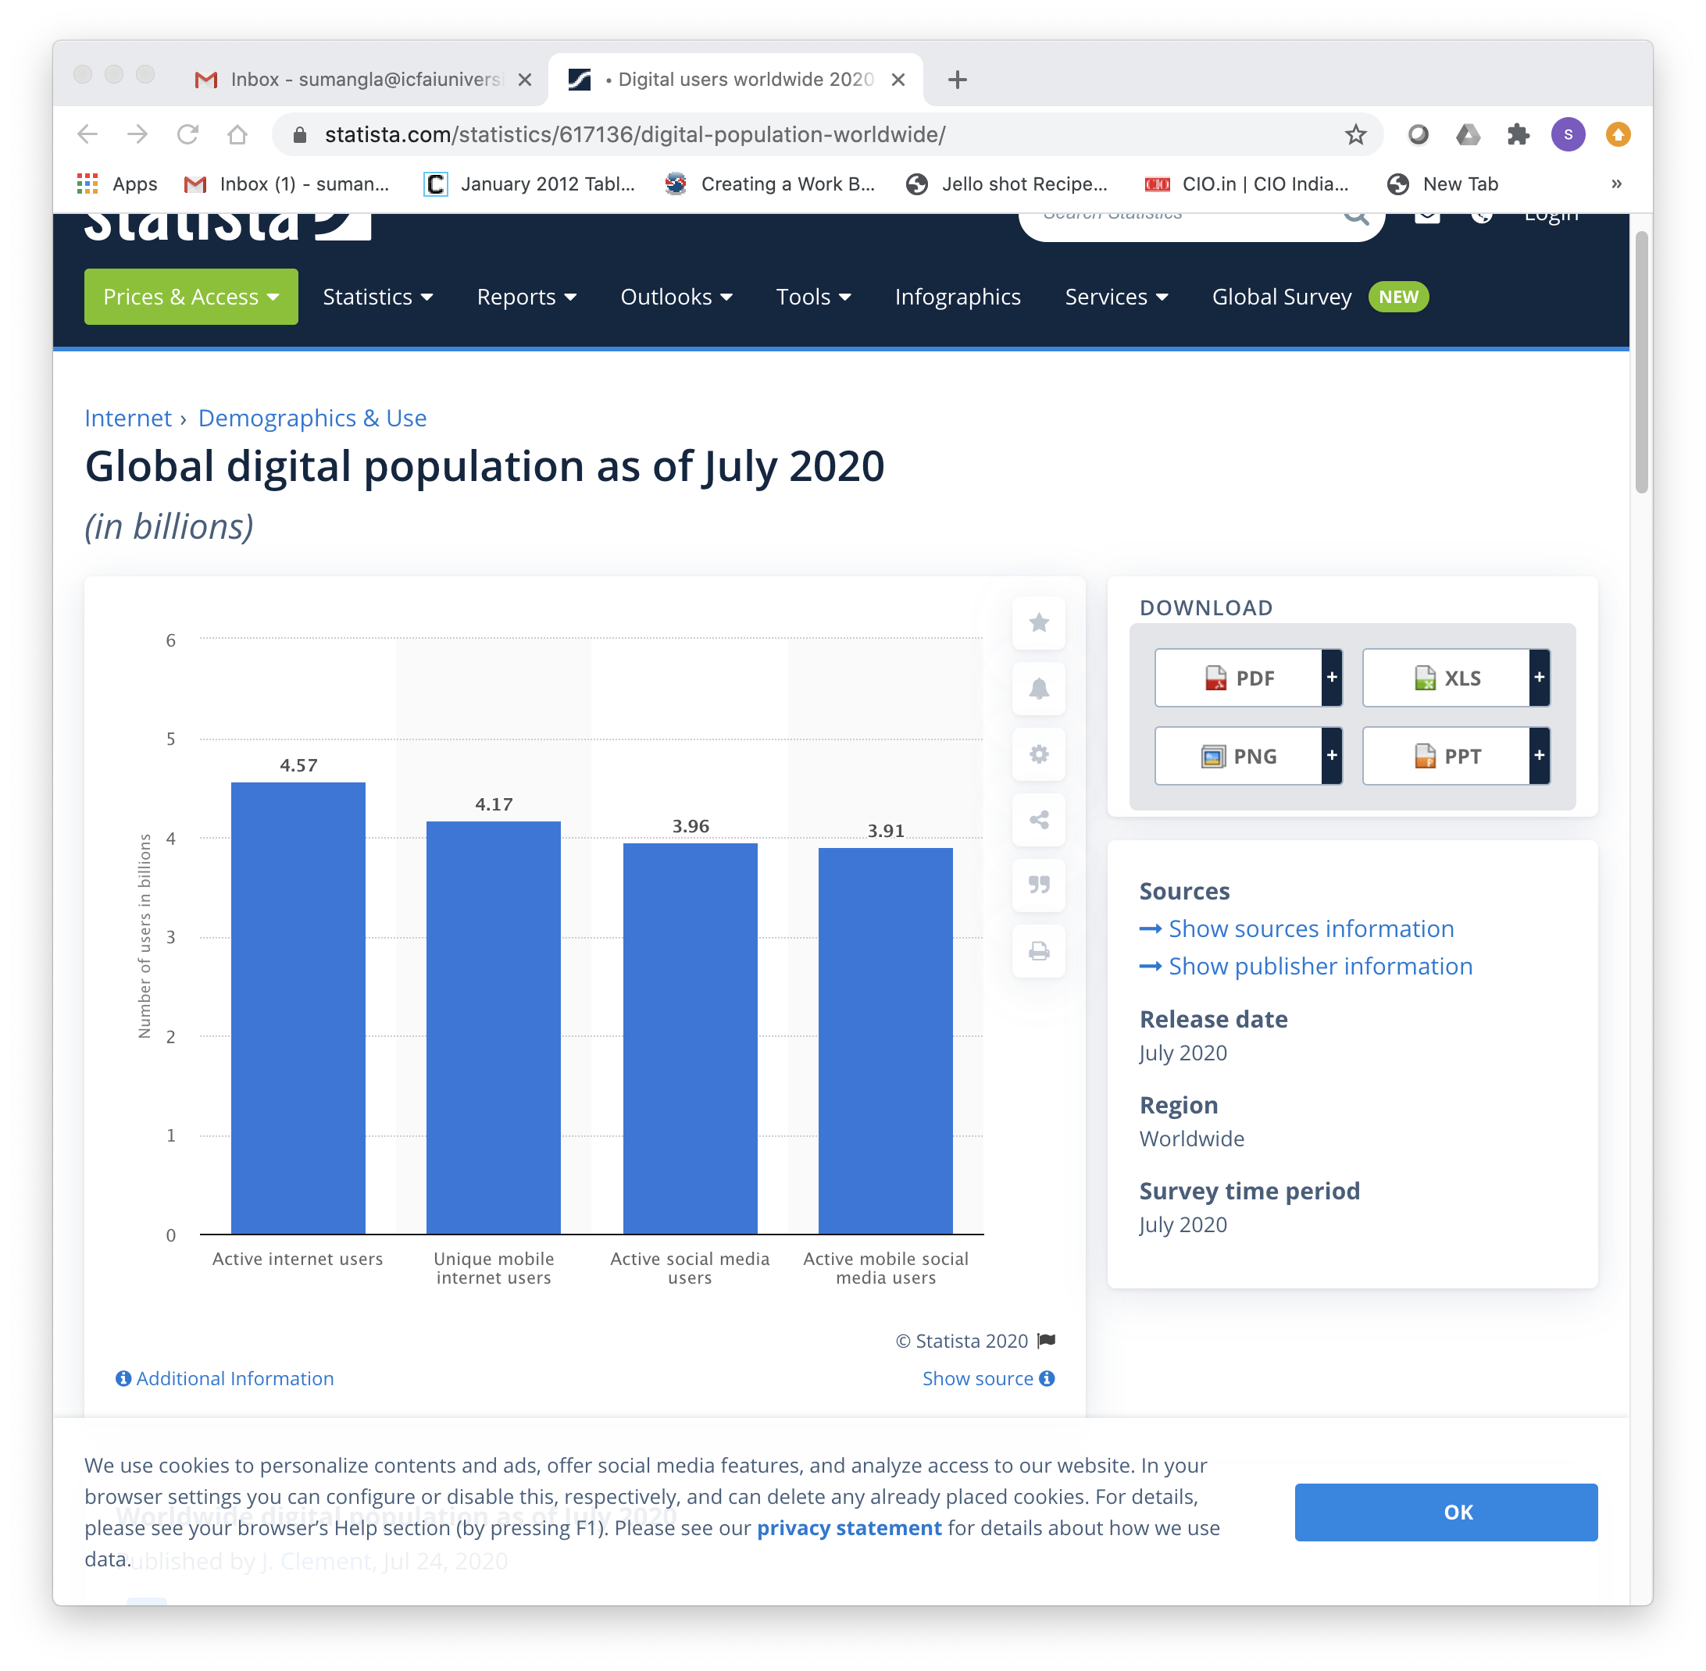
https://www.statista.com/statistics/617136/digital-population-worldwide/

Slide 17
Why Digital Marketing?
2. Targeted Reach
Target people with a very specific:
Demographics
Goal
Profession
Education level
Buying behavior
And more

Slide 18
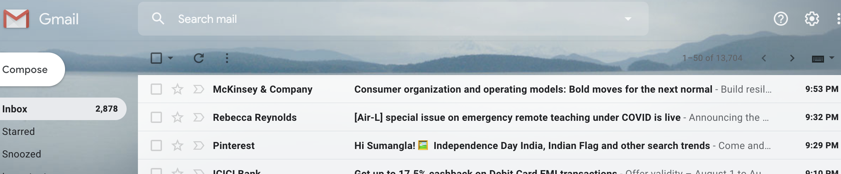
Why Digital Marketing?
3. Personalised communication
Personalised Videos/
Newsfeed
Recommendation Systems
Chatbots with personalized messages
Personalised Email communication

Slide 19
Why Digital Marketing?
4. Advanced Analytics for performance monitoring

Slide 20
Why Digital Marketing?
5. Easy to scale and adapt
Choose a daily budget and know exactly how much an Ad-campaign will cost.
Optimise the campaigns based on the required performance.
Make changes fast to reduce wasted ad spend and lost revenues.

Slide 21
Why Digital Marketing?
6. Better ROI (Return on Investment)
Cost effective
Low investment
Ideal for small businesses

Slide 22
Digital Strategy
The series of actions that help a business achieve its goal(s) using online marketing.

Slide 23
Digital Strategy Roadmap
I. Understand your business
1. Clearly define your goals.
“to generate 25% more leads via website this year than you drove last year.”
“increase sales by 20%, “
or “identify 100 potential customers”
2. Articulate what your business stands for – mission statement
3. Identify your Unique Selling Point (or USP)

Slide 24
Digital Strategy roadmap
Some examples of typical goals and the strategies that can be used to address them:
Increase sales: If your goal is to improve online sales, driving more traffic to your website can help, through paid advertising to content marketing.
Increase awareness of the business or brand: Social media is a popular way to increase brand awareness to both new and existing customers. It provides a platform to express your values, personality, and engage with your audience.
Grow your email marketing list: To encourage customers to sign up to email marketing, try clearly communicating what your audience can expect to receive, whether it’s exclusive content or member-only updates.

Slide 25
Digital Strategy roadmap
II. Know your Audience
Build your buyer personas.
  Quantitative: Location, Age, Income, Job Title
  Qualitative: Goals, challenges, hobbies, priorities
Understanding the differences between offline and online experiences.
For example, the “See, Think, Do, Care” framework in online world

Slide 26
Think about the last product that you bought online and then look back at the See, Think, Do, Care framework explored in this lesson. Map your journey through the touchpoints you encountered before making your purchase. Think about:
What initiated your interest in the product? (See)
How did you go about doing your research? (Think)
What finally made you hit that 'Buy Now' button? (Do)
Did you leave a review or post an image of your purchase online (Care) Now think back to your business scenario:
What types of content could you use at each stage of the customer journey to encourage people to make a purchase?

Slide 27
Digital Strategy roadmap
III. Evaluate your existing digital marketing channels and assets.
1. Owned Media
your website, social media profiles, blog content, or imagery, owned channels
2. Earned Media
Word of mouth earned through press mentions, positive reviews, and by other people sharing your content on social media.
3. Paid Media
Google AdWords, paid social media posts, native advertising (like sponsored posts on other websites)
Google’s Mobile-Friendly test: https://search.google.com/test/mobile-friendly
Google’s test my site: https://testmysite.withgoogle.com/intl/en-gb

Slide 28
Digital Strategy roadmap
IV. Developing Customer Touchpoints
A touchpoint is any stage when a customer, or potential customer, comes into contact with a business.
When a customer encounters a touchpoint multiple times, such as online ads, this provides consistent value and creates ongoing positive associations with a brand.
Map the customer journey and plan how to impress them at every stage.
Regularly review how they’re performing.

Slide 29
Digital Strategy roadmap
V. Identify the right Digital Marketing tools
VI. Plan your strategy for a longer-term period
For example:
In January, you might start a blog which will be continually updated once a week, for the entire year.
In March, you might launch a new ebook, accompanied by paid promotion.
In July, you might be preparing for your biggest business month -- what do you hope to have observed at this point that will influence the content you produce to support it?
In September, you might plan to focus on earned media in the form of PR to drive additional traffic during the run-up.

Slide 30
Top techniques for digital marketing
Website and Content
Companies that published 16+ blog posts per month got almost 3.5X more traffic than companies that published between 0-4 monthly posts.
Email Marketing
86% of consumers would like to receive promotional emails from companies they do business with at least monthly
Search Engine Optimisation
72% of marketers say that relevant content creation was the most effective SEO tactic
PPC Advertising
64.6% of people click on Google ads when they are looking to buy an item online
  Search Marketing
  Display advertising
Social Media Marketing
Mobile Marketing
Affiliate Marketing
Referral Marketing
Source: https://www.forbes.com/sites/forbescommunicationscouncil/2017/10/25/digital-marketing-techniques-that-will-help-you-dominate-online/#6bcde48b4ecb

Slide 31
Top Trends in Digital Marketing
Artificial Intelligence
To analyze consumer behavior and search patterns, utilizing data from social media platforms and blog posts to help businesses understand how users and customers find their products and services.
According to Gartner, by end of 2020, 85% of customer interactions will be managed without the need for a human.
Programmatic Advertising
Using AI to automate the buying of ads and being able to target audiences more specifically, which increases the chances of success of the marketing campaign and reduces the customer acquisition costs.
It has been predicted that almost 88% of US digital display ad dollars will be transacted programmatically by 2021, which equates to a staggering $81 billion!
Source: https://www.singlegrain.com/digital-marketing/11-digital-marketing-trends-you-can-no-longer-ignore-in-2018/
https://www.emarketer.com/content/us-programmatic-ad-spending-forecast-2019

Slide 32
Top Trends in Digital Marketing
  Chatbots
  By 2022, chatbots will help businesses save over $8 billion per annum, especially in the banking and healthcare industries.
  Web personalisation
  A unique experience to customers based on their choices and preferences and is considered a better option than “one-size-fits-all” marketing.
  The open rate for e-mails with a personalized message was 18.8% as compared to 13.1% without any personalization.
Source: https://www.singlegrain.com/digital-marketing/11-digital-marketing-trends-you-can-no-longer-ignore-in-2018/

Slide 33
Top Trends in Digital marketing
Video
According to YouTube, mobile video consumption grows by 100% every year.
Video is projected to claim more than 80% of all web traffic by 2020.
Adding a video to marketing emails can boost click-through rates by 200-300%.
90% of customers report that product videos help them make purchasing decisions.
64% of customers are more likely to buy a product online after watching a video about it.
Vlogging
A video blog or video log, sometimes shortened to vlog (/vlɒɡ/), is a form of blog for which the medium is video
Source: https://www.singlegrain.com/digital-marketing/11-digital-marketing-trends-you-can-no-longer-ignore-in-2018/

Slide 34
Top Trends in Digital Marketing
Influencer marketing
A type of word-of-mouth marketing that focuses on using key leaders to drive your brand’s message to the larger market.
Rather than marketing directly to a large group of consumers, you instead pay influencers to get out the word for you
Micro-Influencers:
Interact with your audience by pitching your product to multiple small-time influencers who will charge you less or negligible for showcasing your product.
Multiple micro-influencers showcase your product to their followers. You reach a wider audience at a reasonable cost.
https://www.socialsamosa.com/2017/10/influencer-marketing-campaigns-2017/
Source: https://www.singlegrain.com/digital-marketing/11-digital-marketing-trends-you-can-no-longer-ignore-in-2018/

Slide 35
Top Trends in Digital Marketing
Social Messaging Apps
46% of people now prefer to communicate with a business via messaging apps rather than email, and 49.4% prefer messaging over phone calls with a business.
Visual Search
Google Images
Google Lens
Bing Visual search
CamFind
Source: https://www.singlegrain.com/digital-marketing/11-digital-marketing-trends-you-can-no-longer-ignore-in-2018/

Slide 36
Top Trends in Digital Marketing
Voice Search
50% of all searches will be voice searches by the year 2020
20% of mobile queries on Google are voice searches
25% of all Bing searches are voice searches
10% of Baidu’s search queries are made using voice
Social Media Stories
With short attention spans, users like to view content and visuals whose time expires, so brands are putting their efforts in the Stories feature and generate more exciting but transient content.
Source: https://www.singlegrain.com/digital-marketing/11-digital-marketing-trends-you-can-no-longer-ignore-in-2018/

Slide 37
Top Digital Marketing Tools
Webbee SEO Spider- considered as one of the best SEO tools
Google Analytics- Best tool for traffic analysis of your online campaign
DeepCrawl- world’s most comprehensive online website crawler
Google Search Console- to monitor and maintain website’s presence in Google search results
Moz Pro- a collection of tools built to help marketing professionals improve their SEO
Raven Tools- to schedule marketing reports, manage marketing campaigns and discover on-page SEO issues
BuzzSumo- help you create and share better content more effectively
ContentMarketer.io- helps you notify people & companies you mentioned in your article
SEMrush- top online competitive research tool for digital marketing professionals
MailChimp- one of the finest tools for email marketing purposes

Slide 38
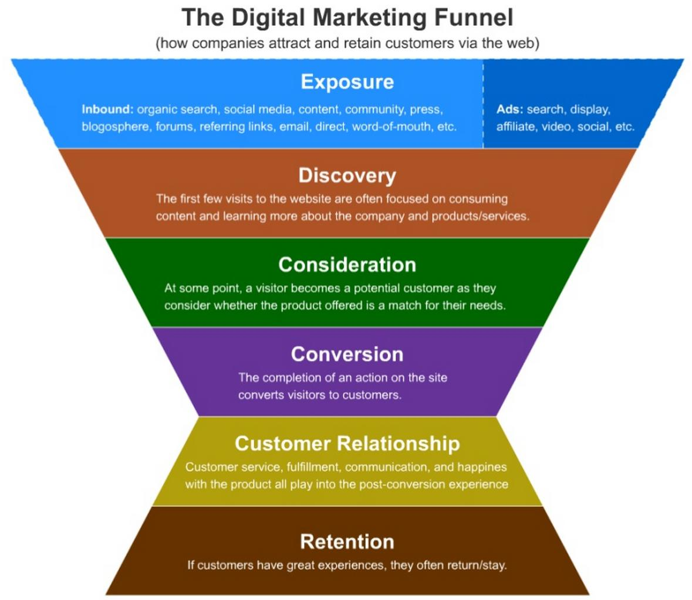

Slide 39
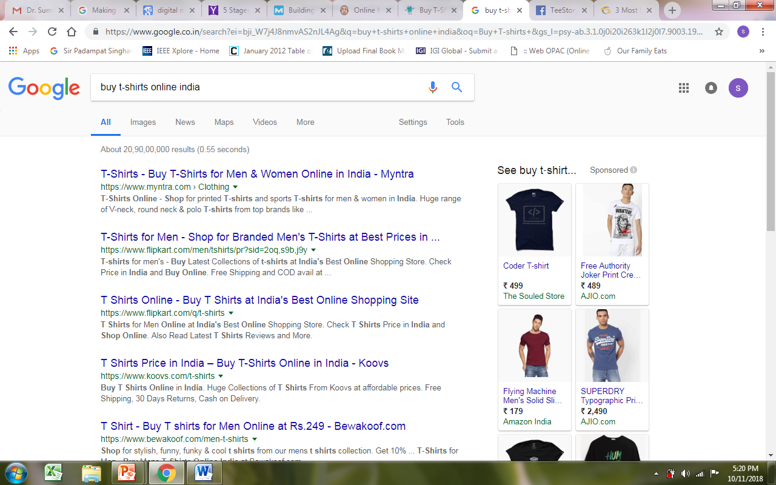
Exposure

Slide 40
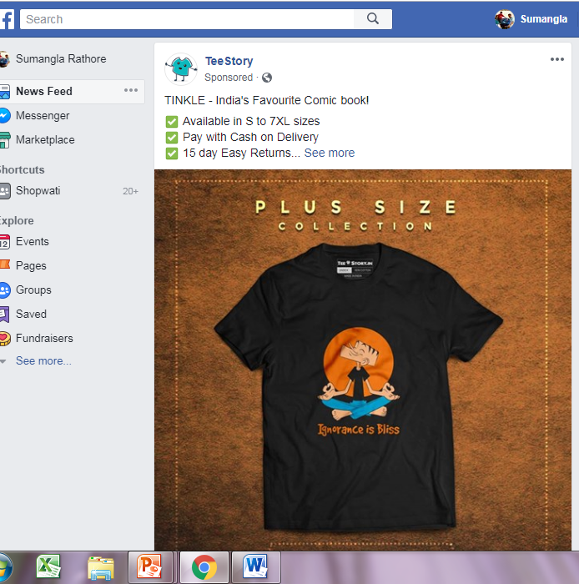
Exposure

Slide 41
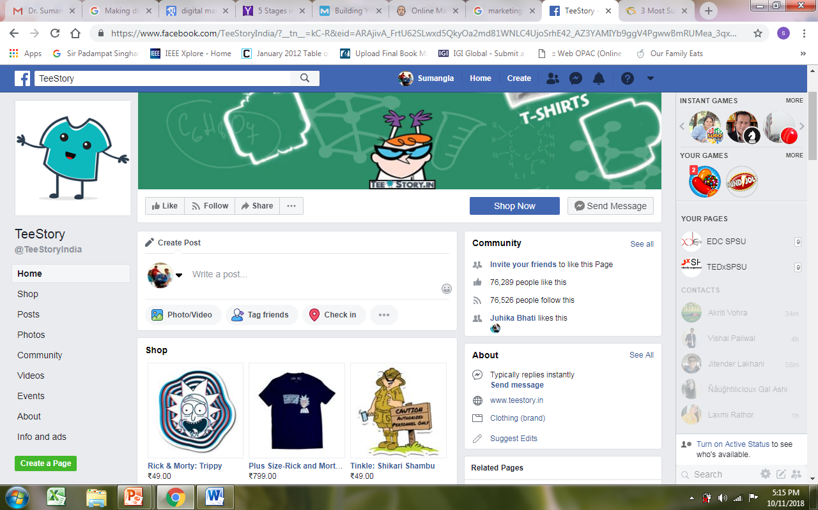
Discovery

Slide 42
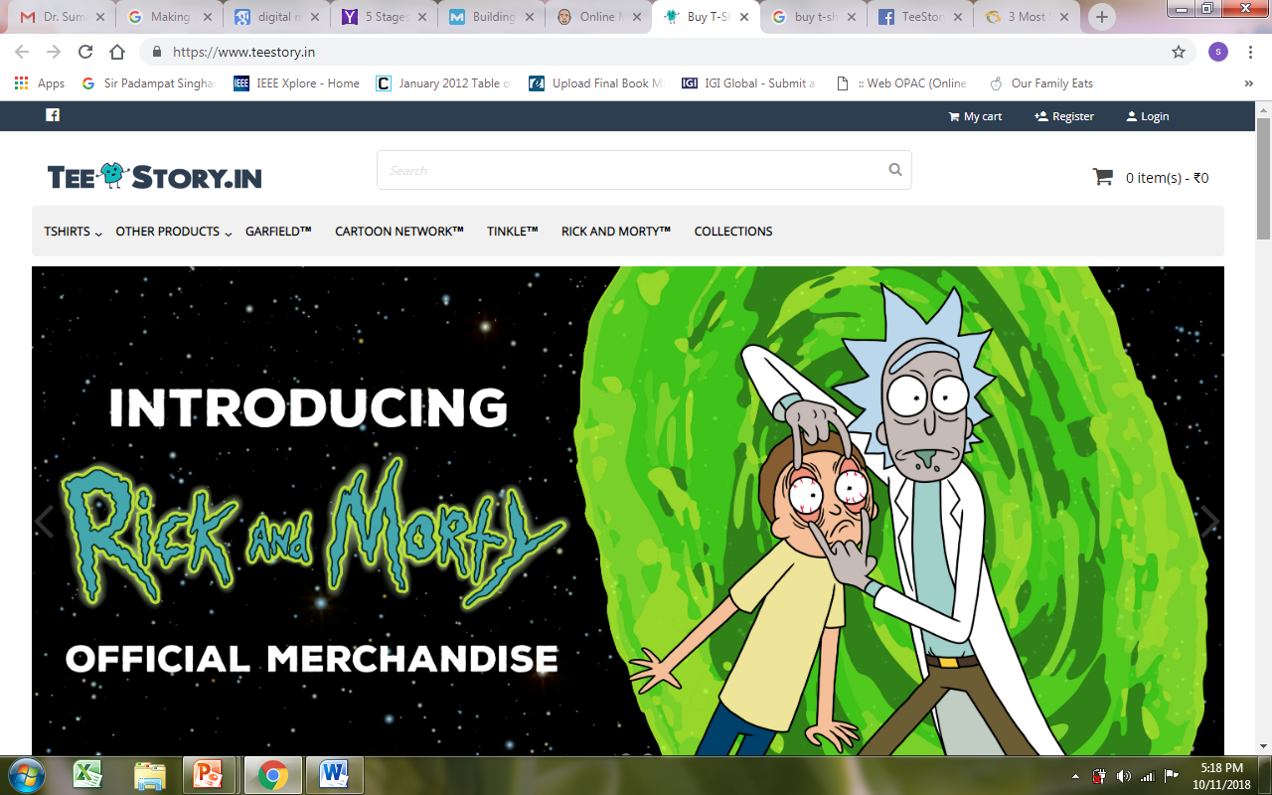
Discovery

Slide 43
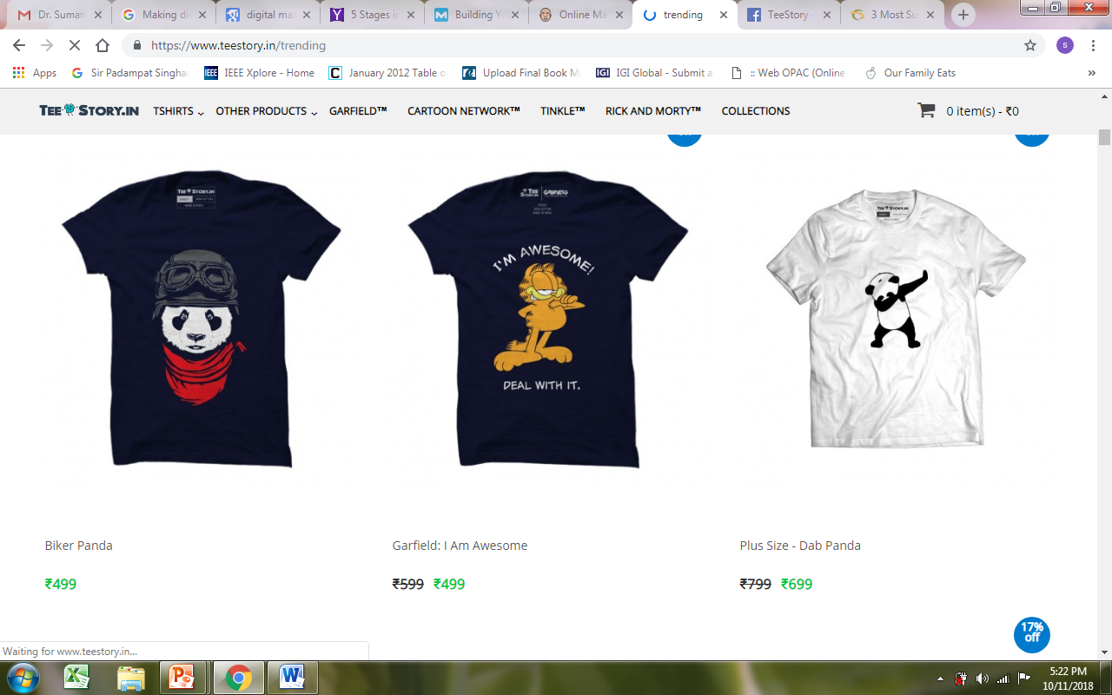
Consideration

Slide 44
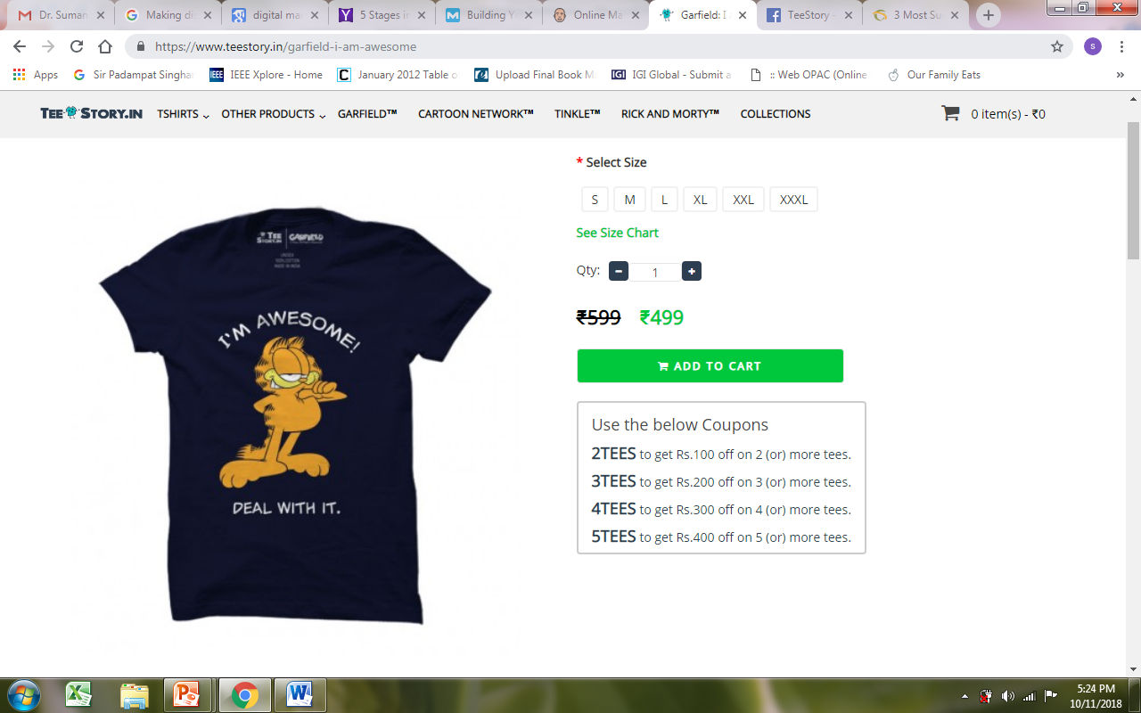
Conversion

Slide 45
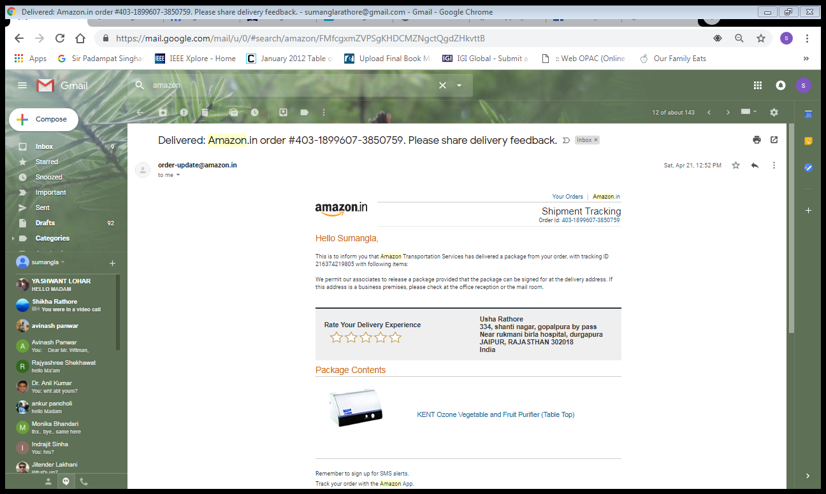
Customer Relationship

Slide 46
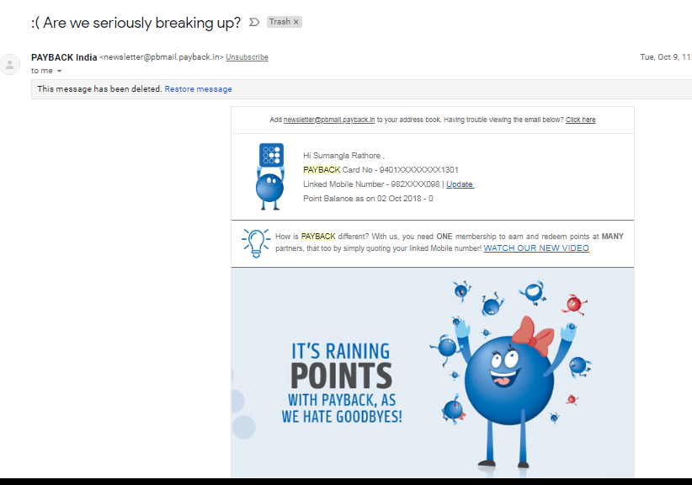
Retention

Slide 47
References:
https://blog.hubspot.com/marketing/digital-strategy-guide
https://www.forbes.com/sites/forbescommunicationscouncil/2017/10/25/digital-marketing-techniques-that-will-help-you-dominate-online/#6bcde48b4ecb
https://www.singlegrain.com/digital-marketing-strategy/how-artificial-intelligence-is-revolutionizing-the-digital-marketing-sphere/

