Slide 1
Search Engine Optimisation

Slide 2
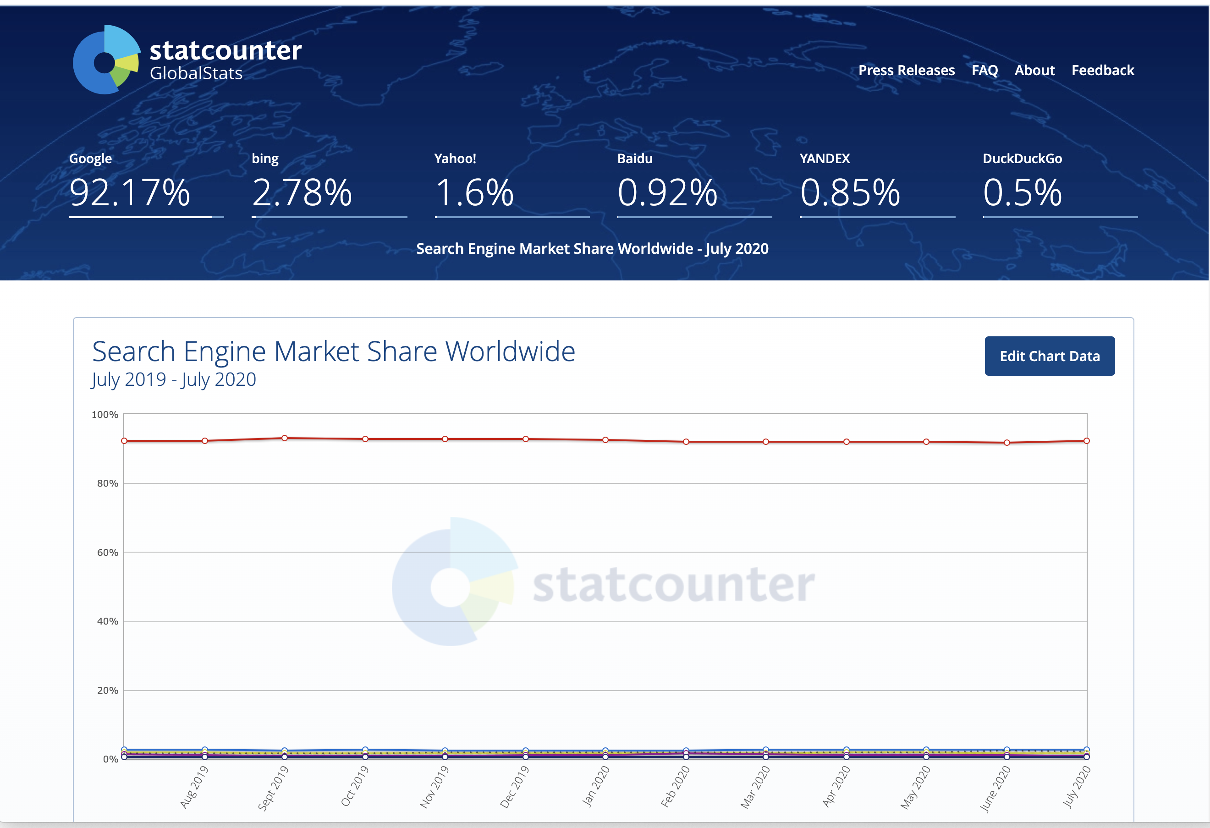
Fact Check: Search Engines Market Share
Source: https://gs.statcounter.com/search-engine-market-share, retrieved August 2020

Slide 3
Google processes over 40,000 search queries every second on average, which translates to over 3.5 billion searches per day and 1.2 trillion searches per year worldwide.
Source: www.internetlivestats.com/google-search-statistics/ retrieved August 2020

Slide 4
Fact Check
71.33% of searches resulted in a page 1 Google search results click.
Page two and three only get 5.59% of clicks.
On the first page alone, the first five results account for 67.60% of all the clicks and the results from 6 to 10 account for only 3.73%.
Source: http://www.zerolimitweb.com/organic-vs-ppc-2018-ctr-results-best-practices/ retrieved 2 October 2018

Slide 5
Organic results
Listings on a search engine results page (SERP) that appear because of factors such as relevance to the search term and valid search engine optimization (SEO) efforts rather than because of search engine marketing (SEM) or trickery.

Slide 6
Paid
Organic

Slide 7
Understanding Search Engines
A service that allows Internet users to search for content via the World Wide Web (WWW).
A user enters keywords or key phrases into a search engine and receives a list of Web content results in the form of websites, images, videos or other online data.

Slide 8
Understanding Search Engines
Three main components:
“Spider” or “Crawler” : automated robots/bots
Index: organized information from webpages and other publicly available content
Search Engine Software : Search Algorithms

Slide 9
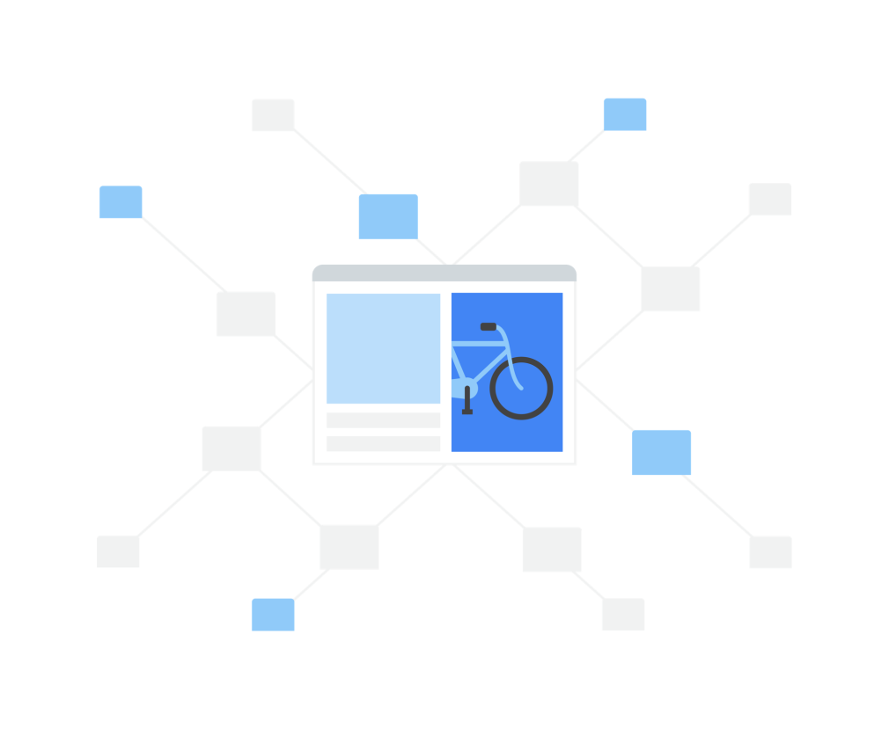
Main functions: 1. Crawling
World Wide Web is a network of unique documents (usually a web page, but sometimes a PDF, JPG, or other file)
The link structure of the web binds all of the pages together.
Links allow the "crawlers" or "spiders," to reach the many billions of interconnected documents on the web.

Slide 10
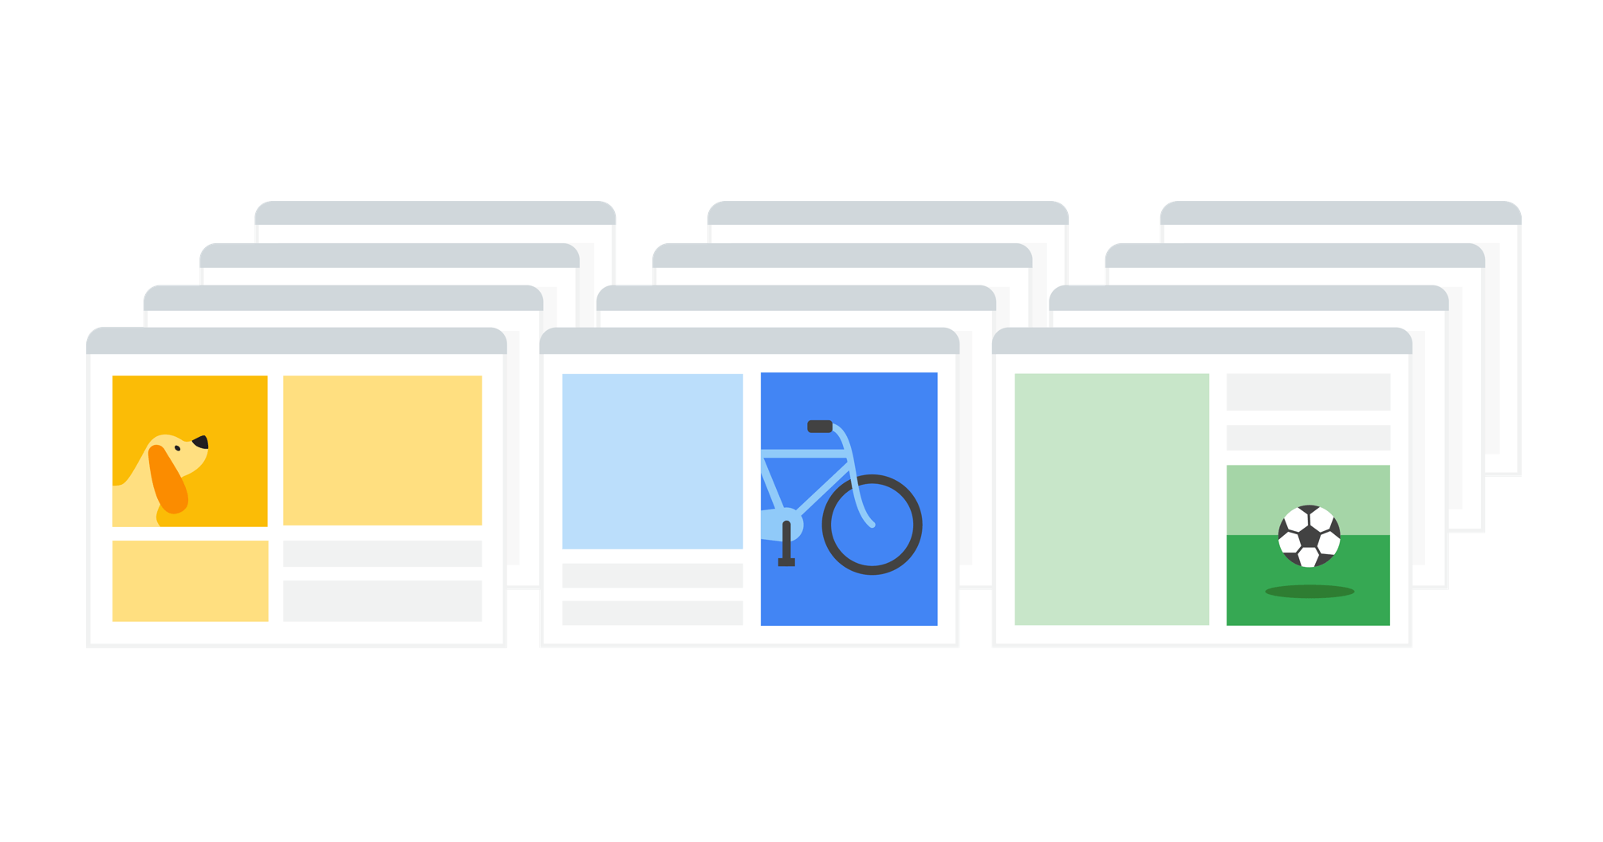
Main functions: 2. Indexing
When crawlers find a webpage, search engine software systems extract the content of the page, keep track of its keywords and other features in the Search index.
The Google Search index contains hundreds of billions of webpages and is well over 100,000,000 gigabytes in size.
It’s like the index in the back of a book — with an entry for every word seen on every web page indexed.
When a web page is indexed, it is added to the entries for all of the words it contains.

Slide 11
Main functions: 3. Search Algorithms
Analysing keywords:
Interpreting spelling mistakes, natural language understanding.
Matching the search
Whether the pages include relevant content and is in the same language
Ranking useful pages
Google PageRank: freshness of the content, number of times your search terms appear, good user experience, how many users seem to value for similar queries, inward links from other websites
Considering context
location, past search history and Search settings
Returning the best results
a diverse set of information in formats that are most helpful for your type of search.

Slide 12
What is SEO?
The process of affecting the visibility of a website or a web page in a search engine’s organic results.

Slide 13
"Build for users, not for search engines."
There are three types of search queries people generally make:
"Do" Transactional Queries: I want to do something, such as buy a plane ticket or listen to a song.
"Know" Informational Queries: I need information, such as the name of a band or the best restaurant in New York City.
"Go" Navigation Queries: I want to go to a particular place on the Internet, such as Facebook or the homepage of the NFL.

Slide 14
White Hat vs. Black Hat
Black Hat SEO: focuses on optimizing the website content only for the search engine, not considering humans at all. Result into spammy, irrelevant pages that often get banned very fast.
White Hat SEO: the way to build a sustainable online business while focusing on the human audience as per the search engine’s rules.

Slide 16
Google’s Commonly used Search Algorithms
1. PageRank
Launch date: 1998
How it works: works by counting the number and quality of links to a page to determine a rough estimate of how important the website is.
The underlying assumption is that more important websites are likely to receive more links from other websites.

Slide 17
Google’s Commonly used Search Algorithms
2. Panda
Launch date: February 24, 2011 How it works: Panda assigns a so-called “quality score” to web pages which is then used as a ranking factor.
Initially, Panda was a filter rather than part of Google’s ranking algorithm, but in January 2016, it was officially incorporated into the core algorithm.

Slide 18
Google’s Commonly used Search Algorithms
3. Penguin
Launch date: April 24, 2012 How it works: Google Penguin’s objective is to down-rank sites whose links it deems manipulative.
Since late 2016, Penguin has been part of Google’s core algorithm; unlike Panda, it works in real time.

Slide 19
Google’s Commonly used Search Algorithms
4. Hummingbird
Launch date: August 22, 2013
How it works: Hummingbird helps Google better interpret search queries and provide results that match searcher intent (as opposed to the individual terms within the query).
While keywords continue to be important, Hummingbird makes it possible for a page to rank for a query even if it doesn’t contain the exact words the searcher entered.
This is achieved with the help of natural language processing that relies on latent semantic indexing, co-occurring terms and synonyms.

Slide 20
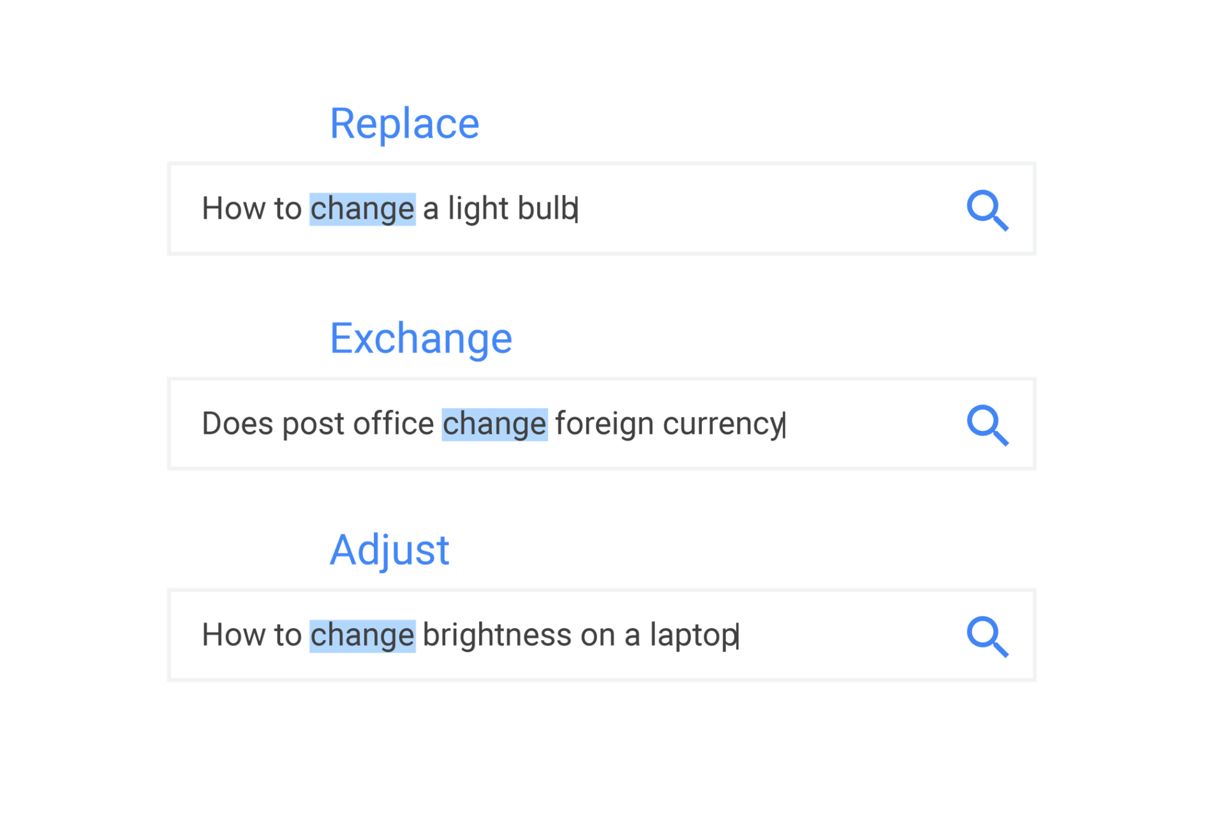

Slide 22
Google’s Commonly used Search Algorithms
5. Pigeon
Launch date: July 24, 2014 (US); December 22, 2014 (UK, Canada, Australia) How it works: Pigeon affects those searches in which the user’s location plays an important part.

Slide 23
Google’s Commonly used Search Algorithms
6. Mobile
Launch date: April 21, 2015
How it works: Google’s Mobile Update (aka Mobilegeddon) ensures that mobile-friendly pages rank at the top of mobile search, while pages not optimized for mobile are filtered out from the SERPs.

Slide 24
Google’s Commonly used Search Algorithms
7. RankBrain
Launch date: October 26, 2015 How it works: RankBrain is part of Google’s Hummingbird algorithm.
It is a machine learning system that helps Google understand the meaning behind queries, and serve best-matching search results in response to those queries.
Google calls RankBrain the third most important ranking factor.
It distinguishes the context of new searches by pulling semantically similar keywords/phrases and comparing them with similar past searches to deliver the most relevant results.
It finds patterns and makes sense of relevant data when it analyzes user engagement with web pages in its SERP listings.
Google employs machine learning technology to Voice based Long-Tail search queries.

Slide 26
Google’s Commonly used Search Algorithms
8. Possum
Launch date: September 1, 2016 How it works: Ensures that local results vary more depending on the searcher’s location: the closer you are to a business’s address, the more likely you are to see it among local results.

Slide 27
Google’s Commonly used Search Algorithms
9. Fred
Launch date: March 8, 2017 How it works: Fred targets websites that violate Google’s webmaster guidelines.
The majority of affected sites are blogs with low-quality posts that appear to be created mostly for the purpose of generating ad revenue.

Slide 29
Search Engine Success Factors
On-Page SEO
Those that are almost entirely within the publisher’s own control. For Example,
Content
HTML clues
Site architecture
Off-Page SEO
Those that publishers do not directly control.
Relying on publisher-controlled signals alone don’t always yield the best results. For instance, some publishers may try to make themselves seem more relevant than they are in reality.
Violations
Techniques that search engines deem “spam” or “black hat,” which could result in your pages receiving a ranking penalty, or worse, being banned from the search engines entirely.

Slide 30
On-Page SEO
“Content is the king”
General Guidelines to follow:
Content research/keyword research: using right keywords, the actual search terms people are using, so you can produce content that effectively “answers” that query.
Content Quality: offering real value, something of substance to visitors that is unique, different and useful
Keyword use: use them naturally on the page.
Content freshness: take advantage of freshness boost by producing relevant content that matches the real-time pulse of their industry.
Vertical search: Images, news, local content
https://moz.com/products/pro

Slide 31
On-Page SEO
Technical Aspects:
INDEXABLE CONTENT
Most important content should be in HTML text format.
Images, Flash files, Java applets, and other non-text content are often ignored or devalued by search engine crawlers.

Slide 32
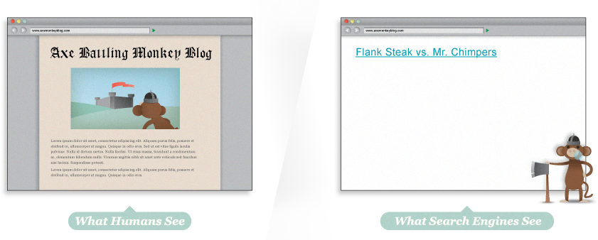
See your site as the search engines do
this means that search engines cannot index any of the text content for this website

Slide 34
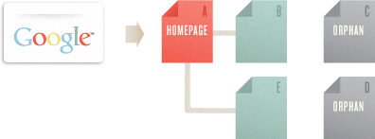
On-Page SEO
Technical Aspects:
2. CRAWLABLE LINK STRUCTURES
One that lets the crawlers browse the pathways of a website.
It is vital to them finding all of the pages on a website.

Slide 35
On-Page SEO
Technical Aspects:
3. KEYWORD USAGE AND TARGETING
Use of the keyword phrase in Title Tag
A title tag is an HTML element that specifies the title of a web page.
Title tags are displayed on search engine results pages (SERPs) as the clickable headline for a given result.
The title tag of a web page is meant to be an accurate and concise description of a page's content.
Optimal format:
Primary Keyword - Secondary Keyword | Brand Name

Slide 36
On-Page SEO
Technical Aspects:
3. KEYWORD USAGE AND TARGETING
Use of the keyword phrase in Title Tag
Be mindful of length
Place important keywords close to the front
Include branding
Consider readability and emotional impact

Slide 37
On-Page SEO
Technical Aspects:
3. KEYWORD USAGE AND TARGETING
b. Use of the keyword phrase in other places
Once prominently near the top of the page.
At least two or three times, including variations, in the body text on the page.
At least once in the alt attribute of an image on the page. This not only helps with web search, but also image search, which can occasionally bring valuable traffic.
Once in the URL.
At least once in the meta description tag - the snippet of text used by the search engines.

Slide 38
On-Page SEO
Technical Aspects:
4. OTHER WEBSITE ATTRIBUTES
Mobile Friendliness
Site Speed
Descriptive URLs
HTTPs/Secure site

Slide 39
Off-Page SEO
1. LINK BUILDING
Links were the first major “Off-the-page” ranking factor used by search engines and still remain most important external signal.
Link Quality (“Link Neighborhood”)
Link text/anchor text
Number of links

Slide 40
Off-Page SEO
LINK BUILDING
Types of Links
Natural Editorial Links
Links that are given naturally by sites and pages that want to link to your content or company.
b. Manual Outreach links
Creating links by emailing bloggers for links, submitting sites to directories, or paying for listings of any kind.
c. Self-created non-editorial links
Hundreds of thousands of websites offer any visitor the opportunity to create links through guest book signings, forum signatures, blog comments, or user profiles.

Slide 41
Off-Page SEO
LINK BUILDING
Common Link Building Strategies
a. Get your partners and customers to link to you
b. Build a company blog; make it a valuable, informative, and entertaining resource
c. Create content that inspires viral sharing and natural linking
d. Be newsworthy

Slide 42
Off-Page SEO
2. ENGAGEMENT
How long do users stay on your page?
Did they search, click through to your listing, but then immediately “bounce” back to the results to try something else?
“Time on site” metric or “long click”: are people sending a relatively long time reviewing your content, in relation to similar content on other sites?
Social gestures such as comments, shares and “likes”

Slide 43
Off-Page SEO
3. HISTORY
How your website has behaved over time.
Any history of violations or penalties
A good overall track record plays an important role

Slide 44
Off-Page SEO
4. PERSONALISATION
Country
Locality
Personal history

Slide 45
Off-Page SEO
5. SOCIAL MEDIA
Indirect effect: Content that gets socially shared can affect links or gain engagement, which are direct ranking factors.
Social reputation
Social Shares

Slide 46
Exercise
Search for keyword “buy antique furniture”
Find a business among the top results
Search for this business by directly using the brand name
Identify the external links and other off-page SEO methods discussed today which have been applied to this website

Slide 47
Violation
a. Thin or Shallow Content:
Google’s Panda targets what is described as “thin” or “shallow” content or content that is lacking in substance.
b. Cloaking:
Rigging your site so that search engines are shown a completely different version from the one humans see
c. Keyword Abuse:
"stuffing" keywords into text, URLs, meta tags, and links
d. Piracy
e. Too many Ads
f. Keyword Cannibalization
Targeting of the same keyword, term or phrase on multiple pages of your website
g. Duplicate content
h. Canonicalization
When two or more duplicate versions of a webpage appear on different URLs.
i. Buying Links

Slide 48
Search Engine Tools
Google Search Console
Bing Webmaster Tools

Slide 49
Measuring and Tracking performance
Google Analytics
Foxmetrics
Matomo
Chartbeat
Zap
Open Web Analytics
Adobe Analytics
Clicky
…….
Source: https://www.computerworlduk.com/galleries/data/best-web-analytics-tools-alternatives-google-analytics-3628473/

Slide 50
Assignment
Think of any business or your favourite business
Think about the keywords customers will use to search for the service or product the business offers. Use tools like Google's Keyword Planner and Answer the Public.
Go to the business’s website home page. Are the most important keywords used naturally in the content?

Slide 51
Assignment
Start reviewing the SEO performance for that business by completing the following tasks:
Take the web address (URL) for the business, add ‘site:’ at the front (e.g. site:www.yourwebsite.com), then search for it in a search engine search. This will show you all the pages that search engine has indexed for that site. Note the top five pages listed in the search results.
Review each of the top five page against SEO best practice guidelines for:
Page title (e.g. is the title longer than 55 characters? Are the characters legible?)
Keywords (e.g. are the keywords on the title relevant?)
Content (e.g. is there enough content on each page?)
Based on your review, suggest improvements for these pages according to SEO best practice guidelines. For example: is there enough relevant content on each page? Does it contain relevant keywords without being spammy? What keywords is the content focused on?

Slide 52
References
www.moz.com
www.searchengineland.com
https://www.google.com/search/howsearchworks/
www.internetlivestats.com

