Slide 1
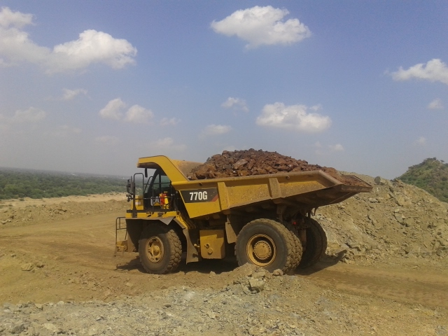
Foliation

Slide 2
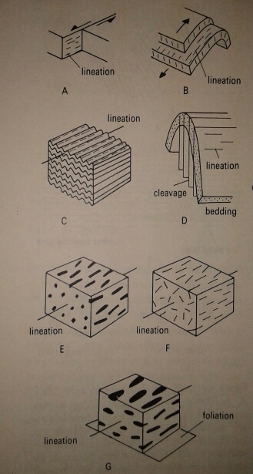
Foliation
A Foliation is a set of new planer surfaces produced in a rock as a result of deformation.
Foliation is a general term covering several different kinds of structure produced in different ways.
‘Slaty Cleavage’, ‘Schistosity’ and ‘Gneissosity’ are all examples of foliation.
In many areas there is a foliation parallel to bedding, often termed a ‘Bedding Foliation’.

Slide 3
Types of Foliation:
The term Cleavage refers to the fissility of a rock, which allows it to be split along a set of foliation planes, and embraces structures of various origins, formed at low metamorphic grade. It is replaced at higher grades by ‘Schistosity’ and ‘Gneissosity’.
The 4 main types of cleavage:
1. Slaty Cleavage 2. Fracture Cleavage
3. Crenulations Cleavage 4. Solution Cleavage

Slide 4
Slaty cleavage
Slaty cleavage are formed by the arrangement of platy minerals such as micas and chlorites or by the arrangement of ellipsoidal grains of such minerals as quartz and feldspar.
This type of cleavage is best shown in fine-grained rocks such as mudstones that have been deformed under very low – metamorphism.

Slide 5
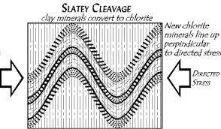
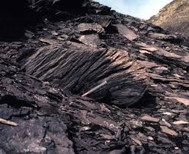
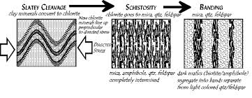

Slide 6
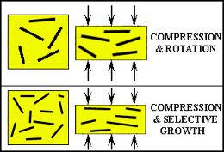
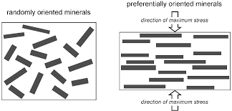
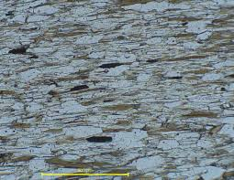
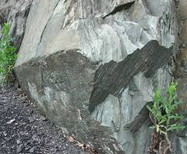

Slide 7
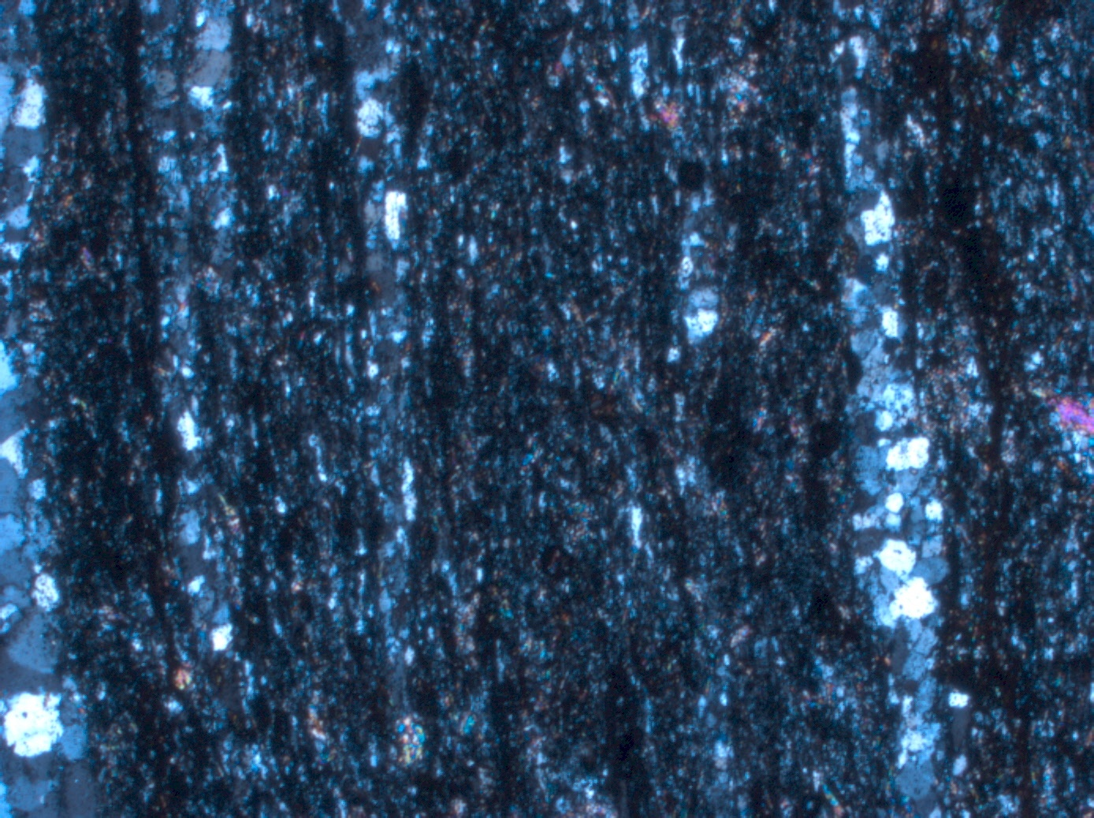

Slide 8
Fracture Cleavage
Fracture cleavage is essentially closely spaced jointing. The minerals are not parallel to the cleavage. The distance between into individual planes of cleavage can be measured and is commonly few millimeters to centimeter.
If the distance between the fractures exceeds a few centimeters the term is called ‘Joint’.

Slide 9
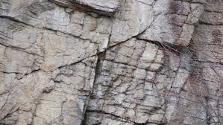
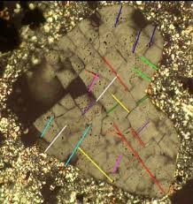
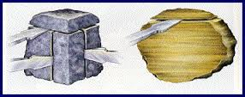

Slide 10
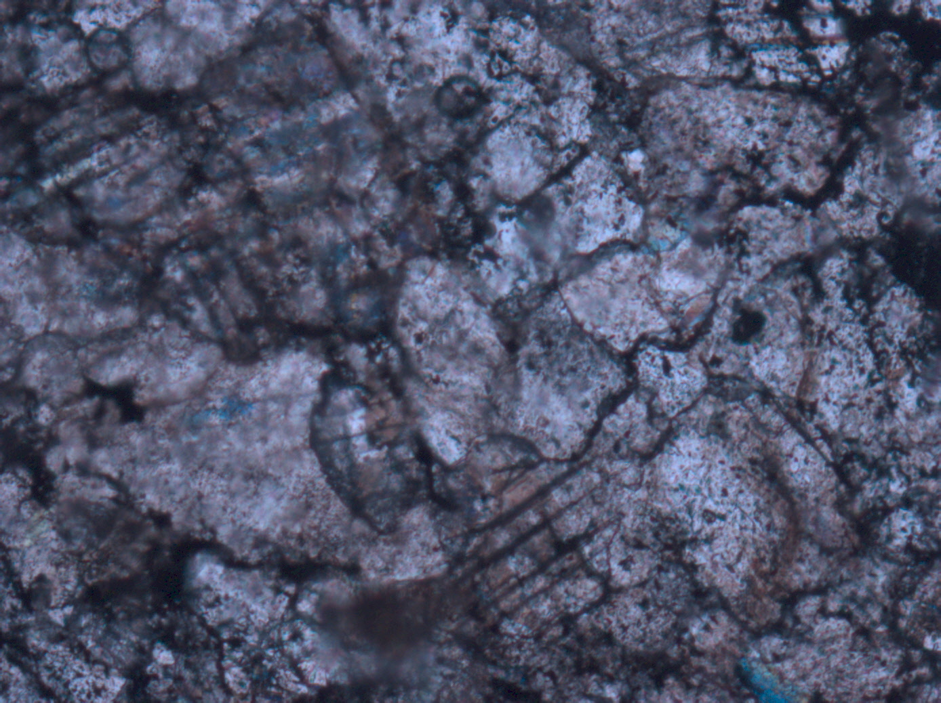

Slide 11
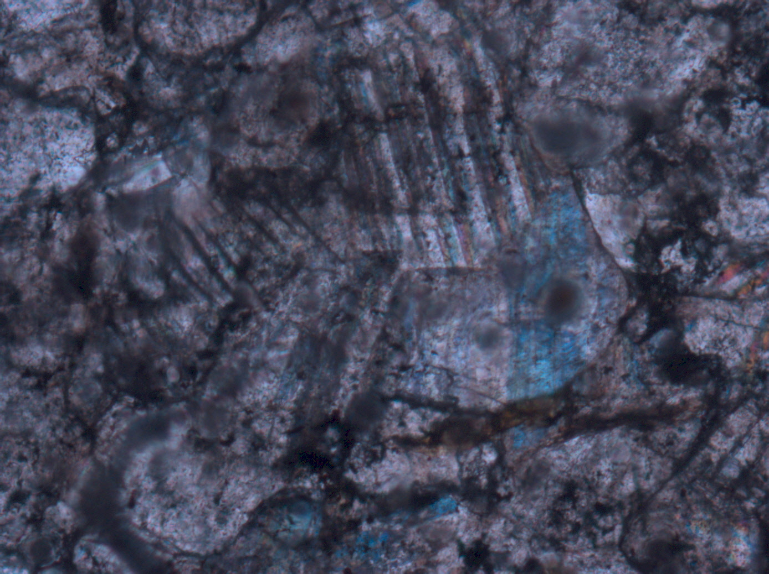

Slide 12
Crenulations Cleavage
Crenulations cleavage is formed, as the name suggests, by small-scale folding (crenulations) of very thin layers or laminations within a rock.
Crenulations cleavage is very commonly associated with the deformation of rocks that already possess a strong cleavage or schistosity as a result of an earlier deformation.

Slide 13
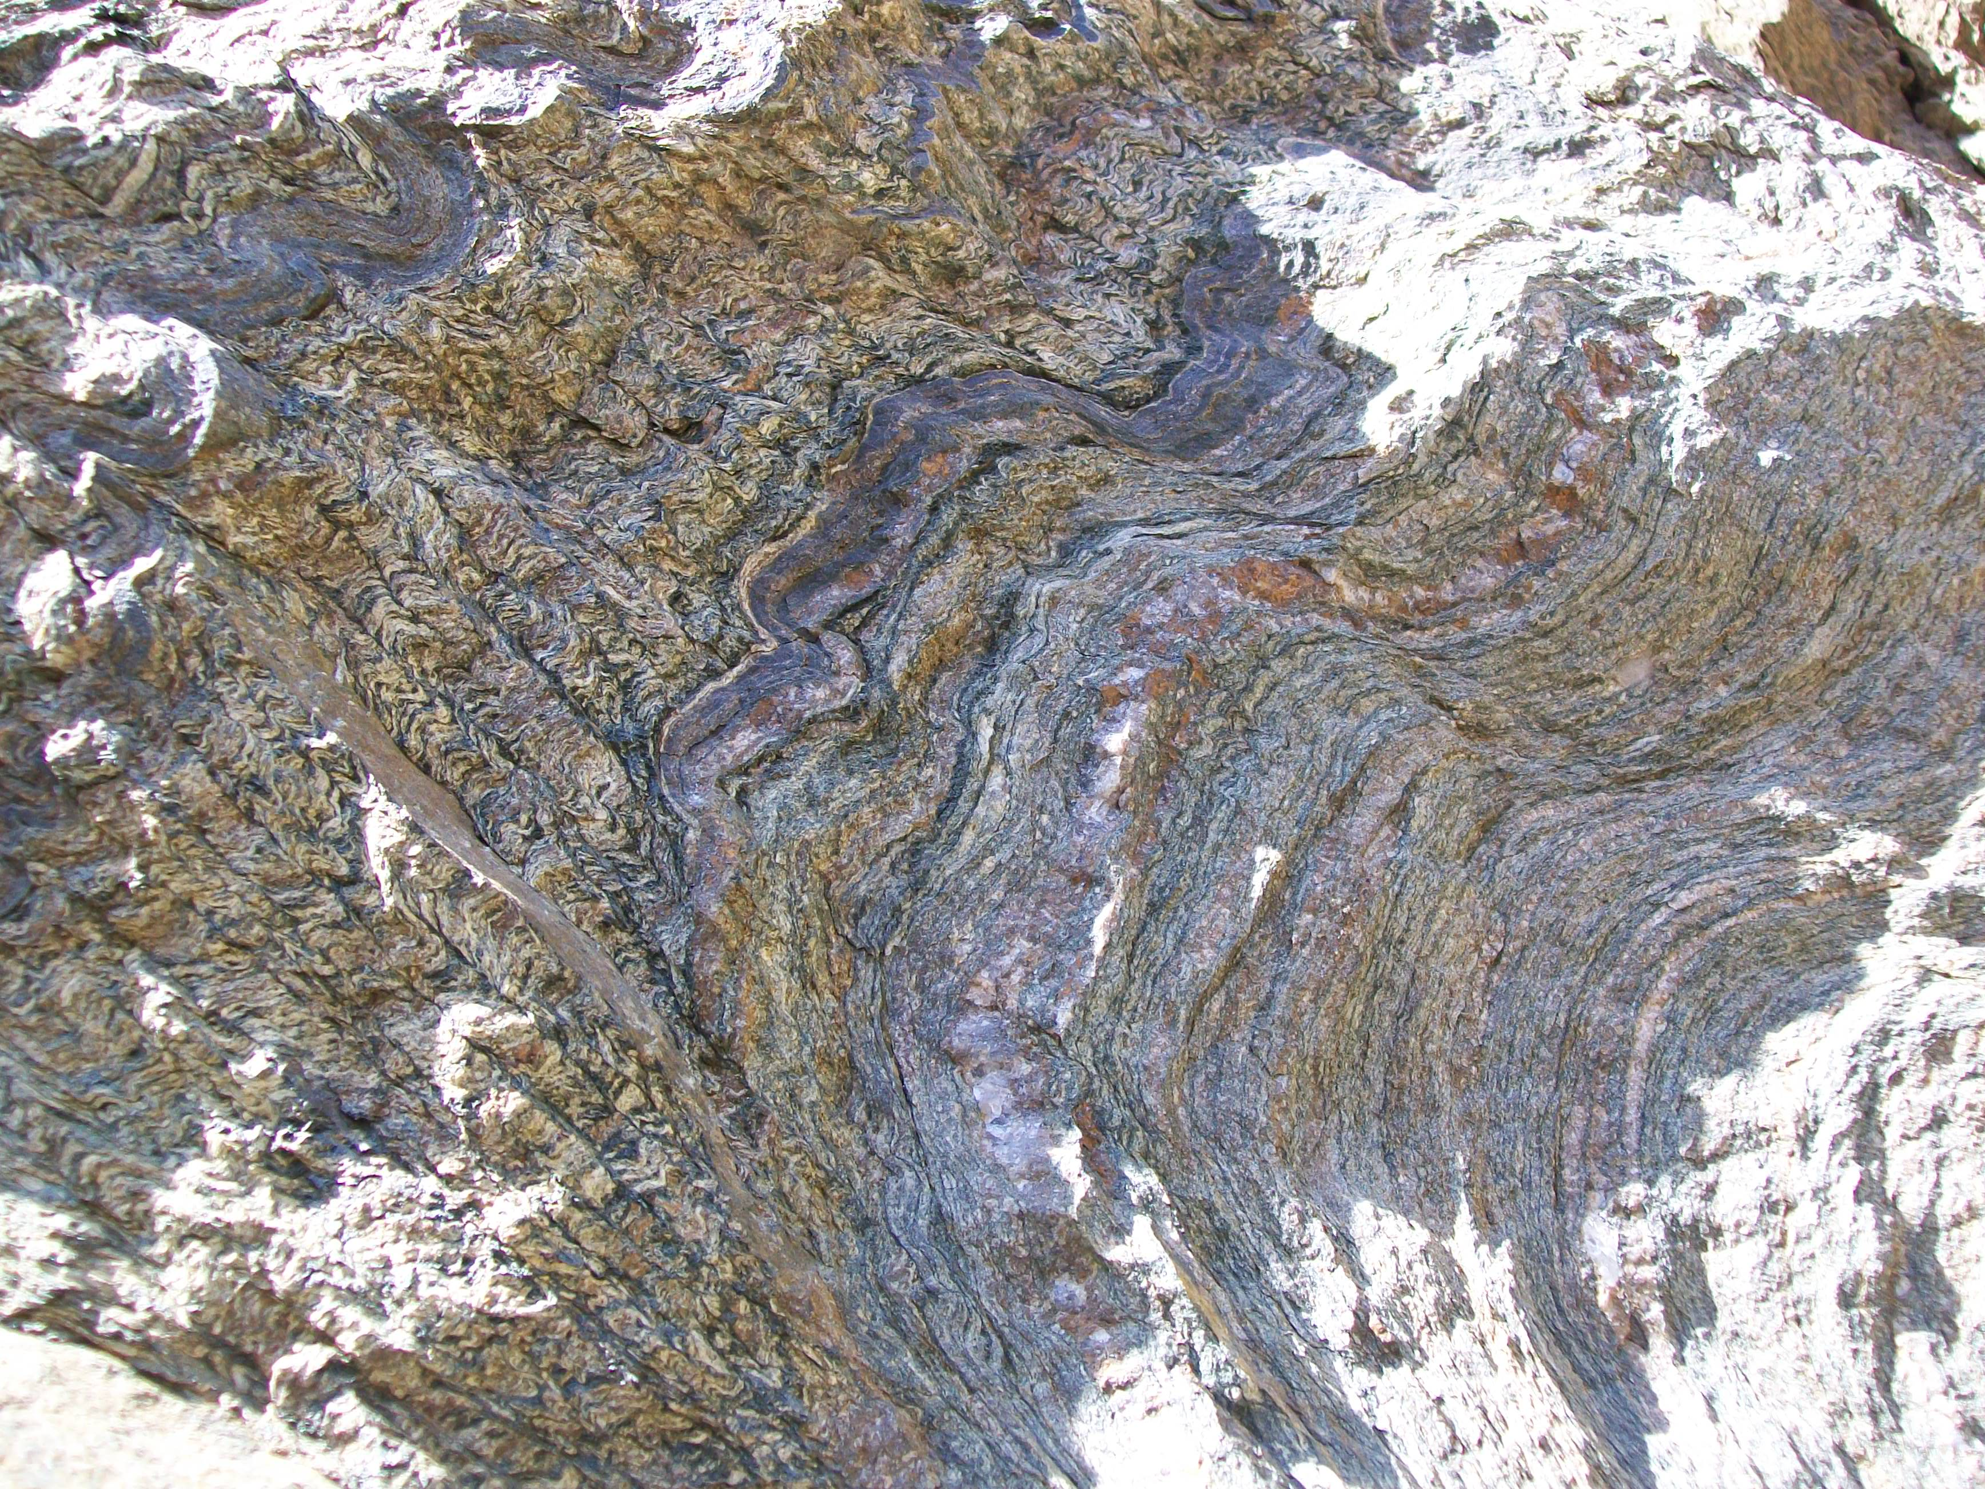

Slide 14
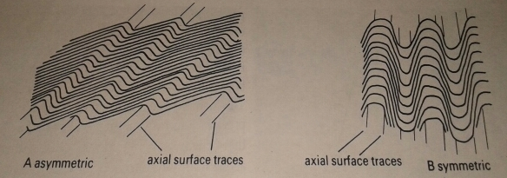

Slide 15
Solution cleavage
A new compositional banding can arise through the migration of certain constituents of a rock during deformation. This structure, is common in low – grade or unmetamorphosed rocks, is formed by the process of pressure solution and the resulting cleavage is termed ‘Solution Cleavage’.

Slide 16
Slip cleavage
Cleavage along which there has been some displacement is called Slip Cleavage.
Bedding or an older cleavage or schistosity is commonly displaced one to few millimeters.
The platy minerals such as micas and chlorites may be dragged into positions that are nearly parallel to the slip cleavage.

Slide 17
Schistosity
With increasing metamorphic grade, Slates are transformed to Phyllite than Schist by an increase in the size of newly formed metamorphic minerals.
In slates, the aligned planer minerals that produce the slaty cleavage are invisible to naked eye, whereas in schist, the individual tabular crystals of mica, hornblende, etc. are large enough to be visible in hand specimen.

Slide 18
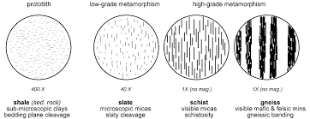
A Foliation marked by the parallel orientation of such tabular minerals in a metamorphic rock with a sufficiently coarse grain size is called a ‘Schistosity’.

Slide 19
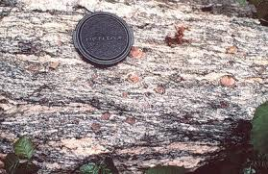

Slide 20
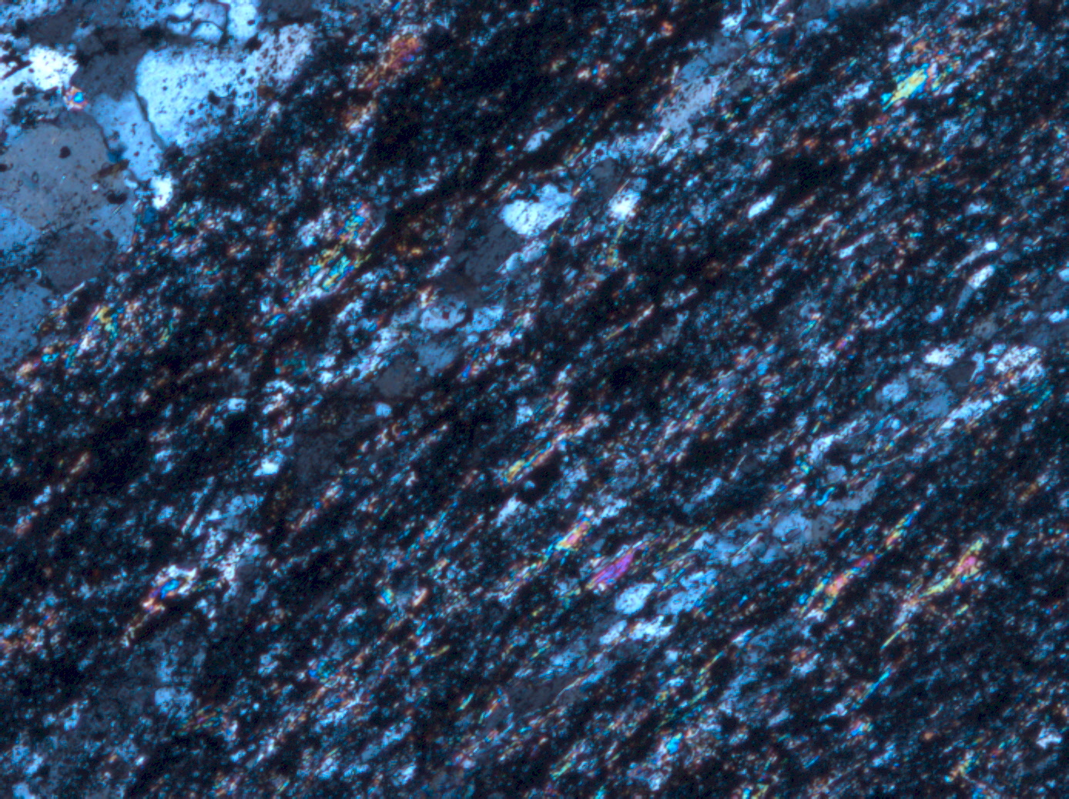

Slide 22
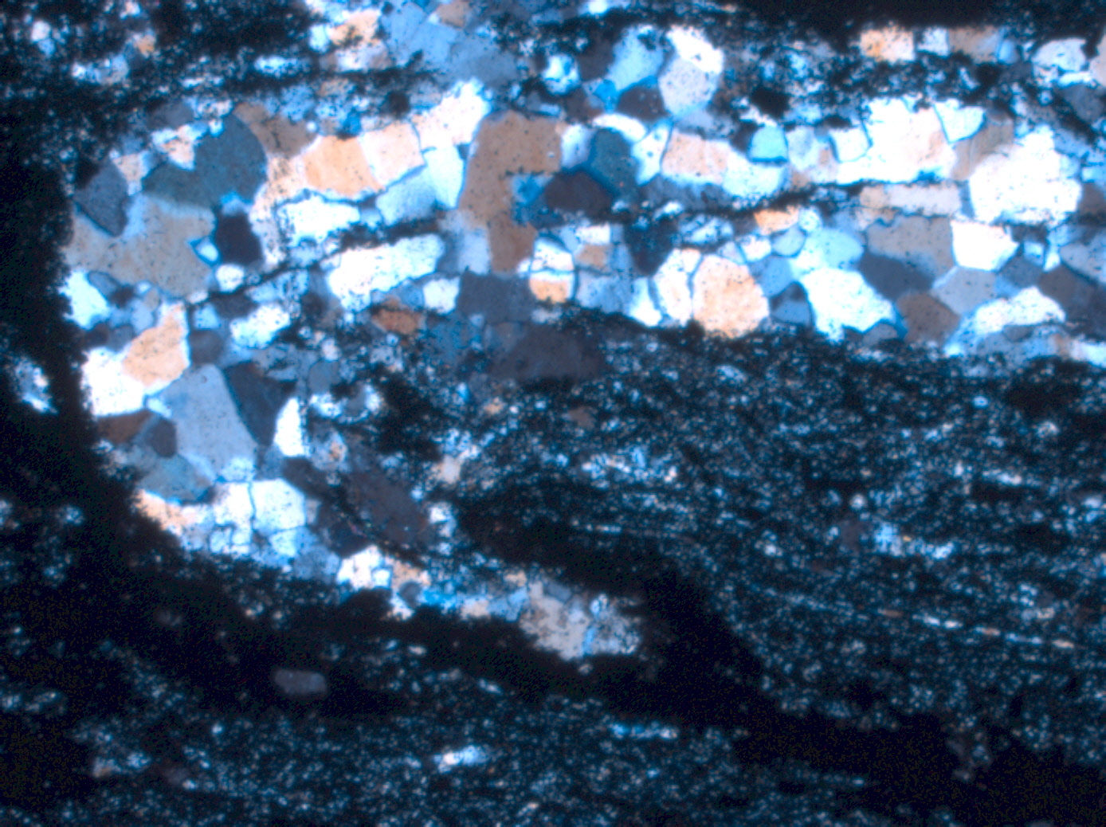

Slide 23
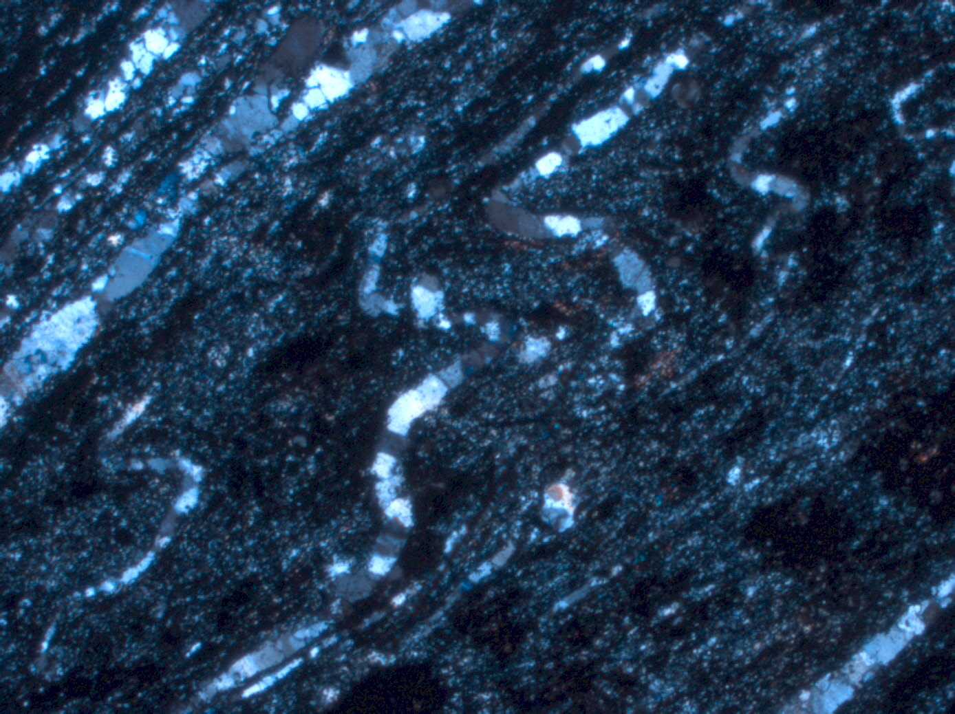

Slide 24
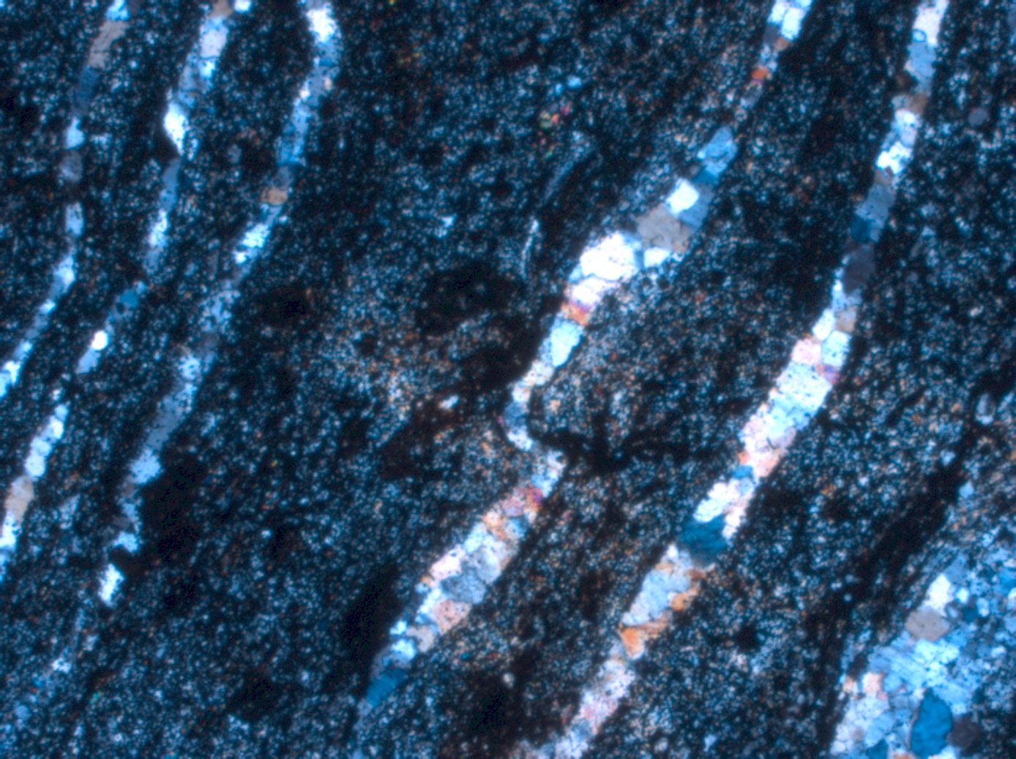

Slide 25
Thank
You

