Slide 1
Sedimentary Structures
By
Harish Kapasya
Department of Geology
Faculty of Earth Sciences
M.L.S.U. Udaipur

Slide 2
Primary Structures
The most reliable information for determination of top and bottom is furnished by features, developed during the deposition of sediments or during the eruption of lava. They are called “Primary Structures”.

Slide 3
The important major structures of sedimentary rocks are
Stratification
Lamination
Graded bedding
Current Bedding and Ripple Marks

Slide 4
Besides these, there are some minor structures such as
Mud cracks
Rain prints and
Tracks etc.

Slide 5
Stratification
Deposition of sediments into layers or beds is called the “Stratification”. The planes dividing different beds are called the “Bedding Plane”. The thickness of a bed may vary from a few centimeter to many meters. Each bed is different to other by Different in mineralogical composition, Variation in grain size and texture, Different in color and Variation in thickness.

Slide 6
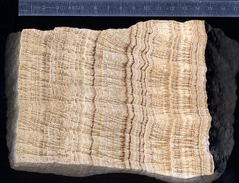

Slide 7
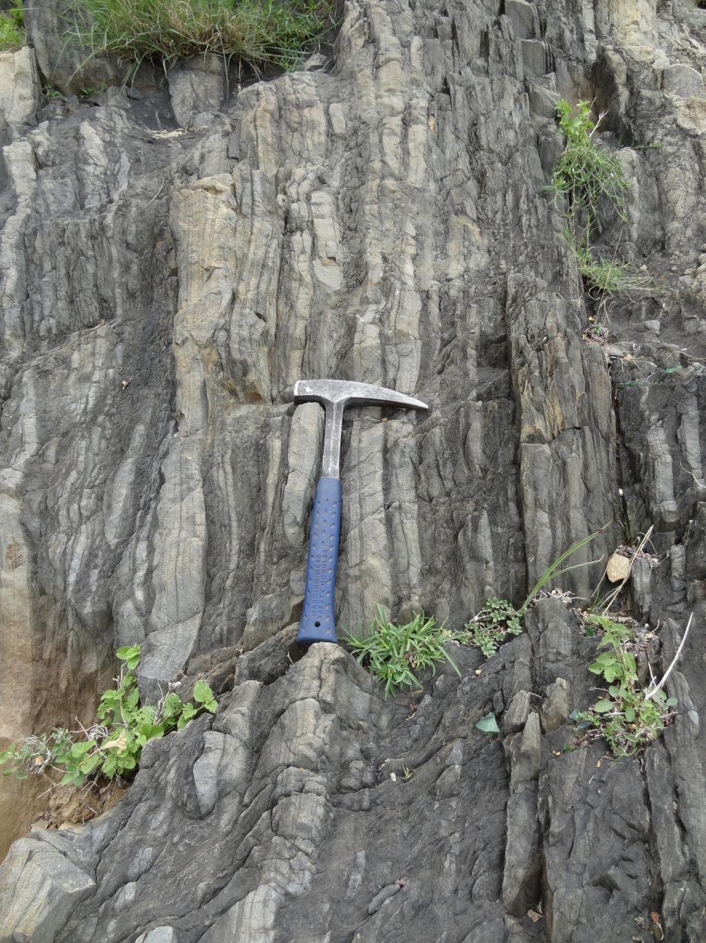

Slide 8
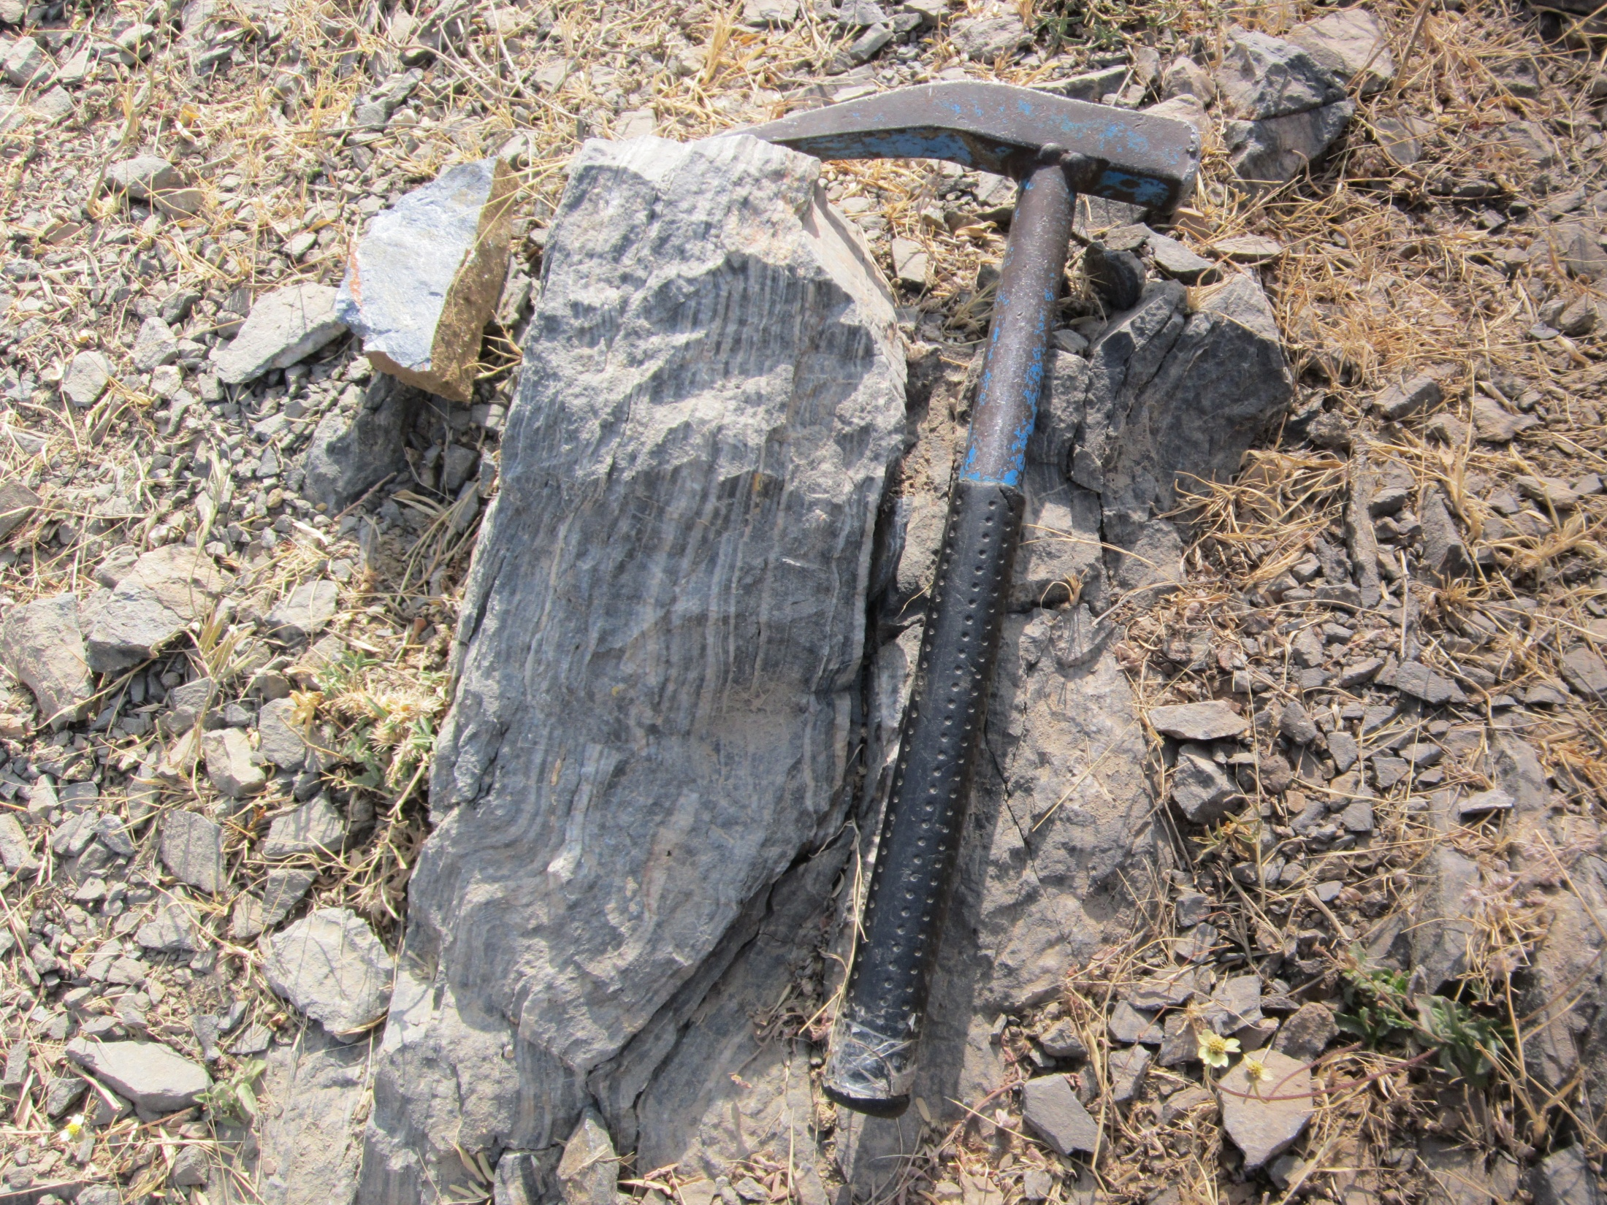

Slide 9
Lamination
The bedding, less than 1 centimeter in thickness, are called “Lamination”. Each bed which has 1 centimeter thickness is called “Lamina”. Lamination is usually found in very fined grained rocks.
In Lamination, parallel arrangements of minerals within a bed whereas Stratification refers to a succession of beds separated by bedding planes.

Slide 10
Graded Bedding
In graded bedding each bed represent a gradation in grain size from coarse to fine. The Graded Bedding result from rapid sedimentation in water. The largest particles are dropped first and then progressively finer particles are deposited.

Slide 11
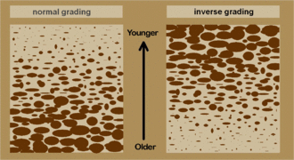
Used in determination of top and bottom of beds. Fine grains are show top and coarse grains are show bottom of beds.

Slide 12
Current Bedding
Current Bedding is also known as the “Cross Bedding”. In this structure minor beds or lamination lie at an angle. These minor beds commonly terminate abruptly at the top where they are overlain by the next current bedded deposit. Current bedding is commonly found in shallow water and wind formed deposits.

Slide 13
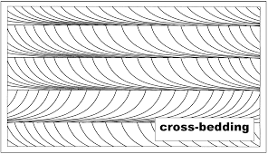
Used in determination of top and bottom of beds. The truncated side is top and tangential side is bottom.

Slide 14
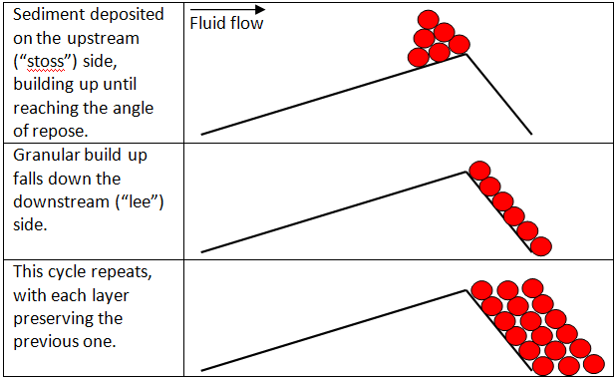

Slide 15
Ripple Marks
“Ripple Marks” are the wavy undulations seen on the surface of bedding planes. They are produced by the action of waves and current in shallow water. Ripple Marks are of two types:
Asymmetrical or Current Ripple Marks, and
Symmetrical or oscillation Ripple Marks.

Slide 16
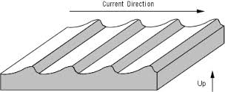
Used in determination of current direction where as the crests are dipping that the flow direction.

Slide 17
Mud - Cracks
“Mud - Cracks” are often found in the fine grained sedimentary rocks that have been exposed to drying under sub – aerial conditions. They are polygonal in plane. Used in determination of top and bottom of beds. Mud cracks are characteristic of the flood plains of large rivers. Mud Crack is also called is “Sun - Cracks”.

Slide 18
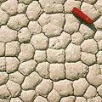

Slide 19
Rain Print
A “Rain Print” is a slight shallow depression rimmed by a low ridge which is raised by the impact of the rain drop. It is formed when a brief rain shower falls on a smooth surface of fine grained sediment.

Slide 20
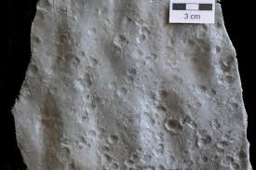

Slide 21
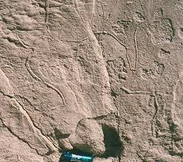
Tracks and Trails
“Tracks and Trails” are the markings indicating the passage of some animal over soft sediments.

Slide 22
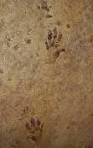

Slide 23
Thank
You

